Slide 1
Lecture 10
Modern Earthquakes:
Case Studies of Catastrophic Earthquakes
John Rundle GEL/EPS 131
Start Here 1/27/2021

Slide 2
Topics
Recent Catastrophic Earthquakes
Tangshan China, Earthquake, 1976
Kashmir 2005
Iran-Pakistan 2013
Wenchuan, China 2008
Haiti 2010
Maule, Chile 2010
Christchurch, NZ 2010, 2011
Nepal, 2015

Slide 3
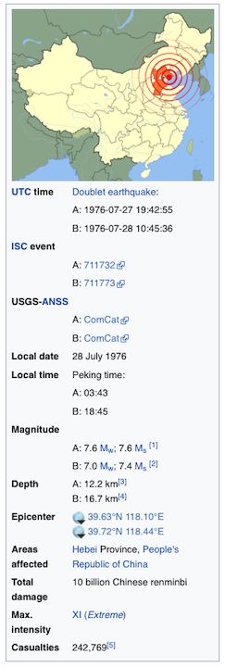
Tangshan, China Earthquake 7/27/1976
The 1976 Tangshan earthquake, also known as Great Tangshan earthquake, was a natural disaster resulting from a magnitude 7.6 earthquake that hit the region around Tangshan, Hebei, People's Republic of China on July 28, 1976, at 3:42 in the morning.
In minutes the city of Tangshan, an industrial city with approximately one million inhabitants, ceased to exist.
Eighty-five percent of the buildings in the city collapsed or were unusable, all services failed, and most of the highway and railway bridges collapsed or were seriously damaged.
At least 242,000 people died (some have said three times that), making this the third (or possibly second) deadliest earthquake in recorded history.
Tangshan was the most notable of several disasters in 1976, which in Chinese tradition might signal that the government had lost political legitimacy.

Slide 4
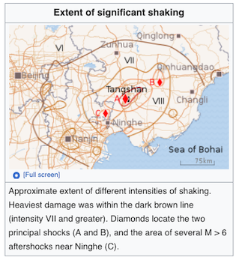
Tangshan, China Earthquake 7/27/1976
The Tangshan earthquake was complex, with multiple events.
The main shock struck at 3:42:56 in the morning (local time), approximately 12 km under the southern part of Tangshan.
The magnitude was initially estimated at around 8.1, subsequently recalculated to be 7.6 on the standard Mw scale.
The Tangshan quake, being relatively shallow, converted much of its energy to surface shaking, and on the Ms (surface magnitude) scale it also measured 7.6. (7.8 on the Chinese surface magnitude scale.)
The Tangshan earthquake also came without warning, undermining a key tenet of Maoist ideology, that earthquakes could be predicted.

Slide 5
Death Toll in Tangshan Earthquake
Estimates of the number of deaths due to the Tangshan earthquake have varied widely, and generally lack a clear (let alone authoritative) basis.
According to author Stephen Spignesi, a "couple of days" after the quake Dr. Pararas-Carayannis gave United Press International (UPI) an estimate of 700,000 to 750,000 deaths, based on a similar sized earthquake in Shensi province in 1556 that caused 830,000 deaths
A 1988 book by several members of the Chinese State Seismological Bureau states that no more than 242,419 people died in the quake.
It is unclear whether this number is merely the personal view of the authors, or an official view of the government.
A webpage of the Chinese Earthquake Administration dated 2009 also attributes "242,769 deaths and 164,851 serious injuries" to the Tangshan quake.

Slide 6
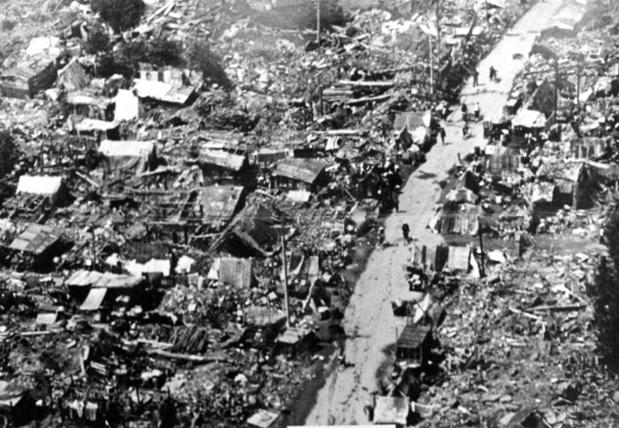
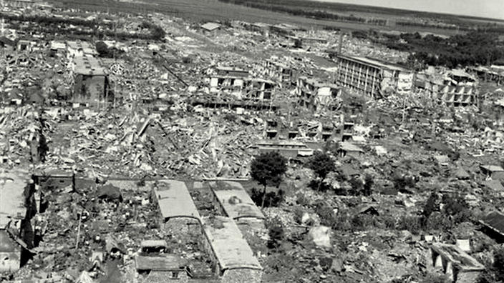
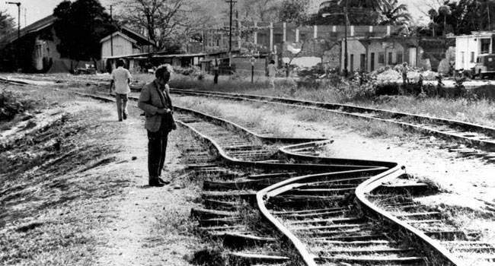
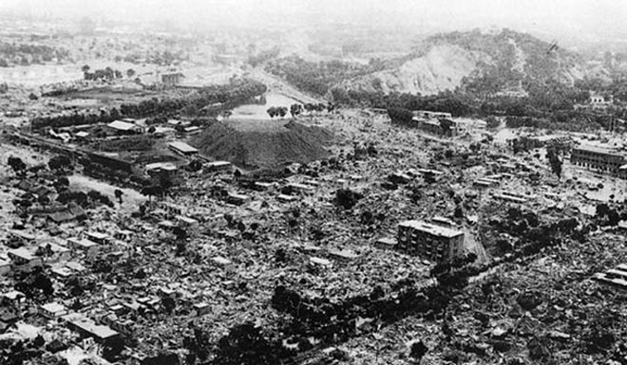
Tangshan: Images of Destruction

Slide 7
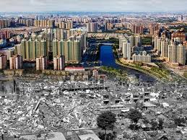
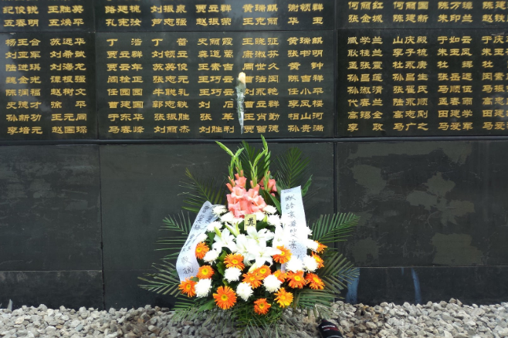
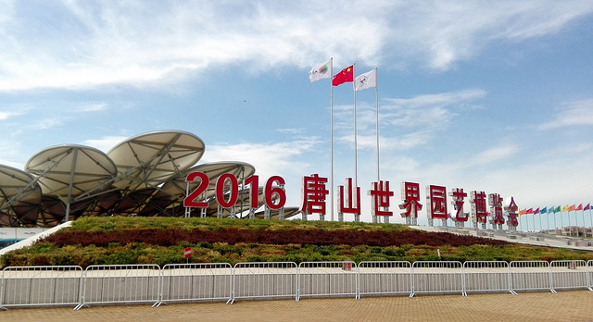
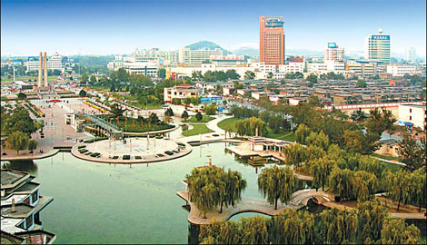
Tangshan 40 Years Later (2016)
A Modern Chinese City

Slide 8
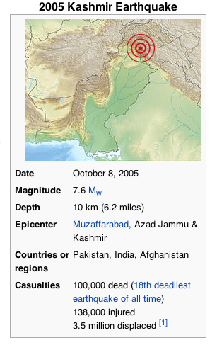
Kashmir M7.6 10/8/2005 http://en.wikipedia.org/wiki/2005_Kashmir_earthquake
"The 2005 Kashmir earthquake was a major earthquake centered in the Pakistan administered Kashmir near the city of Muzaffarabad, also affecting and the Khyber Pakhtunkhwa province of Pakistan.
It occurred at 08:52:37 Pakistan Standard Time (03:52:37 GMT) on 8 October 2005.
It registered a moment magnitude of 7.6 making it similar in size to the 1906 San Francisco earthquake, the 1935 Quetta earthquake, the 2001 Gujarat earthquake, and the 2009 Sumatra earthquakes.
As of 8 November 2005, the government of Pakistan's official death toll was 75,000.
The earthquake also affected countries in the surrounding region where tremors were felt in Tajikistan and western China, while officials say nearly 1,400 people also died in Jammu and Kashmir and four people in neighboring Nangarhar Province of Afghanistan.
The severity of the damage caused by the earthquake is attributed to poor construction"

Slide 9
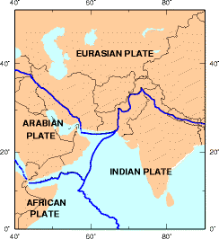
Kashmir M7.6 10/8/2005 http://en.wikipedia.org/wiki/2005_Kashmir_earthquake
"Pakistan-administered Kashmir lies in the area of collision of the Eurasian and Indian tectonic plates.[6]
The Pakistan Meteorological Department estimated the magnitude as 5.2 magnitude on the Richter scale.
The United States Geological Survey (USGS) measured its magnitude as a minimum of 7.6 on the moment magnitude scale
Epicenter at 34°29′35″N 73°37′44″E, about 19 km (12 mi) northeast of Muzaffarabad, Pakistan-administered Kashmir, and 100 km (62 mi) north-northeast of the national capital Islamabad. The hypocenter was located at a depth of 26 km (16 mi) below the surface"

Slide 10
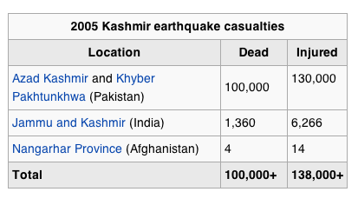
Kashmir M7.6 10/8/2005 http://en.wikipedia.org/wiki/2005_Kashmir_earthquake
"Most of the casualties resulting from the earthquake were in Pakistan, where more than 74,698 people died, putting it higher than the massive scale of destruction of the 1935 Quetta earthquake.
International donors have estimated that about 100,000 died, with an additional 138,000 becoming seriously injured, and 3.5 million becoming displaced.
Saturday is a normal school day in the region, most students were at schools when the earthquake struck.
Many were buried under collapsed school buildings. Many people were also trapped in their homes.
Reports indicate that entire towns and villages were completely wiped out in Northern Pakistan, with other surrounding areas also suffering severe damage."

Slide 11
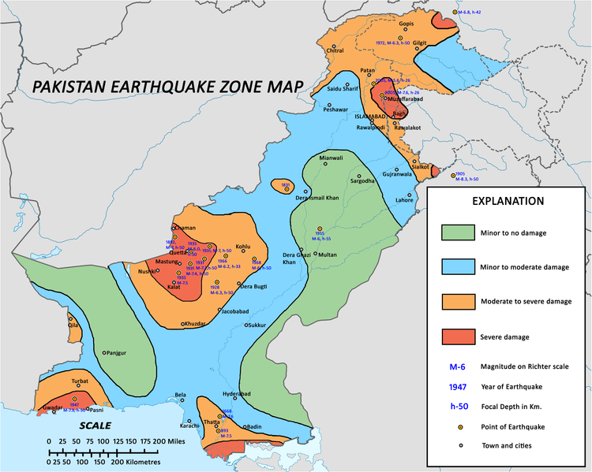
Kashmir M7.6 10/8/2005 http://en.wikipedia.org/wiki/2005_Kashmir_earthquake
"Most of the devastation hit north Pakistan and Pakistan-administered Kashmir.
In Kashmir, the three main districts were badly affected and Muzaffarabad, the state capital of Kashmir, was hardest hit in terms of casualties and destruction.
Hospitals, schools, and rescue services including police and armed forces were paralysed.
There was virtually no infrastructure and communication was badly affected.
More than 70% of all casualties were estimated to have occurred in Muzaffarabad.
Bagh, the second-most-affected district, accounted for 15% of the total casualties."

Slide 12
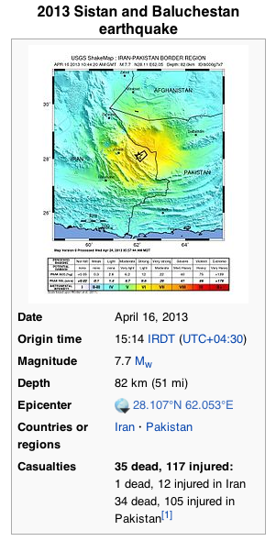
M7.7 Iran – Pakistan 4/16/2013 http://en.wikipedia.org/wiki/2005_Kashmir_earthquake
"The earthquake struck 83 kilometres (52 mi) east of the city of Khash, and was felt throughout much of eastern Iran and southern Pakistan, and as far away as Riyadh, Manama, Doha, Abu Dhabi, Muscat, and Delhi.
Although the earthquake was much stronger than previous ones in the area, the depth and the terrain/population density above the focus, as well as predominating building construction being relatively light materials such as mud and wood, meant that there were relatively few casualties in Iran, although the number of casualties was higher in the neighboring state of Pakistan, with at least 34 reported deaths."

Slide 13
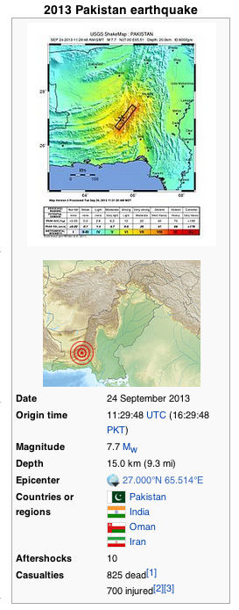
M7.7 Pakistan 9/24/2013 http://en.wikipedia.org/wiki/2005_Kashmir_earthquake
"The 2013 Pakistan earthquake was a magnitude Mw 7.7 earthquake that took place on 24 September, with an epicenter 66 kilometres (41 mi) north-northeast of Awaran in the province of Balochistan, southwestern Pakistan.
At least 825 people were killed, and hundreds more were injured.
On 28 September another earthquake with a 6.8 magnitude hit Pakistan at a depth of 14.8 km, killing at least 22 people."

Slide 14
M8.0 Wenchuan, China 5/12/2008 http://en.wikipedia.org/wiki/2008_Sichuan_earthquake
"The 2008 Sichuan earthquake or the Great Sichuan Earthquake was a deadly earthquake that measured at 8.0 Ms and 7.9 Mw
Occurred at 02:28:01 PM China Standard Time at epicenter (06:28:01 UTC) on Monday, May 12, 2008 in Sichuan province, killing 69,195 people, with 18,392 missing.
It is also known as the Wenchuan earthquake (Chinese: 汶川大地震; pinyin: Wènchuān dà dìzhèn), after the location of the earthquake's epicenter, Wenchuan County, Sichuan.
The epicenter was 80 kilometres (50 mi) west-northwest of Chengdu, the provincial capital, with a focal depth of 19 km (12 mi).
The earthquake was also felt in nearby countries and as far away as both Beijing and Shanghai—1,500 km (930 mi) and 1,700 km (1,060 mi) away—where office buildings swayed with the tremor.
Strong aftershocks, some exceeding magnitude 6, continued to hit the area even months after the main quake, causing new casualties and damage."

Slide 15
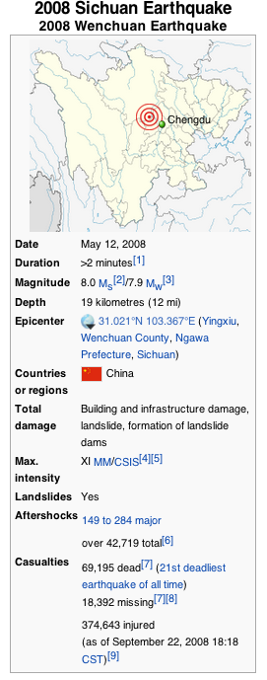
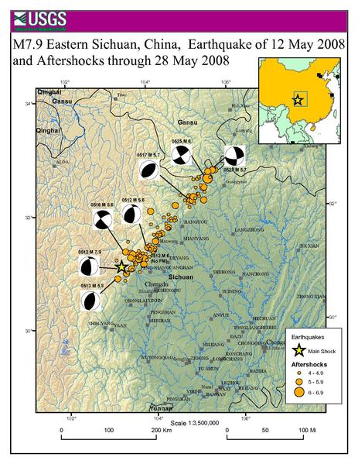
M8.0 Wenchuan, China 5/12/2008 http://en.wikipedia.org/wiki/2008_Sichuan_earthquake

Slide 16
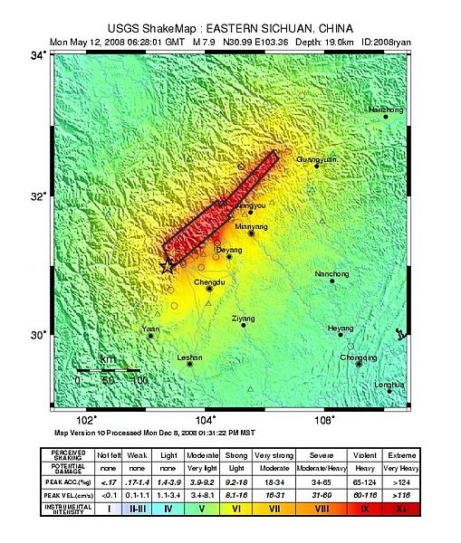
Ground Shaking http://en.wikipedia.org/wiki/2008_Sichuan_earthquake
"Office buildings in Shanghai's financial district, including the Jin Mao Tower and the Hong Kong New World Tower, were evacuated.
A receptionist at the Tibet Hotel in Chengdu said things were "calm" after the hotel evacuated its guests.
Reporters in Chengdu said they saw cracks on walls of some residential buildings in the downtown areas, but no building collapsed.
Many Beijing office towers were evacuated, including the building housing the media offices for the organizers of the 2008 Summer Olympics.
None of the Olympic venues were damaged."

Slide 17
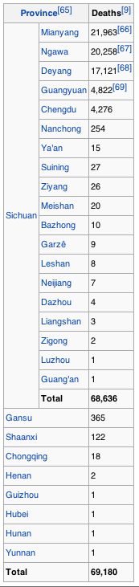
Casualties http://en.wikipedia.org/wiki2008_Sichuan_earthquake
According to Chinese state officials, the quake caused 69,180 known deaths including 68,636 in Sichuan province; 18,498 people are listed as missing, and 374,176 injured
This estimate includes 158 earthquake relief workers who were killed in landslides as they tried to repair roads.
One rescue team reported only 2,300 survivors from the town of Yingxiu in Wenchuan County, out of a total population of about 9,000.[72]
3,000 to 5,000 people were killed in Beichuan County, Sichuan alone; in the same location, 10,000 people were injured and 80% of the buildings were destroyed.
In terms of school casualties, thousands of school children died due to shoddy construction.
In Mianyang City, seven schools collapsed, burying at least 1,700 people. At least 7,000 school buildings throughout the province collapsed.
Another 700 students were buried in a school in Hanwang. At least 600 students and staff died at Juyuan Elementary School. Up to 1,300 children and teachers died at Beichuan Middle School.[77]

Slide 18
Damage http://en.wikipedia.org/wiki/2008_Sichuan_earthquake
"All of the highways into Wenchuan, and others throughout the province, were damaged, resulting in delayed arrival of the rescue troops.
In Beichuan County, 80% of the buildings collapsed according to Xinhua News.
In the city of Shifang, the collapse of two chemical plants led to leakage of some 80 tons of liquid ammonia, with hundreds of people reported buried.
In the city of Dujiangyan, south-east of the epicenter, a whole school collapsed with 900 students buried and fewer than 60 survived.
The Juyuan Middle School, where many teenagers were buried, was excavated by civilians and cranes.
Dujiangyan is home of the Dujiangyan Irrigation System, an ancient water diversion project which is still in use and is a UNESCO World Heritage Site. The project's famous Fish Mouth was cracked but not severely damaged otherwise.
Both the Shanghai Stock Exchange and the Shenzhen Stock Exchange suspended trading of companies based in southwestern China.
Copper rose over speculations that production in southwestern China may be affected, and oil prices dropped over speculations that demand from China would fall."

Slide 19
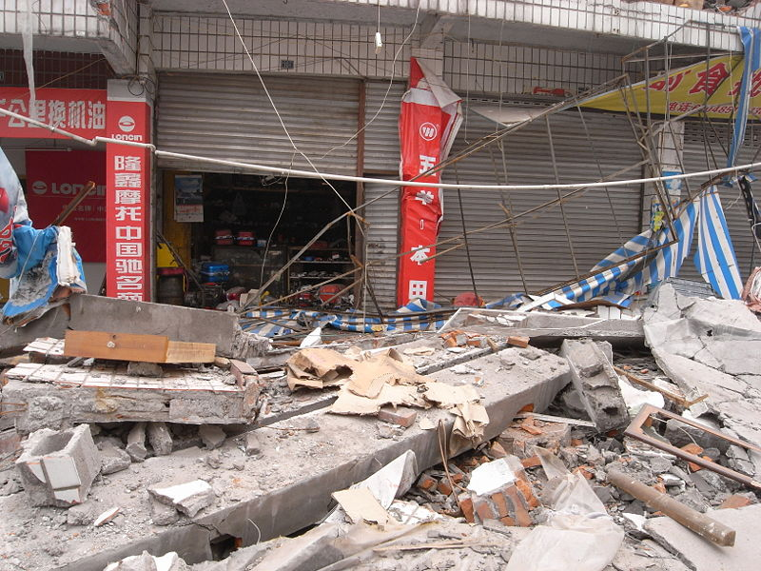
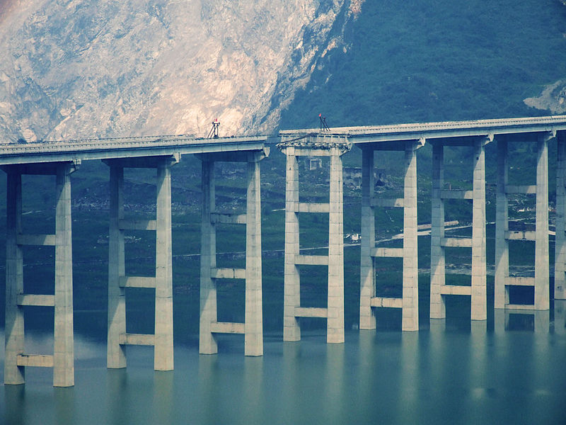
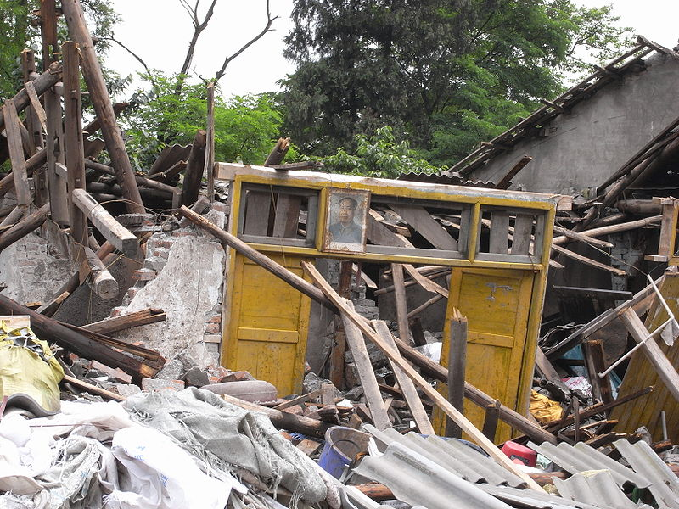
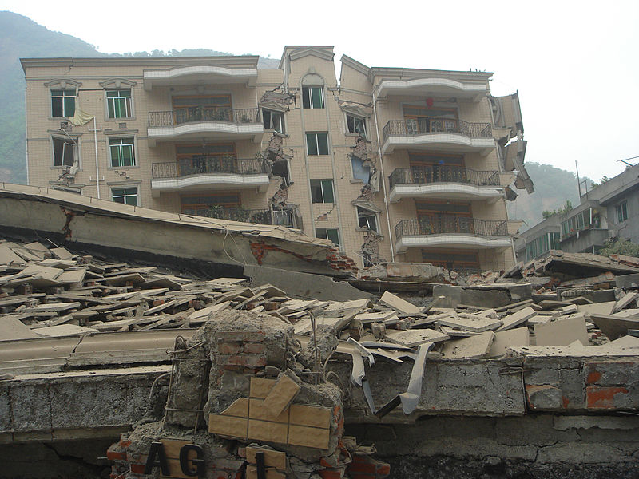
Destruction http://en.wikipedia.org/wiki/2008_Sichuan_earthquake

Slide 20
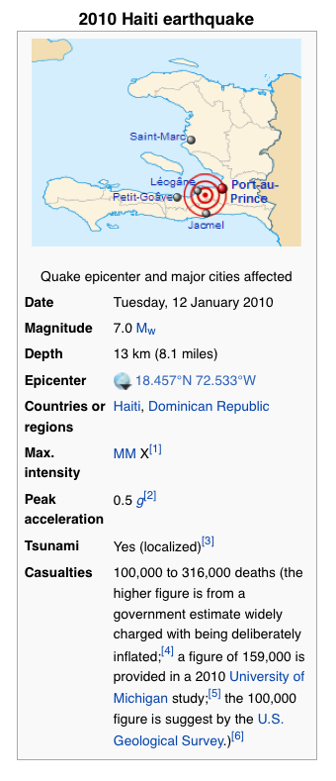
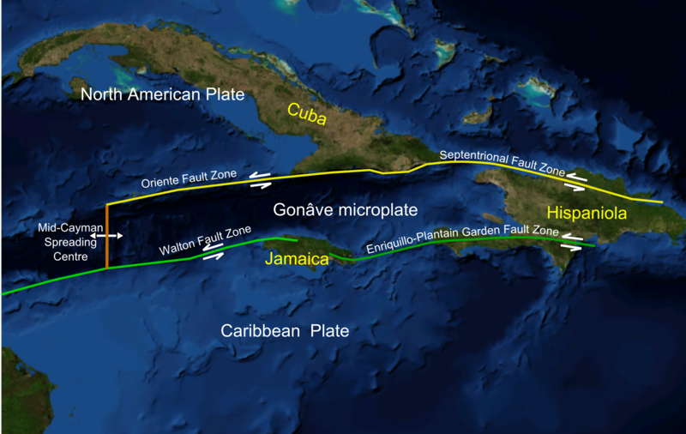
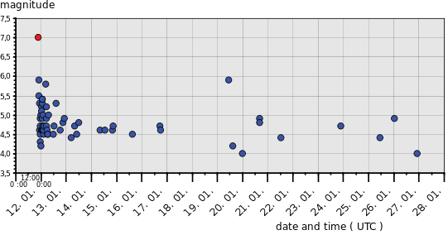
M7.0 Port-au-Prince, Haiti 1/12/2010 http://en.wikipedia.org/wiki/2010_Haiti_earthquake
Tectonics
Mainshock-Aftershocks

Slide 21
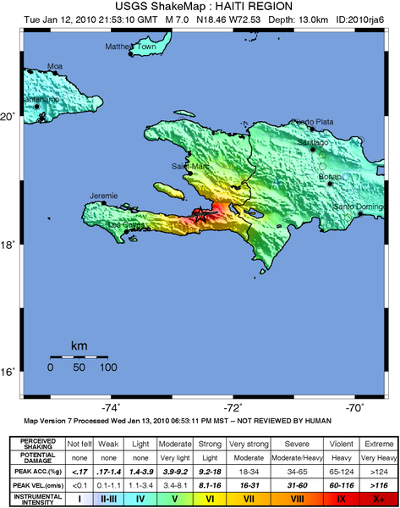
Ground Shaking http://en.wikipedia.org/wiki/2010_Haiti_earthquake
"The earthquake occurred inland at 16:53 (UTC-05:00), approximately 25 km (16 miles) WSW from Port-au-Prince at a depth of 13 km (8.1 miles) on blind thrust faults associated with the Enriquillo-Plantain Garden fault system.
There is no evidence of surface rupture and based on seismological, geological and ground deformation data.
Strong shaking associated with intensity IX on the Modified Mercalli scale (MM) was recorded in Port-au-Prince and its suburbs.
It was also felt in several surrounding countries and regions, including Cuba (MM III in Guantánamo), Jamaica (MM II in Kingston), Venezuela (MM II in Caracas), Puerto Rico (MM II–III in San Juan), and the bordering Dominican Republic (MM III in Santo Domingo).
According to estimates from the United States Geological Survey, approximately 3.5 million people lived in the area that experienced shaking intensity of MM VII to X
Shaking damage was more severe than for other quakes of similar magnitude due to the shallow depth of the quake."

Slide 22
Earthquake of this Type was Anticipated http://en.wikipedia.org/wiki/2010_Haiti_earthquake
"A 2007 earthquake hazard study by C. DeMets and M. Wiggins-Grandison noted that the Enriquillo-Plantain Garden fault zone could be at the end of its seismic cycle and concluded that a worst-case forecast would involve a 7.2 Mw earthquake, similar in size to the 1692 Jamaica earthquake.
Paul Mann and a group including the 2006 study team presented a hazard assessment of the Enriquillo-Plantain Garden fault system to the 18th Caribbean Geologic Conference in March 2008
They noted that large strain accumulation from GPS observations implied the possible future earthquake
The team recommended "high priority" historical geologic rupture studies, as the fault was fully locked and had recorded few earthquakes in the preceding 40 years.
An article published in Haiti's Le Matin newspaper in September 2008 cited comments by geologist Patrick Charles to the effect that there was a high risk of major seismic activity in Port-au-Prince."

Slide 23
Damage http://en.wikipedia.org/wiki/2010_Haiti_earthquake
"Vital infrastructure necessary to respond to the disaster was severely damaged or destroyed, including all hospitals in the capital; air, sea, and land transport facilities; and communication systems.
The quake seriously damaged the control tower at Toussaint L'Ouverture International Airport.
Damage to the Port-au-Prince seaport rendered the harbor unusable for immediate rescue operations
Roads were blocked with road debris or the surfaces broken. The main road linking Port-au-Prince with Jacmel remained blocked ten days after the earthquake, hampering delivery of aid to Jacmel.
When asked why the road had not been opened, Hazem el-Zein, head of the south-east division of the UN World Food Programme said that 'We ask the same questions to the people in charge...They promise rapid response. To be honest, I don't know why it hasn't been done. I can only think that their priority must be somewhere else.'"

Slide 24
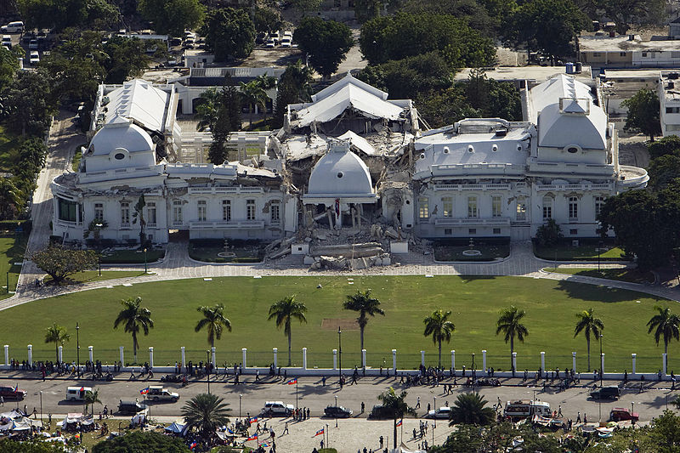
Destruction http://en.wikipedia.org/wiki/2010_Haiti_earthquake
Presidential Palace

Slide 25
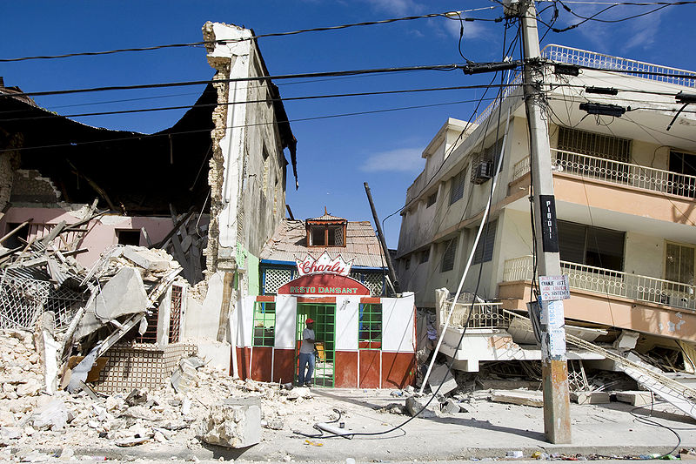
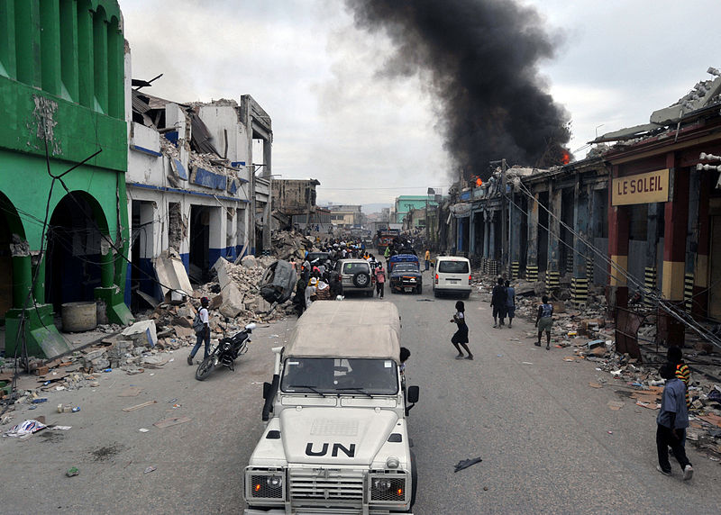
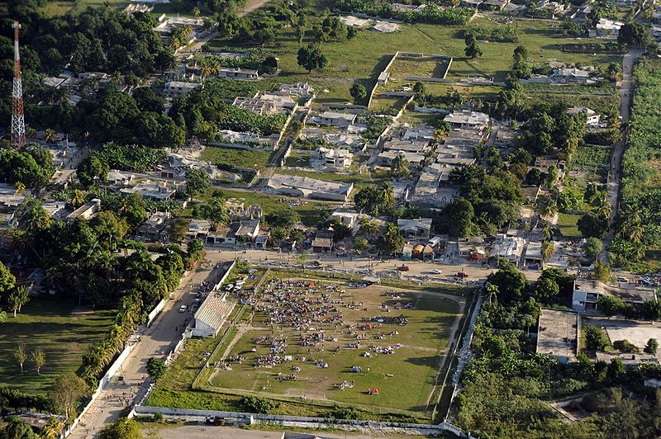
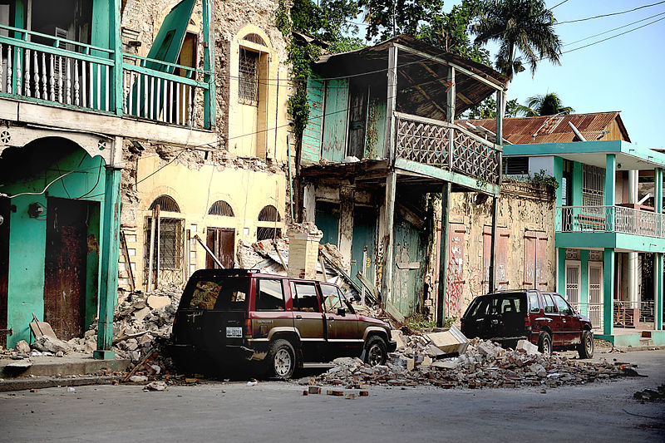
Destruction http://en.wikipedia.org/wiki/2010_Haiti_earthquake

Slide 26
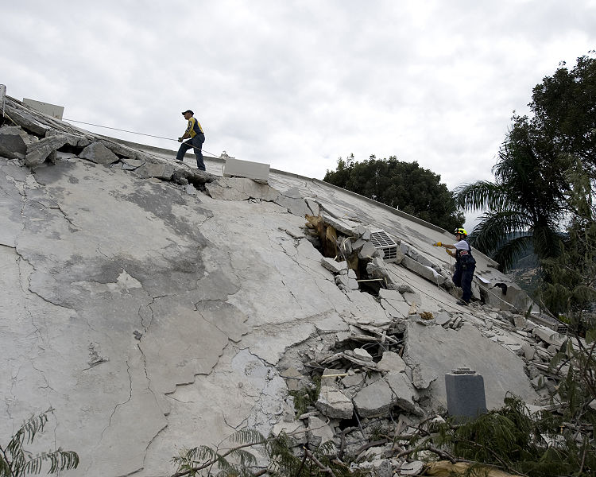
Casualties http://en.wikipedia.org/wiki/2010_Haiti_earthquake
"The earthquake struck in the most populated area of the country. The International Federation of Red Cross and Red Crescent Societies estimated that as many as 3 million people had been affected by the quake.
In mid February 2010, the Haitian government reported the death toll to have reached 230,000.
However, an investigation by Radio Netherlands has questioned the official death toll, reporting an estimate of 92,000 deaths as being a more realistic figure.
On the first anniversary of the earthquake, 12 January 2011, Haitian Prime Minister Jean-Max Bellerive said the death toll from the quake was more than 316,000, raising the figures from previous estimates.
The dead included aid workers, embassy staff, foreign tourists—and a number of public figures, including Archbishop of Port-au-Prince Monsignor Joseph Serge Miot, and officials in the Haitian government, including opposition leader Michel Gaillard.
At least 85 United Nations personnel working with MINUSTAH were killed.
Around 200 guests were killed in the collapse of the Hôtel Montana in Port-au-Prince."
Rescue workers search the hotel Montana for survivors

Slide 27
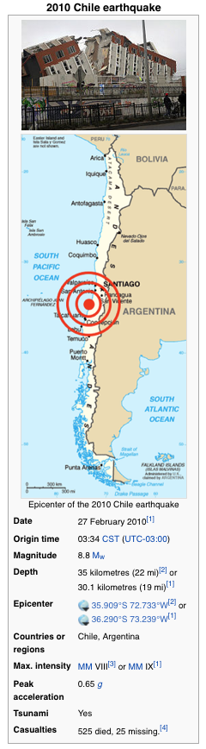
M8.8 Maule, Chile 2/27/2010 http://en.wikipedia.org/wiki/2010_Chile_earthquake
“The 2010 Chile earthquake occurred off the coast of central Chile on Saturday, 27 February 2010, at 03:34 local time (06:34 UTC),
Magnitude 8.8 on the moment magnitude scale, with intense shaking lasting for about three minutes.
It ranks as the sixth largest earthquake ever to be recorded by a seismograph.
It was felt strongly in six Chilean regions (from Valparaíso in the north to Araucanía in the south), that together make up about 80 percent of the country's population.”

Slide 28
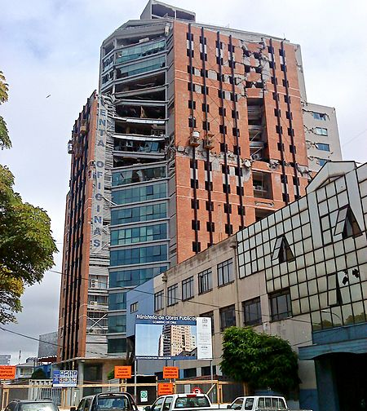
M8.8 Maule, Chile 2/27/2010 http://en.wikipedia.org/wiki/2010_Chile_earthquake
“The earthquake triggered a tsunami which devastated several coastal towns in south-central Chile and damaged the port at Talcahuano.
Tsunami warnings were issued in 53 countries, and the wave caused minor damage in the San Diego area of California,
In the Tōhoku region of Japan, where damage to the fisheries business was estimated at ¥6.26 billion (USD$66.7 million).
The earthquake also generated a blackout that affected 93 percent of the Chilean population and which went on for several days in some locations.
President Michelle Bachelet declared a "state of catastrophe" and sent military troops to take control of the most affected areas. According to official sources, 525 people lost their lives, 25 people went missing and about 9% of the population in the affected regions lost their homes.”
Partially collapsed 21 story Higgins Tower, Concepcion

Slide 29
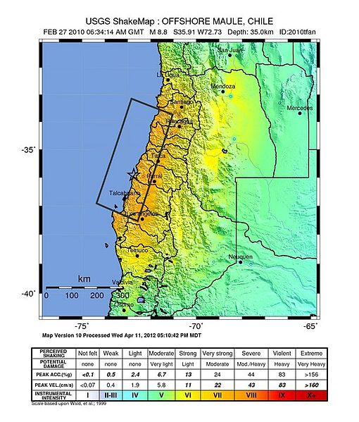
Ground Shaking http://en.wikipedia.org/wiki/2010_Chile_earthquake
“Shaking was felt strongly in six Chilean regions (from Valparaíso in the north to Araucanía in the south), that together make up about 80 percent of the country's population.
According to the United States Geological Survey (USGS) the cities experiencing the strongest shaking—VIII (Destructive) on the Mercalli intensity scale (MM)—were Arauco and Coronel.
According to Chile's Seismological Service Concepción experienced the strongest shaking at MM IX (Violent).
The earthquake was felt in the capital Santiago at MM VII (Very Strong) or MM VIII.
Tremors were felt in many Argentine cities, including Buenos Aires, Córdoba, Mendoza and La Rioja.
Tremors were felt as far north as the city of Ica in southern Peru (approx. 2400 km).”

Slide 30
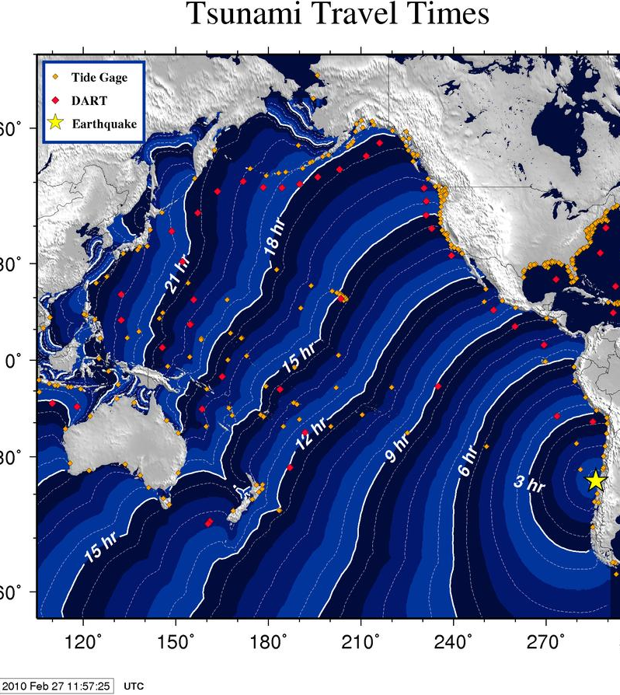
Tsunami http://en.wikipedia.org
“In Valparaíso, a tsunami wave of 1.29 m was reported.
The port of Valparaíso was ordered to be closed due to the damage caused by the earthquake.
The port started to resume limited operations on 28 February.
In Viña del Mar, a touristic city and part of Greater Valparaíso, several buildings were structurally damaged, principally in the district Plan de Viña.
A surfer said the tsunami "...was like the one in Thailand, a sudden rise of water. One could not estimate the dimension of the wave, because it was advancing foam.
There were 10 to 15 rises, the last one being at 08:30 in the morning.
A 2.34 m (7.68 ft) tsunami wave hit Talcahuano, a port city.
The tsunami caused serious damage to port facilities and lifted boats out of the water.
In the fishing town of Dichato, which has 7,000 residents, it was the third tsunami wave that ended up being the most damaging.”

Slide 31
Damage http://en.wikipedia.org/wiki/2010_Chile_earthquake
“Buildings collapsed in Santiago and there were power outages in parts of the city.
A fire was reported in a chemical plant on the outskirts of Santiago and caused the evacuation of the neighborhood.
Santiago's International Airport seemed to have been damaged and the airport authority closed off all flight operations for 24 hours from around 12:00 UTC.
On Sunday, 28 February, Ricardo Ortega, head of the Chilean Air Force, said commercial airline services had been partially re-established and aircraft were being allowed to land in Santiago.
Santiago's national Fine Arts Museum was badly damaged and did not reopen until 9 March 2010.
An apartment building's two-story parking lot collapsed, wrecking 68 cars.
According to one health official, three hospitals in Santiago collapsed, and a dozen more south of the capital also suffered significant damage.”
Notes:
Start here 10/18/2017

Slide 32
Damage and Economic Loss http://en.wikipedia.org/wiki/2010_Chile_earthquake
“In Chile, 370,000 homes were damaged.
The final death toll of 525 victims and 25 people missing was announced by authorities in January 2011.
This is down from early reports on 3 March of 802 people dead.
he Chilean National Emergency Office (Oficina Nacional de Emergencia) estimated that the intensity of the earthquake was 9 on the Mercalli scale in the Biobío Region and 8 in Santiago.
USGS put the intensity in Talcahuano at MM VIII, in Santiago and Concepción at MM VII and in Valparaíso at MM VI.
On 10 March, Swiss Reinsurance Co. estimated that the Chilean quake would cost the insurance industry between 4 and 7 billion dollars, the same estimate made by the rival German-based Munich Re AG.”

Slide 33
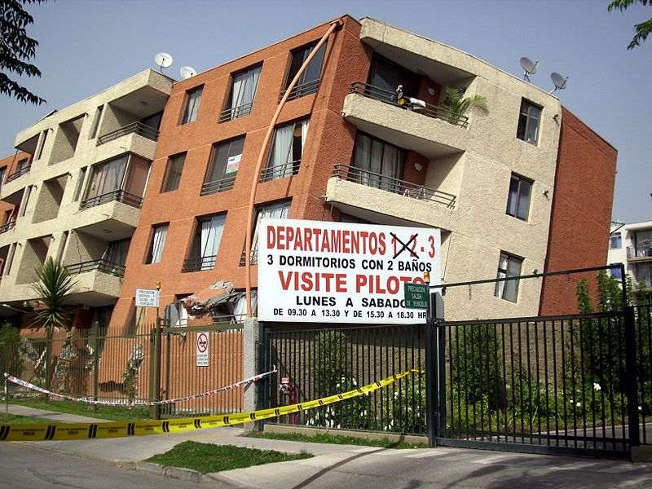
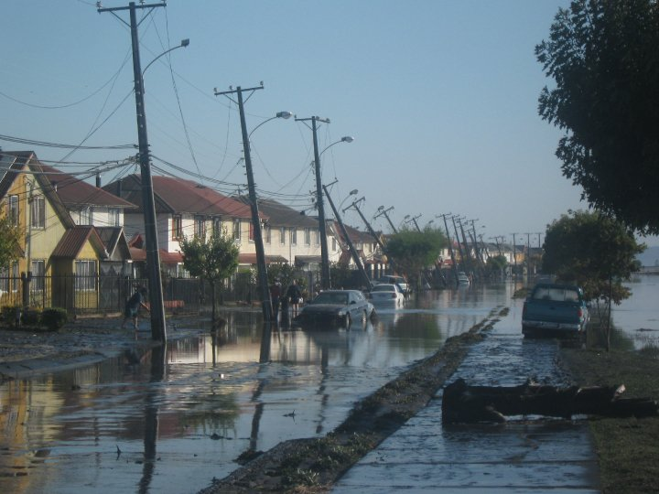
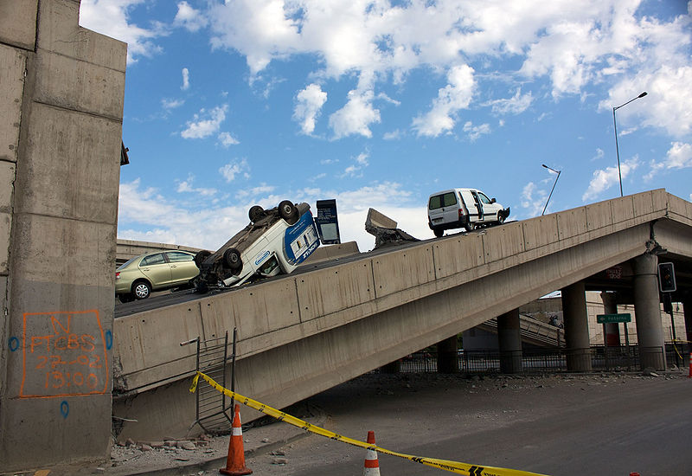
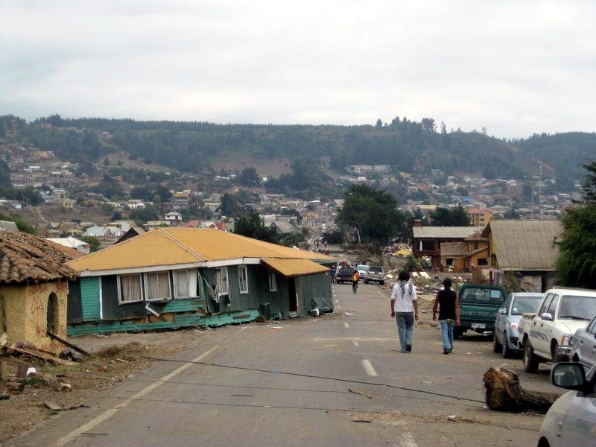
Destruction http://en.wikipedia.org/wiki/2010_Chile_earthquake

Slide 34
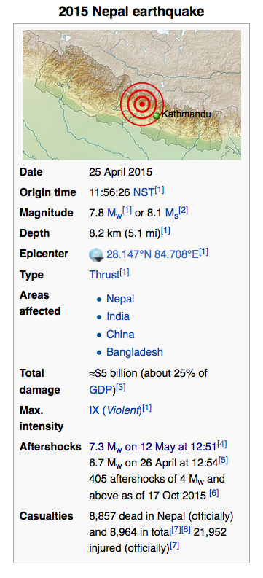
M7.8 Nepal Earthquake, April 25, 2015
and M7.3 Aftershock, May 12, 2015
The April 2015 Nepal earthquake (also known as the Gorkha earthquake) killed over 8,000 people and injured more than 21,000.
It occurred at 11:56 Nepal Standard Time on 25 April, with a magnitude of 7.8Mw or 8.1Ms and a maximum Mercalli Intensity of IX (Violent).
Its epicenter was east of the district of Lamjung, and its hypocenter was at a depth of approximately 8.2 km (5.1 mi).
https://en.wikipedia.org/wiki/April_2015_Nepal_earthquake

Slide 35
Nepal Mainshock https://en.wikipedia.org/wiki/April_2015_Nepal_earthquake
It occurred at 11:56 Nepal Standard Time on 25 April, with a magnitude of 7.8Mw or 8.1Ms and a maximum Mercalli Intensity of IX (Violent). Its epicenter was east of the district of Lamjung, and its hypocenter was at a depth of approximately 8.2 km (5.1 mi).
It was the worst natural disaster to strike Nepal since the 1934 Nepal–Bihar earthquake.
The earthquake triggered an avalanche on Mount Everest, killing at least 19 making April 25, 2015 the deadliest day on the mountain in history.
The earthquake triggered another huge avalanche in the Langtang valley, where 250 people were reported missing.

Slide 36
Damage and Casualties
Hundreds of thousands of people were made homeless with entire villages flattened, across many districts of the country.
Centuries-old buildings were destroyed at UNESCO World Heritage sites in the Kathmandu Valley, including some at the Kathmandu Durbar Square, the Patan Durbar Square, the Bhaktapur Durbar Square, the Changu Narayan Temple and the Swayambhunath Stupa.
Geophysicists and other experts had warned for decades that Nepal was vulnerable to a deadly earthquake, particularly because of its geology, urbanization, and architecture.

Slide 37
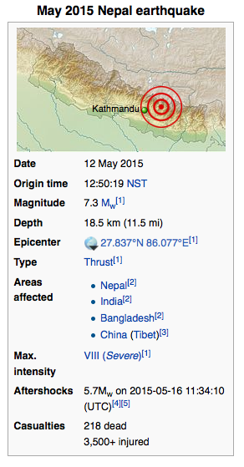
Aftershocks
Continuing aftershocks occurred throughout Nepal at the intervals of 15–20 minutes, with one shock reaching a magnitude of 6.7 on 26 April at 12:54:08 NST. The country also had a continued risk of landslides.
A major aftershock occurred on 12 May 2015 at 12:50 NST with a moment magnitude (Mw) of 7.3.
The epicenter was near the Chinese border between the capital of Kathmandu and Mt. Everest.
More than 200 people were killed and more than 2,500 were injured by this aftershock.
https://en.wikipedia.org/wiki/May_2015_Nepal_earthquake

Slide 38
Forecast for Nepal Aftershocks Made on May 8, 2015
A consensus method using
Reasenberg and Jones 1989
Forecast made by USGS on May 8, 2015 at the request of USAID
99.6% probability of non-occurrence for M>7 during the week of May 8-14
M7.3 aftershock occurred on May 12
280 deaths, 3500+ injuries
(per wikipedia)

Slide 39
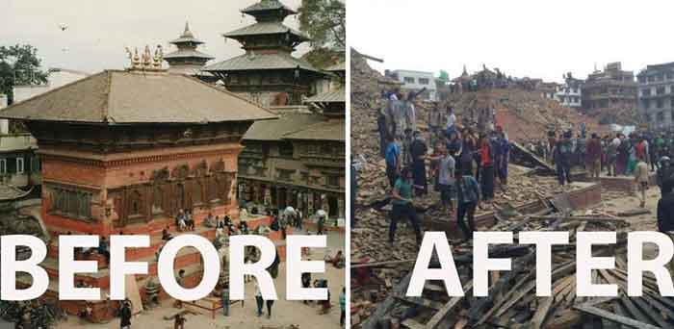
Damage
(Click on Image)

