Slide 1



Anticipating Earthquakes
John Rundle
University of California, Davis
Credits:
Wikipedia
US Geological Survey
NASA
SCEC

Slide 2
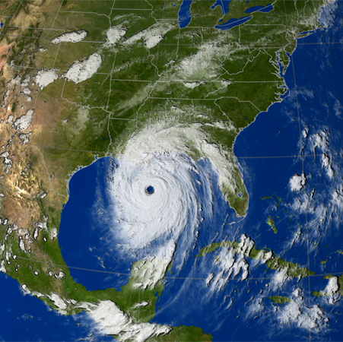
Why are Earthquakes So Hard to Predict?
Hurricane Katrina, 2005
Compare the situation to hurricanes.
Easy answer: You can see hurricanes coming, unlike earthquakes.

Slide 3
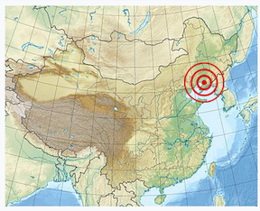
A Successful Earthquake Prediction:
The Haicheng, China Earthquake of February 4, 1975
This earthquake had an magnitude of 7.5, which is associated with total destruction of infrastructure and property.
Haicheng had approximately 1 million residents at the time of the earthquake
Details follow…
https://en.wikipedia.org/wiki/1975_Haicheng_earthquake

Slide 4
Details of the Haicheng Prediction
Early in the morning of February 4, 1975, Chinese officials ordered that the city of Haicheng be evacuated, believing there to be a large chance of an earthquake occurring.
The prediction was allegedly based on reports of changes in groundwater and soil elevations over the past several months as well as widespread accounts of unusual animal behavior, such as snakes crawling out of their holes in the middle of winter
A low-level alert was triggered by regional increases in seismicity (later recognized as foreshocks).
Both authorities and citizens were finally placed on high alert and an evacuation order was issued due to an increase in foreshocks.
The evacuation, despite successfully saving most of Haicheng's population, did not prevent deaths in its entirety.
When the main quake struck at 7:36 pm, 2,041 people died, over 27,000 were injured and thousands of buildings collapsed.
However, the death toll was much lower than the estimate of over 150,000 dead which is believed to have resulted if the evacuation had not taken place.
This was the only successful evacuation of a potentially affected population before a devastating earthquake in history.

Slide 5
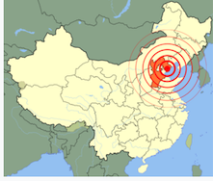
Tangshan, China Earthquake 7/27/1976
One Year Later: A Catastrophic Failure
The 1976 Tangshan earthquake, was a magnitude 7.6 earthquake
In minutes the city of Tangshan, an industrial city with approximately one million inhabitants, ceased to exist.
Eighty-five percent of the buildings in the city collapsed or were unusable, all services failed, and most of the highway and railway bridges collapsed or were seriously damaged.

Slide 6
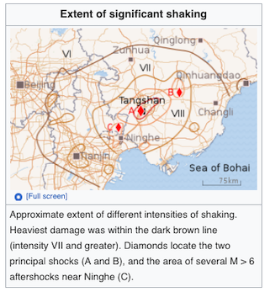
Tangshan, China Earthquake July 27, 1976
Initial estimates were 700,000 to 750,000 deaths, based on a similar sized earthquake in Shensi province in 1556 that caused 830,000 deaths
A 1988 book by several members of the Chinese State Seismological Bureau states that no more than 242,419 people died in the quake.
A webpage of the Chinese Earthquake Administration dated 2009 also attributes "242,769 deaths and 164,851 serious injuries" to the Tangshan quake.

Slide 7
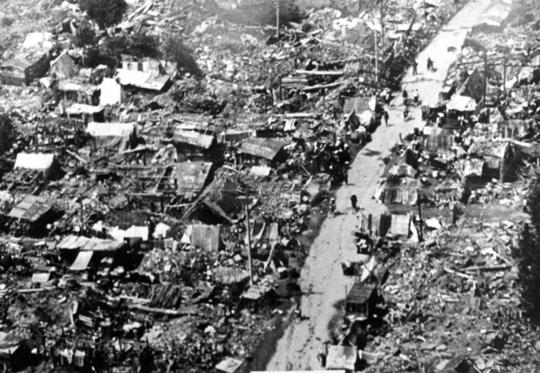
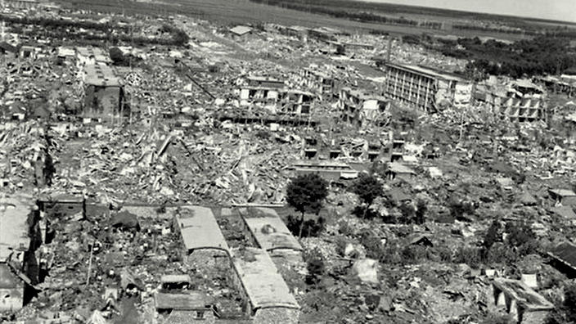
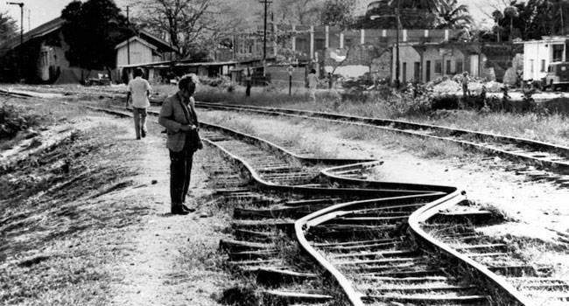
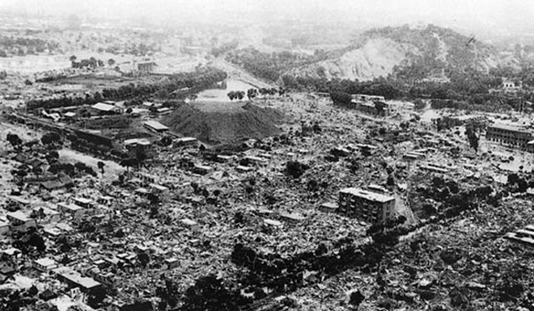
Tangshan: Images of Destruction

Slide 8
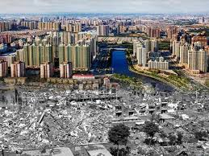

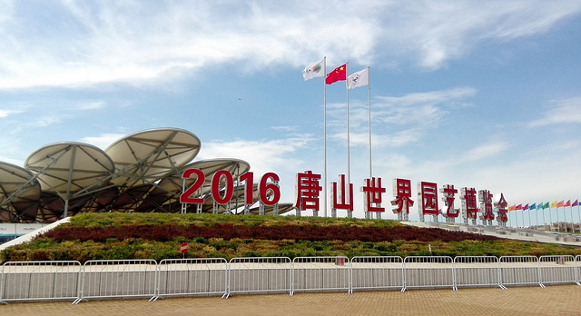
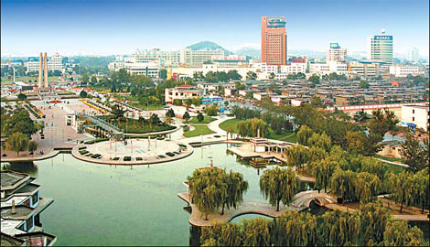
Tangshan 40 Years Later (2016)
A Modern Chinese City

Slide 9
Context | Characteristic | Alternatively
Prediction | A statement that can be validated or falsified with 1 observation | Prediction is characterized by a search for reliable precursors
Forecast | A statement for which multiple observations are required to determine a confidence level | Forecasting is characterized by a computation of probabilities
Forecasting
vs.
Prediction
To be useful, an earthquake prediction must be precise enough to warrant the cost of increased precautions, including disruption of ordinary activities, and timely enough that preparations can be made.
Predictions must also be reliable, as false alarms and cancelled alarms are not only economically costly, but seriously undermine confidence in any kind of warning.”

Slide 10
Definitions http://en.wikipedia.org/wiki/Earthquake_prediction#CITEREFICEF2011
“Earthquake prediction "is usually defined as the specification of the time, location, and magnitude of a future earthquake within stated limits”, and particularly of "the next strong earthquake to occur in a region.”
This can be distinguished from earthquake forecasting, which is the probabilistic assessment of general earthquake hazard, including the frequency and magnitude of damaging earthquakes, in a given area over periods of years or decades.
This can be further distinguished from real-time earthquake warning systems, which, upon detection of a severe earthquake, can provide neighboring regions a few seconds warning of potentially significant shaking
To be useful, an earthquake prediction must be precise enough to warrant the cost of increased precautions, including disruption of ordinary activities and commerce, and timely enough that preparation can be made.
Predictions must also be reliable, as false alarms and cancelled alarms are not only economically costly, but seriously undermine confidence in, and thereby the effectiveness of, any kind of warning.”

Slide 11
Predictions have been based on “precursors” http://en.wikipedia.org/wiki/Earthquake_prediction
“An earthquake precursor could be any anomalous phenomena that can give effective warning of the imminence or severity of an impending earthquake in a given area.
Reports of premonitory phenomena – though generally recognized as such only after the event – number in the thousands, some dating back to antiquity.
In the scientific literature there have been around 400 reports of possible precursors, of roughly twenty different types, running the gamut "from aeronomy to zoology”.
The search for reliable precursors has yet to have a convincing success.

Slide 12
Precursor Examples http://en.wikipedia.org/wiki/Earthquake_prediction#CITEREFICEF2011
Changes in V_{P}/V_{S} Velocity ratio
“Small-scale laboratory experiments have shown that the ratio of these two velocities – represented as Vp/Vs – changes when rock is near the point of fracturing.
In the 1970s it was considered a significant success and likely breakthrough when Russian seismologists reported observing such changes in the region of a subsequent earthquake.
This effect, as well as other possible precursors, has been attributed to dilatancy, where rock stressed to near its breaking point expands (dilates) slightly.
Study of this phenomena near Blue Mountain Lake (New York) led to a successful prediction in 1973.
However, additional successes there have not followed, and it has been suggested that the prediction was only a lucky fluke.
A Vp/Vs anomaly was the basis of James Whitcomb's 1976 prediction of a M 5.5 to 6.5 earthquake near Los Angeles, which failed to occur.”

Slide 13
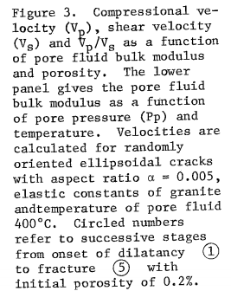
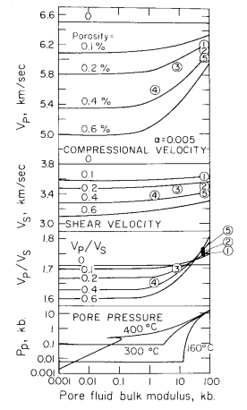
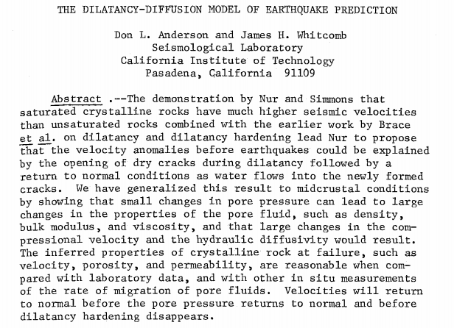
Dilatancy Diffusion Model http://www.gps.caltech.edu/uploads/File/People/dla/DLAtpsaf73.pdf
The idea is that Vp/Vs gradually decreases before the earthquake, then returns to normal just before the earthquake occurs as water flows into newly opening cracks in the source region

Slide 14
Precursor Examples http://en.wikipedia.org/wiki/Earthquake_prediction#CITEREFICEF2011
Radon Emissions
Most rock contains small amount of gases that can be isotopically distinguished from the normal atmospheric gases.
There are reports of spikes in the concentrations of such gases prior to a major earthquake; this has been attributed to release due to pre-seismic stress or fracturing of the rock.
Produced by radioactive decay of the trace amounts of uranium present in most rock active as a potential earthquake predictor because being radioactive it is easily detected, and its short half-life (3.8 days) makes it sensitive to short-term fluctuations.
A 2009 review found 125 reports of changes in radon emissions prior to 86 earthquakes since 1966.
But the earthquakes with which these changes are supposedly linked were up to a thousand kilometers away, months later, and at all magnitudes.
Another review concluded that in some cases changes in radon levels preceded an earthquake, but a correlation is not yet firmly established.

Slide 15
Precursor Examples http://en.wikipedia.org/wiki/Earthquake_prediction#CITEREFICEF2011
Electromagnetic Variations
“Various attempts have been made to identify possible pre-seismic variations in various electrical, electric-resistive, or magnetic phenomena.
The most visible, and most criticized, is the VAN method of professors P. Varotsos, K. Alexopoulos and K. Nomicos – "VAN" – of the National and Capodistrian University of Athens.
An analysis of the wave propagation properties of SES in the Earth’s crut showed that it would have been impossible for signals with the amplitude reported by VAN to have been generated by small earthquakes and transmitted over the several hundred kilometers distances from the epicenter to the monitoring station.
Several authors have pointed out that VAN’s publications are characterized by not accounting for (identifying and eliminating) the possible sources of electromagnetic interference (EMI) to their measuring system.”
Other investigators have claimed to observe electromagnetic precursors prior to the, e.g., Loma Prieta earthquake (1989) that may have been due to a piezo electric effect in stressing of quartz rocks

Slide 16
Precursor Examples http://en.wikipedia.org/wiki/Earthquake_prediction#CITEREFICEF2011
Space-Time Patterns of Earthquake Seismicity
Seismic Gaps:
At the contact where two tectonic plates slip past each other every section must eventually slip, as (in the long-term) none get left behind.
In the seismic gap model the "next big quake" should be expected not in the segments where recent seismicity has relieved the strain, but in the intervening gaps where the unrelieved strain is the greatest.
This method is based on the Characteristic Earthquake model
This model has an intuitive appeal; it is used in long-term forecasting, and was the basis of a series of circum-Pacific (Pacific Rim) forecasts in 1979 and 1989—1991.
However, systematic testing has shown that this pattern is not very predictive of the time or location of the next large earthquake

Slide 17
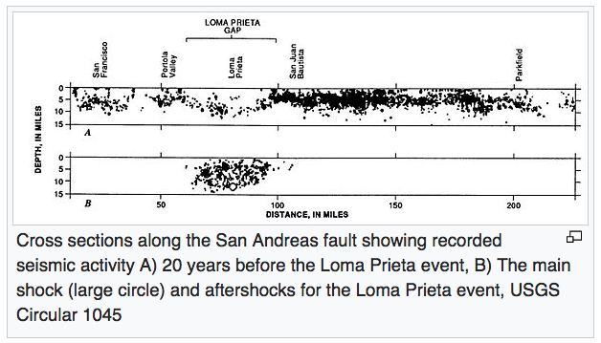
Seismic Gaps https://en.wikipedia.org/wiki/Seismic_gap
Loma Prieta was a location where the seismic gap model seemed to apply

Slide 18
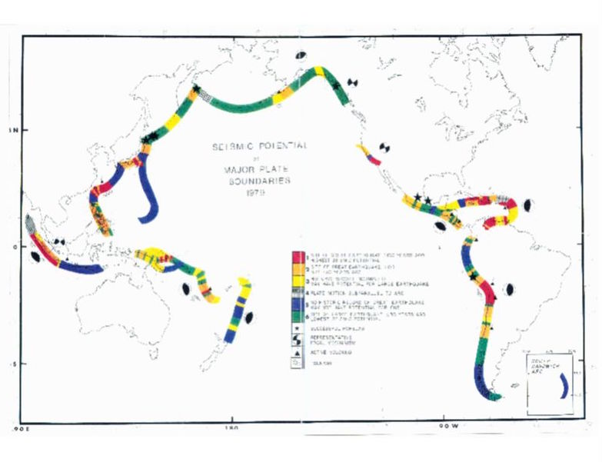
Seismic Gaps
McCann et al (1991)

Slide 19
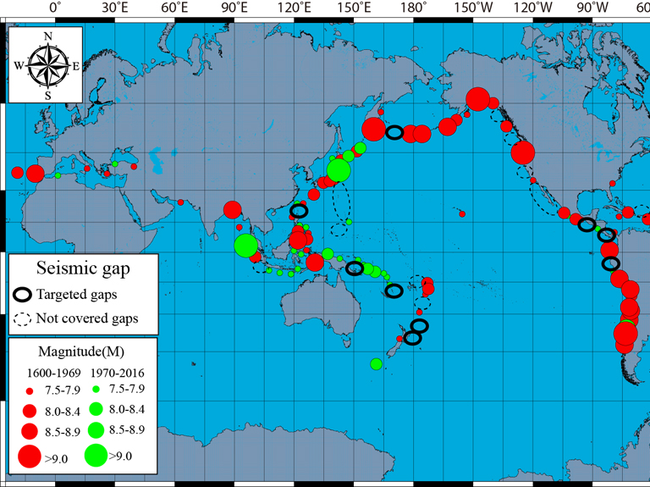
https://www.wtwco.com/en-GB/Insights/2017/07/seismic-gaps-as-the-sources-for-future-tsunamis
There are a number of seismic gaps around the world. Here we only selected some gaps that have high potential of tsunamigenic events. The rings represents the gap areas and the size of the earthquake.

Slide 20
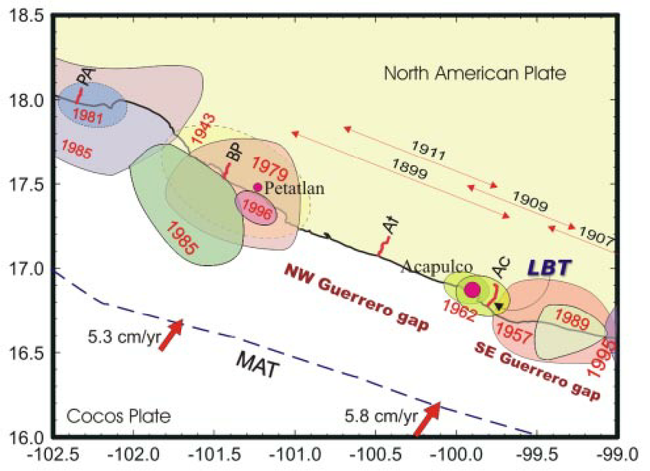
Seismic Gaps https://www.researchgate.net/figure/26490475_fig1_Fig-1-Major-seismic-gaps-along-the-Pacific-coast-of-Mexico-Shaded-areas-annotated-with
Fig. 1. Major seismic gaps along the Pacific coast of Mexico.
Shaded areas annotated with a year are rupture zones of recent large thrust earthquakes.
Thin arrows indicate the approximate rupture length of large earthquakes in 1899, 1907, 1909, and 1911.
Solid arrows are vectors of the Cocos – NA convergence velocities according to the NUVEL 1A model (DeMets et al., 1994). MAT – Middle America trench.
LBT mark with a thin arrow show a location of the tiltmeter.
Annotated short lines (PA, BP, At, and Ac) are leveling profiles.

Slide 21
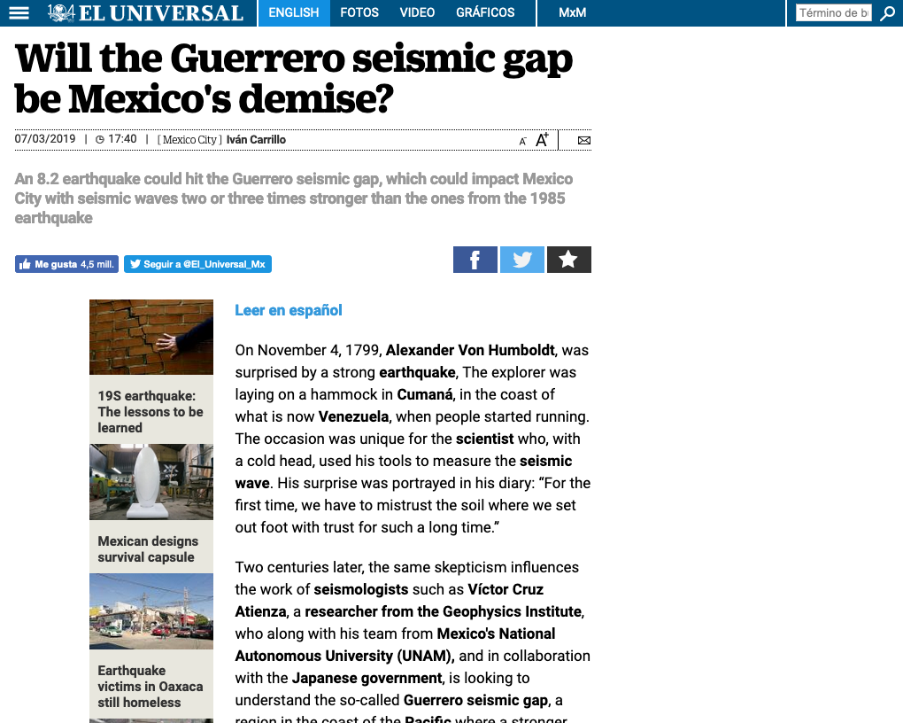

Slide 22
Seismicity Patterns http://en.wikipedia.org/wiki/Earthquake_prediction#CITEREFICEF2011
M8:
“Various pattern analysis algorithms have been developed for predicting earthquakes.
The most widely known is the M8 family of algorithms (including the RTP method) developed under the leadership of Vladimir Keilis-Borok of Russia. M8 issues a "Time of Increased Probability" (TIP) alarms for a large earthquake of a specified magnitude upon observing certain patterns of smaller earthquakes.
TIPs generally cover large areas (up to a thousand kilometers across) for up to five years.
Such large parameters have made M8 controversial, as it is hard to determine whether any hits that happen were skillfully predicted, or only the result of chance.”
AMR:
“Accelerating moment release (AMR, "moment" being a measurement of seismic energy) is based on some observations that foreshock activity prior to a major earthquake not only increased, but increased at an exponential rate.
Testing has shown that apparent AMR trends likely result from how data fitting is done[ and failing to account for spatiotemporal clustering of earthquakes.
The AMR trends have generally not been found to be statistically significant. “

Slide 23
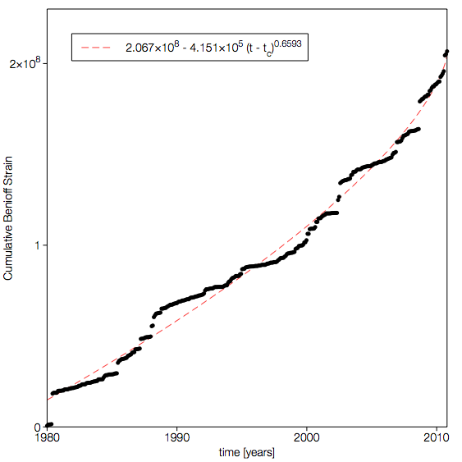

Seismicity Patterns:
Accelerating moment release (AMR)
Cumulative Benioff strain prior to the El Mayor-Cucapah earthquake in a circular region of radius 100km centered on the epicenter.
The dashed line is the best fit AMR correlation with:

Slide 24
Categories of Outcomes for Prediction Schemes
(“Contingency Table” or “Confusion Matrix”)
Earthquake is Observed
Earthquake is Not Observed
Earthquake is
Predicted
Correct Prediction of Earthquake | False Alarm
Failure to Predict | Correct Prediction of No Earthquake
No Earthquake is
Predicted

Slide 25
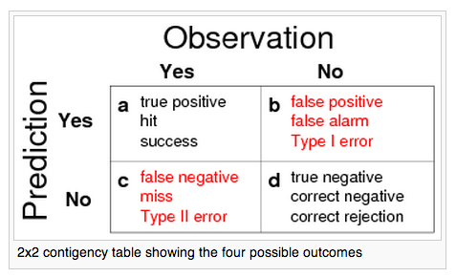
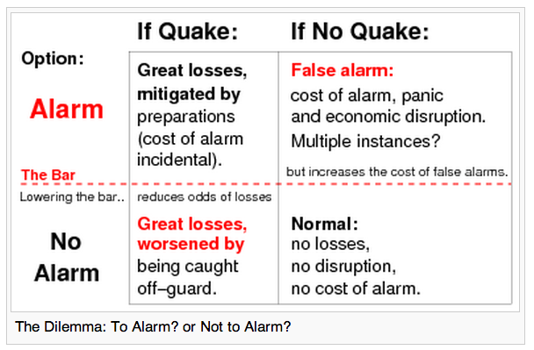
Testing: Contingency Tables
(Also called a confusion matrix in Machine Learning) http://en.wikipedia.org/wiki/Earthquake_prediction#CITEREFICEF2011
The dilemma: To Alarm or Not to Alarm?

Slide 26

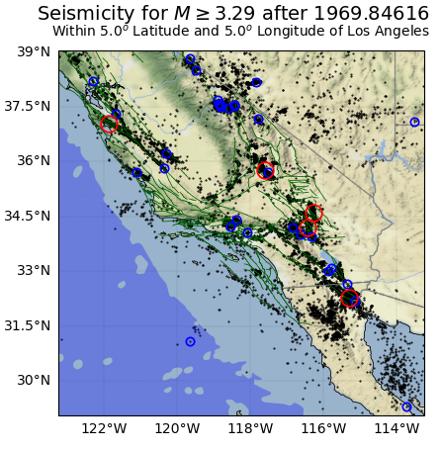
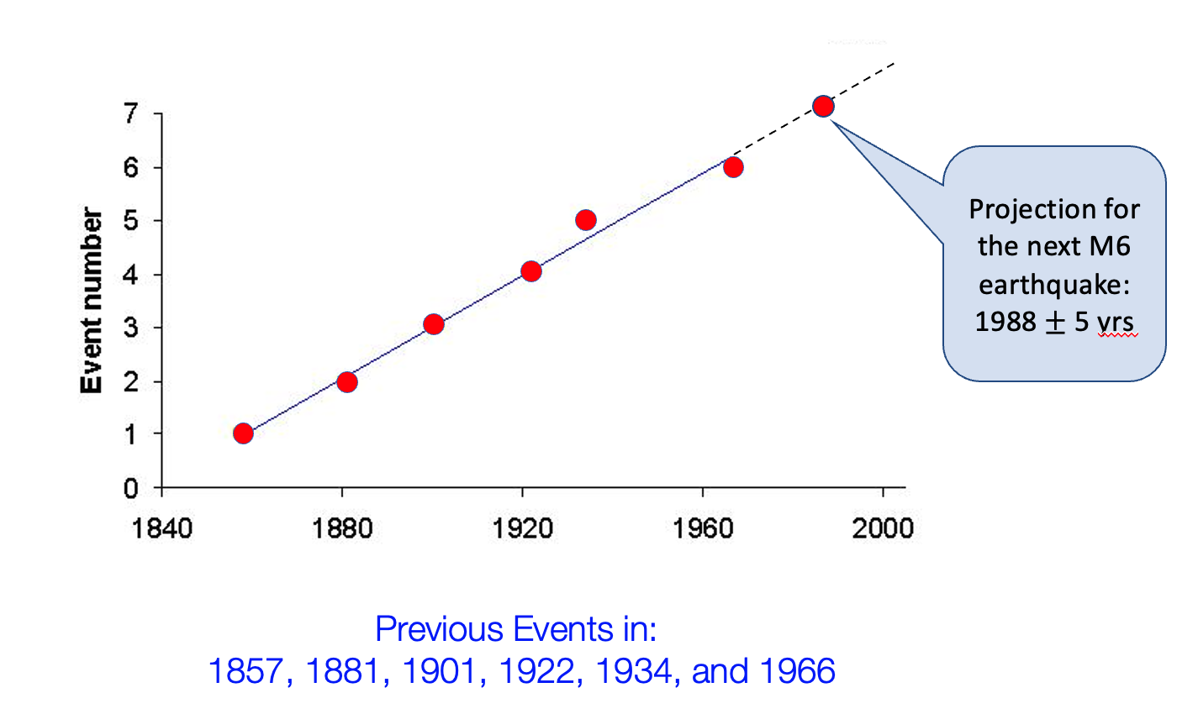
Parkfield, California Earthquake Prediction/Forecast

Slide 27
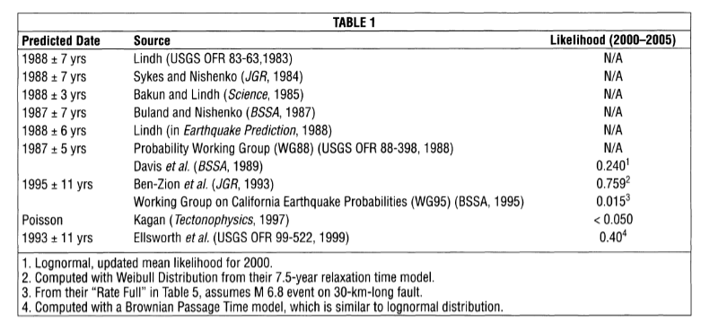
Predicted Time of Occurrence (A. Lindh, SRL, 2005)
Actual Occurrence: 28 September, 2004
Various precursors predicted
Precursors observed: Depends on your interpretation of events

Slide 28
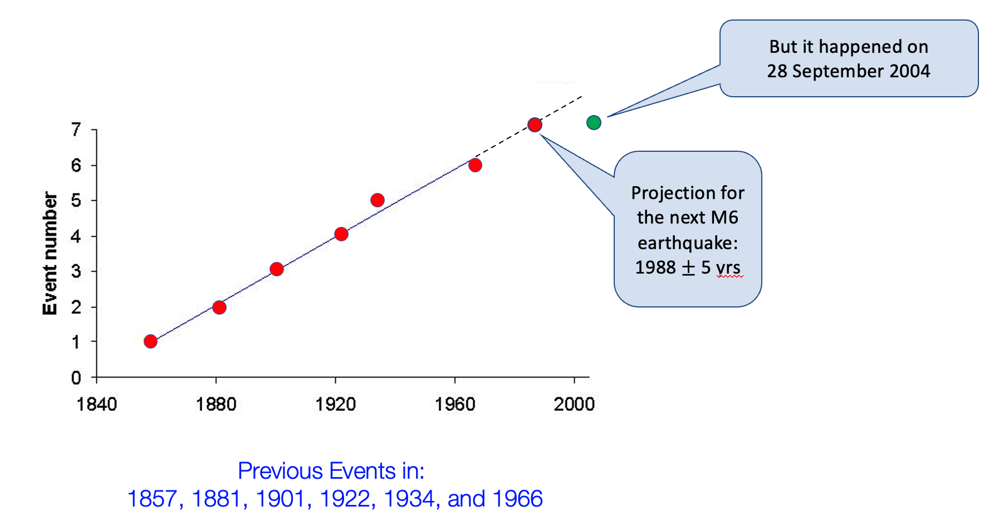
Parkfield, California Earthquake Prediction/Forecast
X
Although the earthquake did not occur when predicted, a wealth of data was recorded due to the dense instrumentation. There were no obvious precursors.

Slide 29
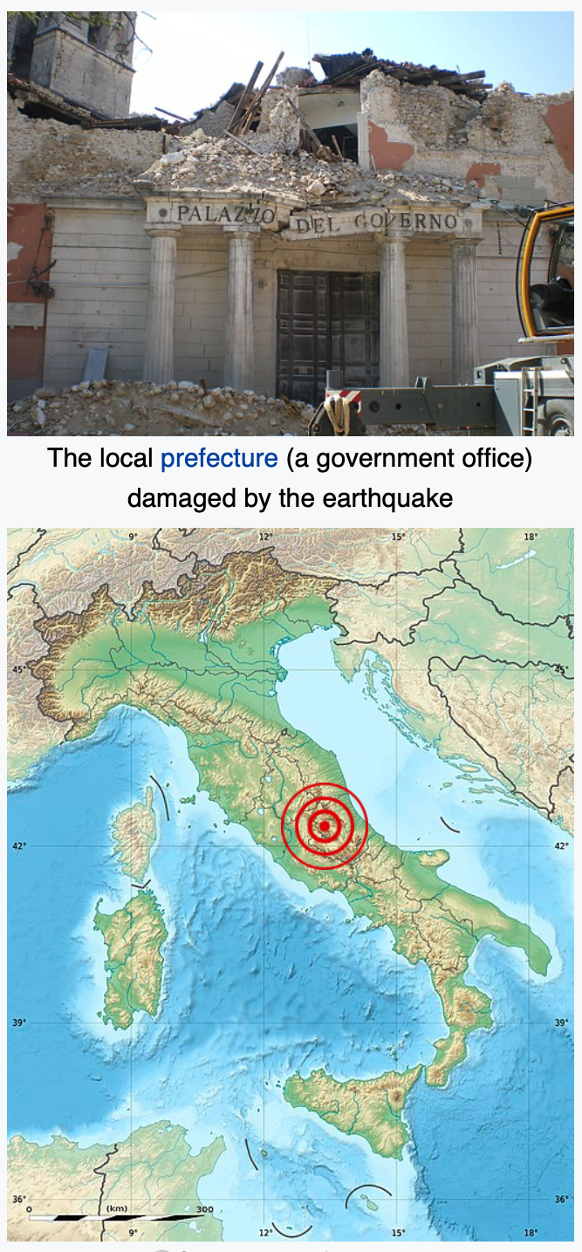
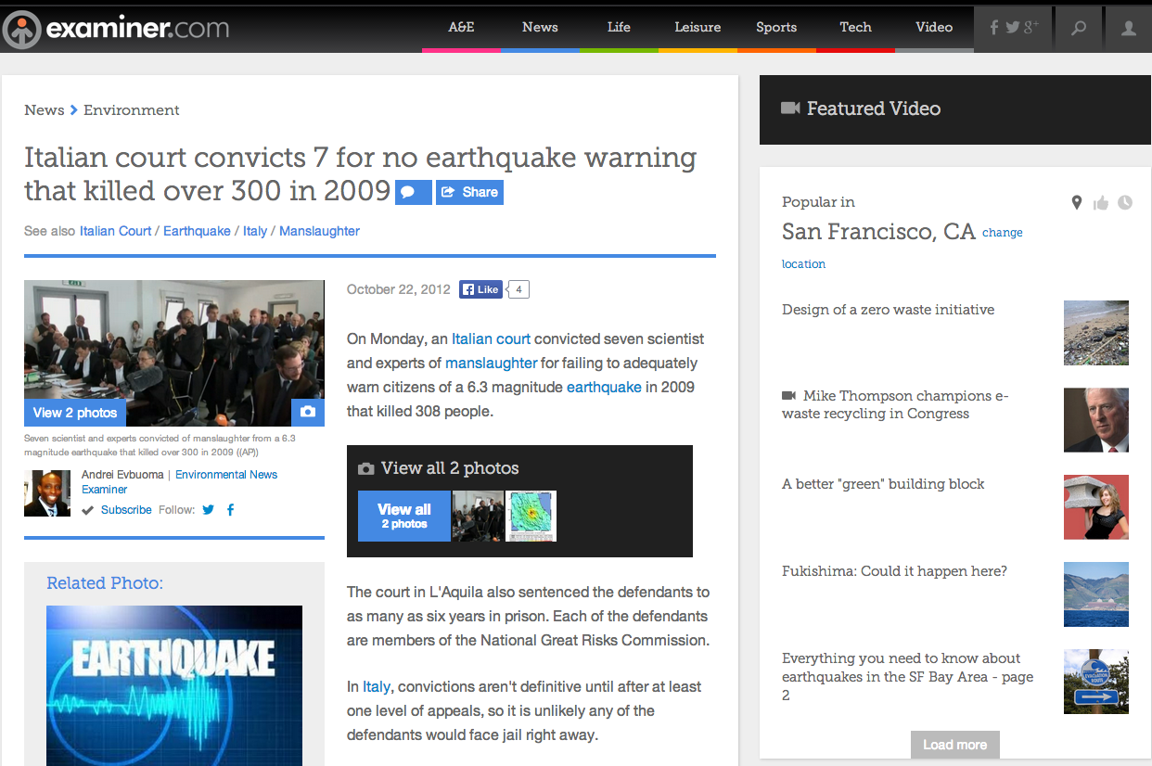
Hazards of Prediction
The L’Aquila, Italy Earthquake of 6 April 2009, M6.3
http://en.wikipedia.org/wiki/Earthquake_prediction

Slide 30
Hazards of Prediction: The Italian Situation http://en.wikipedia.org/wiki/Earthquake_prediction
On 6 April 2009, the L’Aquila, Italy region was shaken by a M6.3 earthquake that collapsed many buildings in the town and killed 308 persons leaving 67,000 homeless
This event had been preceeded by many swarms of small earthquakes in the months before the mainshock
That area of Italy has had significant historic earthquakes, and the tradition in the town was that the public would sleep outside when the activity became intense
Before the mainshock, a laboratory technician, Giampaolo Giuliani, predicted a large earthquake in the region based on radon gas emissions a few weeks prior to the event
Giuliani then placed a loudspeaker on his car and drove through the region warning of the impending earthquake. He was arrested, tried, and convicted for disturbing the peace
A government commission investigated the claims, thought them to be baseless, and dismissed the prediction
At a press conference days prior to the earthquake, one of the 7 commissioners suggested to a reporter that citizens in the region should relax and enjoy a bottle of wine
After the earthquake occurred, the 7 commissioners were tried for failing in their duty to warn the public of a possible disaster - they were convicted and sentenced to 6 years in prison
The case caused an international outcry and sensation, and their sentences were appealed.
6 of the 7 were eventually exonerated, the last had his sentence reduced

Slide 31
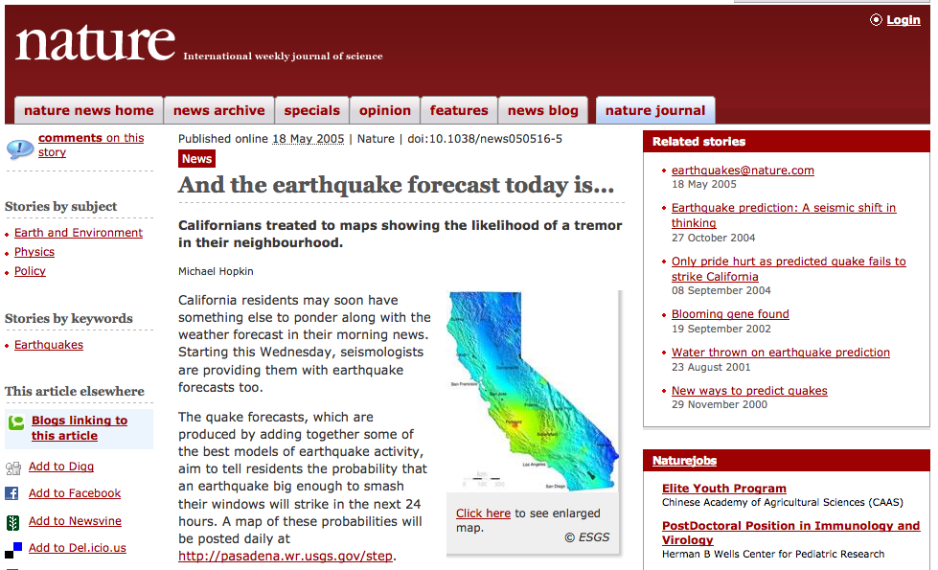
STEP: A “consensus” forecast at the time. Approved by CEPEC and NEPEC
Web site was built to make 24-hour forecasts of aftershocks using the STEP method

Slide 32
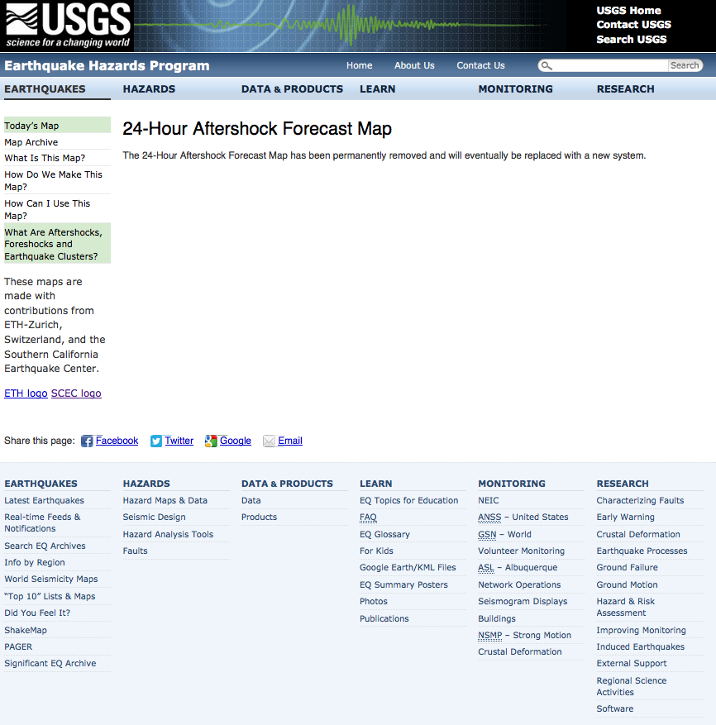
And then the USGS removed the STEP web site…

Slide 33
Forecast for Nepal Aftershocks Made on May 8, 2015
A “consensus” method using
Reasenberg and Jones 1989
Forecast made by USGS on May 8, 2015 at the request of USAID
99.6% probability of non-occurrence for M>7 during the week of May 8-14
M7.3 aftershock occurred on May 12
280 deaths, 3500+ injuries
(per wikipedia)
Notes:
Start here 2017-10-27

Slide 34
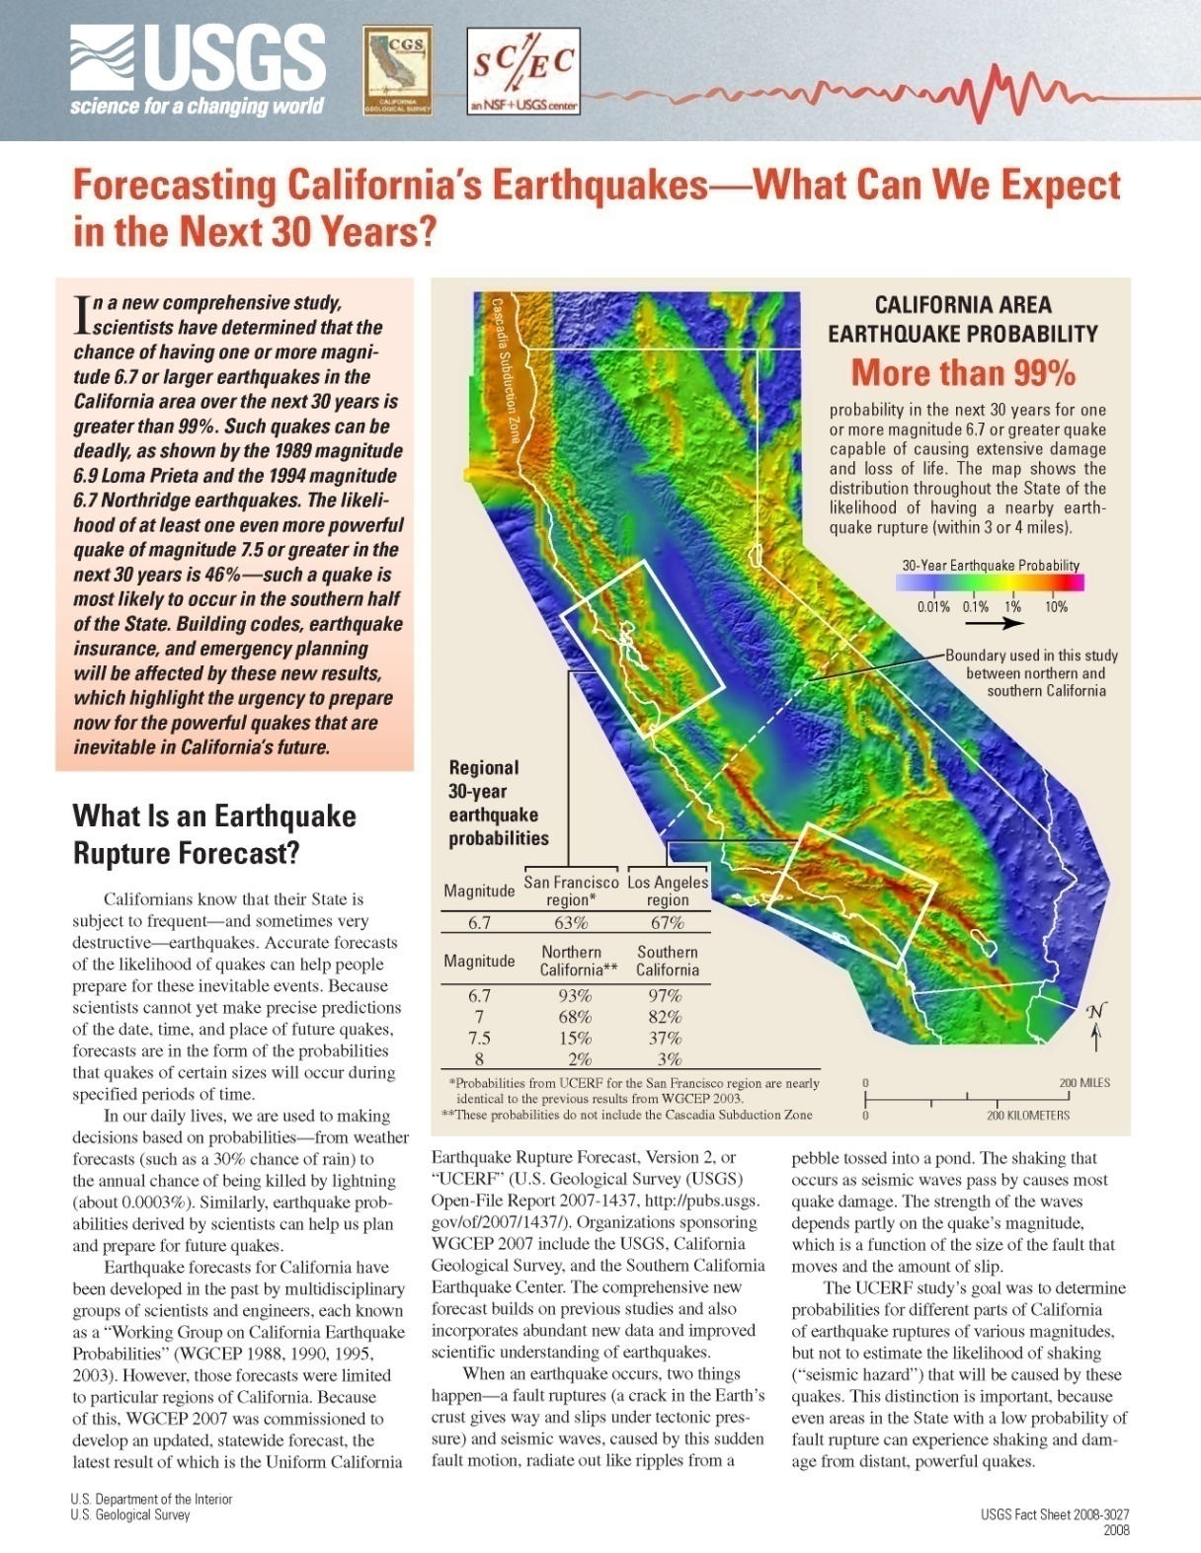
California:
The Official Forecast
http://wgcep.org/
Working Group on California Earthquake Probabilities 2007
Method requires many tens of scientists over ~4 years to produce a single 30 year forecast.
Approx. 2000 model parameters whose values are set using “expert opinion”.
Method cannot be automated (because it uses expert opinion) so the forecast cannot be backtested.

Slide 35
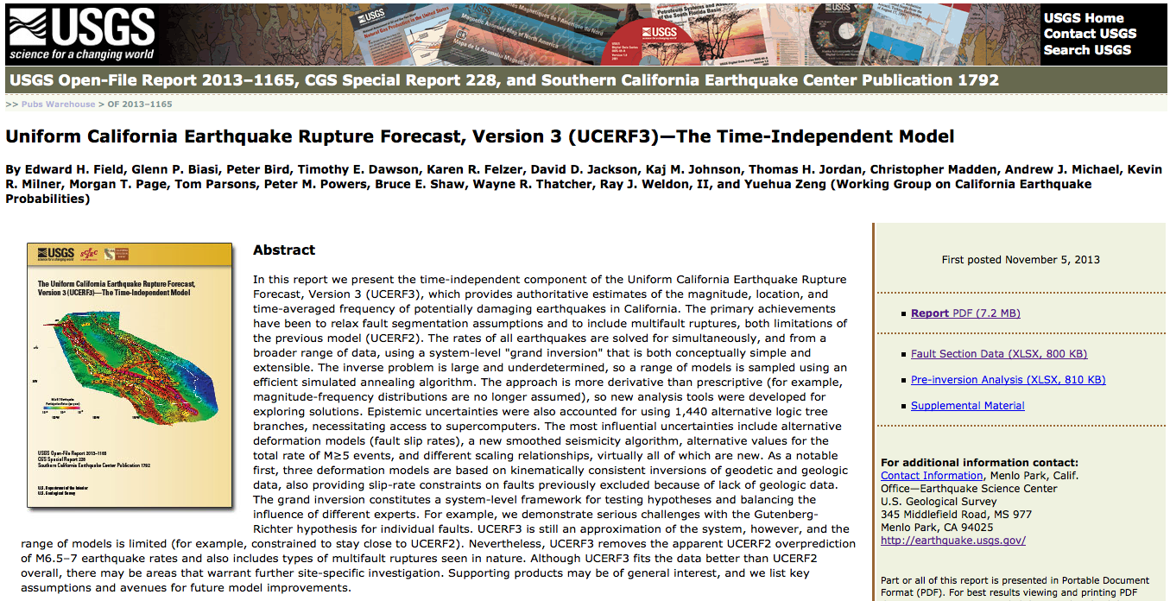
The New “Consensus” Forecast
18 Authors. Official California forecast. Not tested against data.

Slide 36
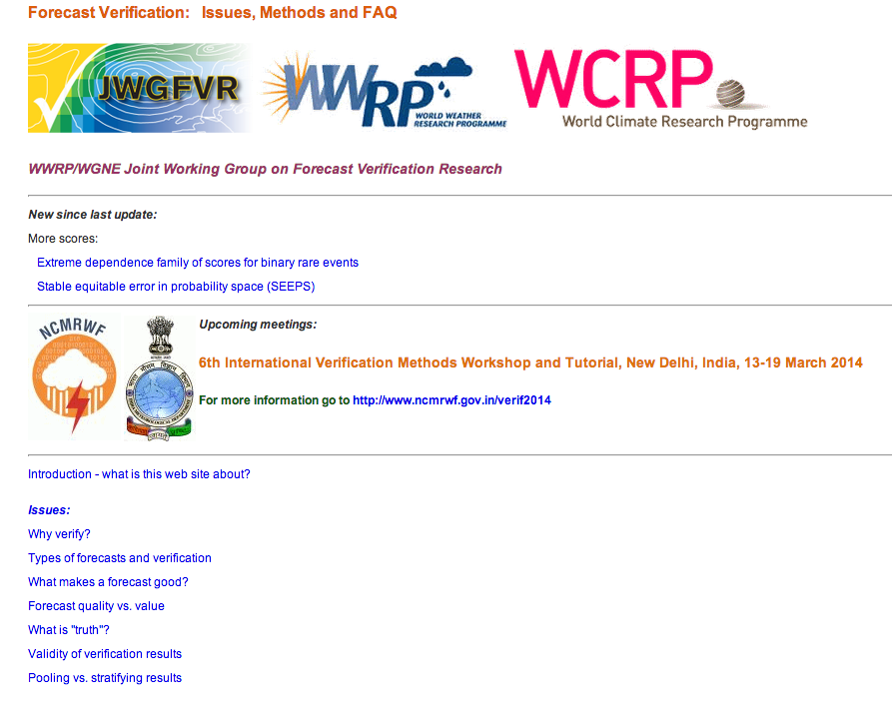
Verification and Validation http://www.cawcr.gov.au/projects/verification/
Australian site for weather and more general validation and verification of forecasts
Common methods are Reliability/Attributes diagrams, ROC diagrams, Briar Scores, etc.

Slide 37
Time Scales for Anticipating Earthquakes
Ended 10/19/2022
Long
Short
NSHM
UCERF
RELM
Nowcasting
EEW
50 Years
30 Years
Years
Tracks
Current
Risk
Seconds
of
Warning
National Seismic Hazard Map (US Geological Survey)
Uniform California Earthquake Rupture Forecast
(USGS and SCEC)
Relative Earthquake Likelihood Models
(Research Area)
Uses Proxy variables to compute short term probabilities
(Research Area)
Earthquake Early Warning (USGS and SCEC: Under development)
Value
Building codes
Insurance
Planning
Preparedness
Imminent Warning

Slide 38
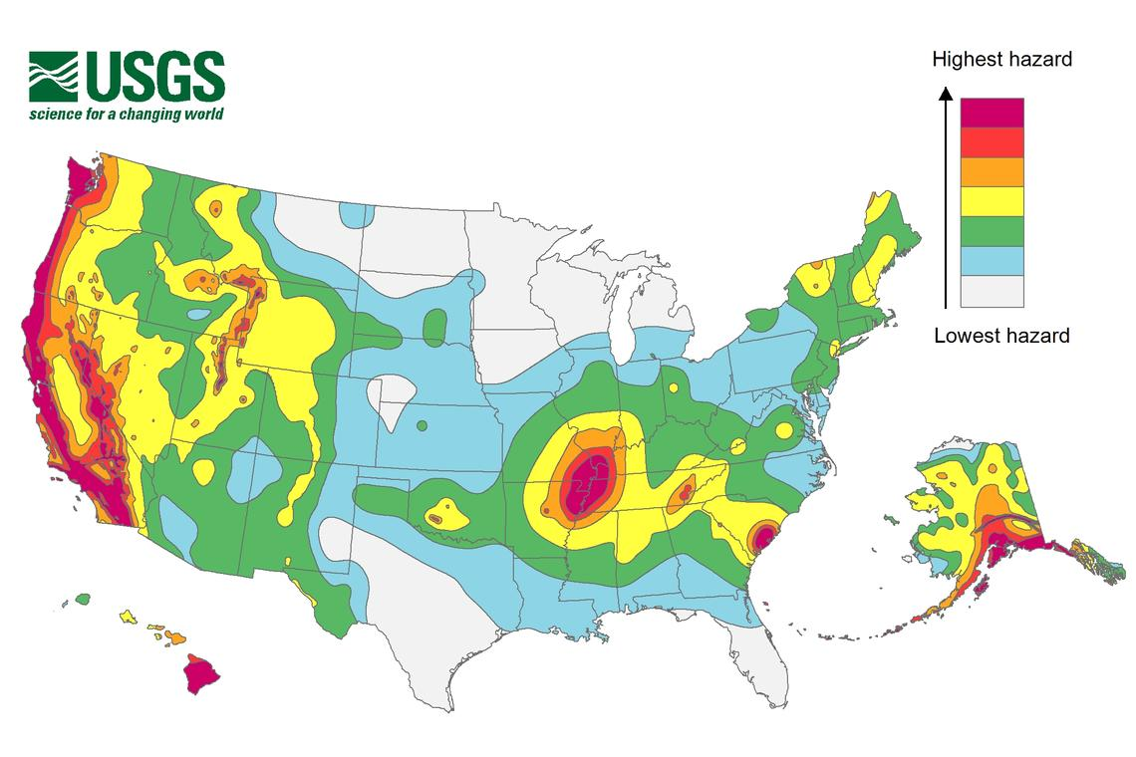
National Seismic Hazard Map
US Geological Survey
50 year ground motion probabilities
https://www.usgs.gov/programs/earthquake-hazards/science/national-seismic-hazard-maps

Slide 39
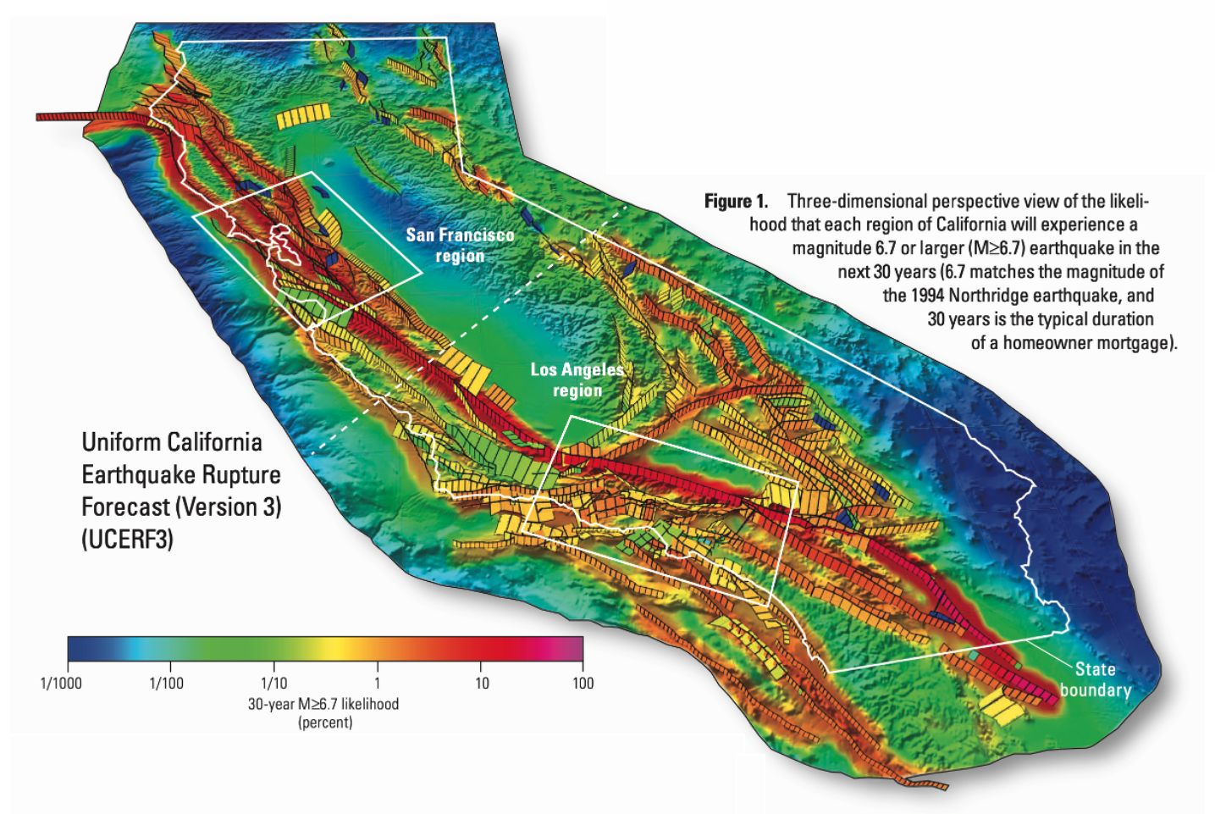
Uniform California Earthquake Rupture Forecast
US Geological Survey + Southern California Earthquake Center
30 year forecast of earthquake likelihood
https://pubs.usgs.gov/fs/2015/3009/pdf/fs2015-3009.pdf

Slide 40
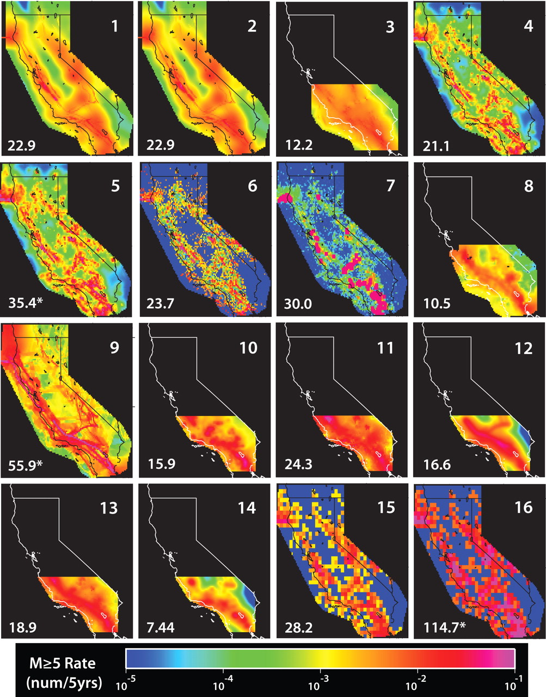

Relative Earthquake Likelihood Model (RELM) Contest
A prospective contest of earthquake forecasting conducted by USGS and SCEC
Forecasts submitted in 2007. Evaluated in 2011 (but ongoing as well)
Numbers in lower left of each panel was the predicted number of M$≥$5 earthquakes
31 M$≥$5 earthquakes actually occurred by the end of the testing period.
E.H. Field, Seismological Research Letters, vol. 78, (1) 7-16 (2007)

Slide 41
No. | Origin Time (UTC) | Lat. | Long. | M
1 | 2006/05/24 04:20:26.01 | 32.3067 | -115.2278 | 5.37 | A
2 | 2006/07/19 11:41:43.46 | 40.2807 | -124.4332 | 5.00
3 | 2007/02/26 12:19:54.48 | 40.6428 | -124.8662 | 5.40
4 | 2007/05/09 07:50:03.83 | 40.3745 | -125.0162 | 5.20
5 | 2007/06/25 02:32:24.62 | 41.1155 | -124.8245 | 5.00
6 | 2007/10/31 03:04:54.81 | 37.4337 | -121.7743 | 5.45
7 | 2008/02/09 07:12:04.55 | 32.3595 | -115.2773 | 5.10 | A
8 | 2008/02/11 18:29:30.53 | 32.3272 | -115.2568 | 5.10 | A
9 | 2008/02/12 04:32:39.24 | 32.4475 | -115.3175 | 4.97 | A
10 | 2008/02/19 22:41:29.66 | 32.4325 | -115.3130 | 5.01 | A
11 | 2008/04/26 06:40:10.60 | 39.5253 | -119.9289 | 5.00
12 | 2008/04/30 03:03:06.90 | 40.8358 | -123.4968 | 5.40
13 | 2008/07/29 18:42:15.71 | 33.9530 | -117.7613 | 5.39
14 | 2008/11/20 19:23:00.19 | 32.3288 | -115.3318 | 4.98 | A
15 | 2008/12/06 04:18:42.85 | 34.8133 | -116.4188 | 5.06
16 | 2009/09/19 22:55:17.84 | 32.3707 | -115.2612 | 5.08
17 | 2009/10/01 10:01:24.67 | 36.3878 | -117.8587 | 5.00 | FS
18 | 2009/10/03 01:16:00.31 | 36.3910 | -117.8608 | 5.19
19 | 2009/12/30 18:48:57.33 | 32.4640 | -115.1892 | 5.80
20 | 2010/01/10 00:27:39.32 | 40.6520 | -124.6925 | 6.50
21 | 2010/02/04 20:20:21.97 | 40.4123 | -124.9613 | 5.88
22 | 2010/04/04 22:40:42.15 | 32.2587 | -115.2872 | 7.20
23 | 2010/04/04 22:50:17.08 | 32.0972 | -115.0467 | 5.51 | AS
24 | 2010/04/04 23:15:14.24 | 32.3000 | -115.2595 | 5.43 | AS
25 | 2010/04/04 23:25:06.95 | 32.2462 | -115.2978 | 5.38 | AS
26 | 2010/04/05 00:07:09.07 | 32.0180 | -115.0172 | 5.32 | AS
27 | 2010/04/05 03:15:24.46 | 32.6282 | -115.8062 | 4.97 | AS
28 | 2010/04/08 16:44:25.92 | 32.2198 | -115.2760 | 5.29 | AS
29 | 2010/06/15 04:26:58.48 | 32.7002 | -115.9213 | 5.72 | AS
30 | 2010/07/07 23:53:33.53 | 33.4205 | -116.4887 | 5.43
31 | 2010/09/14 10:52:18.00 | 32.0485 | -115.1982 | 4.96 | AS
The Earthquakes
Times of occurrence, locations, and magnitudes of the 31 earthquakes in the test region with M ≥ 4.95 from 1 January 2006 until 31 December 2010. The M = 7.2 El Mayor-Cucapah earthquake is in red.
A - activation(6)
FS - foreshock(1) AS - aftershock (8)

Slide 42
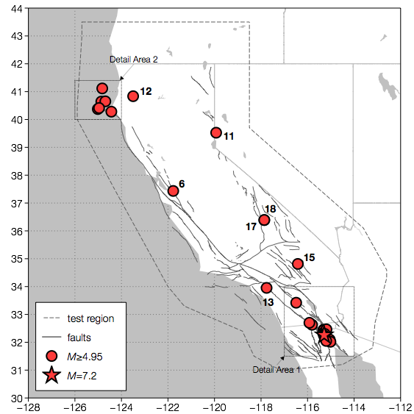
Test Region
Map of the test region, the coast of California, major faults, and the 31 earthquakes with M ≥ 4.95 that occurred in the test region. Also shown are the square regions where large scale maps are given in subsequent slides.

Slide 43
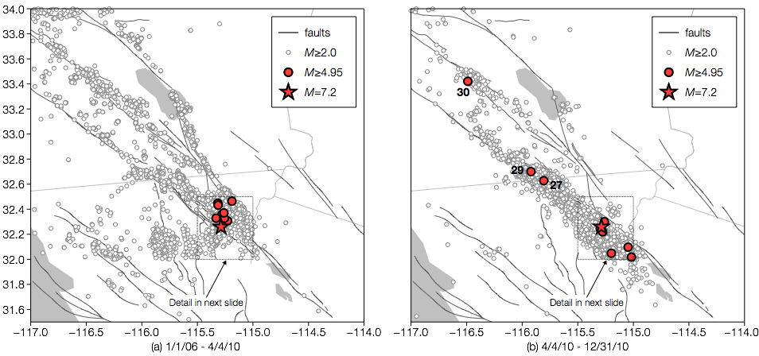
detail area 1
Map of the southeast region around the epicenter of the M = 7.2 El Mayor-Cucapah earthquake that occurred on 4 April 2010 (shown as a star). (a) Earthquakes during the period 1 January 2006 through 4 April 2010. (b) Earthquakes during the period 4 April 2010 through 31 December 2010 (includes aftershocks). Included are the test earthquakes as well as background earthquakes with M ≥ 2.0.
Map of the southeast region around the epicenter of the M = 7.2 El Mayor-Cucapah earthquake that occurred on 4 April 2010 (shown as a star). (a) Earthquakes during the period 1 January 2006 through 4 April 2010. (b) Earthquakes during the period 4 April 2010 through 31 December 2010 (includes aftershocks). Included are the test earthquakes as well as background earthquakes with M ≥ 2.0.

Slide 44
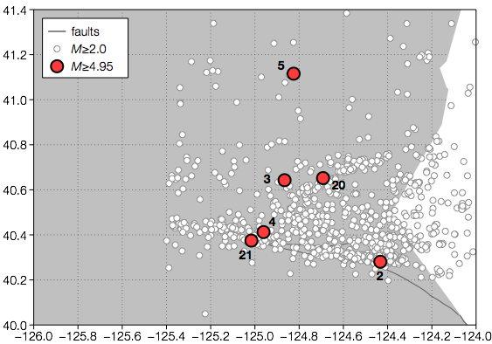
Detail Area 2
Map of the northwest region near Cape Mendocino. Test earthquakes are shown as well as background earthquakes with M ≥ 2.0.

Slide 45
Cell ID | EQ ID | B and L | Ebel | Helm. | Holl. | W-C | W-G | W and S
- A - | 1,7,8,16,24 | 1.99E-02 | 2.20E-02 | 1.17E-01 | 3.32E-02 | 1.87E-02 | 1.28E-02 | 1.24E-01
- B - | 2 | 1.41E-02 | 3.40E-02 | 7.20E-02 | 3.32E-02 | 1.08E-03 | 1.86E-03 | 4.99E-02
- C - | 3 | 7.40E-03 | 6.59E-03 | 7.41E-03 | 3.32E-02 | 8.93E-04 | 1.54E-03 | 7.91E-03
- D - | 4 | 3.54E-02 | 3.29E-02 | 6.97E-02 | 3.32E-02 | 9.50E-04 | 1.64E-03 | 3.59E-02
- E - | 5 | 7.23E-03 | 1.10E-03 | 2.29E-03 | 9.72E-05 | 9.25E-04 | 1.59E-03 | 1.58E-07
- F - | 6 | 9.37E-03 | 2.85E-02 | 3.07E-02 | 3.32E-02 | 5.29E-03 | 8.12E-03 | 4.55E-02
- G - | 9,10 | 9.11E-03 | 5.49E-03 | 2.55E-02 | 3.32E-02 | 2.25E-02 | 1.27E-02 | 2.38E-02
- H - | 11 | 3.42E-04 | 5.49E-03 | 9.15E-04 | 1.62E-04 | 3.77E-04 | 6.49E-04 | 2.06E-04
- I - | 12 | 2.14E-03 | 1.10E-03 | 3.65E-03 | 2.05E-04 | 1.14E-03 | 1.96E-03 | 9.89E-03
- J - | 13 | 1.68E-03 | 8.78E-03 | 1.11E-02 | 3.32E-02 | 8.11E-03 | 5.12E-03 | 1.13E-02
- K - | 14 | 3.12E-02 | 2.20E-02 | 3.30E-02 | 3.32E-02 | 1.93E-02 | 1.17E-02 | 5.90E-02
- L - | 15 | 2.07E-03 | 5.49E-03 | 6.93E-03 | 3.32E-03 | 4.80E-03 | 5.45E-03 | 2.64E-03
- M - | 17,18 | 1.74E-03 | 2.20E-03 | 5.78E-03 | 3.32E-02 | 3.88E-03 | 4.61E-03 | 5.38E-04
- N - | 19 | 5.83E-02 | 6.59E-03 | 1.49E-02 | 3.32E-02 | 1.65E-02 | 1.23E-02 | 7.44E-03
- O - | 20 | 1.25E-02 | 1.43E-02 | 9.45E-03 | 3.32E-02 | 9.30E-04 | 1.60E-03 | 1.62E-02
- P - | 21 | 6.48E-03 | 3.29E-02 | 2.71E-02 | 3.32E-02 | 9.03E-04 | 1.55E-03 | 7.46E-03
- Q - | 22,25,28 | 2.88E-02 | 2.20E-02 | 2.84E-02 | 3.32E-02 | 1.66E-02 | 1.30E-02 | 5.23E-02
- R - | 23,26 | 3.06E-02 | 1.54E-02 | 1.43E-02 | 1.73E-04 | 1.78E-02 | 1.38E-02 | 1.58E-02
- S - | 27 | 2.13E-02 | 5.49E-03 | 1.26E-02 | 3.32E-02 | 9.55E-03 | 7.93E-03 | 1.19E-02
- T - | 29 | 1.83E-02 | 1.32E-02 | 2.43E-02 | 3.32E-02 | 6.35E-03 | 3.90E-03 | 4.99E-02
- U - | 30 | 1.26E-02 | 3.07E-02 | 1.03E-01 | 3.32E-03 | 1.61E-02 | 5.47E-03 | 5.16E-02
- V - | 31 | 6.76E-03 | 1.54E-02 | 5.55E-03 | 3.32E-02 | 1.54E-02 | 1.43E-02 | 2.64E-03
  Normalized probabilities of occurrence λin of an earthquake with M ≥ 4.95 for the 22 cells in which earthquakes occurred during the test period. Seven submitted forecasts are given: (1) Bird and Liu (B and L), (2) Ebel et al. (Ebel), (3) Helmstetter et al. (Helm.), (4) Holliday et al. (Holl.), (5) Ward combined (W-C), (6) Ward geodetic (W-G), (7) Wiemer and Schorlemmer (W and S). The highest (best) probabilities are in red. Perfect skill λin = 1.00, No skill λin = 22/7682 = 2.86×10⁻³.

Slide 46
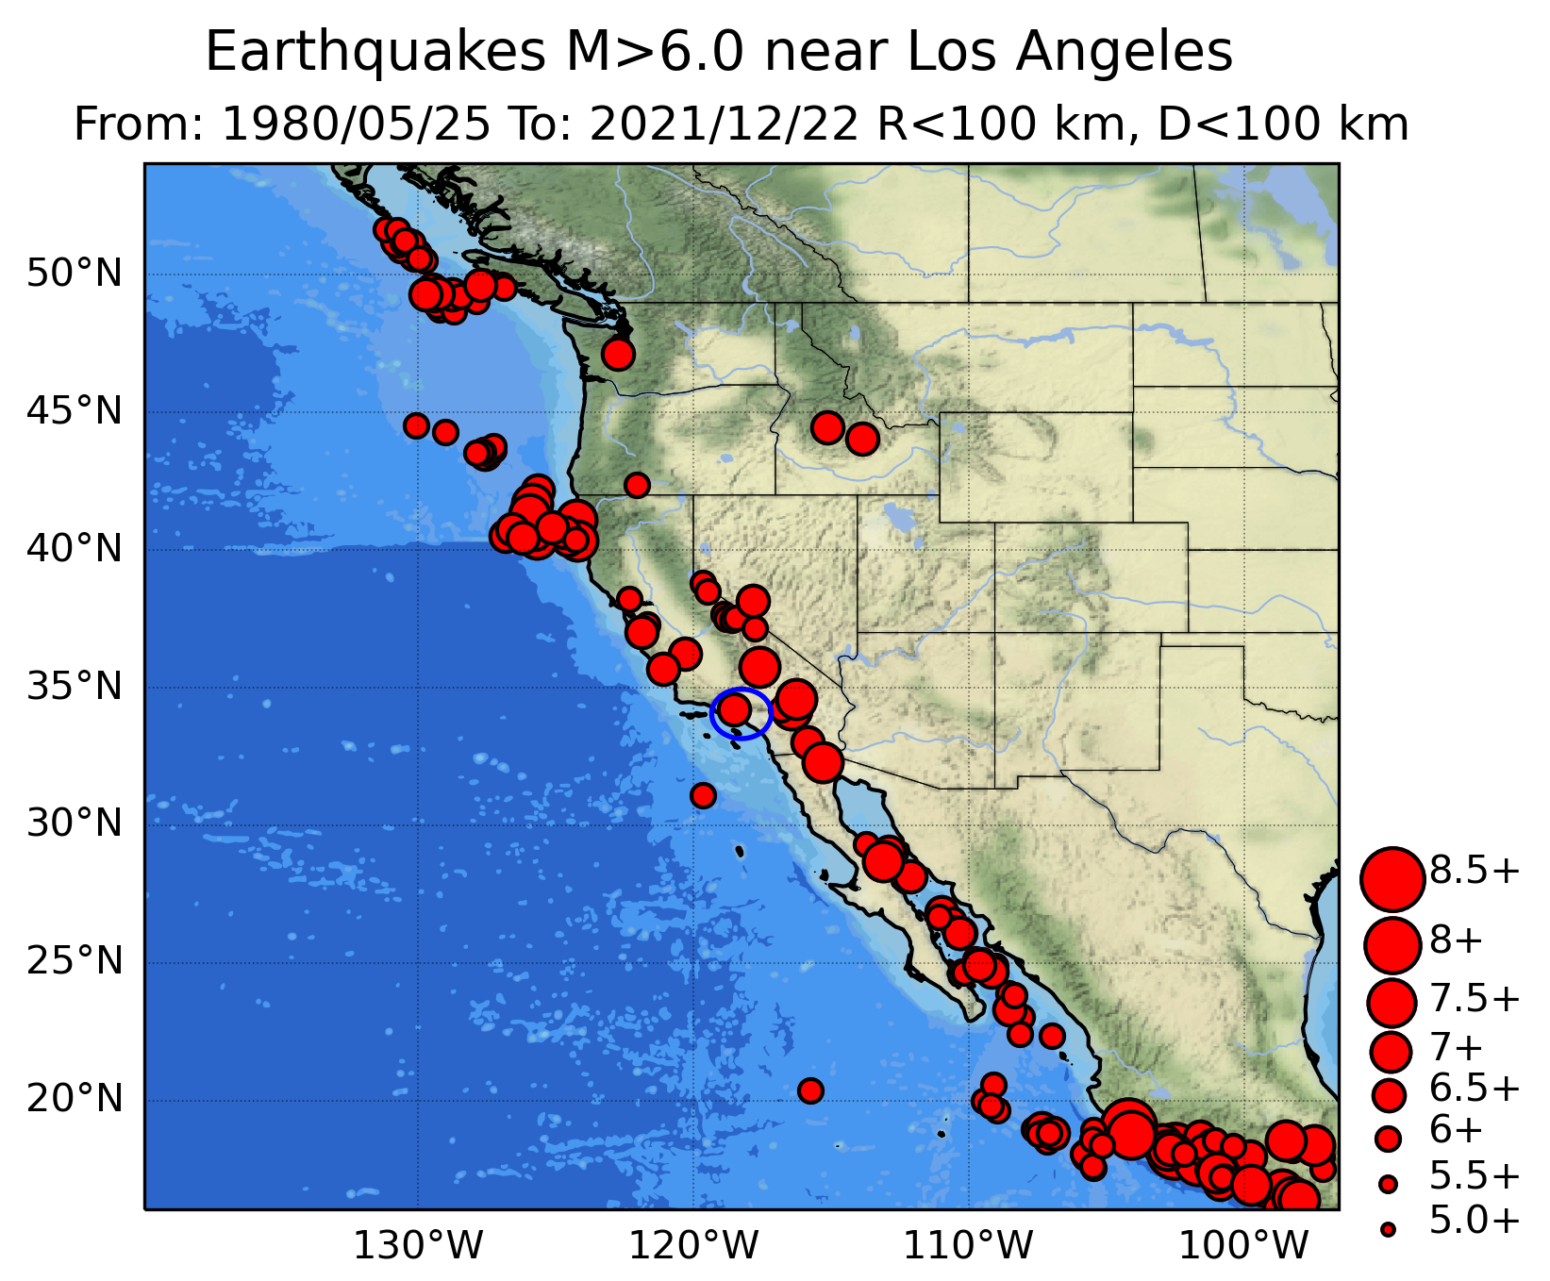
Nowcasting Earthquakes
The Seismic Thermometer
Once a large magnitude earthquake occurs (M = 6), we begin counting the number of small earthquakes (M>3)
After 1000 subsequent M>3 earthquakes occur, on average, we should expect another M = 6 earthquake (“Gutenberg-Richter law”)
We use two regions:
  A ”small” region for the nowcast, within 60 miles around Los Angeles
  A “large” surrounding region to define the appropriate Gutenberg-Richter statistical distribution
Map shows M>6 earthquakes in the large region around Los Angeles since 1980

Slide 47
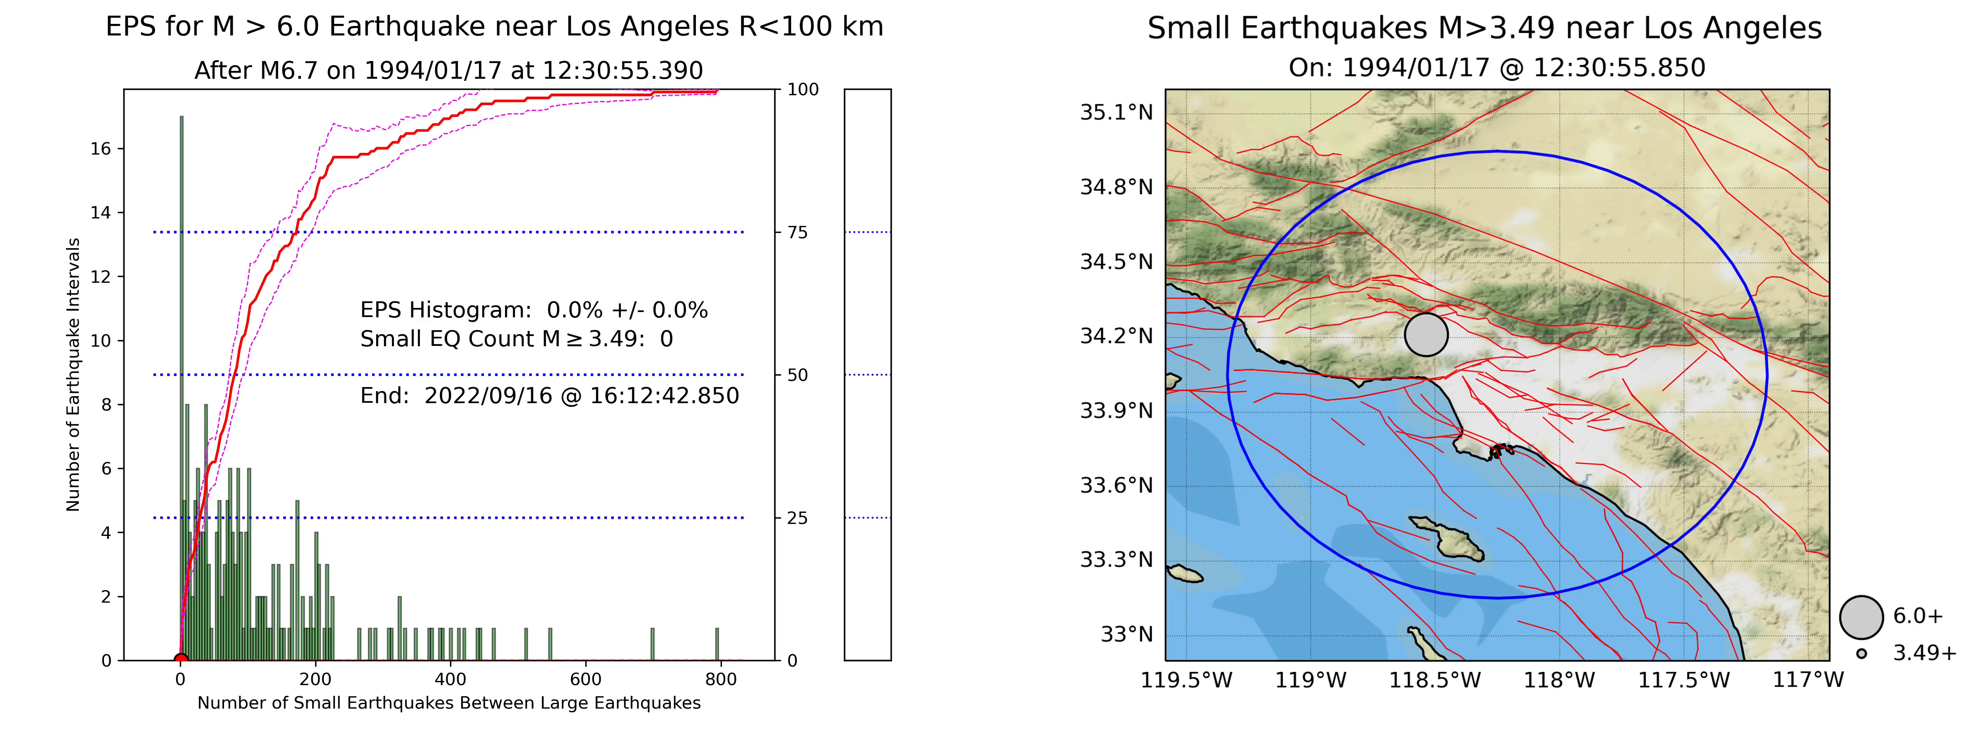
The Seismic Thermometer Measures Increasing Potential for the Next Large Earthquake
EPS = “Earthquake Potential Score” or “Seismic Temperature”
Current research: Not an official statistic!
Tracks the increasing potential of a magnitude > 6.0 earthquake in the LA Region. Hotter colors on the map are more recent events.
The “Seismic
Thermometer”
Curves are computed from the histogram
Green bars: Histogram of # small EQs between large EQs in the large region

Slide 48
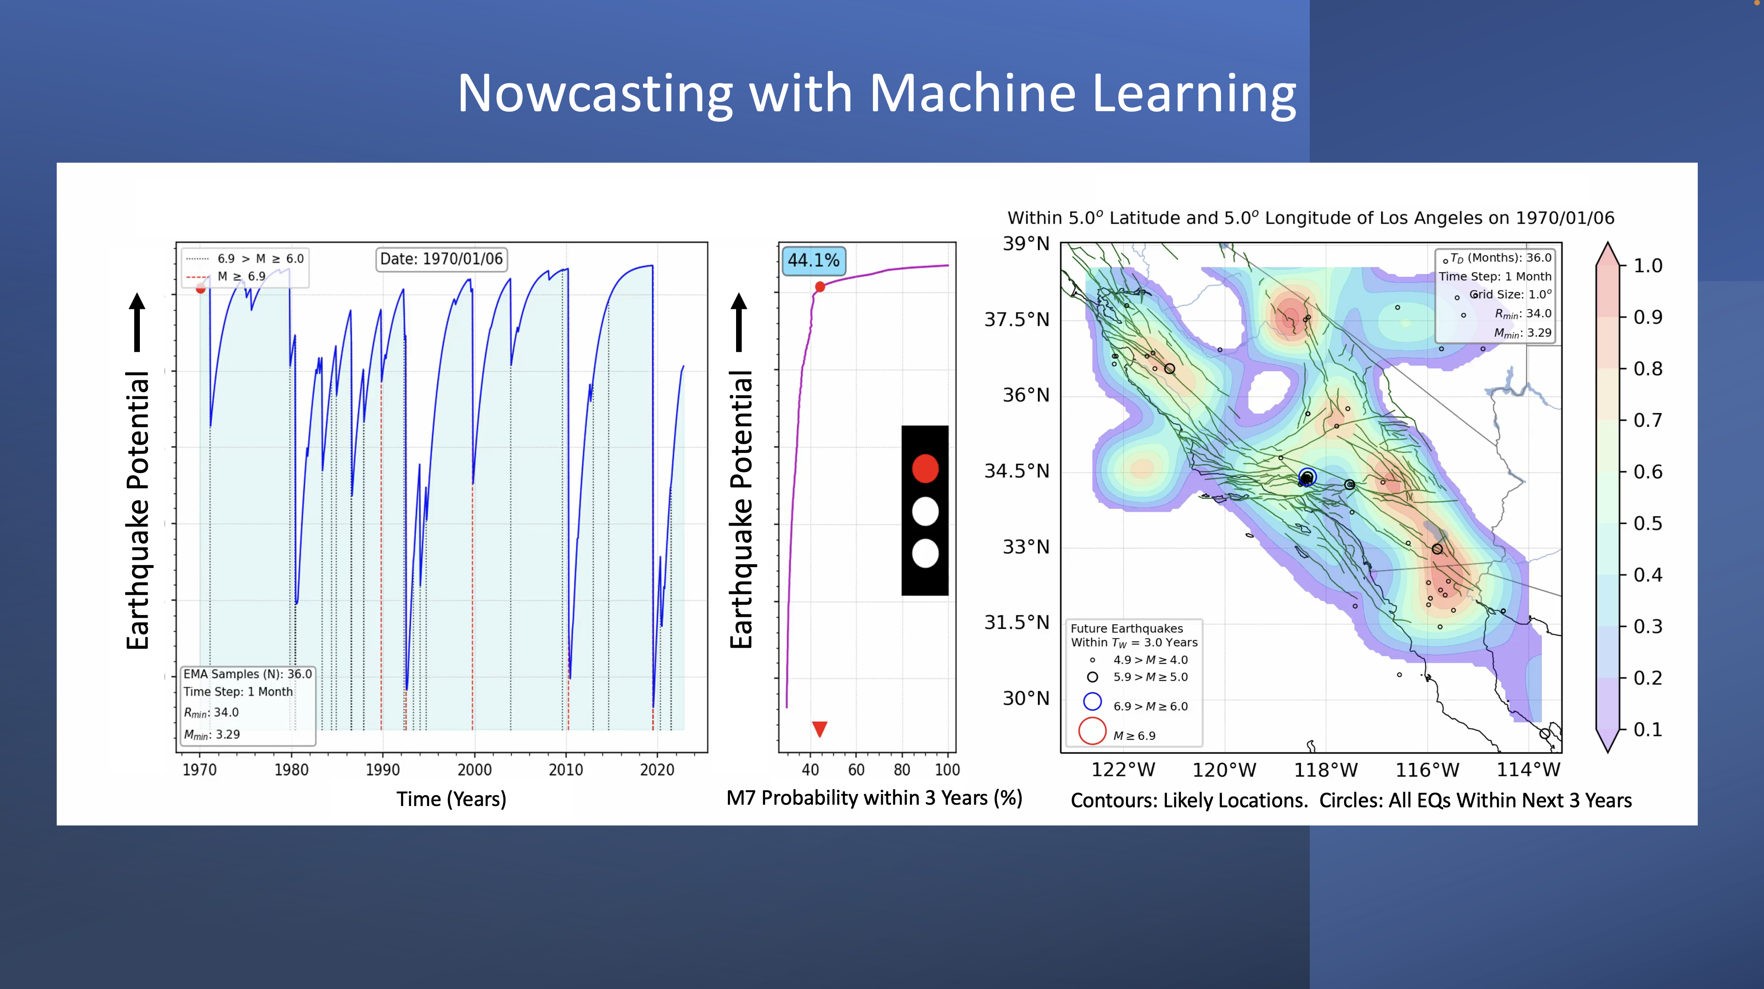

Slide 49
Left Panel: Earthquake Potential vs. Time Since 1970

Slide 50
Middle Panel:
Probability of a Large >(M7) Earthquake
During Next 3 Years

Slide 51
Right Panel:
Likely Locations of Earthquakes During the 3 Years Following Date at the Top

Slide 52
Vertical Red Lines:
M > 7 Earthquakes
Circle Size Indicates Earthquake Magnitude
Vertical Black Lines:
M > 6 Earthquakes

Slide 53
October 17, 1989 M7.0 Loma Prieta
Earthquake
October 17, 1989 M7.0 Loma Prieta
Earthquake

Slide 54
June 28, 1992 M7.3 Landers
Earthquake
June 28, 1992 M7.3 Landers
Earthquake

Slide 55
October 16, 1999 M7.1 Hector Mine
Earthquake
October 16, 1999 M7.1 Hector Mine
Earthquake

Slide 56
April 4, 2010 M7.2 El Mayor- Cucupah
Earthquake
April 4, 2010 M7.2 El Mayor- Cucupah
Earthquake

Slide 57
July 5, 2019 M7.1 Ridgecrest
Earthquake
July 5, 2019 M7.1 Ridgecrest
Earthquake

Slide 58
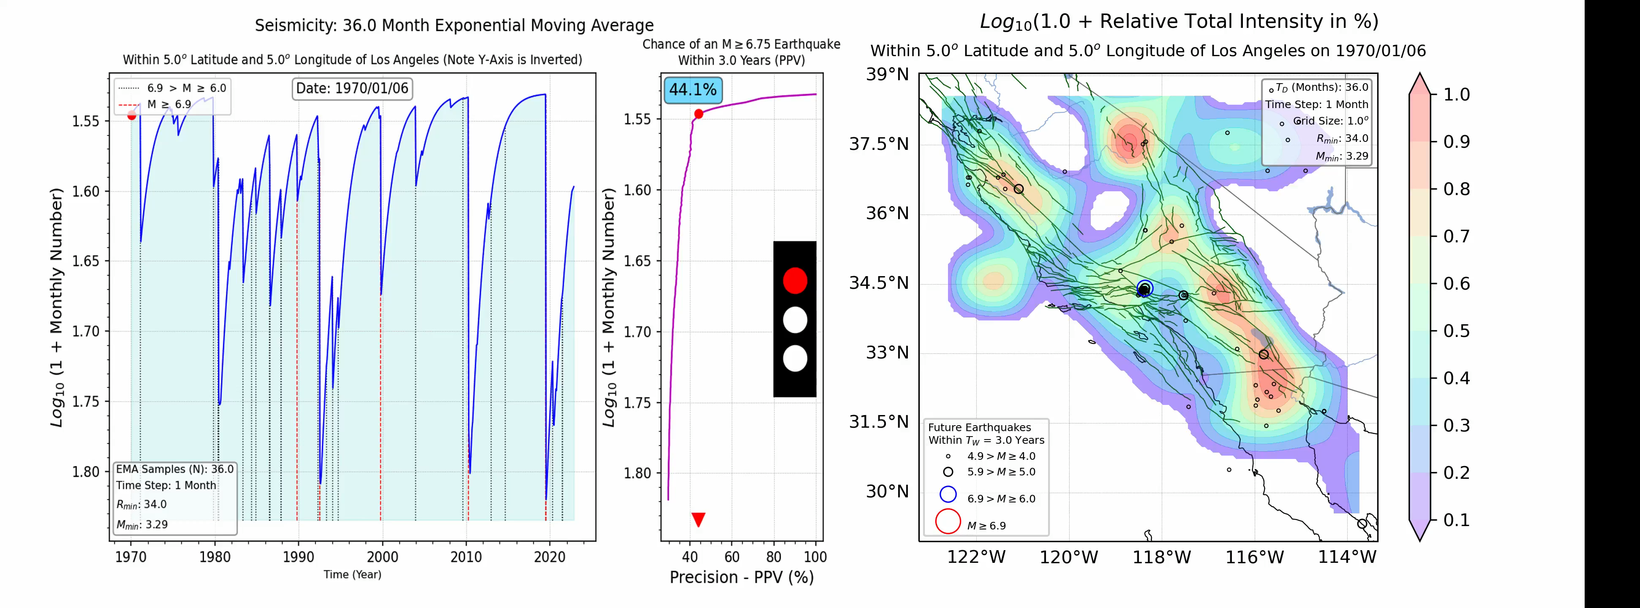
Nowcasting with Machine Learning
Earthquake Potential
Earthquake Potential
Time (Years)
M7 Probability for Next 3 Years (%)
Contours: Likely Locations in Next 3 Years. Circles: Actual Locations

Slide 59
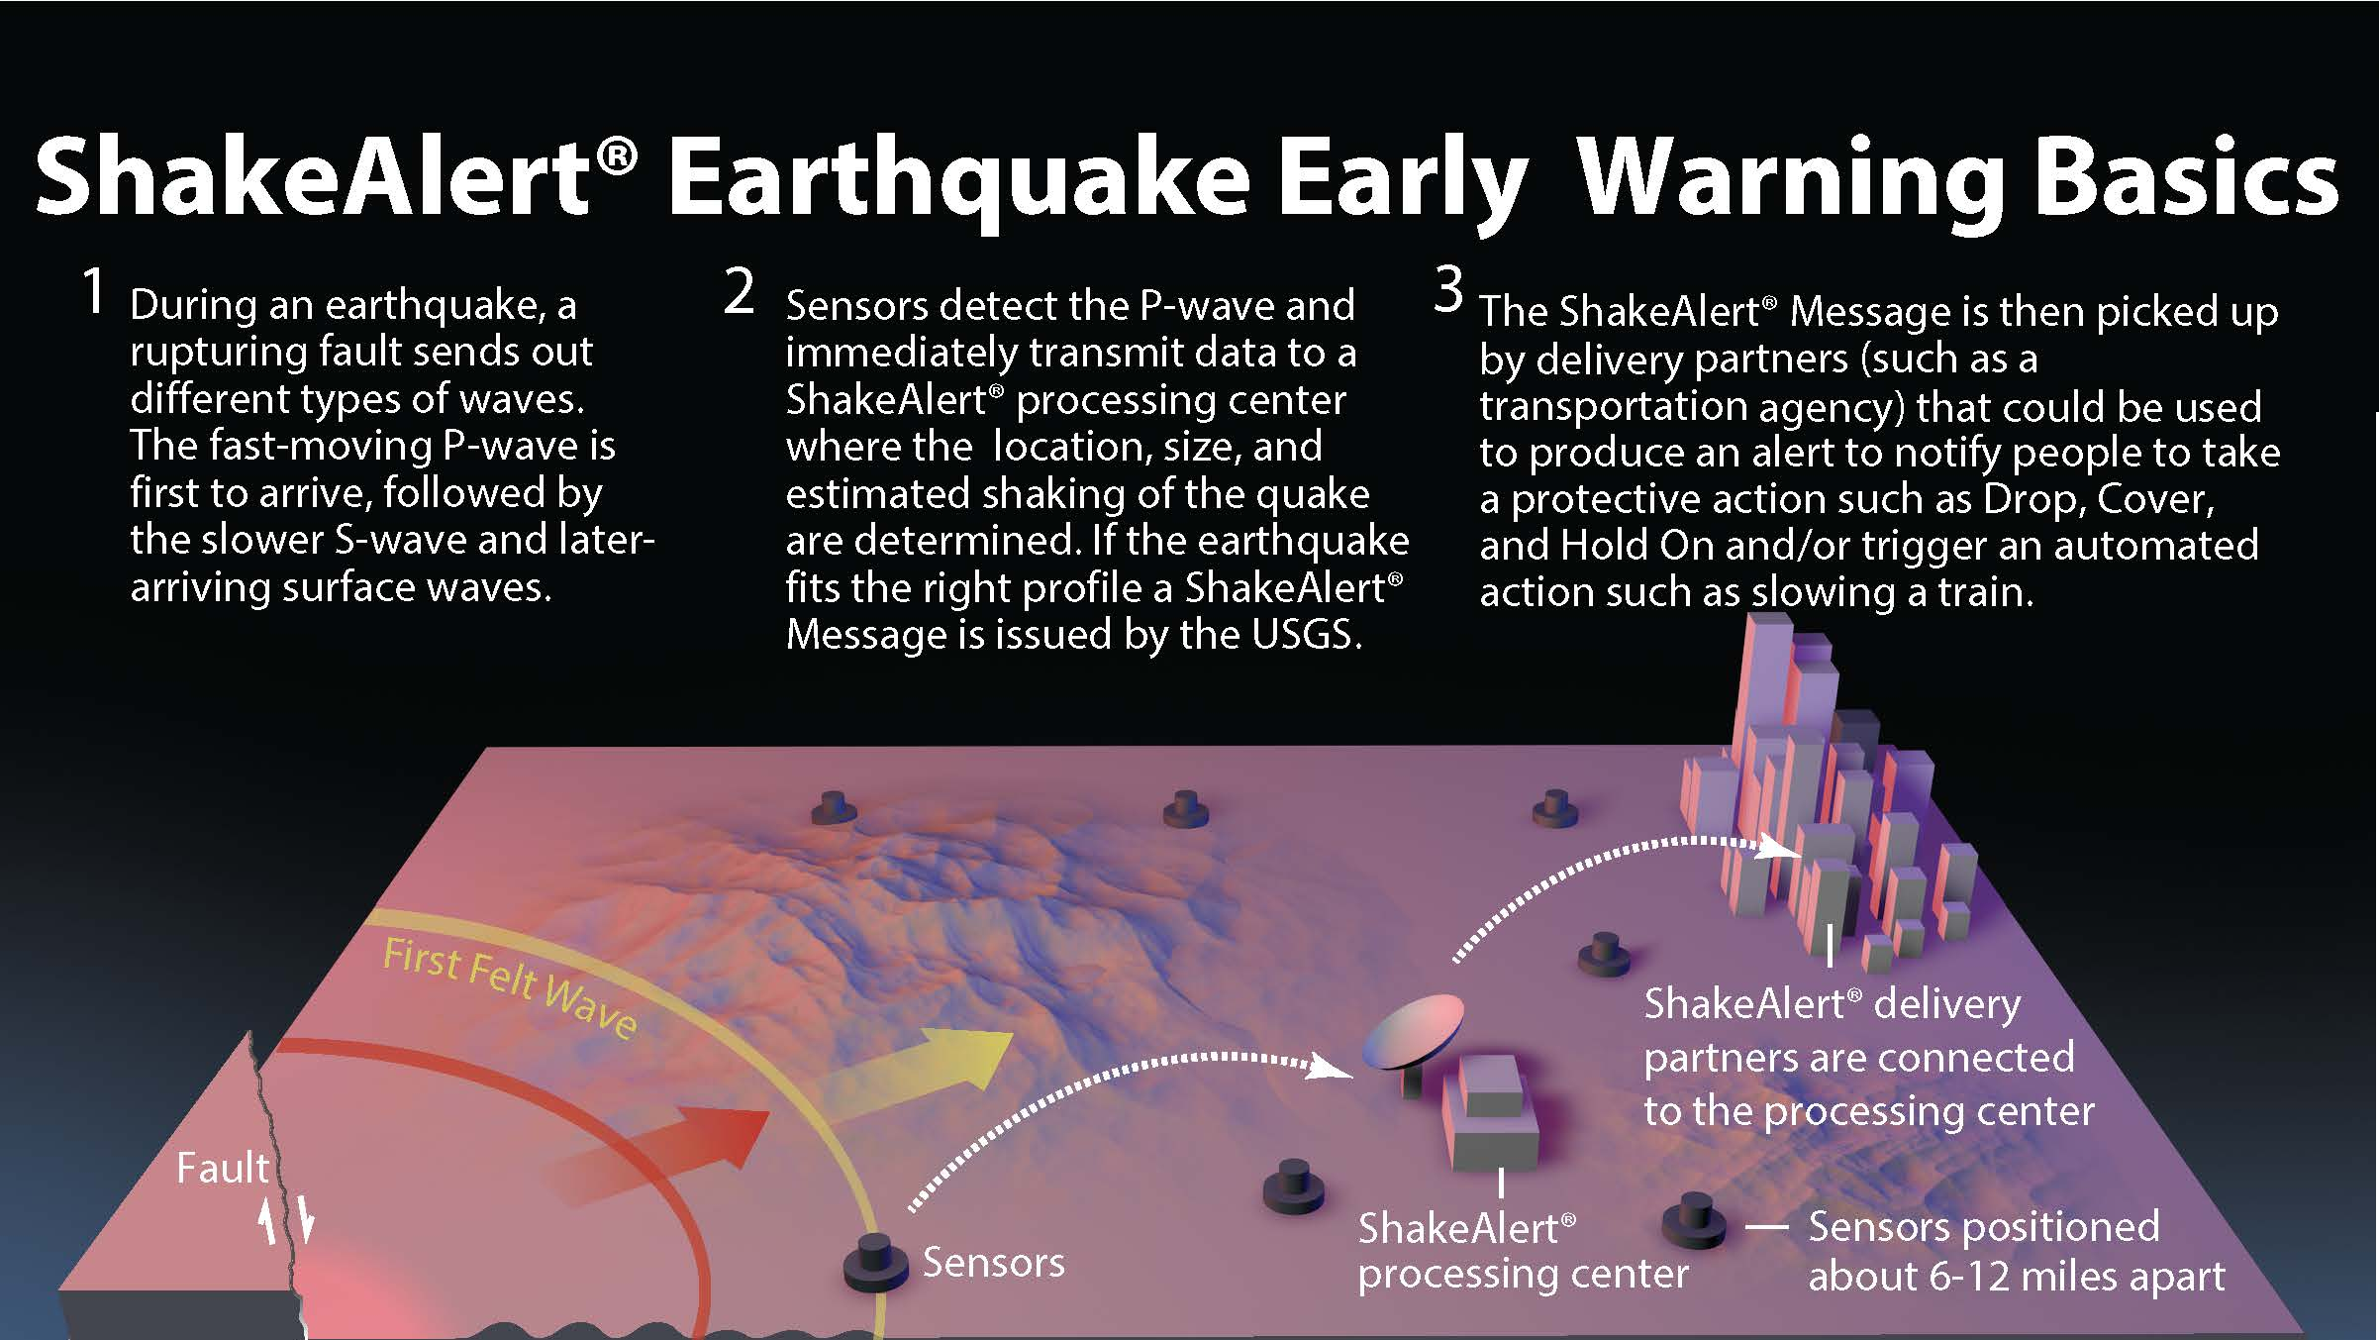
https://www.shakealert.org/

Slide 60
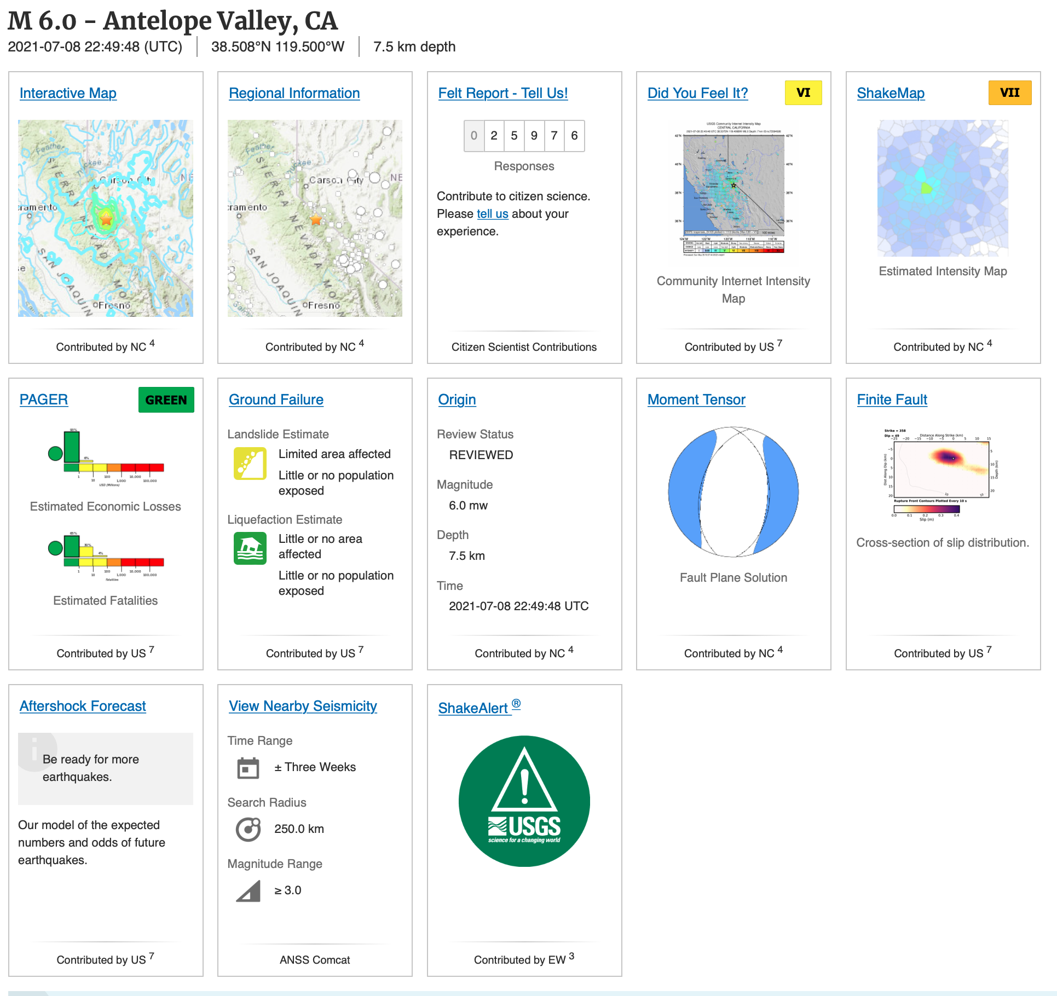
Response Alerts (USGS):
Aftershocks, damage, injuries, tsunamis, ground shaking, economic loss, shake alert

Slide 61
Conclusions / Summary
Earthquake forecasting and nowcasting research is ongoing (probabilities)
The prospects for precise earthquake prediction appear dim, since no one has yet been able to define reliable precursors
Machine learning and artificial intelligence methods are being applied
New types of data (InSAR, GPS) together with these novel analysis techniques could well lead to greatly improved information about future damaging earthquakes

