Slide 1
Lecture 23
Catastrophic Cyclones
John Rundle GEL/EPS 131

Slide 2
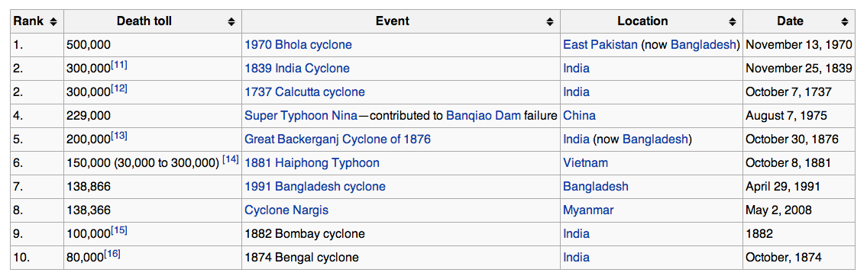
Ten Deadliest Tropical Cyclones http://en.wikipedia.org/wiki/List_of_natural_disasters_by_death_toll

Slide 3
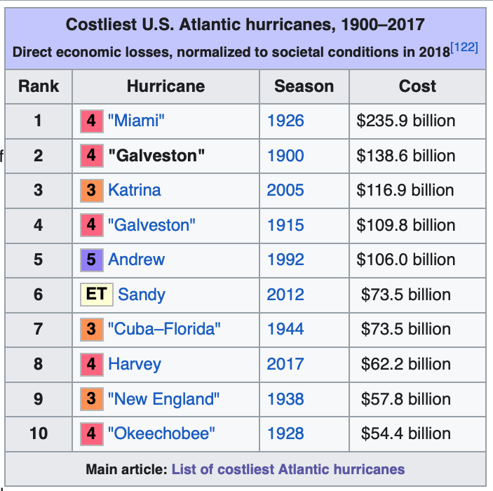
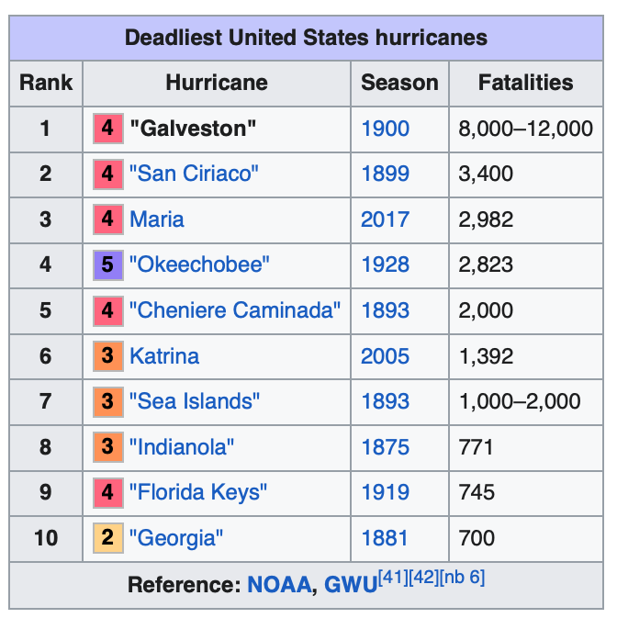
US Hurricanes (ca. 2017) http://en.wikipedia.org/wiki/1900_Galveston_hurricane

Slide 4
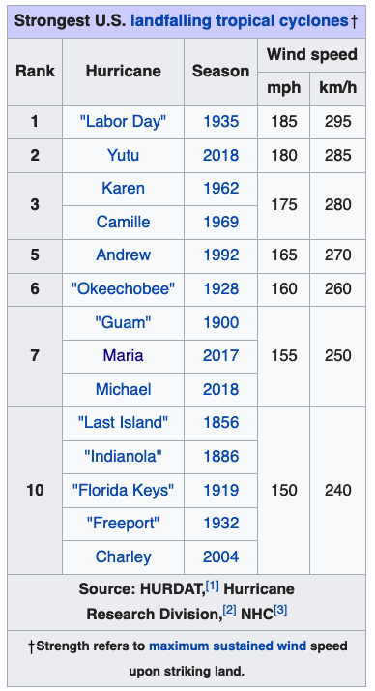
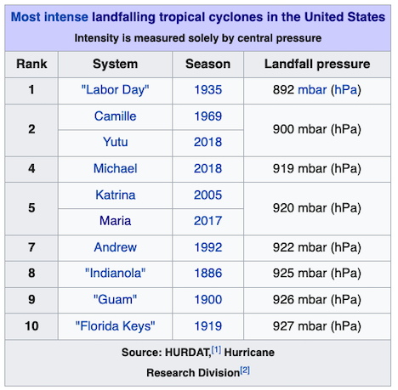
US Landfalling Hurricanes (ca. 2017) http://en.wikipedia.org/wiki/Hurricane_Andrew

Slide 5
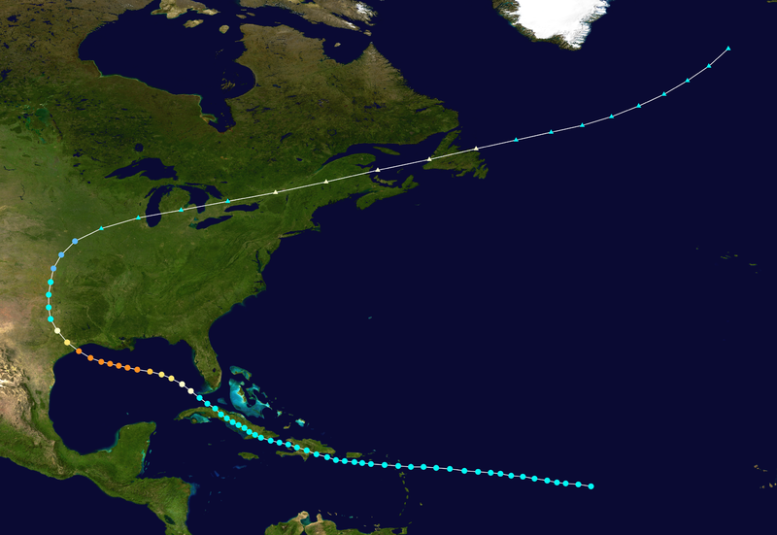
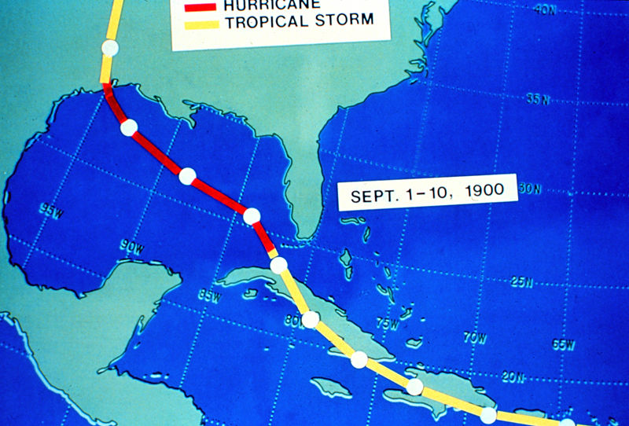
Galveston Hurricane, September 8, 1900 http://en.wikipedia.org/wiki/1900_Galveston_hurricane
“This 1900 storm, like many powerful Atlantic hurricanes, is believed to have begun as a Cape Verde-type hurricane—a tropical wave moving off the western coast of Africa.
The first formal sighting of the hurricane's precursor occurred on August 27, about 1,000 miles (1,600 km) east of the Windward Islands, when a ship recorded an area of "unsettled weather.”
By September 1, U.S. Weather Bureau observers were reporting on a "storm of moderate intensity (not a hurricane)" southeast of Cuba.
Continuing westward, the storm made landfall on southwest Cuba on September 3, dropping heavy rains. On September 5, it emerged into the Florida Straits as a tropical storm or a weak hurricane.”
Storm Track

Slide 6
Galveston Hurricane, September 8, 1900 http://en.wikipedia.org/wiki/1900_Galveston_hurricane
“The storm was reported to be north of Key West on September 6, and in the early morning hours of Friday, September 7, the Weather Bureau office in New Orleans, Louisiana, issued a report of heavy damage along the Louisiana and Mississippi coasts.
Details of the storm were not widespread, damage to telegraph lines limited communication.
The Weather Bureau's central office in Washington, D.C., ordered storm warnings raised from Pensacola, Florida, to Galveston.
By the afternoon of the 7th, large swells from the southeast were observed on the Gulf, and clouds at all altitudes began moving in from the northeast.
The Galveston Weather Bureau office raised its double square flags; a hurricane warning was in effect.
The ship Louisiana encountered the hurricane at 1 p.m. that day after departing New Orleans. Captain Halsey estimated wind speeds of 100 mph (160 km/h).
These winds correspond to a Category 2 hurricane in the modern-day Saffir–Simpson Hurricane Scale.
By early afternoon on Saturday, September 8, a steady northeasterly wind had picked up.
By 5 p.m., the Bureau office was recording sustained hurricane-force winds.
That night, the wind direction shifted to the east, and then to the southeast as the hurricane's eye began to pass over the island just west of the city.
On Sunday morning, clear skies and a 20 mph (30 km/h) breeze off the Gulf of Mexico greeted the Galveston survivors.”

Slide 7
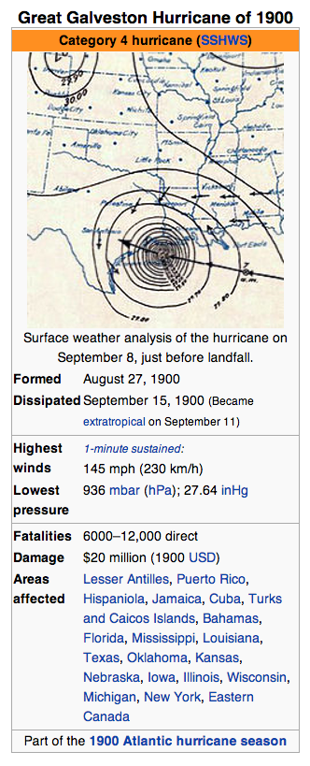
Galveston Hurricane, September 8, 1900 http://en.wikipedia.org/wiki/1900_Galveston_hurricane
“The Hurricane of 1900 made landfall on September 8, 1900, in the city of Galveston, Texas, in the United States.
It had estimated winds of 145 miles per hour (233 km/h) at landfall, making it a Category 4 storm on the Saffir–Simpson Hurricane Scale.
It was the deadliest hurricane in US history, and the second costliest hurricane in U.S. history based on the dollar's 2005 value (to compare costs with those of Hurricane Katrina and others).
The hurricane caused great loss of life with the estimated death toll between 6,000 and 12,000 individuals
The number most cited in official reports is 8,000, giving the storm the third-highest number of deaths or injuries of any Atlantic hurricane, after the Great Hurricane of 1780 and 1998's Hurricane Mitch.
The Galveston Hurricane of 1900 is the deadliest natural disaster ever to strike the United States.
By contrast, the second-deadliest storm to strike the United States, the 1928 Okeechobee hurricane, caused more than 2,500 deaths, and the deadliest storm of recent times, Hurricane Katrina, claimed the lives of approximately 1,800 people. ”

Slide 8
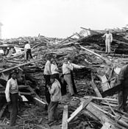
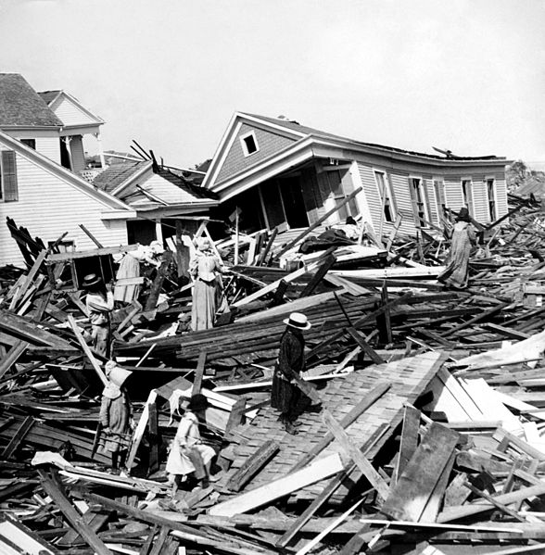
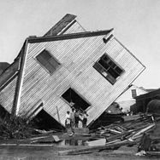
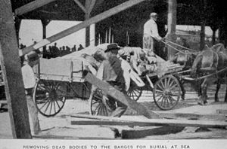
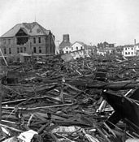
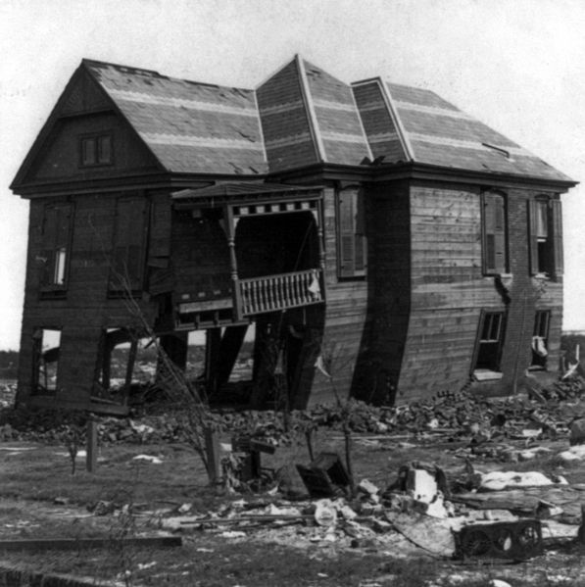
Impacts: Galveston Hurricane http://en.wikipedia.org/wiki/1900_Galveston_hurricane
Corpses were piled in wagons for burial at sea

Slide 9
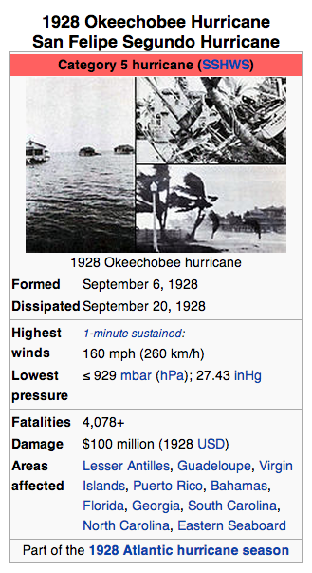
Okeechobee, FL, 1928 http://en.wikipedia.org/wiki/1928_Okeechobee_hurricane
“The Okeechobee hurricane, or San Felipe Segundo hurricane, was a deadly hurricane that struck the Leeward Islands, Puerto Rico, the Bahamas, and Florida in September of the 1928 Atlantic hurricane season.
As of 2010, it is the only recorded hurricane to strike Puerto Rico at Category 5 strength on the Saffir-Simpson Hurricane Scale, and one of the ten most intense ever recorded to make landfall in the United States.
The storm directly struck Puerto Rico at peak strength, killing at least 300 and leaving hundreds of thousands homeless.
In South Florida at least 2,500 were killed when a storm surge from Lake Okeechobee breached the dike surrounding the lake, flooding an area covering hundreds of square miles.
In total, the hurricane killed at least 4,078 people and caused around US$100 million ($1.36 billion 2013 USD) in damages over the course of its path.”

Slide 10
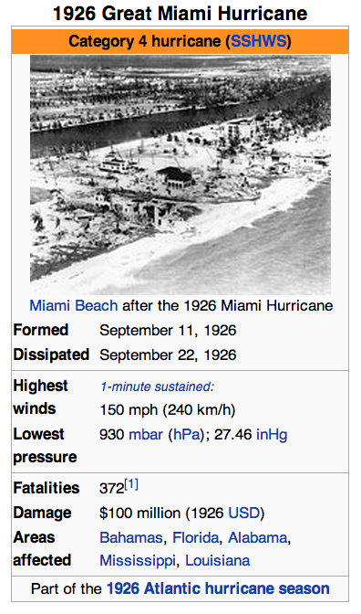
Miami, September 18, 1926 http://en.wikipedia.org/wiki/1926_Miami_hurricane
“The 1926 Miami hurricane (or Great Miami Hurricane) was a Category 4 hurricane that devastated Miami in September 1926.
The storm's enormous regional economic impact helped end the Florida land boom of the 1920s and pushed the region on an early start into the Great Depression.
The Cape Verde-type hurricane formed on September 10 and later passed near St. Kitts on September 14.
By September 17 it was battering the Bahamas, impacting the Turks and Caicos Islands with winds estimated at 150 mph (240 km/h).
Then, in the early morning hours of September 18, it made landfall just south of Miami between Coral Gables and South Miami as a devastating Category 4 hurricane on the Saffir-Simpson Hurricane Scale.
The storm crossed the peninsula south of Lake Okeechobee, entered the Gulf of Mexico, and made another landfall near Mobile, Alabama as a Category 3 hurricane on September 20 ”

Slide 11
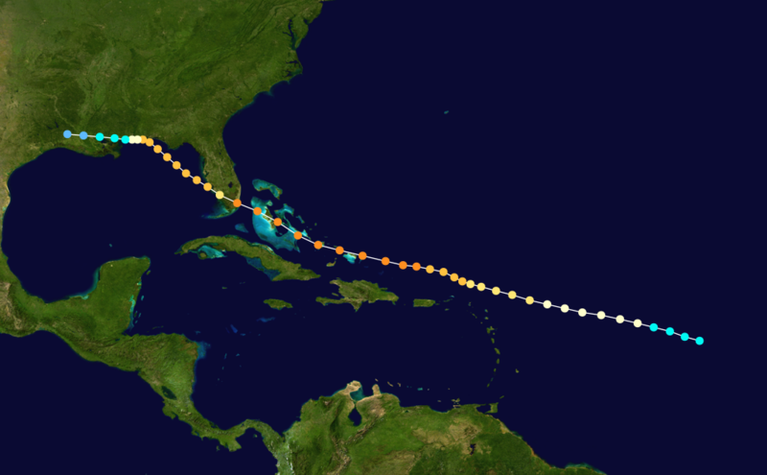
Impacts (Miami) http://en.wikipedia.org/wiki/1926_Miami_hurricane
“In Florida, winds on the ground were reported around 145 mph (233 km/h) and the pressure measured at 930 mbar (27.46 inHg) — though all such data is suspect.
Most of the coastal inhabitants had not evacuated, partly because of short warning (a hurricane warning was issued just a few hours before landfall) and partly because the "young" city's population knew little about the danger a major hurricane posed.
A 15-foot (4.6 m) storm surge inundated the area, causing massive property damage and some fatalities.
As the eye of the hurricane crossed over Miami Beach and downtown Miami, many people believed the storm had passed.
Some tried to leave the barrier islands, only to be swept off the bridges by the rear eyewall.
"The lull lasted 35 minutes, and during that time the streets of the city became crowded with people," wrote Richard Gray, the local weather chief. ”
Inland, Lake Okeechobee experienced a high storm surge that broke a portion of the dikes, flooding the town of Moore Haven and killing many.
According to the Red Cross there were 373 fatalities. Other estimates vary, since there were a large number of people listed as "missing". Between 25,000 and 50,000 people were left homeless, mostly in the Miami”
The damage from the storm was immense; few buildings in Miami or Miami Beach were left intact.
The Fulford–Miami Speedway in North Miami Beach was destroyed by the storm.
The toll for the storm was $100 million ($1.32 billion 2013 USD).
It is estimated that if an identical storm hit in the year 2005, with modern development and prices, the storm would have caused $140–157 billion in damage.
After the hurricane, the Great Depression started in South Florida, slowing recovery.
John J. Farrey was appointed chief building, plumbing and electrical inspector.
He initiated and enforced the first building code in the United States, which more than 5000 US cities duplicated.

Slide 12
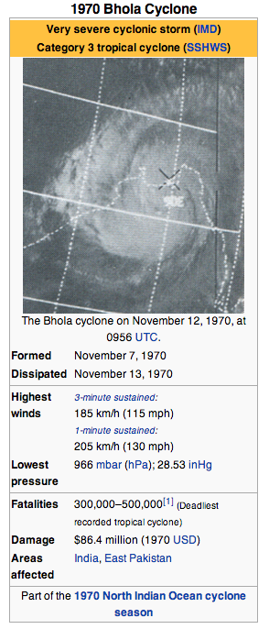
Bhola Cyclone http://en.wikipedia.org/wiki/1970_Bhola_cyclone
“The 1970 Bhola cyclone was a devastating tropical cyclone that struck East Pakistan (now Bangladesh) and India's West Bengal on November 12, 1970.
It remains the deadliest tropical cyclone ever recorded, and one of the deadliest natural disasters in modern times.[2]
Up to 500,000 people lost their lives in the storm, primarily as a result of the storm surge that flooded much of the low-lying islands of the Ganges Delta.
This cyclone was the sixth cyclonic storm of the 1970 North Indian Ocean cyclone season, and also the season's strongest, reaching a strength equivalent to a strong Category 3 hurricane.
The cyclone formed over the central Bay of Bengal on November 8 and traveled north, intensifying as it did so.
It reached its peak with winds of 185 km/h (115 mph) on November 11 and made landfall on the coast of East Pakistan (now Bangladesh) the following afternoon.
The storm surge devastated many of the offshore islands, wiping out villages and destroying crops throughout the region.
In the most severely affected area, Tazumuddin, over 45% of the population of 167,000 was killed by the storm.”

Slide 13
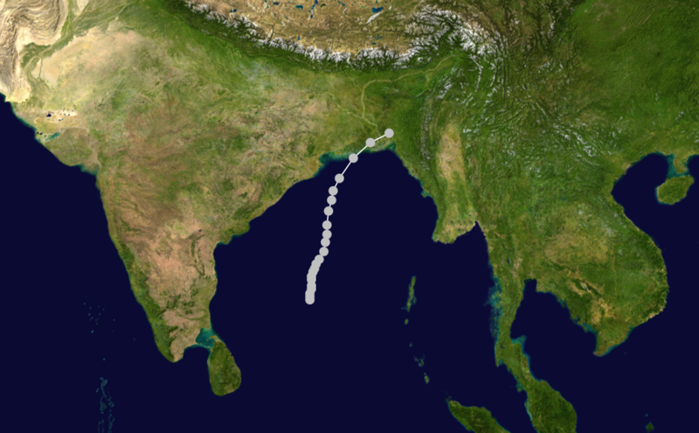
Bhola Cyclone http://en.wikipedia.org/wiki/1970_Bhola_cyclone
“The remnants of this Tropical Storm Nora from the south China sea contributed to the development of a new depression in the central Bay of Bengal on the morning of November 8.
The depression intensified as it moved slowly northward, and the India Meteorological Department upgraded it to a cyclonic storm the next day.
The storm became nearly stationary that evening near 14.5° N, 87° E, but began to accelerate to the north on November 10.
No country in the region had ever named tropical cyclones during this time.
The hurricane intensified into a severe cyclonic storm on November 11 and began to turn towards the northeast as it approached the head of the bay.
A clear eye formed in the storm, and it reached its peak later that day with sustained winds of 185 km/h (115 mph) and a central pressure of 966 hPa, equivalent to that of a Category 3 hurricane on the Saffir-Simpson Hurricane Scale.
The cyclone made landfall on the East Pakistan coastline during the evening of November 12, around the same time as the local high tide.”
This storm would also inspire ex-Beatle George Harrison and Bengali musician Ravi Shankar to organize The Concert for Bangladesh, the prototype benefit concert, to raise money for aid, in 1971.

Slide 14
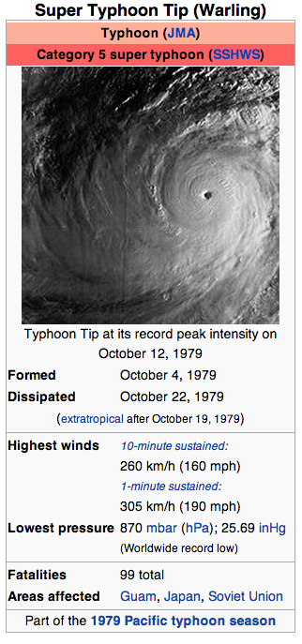
Super Typhoon Tip, August 1992 Largest Typhoon http://en.wikipedia.org/wiki/Typhoon_Tip
“Typhoon Tip (international designation: 7920, JTWC designation: 23W, PAGASA name: Warling) was the largest and most intense tropical cyclone ever recorded.
The nineteenth storm and twelfth typhoon of the 1979 Pacific typhoon season, Tip developed out of a disturbance in the monsoon trough on October 4 near Pohnpei.
Initially, a tropical storm to the northwest hindered the development and motion of Tip, though after it tracked farther north Tip was able to intensify.
After passing Guam, Tip rapidly intensified and reached peak winds of 305 km/h (190 mph) and a worldwide record-low sea-level pressure of 870 mbar (870.0 hPa; 25.69 inHg) on October 12.
At its peak strength, it was also the largest tropical cyclone on record with a wind diameter of 2,220 km (1,380 mi).
Tip slowly weakened as it continued west-northwestward and later turned to the northeast in response to an approaching trough.
The typhoon made landfall on southern Japan on October 19 and became an extratropical cyclone shortly thereafter.”

Slide 15
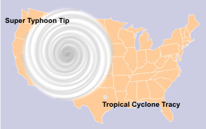
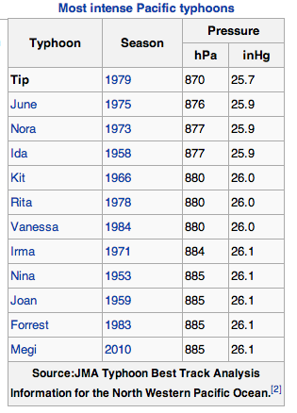
Typhoon Tip http://en.wikipedia.org/wiki/Typhoon_Tip
“U.S. Air Force aircraft flew 60 weather reconnaissance missions into the typhoon, making Tip one of the most closely observed tropical cyclones.
Rainfall from Tip indirectly led to a fire that killed 13 Marines and injured 68 at a United States Marine Corps training camp in the Kanagawa Prefecture of Japan.
Elsewhere in the country, the typhoon caused widespread flooding and 42 deaths; offshore shipwrecks left 44 people killed or missing.
Typhoon Tip was the largest tropical cyclone on record, with a diameter of 1,380 mi (2,220 km)
The temperature inside the eye of Typhoon Tip at peak intensity was 30 °C (86 °F) and described as exceptionally high.
With 10-minute sustained winds of 160 mph (260 km/h), Typhoon Tip is the strongest cyclone in the complete tropical cyclone listing by the Japan Meteorological Agency.
The typhoon was also the most intense tropical cyclone on record with a pressure of 870 mbar (870.0 hPa; 25.69 inHg), 6 mbar (6.0 hPa; 0.18 inHg) lower than the previous record set by Super Typhoon June in 1975.
The records set by Tip still stand, though with the end of routine reconnaissance aircraft in the western Pacific Ocean in August 1987, modern researchers questioned if Tip is the strongest on record. “

Slide 16
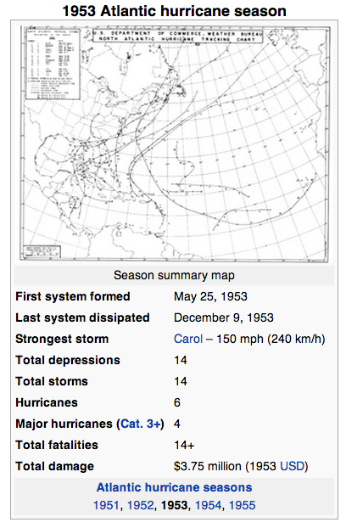
1953 Atlantic Hurricanes http://en.wikipedia.org/wiki/1953_Atlantic_hurricane_season
“The 1953 Atlantic hurricane season was the first time an organized list of female names was used to name Atlantic storms.
It officially began on June 15, and lasted until November 15, although activity occurred both before and after the season's limits.
It is one of only four seasons to have a pre-season storm and a post-season storm, the others being the 1887, 2003, and 2007 seasons.
The season was active with fourteen total storms, six of which developed into hurricanes; four of the hurricanes attained major hurricane status, or a Category 3 or greater on the Saffir-Simpson scale.
The strongest hurricane of the season was Carol, although by the time it struck Atlantic Canada it was much weaker.
Bermuda was threatened by three hurricanes within two weeks
The final named storm of the season, Hazel, produced additional rainfall in Florida after previous flooding conditions.
There were several unnamed storms, the last of which dissipated on December 9.”
When I lived there

Slide 17
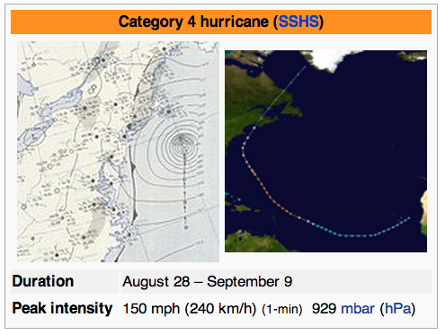
Hurricane Carol http://en.wikipedia.org/wiki/1953_Atlantic_hurricane_season
“On August 28, a tropical wave developed into a tropical depression near Cape Verde.
After moving west-southwestward, it turned to the northwest, intensifying into a tropical storm on August 31 and into a hurricane on September 2.
Passing northeast of the Lesser Antilles, Carol rapidly intensified to reach peak winds of 150 mph (240 km/h) on September 3, making it the strongest hurricane of the season.
It gradually weakened, bypassing Bermuda on September 6 and producing high waves.
Carol later turned to the north-northeast, brushing Cape Cod and causing boating accidents across New England.
Four people were killed in the region.
Fishing losses totaled around $1 million (1953 USD, $8.73 million 2013 USD).
After bypassing New England, Carol brushed western Nova Scotia before moving ashore near Saint John, New Brunswick as a minimal hurricane.
As it moved ashore, it produced hurricane conditions in eastern Maine, one of only six Atlantic hurricanes to do so.”

Slide 18
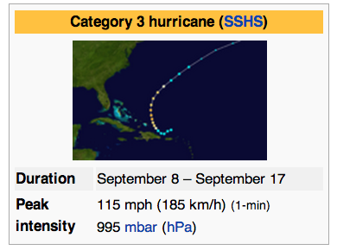
Hurricane Dolly http://en.wikipedia.org/wiki/1953_Atlantic_hurricane_season
“The origins of Dolly were from a tropical wave that moved through the eastern Caribbean Sea, producing 10 in (250 mm) in Saint Thomas in the U.S. Virgin Islands.
On September 8, a tropical storm developed north of Puerto Rico, which moved slowly west-southwestward before turning to the north.
It quickly intensified, and after Hurricane Hunters reported an eye, Dolly reached hurricane status on September 9.
At that time, hurricane warnings were issued in the Bahamas, although the storm turned away from the archipelago.
It rapidly intensified to peak winds of 115 mph (185 km/h) on September 10, as reported by aircraft.
After continued weakening, Dolly passed over the island on September 11, producing only gale-force winds, rains, and little to no damage.
It deteriorated into a tropical storm on September 12 and transitioned into an extratropical cyclone later that day.
The remnants of Dolly later turned eastward, dissipating just west of Portugal on September 17.”
Dolly weakened as it accelerated northeastward, although it still threatened to strike Bermuda with strong winds.
As a result, the United States Air Force ordered all of the planes on the island to fly to the mainland, leaving the families to weather the storm on their own

Slide 19
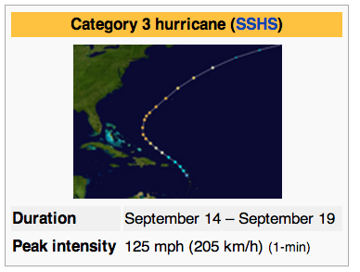
Hurricane Edna http://en.wikipedia.org/wiki/1953_Atlantic_hurricane_season
“Shortly behind Dolly, another tropical wave spawned a tropical depression over the Lesser Antilles on September 14.
As it moved through the region, it produced unsettled conditions across the northeast Caribbean.
Dolly quickly intensified as it tracked northwestward, attaining hurricane status on September 15 and peak winds of 125 mph (205 km/h) the next day.
After peaking, the hurricane turned to the northeast and maintained most of its intensity for a few days.
It passed just north of Bermuda early on September 18 with winds of 115 mph (185 km/h), before beginning a steady weakening trend as it accelerated
Before Edna struck Bermuda, the islanders were well-prepared due to being previously impacted by hurricanes Carol and Dolly, and they boarded up their homes.
The hurricane caused "considerable damage", with wind gusts reaching 120 mph (190 km/h).
The winds downed trees, blocking roads, and also caused disruptions to the power and water services.
During its passage, Edna produced heavy rainfall and also damaged several roofs. There were three injuries on the island.”

Slide 20
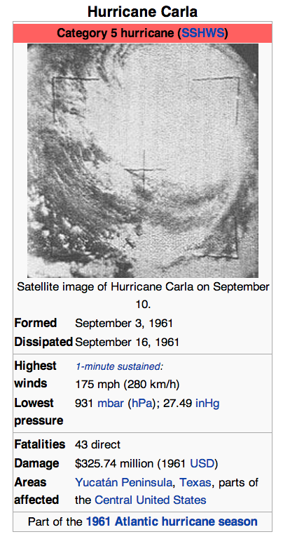
Hurricane Carla http://en.wikipedia.org/wiki/Hurricane_Carla
“One of the first hurricanes to be captured on satellite imagery
Hurricane Carla ranks as the most intense U.S. tropical cyclone landfall on the Hurricane Severity Index.
The third named storm and first Category 5 hurricane of the 1961 Atlantic hurricane season, Carla developed from an area of squally weather in the southwestern Caribbean Sea on September 3.
Initially a tropical depression, it strengthened slowly while heading northwestward, and by September 5, the system was upgraded to Tropical Storm Carla.
About 24 hours later, Carla was upgraded to a hurricane. Shortly thereafter, the storm curved northward while approaching the Yucatán Channel. Late on September 7, Carla entered the Gulf of Mexico while passing just northeast of the Yucatán Peninsula.
By early on the following day, the storm became a major hurricane after reaching Category 3 intensity.
Resuming its northwestward course, Carla continued intensification and on September 11, it was upgraded to a Category 5 hurricane.
Later that day, Carla weakened slightly, but was still a large and intense hurricane when the storm made landfall near Port O'Connor, Texas.
It weakened quickly inland and was reduced to a tropical storm on September 12. Heading generally northward, Carla transitioned into an extratropical cyclone on September 13, while centered over southern Oklahoma.”

Slide 21
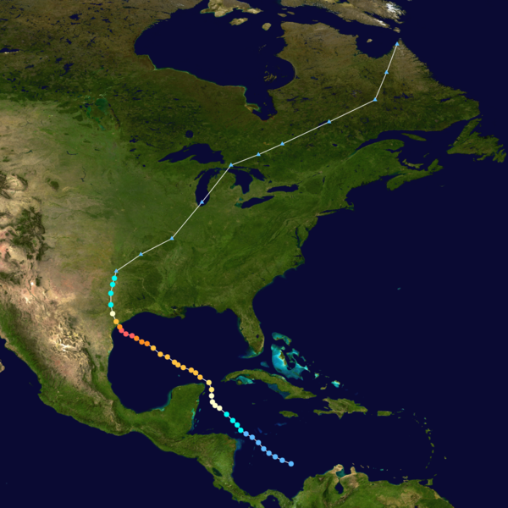
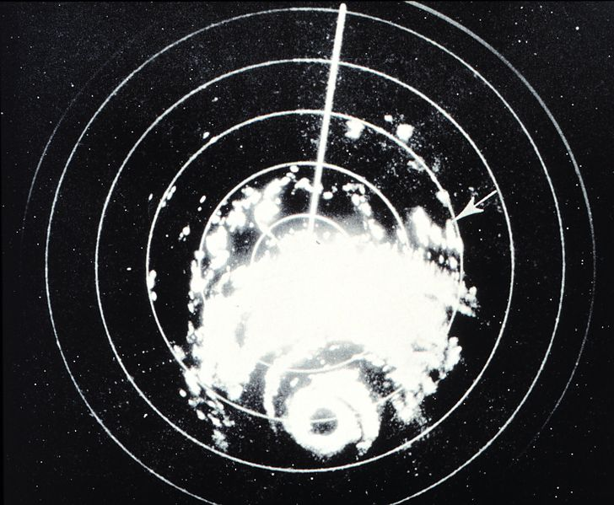
Hurricane Carla http://en.wikipedia.org/wiki/Hurricane_Carla
“Carla spawned the largest hurricane-related tornado outbreak on record at the time, when 26 tornadoes touched down within its circulation.
However, it was overwhelmingly surpassed by Hurricane Beulah in 1967, which spawned at least 115 tornadoes.
Throughout its path, 43 fatalities and about $325.74 million in damage were attributed to Carla.
Most of the impact occurred in Texas, where the storm made landfall as a large and strong Category 4 hurricane.
In Texas, wind gusts as high as 170 mph (280 km/h) were observed in Port Lavaca.
Additionally, several tornadoes spawned in the state caused notable impacts, with the most destructive twister resulting in 200 buildings severely damaged, of which at least 60 were destroyed, and 8 deaths and 55 injuries.”
Storm Track
Radar Image

Slide 22
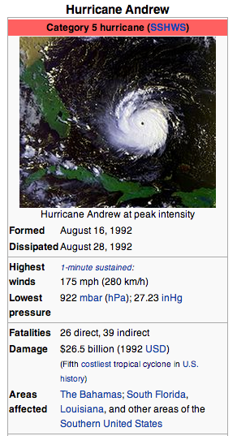
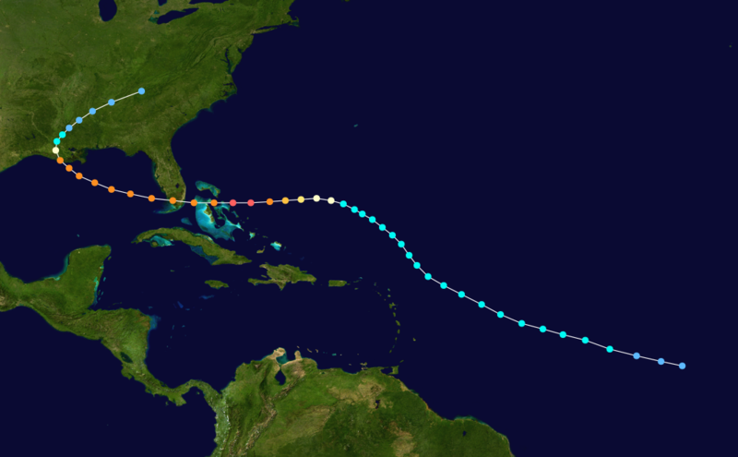
Hurricane Andrew http://en.wikipedia.org/wiki/Hurricane_Andrew
“Hurricane Andrew was, at the time of its occurrence in August 1992, the costliest hurricane in United States history, superceded now by Harvey and Irma (2017)
The fourth tropical cyclone and the first hurricane of the 1992 Atlantic hurricane season, Andrew originated from a tropical wave over the central Atlantic.
Initially, strong wind shear prevented much intensification, though increasingly favorable conditions allowed the system to become a tropical storm on August 17 and a minimal hurricane six days later.
After turning westward, Andrew entered a stage of rapid intensification, strengthening into a Category 5 hurricane near the Bahamas on August 23.
It briefly weakened to a Category 4 hurricane over the island nation, but regained Category 5 intensity on August 24 before making landfall on Elliott Key and later in Homestead, Florida.
Several hours later, the hurricane emerged into the Gulf of Mexico at Category 4 strength as it curved toward the Gulf Coast of the United States.
After weakening to a low-end Category 3 hurricane, Andrew moved ashore near Morgan City, Louisiana.
Interaction with land hastened the weakening process, and the Andrew was downgraded to a tropical depression by August 27 while crossing Mississippi.
The next day, the storm merged with a frontal system over the southern Appalachian Mountains.”

Slide 23
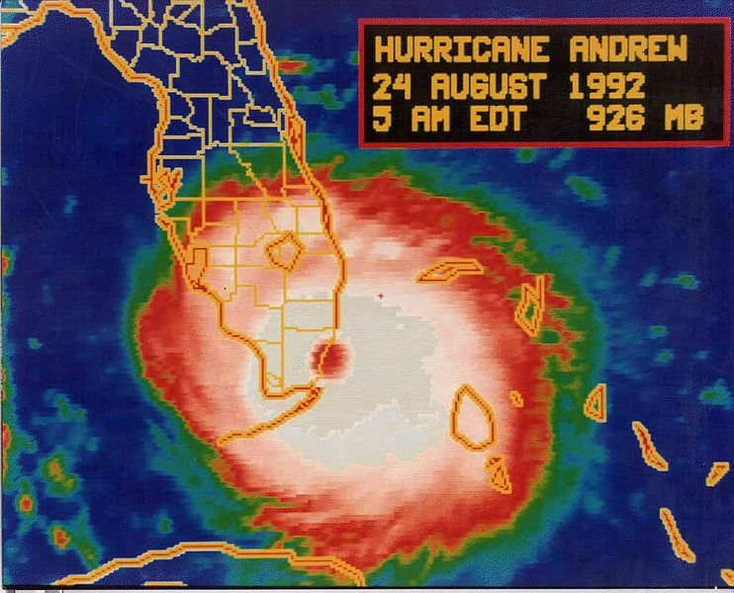
Hurricane Andrew http://en.wikipedia.org/wiki/Hurricane_Andrew
“In the Bahamas, Andrew brought high tides, hurricane force winds, and tornadoes, which caused considerable damage in the archipelago, especially on Cat Cays.
At least 800 houses were destroyed and there was substantial damage to the transport, communications, water, sanitation, agriculture, and fishing sectors.
Overall, Andrew caused four deaths and $250 million (1992 USD) in damage in the Bahamas.
Andrew led to the founding of several catastrophe modeling companies: RMS, AIR, EQECAT (now Corelogic)
Throughout the southern portions of Florida, Andrew brought very high winds; a wind gust of 177 mph (282 km/h) was reported at a house in Perrine.
Strong winds caused catastrophic damage in Florida, with Miami-Dade County cities of Florida City, Homestead, and Kendall receiving the brunt of the storm. “
About 63,000 homes were destroyed and over 101,000 others were damaged.
This left roughly 175,000 people homeless. As many as 1.4 million people were left without electricity at the height of the storm.
In the Everglades, 70,000 acres (280 km2) of trees were knocked down.
Additionally, rainfall in Florida was substantial, peaking at 13.98 in (355 mm) in western Miami-Dade County.
About $25 billion in damage and 44 fatalities were reported in Florida.

Slide 24
Hurricane Andrew http://en.wikipedia.org/wiki/Hurricane_Andrew
“Considerable damage to oil platforms was reported, with one company reporting 13 platforms lost, 104 structures damaged, and five drilling wells blown off course.
Total losses to oil companies reached approximately $500 million.
In Louisiana, Andrew produced hurricane force winds along its path, which left about 152,000 without electricity, downed 80% of trees in the Atchafalaya River Basin, and caused significant agricultural damage.
Also in the Atchafalaya River Basin and Bayou Lafourche, about 187 million freshwater fish were killed. An F3 tornado in St. John the Baptist Parish damaged or destroyed 163 structures.
Seventeen deaths were reported in Louisiana, six of which were drowning victims offshore.
With 23,000 homes damaged, and 985 homes and 1,951 mobile homes destroyed, property losses in the state exceeded $1.5 billion.
Elsewhere, the storm spawned at least 28 tornadoes, especially in Alabama, Georgia, and Mississippi.
Overall, Andrew caused 65 fatalities and $26 billion in damage, and it is currently the fifth costliest hurricane in Atlantic hurricane history, behind only Hurricanes Katrina and Wilma in 2005, Ike in 2008, and Sandy in 2012.
Other sources state that damage from Andrew reached as high as $32 billion.
Due to the destruction, the name was retired in the spring of 1993.”

Slide 25
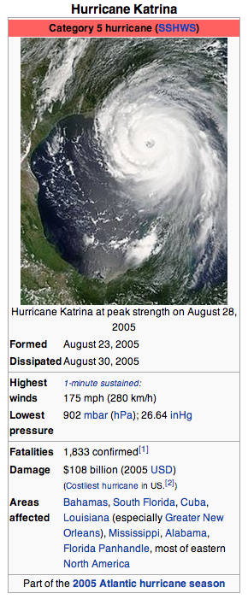
Hurricane Katrina http://en.wikipedia.org/wiki/Hurricane_Katrina
“Hurricane Katrina was the deadliest and most destructive Atlantic tropical cyclone of the 2005 Atlantic hurricane season.
It was the costliest natural disaster, as well as one of the five deadliest hurricanes, in the history of the United States (since superceded by Harvey, Maria and Irma)
Among recorded Atlantic hurricanes, it was the sixth strongest overall.
At least 1,833 people died in the hurricane and subsequent floods, making it the deadliest U.S. hurricane since the 1928 Okeechobee hurricane
Total property damage was estimated at $81 billion (2005 USD), nearly triple the damage brought by Hurricane Andrew in 1992.
Hurricane Katrina formed over the Bahamas on August 23, 2005 and crossed southern Florida as a moderate Category 1 hurricane, causing some deaths and flooding there before strengthening rapidly in the Gulf of Mexico.
The hurricane strengthened to a Category 5 hurricane over the warm Gulf water but weakened before making its second landfall as a Category 3 hurricane on the morning of Monday, August 29 in southeast Louisiana.
It caused severe destruction along the Gulf coast from central Florida to Texas, much of it due to the storm surge. “

Slide 26
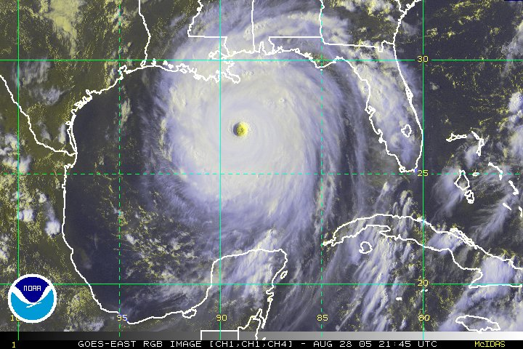
Hurricane Katrina http://en.wikipedia.org/wiki/Hurricane_Katrina
“The most significant number of deaths occurred in New Orleans, Louisiana, which flooded as the levee system catastrophically failed, in many cases hours after the storm had moved inland.
Eventually 80% of the city and large tracts of neighboring parishes became flooded, and the floodwaters lingered for weeks.
However, the worst property damage occurred in coastal areas, such as all Mississippi beachfront towns, which were flooded over 90% in hours, as boats and casino barges rammed buildings, pushing cars and houses inland, with waters reaching 6–12 miles (10–19 km) from the beach.
The hurricane surge protection failures in New Orleans are considered the worst civil engineering disaster in U.S. history and prompted a lawsuit against the U.S. Army Corps of Engineers (USACE), the designers and builders of the levee system as mandated by the Flood Control Act of 1965.
Responsibility for the failures and flooding was laid squarely on the Army Corps in January 2008 by Judge Stanwood Duval, U.S. District Court
But the federal agency could not be held financially liable because of sovereign immunity in the Flood Control Act of 1928. ”
“There was an investigation of the responses from federal, state and local governments, resulting in the resignation of Federal Emergency Management Agency (FEMA) director Michael D. Brown, and of New Orleans Police Department (NOPD) Superintendent Eddie Compass.”

Slide 27
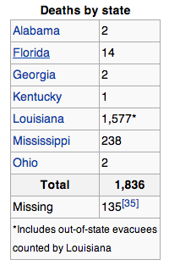
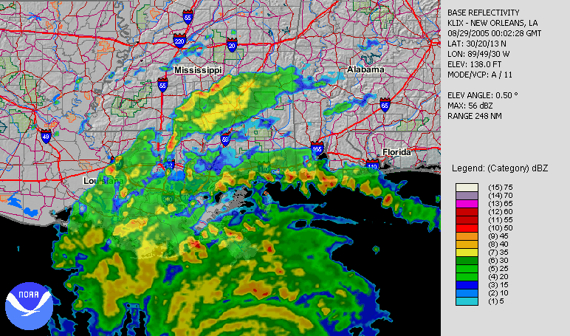
Hurricane Katrina http://en.wikipedia.org/wiki/Hurricane_Katrina
11/29/2023

Slide 28
Run-Up to the Catastrophe http://en.wikipedia.org/wiki/Hurricane_Katrina
“By August 26, many of the computer models had shifted the potential path of Katrina 150 miles (240 km) westward from the Florida Panhandle, putting the city of New Orleans directly in the center of their track probabilities
The chances of a direct hit were forecast at 17%, with strike probability rising to 29% by August 28.
This scenario was considered a potential catastrophe because some parts of New Orleans and the metro area are below sea level.
Since the storm surge produced by the hurricane's right-front quadrant (containing the strongest winds) was forecast to be 28 feet (8.5 m), emergency management officials in New Orleans feared that the storm surge could go over the tops of levees protecting the city, causing major flooding.
At a news conference at 10 am on August 28, shortly after Katrina was upgraded to a Category 5 storm, New Orleans mayor Ray Nagin ordered the first-ever mandatory evacuation of the city, calling Katrina "a storm that most of us have long feared.”
The city government also established several "refuges of last resort" for citizens who could not leave the city, including the massive Louisiana Superdome, which sheltered approximately 26,000 people and provided them with food and water for several days as the storm came ashore.”

Slide 29
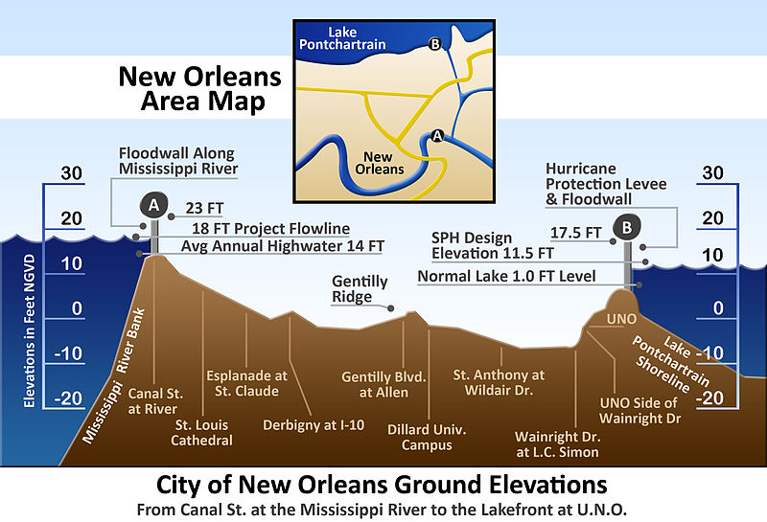
Levees in New Orleans http://en.wikipedia.org/wiki/Hurricane_Katrina

Slide 30
Failure of the Levees http://en.wikipedia.org/wiki/Hurricane_Katrina
“Katrina's storm surge led to 53 levee breaches in the federally built levee system protecting metro New Orleans and the failure of the 40 Arpent Canal levee.
Nearly every levee in metro New Orleans was breached as Hurricane Katrina passed just east of the city limits.
Failures occurred in New Orleans and surrounding communities, especially St. Bernard Parish.
The Mississippi River Gulf Outlet (MR-GO) breached its levees in approximately 20 places, flooding much of east New Orleans, most of Saint Bernard Parish and the East Bank of Plaquemines Parish.
‘The major levee breaches in the city included breaches at the 17th Street Canal levee, the London Avenue Canal, and the wide, navigable Industrial Canal, which left approximately 80% of the city flooded.
Most of the major roads traveling into and out of the city were damaged.
The only routes out of the city were the westbound Crescent City Connection and the Huey P. Long Bridge, as large portions of the I-10 Twin Span Bridge traveling eastbound towards Slidell, Louisiana had collapsed.
Both the Lake Pontchartrain Causeway and the Crescent City Connection only carried emergency traffic.
On August 29, at 7:40 am CDT, it was reported that most of the windows on the north side of the Hyatt Regency New Orleans had been blown out, and many other high-rise buildings had extensive window damage.
The Hyatt was the most severely damaged hotel in the city, with beds reported to be flying out of the windows.

Slide 31
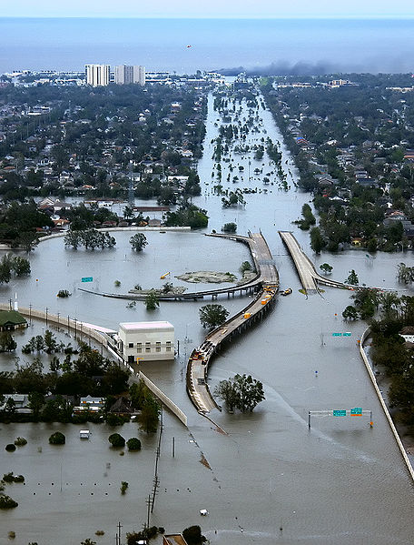
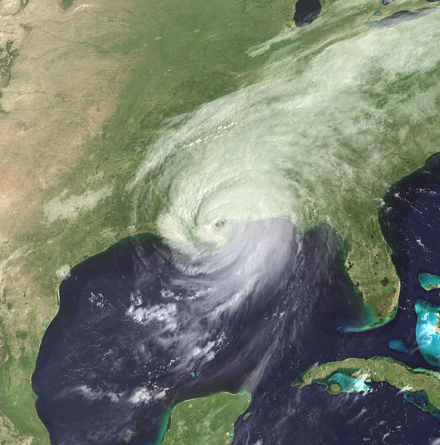
Flooding in New Orleans http://en.wikipedia.org/wiki/File:KatrinaNewOrleansFlooded_edit2.jpg

Slide 32
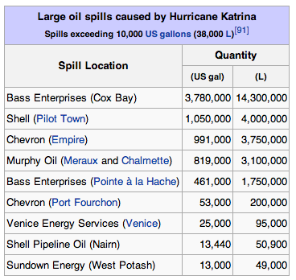
Other Impacts of Katrina
“The storm caused oil spills from 44 facilities throughout southeastern Louisiana, which resulted in over 7 million U.S. gallons (26 million L) of oil being leaked.
Some spills were as small as a few hundred gallons; the largest are tabulated to the right. While most of the spills were contained on-site, some oil entered the ecosystem, and the town of Meraux was flooded with a blend of water and oil.
Unlike Hurricane Ivan no offshore oil spills were officially reported after Hurricane Katrina.
However, Skytruth reported some signs of surface oil in the Gulf of Mexico.
Finally, as part of the cleanup effort, the flood waters that covered New Orleans were pumped into Lake Pontchartrain, a process that took 43 days to complete.
These residual waters contained a mix of raw sewage, bacteria, heavy metals, pesticides, toxic chemicals, and oil, which sparked fears in the scientific community of massive numbers of fish dying. ”
Prior to the storm, subsidence and erosion caused erosion in the Louisiana wetlands and bayous. This, along with the canals built in the area, allowed for Katrina to maintain more of its intensity when it struck.

Slide 33
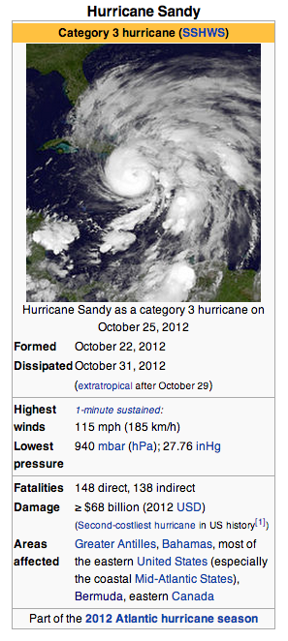
Hurricane (“Superstorm”) Sandy http://en.wikipedia.org/wiki/Hurricane_Sandy
“Hurricane Sandy (unofficially known as "Superstorm Sandy") was the deadliest and most destructive hurricane of the 2012 Atlantic hurricane season, as well as the second-costliest hurricane in United States history.
Sandy was a Category 3 storm at its peak intensity when it made landfall in Cuba.
While it was a Category 2 storm off the coast of the Northeastern United States, the storm became the largest Atlantic hurricane on record (as measured by diameter, with winds spanning 1,100 miles (1,800 km)).
Estimates as of June 2013 assess damage to have been over $68 billion (2013 USD), a total surpassed only by Hurricane Katrina.
At least 286 people were killed along the path of the storm in seven countries.
In the United States, Hurricane Sandy affected 24 states, including the entire eastern seaboard from Florida to Maine and west across the Appalachian Mountains to Michigan and Wisconsin, with particularly severe damage in New Jersey and New York.
Its storm surge hit New York City on October 29, flooding streets, tunnels and subway lines and cutting power in and around the city.
Damage in the United States amounted to $65 billion (2013 USD).”

Slide 34
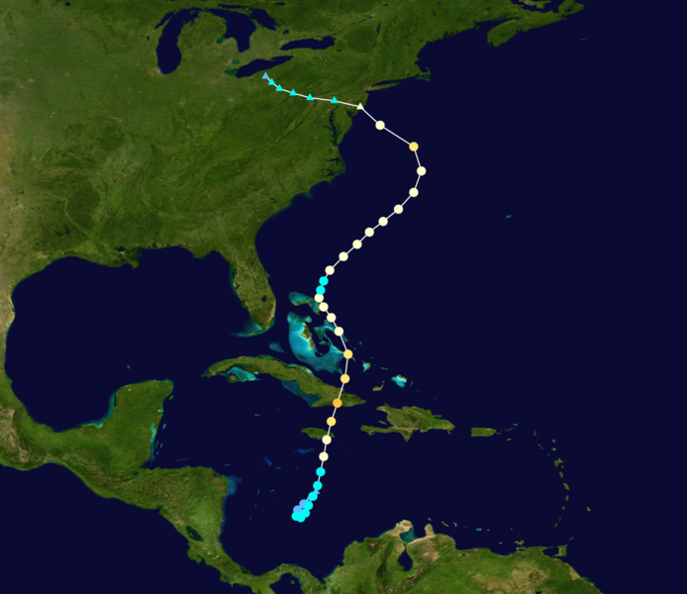
Hurricane Sandy http://en.wikipedia.org/wiki/Hurricane_Sandy
“Sandy developed from a tropical wave in the western Caribbean Sea on October 22, quickly strengthened, and was upgraded to Tropical Storm Sandy six hours later.
Sandy moved slowly northward toward the Greater Antilles and gradually intensified.
On October 24, Sandy became a hurricane, made landfall near Kingston, Jamaica, re-emerged a few hours later into the Caribbean Sea and strengthened into a Category 2 hurricane.
On October 25, Sandy hit Cuba as a Category 3 hurricane, then weakened to a Category 1 hurricane.
On October 27, Sandy briefly weakened to a tropical storm and then restrengthened to a Category 1 hurricane.
Early on October 29, Sandy curved north-northwest and then moved ashore near Brigantine, New Jersey, just to the northeast of Atlantic City, as a post-tropical cyclone with hurricane-force winds.”

Slide 35
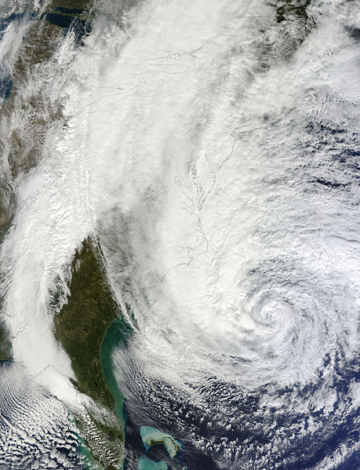
Relation to Global Warming http://en.wikipedia.org/wiki/Hurricane_Sandy
“As they move north, Atlantic hurricanes typically are forced east and out to sea by the Prevailing Westerlies.
In Sandy's case, this typical pattern was blocked by a ridge of high pressure over Greenland resulting in a negative North Atlantic Oscillation, forming a kink in the jet stream, causing it to double back on itself off the East Coast.
Sandy was caught up in this northwesterly flow.
The blocking pattern over Greenland also stalled an arctic front which combined with the cyclone.
Kevin Trenberth of NCAR said that while a negative North Atlantic Oscillation and a blocking anticyclone were in place, the null hypothesis remained that this was just the natural variability of weather (and not due to global warming)
Sea level at New York and along the New Jersey coast has increased by nearly a foot over the last hundred years, which contributed to the storm surge.
Harvard geologist Daniel P. Schrag calls Hurricane Sandy's 13-foot storm surge an example of what will, by mid-century, be the "new norm on the Eastern seaboard”.”

Slide 36
Sandy: Impact on New Jersey http://en.wikipedia.org/wiki/Hurricane_Sandy
“Preparations began on October 26, when officials in Cape May County advised residents on barrier islands to evacuate.
Governor of New Jersey Chris Christie ordered all residents of barrier islands from Sandy Hook to Cape May to evacuate and closed Atlantic City casinos.
President Obama signed an emergency declaration for New Jersey, allowing the state to request federal funding and other assistance for actions taken before Sandy's landfall.
On October 28, Mayor of Hoboken Dawn Zimmer ordered residents of basement and street-level residential units to evacuate, due to possible flooding.
On October 29, residents of Logan Township were ordered to evacuate. Jersey Central Power & Light told employees to prepare to work extended shifts.
Most schools, colleges and universities were closed October 29 while at least 509 out of 580 school districts were closed October 30.
Although tropical storm conditions were inevitable and hurricane force winds were likely, the National Hurricane Center did not issue any tropical cyclone watches or warnings for New Jersey, because Sandy was forecast to become extratropical before landfall and thus would not be a tropical cyclone.”

Slide 37
Sandy: Impact on New York http://en.wikipedia.org/wiki/Hurricane_Sandy
“The New York Stock Exchange was closed for trading for two days, the first weather closure of the exchange since 1985.
It was also the first two-day weather closure since the Great Blizzard of 1888.
The East River overflowed its banks, flooding large sections of Lower Manhattan. Battery Park had a water surge of 13.88 ft.
Seven subway tunnels under the East River were flooded.
The Metropolitan Transportation Authority said that the destruction caused by the storm was the worst disaster in the 108-year history of the New York City subway system.
Sea water flooded the Ground Zero construction site.
Over 10 billion gallons of raw and partially treated sewage were released by the storm, 94% of which went into waters in and around New York and New Jersey.
In addition, a four story Chelsea building's facade crumbled and collapsed, leaving the interior on full display; however, no one was hurt by the falling masonry.
On November 26, Governor Cuomo called Sandy "more impactful" than Hurricane Katrina, and estimated costs to New York at $42 billion.
The storm severely damaged or destroyed around 100,000 homes on Long Island with more than 2,000 homes deemed uninhabitable there.”

Slide 38
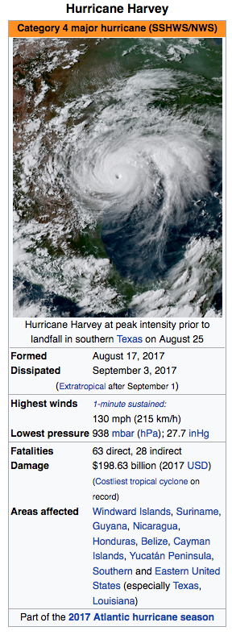
Hurricane Harvey August 17- September 3, 2017 https://en.wikipedia.org/wiki/Hurricane_Harvey
Hurricane Harvey was the costliest tropical cyclone on record, inflicting nearly $200 billion in damage, primarily from widespread flooding in the Houston metropolitan area, breaking the previous record set by Hurricane Katrina.
It was the first major hurricane to make landfall in the United States since Wilma in 2005, ending a record 12-year span in which no hurricanes made landfall at such an intensity in the country.
In a four-day period, many areas received more than 40 inches (100 cm) of rain as the system slowly meandered over eastern Texas and adjacent waters, causing catastrophic flooding.
With peak accumulations of 64.58 inches (164.0 cm), Harvey was the wettest tropical cyclone on record in the United States.
The resulting floods inundated hundreds of thousands of homes, displaced more than 30,000 people, and prompted more than 17,000 rescues

Slide 39
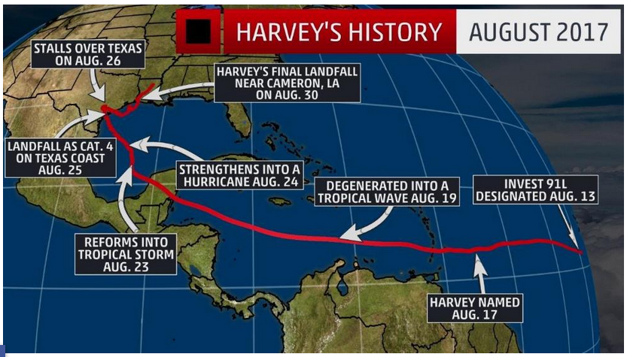
Hurricane Harvey 2017 https://weather.com/storms/hurricane/news/tropical-storm-harvey-forecast-texas-louisiana-arkansas
Harvey was a catastrophic flood disaster in southeast Texas.
Harvey made landfall as a Category 4 Hurricane with winds of 130 mph near Rockport, Texas.
Harvey meandered around southern Texas for days as a weakening hurricane and tropical storm.
As a tropical storm, Harvey dropped 40-61 inches of rainfall in southeast Texas and southwest Louisiana.
All-time U.S. tropical cyclone rain records were broken.
Harvey triggered flash flooding in parts of Arkansas, Kentucky, and Tennessee from Aug. 31-Sept. 1.
Harvey's long-lived odyssey has come to an end but its catastrophic impacts will be felt for weeks and months

Slide 40
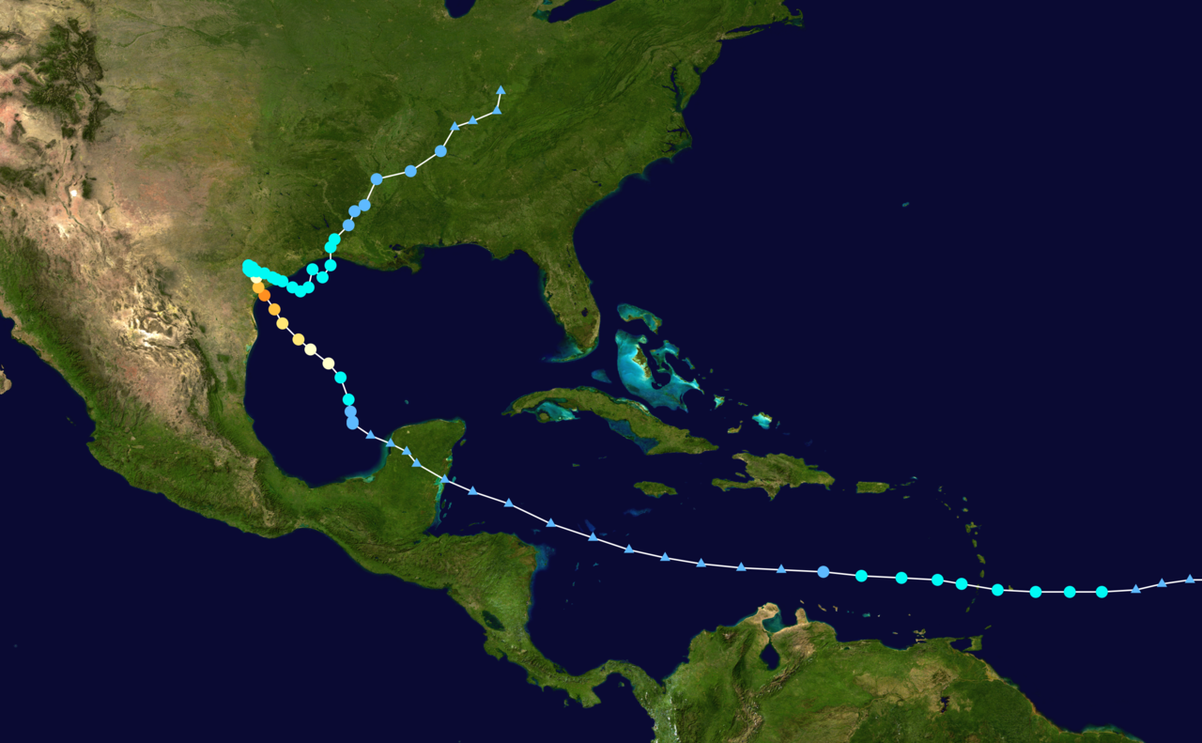
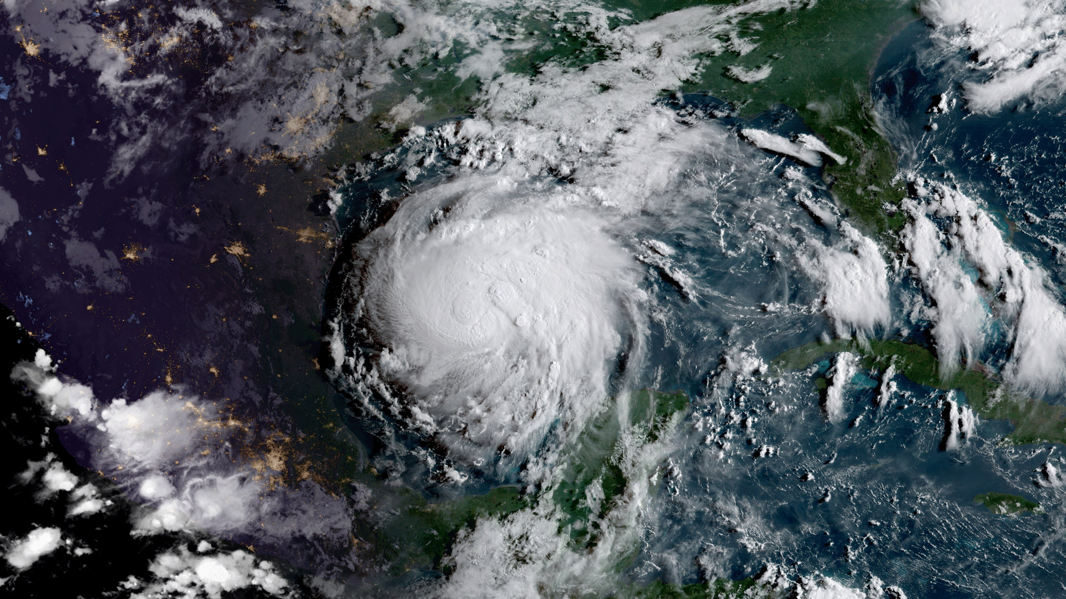
Harvey Storm Track
After striking land, the storm moved over the Copano Bay and made a second landfall in Texas just north of Holiday Beach at 06:00 UTC on August 26 as a Category 3 hurricane.
Harvey weakened to a tropical storm at 18:00 UTC on August 26.
For about two days the storm stalled just inland, dropping very heavy rainfall and causing widespread flash flooding.
Harvey's center drifted back towards the southeast, positioning itself near or just off the Texas coast at Matagorda on August 28.
Once offshore, convection blossomed and allowed the once-exposed low-level circulation to become obscured.
An Air Force reconnaissance plane investigating the system during the afternoon of August 29 found that maximum winds had increased to 50 mph (85 km/h).
Around 09:00 UTC the next morning, Harvey made its third and final landfall just west of Cameron, Louisiana, with winds of 45 mph (75 km/h).

Slide 41
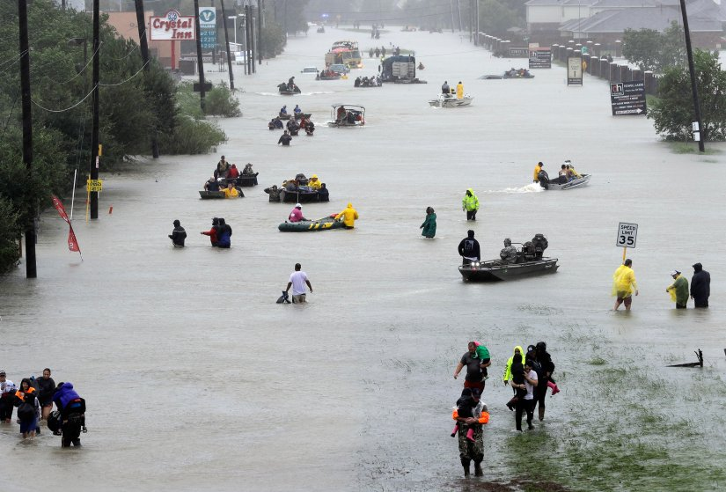
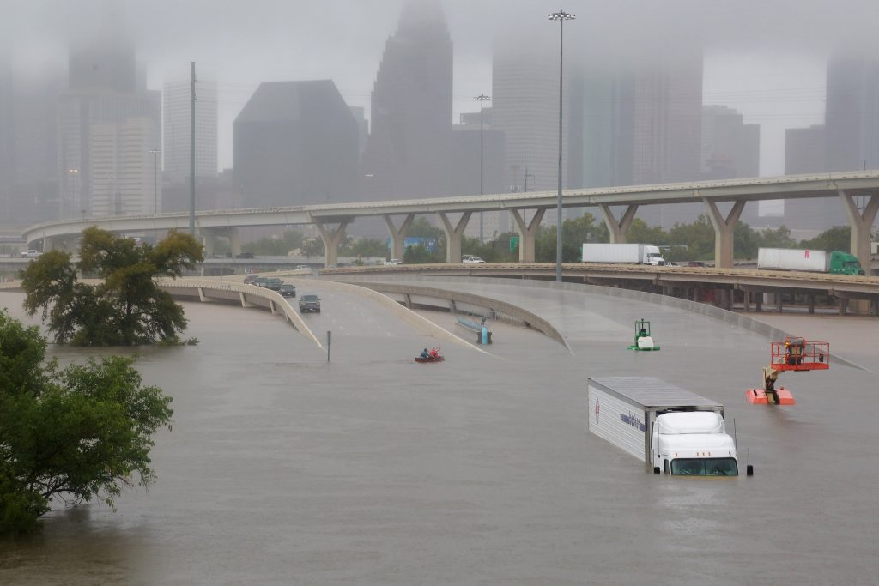
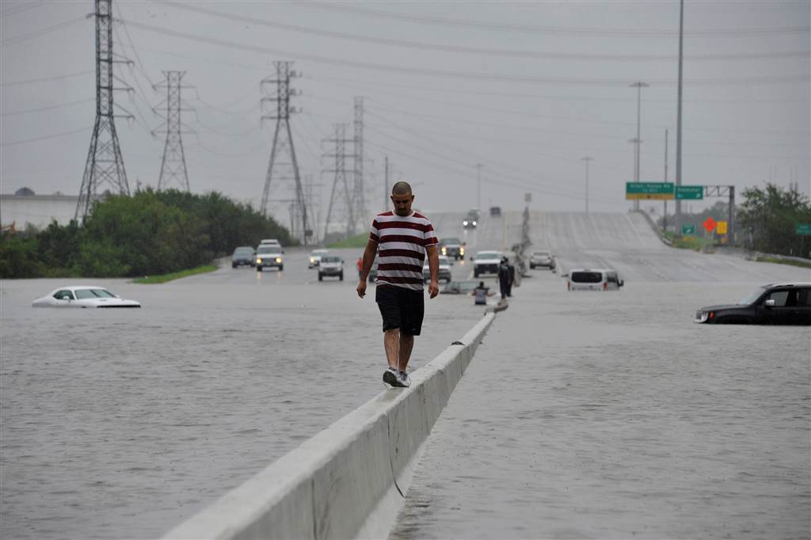

Harvey Caused Widespread Flooding in the Houston Metro Area

Slide 42

Hurricane Irma 2017 August 30-September 16, 2017 https://en.wikipedia.org/wiki/Hurricane_Irma
Hurricane Irma was an extremely powerful and catastrophic Cape Verde-type hurricane, the strongest observed in the Atlantic since Wilma in 2005 in terms of maximum sustained winds.
It was the first Category 5 hurricane to strike the Leeward Islands on record, followed by Hurricane Maria two weeks later, and the costliest Caribbean hurricane.
It was also the most intense Atlantic hurricane to strike the United States since Katrina in 2005, and the first major hurricane to make landfall in Florida since Wilma in 2005.
The ninth named storm, fourth hurricane, second major hurricane, and first Category 5 hurricane of the 2017 Atlantic hurricane season, Irma caused widespread and catastrophic damage throughout its long lifetime, particularly in parts of the northeastern Caribbean and the Florida Keys.

Slide 43


Irma Storm Track and Infrared Loop
On September 4, Florida Governor Rick Scott declared a state of emergency for Florida, and placed 100 members of the Florida National Guard on duty to assist in preparations.
All 7,000 troops were ordered to be on duty by September 8.
Officials advised residents to stock their hurricane kits.[68] Governor Scott suspended tolls on all toll roads in Florida, including Florida's Turnpike, starting at 5:00 p.m. on September 5.
All state offices in Florida were closed on September 8.
All schools in the Florida Keys were ordered closed from September 6 until further notice.
Mandatory evacuations for the islands were expected, with tourists to leave on September 6 and residents the following day; an estimated 25% of residents stayed.
Schools and colleges were closed in 44 of the state's 67 counties, before Governor Scott ordered all state colleges, universities, schools, and offices to be closed from September 8 to 11.

Slide 44


Effect of Low Pressure in a Tropical Cyclone
http://www.telegraph.co.uk/news/2017/09/10/force-hurricane-irma-displayed-sucks-water-bahamas-beach/

Slide 45


Impacts of Irma
Operational Land Imager imagery by Landsat 8 of the Virgin Islands from before Hurricane Irma's impact on August 25, 2017, and after on September 10, 2017, depicting a "browning" of the landscape and vegetation.[180]

Slide 46

Records
When Irma reached Category 5 intensity with winds of 175 mph (280 km/h) at 11:45 UTC on September 5 at 57.7°W, it became the easternmost Atlantic hurricane of this strength on record, surpassing Hurricane David of 1979.
By 00:15 UTC on September 6, Irma reached peak intensity with 185 mph (295 km/h) winds and a minimum pressure of 914 mbar (914 hPa; 27.0 inHg).
This ties it as the second-strongest Atlantic hurricane by wind speed, surpassed only by Allen of 1980 which reached wind speeds of 190 mph (305 km/h).
Irma achieved one of the longest durations of Category 5 strength winds, and the third-highest accumulated cyclone energy (ACE) index for a tropical cyclone in the Atlantic basin, with a value of 66.6 units

Slide 47

Hurricane Maria September 16 – October 3, 2017 https://en.wikipedia.org/wiki/Hurricane_Maria
Hurricane Maria is regarded as the worst natural disaster on record in Dominica and caused catastrophic damage and a major humanitarian crisis in Puerto Rico.
The tenth-most intense Atlantic hurricane on record, Maria was the thirteenth named storm, seventh consecutive hurricane, fourth major hurricane, and the second Category 5 hurricane of the hyperactive 2017 Atlantic hurricane season.
At its peak, the hurricane caused catastrophic damage and numerous fatalities across the northeastern Caribbean, compounding recovery efforts in the areas of the Leeward Islands already struck by Hurricane Irma just two weeks prior.
Maria was the third consecutive major hurricane to threaten the Leeward Islands in two weeks, after Irma made landfall in several of the islands two weeks prior and Hurricane Jose passed dangerously close, bringing tropical storm force winds to Barbuda.

Slide 48

Impacts
As of November 13, at least 129 people are confirmed to have been killed by the hurricane: 55 in Puerto Rico, 57 in Dominica, 5 in the Dominican Republic, 4 in the contiguous United States, 3 in Haiti, 2 in Guadeloupe, and 3 in the United States Virgin Islands.
Dozens of others, mostly in Dominica and Puerto Rico, are still missing. San Juan Mayor Yulín Cruz claimed that the actual death toll in Puerto Rico may actually be as high as 500.
Maria wrought catastrophic damage to the entirety of Dominica, which suffered an island-wide communication blackout. Much of the housing stock and infrastructure were left beyond repair, while the island's lush vegetation had been practically eradicated.
Total losses from the hurricane are estimated at between $15.9 and $95 billion (2017 USD), mostly in Puerto Rico, making Maria's cost comparable to that of previous Hurricanes Irma and Harvey.
Infrared loop of Hurricane Maria passing St. Croix, Vieques, and landfalling on Puerto Rico on the morning of September 20

Slide 49


Damage and Destruction in the Lesser Antilles

Slide 50

US Government Response
San Juan Mayor Carmen Yulín Cruz, called the disaster a "terrifying humanitarian crisis" and pleaded for relief efforts to be sped up on September 26.
The White House contested claims that the administration was not responding effectively.
General Joseph L. Lengyel, Chief of the National Guard Bureau, defended the Trump Administration's response, and reiterated that relief efforts were hampered by Puerto Rico being an island rather than on the mainland.
President Donald Trump responded to accusations that he does not care about Puerto Rico: "Puerto Rico is very important to me, and Puerto Rico -- the people are fantastic people.
Frustrated with the federal government's "slow and inadequate response", relief group Oxfam announced on October 2 that it plans to get involved in the humanitarian aid effort, sending a team to "assess a targeted and effective response" and support its local partners' on-the-ground efforts.
San Juan Mayor Carmen Yulín Cruz (pictured) harshly criticized the federal response to Maria in Puerto Rico as inadequate.

Slide 51

Hurricane Dorian 9/2019 https://en.wikipedia.org/wiki/Hurricane_Dorian
Hurricane Dorian was the most powerful tropical cyclone on record to strike the Bahamas, and is regarded as the worst natural disaster in the country's history.
It was the fourth named storm, second hurricane, and the first major hurricane of the 2019 Atlantic hurricane season.
Dorian struck the Abaco Islands on September 1 with maximum sustained winds of 185 mph (295 km/h), tying with the Labor Day hurricane of 1935 for the highest winds of an Atlantic hurricane ever recorded at landfall.
Dorian went on to strike Grand Bahama at similar intensity, stalling just north of the territory with unrelenting winds for at least 24 hours.
The resultant damage to these islands was catastrophic; most structures were destroyed or swept out to sea, and at least 70,000 people were left homeless.
The hurricane proceeded along the coasts of the Southeastern United States and Atlantic Canada, leaving behind considerable damage and economic losses throughout those regions.

Slide 52

Dorian from the International Space Station

Slide 53


Statistics and Storm Track

Slide 54


Precipitation & Impacts

Slide 55





Slide 56

Controversy

Slide 57


Hurricane Helene 2024 https://en.wikipedia.org/wiki/Hurricane_Helene

Slide 58

Hurricane Helene 2024 https://en.wikipedia.org/wiki/Hurricane_Helene
Hurricane Helene was a devastating tropical cyclone that caused widespread catastrophic damage and many fatalities across the Southeastern United States in late September 2024.
It was the strongest hurricane on record to strike the Big Bend region of Florida, the deadliest Atlantic hurricane since Maria in 2017, and the deadliest to strike the mainland U.S. since Katrina in 2005.
The eighth named storm, fifth hurricane, and second major hurricane of the 2024 Atlantic hurricane season, Helene began forming on September 22 as a broad low-pressure system in the western Caribbean Sea.
By September 24, the disturbance had consolidated enough to become a tropical storm as it approached the Yucatán Peninsula, receiving the name Helene from the National Hurricane Center.

Slide 59

Hurricane Helene 2024 https://en.wikipedia.org/wiki/Hurricane_Helene
Hurricane warnings were issued for the Big Bend area of Florida, with nearly all of Florida, except the westernmost part of the Florida panhandle, put under a tropical storm warning.
In addition, on the evening of September 26, an extreme wind warning was issued for the east part of the Florida Panhandle, the first since Hurricane Idalia.
On September 23, Governor Ron DeSantis issued a state of emergency for 41 Florida counties.
The next day, this was expanded to 61 counties.
U.S. President Joe Biden authorized a federal disaster declaration for 61 counties across Florida.
Image captured by the International Space Station crew

Slide 60

Helene Impacts in North Carolina https://en.wikipedia.org/wiki/Effects_of_Hurricane_Helene_in_North_Carolina
North Carolina was severely impacted by Hurricane Helene during late September 2024, primarily in its western Appalachian region, causing at least 103 reported deaths and significant destruction of infrastructure and residential areas across several settlements.
After making landfall in the Big Bend region of Florida on September 27, the hurricane began to traverse over land across Georgia as a Category 2 hurricane and into the Appalachian mountain range as a Tropical Storm
It deposited record-breaking amounts of rainfall across several settlements in western North Carolina, such as Asheville, Swannanoa, Spruce Pine, Chimney Rock, Montreat, Lake Lure, and several others.

Slide 61

Hurricane Milton 2024 https://en.wikipedia.org/wiki/Hurricane_Milton
Hurricane Milton was an extremely powerful and destructive tropical cyclone which became the second-most intense Atlantic hurricane ever recorded over the Gulf of Mexico, behind only Hurricane Rita in 2005.
Milton made landfall on the west coast of the U.S. state of Florida, less than two weeks after Hurricane Helene devastated the state's Big Bend region.
The thirteenth named storm, ninth hurricane, fourth major hurricane, and second Category 5 hurricane of the 2024 Atlantic hurricane season, Milton is the strongest tropical cyclone to occur worldwide in 2024 thus far.

Slide 62

Hurricane Milton 2024 https://en.wikipedia.org/wiki/Hurricane_Milton
Milton formed from a long-tracked tropical disturbance that originated in the western Caribbean Sea and consolidated in the Bay of Campeche on October 5.
Gradual intensification occurred as it slowly moved eastward, becoming a hurricane early on October 7.
Later that day, Milton underwent explosive intensification and became a Category 5 hurricane with winds of 180 mph (285 km/h).
At peak intensity, it had a pressure of 897 millibars (26.49 inHg), making it the fifth-most intense Atlantic hurricane on record.
Milton weakened to a Category 4 hurricane after an eyewall replacement cycle, and reintensified into a Category 5 hurricane the following day.

Slide 63

Typhoon Haiyan https://en.wikipedia.org/wiki/Typhoon_Haiyan
Typhoon Haiyan, known in the Philippines as Super Typhoon Yolanda, was one of the most powerful tropical cyclones ever recorded.
On making landfall, Haiyan devastated portions of Southeast Asia, particularly the Philippines.
It is one of the deadliest Philippine typhoons on record, killing at least 6,300 people in that country alone.
In terms of JTWC-estimated 1-minute sustained winds, Haiyan is tied with Meranti in 2016 for being the second strongest landfalling tropical cyclone on record, only behind Goni of 2020.
As of January 2014, bodies were still being found.
Haiyan was also the most intense tropical cyclone worldwide in 2013.

Slide 64

Typhoon Haiyan http://en.wikipedia.org/wiki/Typhoon_Haiyan
“At 1200 UTC on November 7, the Japan Meteorological Agency (JMA) upgraded the storm's maximum ten-minute sustained winds to 235 km/h (145 mph), the highest in relation to the cyclone.
The Hong Kong Observatory put the storm's maximum ten-minute sustained winds at 260 km/h (160 mph) prior to landfall in the central Philippines, while the China Meteorological Administration estimated the maximum ten-minute sustained winds at the time to be around 75 m/s (270 km/h or 167 mph).
At 1800 UTC, the JTWC estimated the system's one-minute sustained winds to 315 km/h (196 mph), unofficially making Haiyan the fourth most intense tropical cyclone ever observed.
Several hours later, the eye of the cyclone made its first landfall in the Philippines at Guiuan, Eastern Samar, without any change in intensity
If verified, this would make Haiyan the strongest tropical cyclone to make a landfall on record, surpassing the old record of 305 km/h (190 mph) set by Atlantic Hurricane Camille in 1969. “
Typhoon Haiyan of 2013 was estimated from satellite imagery by NOAA to have a pressure possibly as low as 858 mbar though it is uncertain without direct obsevation.
So far, due to lack of direct observations, it is unknown if Typhoon Tip maintains the world record

Slide 65

Haiyan & Climate http://en.wikipedia.org/wiki/Typhoon_Haiyan
“Gradually weakening, the storm made five additional landfalls in the country before emerging over the South China Sea.
The cyclone caused catastrophic destruction in the Visayas, particularly on Samar and Leyte.
According to UN officials, about 11 million people have been affected and many have been left homeless.
Both political leaders and climatologists have connected the typhoon to climate change.
Climatologists have consequently published analyses correlating the increasing intensity of storms with the progression of global warming.
As Yeb Saño continued his hunger strike (box at right), several delegates, including American delegate Collin Reese, joined him in fasting.
Sixty people from Climate Action Network, an umbrella group of environmental non-governmental organisations, also joined the hunger strike.”
During the 2013 United Nations Climate Change Conference (which was coincidentally held concurrently with the typhoon), Yeb Saño, the lead negotiator of the Philippines delegation, received a standing ovation when he declared a hunger strike in solidarity with his country.

Slide 66

Impacts http://en.wikipedia.org/wiki/Typhoon_Haiyan
“Typhoon Haiyan caused catastrophic damage throughout much of Leyte and Samar islands, where cities and towns were largely destroyed.
As of 6:00 a.m. local time on December 16, the National Disaster Risk Reduction and Management Council (NDRRMC) confirmed 6,069 fatalities across the country, 5,715 of those taking place in the Eastern Visayas.
The actual death toll remains unclear, with the total loss of life estimated as low as 2,500 by President Benigno Aquino III.
As of November 13, Red Cross estimated that 22,000 people were missing while approximately 65,500 people were listed as such through Google Person Finder.
Google, however, cautioned that this value is not to be read into, as shown during the 2011 Tōhoku earthquake and tsunami when more than 600,000 names were listed in contrast to the final death toll of roughly 20,000.”

Slide 67

Steve Ward
Video

Slide 68
Impacts http://en.wikipedia.org/wiki/Typhoon_Haiyan
“In Surigao City, 281.9 mm (11.10 in) of rainfall was recorded, much of which fell in under 12 hours.
Storm surges were also recorded in many places. In the island of Leyte and Samar, PAGASA measured 5–6 meter (15–19 ft) waves.
In Tacloban, Leyte, the terminal building of Tacloban Airport was destroyed by a 5.2 m (17 ft) storm surge up to the height of the second story.
Along the airport, a storm surge of 4 m (13 ft) was estimated.
Waves of 4.6 m (15 ft) were also estimated.
On the western coast of Samar, the storm surge was not as significant.
Guiuan in Eastern Samar was the point of Haiyan's first landfall, and was severely affected due to the typhoon's impacts.
Nearly all structures in the township suffered at least partial damage, many of which were completely flattened.
For several days following Haiyan's first landfall, the damage situation in the fishing town remained unclear due to lack of communication.
However, the damage could finally be assessed after Philippine Air Force staff arrived in Guiuan on November 10.”

Slide 69
Impacts http://en.wikipedia.org/wiki/Typhoon_Haiyan
“There was widespread devastation from the storm surge in Tacloban City especially in San Jose, with many buildings being destroyed, trees knocked over or broken, and cars piled up.
The low-lying areas on the eastern side of Tacloban city were hardest hit, with some areas completely washed away.
Flooding also extended for 1 km (0.62 mi) inland on the east coast of the province.
City administrator Tecson John Lim stated that roughly 90 percent of the city had been destroyed.
Journalists on the ground have described the devastation as, "off the scale, and apocalyptic”.
Most families in Samar and Leyte lost some family members or relatives; families came in from outlying provinces looking for relatives, especially children, who may have been washed away.
The entire first floor of the Tacloban City Convention Center, which was serving as an evacuation shelter, was submerged by storm surge.
Many residents in the building were caught off-guard by the fast rising waters and subsequently drowned or were injured in the buildings.”

Slide 70




Images of Tacloban (Various Sources as Listed)
http://www.bbc.co.uk
http://www.theguardian.com
http://www.abc.net.au
http://www.usaid.gov

Slide 71

http://reliefweb.int/report/philippines/philippines-typhoon-haiyan-humanitarian-snapshot-28-nov-2013-1800-utc8

