Slide 1
Lecture 26
Floods
John Rundle GEL 131

Slide 2
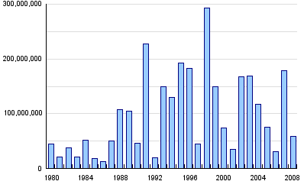
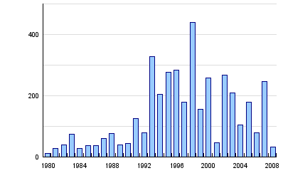
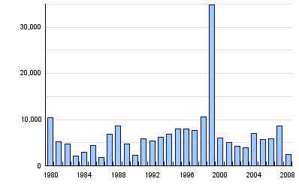
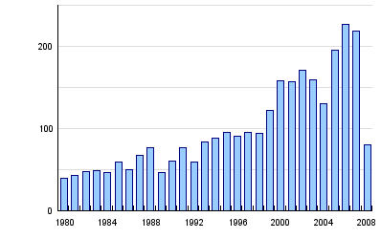
Global Flood Statistics, 1980-2008 http://www.preventionweb.net/english/hazards/statistics/?hid=62
Persons Affected
Economic Damage (USD in B$)
Persons Killed
Number of Reported Events

Slide 3
Global Floods Summary Statistics, 1980-2008 http://www.preventionweb.net/english/hazards/statistics/?hid=62

Slide 4
Floods http://en.wikipedia.org/wiki/Flood
A flood is an overflow of water that submerges land which is usually dry.
The European Union (EU) Floods Directive defines a flood as a covering by water of land not normally covered by water.
In the sense of "flowing water", the word may also be applied to the inflow of the tide.
Flooding may occur as an overflow of water from water bodies, such as a river or lake, in which the water overtops or breaks levees, resulting in some of that water escaping its usual boundaries, or it may occur due to an accumulation of rainwater on saturated ground in an areal flood.
While the size of a lake or other body of water will vary with seasonal changes in precipitation and snow melt, these changes in size are unlikely to be considered significant unless they flood property or drown domestic animals.
Flooding of a creek due to heavy monsoonal rain and high tide in Darwin, Northern Territory, Australia.

Slide 5
Floods http://en.wikipedia.org/wiki/Flood
Floods can also occur in rivers when the flow rate exceeds the capacity of the river channel, particularly at bends or meanders in the waterway.
While riverine flood damage can be eliminated by moving away from rivers and other bodies of water, people have traditionally lived and worked by rivers because the land is usually flat and fertile and because rivers provide easy travel and access to commerce and industry.
Some floods develop slowly, while others such as flash floods, can develop in just a few minutes and without visible signs of rain.
Additionally, floods can be local, impacting a neighborhood or community, or very large, affecting entire river basins.
Flooding near Key West, Florida, United States from Hurricane Wilma's storm surge in October 2005.

Slide 6
National Weather Service Flood Forecasting http://water.weather.gov/ahps/forecasts.php

Slide 7
FEMA Flood Zones http://www.openhazards.com/viewer
New Orleans, Louisiana

Slide 8
Types of Floods http://en.wikipedia.org/wiki/Flood
Areal (rainfall related)
Floods can happen on flat or low-lying areas when the ground is saturated and water either cannot run off or cannot run off quickly enough to stop accumulating.
This may be followed by a river flood as water moves away from the floodplain into local rivers and streams.
Floods can also occur if water falls on an impermeable surface, such as concrete, paving or frozen ground, and cannot rapidly dissipate into the ground.
Localised heavy rain from a series of storms moving over the same area can cause areal flash flooding when the rate of rainfall exceeds the drainage capacity of the area.
When this occurs on tilled fields, it can result in a muddy flood where sediments are picked up by run off and carried as suspended matter or bed load.
Jeddah Flood, covering King Abdullah Street in Saudi Arabia

Slide 9
Types of Floods http://en.wikipedia.org/wiki/Flood
Riverine
River flows may rise to floods levels at different rates, from a few minutes to several weeks, depending on the type of river and the source of the increased flow.
Slow rising floods most commonly occur in large rivers with large catchment areas. The increase in flow may be the result of sustained rainfall, rapid snow melt, monsoons, or tropical cyclones.
Localised flooding may be caused or exacerbated by drainage obstructions such as landslides, ice, or debris.
Rapid flooding events, including flash floods, more often occur on smaller rivers, rivers with steep valleys or rivers that flow for much of their length over impermeable terrain.
The cause may be localised convective precipitation (intense thunderstorms) or sudden release from an upstream impoundment created behind a dam, landslide, or glacier.
Dam-building beavers can flood low-lying urban and rural areas, occasionally causing some damage.
Dozens of villages were inundated when rain pushed the rivers of northwestern Bangladesh over their banks in early October 2005. The MODIS instrument on NASA’s Terra satellite captured the top image of the flooded Ghaghat and Atrai Rivers on October 12, 2005.
The deep blue of the rivers is spread across the countryside in the flood image

Slide 10
Types of Floods http://en.wikipedia.org/wiki/Flood
Urban flooding
Urban flooding is the inundation of land or property in a built environment, particularly in more densely populated areas, caused by rainfall overwhelming the capacity of drainage systems, such as storm sewers.
Although sometimes triggered by events such as flash flooding or snowmelt, urban flooding is a condition, characterized by its repetitive and systemic impacts on communities, that can happen regardless of whether or not affected communities are located within formally designated floodplains or near any body of water.
There are several ways in which stormwater enters properties:
Backup through sewer pipes, toilets and sinks into buildings
Seepage through building walls and floors;
The accumulation of water on property and in public rights-of-way;
The overflow from water bodies such as rivers and lakes.
Floods in 2013 in Boulder, Colorado

Slide 11
Types of Floods http://en.wikipedia.org/wiki/Flood
Estuarine and coastal
Flooding in estuaries is commonly caused by a combination of sea tidal surges caused by winds and low barometric pressure, and they may be exacerbated by high upstream river flow.
Coastal areas may be flooded by storm events at sea, resulting in waves over-topping defences or in severe cases by tsunami or tropical cyclones.
A storm surge, from either a tropical cyclone or an extratropical cyclone, falls within this category.
Catastrophic
Catastrophic flooding is usually associated with major infrastructure failures such as the collapse of a dam, but they may also be caused by damage sustained in an earthquake or volcanic eruption.
See outburst flood.
Flooded I-10/I-610/West End Blvd interchange and surrounding area of northwest New Orleans and Metairie, Louisiana

Slide 12
Floods: Primary Effects http://en.wikipedia.org/wiki/Flood
The primary effects of flooding include loss of life, damage to buildings and other structures, including bridges, sewerage systems, roadways, and canals.
Floods also frequently damage power transmission and sometimes power generation, which then has knock-on effects caused by the loss of power.
This includes loss of drinking water treatment and water supply, which may result in loss of drinking water or severe water contamination.
It may also cause the loss of sewage disposal facilities.
Lack of clean water combined with human sewage in the flood waters raises the risk of waterborne diseases, which can include typhoid, giardia, cryptosporidium, cholera and many other diseases depending upon the location of the flood.
Damage to roads and transport infrastructure may make it difficult to mobilise aid to those affected or to provide emergency health treatment.
Flood waters typically inundate farm land, making the land unworkable and preventing crops from being planted or harvested, which can lead to shortages of food both for humans and farm animals.
Entire harvests for a country can be lost in extreme flood circumstances. Some tree species may not survive prolonged flooding of their root systems

Slide 13
Floods: Secondary Effects http://en.wikipedia.org/wiki/Flood
Economic hardship due to a temporary decline in tourism, rebuilding costs, or food shortages leading to price increases is a common after-effect of severe flooding.
The impact on those affected may cause psychological damage to those affected, in particular where deaths, serious injuries and loss of property occur.
Urban flooding can lead to chronically wet houses, which are linked to an increase in respiratory problems and other illnesses.
Urban flooding also has significant economic implications for affected neighborhoods.
In the United States, industry experts estimate that wet basements can lower property values by 10-25 percent and are cited among the top reasons for not purchasing a home.
According to the U.S. Federal Emergency Management Agency (FEMA), almost 40 percent of small businesses never reopen their doors following a flooding disaster.

Slide 14
Flood Forecasting http://en.wikipedia.org/wiki/Flood
Anticipating floods before they occur allows for precautions to be taken and people to be warned so that they can be prepared in advance for flooding conditions.
For example, farmers can remove animals from low-lying areas and utility services can put in place emergency provisions to re-route services if needed.
Emergency services can also make provisions to have enough resources available ahead of time to respond to emergencies as they occur.
In order to make the most accurate flood forecasts for waterways, it is best to have a long time-series of historical data that relates stream flows to measured past rainfall events.
Coupling this historical information with real-time knowledge about volumetric capacity in catchment areas, such as spare capacity in reservoirs, ground-water levels, and the degree of saturation of area aquifers is also needed in order to make the most accurate flood forecasts.

Slide 15
Flood Forecasting http://en.wikipedia.org/wiki/Flood
Radar estimates of rainfall and general weather forecasting techniques are also important components of good flood forecasting.
In areas where good quality data is available, the intensity and height of a flood can be predicted with fairly good accuracy and plenty of lead time.
The output of a flood forecast is typically a maximum expected water level and the likely time of its arrival at key locations along a waterway, and it also may allow for the computation of the likely statistical return period of a flood.
In many developed countries, urban areas at risk of flooding are protected against a 100-year flood - that is a flood that has a probability of around 63% of occurring in any 100 year period of time.
According to the U.S. National Weather Service (NWS) Northeast River Forecast Center (RFC) in Taunton, Massachusetts, a general rule-of-thumb for flood forecasting in urban areas is that it takes at least 1 inch (25 mm) of rainfall in around an hour's time in order to start significant ponding of water on impermeable surfaces.
Many NWS RFCs routinely issue Flash Flood Guidance and Headwater Guidance, which indicate the general amount of rainfall that would need to fall in a short period of time in order to cause flash flooding or flooding on larger water basins.

Slide 16
https://www.cityofsacramento.org/utilities/drainage/flood-ready/maps

Slide 17
Deadliest Floods WorldWide http://en.wikipedia.org/wiki/Flood

Slide 18
Controlling Floods http://en.wikipedia.org/wiki/Flood
In many countries around the world, waterways prone to floods are often carefully managed. Defenses such as detention basins, levees, bunds, reservoirs, and weirs are used to prevent waterways from overflowing their banks.
Coastal flooding has been addressed in portions of Europe and the Americas with coastal defenses, such as sea walls, beach nourishment, and barrier islands.
In the riparian zone near rivers and streams, erosion control measures can be taken to try and slow down or reverse the natural forces that cause many waterways to meander over long periods of time.
Flood controls, such as dams, can be built and maintained over time to try and reduce the occurrence and severity of floods as well. In the USA, the U.S. Army Corps of Engineers maintains a network of such flood control dams.
In areas prone to urban flooding, one solution is the repair and expansion of man-made sewer systems and stormwater infrastructure.
Another strategy is to reduce impervious surfaces in streets, parking lots and buildings through natural drainage channels, porous paving, and wetlands (collectively known as green infrastructure or sustainable urban drainage systems [SUDS]).
Areas identified as flood-prone can be converted into parks and playgrounds that can tolerate occasional flooding.
Ordinances can be adopted to require developers to retain stormwater on site and require buildings to be elevated, protected by floodwalls and levees, or designed to withstand temporary inundation.
Property owners can also invest in solutions themselves, such as re-landscaping their property to take the flow of water away from their building and installing rain barrels, sump pumps, and check valves.

Slide 19
Benefits of Floods http://en.wikipedia.org/wiki/Flood
Floods (in particular more frequent or smaller floods) can also bring many benefits, such as recharging ground water, making soil more fertile and increasing nutrients in some soils.
Flood waters provide much needed water resources in arid and semi-arid regions where precipitation can be very unevenly distributed throughout the year.
Freshwater floods particularly play an important role in maintaining ecosystems in river corridors and are a key factor in maintaining floodplain biodiversity.
Flooding can spread nutrients to lakes and rivers, which can lead to increased biomass and improved fisheries for a few years.
For some fish species, an inundated floodplain may form a highly suitable location for spawning with few predators and enhanced levels of nutrients or food.
Fish, such as the weather fish, make use of floods in order to reach new habitats.
Bird populations may also profit from the boost in food production caused by flooding.
Periodic flooding was essential to the well-being of ancient communities along the Tigris-Euphrates Rivers, the Nile River, the Indus River, the Ganges and the Yellow River among others.
The viability of hydropower, a renewable source of energy, is also higher in flood prone regions.

Slide 20
Flood Insurance http://www.insurance.ca.gov/0100-consumers/0065-catastrophe/index.cfm
Resources are available in all states and at the federal level

Slide 21
https://www.fema.gov/flood-insurance

Slide 22
Oroville Dam near-Failure https://en.wikipedia.org/wiki/Oroville_Dam
The rainy season of 2016–2017 was Northern California's wettest winter in over 100 years.
Heavy rainfall resulted in record inflows from the Feather River, and the spillway was opened in January to relieve pressure on Oroville Dam.
After a second series of heavy storms in February, the spillway flow was increased to 50,000 cubic feet per second (1,400 m3/s), and on February 7 a crater appeared in the midsection of the spillway.
High inflows to Lake Oroville forced dam operators to continue using the damaged spillway, causing additional damage.
The spillway hole continued to grow.
Debris from the crater in the main spillway were carried downstream, and caused damage to the Feather River Fish Hatchery due to high turbidity.
Although engineers had hoped that using the damaged spillway could drain the lake enough to avoid use of the emergency spillway, they were forced to reduce its discharge from 65,000 cu ft/s (1,800 m3/s) to 55,000 cu ft/s (1,600 m3/s) due to potential damage to nearby power lines.

Slide 23
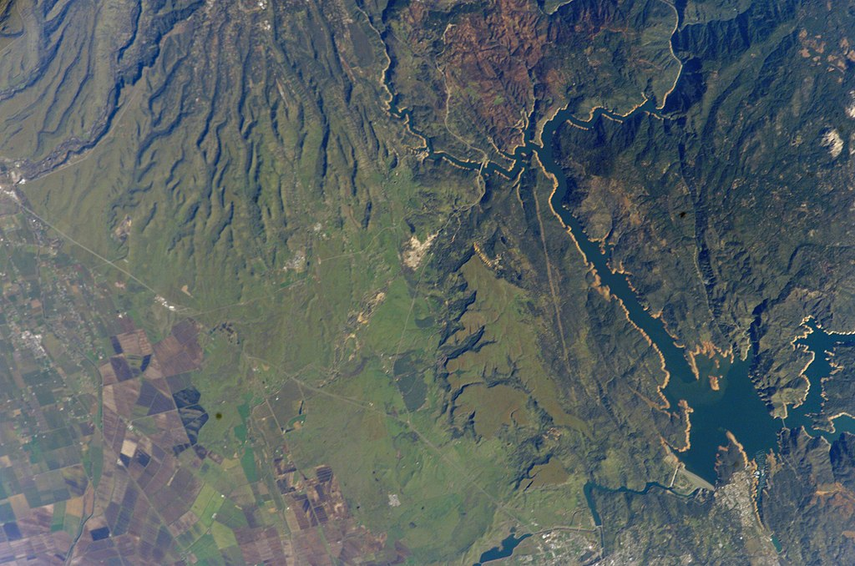

Slide 24
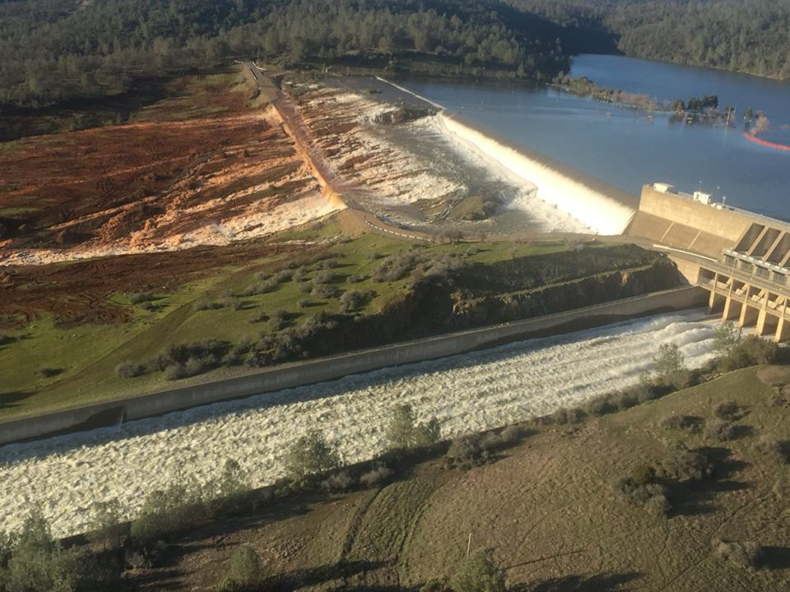

Slide 25
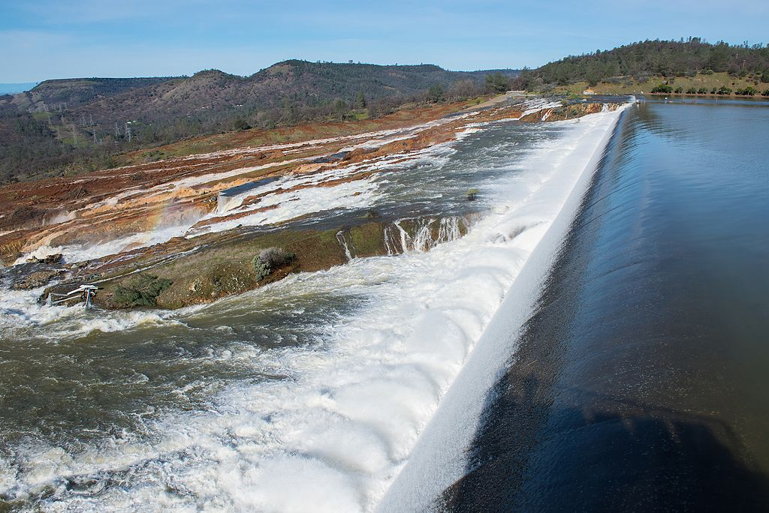

Slide 26
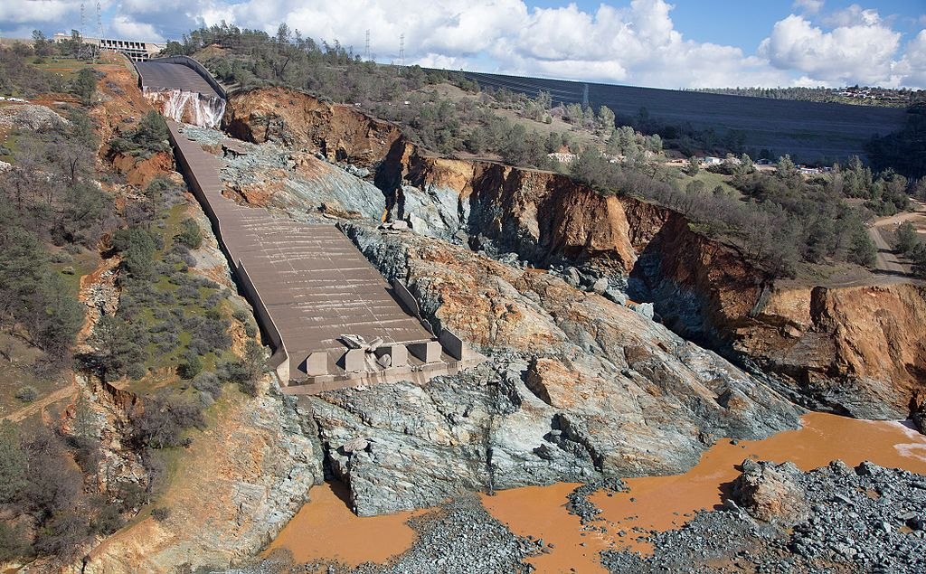

Slide 27
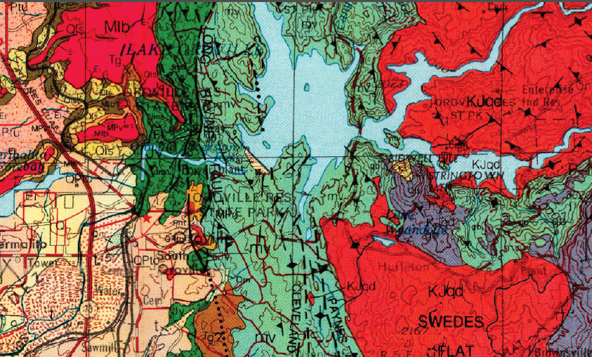

Slide 28
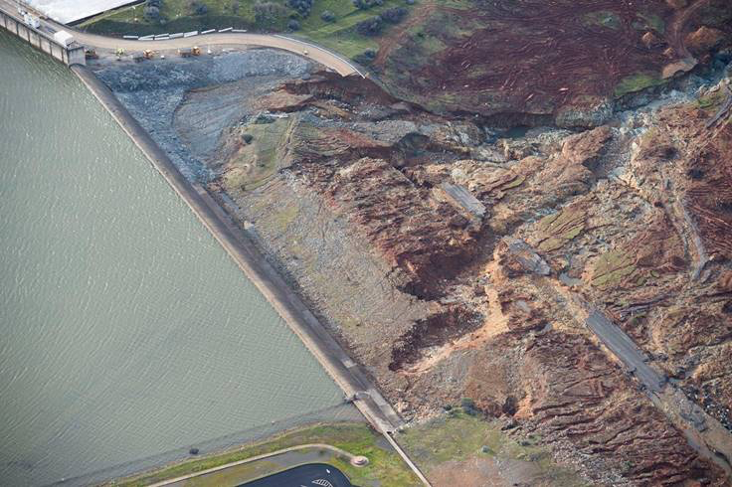

Slide 29
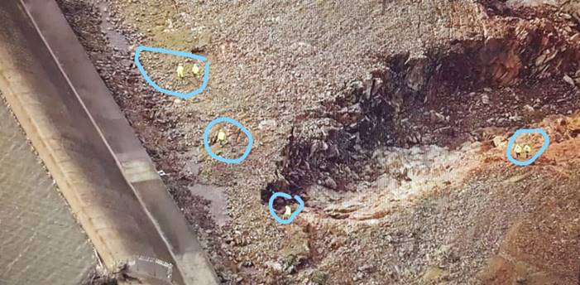

Slide 30
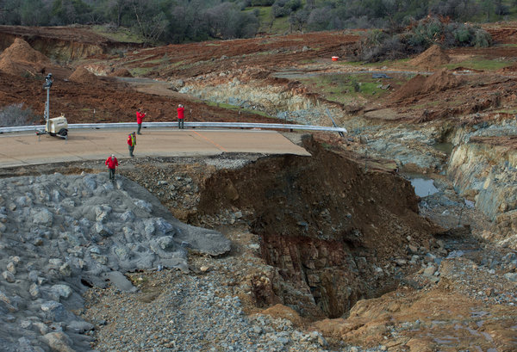

Slide 31
Reconstruction https://en.wikipedia.org/wiki/Oroville_Dam
On May 19, the spillway was shut down for the summer, in order to allow demolition and repair work to begin.
The total cost of the repair is projected to exceed $400 million, with the $275 million primary contract awarded to Kiewit Construction.
FEMA is expected to cover a large portion of the expenses.
According to an independent forensics team led by John France, the exact cause of the spillway failure remains uncertain, though they identified "24 possible causes for the spillway failure, including a faulty drainage system, variations in concrete thickness and corrosion in the structure’s rebar."
In 2018, the upper section of the spillway which was undamaged by the flood but also has been identified as structurally defective, will be demolished and rebuilt.
On November 1, DWR director Grant Davis said, "Lake Oroville’s main spillway is indeed ready to safely handle winter flows if needed".

