Slide 1
Fractals, Chaos, Complexity Physics-EPS 30
Lecture
Probability
https://en.wikipedia.org/wiki/Probability
https://en.wikipedia.org/wiki/Venn_diagram
https://en.wikipedia.org/wiki/Bayes_theorem

Slide 2
Venn Diagrams
A Venn diagram is a widely used diagram style that shows the logical relation between sets, popularized by John Venn in 1880.
The diagrams are used to teach elementary set theory, and to illustrate simple set relationships in probability, logic, statistics, linguistics and computer science.
A Venn diagram uses simple closed curves drawn on a plane to represent sets.
Very often, these curves are circles or ellipses.
Similar ideas had been proposed before Venn.
Venn diagram showing the uppercase glyphs shared by the Greek, Latin, and Russian alphabets

Slide 3
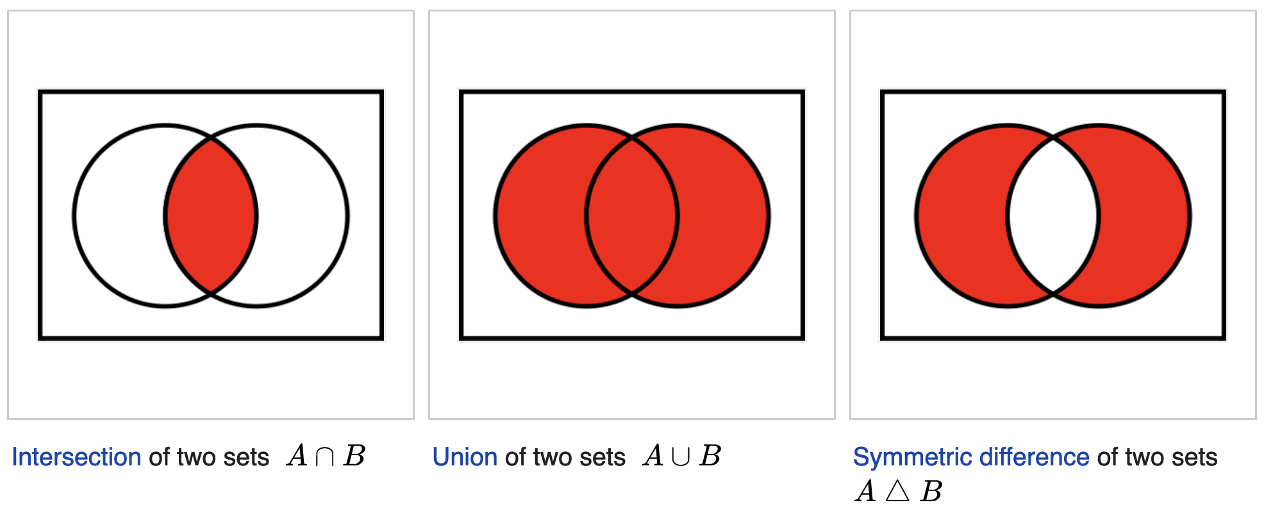
Venn Diagrams

Slide 4
Probability
Probability is the branch of mathematics concerning numerical descriptions of how likely an event is to occur, or how likely it is that a proposition is true.
The probability of an event is a number between 0 and 1, where, roughly speaking, 0 indicates impossibility of the event and 1 indicates certainty.
Probabilities can also be expressed as percentages, lying between 0% and 100%
The higher the probability of an event, the more likely it is that the event will occur.
A simple example is the tossing of a fair (unbiased) coin.
Since the coin is fair, the two outcomes ("heads" and "tails") are both equally probable;
The probability of "heads" equals the probability of "tails"
Since no other outcomes are possible, the probability of either "heads" or "tails" is 1/2 (which could also be written as 0.5 or 50%).

Slide 5
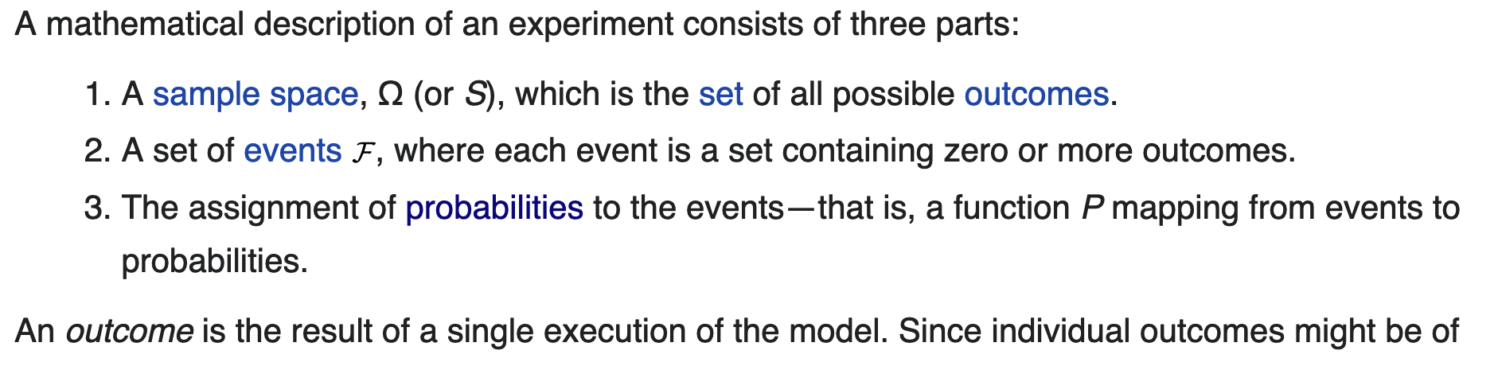
Probability https://en.wikipedia.org/wiki/Experiment_(probability_theory)

Slide 6
Terminology
Experiment: An operation which can produce some well-defined outcomes, is called an Experiment.
Example: When we toss a coin, we know that either head or tail shows up. So, the operation of tossing a coin may be said to have two well-defined outcomes, namely, (a) heads showing up; and (b) tails showing up.
Random Experiment: When we roll a dice we are well aware of the fact that any of the numerals 1,2,3,4,5, or 6 may appear on the upper face but we cannot say that which exact number will show up.
Such an experiment in which all possible outcomes are known, and the exact outcome cannot be predicted in advance, is called a Random Experiment.
This is the Density of States idea:
The macro configuration (sum of numbers on the 2 dice) with the largest number of micro configurations is: Sum = 7

Slide 7
Terminology
Sample Space: All the possible outcomes of an experiment as a whole, form the Sample Space.
Example: When we roll a dice, we can get any outcome from 1 to 6. All the possible numbers which can appear on the upper face form the Sample Space(denoted by S). Hence, the Sample Space of a dice roll is S={1,2,3,4,5,6}
Outcome: Any possible result out of the Sample Space S for a Random Experiment is called an Outcome.
Example: When we roll a die, we might obtain 3 or when we toss a coin, we might obtain heads.
Definition of a “trial”: Performing an experiment

Slide 8
Terminology
Event: Any subset of the Sample Space S is called an Event (denoted by E).
When an outcome which belongs to the subset E takes place, it is said that an Event has occurred.
When an outcome which does not belong to subset E takes place, the Event has not occurred.
Example: Consider the experiment of throwing a die, with Sample Space S={1,2,3,4,5,6}.
Let E denote the event of “a number appearing less than 4.”
Thus, the Event E={1,2,3}.
If the number 1 appears, we say that Event E has occurred.
Similarly, if the outcomes are 2 or 3, we can also say Event E has occurred since these outcomes belong to subset E.

Slide 9
Definition of a Probability
A probability is a way of assigning every event a value between 0 and 1, with the requirement that the event is made up of all possible results.
As an example, in tossing a dice, the event {1,2,3,4,5,6} is assigned a value of one or 100%.
To qualify as a probability, the assignment of values must satisfy the requirement:
For any collection of mutually exclusive events (events with no common results, such as the events {1,6}, {3}, and {2,4}), the probability that at least one of the events will occur is given by the sum of the probabilities of all the individual events.
Thus, the probability that {1,6} will occur is given by the sum of probabilities that {1} and {6} will occur = 1/3
Note that the opposite or complement of an event A is the event [A^{C}]
That is, the event of A not occurring is given by: P(A^{C}) = 1 − P(A)

Slide 10
Independent Events

Slide 11
Mutually Exclusive Events

Slide 12
Non-Exclusive Events

Slide 13
Probability, Sets and Truth Tables
Note that the operations we have just described are usually encoded as truth tables
They are frequently used in computer programming
They are an example of Boolean algebra, which we will discuss soon
Also used as an example for contingency tables (or referred to as a “confusion matrix” in machine learning terminology)

Slide 14
Histograms
https://citoolkit.com/articles/histogram/

Slide 15
From Time Series to Histograms
A time series is a plot of value of some variable vs. time
A histogram is a plot of number of items vs value
Time series can be used to generate histograms
The histogram is a measure of how many time intervals the various time series values ”spend” at each value
Simple examples are given at right
Note that the time series are very different, but the histograms are similar
https://images.slideplayer.com/24/7311641/slides/slide_18.jpg

Slide 16
Scatterplots and Histograms
Probability Mass Functions
https://www.machinelearningplus.com/plots/top-50-matplotlib-visualizations-the-master-plots-python/

Slide 17
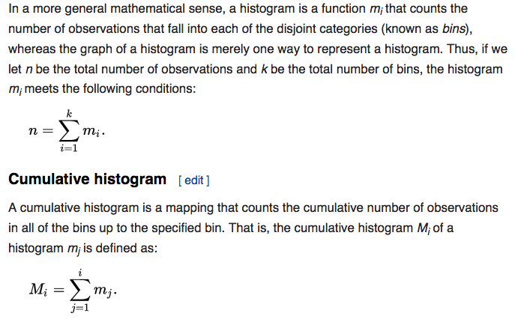
Ordinary and Cumulative Histograms https://en.wikipedia.org/wiki/Density_estimation

Slide 18
Ordinary and Cumulative Histograms https://en.wikipedia.org/wiki/Density_estimation

Slide 19
Mean and Standard Deviation
In statistics, the standard deviation is a measure of the amount of variation or dispersion of a set of values.
A low standard deviation indicates that the values tend to be close to the mean (also called the expected value) of the set, while a high standard deviation indicates that the values are spread out over a wider range.
Standard deviation may be abbreviated SD, and is most commonly represented in mathematical texts and equations by the lower case Greek letter sigma σ, for the population standard deviation, or the Latin letter s, for the sample standard deviation.

Slide 20
Statistics of Stock Market Data http://investexcel.net/plot-stock-returns-histogram/
Coca-Cola
Google

Slide 21
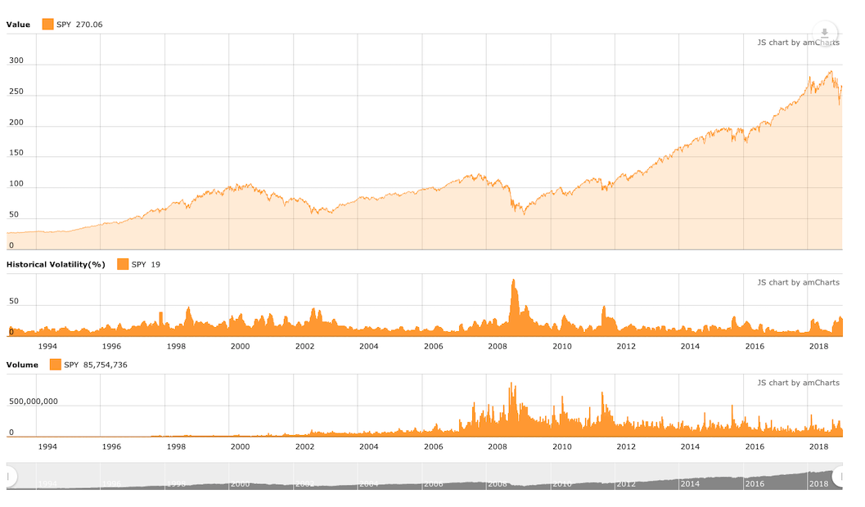
Stock Market Data
An Application of Probability to the SPY Exchange Traded Fund (ETF)
Holding Period

Slide 22
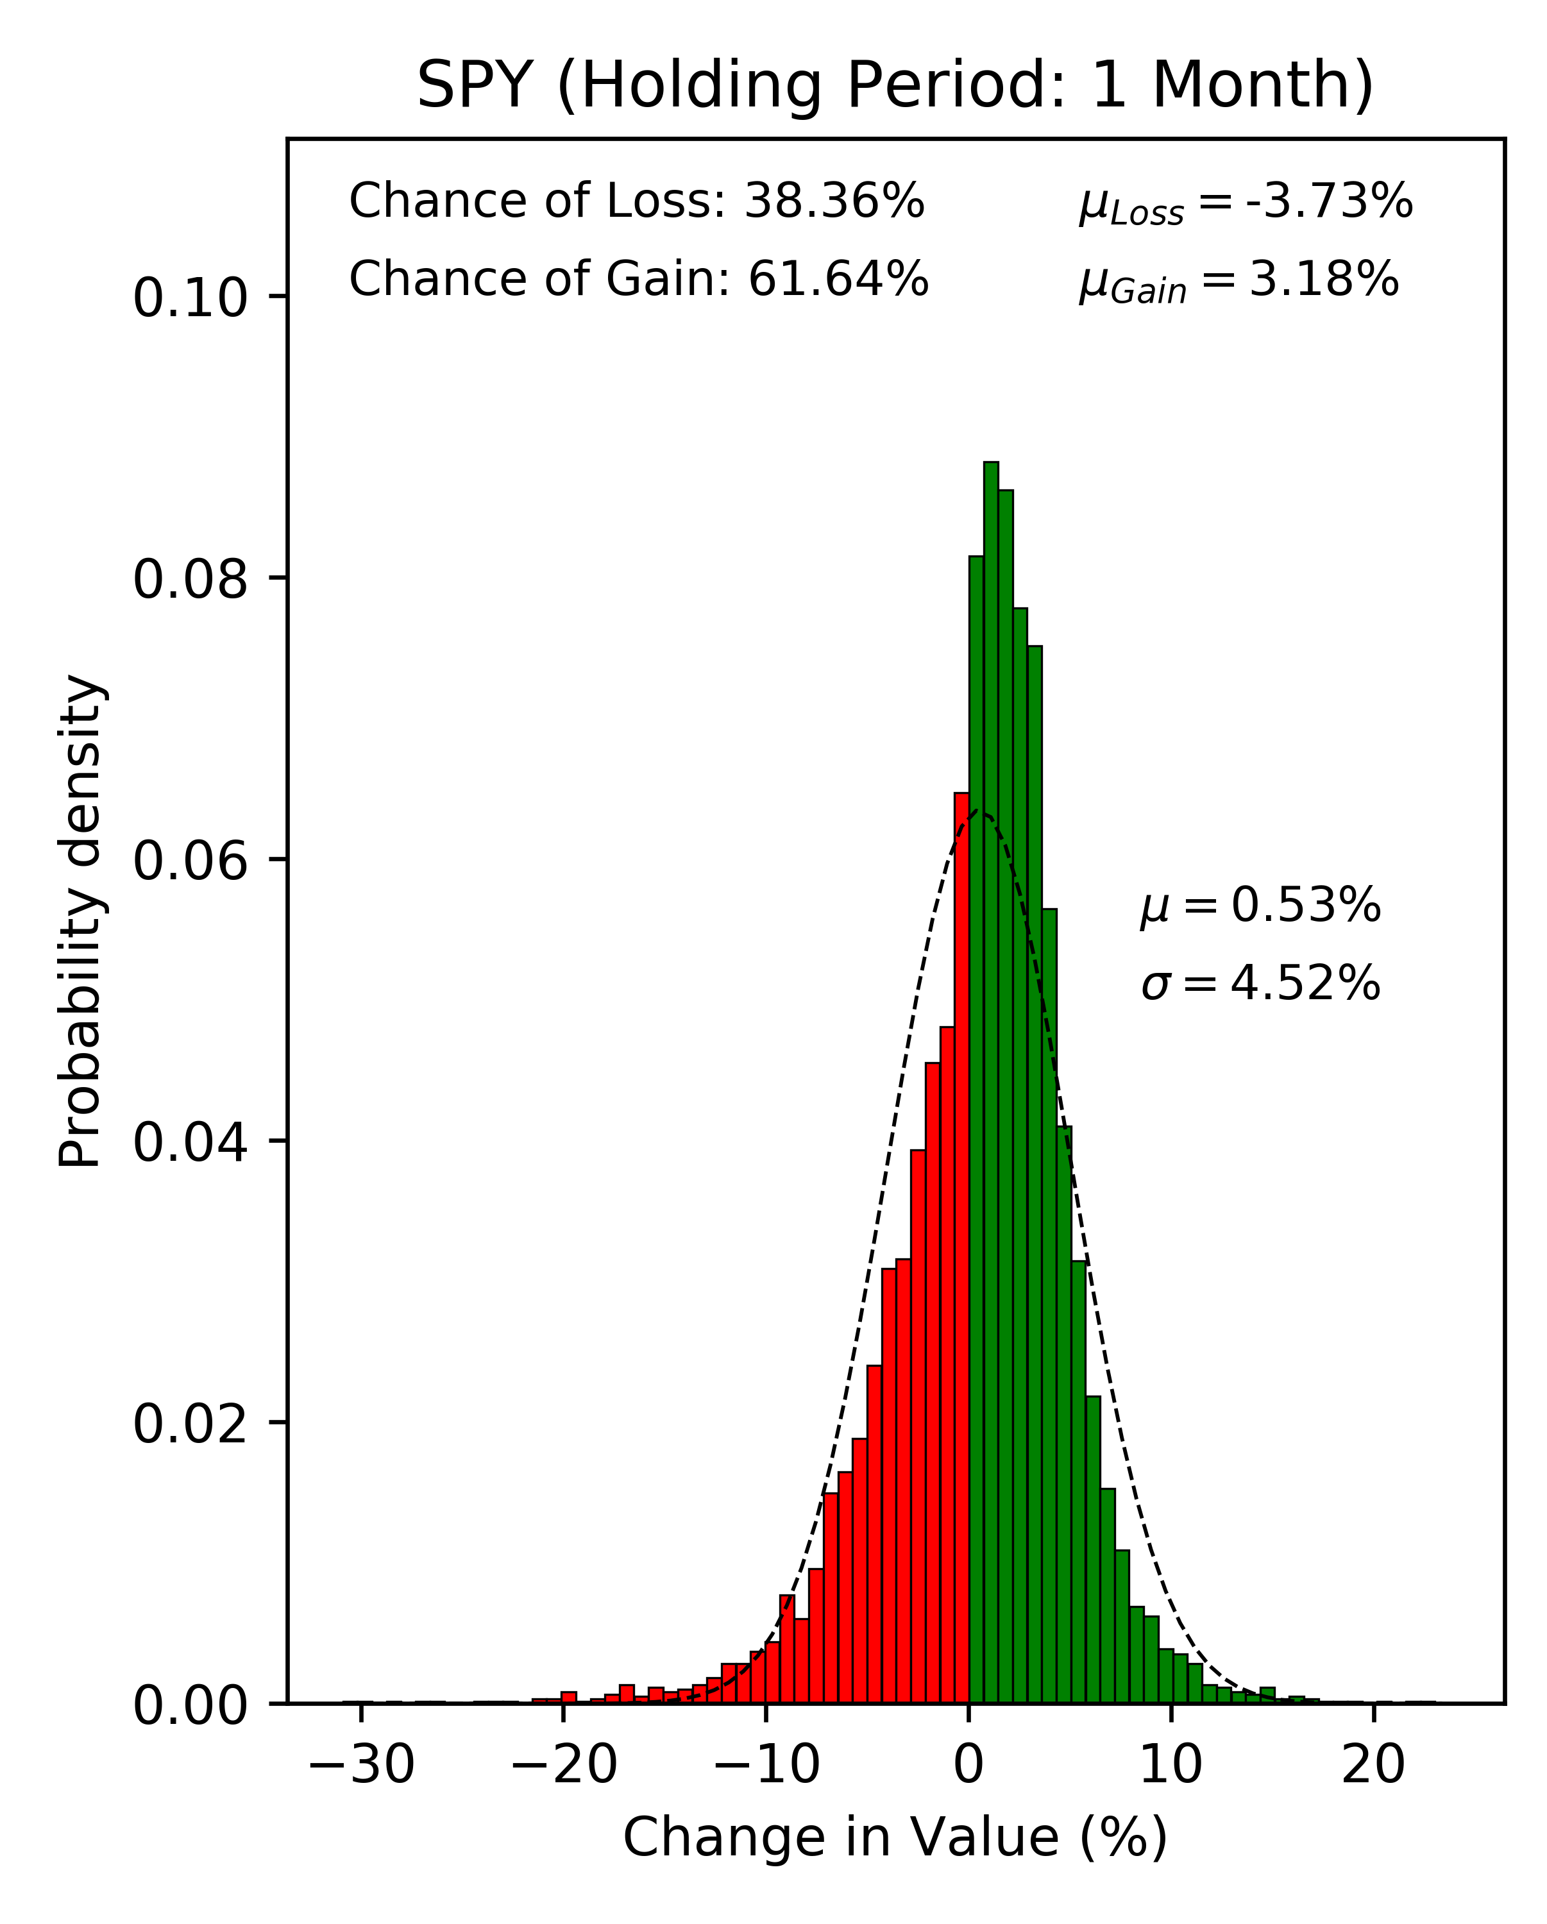
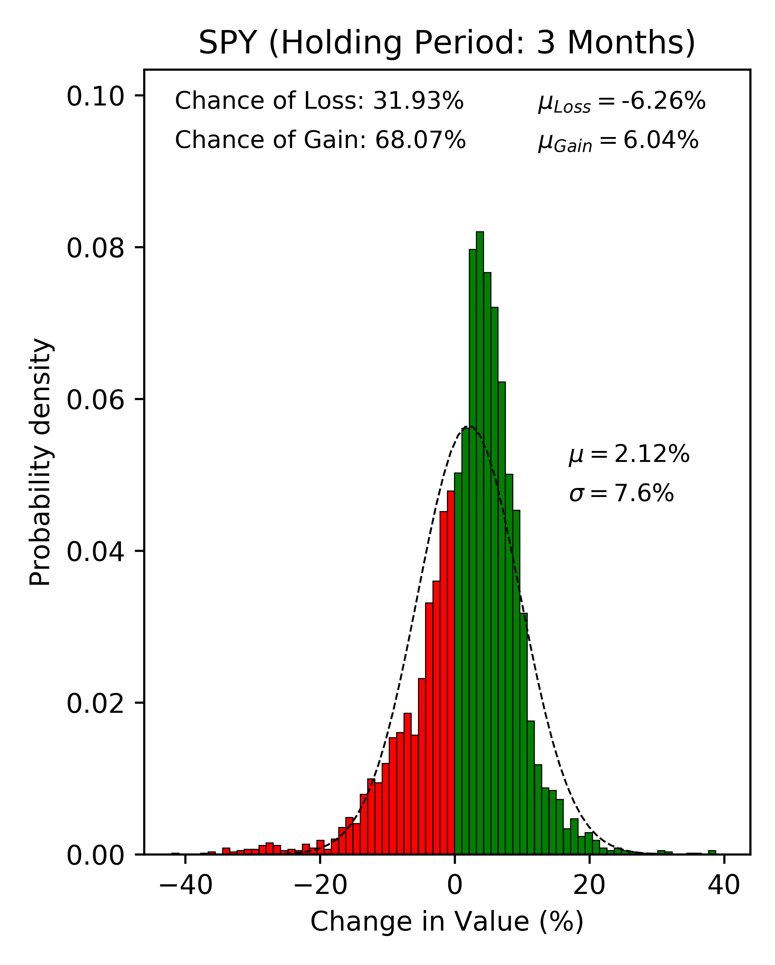
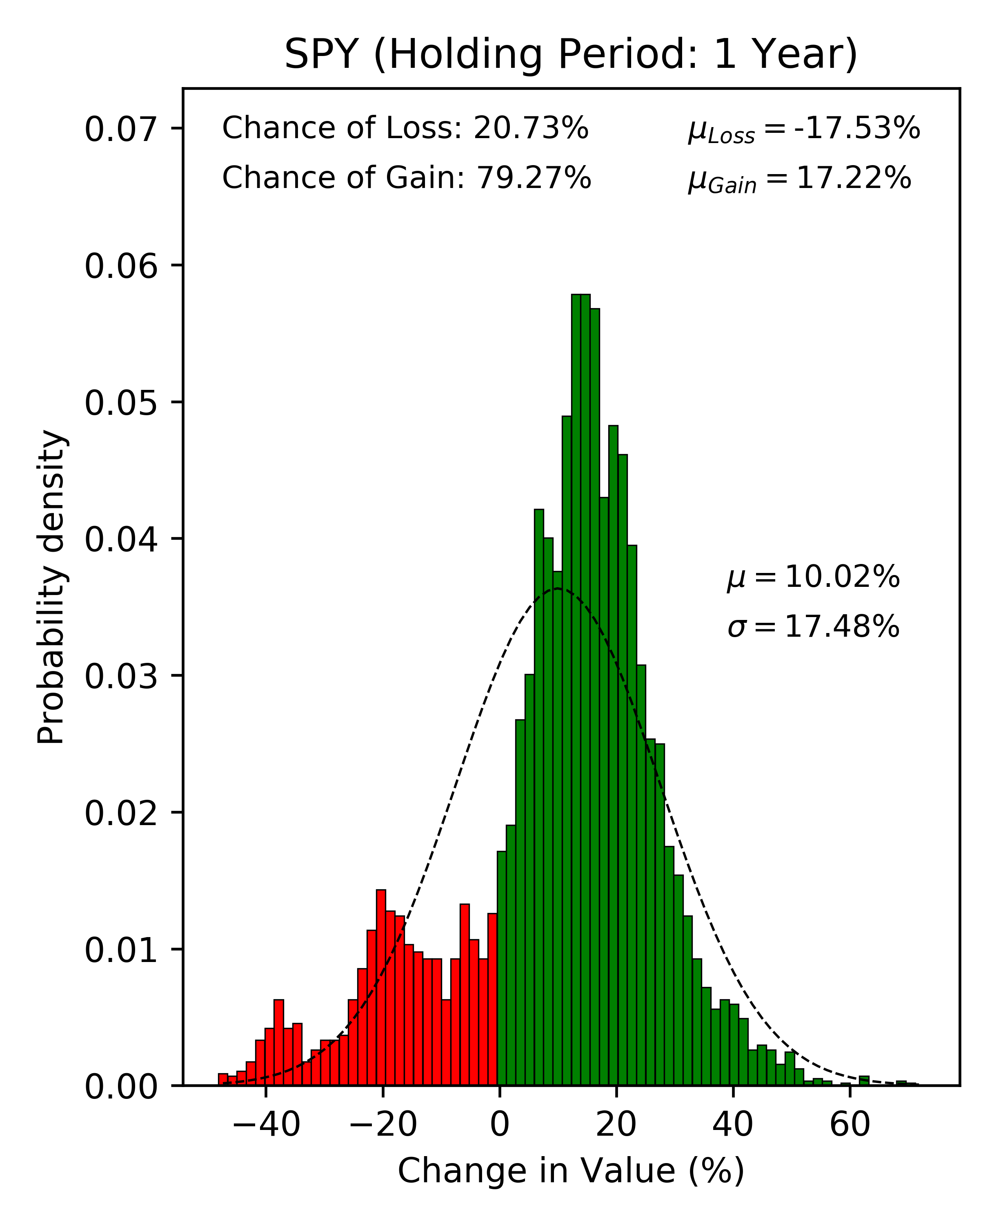
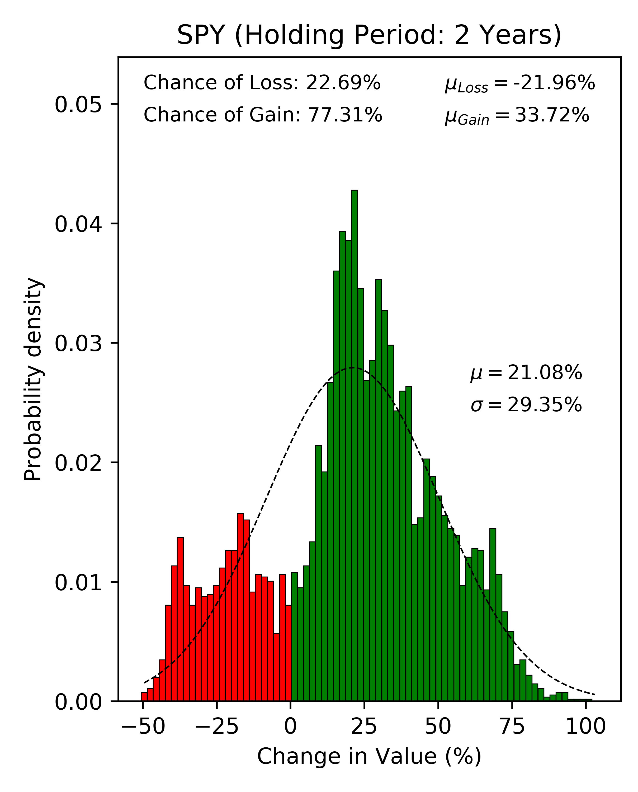
Buy and Hold: Does it Work?
An Application of Probability to the SPY ETF

Slide 23
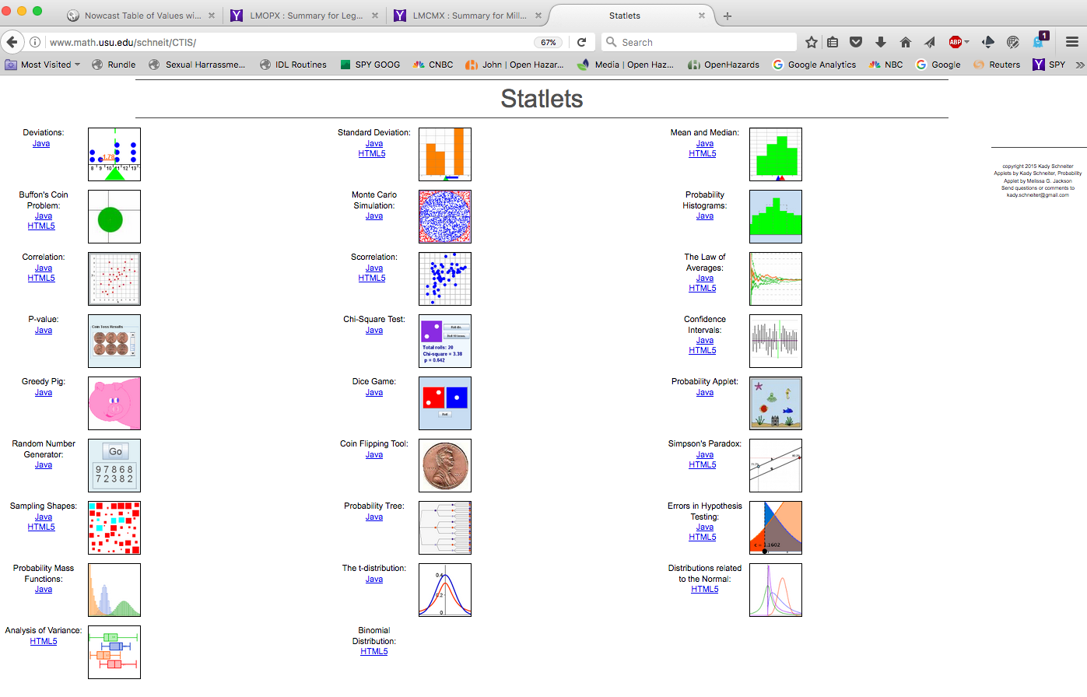
Statlets http://www.math.usu.edu/schneit/CTIS/

Slide 24
Probability: Continuous Distributions
In probability theory, a probability density function (PDF), or density of a continuous random variable
The PDF is typically defined on a sample space, the set of possible values taken by the random variable, of continuous variables, say x, so that we have:
PDF = p(x)
It is a function whose value at any given sample (or point) in the sample space can be interpreted as providing a relative likelihood that the value of the random variable would be close to that sample.
The absolute likelihood for a continuous random variable to take on any particular value is 0 (since there is an infinite set of possible values to begin with)

Slide 25
Probability Densities https://en.wikipedia.org/wiki/Probability_distribution
Basic terms
Mode: for a discrete random variable, the value with highest probability (the location at which the probability mass function has its peak); for a continuous random variable, the location at which the probability density function has its peak.
Tail: the complement of the head within the support; the large set of values where the pmf or pdf is relatively low.
Expected value or mean: the weighted average of the possible values, using their probabilities as their weights; or the continuous analog thereof.
Median: the value such that the set of values less than the median has a probability of one-half.
Variance: the second moment of the pmf or pdf about the mean; an important measure of the dispersion of the distribution.
Standard deviation: the square root of the variance, and hence another measure of dispersion.

Slide 26
Probability Densities https://en.wikipedia.org/wiki/Probability_distribution
Symmetry: a property of some distributions in which the portion of the distribution to the left of a specific value is a mirror image of the portion to its right.
Skewness: a measure of the extent to which a pmf or pdf "leans" to one side of its mean. (The third standardized moment , or moment with respect to the mean, of the distribution.)
Kurtosis: a measure of the "fatness" of the tails of a pmf or pdf.( The fourth standardized moment of the distribution.)

Slide 27
Probability Densities https://en.wikipedia.org/wiki/Probability_distribution
The following terms are used for non-cumulative probability distribution functions:
Probability mass, Probability mass function, PMF: for discrete random variables.
Probability density, Probability density function, PDF: most often reserved for continuous random variables.
A probability density function can be thought of as a histogram that has been normalized so that its total mass is 1.

Slide 28
Probability Density Function (“PDF”)
In a more precise sense, the PDF is used to specify the probability of the random variable falling within a particular range of values, as opposed to taking on any one value.
This probability is given by the integral of this variable's PDF over that range—that is, it is given by the area under the density function but above the horizontal axis and between the lowest and greatest values of the range.
The probability density function is nonnegative everywhere, and its integral over the entire space is equal to 1.

Slide 29
Markets: From Time Series to Probability Densities http://www.value-at-risk.net/leptokurtosis-conditional-heteroskedasticity/

Slide 30
Probability Moments
Mode: Value that occurs
most frequently
Median: Half the samples
are larger than the median,
half are smaller
Mean or Expected Value:
Average sample value

Slide 31
Mean and Standard Deviation https://www.evestment.com/resources/investment-statistics-guide/assessing-skewness-and-kurtosis-in-the-returns-distribution/

Slide 32
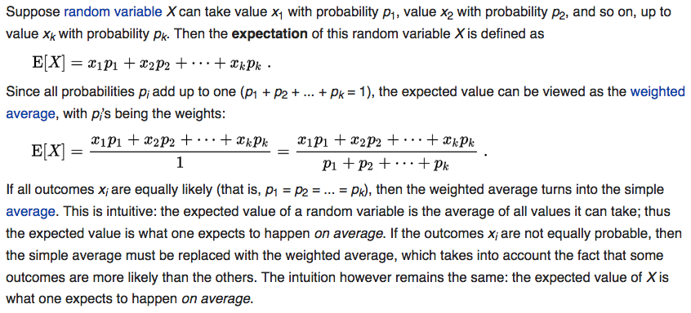
Expected Value (Sample Mean) https://en.wikipedia.org/wiki/Experiment_(probability_theory)

Slide 33
Expected Value (Sample Mean) https://en.wikipedia.org/wiki/Expected_value

Slide 34
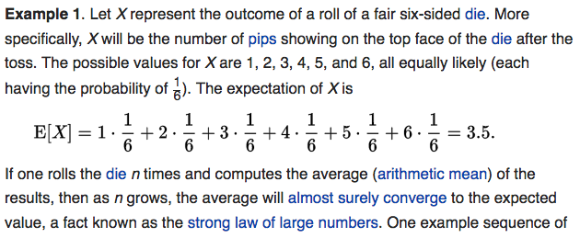
Expected Value (Sample Mean) https://en.wikipedia.org/wiki/Experiment_(probability_theory)

Slide 35
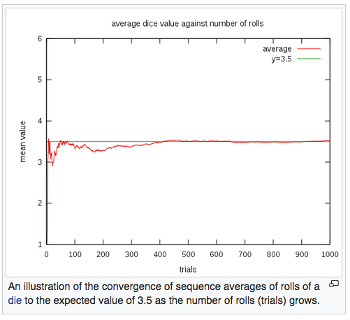
Expected Value (Sample Mean) https://en.wikipedia.org/wiki/Experiment_(probability_theory)
The rate of convergence can be
roughly quantified by
Chebyshev's inequality and the
Berry–Esseen theorem.

Slide 36
Expected Value (Discrete Random Variables) https://en.wikipedia.org/wiki/Experiment_(probability_theory)

Slide 37
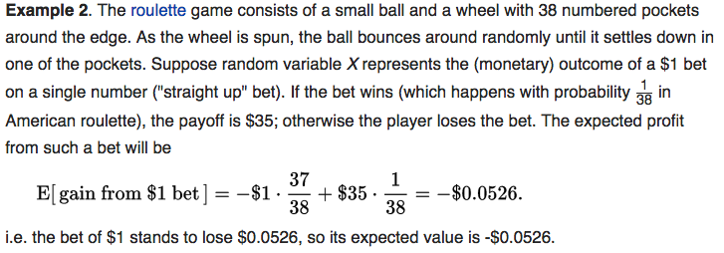
Expected Value (Sample Mean) https://en.wikipedia.org/wiki/Experiment_(probability_theory)
This is why the house always wins!
Bad bet !!

Slide 38
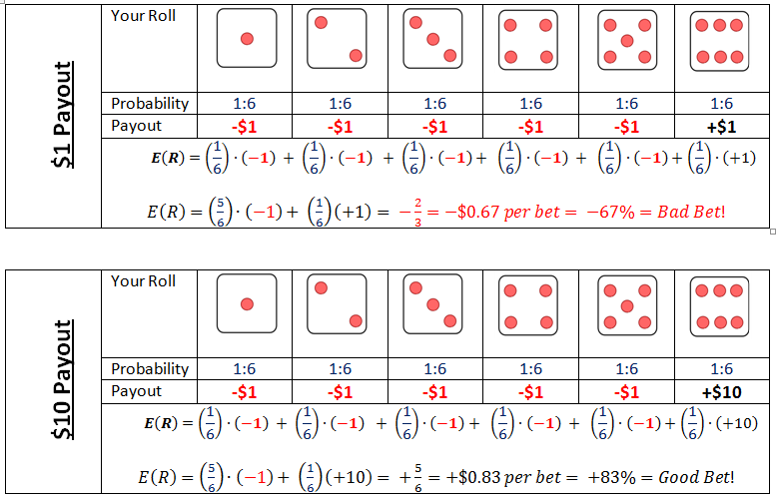
Expectation: Example https://www.boundless.com/finance/textbooks/boundless-finance-textbook/introduction-to-risk-and-return-8/understanding-return-76/expected-return-340-3795/

Slide 39
Ed Thorp: A Man for All Markets
Edward Oakley Thorp (born August 14, 1932) is an American mathematics professor, author, hedge fund manager, and blackjack researcher.
He pioneered the modern applications of probability theory, including the harnessing of very small correlations for reliable financial gain.
Thorp is the author of Beat the Dealer, which mathematically proved that the house advantage in blackjack could be overcome by card counting.
He also developed and applied effective hedge fund techniques in the financial markets, and collaborated with Claude Shannon in creating the first wearable computer.

Slide 40
Example: Probability of 100 Year Flood
Prob in 1 year = $1/N$
Prob of no flood in 1 year: $1−1/N$
Prob of no flood in N years = ${\left(1−\frac{1}{N}\right)}^{N}$
In limit $N→∞,\left(1−\frac{1}{N}\right)→e^{−1/N}$
So in limit $N→∞, {\left(1−\frac{1}{N}\right)}^{N}→e^{−1}$ = 0.37
So prob of flood in at least 1 of N years is 1 – (${\left(1−\frac{1}{N}\right)}^{N}$) => 0.63 or 63%
Note: $e^{−x} ≈1 −x$as $x →0$

Slide 41
Example: Monty Hall Game Show Problem https://en.wikipedia.org/wiki/Monty_Hall_problem
The Monty Hall problem is a brain teaser, in the form of a probability puzzle, loosely based on the American television game show Let's Make a Deal and named after its original host, Monty Hall.
The problem was originally posed (and solved) in a letter by Steve Selvin to the American Statistician in 1975.
It became famous as a question from reader Craig F. Whitaker's letter quoted in Marilyn vos Savant's "Ask Marilyn" column in Parade magazine in 1990:
Suppose you're on a game show, and you're given the choice of three doors: Behind one door is a car; behind the others, goats. You pick a door, say No. 1, and the host, who knows what's behind the doors, opens another door, say No. 3, which has a goat. He then says to you, "Do you want to pick door No. 2?" Is it to your advantage to switch your choice?
Vos Savant's response was that the contestant should switch to the other door.
Under the standard assumptions, the switching strategy has a 2/3 probability of winning the car, while the strategy that remains with the initial choice has only a 1/3 probability.

Slide 42
Example: Monty Hall Game Show Problem https://en.wikipedia.org/wiki/Monty_Hall_problem

Slide 43
Example: Monty Hall Game Show Problem https://en.wikipedia.org/wiki/Monty_Hall_problem
The Answer to the standard configuration:
Always switch!

