Slide 1
Major Credits
Lecture 9
Introduction to Time Series
https://en.wikipedia.org/wiki/Time_series
B.D. Malamud, King’s College, London
Topics:
Self-Affine Time Series and Hurst Exponent
Fourier Decomposition

Slide 2
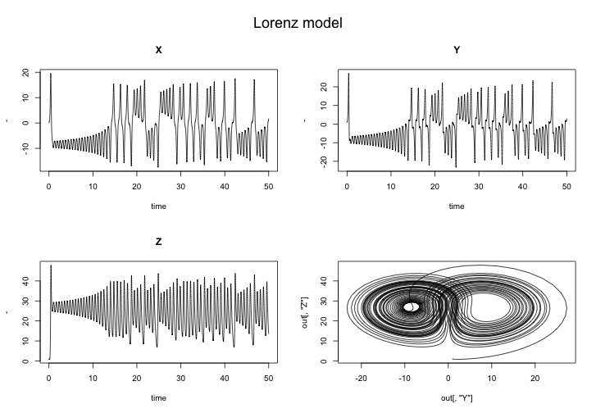
Time Series of the Lorenz Attractor https://www.sixhat.net/lorenz-attractor-in-r.html

Slide 3
Time Series https://en.wikipedia.org/wiki/Time_series
In mathematics, a time series is a series of data points indexed (or listed or graphed) in time order.
Most commonly, a time series is a sequence taken at successive equally spaced points in time.
Thus, it is a sequence of discrete-time data.
Examples of time series are heights of ocean tides, counts of sunspots, and the daily closing value of the Dow Jones Industrial Average.
A Time series is very frequently plotted via a run chart (which is a temporal line chart).
Time series are used in statistics, signal processing, pattern recognition, econometrics, mathematical finance, weather forecasting, earthquake prediction, electroencephalography, control engineering, astronomy, communications engineering, and largely in any domain of applied science and engineering which involves temporal measurements.

Slide 4
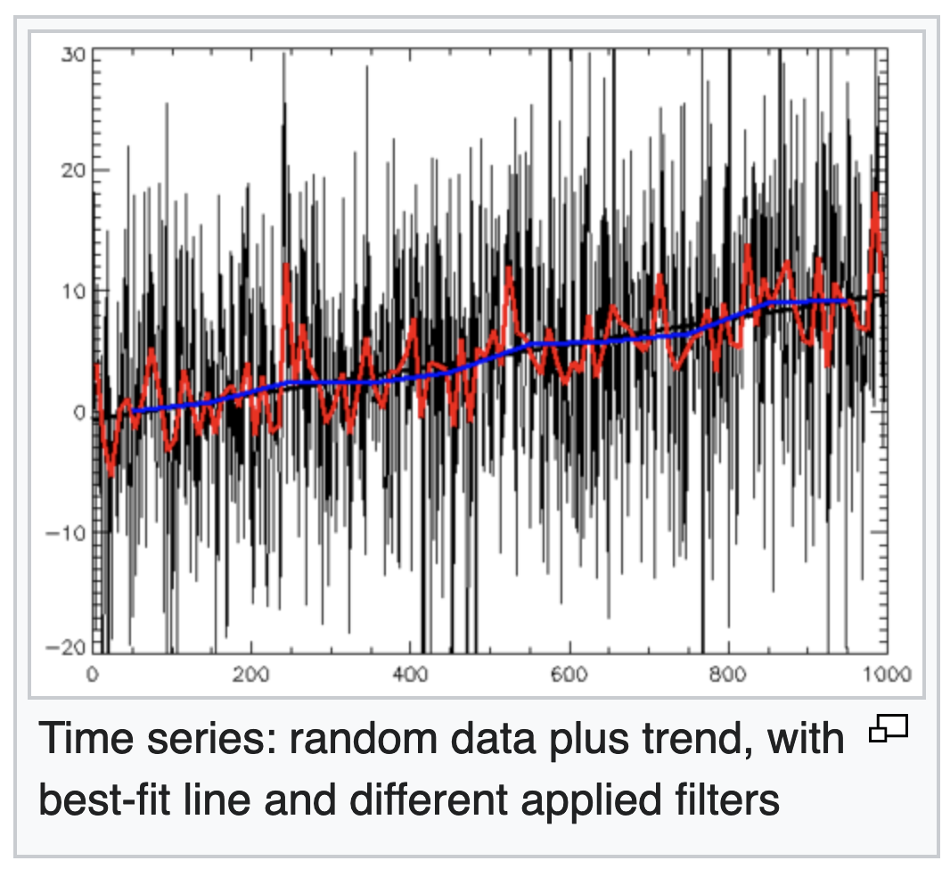
Time Series https://en.wikipedia.org/wiki/Time_series
Time series analysis comprises methods for analyzing time series data in order to extract meaningful statistics and other characteristics of the data.
Time series forecasting is the use of a model to predict future values based on previously observed values.
While regression analysis is often employed in such a way as to test relationships between one or more different time series, this type of analysis is not usually called "time series analysis", which refers in particular to relationships between different points in time within a single series.
Interrupted time series analysis is used to detect changes in the evolution of a time series from before to after some intervention which may affect the underlying variable.

Slide 5
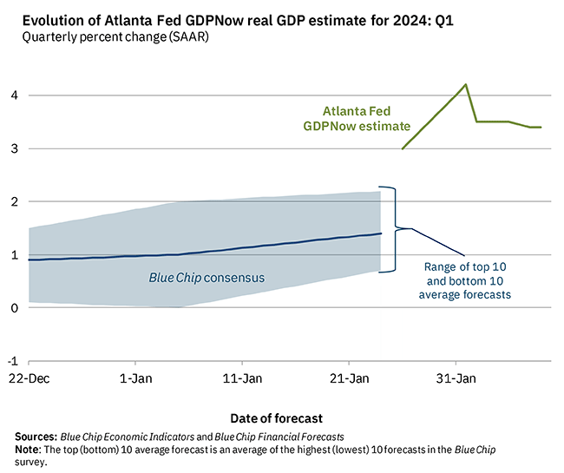
Examples
This is what the Federal Reserve does to track the GDP of the US in real time using proxy variables

Slide 6
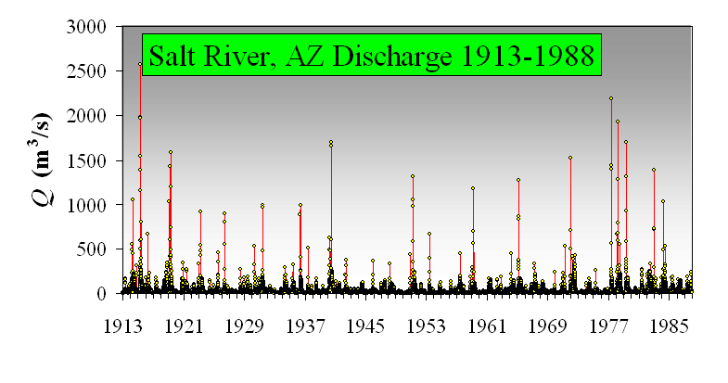
Examples

Slide 7
Examples https://www.aptech.com/blog/introduction-to-the-fundamentals-of-time-series-data-and-analysis/

Slide 8
Examples https://www.aptech.com/blog/introduction-to-the-fundamentals-of-time-series-data-and-analysis/
Trend: “Walk”
“Noise”

Slide 9
Time Series https://en.wikipedia.org/wiki/Time_series
Time series data have a natural temporal ordering.
This makes time series analysis distinct from cross-sectional studies, in which there is no natural ordering of the observations (e.g., explaining people's wages by reference to their respective education levels, where the individuals' data could be entered in any order).
Time series analysis is also distinct from spatial data analysis where the observations typically relate to geographical locations (e.g., accounting for house prices by the location as well as the intrinsic characteristics of the houses).
A stochastic (statistical) model for a time series will generally reflect the fact that observations close together in time will be more closely related than observations further apart. (Correlation)
In addition, time series models will often make use of the natural one-way ordering of time so that values for a given period will be expressed as deriving in some way from past values, rather than from future values (see time reversibility).

Slide 10
Time Series https://en.wikipedia.org/wiki/Time_series
Time series are used in statistics, signal processing, pattern recognition, econometrics, mathematical finance, weather forecasting, intelligent transport and trajectory forecasting, earthquake prediction, electroencephalography, control engineering, astronomy, communications engineering, and largely in any domain of applied science and engineering which involves temporal measurements.
Time series analysis comprises methods for analyzing time series data in order to extract meaningful statistics and other characteristics of the data.
Time series forecasting is the use of a model to predict future values based on previously observed values.
“Time series analysis” focuses on comparing values of a single time series or multiple dependent time series at different points in time.

Slide 11
Time Series https://en.wikipedia.org/wiki/Time_series
Methods for time series analysis may be divided into two classes: frequency-domain methods and time-domain methods.
The former include spectral analysis and wavelet analysis
The latter include auto-correlation and cross-correlation analysis.
Time series analysis techniques may be divided into parametric (model variables) and non-parametric methods.
The parametric approaches assume that the underlying stationary stochastic (statistical) process has a certain structure which can be described using a small number of model parameters (for example, using an autoregressive or moving average model).
In these approaches, the task is to estimate the parameters of the model that describes the stochastic process.
Note:
Models can be stochastic
Data can be random

Slide 12
Persistence and Anti-persistence
Persistence (“Joseph Effect”): Correlations between adjacent values, clustering of values (big follow big, small follow small).
  Short-range persistence: Values in the series affect only those close by.
  Long-range persistence: Values in the series affect those far away in time (space).
  Also called long memory, long-range correlations, etc.
  By definition, a self-affine fractal is one that exhibits long-range persistence.
Anti-Persistence (“Noah Effect”): Anti-Correlations between adjacent values, anti-clustering of values (small follows big, big follows small).

Slide 13
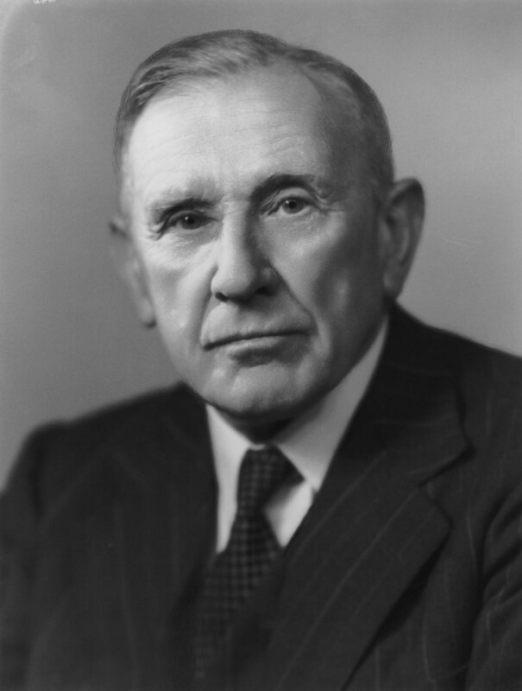
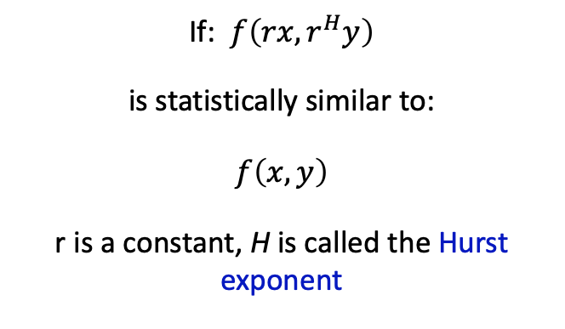
Self Affine Fractal
If: $f\left(rx,r^{H}y\right)$
is statistically similar to:
$$f\left(x, y\right)$$
r is a constant, H is called the Hurst exponent
i.e., same statistical moments and properties
Harold Edwin Hurst (1 January 1880 – 7 December 1978) was a British hydrologist from Leicester.
Hurst's (1951) study on measuring the long-term storage capacity of reservoirs documented the presence of long-range dependence in hydrology, especially concerning the fluctuations of the water level in the Nile River.
In doing so, he developed the empirical rescaled range methodology for measuring long-range dependence.
Much of Hurst's research was motivated by his empirical observations of the Nile.
The Hurst exponent, which has been used in other fields, such as finance and cardiology, was named after him.

Slide 14
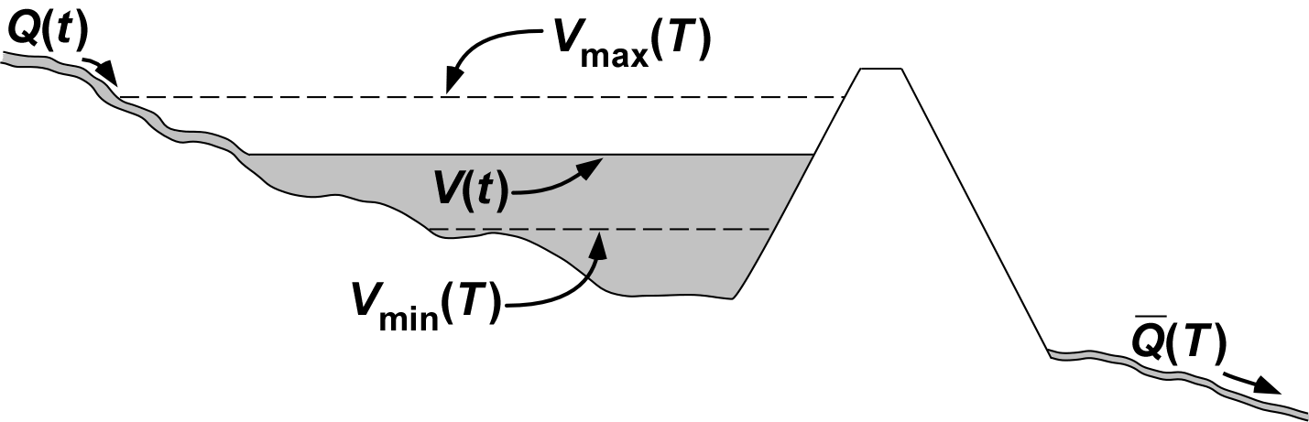
Hurst Rescaled-Range (R/S) Analysis
Q(t) = Flow of water.
V(t) = Volume of water in reservoir at a given time t.
V(T) = Max and Min volume of water during a period T.
Notes:
PUT EQUATION of how done, ? Information on Hurst, Nile. ? Put relationship to hurst exponent.

Slide 15
Self-Affine Fractal
Recall: D = fractal dimension.
‘Smooth’ time series approach a straight line [D ≈ 1].
[Low frequencies dominate over high ones.]
Very ‘rough’ time series becomes area filling [D ≈ 2].
[Large high-frequency component.]
Time series are constrained: 1 ≤ D ≤ 2.
Notes:
Need to add in relationship of Ha and D.

Slide 16
Self-Affine Fractal
There are many ways to measure the strength of self-affinity of a fractal (e.g., D), including:
  Autocorrelation
  Semivariogram Analysis
  Hurst Rescaled-Range (R/S) Analysis
  Fourier Power-Spectral Analysis
  Wavelet Spectral Analysis
  Detrended Fluctuation Analysis (DFA)
  Inter-event occurrence times.
Many others including lots of derivations of the above.
Most of these techniques examine the strength of the fluctuations of the data series as function of frequency (or wavelength).
If the fluctuations are scale-invariant, it is a self-affine fractal.
Notes:
Need to add in relationship of Ha and D.

Slide 17
Self Affine Time Series
Scale invariance in Time Series
Pattern approximately repeats itself at different scales.
We can judge the similarity by methods to be discussed below.
One of these methods is that the short interval has the same statistics and scaling as the longer interval

Slide 18
Self Affine Time Series
But we need to be careful, as x and y axes scale differently, as in the Hurst example.

Slide 19
Self Affine Time Series
But we need to be careful, as x and y axes scale differently.

Slide 20
Self Affine Time Series
We call this a
Self-Affine Time Series
Notes:
20

Slide 21
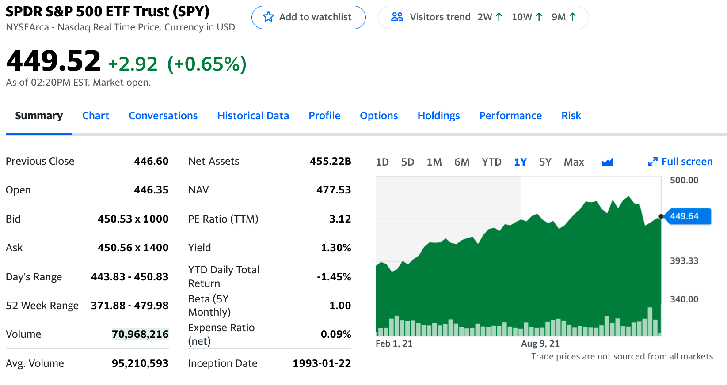
Example: Stock Charts

Slide 22
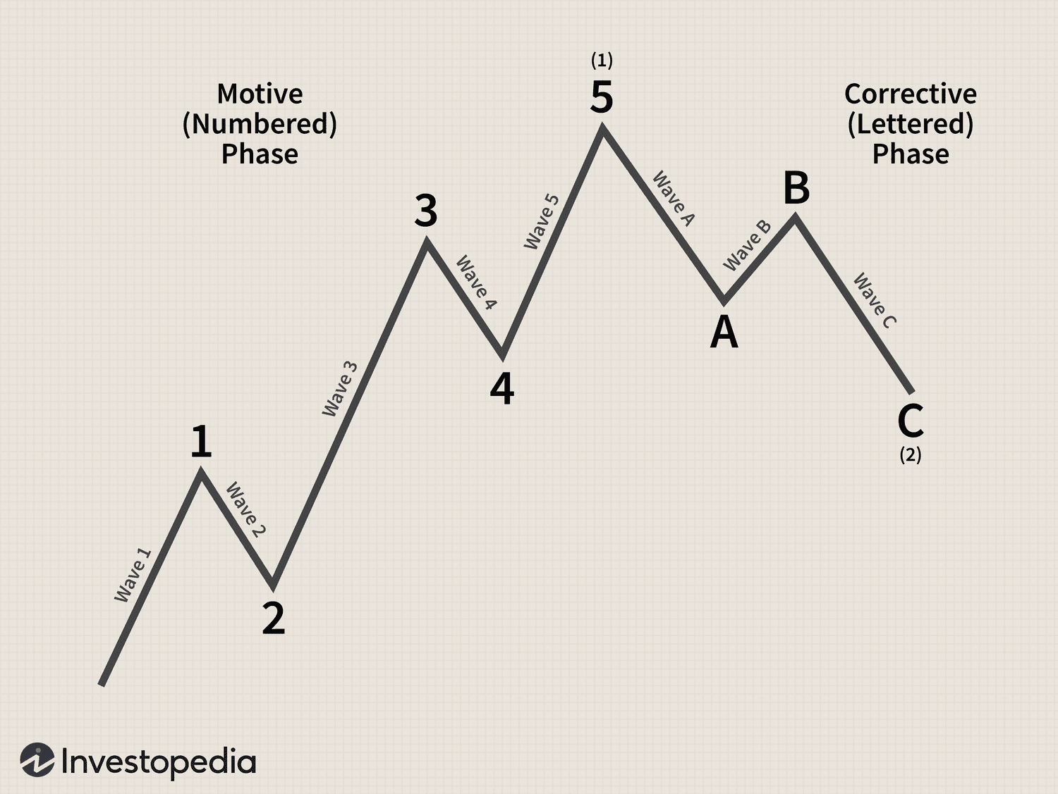
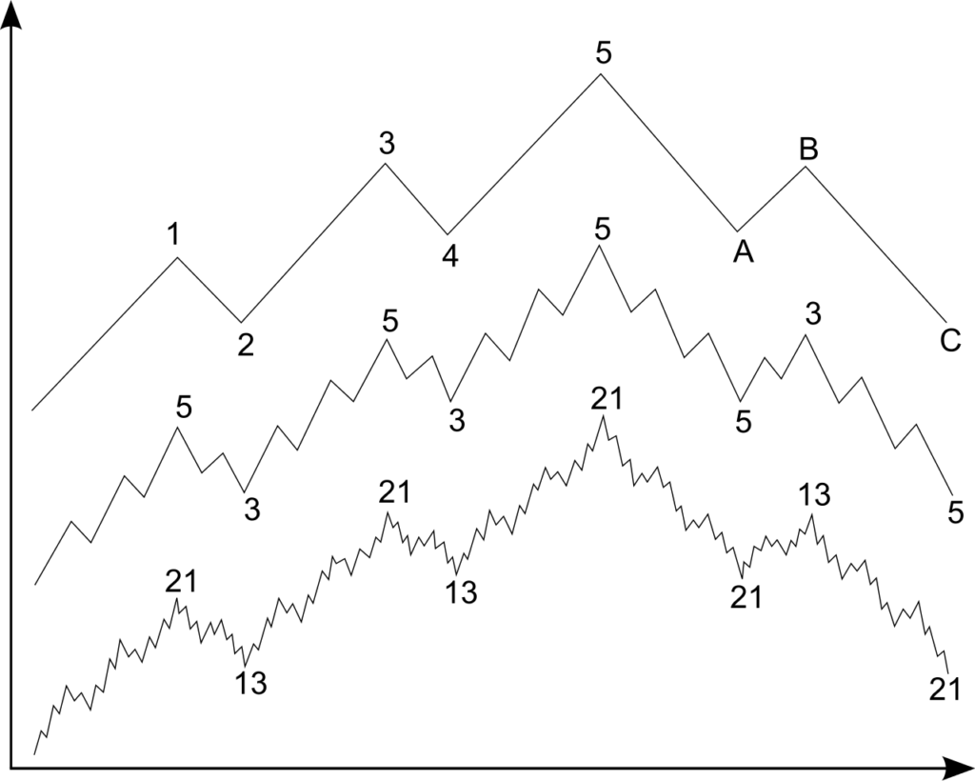
Elliott Waves in Financial Markets
https://www.investopedia.com/articles/technical/111401.asp
https://corporatefinanceinstitute.com/resources/career-map/sell-side/capital-markets/elliott-wave-theory/

Slide 23
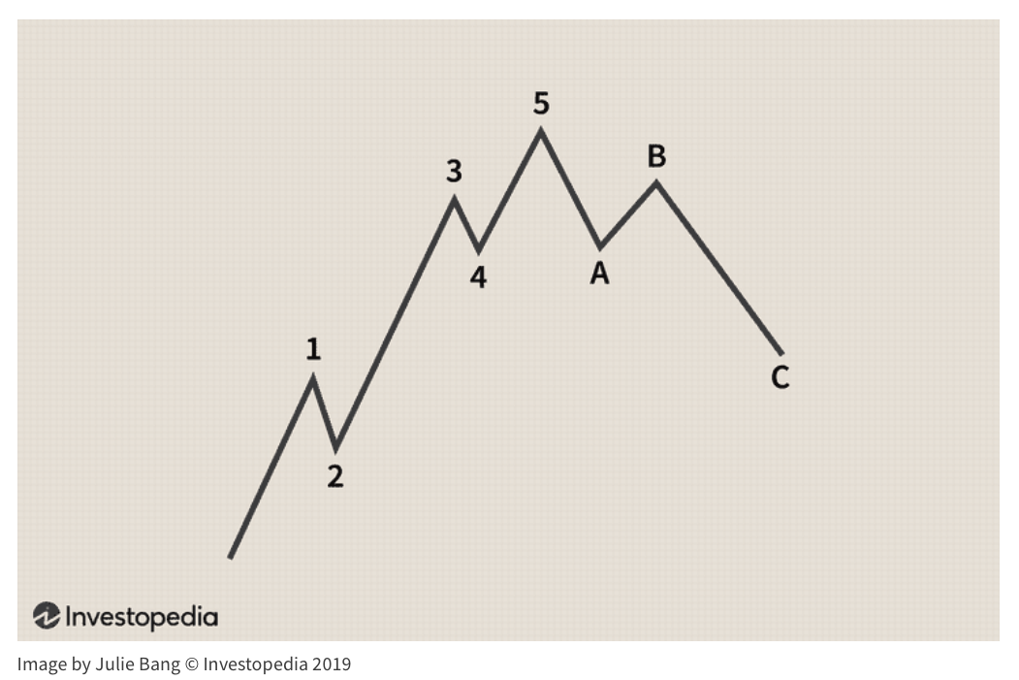
Elliott Waves https://www.investopedia.com/articles/technical/111401.asp
The Elliott Wave Theory is a form of technical analysis that looks for recurrent long-term price patterns related to persistent changes in investor sentiment and psychology.
The theory identifies impulse waves that set up a pattern and corrective waves that oppose the larger trend.
Each set of waves is nested within a larger set of waves that adhere to the same impulse or corrective pattern, which is described as a fractal approach to investing.
He found that swings in mass psychology always showed up in the same recurring fractal patterns, or "waves," in financial markets.

Slide 24
Elliott Waves https://www.investopedia.com/articles/technical/111401.asp
Five waves move in the direction of the main trend, followed by three waves in a correction (totaling a 5-3 move). This 5-3 move then becomes two subdivisions of the next higher wave move.
The underlying 5-3 pattern remains constant, though the time span of each wave may vary.
Look at the chart made up of eight waves (five net up and three net down) labeled 1, 2, 3, 4, 5, A, B, and C.
Waves 1, 2, 3, 4 and 5 form an impulse, and waves A, B and C form a correction. The five-wave impulse, in turn, forms wave 1 at the next-largest degree, and the three-wave correction forms wave 2 at the next-largest degree.
The corrective wave normally has three distinct price movements – two in the direction of the main correction (A and C) and one against it (B).
Waves 2 and 4 in the above picture are corrections.

Slide 25

Stock Traders Use Elliott Waves http://elliottwavetrader.net

Slide 26
Other Types of Time Series:
Topographic Profiles
Topographic profile across small gulley

Slide 27
Fourier Series and Fourier Transform
The Fourier transform (FT) decomposes a function of time (a signal) into its constituent frequencies.
This is similar to the way a musical chord can be expressed in terms of the volumes and frequencies of its constituent notes.
The term Fourier transform refers to both the frequency domain representation and the mathematical operation that associates the frequency domain representation to a function of time.
The Fourier transform is not limited to functions of time, but the domain of the original function is commonly referred to as the time domain.
There is also an inverse Fourier transform that mathematically synthesizes the original function from its frequency domain representation.
Notes:
PUT IN RELATIONSHIP BETWEEN fractal dimension and beta.

Slide 28
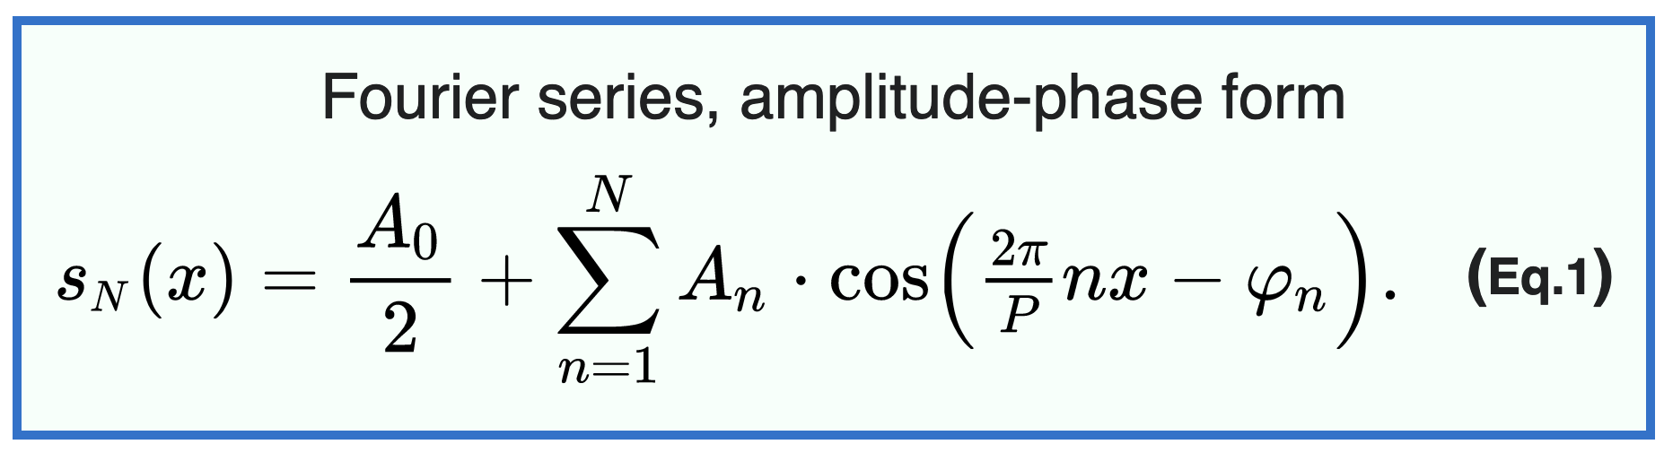
Fourier Analysis https://en.wikipedia.org/wiki/Fourier_series
In mathematics, a Fourier series is a periodic function composed of harmonically related sinusoids combined by a weighted summation.
With appropriate weights, one cycle (or period) of the summation can be made to approximate an arbitrary function in that interval (or the entire function if it too is periodic).
As such, the summation is a synthesis of another function.
The discrete-time Fourier transform is an example of Fourier series.
The process of deriving weights that describe a given function is a form of Fourier analysis.
The first four partial sums of the Fourier series for a square wave

Slide 29
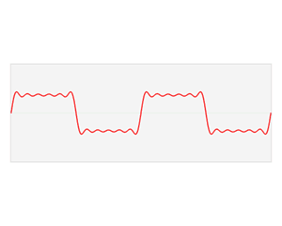
Fourier Analysis
One motivation for the Fourier transform comes from the study of Fourier series.
In the study of Fourier series, complicated but periodic functions are written as the sum of simple waves mathematically represented by sines and cosines.
The Fourier transform is an extension of the Fourier series that results when the period of the represented function is lengthened and allowed to approach infinity

Slide 30
Fourier Analysis
In the first frames of the animation, a function f is resolved into Fourier series: a linear combination of sines and cosines (in blue).
The component frequencies of these sines and cosines spread across the frequency spectrum, are represented as peaks in the frequency domain (actually Dirac delta functions, shown in the last frames of the animation).
The frequency domain representation of the function, f̂, is the collection of these peaks at the frequencies that appear in this resolution of the function.
The energy in the time series at any frequency (or “harmonic”) is the square of the amplitude of that harmonic in the series
This energy is called the Power Spectrum S(f)

Slide 31
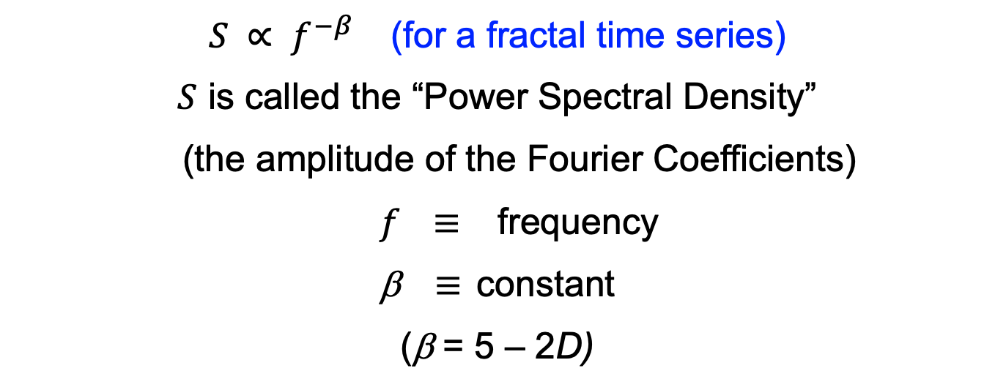
Fourier Power Spectral Analysis
$S ∝ f^{−β}$ (for a fractal time series)
$S$ is called the “Power Spectral Density”
(the amplitude of the Fourier Coefficients)
$f$ $≡$ frequency
β $≡$ constant
(β = 5 – 2D)
β = 0 White noise. [Uncorrelated]
β = 1 Pink (1/f ) noise. [Medium strength long-range persistence.]
β = 2 Brownian motion. [Strong long-range persistence, e.g. topography.]
Notes:
PUT IN RELATIONSHIP BETWEEN fractal dimension and beta.

Slide 32
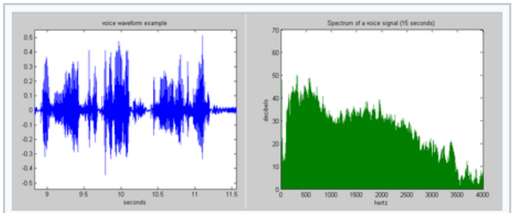
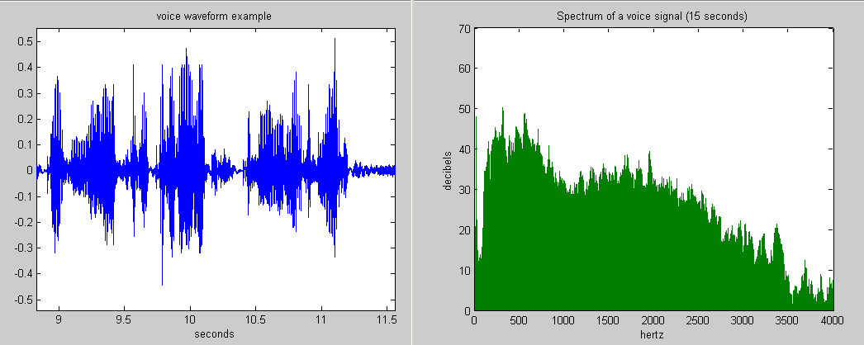
Example: Power Spectrum
The voice wave form (time series) on the left has a broad power spectrum (right), typically measured in “decibels”, which is the Log₁₀ of the amplitude
The unit “hertz” is the frequency in cycles/second
Notes:
PUT IN RELATIONSHIP BETWEEN fractal dimension and beta.

Slide 33
Data Series
Power-Spectral Analysis
S ~ f ⁰
(β = 0)
“Noise”: Has no trend
S ~ f ^{–2}
(β = 2)
This is Brownian Motion (random walk)
“Walk”: Has a trend
Notes:
If this were a periodic signal, would see only one frequency. Is a scaling relationship in the frequency domain.

Slide 34
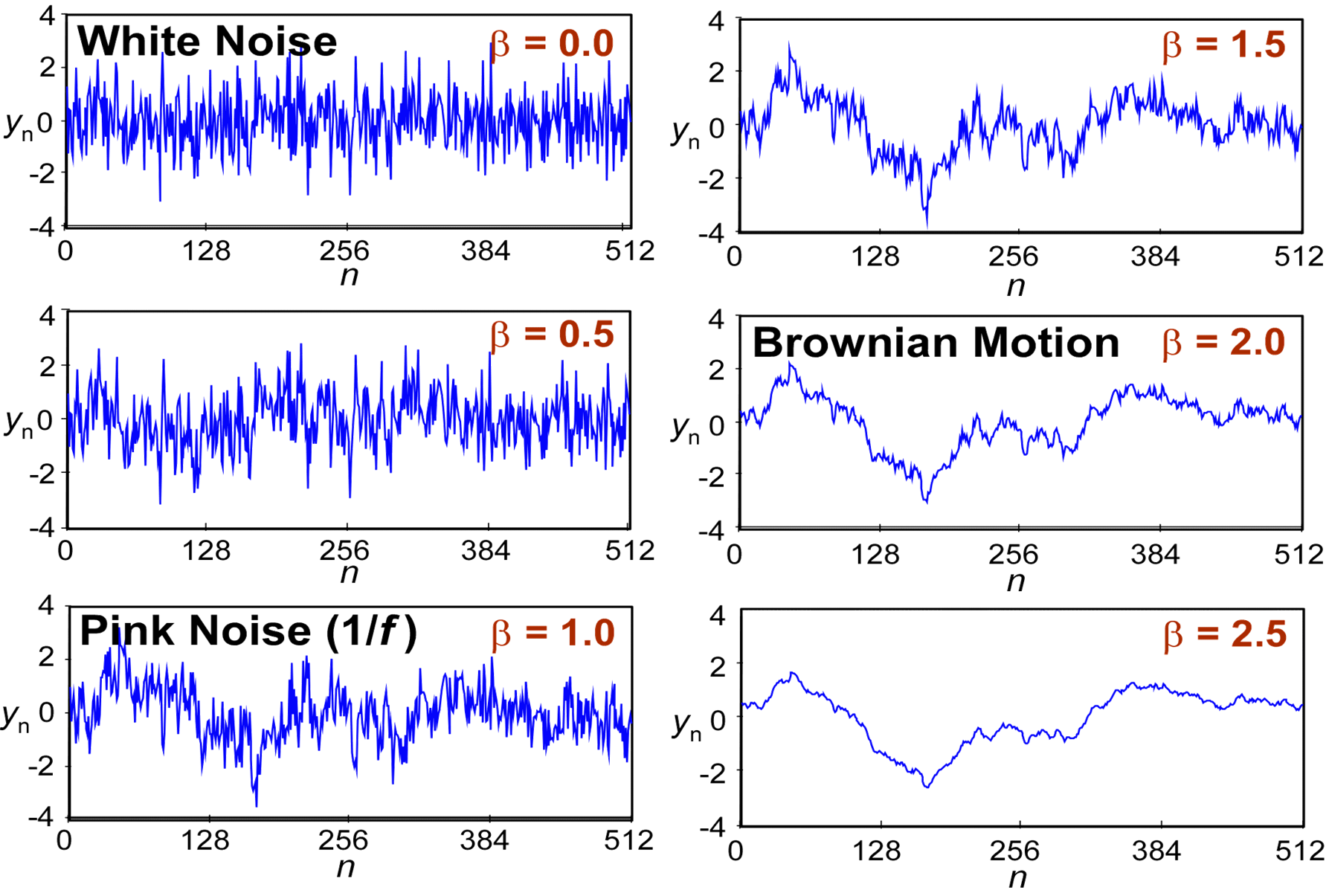
S ~ f ^{–β} (S = power spectral density; f = frequency; β = constant) [D = (5–β)/2]
Fractional Gaussian Noises created by Fourier Filtering
Notes:
Can use to create self-affine series of data.

Slide 35
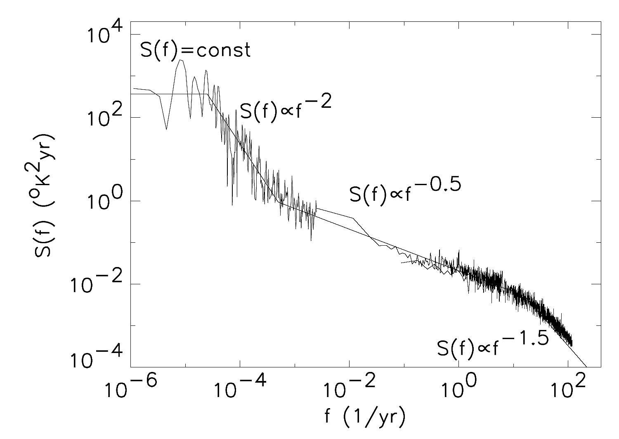
Breaks in Scaling Behavior May Indicate a Change in Dynamics
Sometimes ‘breaks’ are more interesting than the same self-affine behavior.
Might indicate a change in underlying processes/physics.
Power-spectral density of local atmospheric temperature from instrumental data and inferred from ice cores, time scales of 200 ky to 2 dy. [Pelletier and Turcotte, 1999]

Slide 36
Properties of Time Series: Mean Reversion https://en.wikipedia.org/wiki/Mean_reversion_(finance)
In finance, mean reversion is the assumption that a stock's price will tend to move to the average price over time.
Using mean reversion in stock price analysis involves both identifying the trading range for a stock and computing the average price using analytical techniques taking into account considerations such as earnings, etc.
When the current market price is less than the average price, the stock is considered attractive for purchase, with the expectation that the price will rise (“value investing” or “oversold condition”).
When the current market price is above the average price, the market price is expected to fall (“momentum investing” or “overbought condition”)
In other words, deviations from the average price are expected to revert to the average.
Stock reporting services commonly offer moving averages for periods such as 50 and 200 days.
While reporting services provide the averages, identifying the high and low prices for the study period is still necessary.

Slide 37
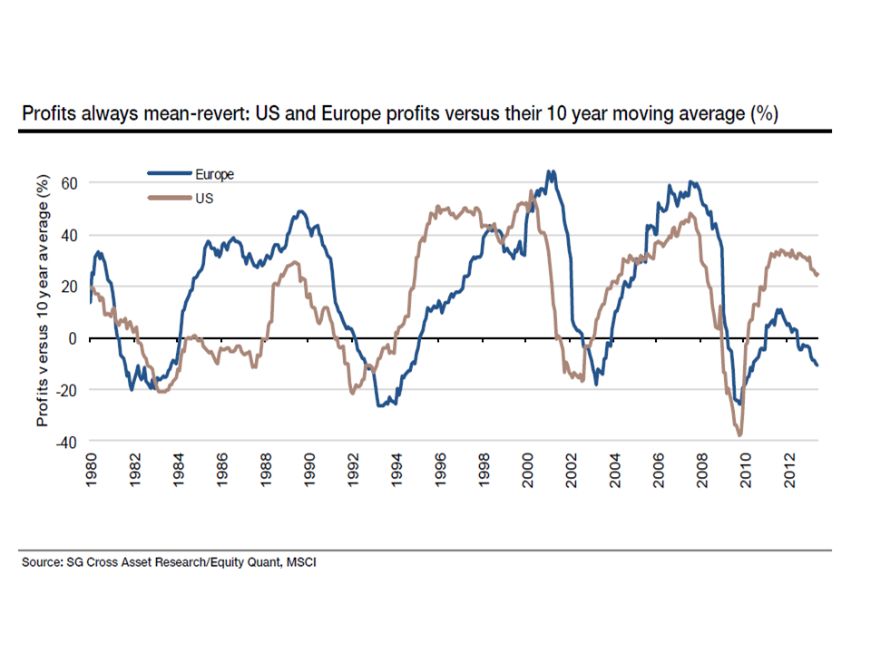
Mean Reversion https://deconstructingrisk.com/tag/mean-reversion-in-earnings/
Mean approximately here
Start Here 2/22/2021

Slide 38
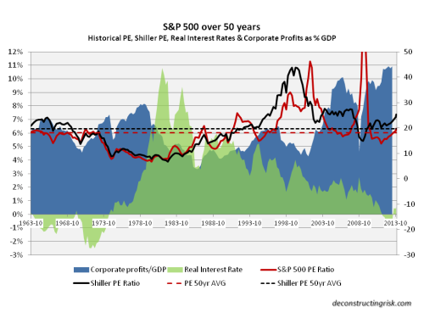
Mean Reversion https://deconstructingrisk.com/tag/mean-reversion-in-earnings/

Slide 39
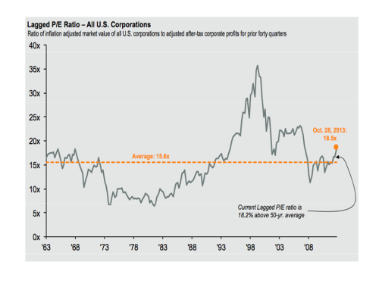
Mean Reversion https://deconstructingrisk.com/tag/mean-reversion-in-earnings/

Slide 40
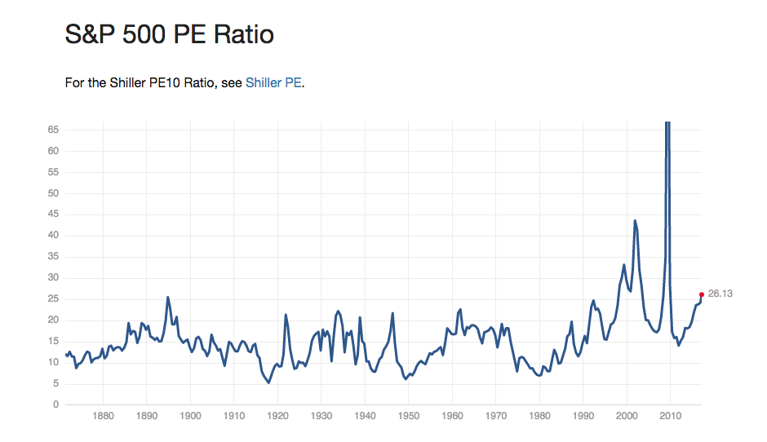
Mean Reversion http://www.multpl.com/
Mean about here

Slide 41
Mean Reversion https://www.aptech.com/blog/introduction-to-the-fundamentals-of-time-series-data-and-analysis/
(Not mean reverting)

Slide 42
Other Properties https://www.aptech.com/blog/introduction-to-the-fundamentals-of-time-series-data-and-analysis/

Slide 43
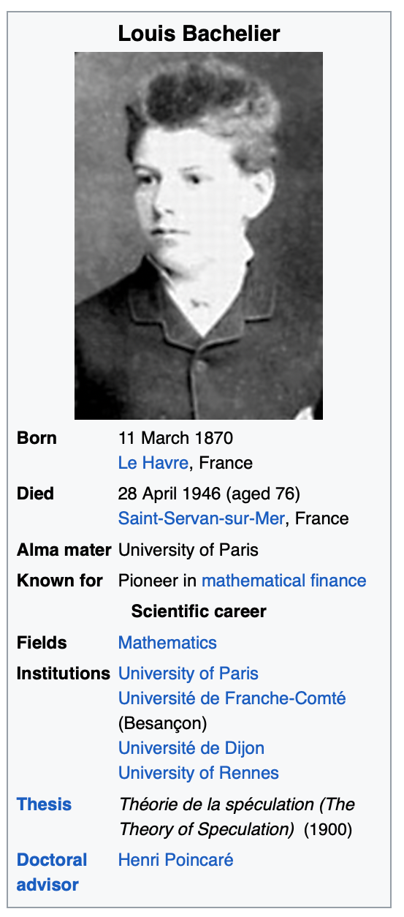
Modeling Time Series: Louis Bachelier https://en.wikipedia.org/wiki/Louis_Bachelier
Louis Jean-Baptiste Alphonse Bachelier 11 March 1870 – 28 April 1946)was a French mathematician at the turn of the 20th century.
He is credited with being the first person to model the stochastic process now called Brownian motion, as part of his doctoral thesis The Theory of Speculation (Théorie de la spéculation, defended in 1900).
Bachelier's doctoral thesis, which introduced the first mathematical model of Brownian motion and its use for valuing stock options, was the first paper to use advanced mathematics in the study of finance.
His Bachelier model has been influential in the development of other widely used models, including the Black-Scholes model, developed by Myron Scholes and Fischer Black, for which they won the Nobel Prize in Economics.
Bachelier is considered as the father of mathematical finance and a pioneer in the study of stochastic processes.

Slide 44
Modeling Time Series https://en.wikipedia.org/wiki/Time_series
Models
Models for time series data can have many forms and represent different stochastic processes.
When modeling variations in the level of a process, broad classes of practical importance are the autoregressive (AR) models, the integrated (I) models, and the moving average (MA) models
These classes depend linearly on previous data points.
Combinations of these ideas produce autoregressive moving average (ARMA) and autoregressive integrated moving average (ARIMA) models.
More recent methods include Random Forest (RF) and Long Short Term Memory - Recurrent Neural Network (LSTM RNN), which do not depend linearly on previous data
Non-linear dependence of the value of a series of previous data points is of interest, partly because of the possibility of producing a chaotic time series.

Slide 45
Modeling Time Series https://en.wikipedia.org/wiki/Time_series
Among other types of non-linear time series models, there are models to represent the changes of variance over time (heteroskedasticity).
These represent Autoregressive Conditional Heteroskedasticity (ARCH) models
Here changes in variability are related to, or predicted by, recent past values of the observed series.
In financial markets, this is associated with use of the VIX (“Fear”) index
This is in contrast to other possible representations of locally varying variability, where the variability might be modelled as being driven by a separate time-varying process, as in a doubly stochastic model.
In recent work on model-free analyses, wavelet transform based methods (for example locally stationary wavelets and wavelet decomposed neural networks) have gained favor.

Slide 46
Time Series Prediction https://en.wikipedia.org/wiki/Time_series
In statistics, prediction is a part of statistical inference.
One particular approach to such inference is known as predictive inference, but the prediction can be undertaken within any of the several approaches to statistical inference.
Indeed, one description of statistics is that it provides a means of transferring knowledge about a sample of a population to the whole population, and to other related populations, which is not necessarily the same as prediction over time.
An example of this is out-of-sample prediction and/or testing
When information is transferred across time, often to specific points in time, the process is known as forecasting.
When information describes only the current state, it is called nowcasting.

Slide 47
Time Series Prediction https://en.wikipedia.org/wiki/Time_series
Stochastic simulation is used to generate alternative versions of the time series, representing what might happen over non-specific time-periods in the future
Conditional prediction is also based on statistical models to describe the likely outcome of the time series in the immediate future, given knowledge of the most recent outcomes (forecasting).
An example of this type of conditional prediction is often based on Bayes theorem
Forecasting on time series is usually done using automated statistical software packages and programming languages, such as R, S, SAS, SPSS, Minitab, pandas (Python) and many others.

Slide 48
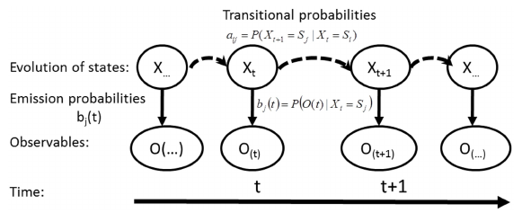
Example: Hidden Markov Model https://www.researchgate.net/figure/Structure-and-temporal-evolution-process-of-a-hidden-Markov-model-system_fig3_278639262
HMMs have internal states and transition probabilities that are not observable, yet produce observable dynamics
A Hidden Markov Model (HMM) is a statistical model in which the system being modeled is assumed to be a Markov process with unobserved (hidden) states.
HMM models are widely used in speech recognition, for translating a time series of spoken words into text.

Slide 49
Random Forest Classifier for Time Series Prediction
(e.g., https://medium.com/capital-one-tech/random-forest-algorithm-for-machine-learning-c4b2c8cc9feb)
A Random Forest model is a powerful and versatile machine learning algorithm used for both classification and regression tasks.
It operates by constructing a large number of individual decision trees during training and outputting the class that is the mode of the classes (classification) or the mean prediction (regression) of the individual trees.
Ensemble Learning: It is an ensemble method that combines the predictions from multiple simple models (decision trees) to produce a more accurate and stable result than a single tree could
Reduced Overfitting: A single decision tree is often prone to overfitting the training data. The "randomness" in a random forest helps to mitigate this issue, making the overall model more robust
High Accuracy: It generally provides high accuracy compared to many single-model algorithms and works well on both linear and non-linear data
Handles High-Dimensional Data: It can efficiently manage datasets with a large number of features without requiring extensive feature selection or dimensionality reduction

Slide 50
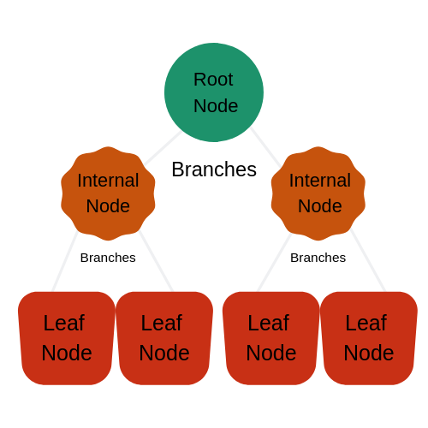
Random Forest Classifier for Time Series Prediction
(e.g., https://medium.com/capital-one-tech/random-forest-algorithm-for-machine-learning-c4b2c8cc9feb)
We all have to use this decision making process multiple times, every single day.
In the machine learning world this process is called a decision tree.
You start with a node which then branches to another node, repeating this process until you reach a leaf.
A node asks a question in order to help classify the data.
A branch represents the different possibilities that this node could lead to.
A leaf is the end of a decision tree, or a node that no longer has any branches.

Slide 51
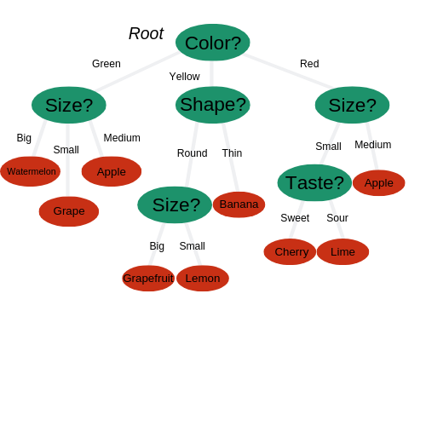
Random Forest Classifier for Time Series Prediction
(e.g., https://medium.com/capital-one-tech/random-forest-algorithm-for-machine-learning-c4b2c8cc9feb)
The Random Forest Algorithm is composed of different decision trees, each with the same nodes, but using different data that leads to different leaves.
It merges the decisions of multiple decision trees in order to find an answer, which represents the average of all these decision trees. The random forest algorithm is a supervised learning model
It uses labeled data to “learn” how to classify unlabeled data.
The Random Forest Algorithm is used to solve both regression and classification problems, making it a diverse model that is widely used by engineers.

Slide 52
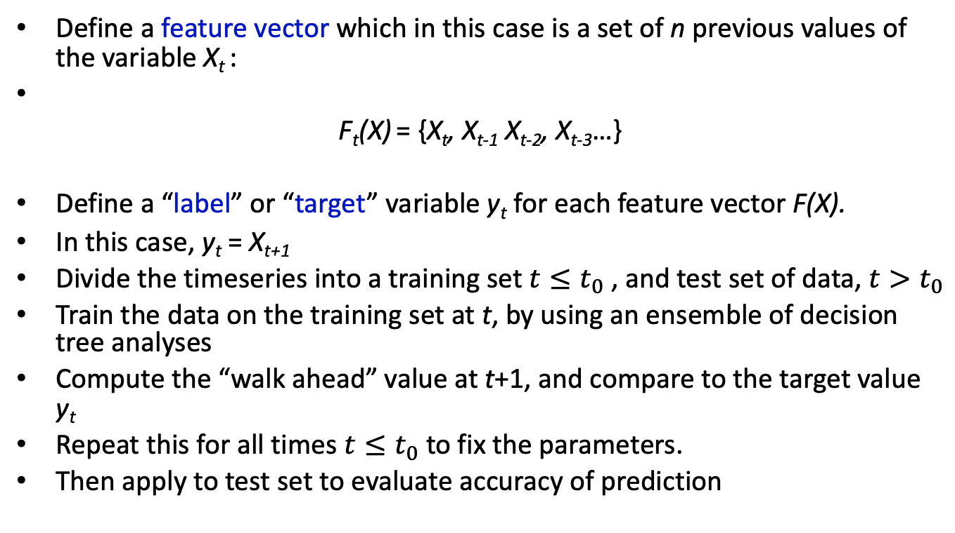
Basic Method for Random Forest for Time Series Prediction
Define a feature vector which in this case is a set of n previous values of the variable X_{t} :
F_{t}(X) = {X_{t}, X_{t-1} X_{t-2}, X_{t-3}…}
Define a “label” or “target” variable y_{t} for each feature vector F(X).
In this case, y_{t} = X_{t+1}
Divide the timeseries into a training set $t≤t_{0}$ , and test set of data, $t>t_{0}$
Train the data on the training set at t, by using an ensemble of decision tree analyses
Compute the “walk ahead” value at t+1, and compare to the target value y_{t}
Repeat this for all times $t≤t_{0}$ to fix the parameters.
Then apply to test set to evaluate accuracy of prediction

Slide 53
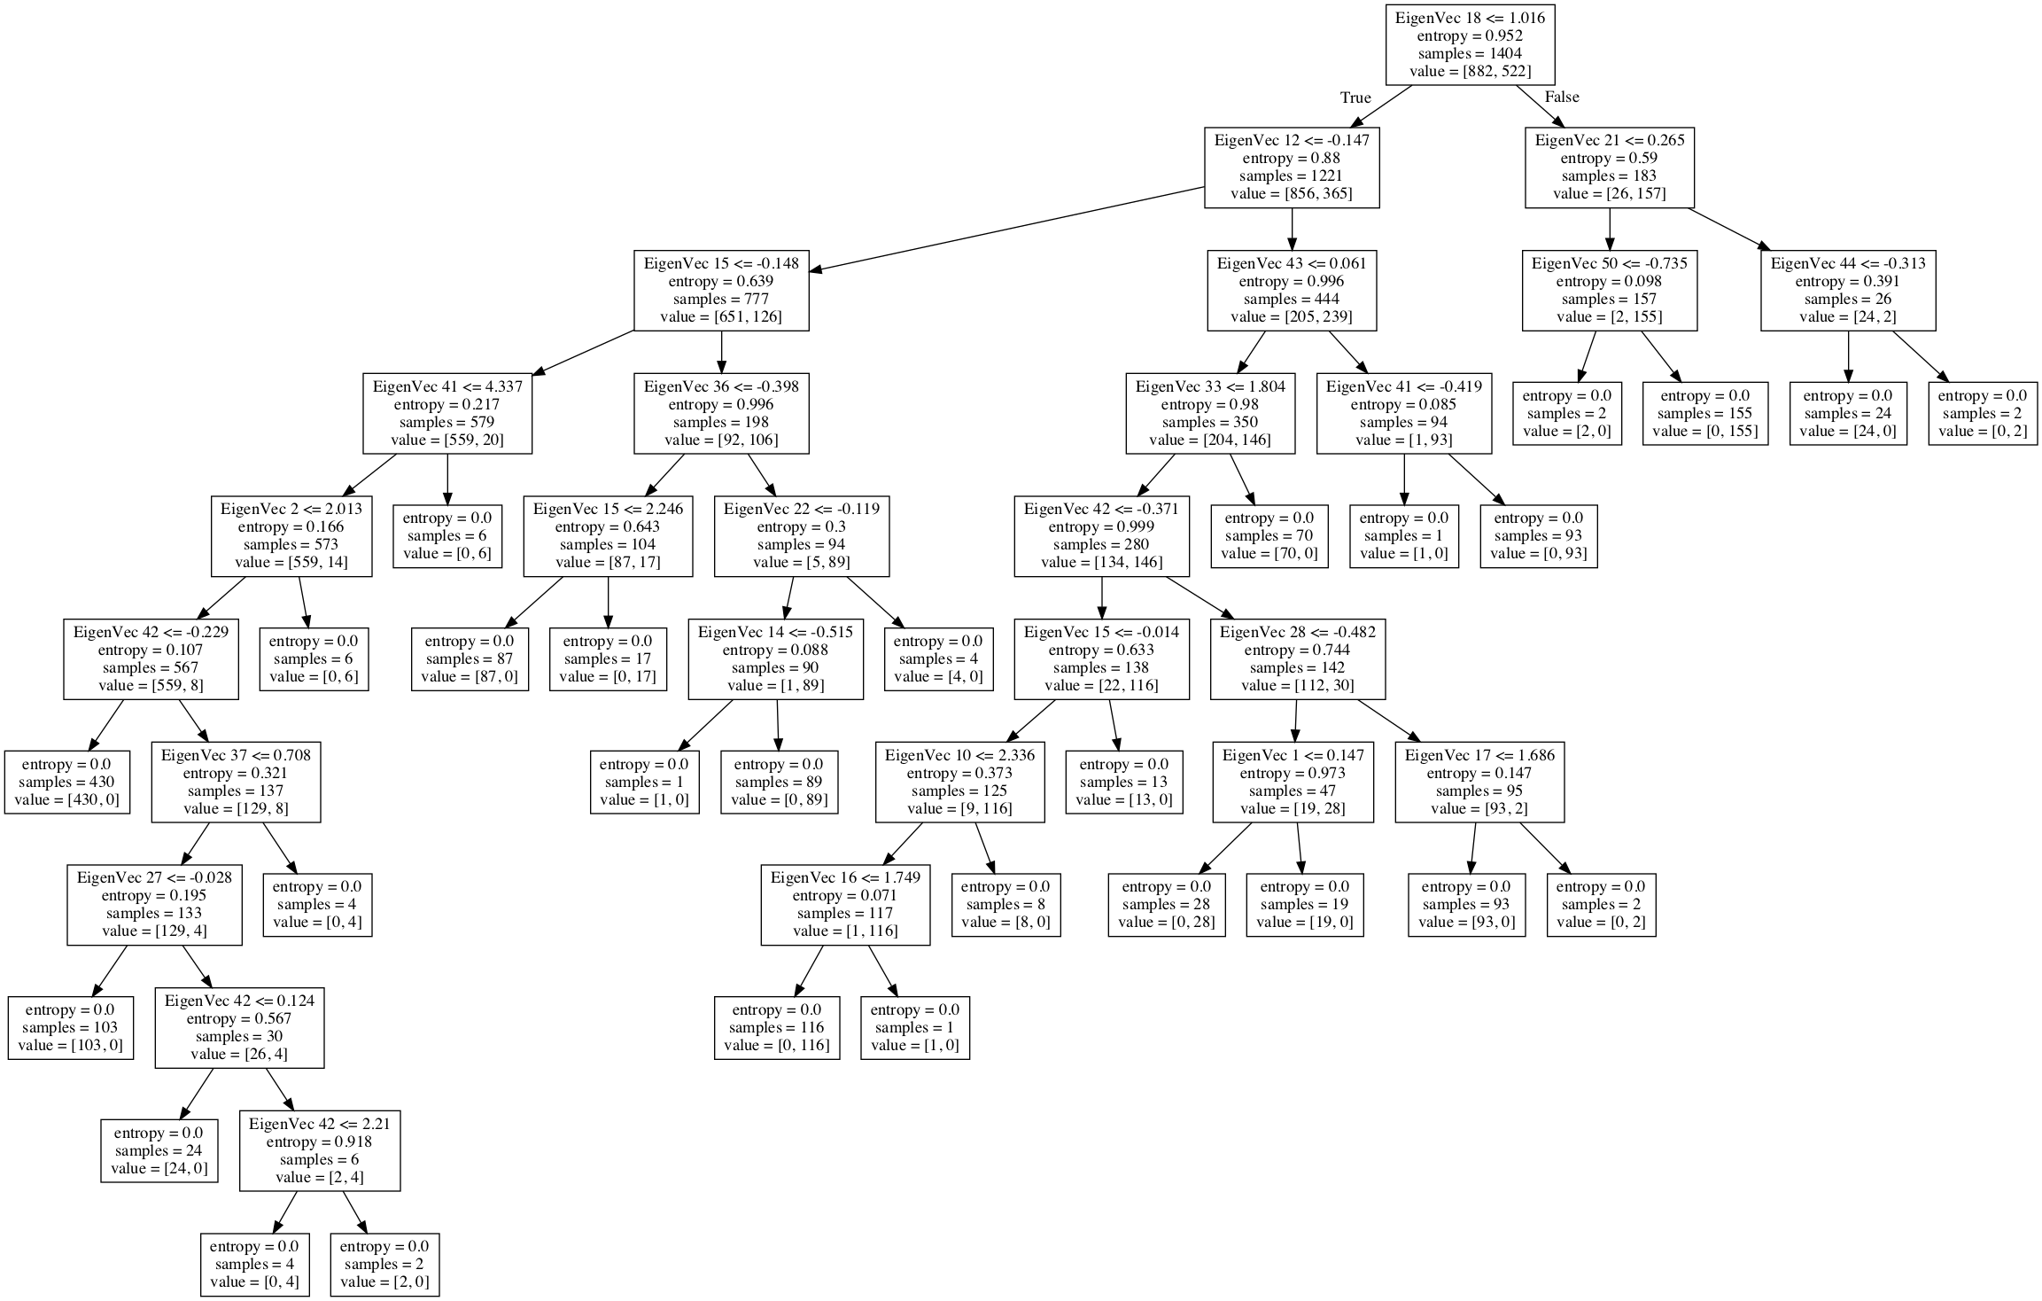
Example of a Decision Tree
(Used in Random Forest Method)
Root node
Scikit-learn or SKLearn
Leaves

Slide 54
An Example of Time Series Prediction
Using a Random Forest Classifier
This method has been applied to a timeseries describing natural and laboratory earthquakes
If we have the time series, one can apply machine learning methods to forecast future values of the timeseries after time T, given values of the timeseries for times t < T
This was used in a series of previous papers by the Los Alamos group to predict laboratory-observed sliding events, and for episodic tremor and slip events in the Pacific Northwest.
Note that in both of these applications, the sliding events occurred at very regular intervals
Rouet‐Leduc, Bertrand, et al. "Machine learning predicts laboratory earthquakes." Geophysical Research Letters 44.18 (2017): 9276-9282.
Rouet-Leduc, Bertrand, Claudia Hulbert, and Paul A. Johnson. "Continuous chatter of the Cascadia subduction zone revealed by machine learning." Nature Geoscience 12.1 (2019): 75-79.
A description of this random forest method is given at:
https://machinelearningmastery.com/random-forest-for-time-series-forecasting

Slide 55
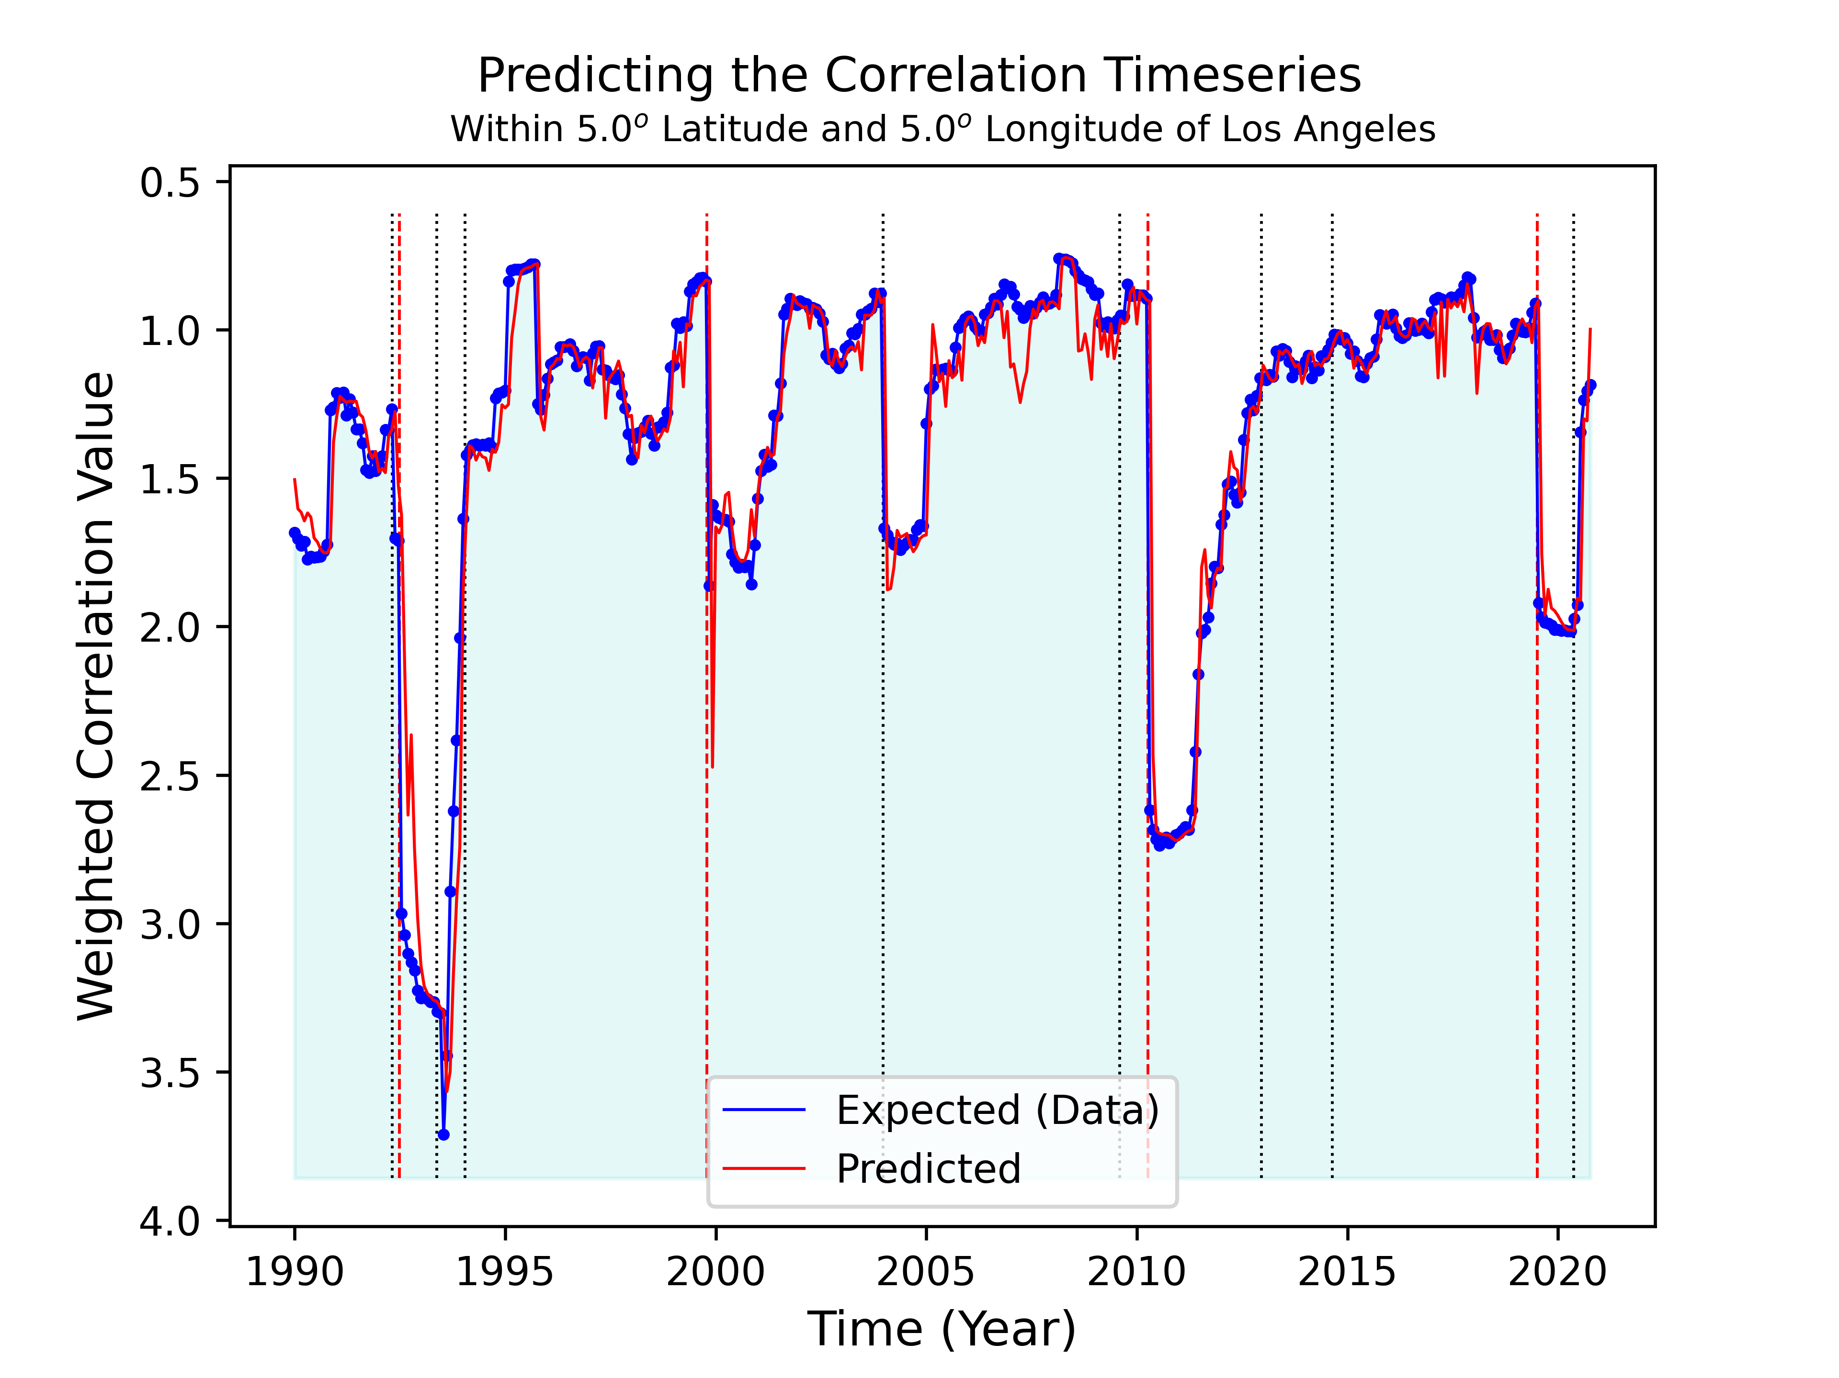
An Example of Time Series Prediction
Using a Random Forest Classifier
Receiver Operating Characteristic (ROC)
Time series prediction of correlation values by a random forest classifier*.
Blue curve is the weighted correlation values as above. Red curve is the 1-month walk-ahead prediction as implemented in the random forest classifier. Note that the prediction does not predict the sharp drops associated with the M>7 earthquakes (see next slide). Note that the feature vector uses 6 previous values to forecast the next value.
El Mayor Cucupah M7.2 4/4/2010
Landers-Big Bear M7.3, 6.3 6/28/1992
Hector Mine M7.1 10/16/1999
Ridgecrest M7.1 7/5/2019
Large Earthquakes
* https://machinelearningmastery.com/random-forest-for-time-series-forecasting/

Slide 56
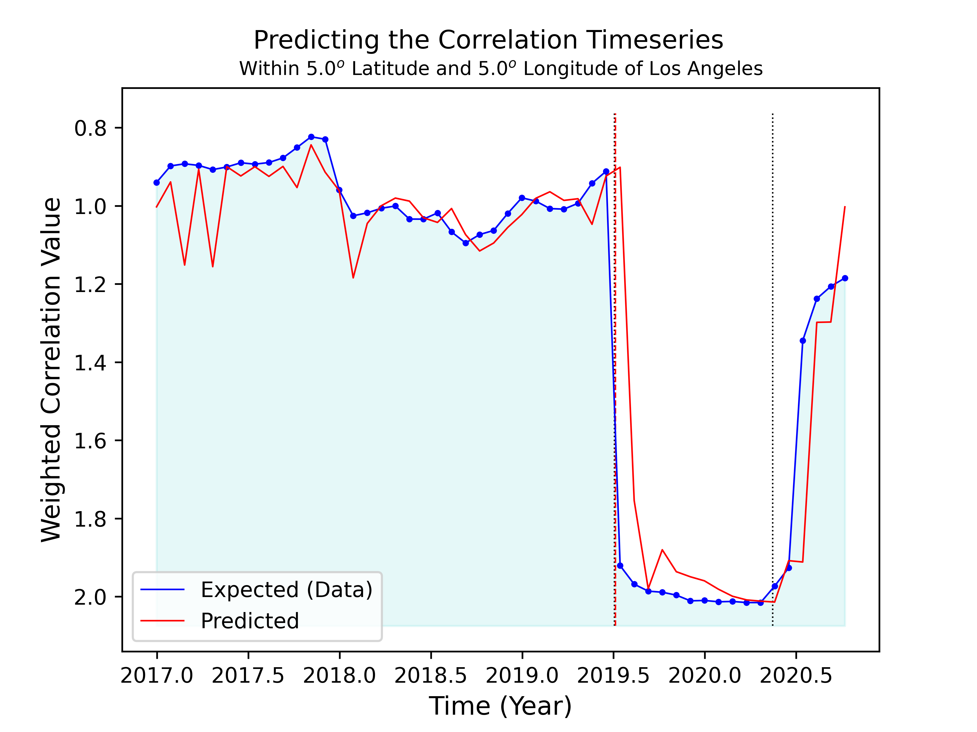
An Example of Time Series Prediction
Using a Random Forest Classifier – Close Up
Time series prediction of correlation values by a random forest classifier*.
Tonopah M6.5 5/15/2020
Blue curve is the weighted correlation values as above. Red curve is the 1-month walk-ahead prediction as implemented in the random forest classifier. Note that the prediction does not predict the sharp drops associated with the M>7 earthquakes (see next slide). Note that the feature vector uses 6 previous values to forecast the next value. (closeup from last slide).
Ridgecrest M7.1 7/5/2019
* https://machinelearningmastery.com/random-forest-for-time-series-forecasting/
Showing that sudden large events are not well predicted

Slide 57
Time Series Analysis Tools https://en.wikipedia.org/wiki/Time_series
Tools for investigating time-series data include:
Consideration of the autocorrelation function and the spectral density function (also cross-correlation functions and cross-spectral density functions)
Scaled or filtered cross- and auto-correlation functions to remove contributions of slow components
Performing a Fourier transform to investigate the series in the frequency domain
Use of a filter to remove unwanted noise or frequency components
Principal component analysis (or empirical orthogonal function analysis)
Singular spectrum analysis

Slide 58
Time Series Analysis Tools https://en.wikipedia.org/wiki/Time_series
Tools for investigating time-series data include:
Machine Learning
Artificial neural networks
Support Vector Machine
Fuzzy Logic
Gaussian Processes
Hidden Markov model
Queueing Theory Analysis
Control chart
Cumulative Sum (CUSUM) chart
Exponentially Weighted Moving Average (EWMA) chart

Slide 59
Time Series Analysis Tools https://en.wikipedia.org/wiki/Time_series
Tools for investigating time-series data include:
Detrended fluctuation analysis
Dynamic time warping
Cross-correlation
Dynamic Bayesian network
Time-frequency analysis techniques:
  Fast Fourier Transform
  Continuous wavelet transform
  Short-time Fourier transform
  Chirplet transform
  Fractional Fourier transform

Slide 60
Time Series Analysis Tools https://en.wikipedia.org/wiki/Time_series
Tools for investigating time-series data include:
Chaotic analysis
  Correlation dimension
  Recurrence plots (attractors)
  Recurrence quantification analysis
  Lyapunov exponents
  Entropy encoding

