Slide 1
Fractals, Chaos, Complexity
Physics-EPS 30
Lecture
Physics of Computation and Information Theory

Slide 2
Credits
https://en.wikipedia.org/wiki/Theory_of_computation
https://en.wikipedia.org/wiki/Finite-state_machine
https://en.wikipedia.org/wiki/Turing_machine
https://en.wikipedia.org/wiki/Logic_gate
https://en.wikipedia.org/wiki/Hamming_distance
https://en.wikipedia.org/wiki/Hopfield_network
https://en.wikipedia.org/wiki/Information_theory
https://en.wikipedia.org/wiki/Bit_array
Parity machine: https://inst.eecs.berkeley.edu/~cs150/sp03/handouts/4/LectureA/lec07-fsm1-2up.pdf

Slide 3
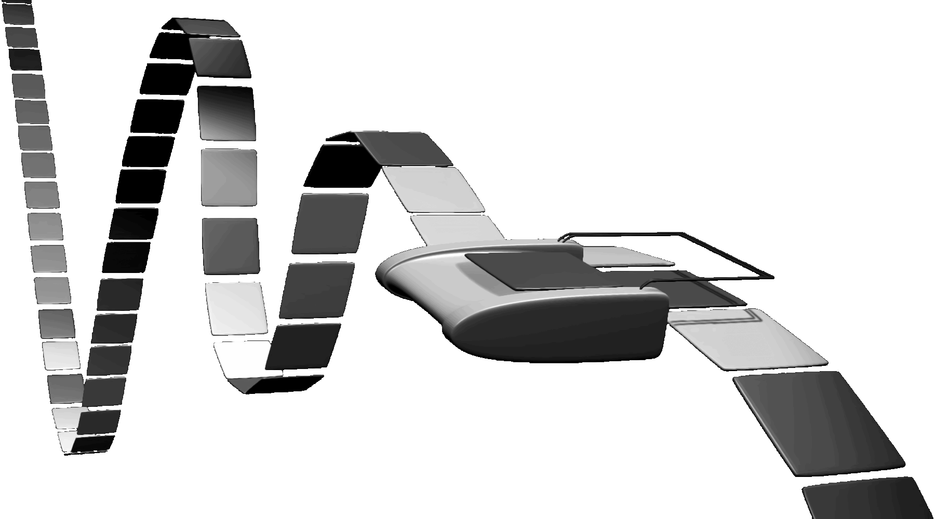
Theory of Computation
In theoretical computer science and mathematics, the theory of computation is the branch that deals with:
  What problems can be solved on a model of computation, using an algorithm,
  How efficiently they can be solved or to what degree (e.g., approximate solutions versus precise ones).
  The field is divided into three major branches:
    Automata theory (next lecture) and formal languages
    Computability theory,
    And computational complexity theory
    These are linked by the question: "What are the fundamental capabilities and limitations of computers?".
An artistic representation of a Turing machine. Turing machines are frequently used as theoretical models for computing.

Slide 4
Models for Computation
In order to perform a rigorous study of computation, computer scientists work with a mathematical abstraction of computers called a model of computation.
There are several models in use, but the most commonly examined is the Turing machine.
Computer scientists study the Turing machine because it is simple to formulate, can be analyzed and used to prove results, and because it represents what many consider the most powerful possible "reasonable" model of computation (see Church–Turing thesis).
It might seem that the potentially infinite memory capacity is an unrealizable attribute, but any decidable problem solved by a Turing machine will always require only a finite amount of memory.
So, in principle, any problem that can be solved (decided) by a Turing machine can be solved by a computer that has a finite amount of memory.

Slide 5
History
The theory of computation can be considered the creation of models of all kinds in the field of computer science.
Therefore, mathematics and logic are used. In the last century it became an independent academic discipline and was separated from mathematics.
Some pioneers of the theory of computation were Ramon Llull, Alonzo Church, Kurt Gödel, Alan Turing, Stephen Kleene, Rózsa Péter, John von Neumann and Claude Shannon.
  Gödel is known for studies of Logic
  von Neumann invented the first digital computer with Jules Charnay, and his invention of the cellular automaton
  Turing is known for his WWII work and his design of theoretical computing machines
  Shannon is known for his work in information theory

Slide 6
Automata Theory: Brief Description
Automata theory is the study of abstract machines (or more appropriately, abstract 'mathematical' machines or systems) and the computational problems that can be solved using these machines. These abstract machines are called automata.
Automata comes from the Greek word (Αυτόματα) which means that something is doing something by itself.
Automata theory is also closely related to formal language theory.
An automaton can be a finite representation of a formal language that may be an infinite set.
Automata are used as theoretical models for computing machines and are used for proofs about computability.
We describe Cellular Automata (CA) in the next lecture

Slide 7
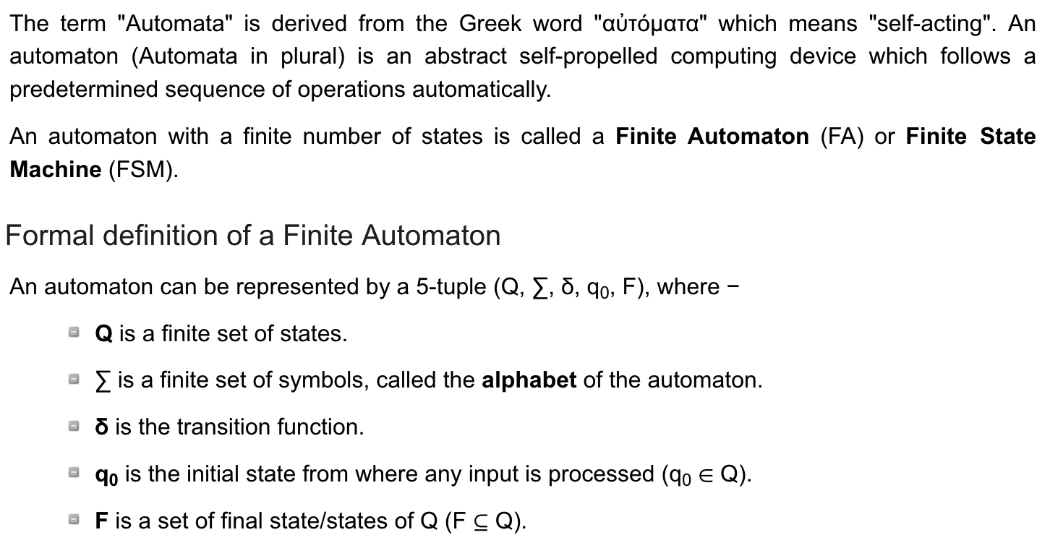
Automata https://www.tutorialspoint.com/automata_theory/index.htm

Slide 8
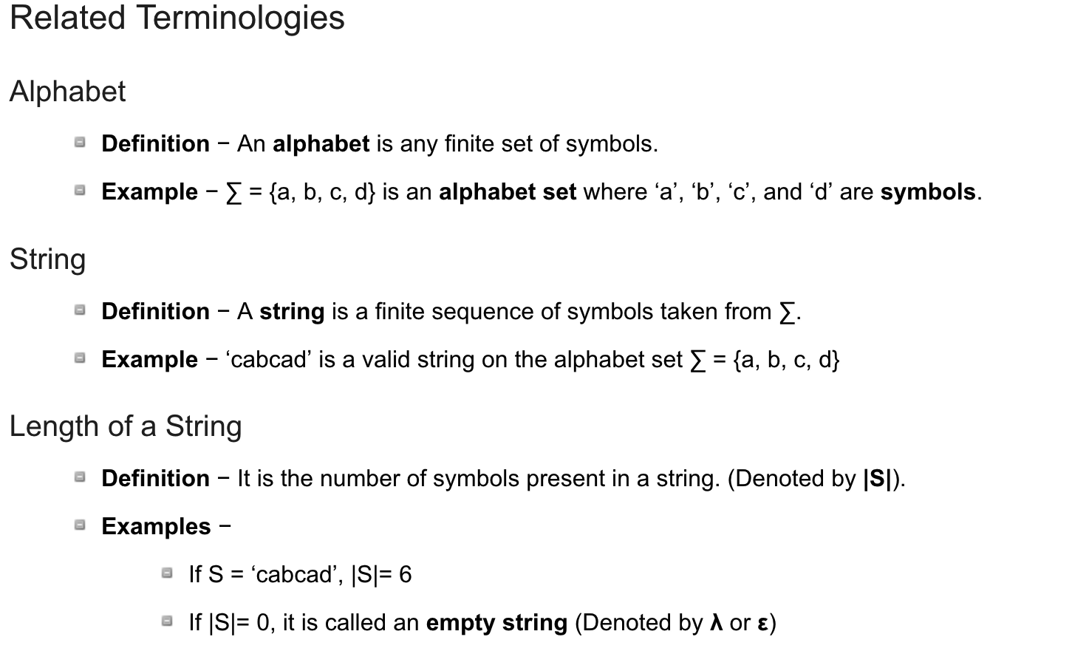
Terminologies https://www.tutorialspoint.com/automata_theory/index.htm

Slide 9
Computability Theory https://en.wikipedia.org/wiki/Halting_problem
Computability theory deals primarily with the question of the extent to which a problem is solvable on a computer.
Halting means that the computation eventually reaches an answer and stops.
The halting problem is the problem of determining, from a description of an arbitrary computer program and an input, whether the program will finish running, or continue to run forever.
Alan Turing proved in 1936 that a general algorithm to solve the halting problem for all possible program-input pairs cannot exist.
The statement that the halting problem cannot be solved by a Turing machine is one of the most important results in computability theory
It is an example of a concrete problem that is both easy to formulate and impossible to solve using a Turing machine.
Much of computability theory builds on the halting problem result.

Slide 10
Complexity in Computation https://en.wikipedia.org/wiki/Computational_complexity
In computer science, the computational complexity or simply complexity of an algorithm is the number of resources required to run it.
Particular focus is given to time and memory requirements.
The complexity of a problem is the complexity of the best algorithms that allow solving the problem.
The study of the complexity of explicitly given algorithms is called analysis of algorithms, while the study of the complexity of problems is called computational complexity theory.
Both areas are highly related, as the complexity of an algorithm is always an upper bound on the complexity of the problem solved by this algorithm.
Moreover, for designing efficient algorithms, it is often fundamental to compare the complexity of a specific algorithm to the complexity of the problem to be solved.
Also, in most cases, the only thing that is known about the complexity of a problem is that it is lower than the complexity of the most efficient known algorithms.
Therefore, there is a large overlap between analysis of algorithms and complexity theory.

Slide 11
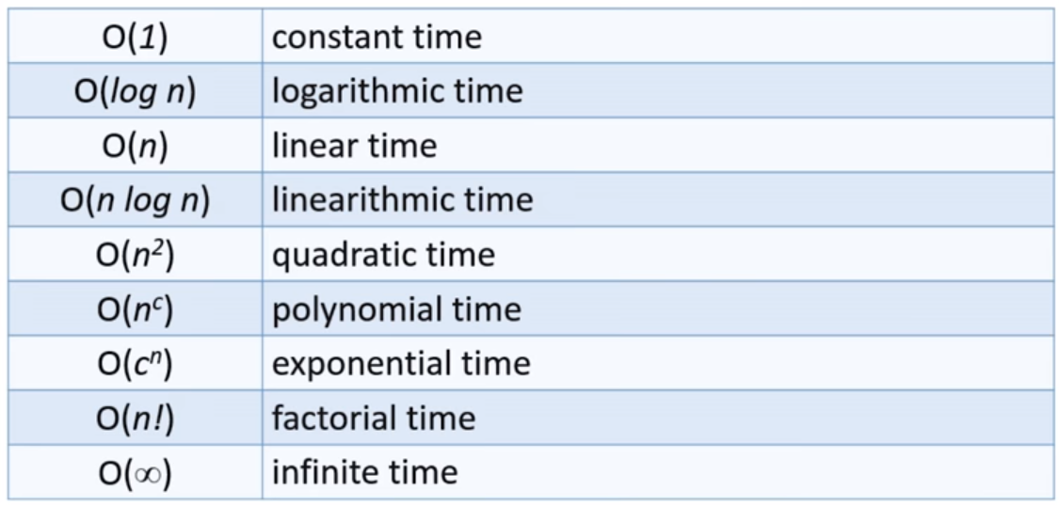
Complexity in Computation https://en.wikipedia.org/wiki/Computational_complexity
Here n is the input length for a particular problem

Slide 12
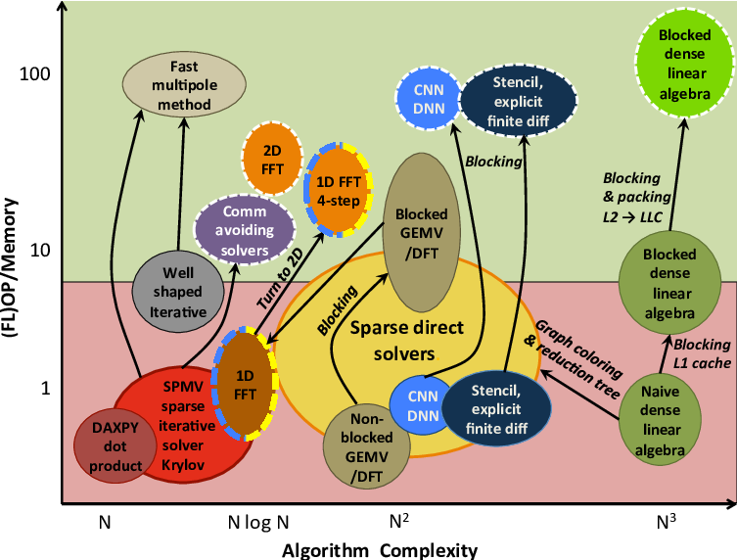
Algorithmic Complexity https://www.researchgate.net/publication/301647942_Dark_Memory_and_Accelerator-Rich_System_Optimization_in_the_Dark_Silicon_Era/figures?lo=1
Complexity vs. computation/memory-access ratio for several algorithms .
Dashed algorithms increase algorithm complexity for efficient implementation.

Slide 13
Finite State Machines https://en.wikipedia.org/wiki/Finite-state_machine
A finite-state machine (FSM) or finite-state automaton, finite automaton, or simply a state machine, is a mathematical model of computation.
It is an abstract machine that can be in exactly one of a finite number of states at any given time.
The FSM can change from one state to another in response to some inputs; the change from one state to another is called a transition.
An FSM is defined by a list of its states, its initial state, and the inputs that trigger each transition.
Finite-state machines are of two types—deterministic finite-state machines and non-deterministic finite-state machines.
A deterministic finite-state machine can be constructed equivalent to any non-deterministic one.
https://en.wikipedia.org/wiki/Finite-state_machine
https://medium.com/wesionary-team/finite-state-machines-with-go-lang-ccd20e329a7b

Slide 14
Finite State Machines https://en.wikipedia.org/wiki/Finite-state_machine
The behavior of state machines can be observed in many devices in modern society that perform a predetermined sequence of actions depending on a sequence of events with which they are presented.
Simple examples are:
  Vending machines, which dispense products when the proper combination of coins is deposited,
  Elevators, whose sequence of stops is determined by the floors requested by riders,
  Traffic lights, which change sequence when cars are waiting,
  Combination locks, which require the input of a sequence of numbers in the proper order.
  The finite-state machine has less computational power than some other models of computation such as the Turing machine.
  The computational power distinction means there are computational tasks that a Turing machine can do but an FSM cannot. This is because an FSM's memory is limited by the number of states it has.
  A finite-state machine has the same computational power as a Turing machine that is restricted such that its head may only perform "read" operations, and always has to move from left to right.
  FSMs are studied in the more general field of automata theory.

Slide 15
A Simple Finite State Machine
R₁
S₁
S₃
R₄
A
B
R₃
S₄
S₂
R₂
State A
State B
Stimulus S_{i}
Response R_{i}

Slide 16
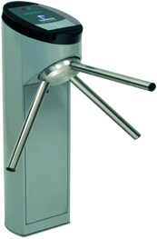
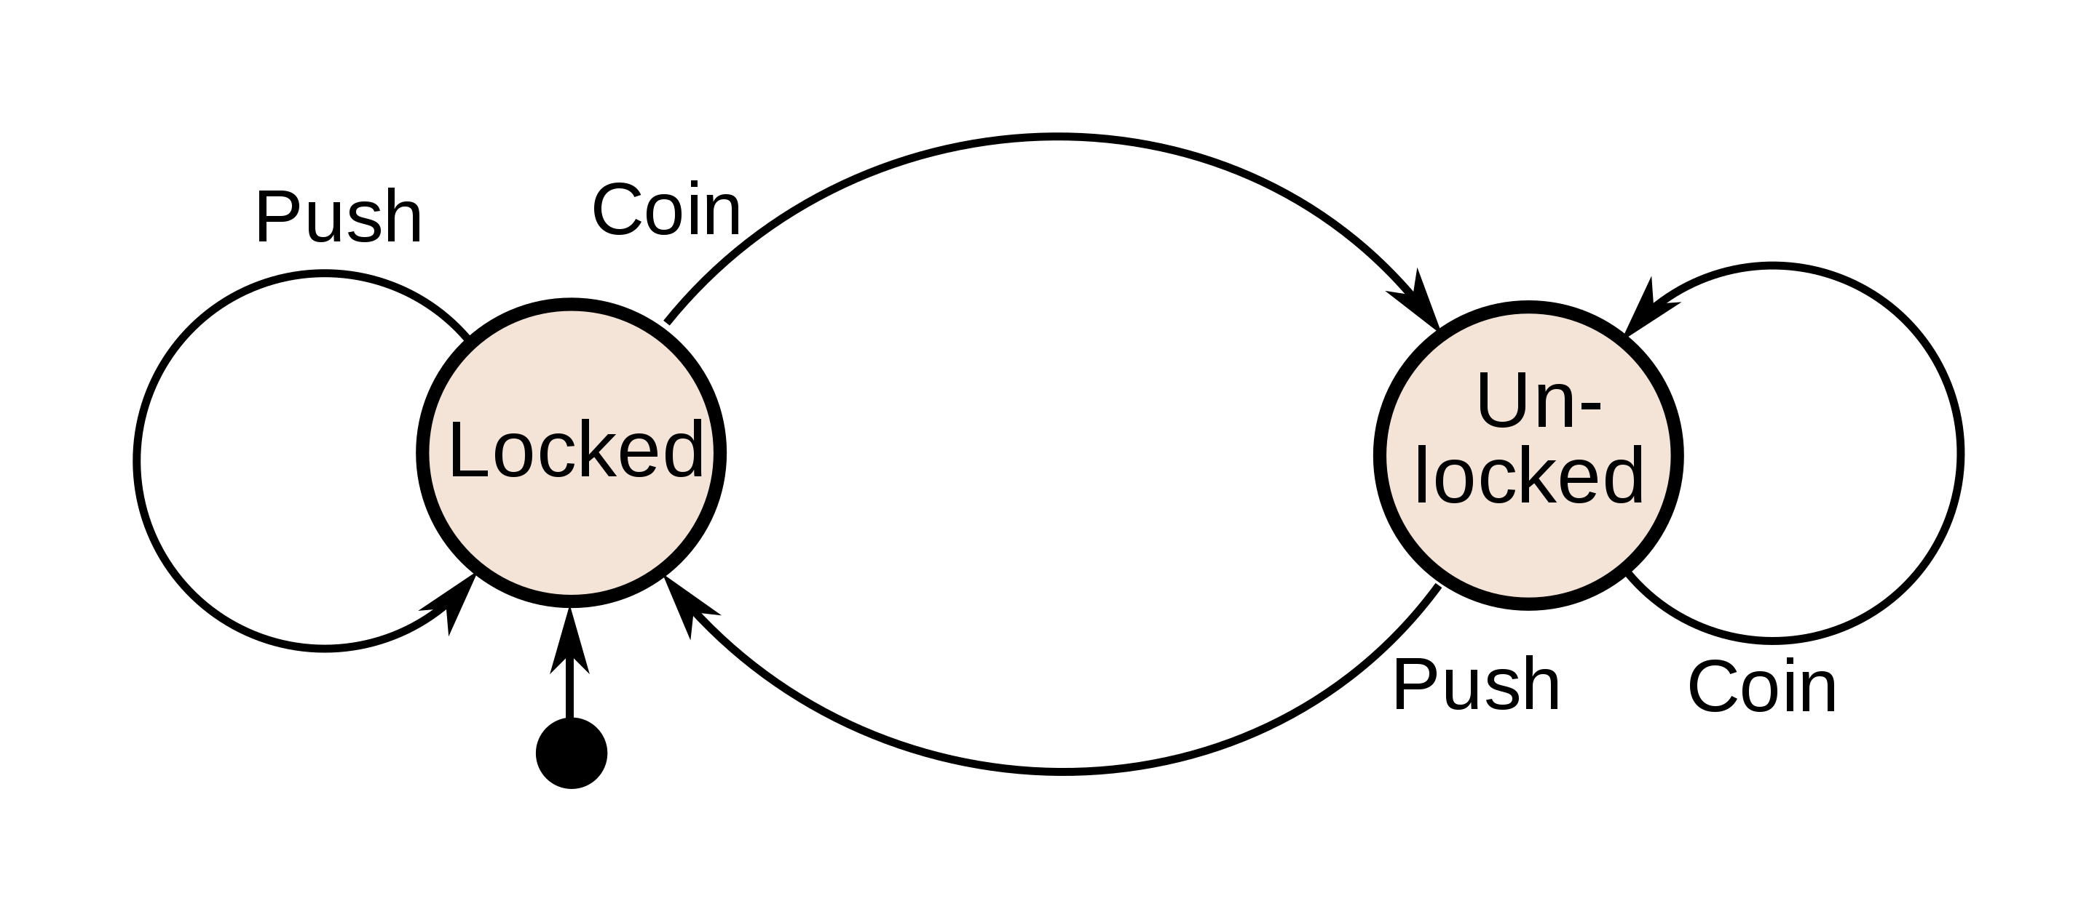
Example: Coin Operated Turnstile
An example of a simple mechanism that can be modeled by a state machine is a turnstile.
A turnstile, used to control access to subways and amusement park rides is a gate with three rotating arms at waist height, one across the entryway. Initially the arms are locked, blocking the entry, preventing patrons from passing through.
Depositing a coin or token in a slot on the turnstile unlocks the arms, allowing a single customer to push through.
After the customer passes through, the arms are locked again until another coin is inserted.
State diagram for a turnstile

Slide 17
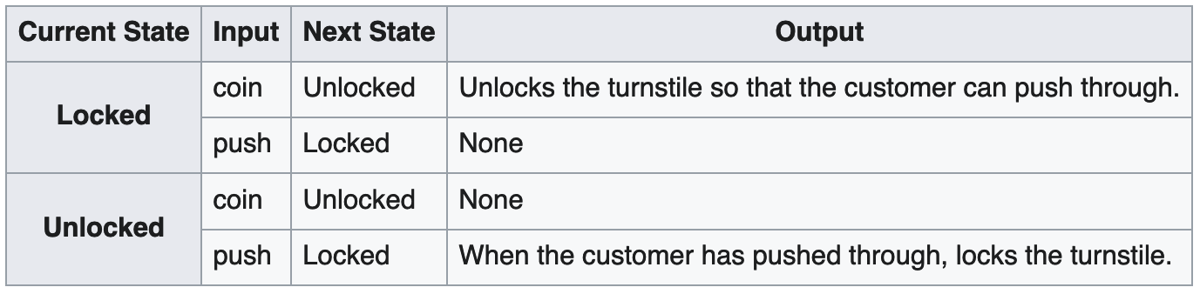
Turnstile States
Considered as a state machine, the turnstile has two possible states: Locked and Unlocked.
There are two possible inputs that affect its state: putting a coin in the slot (coin) and pushing the arm (push).
In the locked state, pushing on the arm has no effect
No matter how many times the input push is given, it stays in the locked state.
Putting a coin in – that is, giving the machine a coin input – shifts the state from Locked to Unlocked.
In the unlocked state, putting additional coins in has no effect, that is, giving additional coin inputs does not change the state.
However, a customer pushing through the arms, giving a push input, shifts the state back to Locked.

Slide 18
State Transition Diagram is a “Directed Graph”
The turnstile state machine can also be represented by a directed graph called a state diagram (at right).
Each state is represented by a node (circle).
Edges (arrows) show the transitions from one state to another.
Each arrow is labeled with the input that triggers that transition.
An input that doesn't cause a change of state (such as a coin input in the Unlocked state) is represented by a circular arrow returning to the original state.
The arrow into the Locked node from the black dot indicates it is the initial state.

Slide 19
States Terminology: Audio System
A state is a description of the status of a system that is waiting to execute a transition.
A transition is a set of actions to be executed when a condition is fulfilled or when an event is received.
For example, using an audio system to listen to the radio (the system is in the ”Radio State”), receiving a "next" stimulus results in moving to the next station.
When the system is in the "CD State”, the "next" stimulus results in moving to the next track. Identical stimuli trigger different actions depending on the current state.
In some finite-state machine representations, it is also possible to associate actions with a state:
  An entry action: performed when entering the state, and
  An exit action: performed when exiting the state.

Slide 20
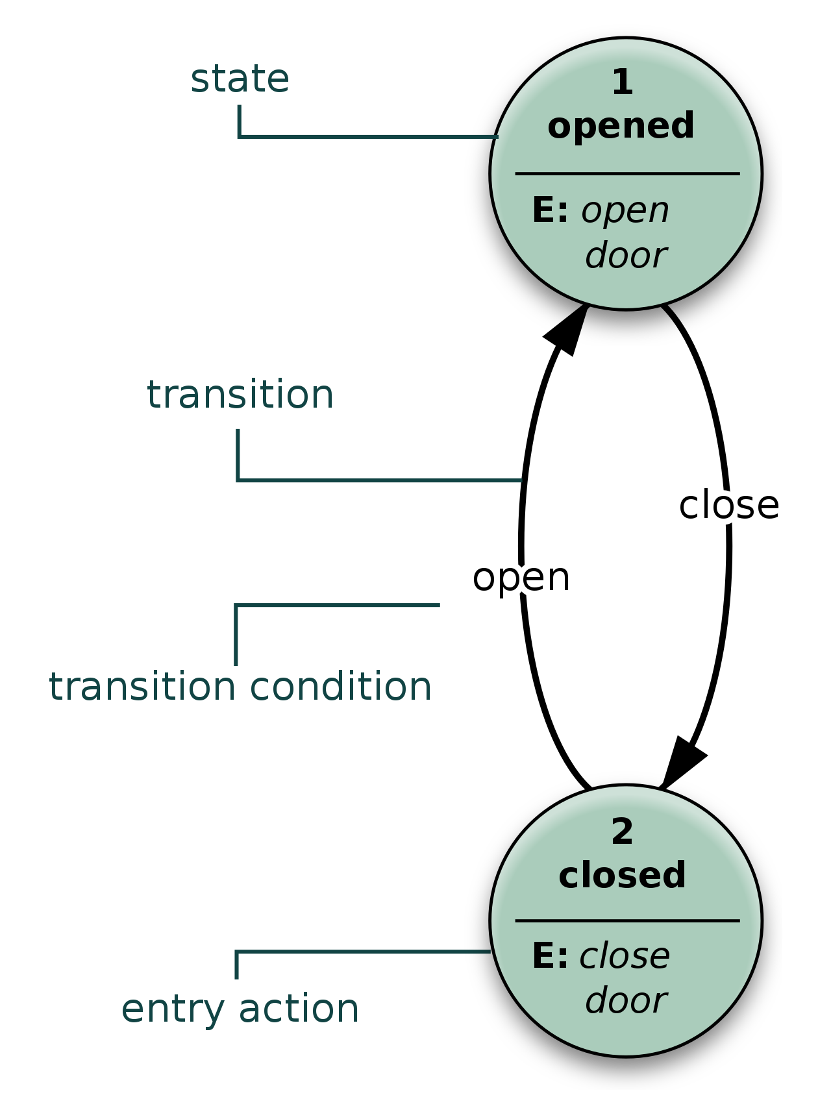
Graphical Symbols
The Specification and Description Language (SDL) is a standard from the International Telecommunication Union (ITU) that includes graphical symbols to describe actions in the transition:
  send an event
  receive an event
  start a timer
  cancel a timer
  start another concurrent state machine
  decision
SDL embeds basic data types called "Abstract Data Types", an action language, and an execution semantic in order to make the finite-state machine executable.

Slide 21
Bit Strings and Arrays
A bit array (also known as bit map, bit set, bit string, or bit vector) is a data structure such as the following:
…0 1 1 0 1 0 0 0 0 1 1 1 1 1 0 1 …
A bit string is effective at exploiting bit-level parallelism in hardware to perform operations quickly.
A typical bit string stores kw bits, where w is the number of bits in the unit of storage, such as a byte (typically 8 bits) or word (typically 2 bytes), and k is some nonnegative integer.
If w does not evenly divide the number of bits to be stored, some space is wasted due to internal fragmentation

Slide 22
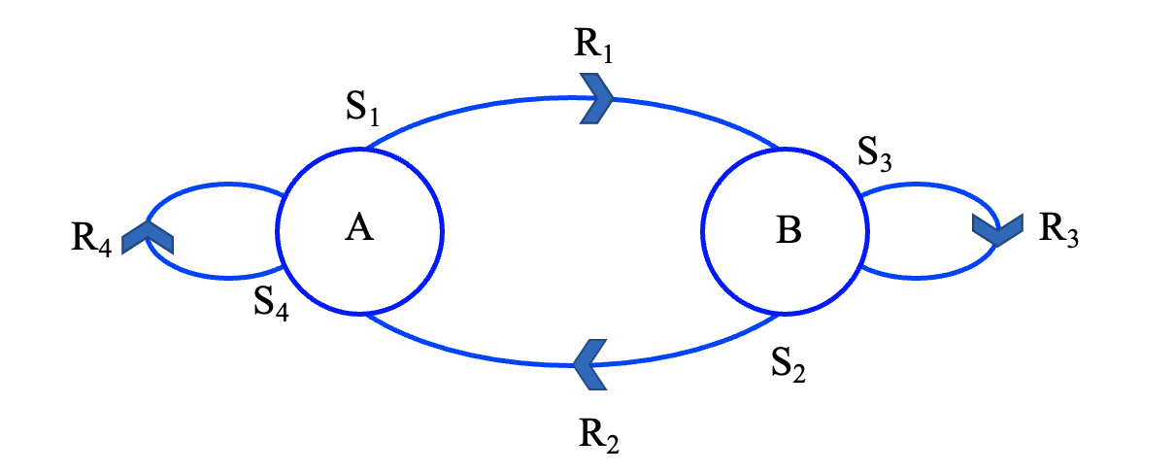
State Dynamics
Machine starts in State A, a stimulus S1 produces a response R1 and causes internal state to flip to state B.
Machine starts in State B, a stimulus S2 produces a response R2 and causes internal state to flip to state A.
Machine starts in State B, a stimulus S3 produces a response R3 and causes internal state to stay in state B.
Machine starts in State A , a stimulus S4 produces a response R4 and causes internal state to stay in state A.

Slide 23
Example: A Delay Machine
t | t+1 | t+2 | t+3 | t+4
1 | 0 | 1 | 1 | 0
0
1
1
0
A
B
1
0
0
1
t | t+1 | t+2 | t+3 | t+4
1 | 0 | 1 | 1 | 0
0 | 1 | 0 | 1 | 1
B | A | B | B | A
Input
Output
State A
State B
Stimulus S_{i}
Response R_{i}
A
State
Starting State

Slide 24
Example: A Parity Detection Machine
(In this case, parity is described as whether an even or an odd number of 1’s has been received)
t | t+1 | t+2 | t+3 | t+4
1 | 0 | 1 | 1 | 0
1
1
0
0
E
O
0
0
1
0
t | t+1 | t+2 | t+3 | t+4
1 | 0 | 1 | 1 | 0
1 | 0 | 0 | 1 | 0
O | O | E | O | O
Input
Output
State E (Even)
State O (Odd)
Stimulus S_{i}
Response R_{i}
E
State
Starting State

Slide 25
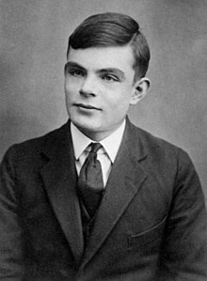
Alan Turing
Alan Mathison Turing OBE FRS (23 June 1912 – 7 June 1954) was an English mathematician, computer scientist, logician, cryptanalyst, philosopher, and theoretical biologist.
Turing was highly influential in the development of theoretical computer science, providing a formalization of the concepts of algorithm and computation with the Turing machine, which can be considered a model of a general-purpose computer.
Turing is widely considered to be the father of theoretical computer science and artificial intelligence.

Slide 26
Alan Turing
Born in Maida Vale, London, Turing was raised in southern England.
He graduated at King's College, Cambridge, with a degree in mathematics.
While he was a fellow at Cambridge, he published a proof demonstrating that some purely mathematical “yes/no” questions can never be answered by computation
He defined a Turing machine and went on to prove the halting problem for Turing machines is undecidable.
In 1938, he obtained his PhD from the Department of Mathematics at Princeton University.
During the Second World War, Turing worked for the Government Code and Cypher School (GC&CS) at Bletchley Park, Britain's code-breaking center that produced Ultra intelligence.
For a time, he led Hut 8, the section that was responsible for German naval cryptanalysis.
Here, he devised a number of techniques for speeding the breaking of German ciphers, including improvements to the pre-war Polish bombe method, an electromechanical machine that could find settings for the Enigma machine.
Turing played a crucial role in cracking intercepted coded messages that enabled the Allies to defeat the Axis powers in many crucial engagements, including the Battle of the Atlantic.

Slide 27
Alan Turing
After the war, Turing worked at the National Physical Laboratory, where he designed the Automatic Computing Engine (ACE), one of the first designs for a stored-program computer.
In 1948, Turing joined Max Newman's Computing Machine Laboratory, at the Victoria University of Manchester, where he helped develop the Manchester computers and became interested in mathematical biology.
He wrote a paper on the chemical basis of morphogenesis and predicted oscillating chemical reactions such as the Belousov–Zhabotinsky reaction, first observed in the 1960s.
Despite these accomplishments, he was never fully recognized in his home country during his lifetime because much of his work was covered by the Official Secrets Act.
Turing was prosecuted in 1952 for homosexual acts. He accepted chemical castration treatment, with DES, as an alternative to prison.
Turing died in 1954, 16 days before his 42nd birthday, from cyanide poisoning.
An inquest determined his death as a suicide, but it has been noted that the known evidence is also consistent with accidental poisoning.

Slide 28
Alan Turing
In 2009, following an Internet campaign, British Prime Minister Gordon Brown made an official public apology on behalf of the British government for "the appalling way he was treated".
Queen Elizabeth II granted Turing a posthumous pardon in 2013.
The "Alan Turing law" is now an informal term for a 2017 law in the United Kingdom that retroactively pardoned men cautioned or convicted under historical legislation that outlawed homosexual acts.
Turing has an extensive legacy with statues of him and many things named after him, including an annual award for computer science innovations.
He appears on the current Bank of England £50 note, which was released to coincide with his birthday.
A 2019 BBC series, as voted by the audience, named him the greatest person of the 20th century.

Slide 29
Turing Machines
A Turing machine is a mathematical model of computation that defines an abstract machine that manipulates symbols on a strip of tape according to a table of rules.
Despite the model's simplicity, given any computer algorithm, a Turing machine capable of simulating that algorithm's logic can be constructed.
The Turing machine was invented in 1936 by Alan Turing, who called it an "a-machine" (automatic machine).
With this model machine, Turing was able to answer two questions in the negative:
  Does a machine exist that can determine whether any arbitrary machine on its tape is "circular" (e.g., freezes, or fails to continue its computational task)?
  Does a machine exist that can determine whether any arbitrary machine on its tape ever prints a given symbol?
  Thus, by providing a mathematical description of a very simple device capable of arbitrary computations, he was able to prove properties of computation in general—and in particular, the uncomputability of the Entscheidungsproblem ('decision problem')

Slide 30
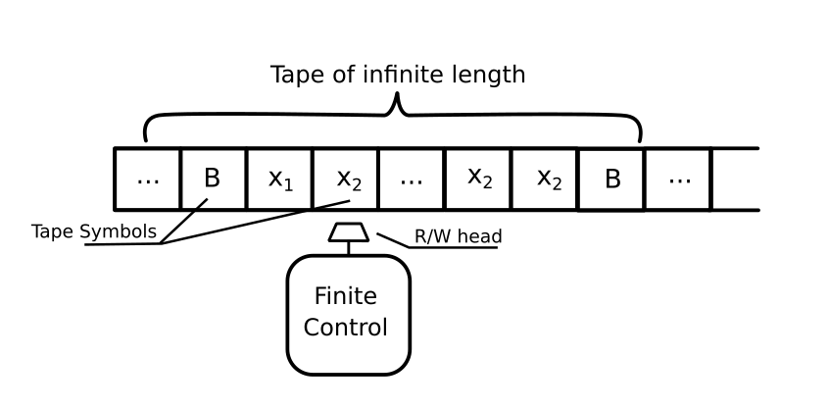
Turing Machine
The machine operates on an infinite memory tape divided into discrete "cells".
The machine positions its "head" over a cell and "reads" or "scans" the symbol there.
Based on the symbol and the machine's own present state in a "finite table" of user-specified instructions, the Turing Machine:
  Writes a symbol (e.g., a digit or a letter from a finite alphabet) in the cell (some models allow symbol erasure or no writing), then
  Either moves the tape one cell left or right (some models allow no motion, some models move the head), then
  Based on the observed symbol and the machine's own state in the table either proceeds to another instruction or halts the computation.

Slide 31
Turing Machine Limitations
Turing machines proved the existence of fundamental limitations on the power of mechanical computation.
While they can express arbitrary computations, their minimalist design makes them unsuitable for computation in practice
Real-world computers are based on different designs that, unlike Turing machines, use random-access memory.
Neural networks often use content-addressable memory
Turing completeness is the ability for a system of instructions to simulate a Turing machine.
A programming language that is Turing complete is theoretically capable of expressing all tasks accomplishable by computers
Nearly all programming languages are Turing complete if the limitations of finite memory are ignored.

Slide 32
Description of a Turing Machine
The Turing machine mathematically models a machine that mechanically operates on a tape.
On this tape are symbols, which the machine can read and write, one at a time, using a tape head.
Operation is fully determined by a finite set of elementary instructions such as
  In state 42, if the symbol seen is 0, write a 1
  If the symbol seen is 1, change into state 17
  In state 17, if the symbol seen is 0, write a 1 and change to state 6, etc.
  In the original article Turing imagines not a mechanism, but a person whom he calls the "computer", who executes these deterministic mechanical rules slavishly (or as Turing puts it, "in a desultory manner").

Slide 33
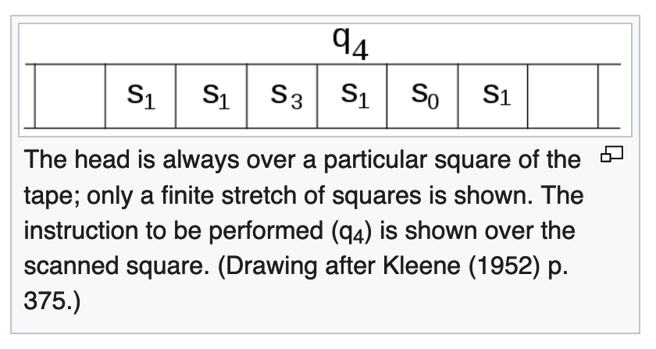
A Turing Machine is:
A tape divided into cells, one next to the other.
Each cell contains a symbol from some finite alphabet.
The alphabet contains a special blank symbol (here written as '0') and one or more other symbols.
The tape is assumed to be arbitrarily extendable to the left and to the right, so that the Turing machine is always supplied with as much tape as it needs for its computation.
Cells that have not been written before are assumed to be filled with the blank symbol.
In some models the tape has a left end marked with a special symbol
The tape extends or is indefinitely extensible to the right.

Slide 34
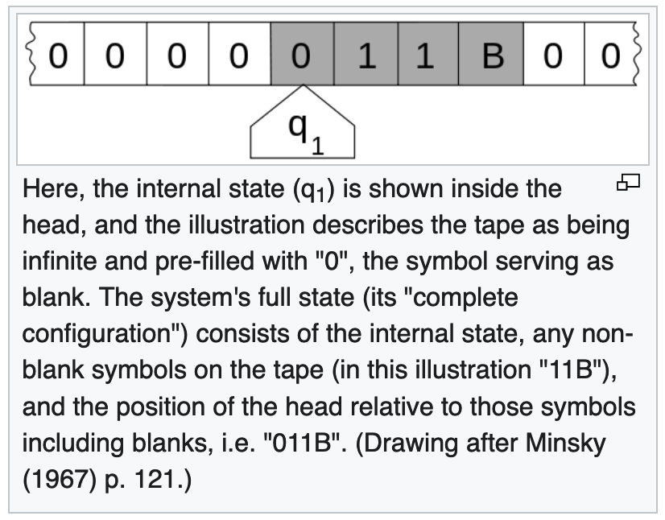
More Explicitly, a Turing Machine is:
A head that can read and write symbols on the tape and move the tape left and right one (and only one) cell at a time.
In some models the head moves and the tape is stationary.
A state register that stores the state of the Turing machine, one of finitely many.
Among these is the special start state with which the state register is initialized.
These states, writes Turing, replace the "state of mind" a person performing computations would ordinarily be in.

Slide 35
And Even More Explicitly, a Turing Machine is:
A finite table of instructions that, given the state(q_{i}) the machine is currently in and the symbol(a_{j}) it is reading on the tape (symbol currently under the head)
The table tells the machine to do the following in sequence (for a particular computing model):
  Either erase or write a symbol (replacing a_{j} with a_{j1}).
  Move the head (which is described by d_{k} and can have values: 'L' for one step left or 'R' for one step right or 'N' for staying in the same place).
  Assume the same or a new state as prescribed (go to state q_{i1}).

Slide 36
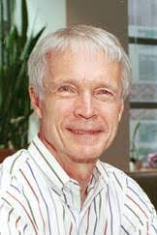
John J Hopfield
Father of the Modern Neural Network
He received his A.B. from Swarthmore College in 1954, and a Ph.D. in physics from Cornell University in 1958 (supervised by Albert Overhauser).
He spent two years in the theory group at Bell Laboratories, and subsequently was a faculty member at University of California, Berkeley (physics), Princeton University (physics), California Institute of Technology (chemistry and biology) and again at Princeton, where he is the Howard A. Prior Professor of Molecular Biology, emeritus.
For 35 years, he also continued a strong connection with Bell Laboratories.
In 1986 he was a co-founder of the Computation and Neural Systems PhD program at Caltech.

Slide 37
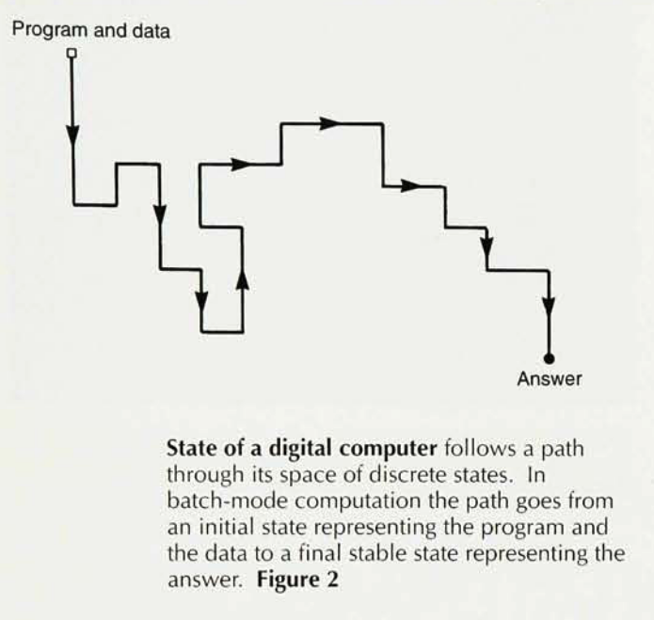
A Dynamical Systems View of Computation
(See Hopfield, Physics Today, 1994)
A computer is a dynamical system
A computation is a directed walk through the state space of the computer
The answer is viewed as the fixed point of the computation, so that the calculation evolves to the fixed point
The system Halts at the fixed point
Cases of numerical instability can be viewed as a chaotic regime within the state space of the computer

Slide 38
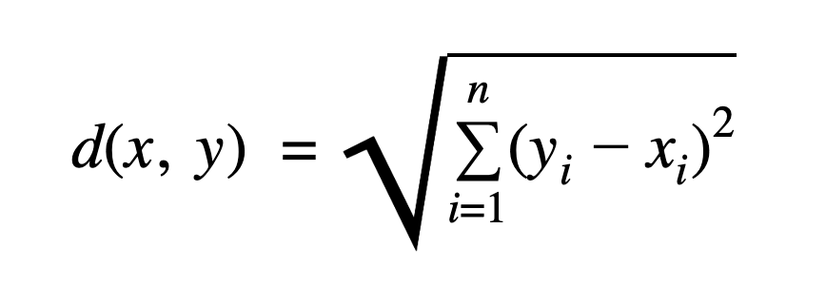
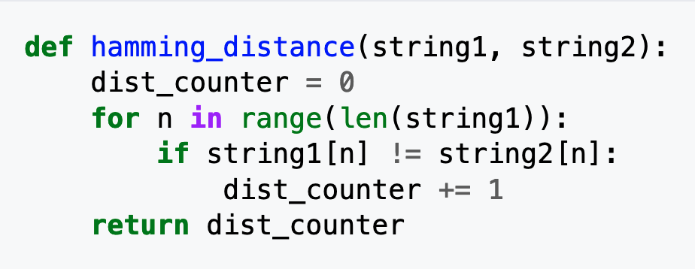
Hamming Distance
By contrast, in a ”normal” computer, the system would recognize a memory (given piece of data), say a bit string such as
y = [0 1 1 0 0 1 1 1 0]
by computing the “Hamming distance” between the given bit string and any other arbitrary bit string of equal length, such as:
x = [0 1 1 0 1 1 1 1 0]
The Hamming distance between these two strings is defined as the number of bits that are different.
Mathematically:
In Python:
The Hamming distance for these two bit strings = 1

Slide 39
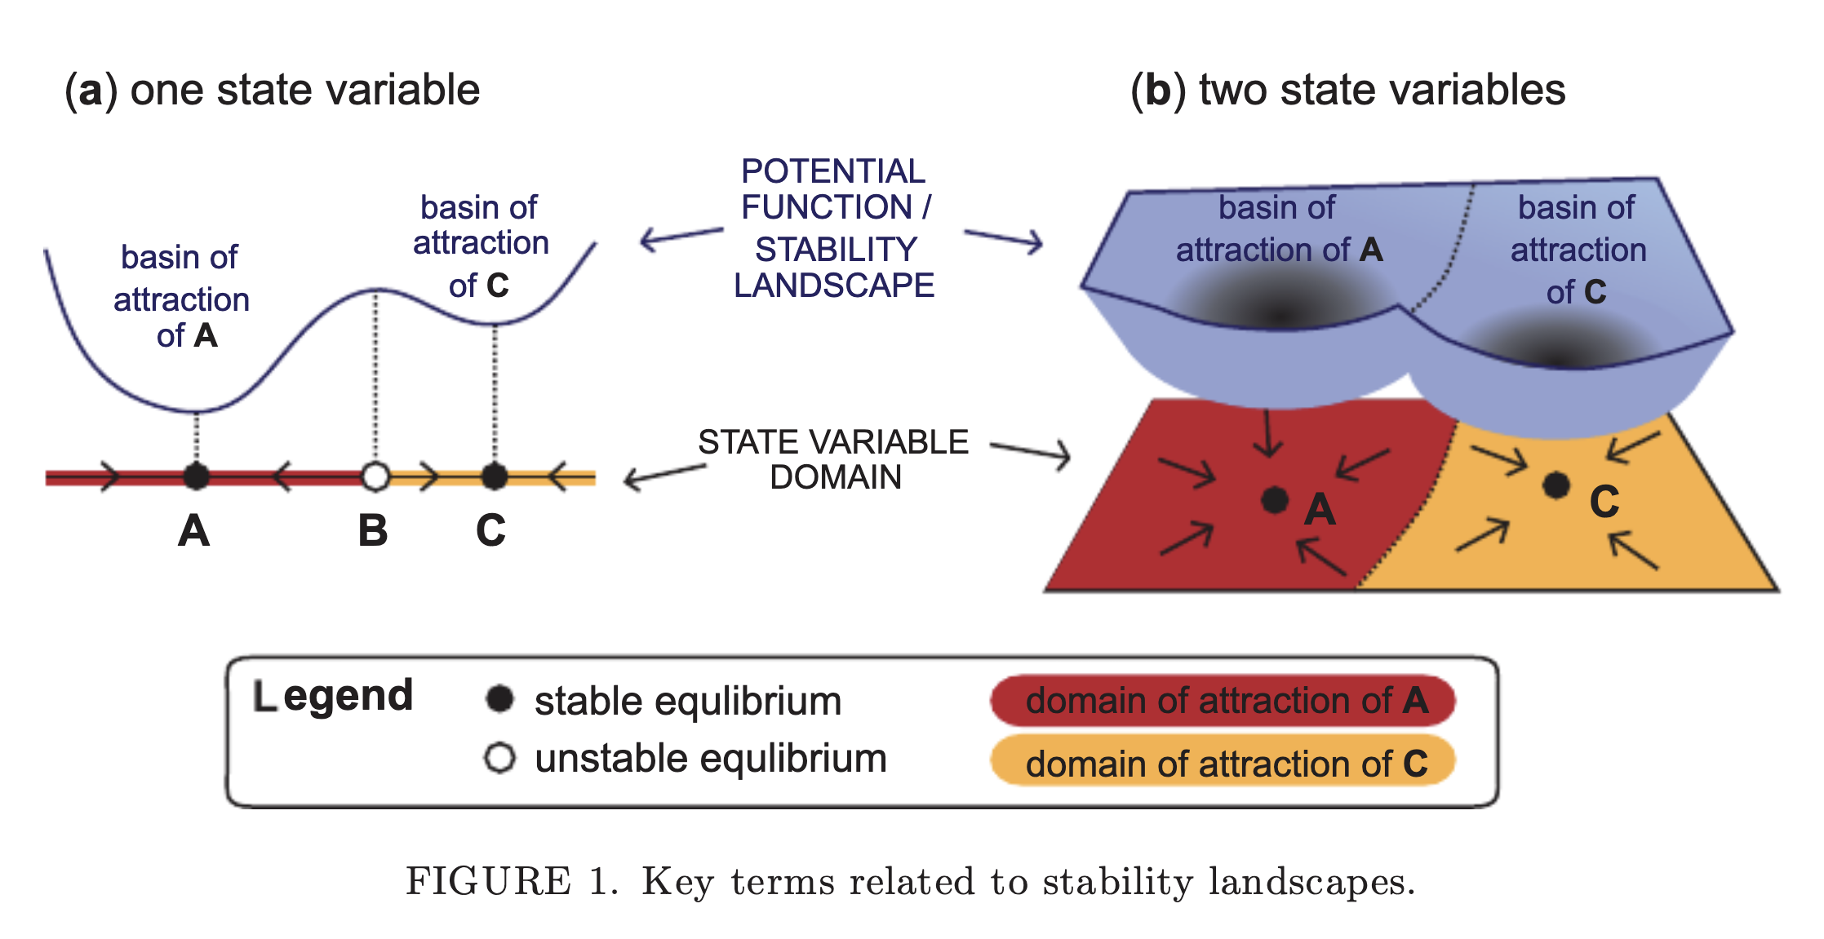
Hopfield’s View of Neural Computation
(See Hopfield, Physics Today, 1994)
Associative memory is the process by which the brain recognizes memories
In a computer, one must know the address of the data in order to access it
The brain uses a different mechanism, in which Hopfield described memories as fixed points within a surrounding basin of attraction
He described the process of memory recall as an iteration to the fixed point (memory) within the basin of attraction of the brain
We will discuss this in more detail soon
Ended Here 2/14/2022

Slide 40
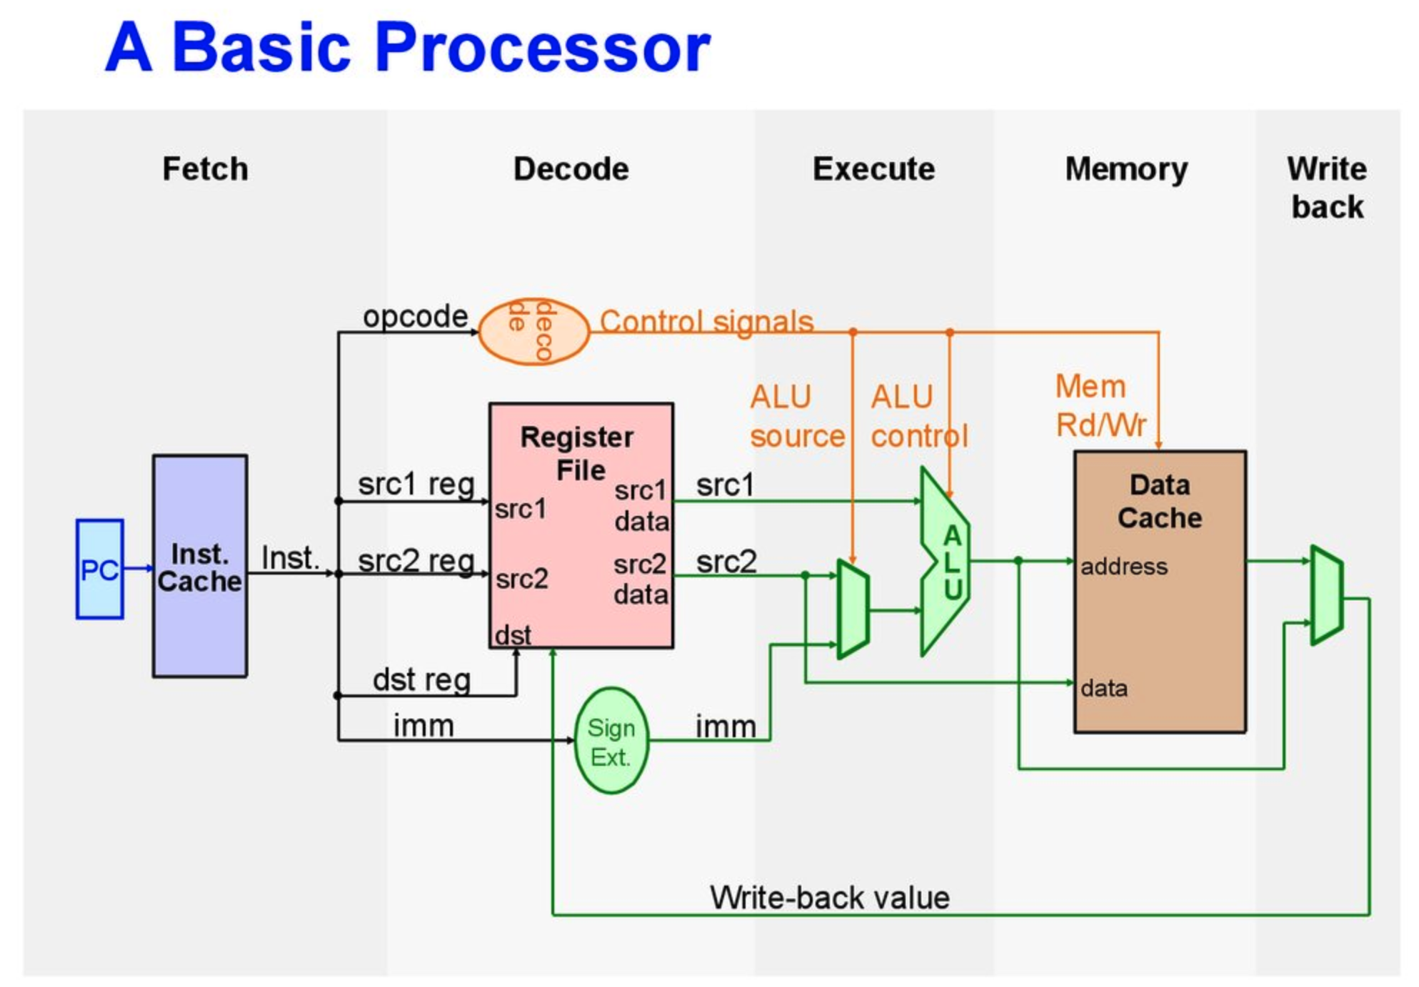
Digital Computers
Today’s computers are built with integrated circuits, which appeared in the late 1960’s
ICs supplanted the vacuum tube machines of early times
The transistors on ICs are built around logic gates and truth tables
https://en.ppt-online.org/41276

Slide 41
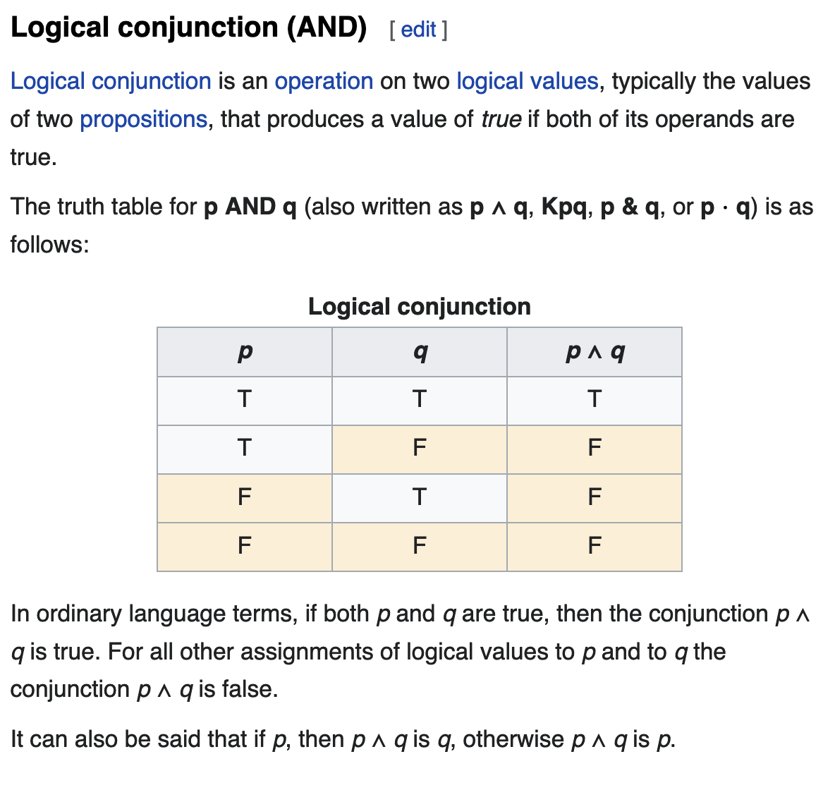
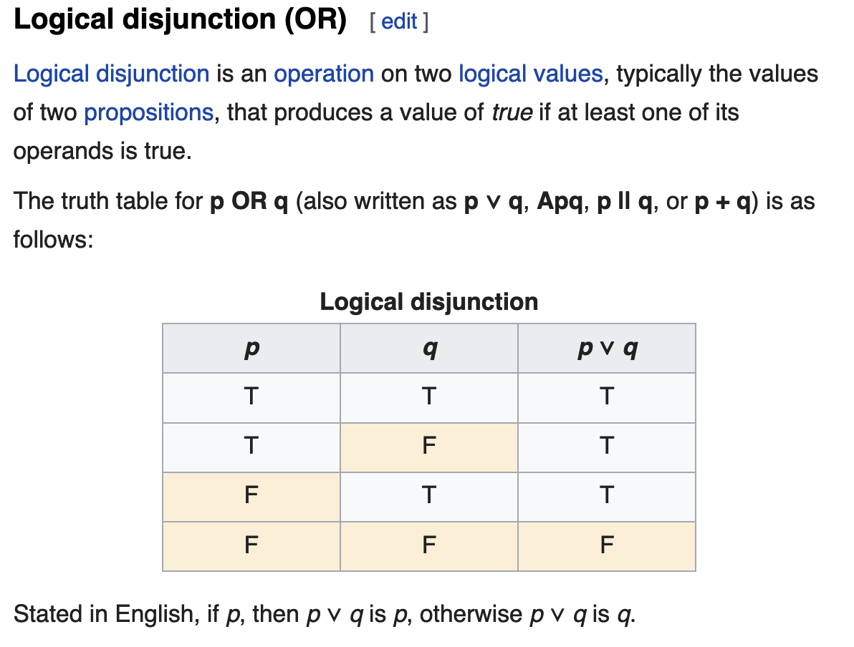
Computation uses Boolean Variables and Truth Tables https://en.wikipedia.org/wiki/Truth_table

Slide 42
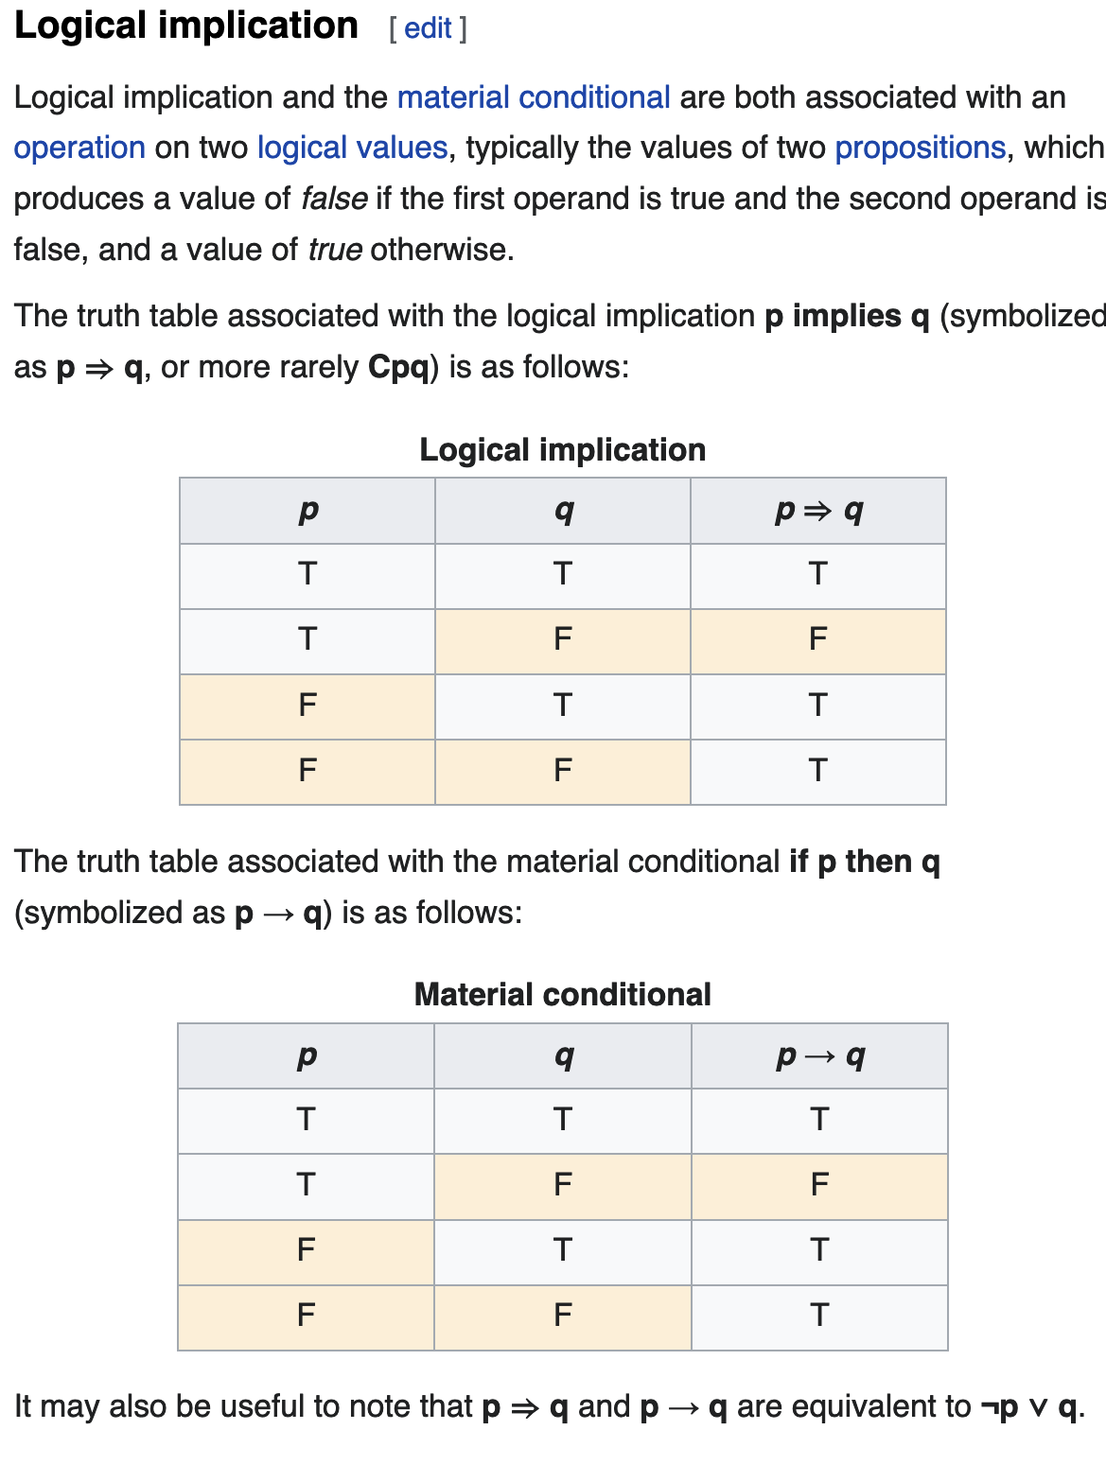
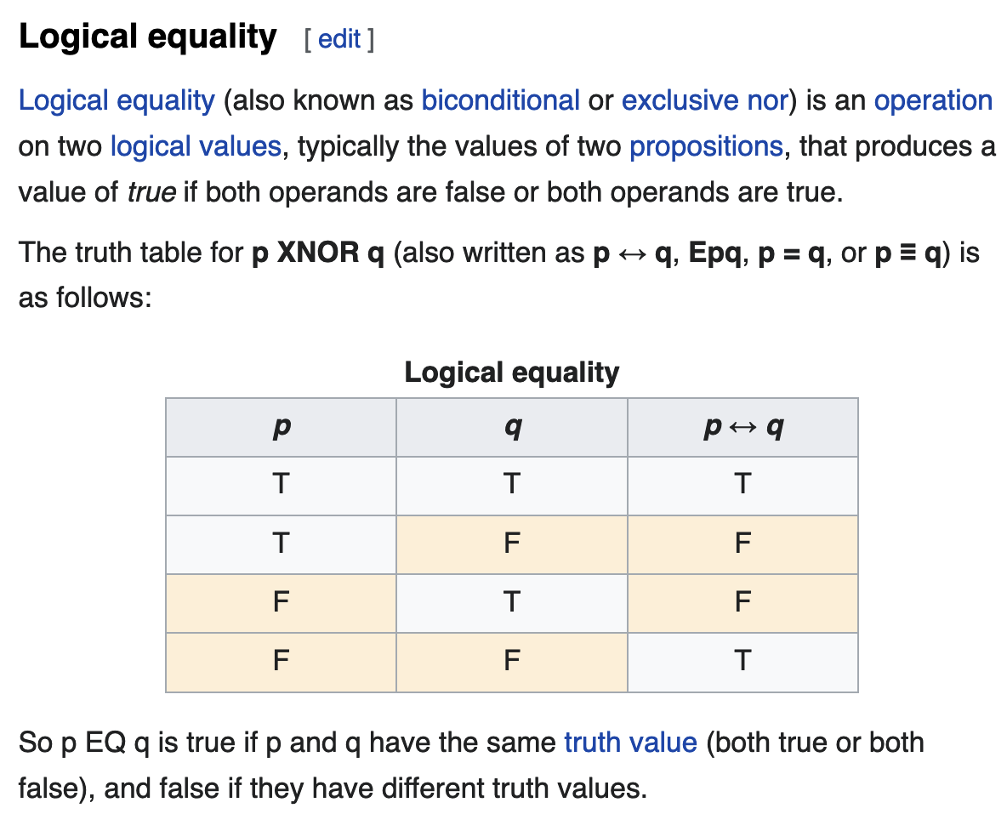
Other Tables

Slide 43
Logic Gates
Truth tables are implemented on silicon trips as arrays of transistors forming “Logic Gates”
A logic gate is an idealized model of computation or physical electronic device implementing a Boolean function, a logical operation performed on one or more binary inputs that produces a single binary output.
Logic gates are primarily implemented using diodes or transistors acting as electronic switches, but can also be constructed using vacuum tubes, electromagnetic relays (relay logic), fluidic logic, pneumatic logic, optics, molecules, or even mechanical elements.
With amplification, logic gates can be cascaded in the same way that Boolean functions can be composed, allowing the construction of a physical model of all of Boolean logic, and therefore, all of the algorithms and mathematics that can be described with Boolean logic.
Logic circuits include such devices as multiplexers, registers, arithmetic logic units (ALUs), and computer memory, all the way up through complete microprocessors, which may contain more than 100 million gates.
In modern practice, most gates are made from MOSFETs (metal–oxide–semiconductor field-effect transistors).
Compound logic gates AND-OR-Invert (AOI) and OR-AND-Invert (OAI) are often employed in circuit design because their construction using MOSFETs is simpler and more efficient than the sum of the individual gates.

Slide 44
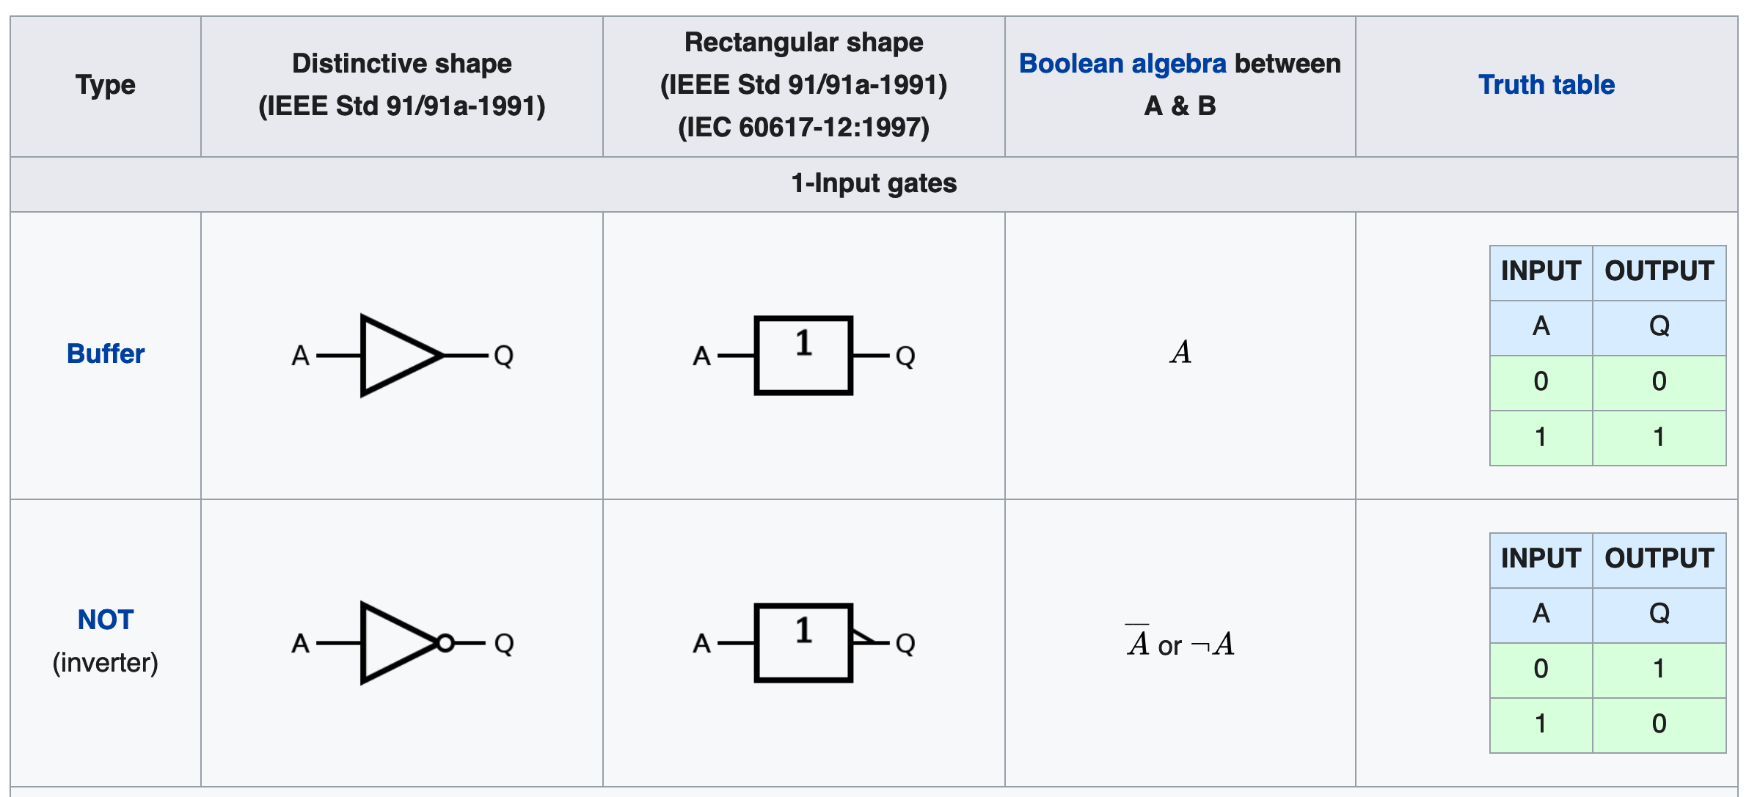
Examples of Logic Gates

Slide 45
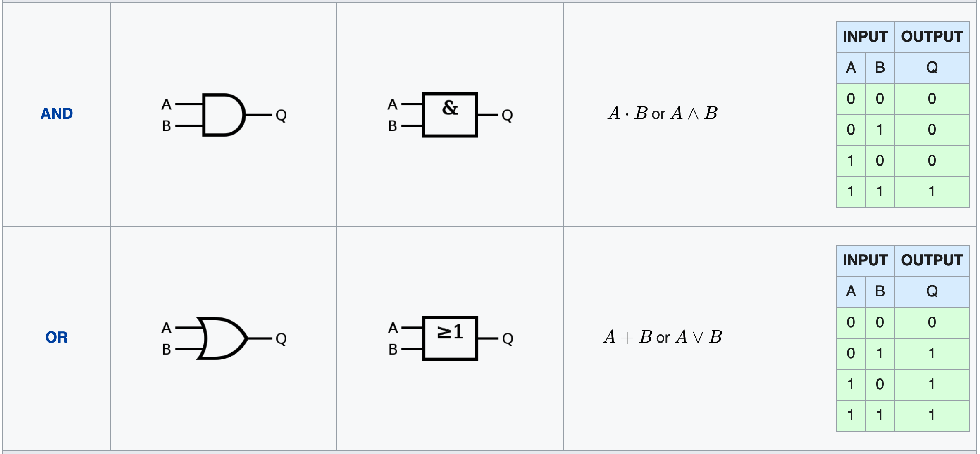
Examples of Logic Gates

Slide 46
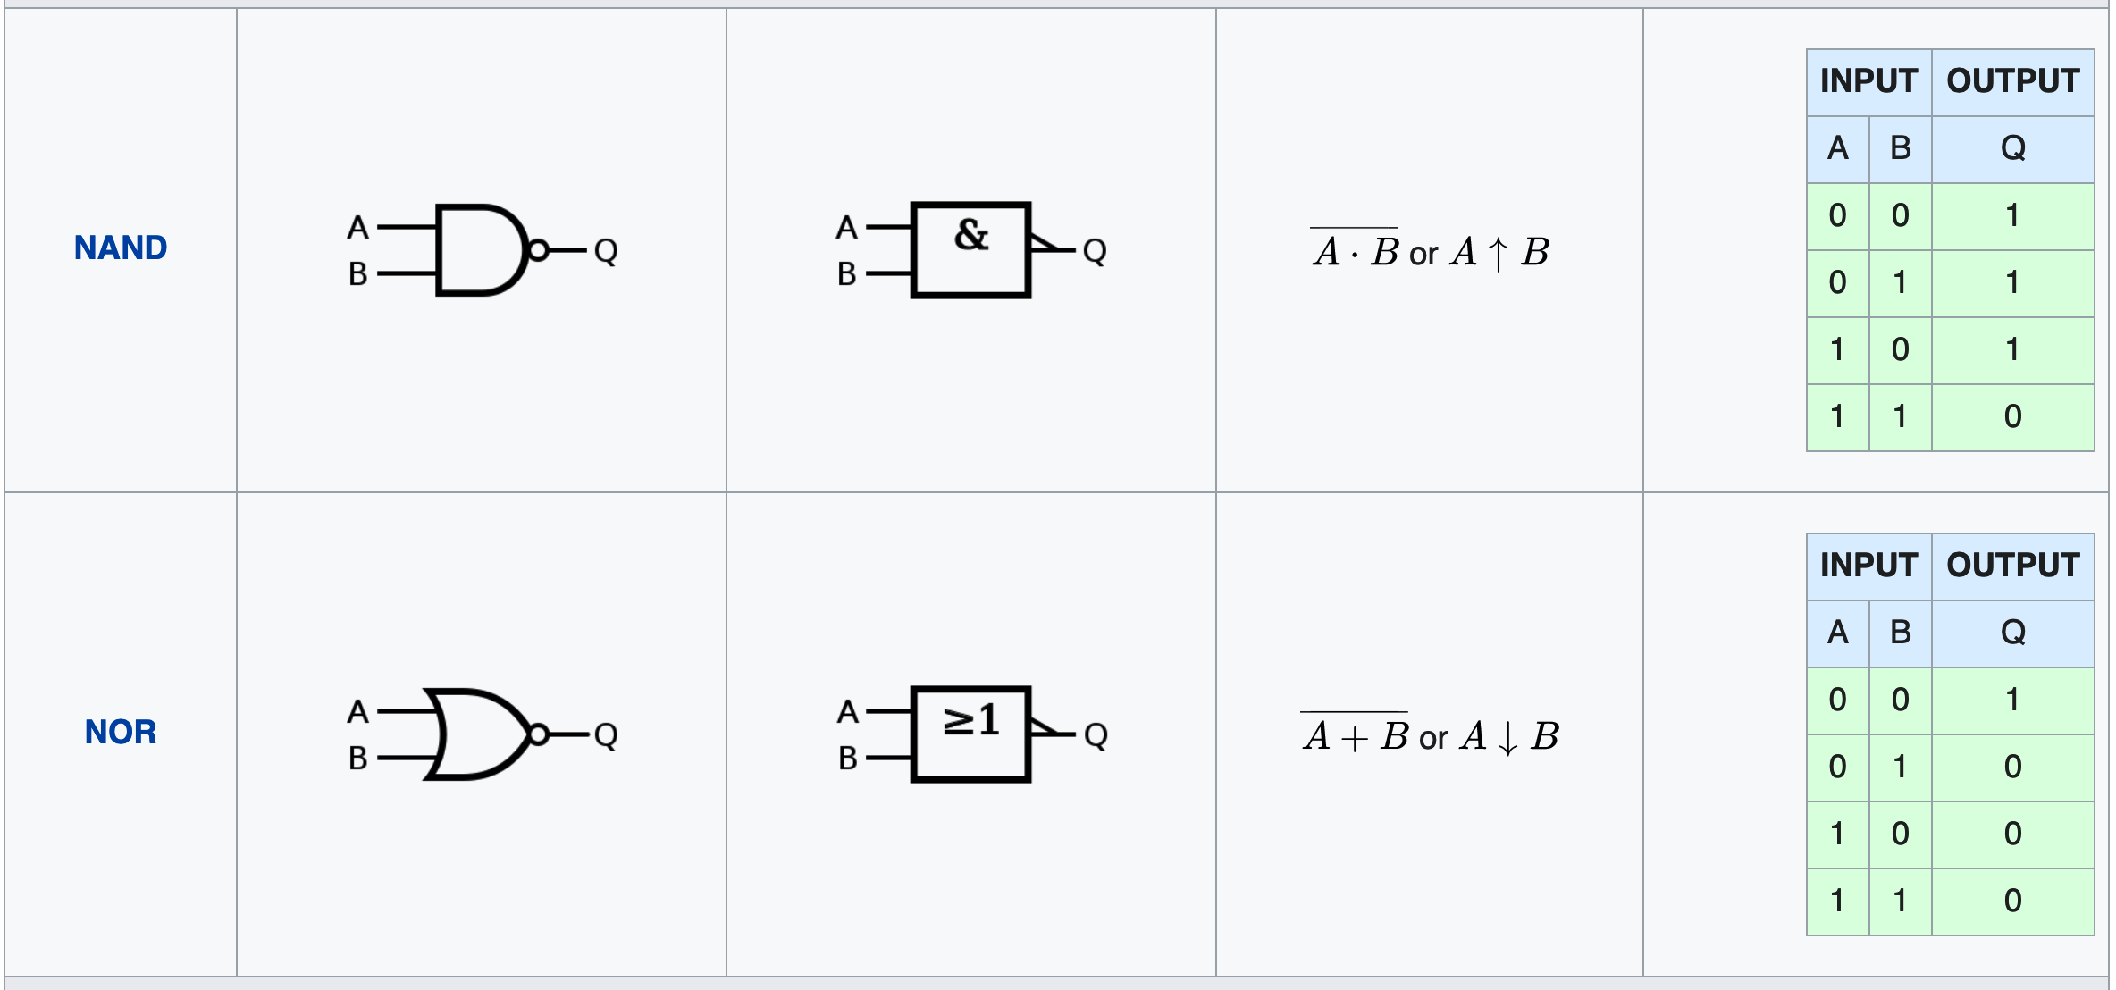
Examples of Logic Gates

Slide 47
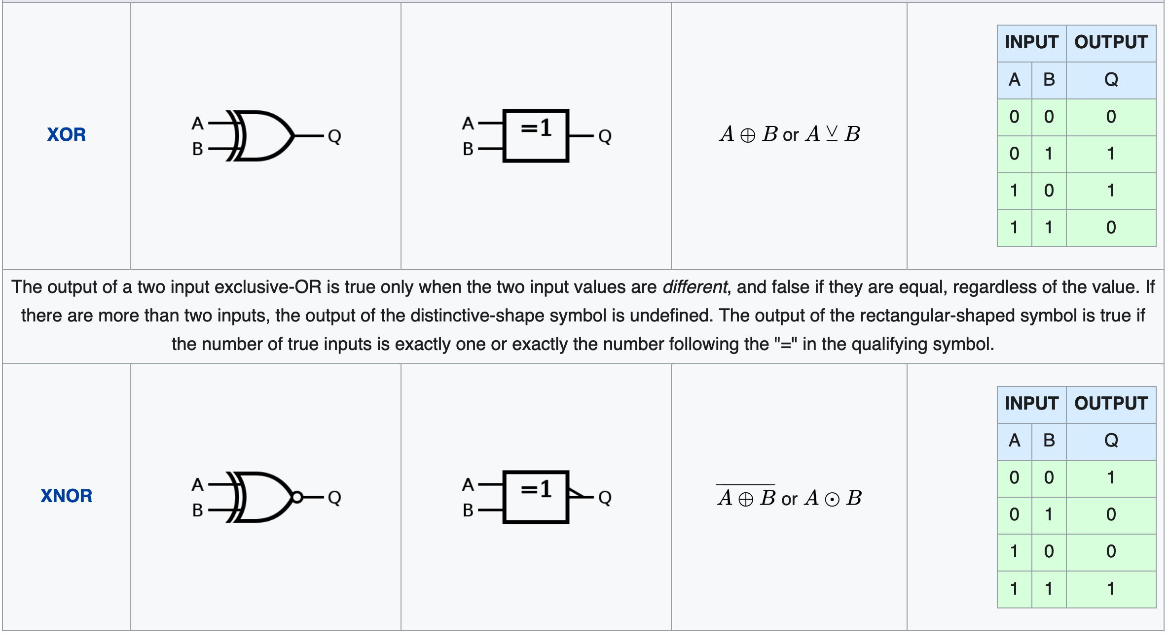
Examples of Logic Gates

Slide 48
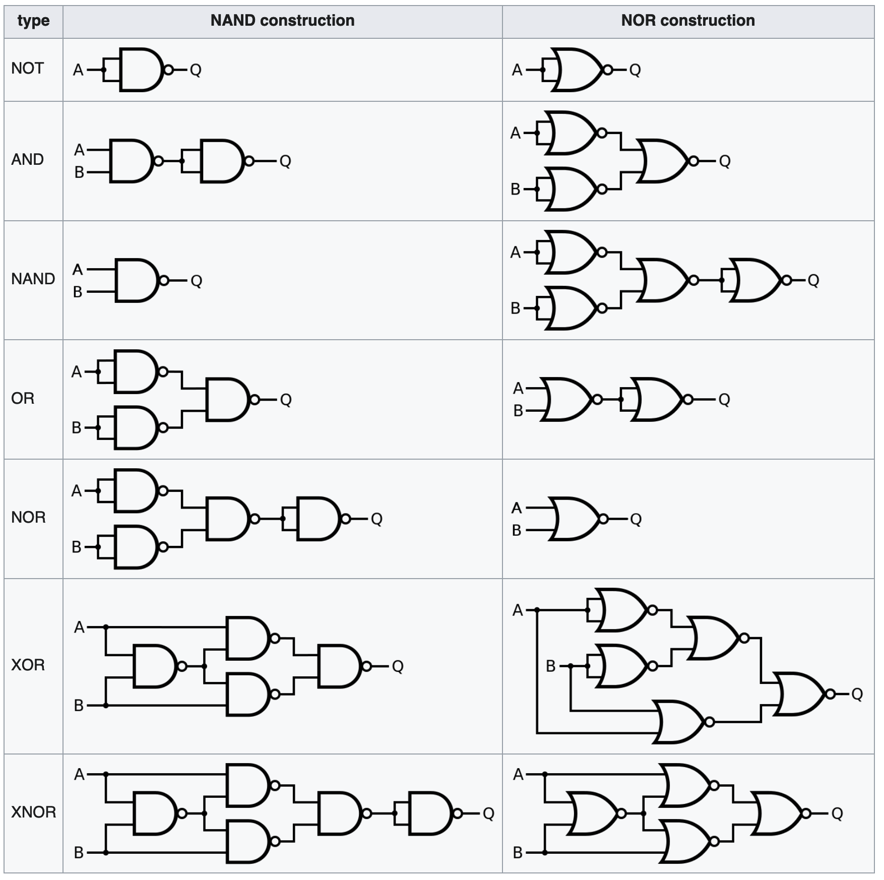
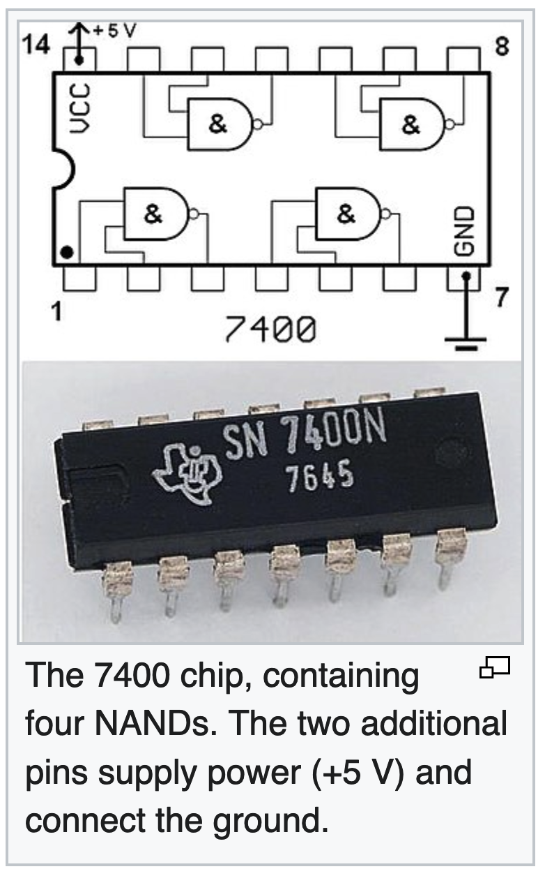
In Practice

Slide 49
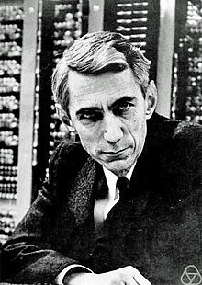
The Father of Information Theory: Claude Shannon
Claude Elwood Shannon (April 30, 1916 – February 24, 2001) was an American mathematician, electrical engineer, and cryptographer known as "the father of information theory".
Shannon founded information theory with a landmark paper, "A Mathematical Theory of Communication", which he published in 1948.
He also founded digital circuit design theory in 1937, when, as a 21-year-old master's degree student at the Massachusetts Institute of Technology (MIT), he wrote his thesis demonstrating that electrical applications of Boolean algebra could construct any logical numerical relationship.
Shannon contributed to the field of cryptanalysis for national defense during World War II, including his fundamental work on codebreaking and secure telecommunications

Slide 50
Q: How Much Information is Contained in a Message?
In 1948, the promised memorandum appeared as "A Mathematical Theory of Communication", an article in two parts in the July and October issues of the Bell System Technical Journal.
This work focuses on the problem of how best to encode the message a sender wants to transmit.
In this fundamental work, he used tools in probability theory, developed by Norbert Wiener, which were in their nascent stages of being applied to communication theory at that time.
Shannon developed information entropy as a measure of the information content in a message, which is a measure of uncertainty reduced by the message.
In so doing, he essentially invented the field of information theory.
The book The Mathematical Theory of Communication reprints Shannon's 1948 article and Warren Weaver's popularization of it, which is accessible to the non-specialist.
Weaver pointed out that the word "information" in communication theory is not related to what you do say, but to what you could say.
That is, information is a measure of one's freedom of choice when one selects a message.
Shannon's concepts were also popularized, subject to his own proofreading, in John Robinson Pierce's Symbols, Signals, and Noise.

Slide 51
Claude Shannon
Information theory's fundamental contribution to natural language processing and computational linguistics was further established in 1951, in his article "Prediction and Entropy of Printed English", showing upper and lower bounds of entropy on the statistics of English, giving a statistical foundation to language analysis.
In addition, he proved that treating whitespace as the 27th letter of the alphabet actually lowers uncertainty in written language, providing a clear quantifiable link between cultural practice and probabilistic cognition.
Another notable paper published in 1949 is "Communication Theory of Secrecy Systems", a declassified version of his wartime work on the mathematical theory of cryptography, in which he proved that all theoretically unbreakable ciphers must have the same requirements as the one-time pad.
He is also credited with the introduction of sampling theory, which is concerned with representing a continuous-time signal from a (uniform) discrete set of samples.
This theory was essential in enabling telecommunications to move from analog to digital transmissions systems in the 1960s and later.
He returned to MIT to hold an endowed chair in 1956.

Slide 52
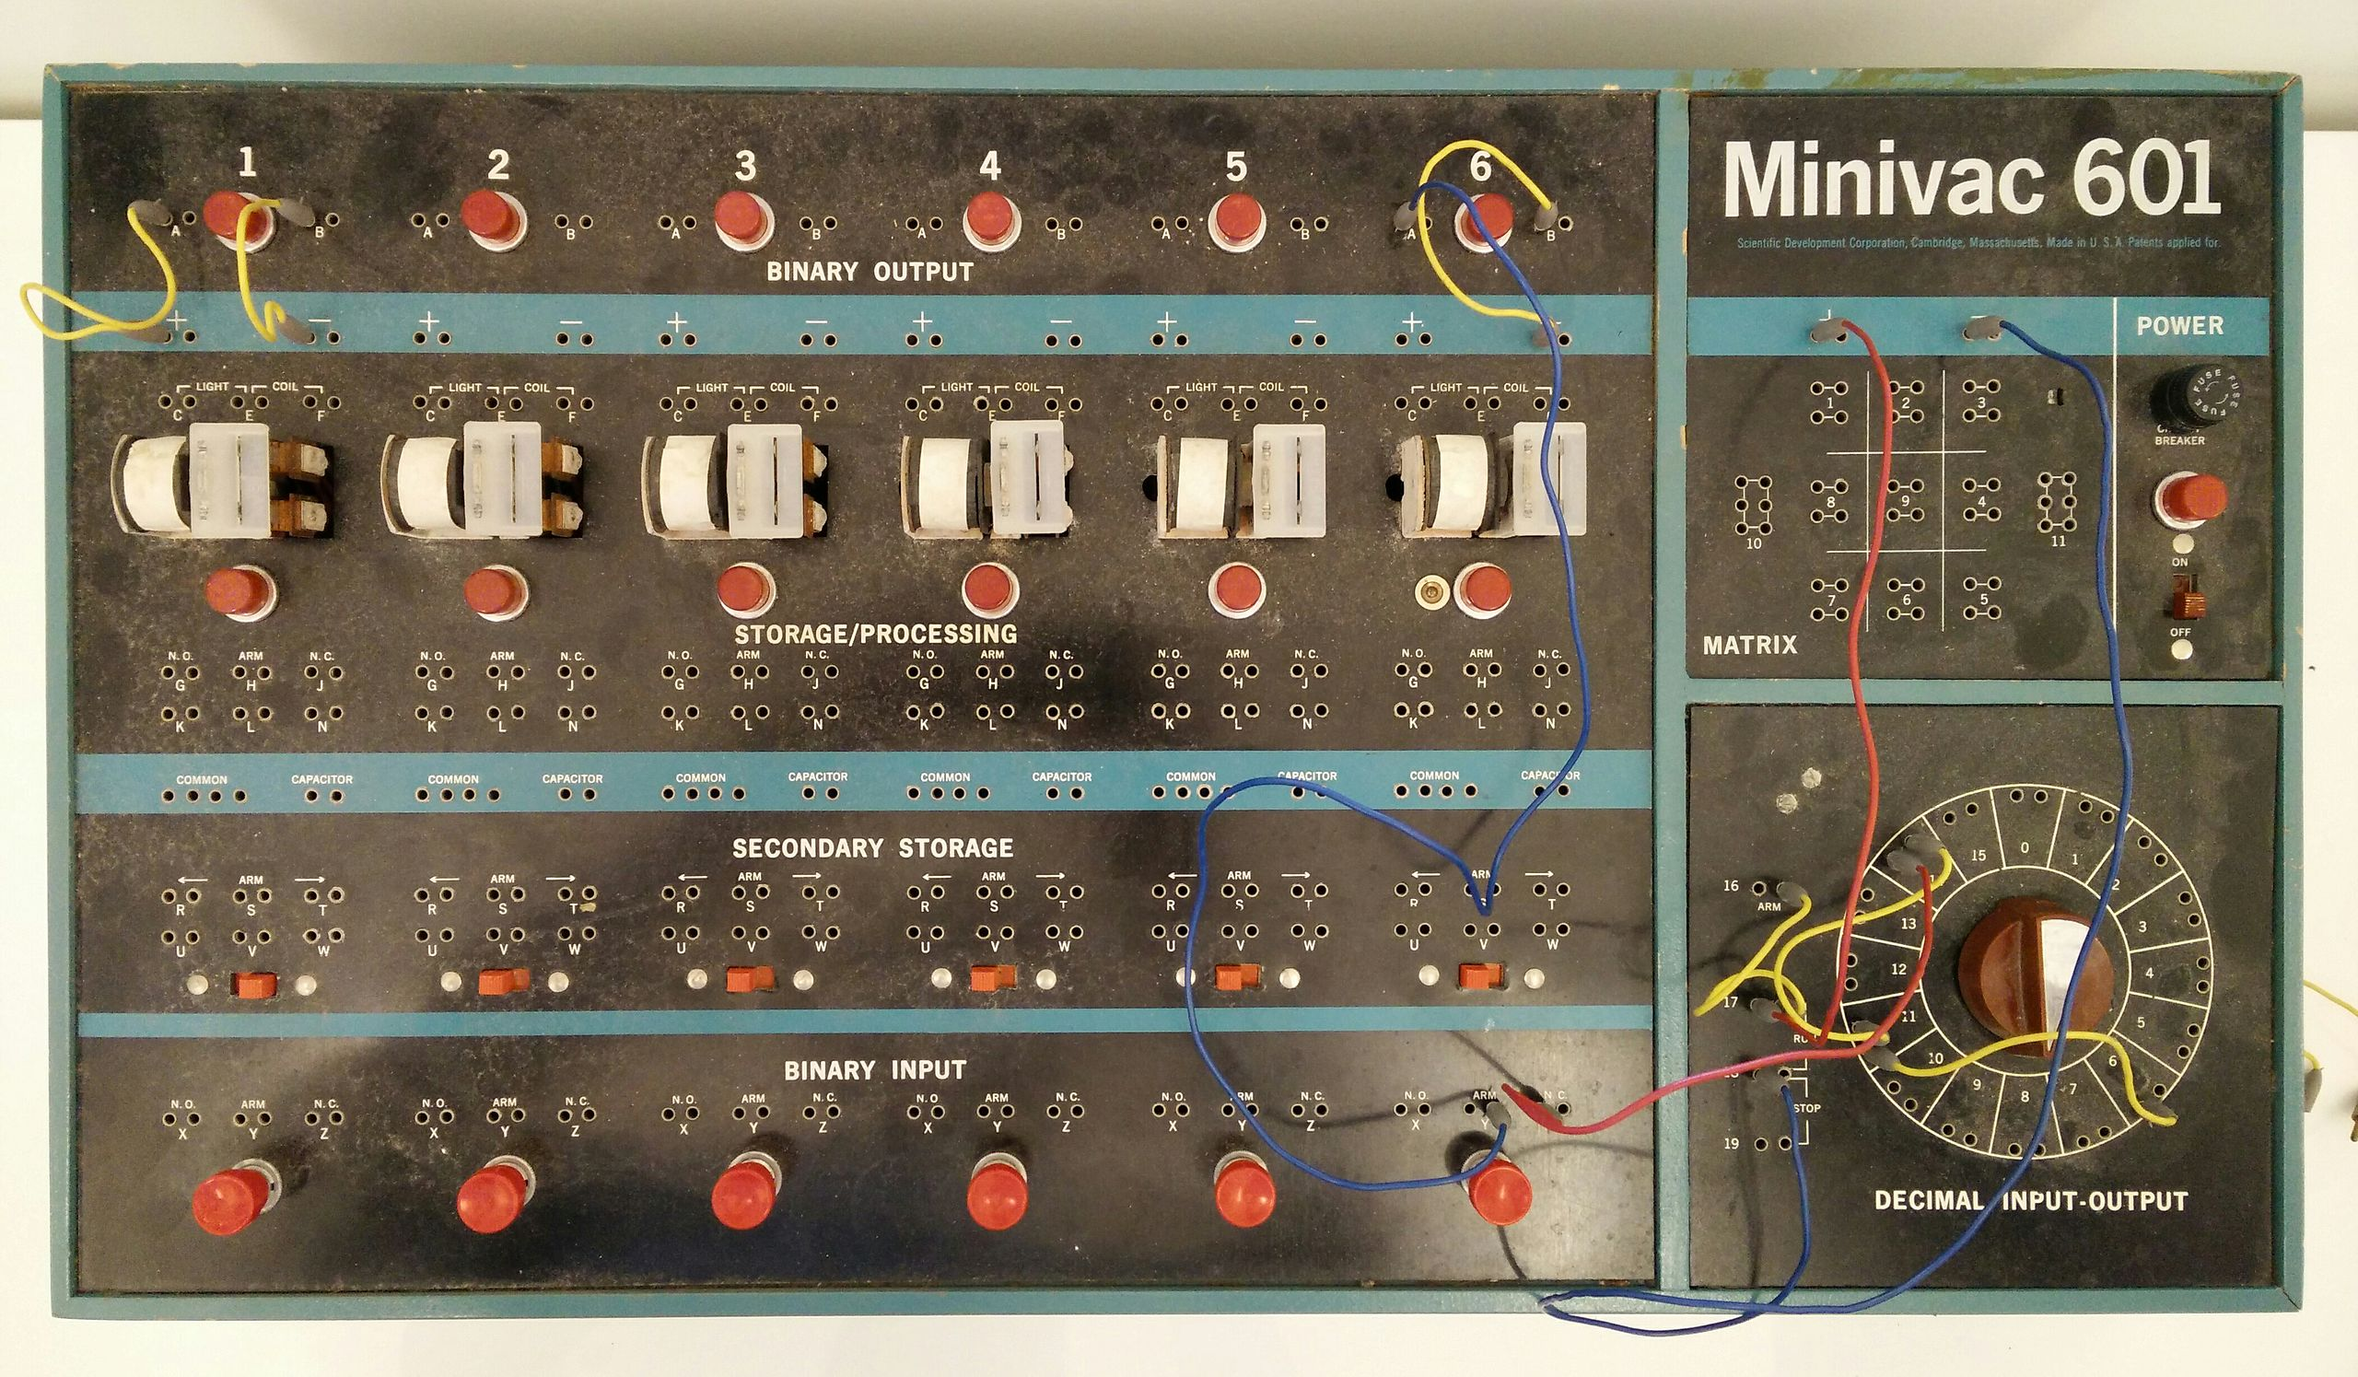
Shannon Had Many Interests
Outside of Shannon's academic pursuits, he was interested in juggling, unicycling, and chess.
He also invented many devices, including a Roman numeral computer called THROBAC, juggling machines, and a flame-throwing trumpet.
He built a device that could solve the Rubik's Cube puzzle.
Shannon designed the Minivac 601, a digital computer trainer to teach business people about how computers functioned.
It was sold by the Scientific Development Corp starting in 1961.
He is also considered the co-inventor of the first wearable computer along with Edward O. Thorp, and the device was used to improve the odds when playing roulette, about which we will discuss more later

Slide 53
Information Theory https://en.wikipedia.org/wiki/Information_theory
As implied earlier, information theory is the scientific study of the quantification, storage, and communication of digital information.
The field was fundamentally established by the works of Harry Nyquist and Ralph Hartley, in the 1920s, and Claude Shannon in the 1940s.
The field is at the intersection of probability theory, statistics, computer science, statistical mechanics, information engineering, and electrical engineering.
A key measure in information theory is entropy.
Entropy quantifies the amount of uncertainty involved in the value of a random variable or the outcome of a random process. (Ludwig Boltzmann)
For example, identifying the outcome of a fair coin flip (with two equally likely outcomes) provides less information (lower entropy) than specifying the outcome from a roll of a die (with six equally likely outcomes).
Some other important measures in information theory are mutual information, channel capacity, error exponents, and relative entropy.

Slide 54
Areas that have been impacted by Information Theory Include:
  lossless data compression (e.g. ZIP files)
  lossy data compression (e.g. MP3s and JPEGs)
  channel coding (e.g. for DSL
  statistical inference
  cryptography
  neurobiology
  perception
  linguistics
  bioinformatics
  thermal physics
  molecular dynamics
  quantum computing
  black holes,
  information retrieval,
  intelligence gathering,
  plagiarism detection, pattern recognition,
  anomaly detection
  art creation
  invention of the compact disc
  the Voyager deep space mission
  mobile phones
  the internet
  earthquake models

Slide 55
Quantity of Information
Information theory is based on probability theory and statistics.
Information theory often concerns itself with measures of information of the distributions associated with random variables.
As stated before, important quantities of information are entropy, a measure of information in a single random variable, and mutual information, a measure of information in common between two random variables.
The former quantity is a property of the probability distribution of a random variable and gives a limit on the rate at which data generated by independent samples with the given distribution can be reliably compressed.
The latter is a property of the joint distribution of two random variables, and is the maximum rate of reliable communication across a noisy channel in the limit of long block lengths, when the channel statistics are determined by the joint distribution.
A common unit of information is the bit, based on the binary logarithm.
Other units include the nat, which is based on the natural logarithm, and the decimal digit, which is based on the common logarithm.

Slide 56
Noisy Channel Coding Theorem https://en.wikipedia.org/wiki/Noisy-channel_coding_theorem
In information theory, the noisy-channel coding theorem (sometimes Shannon's theorem or Shannon's limit), establishes that for any given degree of noise contamination of a communication channel, it is possible to communicate discrete data (digital information) nearly error-free up to a computable maximum rate through the channel.
This result was presented by Claude Shannon in 1948 and was based in part on earlier work and ideas of Harry Nyquist and Ralph Hartley.
The Shannon limit or Shannon capacity of a communication channel refers to the maximum rate of error-free data that can theoretically be transferred over the channel if the link is subject to random data transmission errors, for a particular noise level.
It was first described by Shannon (1948), and shortly after published in a book by Shannon and Warren Weaver entitled The Mathematical Theory of Communication (1949).

Slide 57
To Repeat: Basic Overview
Information theory studies the transmission, processing, extraction, and utilization of information.
Abstractly, information can be thought of as the resolution of uncertainty.
In the case of communication of information over a noisy channel, this abstract concept was formalized in 1948 by Claude Shannon in the paper mentioned earlier, A Mathematical Theory of Communication
Here information is thought of as a set of possible messages, and the goal is to send these messages over a noisy channel, and to have the receiver reconstruct the message with low probability of error, in spite of the channel noise.
Shannon's main result, the noisy-channel coding theorem showed that, in the limit of many channel uses, the rate of information that is asymptotically achievable is equal to the channel capacity, a quantity dependent merely on the statistics of the channel over which the messages are sent.

Slide 58
To Repeat: Basic Overview
In Shannon's groundbreaking paper, Shannon for the first time introduced the qualitative and quantitative model of communication as a statistical process underlying information theory, opening with the assertion:
"The fundamental problem of communication is that of reproducing at one point, either exactly or approximately, a message selected at another point." With it came the ideas of :
  The information entropy and redundancy of a source, and its relevance through the source coding theorem;
  The mutual information, and the channel capacity of a noisy channel, including the promise of perfect loss-free communication given by the noisy-channel coding theorem;
  The practical result of the Shannon–Hartley law for the channel capacity of a Gaussian channel; as well as
  The bit—a new way of seeing the most fundamental unit of information.

Slide 59
History
As stated before, the landmark event establishing the discipline of information theory and bringing it to immediate worldwide attention was the publication of Claude E. Shannon's classic paper "A Mathematical Theory of Communication” in 1948
Prior to this paper, limited information-theoretic ideas had been developed at Bell Labs, all implicitly assuming events of equal probability.
Harry Nyquist's 1924 paper, Certain Factors Affecting Telegraph Speed, contains a theoretical section quantifying "intelligence" and the "line speed" at which it can be transmitted by a communication system, giving the relation
W = K log m
Here K is similar to Boltzmann's constant, W is the speed of transmission of intelligence, m is the number of different voltage levels to choose from at each time step, and K is a constant.
Ralph Hartley's 1928 paper, Transmission of Information, uses the word information as a measurable quantity, reflecting the receiver's ability to distinguish one sequence of symbols from any other, thus quantifying information as:
H = log S^{n} = n log S,
where S was the number of possible symbols, and n the number of symbols in a transmission.

Slide 60
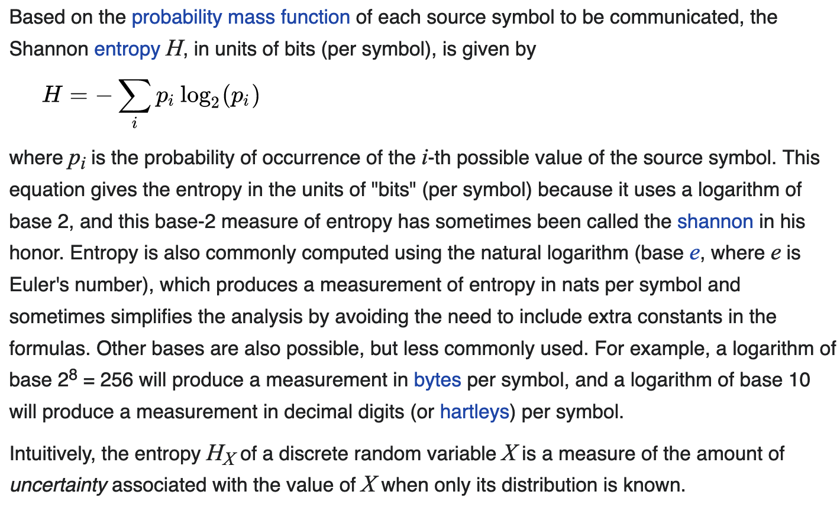
Definition
Shannon entropy represents the surprise value (or “surprisal”) of the bit string.
The entropy of a source that emits a sequence of N symbols that are independent and identically distributed (iid) is N ⋅ H bits (per message of N symbols). If the source data symbols are identically distributed but not independent, the entropy of a message of length N will be less than N ⋅ H.

Slide 61
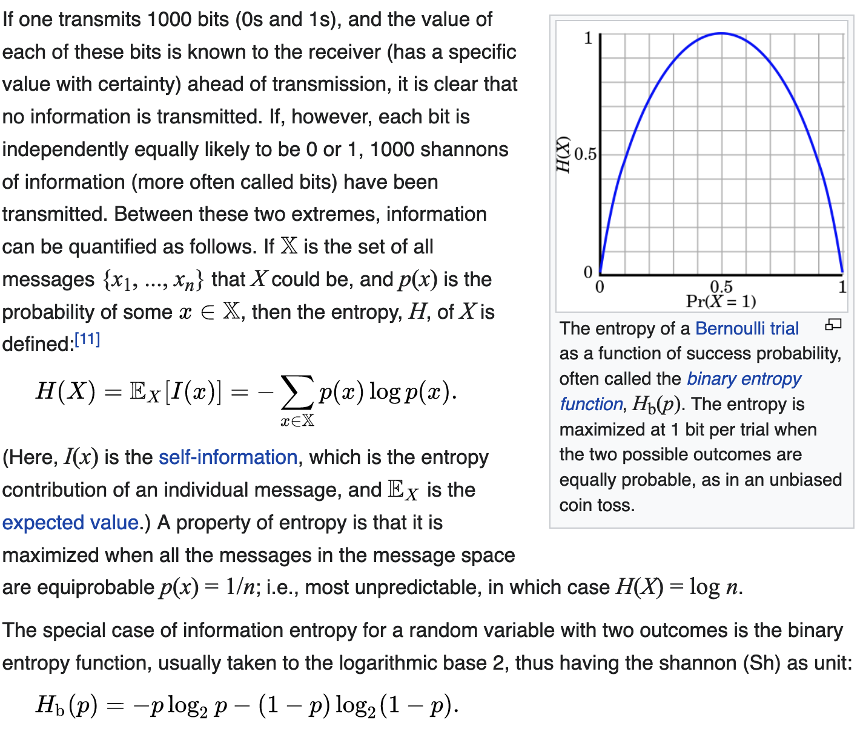
Shannon Information (Entropy) H(X)

Slide 62
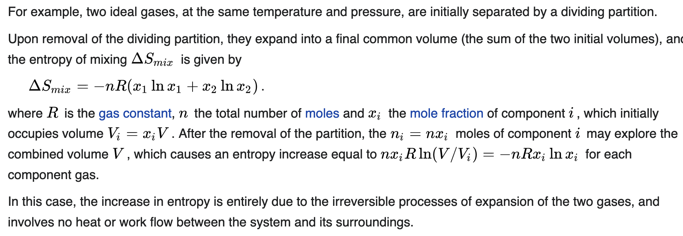
Entropy of Mixing of Two Sets of Molecules
Note that this is basically the same as Shannon Entropy, since there we are mixing 1’s and 0’s in a bit string

Slide 63
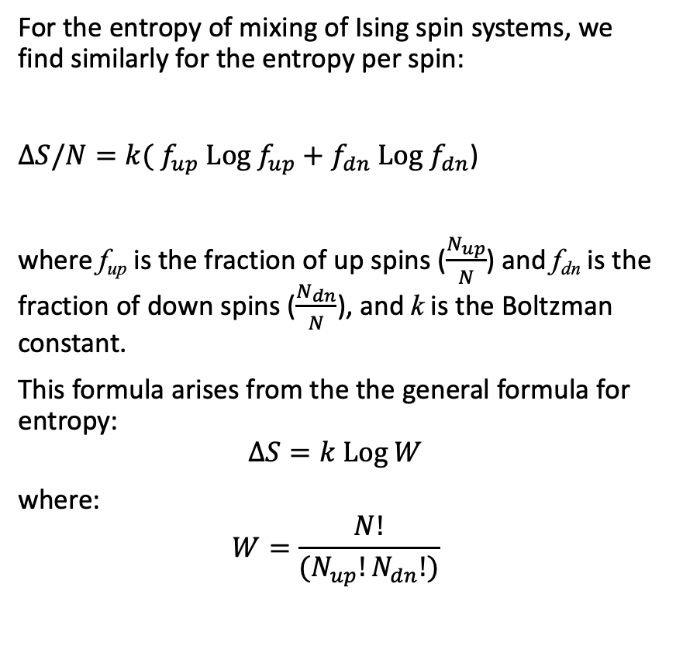
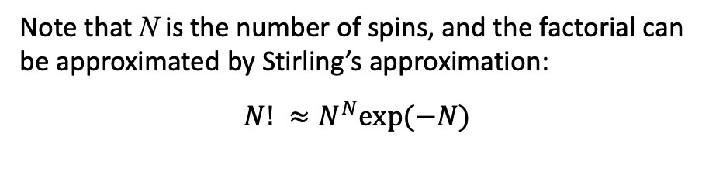
Entropy of Mixing of a Magnetic (Ising) System
(or a system of 1’s and 0’s, i.e., bits)
For the entropy of mixing of Ising spin systems, we find similarly for the entropy per spin:
$∆S/N={k( f}_{up} Log f_{up}+f_{dn} Log f_{dn}$)
where f_{up} is the fraction of up spins ($\frac{N_{up}}{N}$) and f_{dn} is the fraction of down spins ($\frac{N_{dn}}{N}$), and k is the Boltzman constant.
This formula arises from the the general formula for entropy:
$$∆S=k Log W$$
where:
$$W=\frac{N!}{{(N}_{up}!N_{dn}!)}$$
Note that N is the number of spins, and the factorial can be approximated by Stirling’s approximation:
$$N! ≈N^{N}exp⁡(−N)$$
A bit string can be represented as a 1-dimensional Ising model

