Slide 1

Information Theory: An Application
To analyze information transmitted, we ask a series of Yes/No questions
How can we use this formalism to anticipate an event like an earthquake?
Related: Is there information contained in earthquake records?

Slide 2






Anticipating Earthquakes with AI-Enhanced Machine Learning: Earthquake Research at the University of California
Collaborators:
Geoffrey Fox
James Crutchfield
Andrea Donnellan
Lisa Grant
Cristián Siegal
John Rundle
University of California, Davis
Credits:
Wikipedia
US Geological Survey
NASA

Slide 3

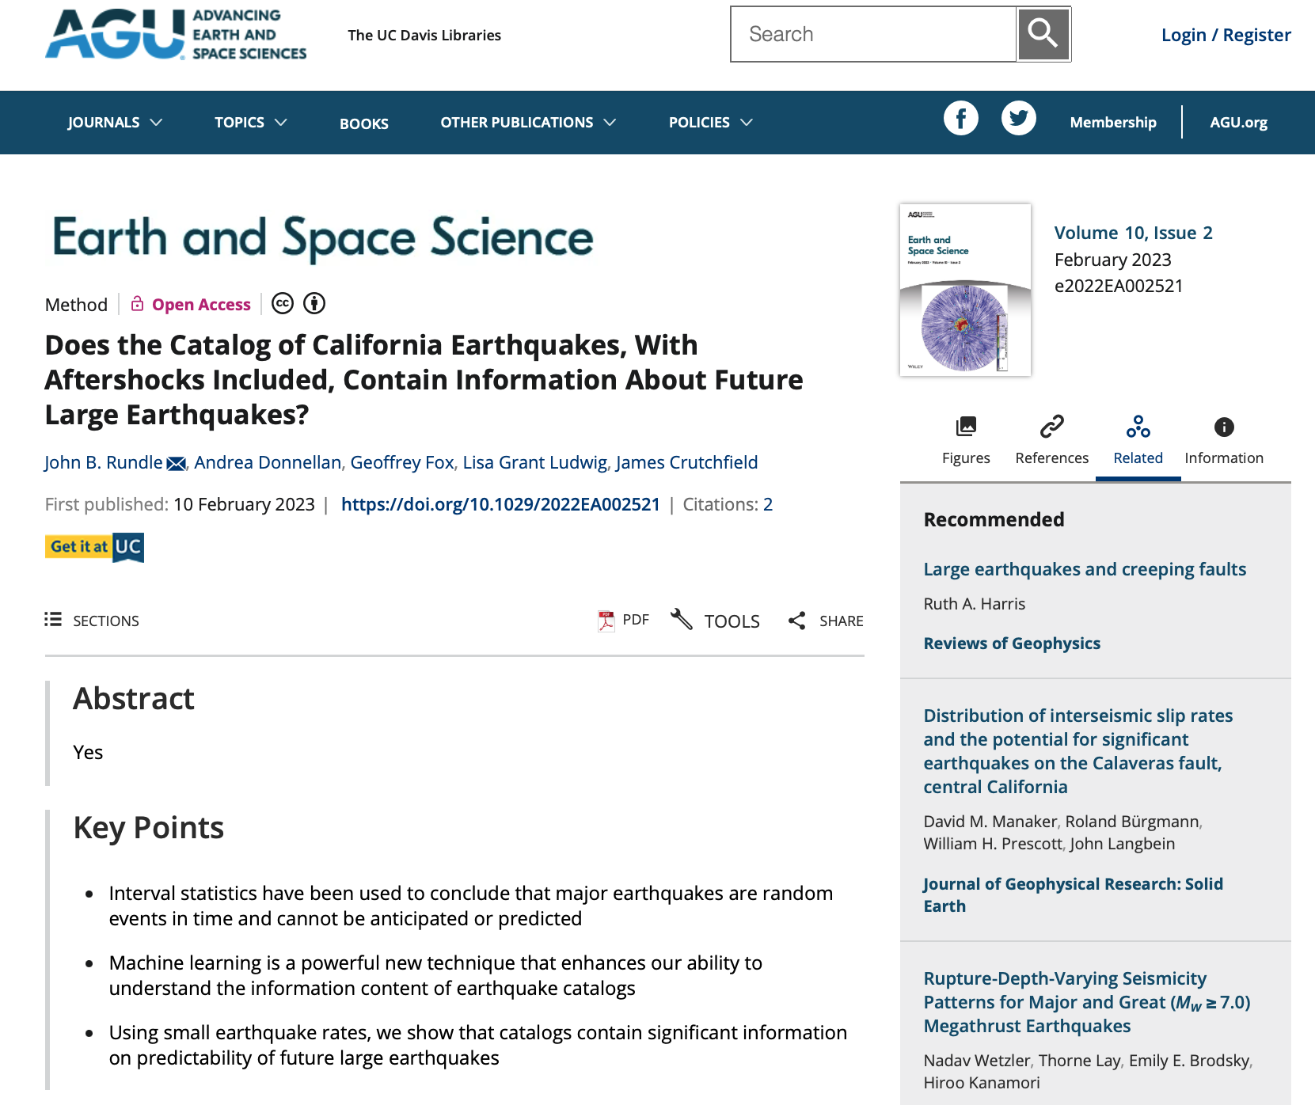
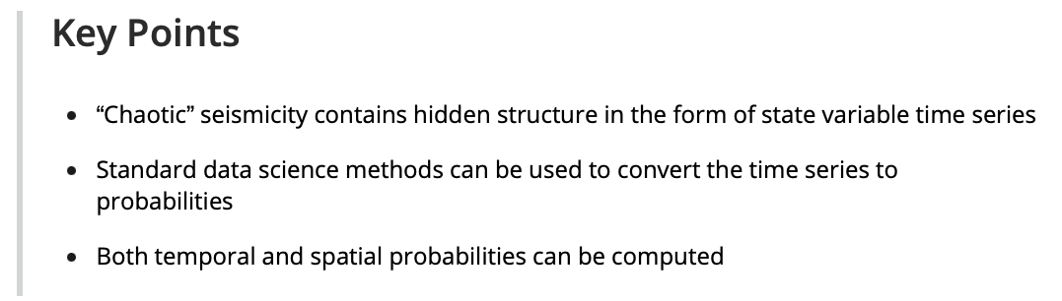
Recent Papers
(For code availability, see sections in the papers below on “Open Research”)
https://agupubs.onlinelibrary.wiley.com/doi/full/10.1029/2022EA002343
https://agupubs.onlinelibrary.wiley.com/doi/full/10.1029/2022EA002521

Slide 4
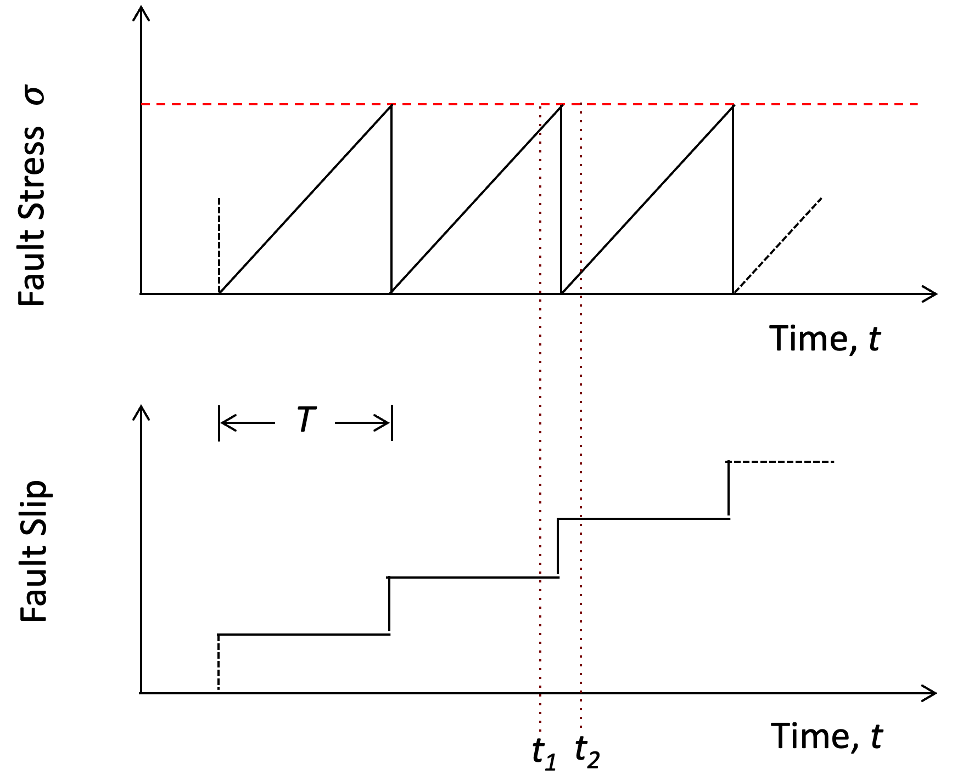
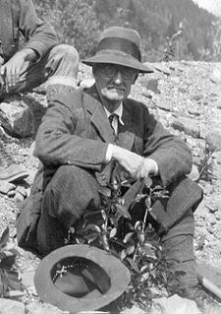
The Earthquake Cycle: Elastic Rebound on a Fault
Report of the 1906 Earthquake Investigation (1910)
Earthquake forecasting and prediction would be easy if we could observe the buildup of tectonic stress…
But we can’t !!!!
What we would like is some observable that increases following the last large earthquake towards the occurrence of the next large earthquake, and some threshold value that tells us when the next earthquake is imminent!
Harry Fielding Reid (1859-1944)

Slide 5
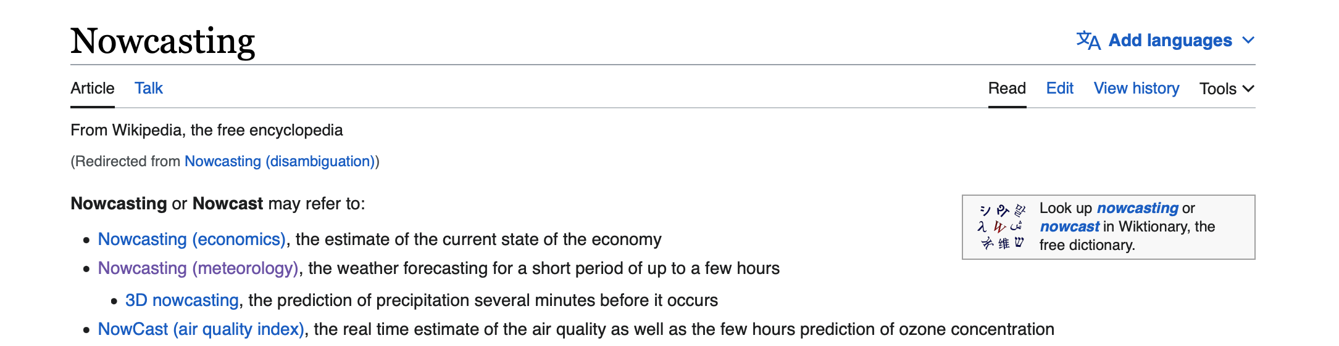
Nowcasting
The estimation of the state of a system in the recent past, currently, and the near future
https://en.wikipedia.org/wiki/Nowcasting
Nowcasting Earthquakes
We use space-time patterns of small earthquakes
to nowcast large earthquakes
Nowcasting in Continuous Time with Machine Learning
Nowcasting in Continuous Time with Generative AI

Slide 6
Terminology
“Prediction”
vs.
“Forecasting”
vs.
“Nowcasting”
Context | Characteristic | Comments
Prediction | A precise statement of time, location, magnitude based on “precursor signals” | No reliable precursors have yet been found
Forecast | Computation of long- term probabilities for time, location, magnitude | Probabilities for large earthquakes are typically very low and are often ignored
Nowcast | Tracks the current state of the earthquake system in time | Large earthquake potential for current time and near future

Slide 7
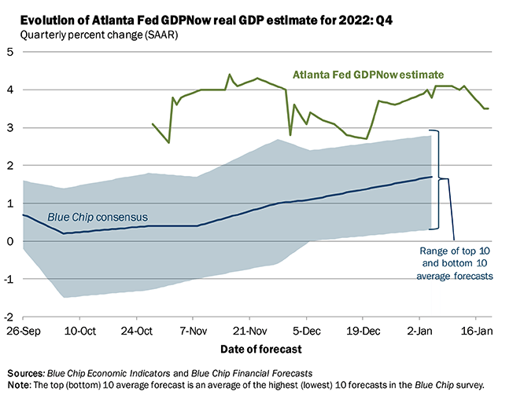
But…What is a Nowcast??
This is what the Federal Reserve does to track the GDP of the US in real time using proxy variables

Slide 8
Beyond Poisson
Continuous Time Nowcasting for Earthquake Hazard Analysis
Requirements
Simplicity
Rigorous methods for testing and optimization using machine learning
>> Desired: Transparent computation of probabilities directly from observed data <<
(No pre-assumed statistical distribution or stress models)
JBR et al., 2021a,b,c; 2022a,b

Slide 9
Basic Method for Earthquake Nowcasting
Download catalog data from USGS.
Build a filter with adjustable parameters for the small earthquake seismicity.
Using the Receiver Operating Characteristic skill score, also called Area Under Curve (AUC) as a loss function, optimize parameters using machine learning ideas.
Compute the Precision, Recall, and other ML measures.
JBR et al., Earth and Space Science (2022); Code Available under “Open Research
https://doi.org/10.1029/2022EA002343
JBR et al., Earth and Space Science, in Press (2023); Code Available under “Open Research

Slide 10
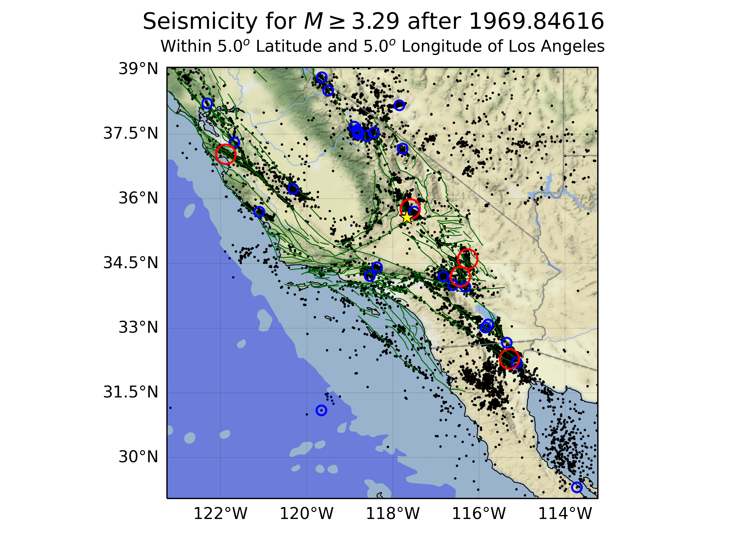
Seismicity in California 1970-Present, M>3.5
Major Earthquakes M>6.9
Loma Prieta, 1989, M=6.9
Landers, 1992, M=7.3
Hector Mine, 1999, M=7.1
El Mayor Cucupah, 2010, M=7.2
Ridgecrest, 2019, M=7.1
Machine learning is used in a new research method to compute large earthquake potential for the following 3 years, beginning in 1970

Slide 11
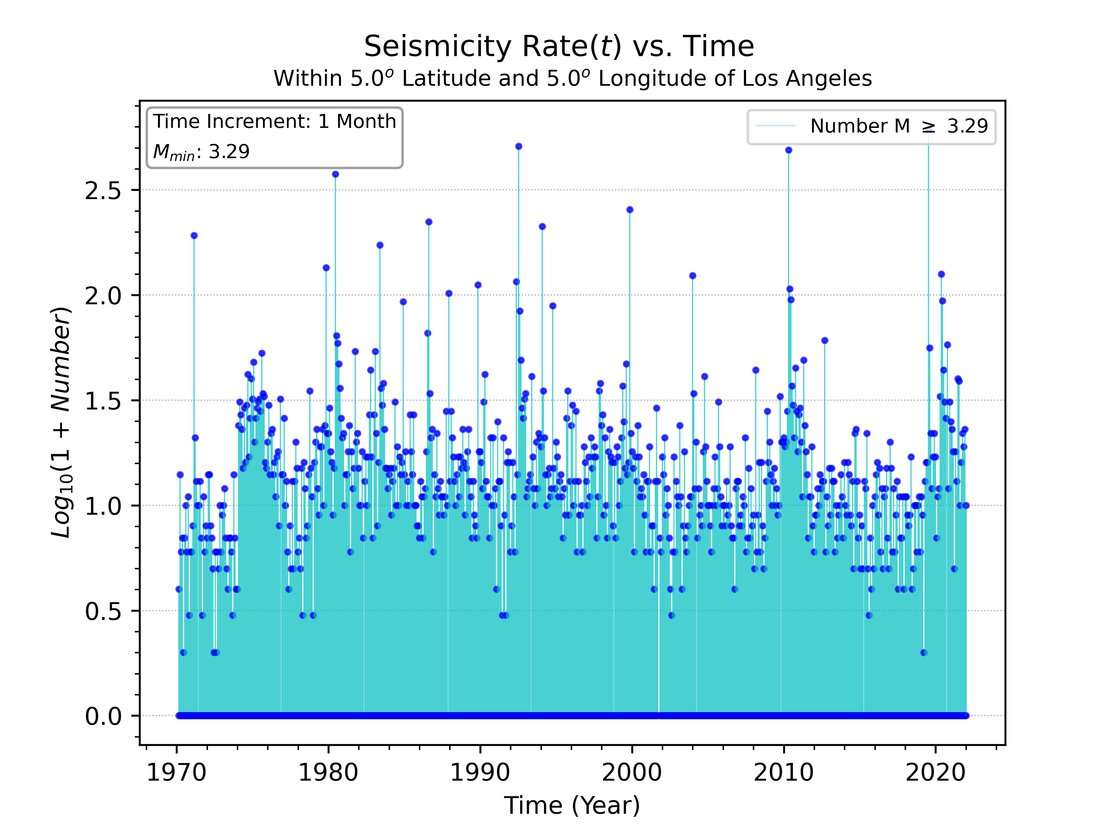
Earthquake Nowcast: Data
Red circles: M>7
Blue circles: M>6
Black dots: M>3.29
https://doi.org/10.1029/2022EA002343
Monthly Seismicity Rate

Slide 12
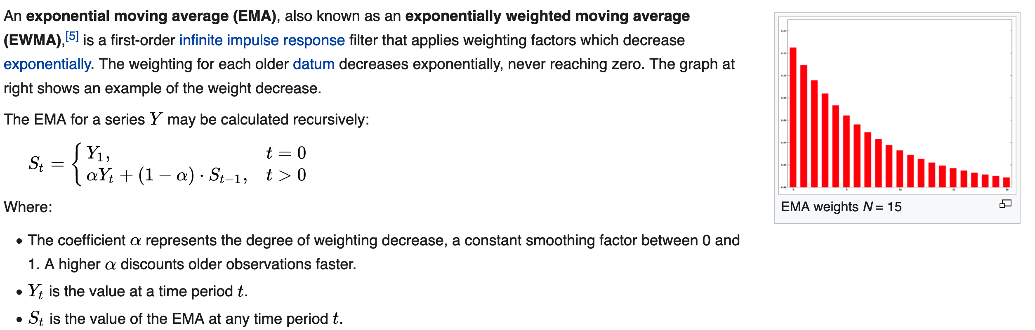

Exponential Moving Average (EMA) https://en.wikipedia.org/wiki/Moving_average
In general, $α= \frac{2}{1+N}$
We use an optimized value N = 36

Slide 13
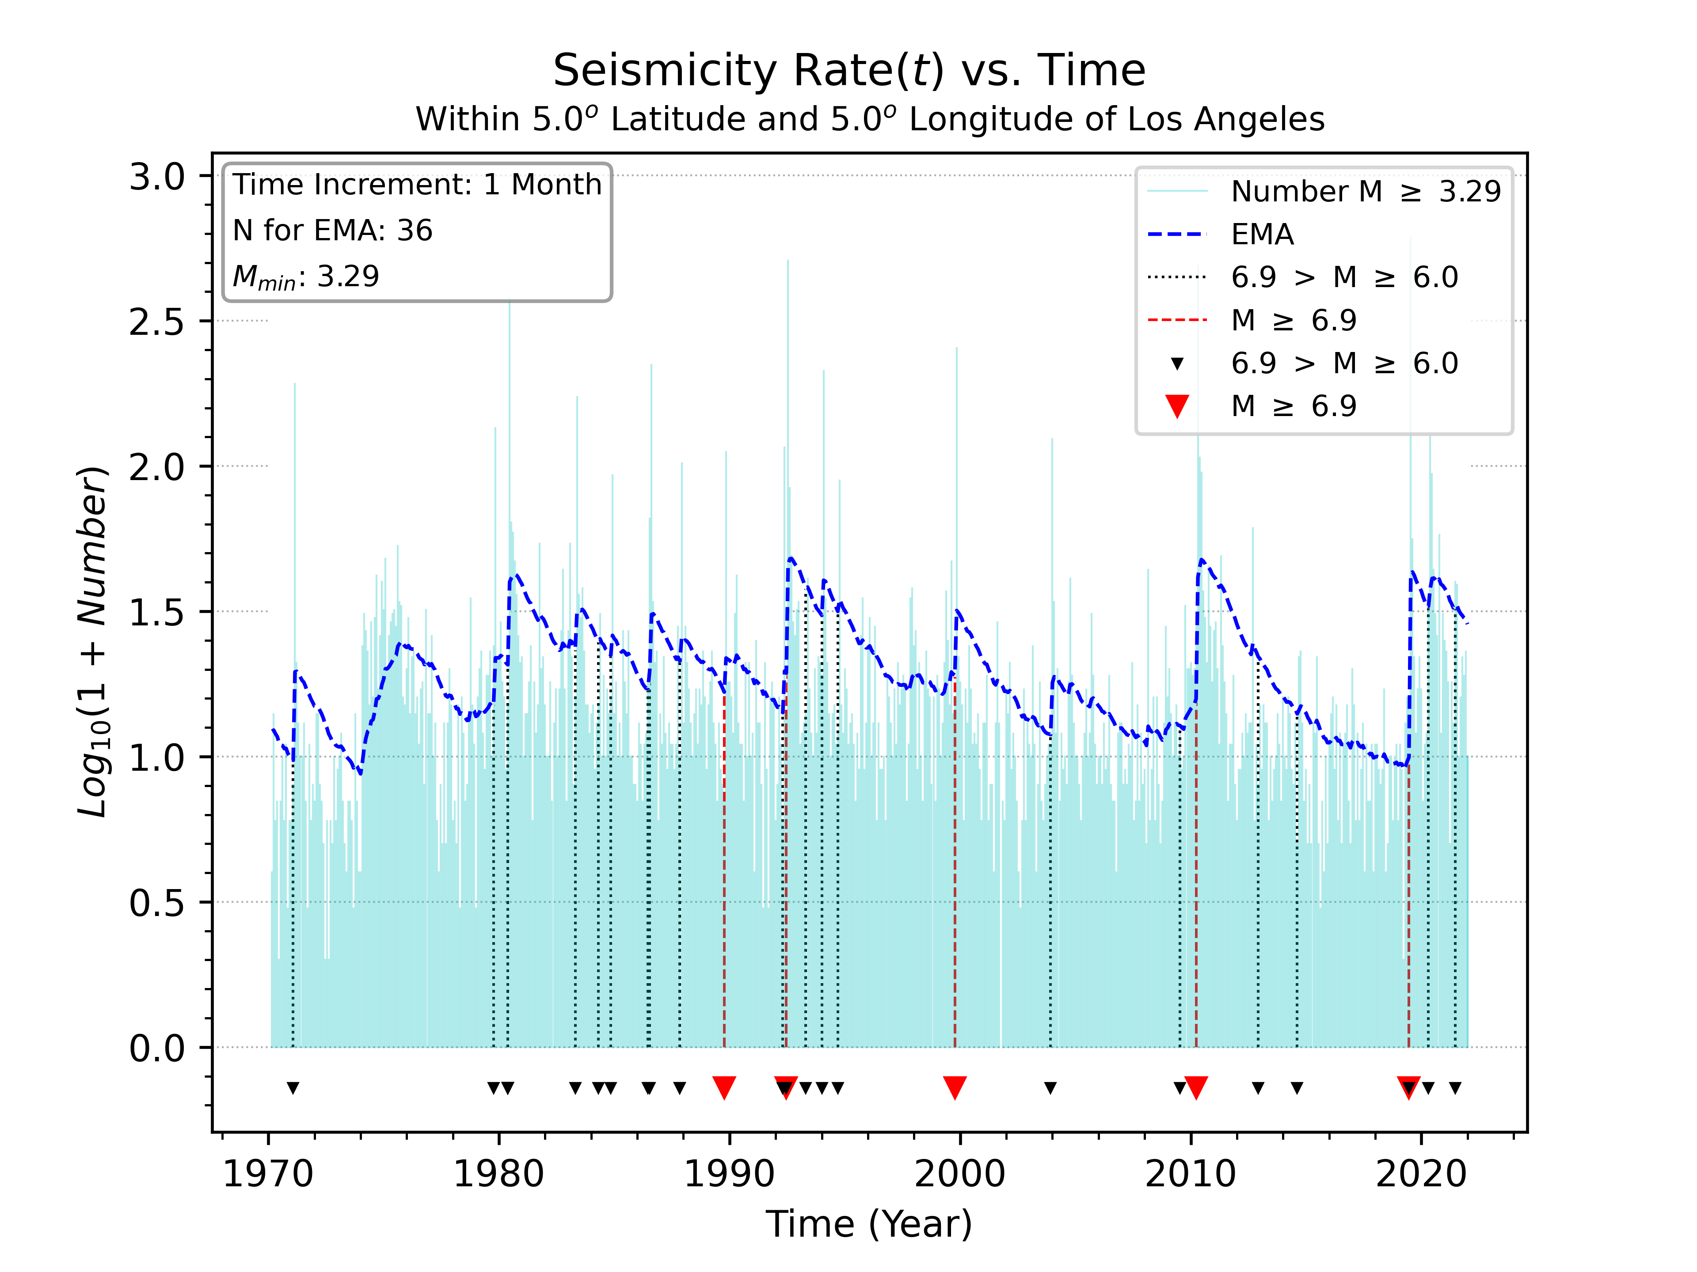
Applying EMA to Monthly Seismicity Timeseries
N= 36 is optimal
(Explained in the following)
Prior to the large earthquakes, we see relative quiescence in the Exponential Moving Average (EMA) curve
Notice that the EMA curve resembles an inverted version of the earthquake cycle
Activation
Quiescence

Slide 14
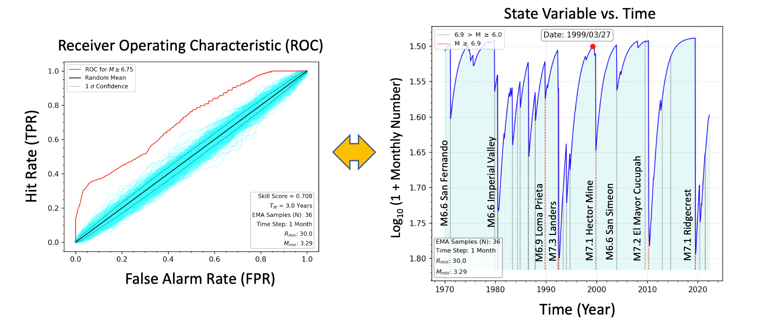
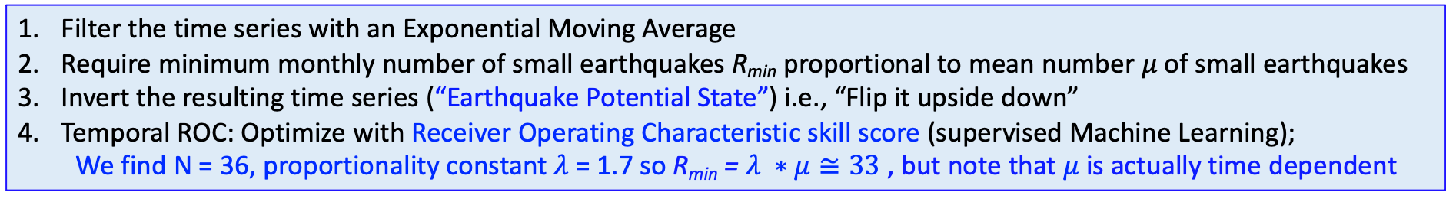
Building the Nowcast Timeseries
Filter the time series with an Exponential Moving Average
Require minimum monthly number of small earthquakes R_{min} proportional to mean number $μ$of small earthquakes
Invert the resulting time series (“Earthquake Potential State”) i.e., “Flip it upside down”
Temporal ROC: Optimize with Receiver Operating Characteristic skill score (supervised Machine Learning);
  We find N = 36, proportionality constant $λ$ = 1.7 so R_{min} = $λ ∗μ≅33$ , but note that $μ$ is actually time dependent
Earthquake Potential State vs. Time
Quiescence
Optimized EMA flipped upside down
Activation
M6.6 Superstition Hills
M6.7 Northridge
The EPS timeseries is a proxy for the regional stress accumulation and release

Slide 15
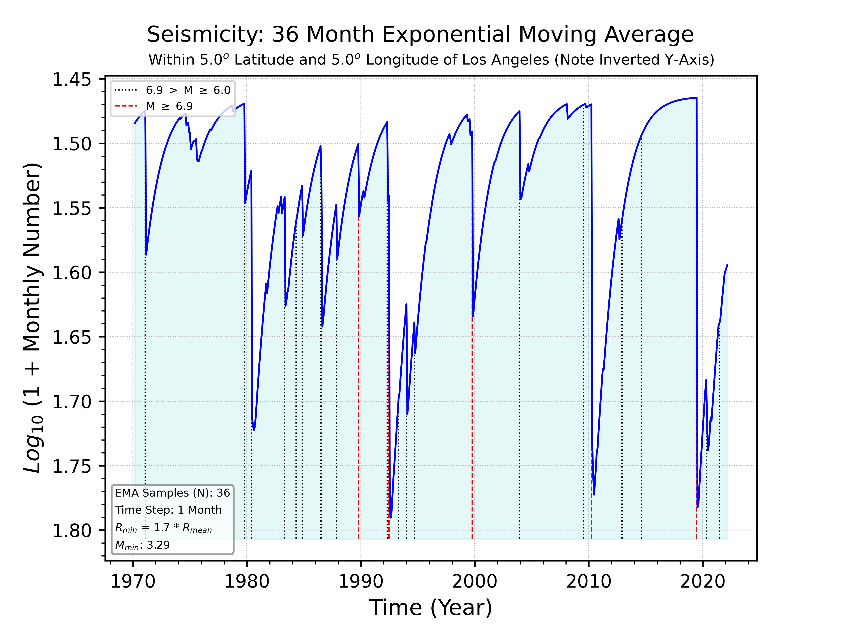
Forward Time Window T_{w}
Temporal ROC and Decision Thresholds
Forward Time Window T_{w}
With a chosen decision threshold D_{T}, sweep over all times and compute TP(D_{T}), FP(D_{T}), FN(D_{T}), TN(D_{T}), then populate the confusion matrix or contingency table.
For each threshold value we construct a contingency table or confusion matrix as below
Above Decision Threshold
Above Decision Threshold
Observed Predicted | Earthquake Observed in T_{W} | No Earthquake Observed in T_{W}
Earthquake Predicted in T_{W} | True Positive (TP) | False Positive (FP)
No Earthquake Predicted in T_{W} | False Negative (FN) | True Negative (TN)
Below Decision Threshold
Below Decision Threshold
Time series point is below decision threshold:
If large earthquake does occur within T_{W}, False Negative (FN)
If large earthquake does not occur within T_{W}, True Negative (TN)
Time series point is at or above decision threshold:
If large earthquake does occur within T_{W}, True Positive (TP)
If large earthquake does not occur within T_{W}, False Positive (FP)
Here we use T_{W} = 3 years, with 500 threshold values

Slide 16

Forward Time Window T_{w}
Temporal ROC and Decision Thresholds
Forward Time Window T_{w}
Next, compute the True Positive Rate TPR, False Positive Rate FPR, and Precision PPV:
$TPR= \frac{TP}{(TP+FN)}$ $FPR= \frac{FP}{(FP+TN)}$ $PPV= \frac{TP}{(TP+FP)}$
Then, sweep over all Decision Thresholds D_{T}
To construct the Receiver Operating Characteristic (ROC), plot TPR vs. FPR (both are functions of D_{T})
Note that each point on the ROC curve corresponds to a particular value of decision threshold D_{T} .
To construct the Precision, plot PPV vs. D_{T} .
Above Decision Threshold
Above Decision Threshold
Below Decision Threshold
Below Decision Threshold
Time series point is below decision threshold:
If large earthquake does occur within T_{W}, False Negative (FN)
If large earthquake does not occur within T_{W}, True Negative (TN)
Time series point is at or above decision threshold:
If large earthquake does occur within T_{W}, True Positive (TP)
If large earthquake does not occur within T_{W}, False Positive (FP)
Here we use T_{W} = 3 years, with 500 threshold values

Slide 17
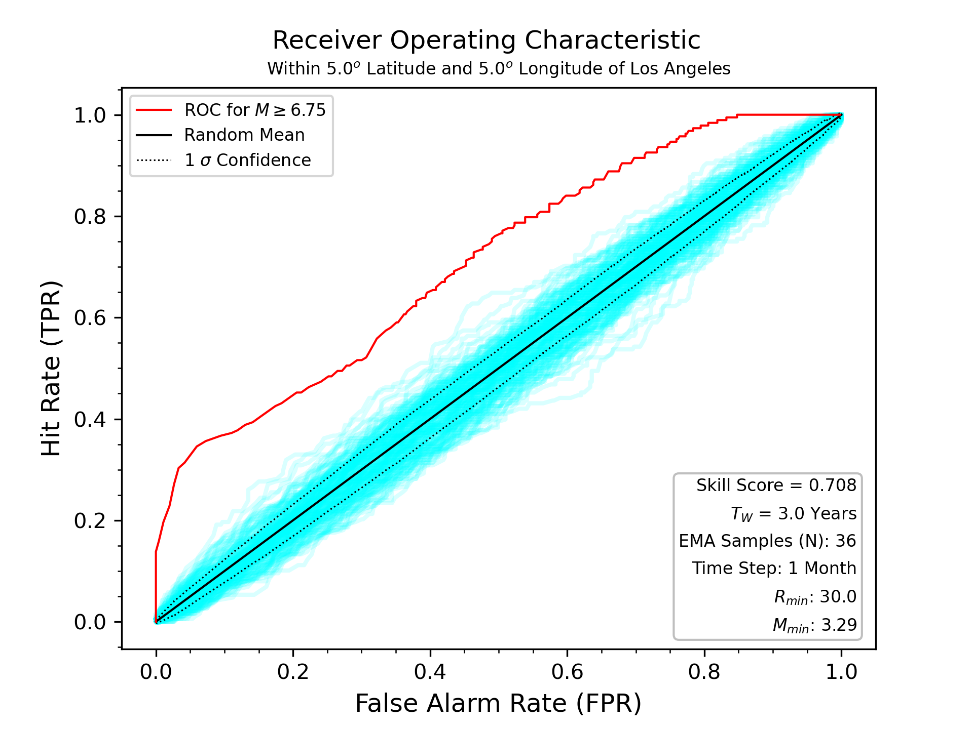
Optimize Nowcast “Skill” with a Receiver Operating Characteristic (ROC)
(Invented by the British in WWII for the analysis of radar returns)
Skill is the area under the ROC curve
For us, skill is the measure of how well a detection method can distinguish between a ”true signal” and a “false signal” for an M > 6.75 earthquake to occur during the following T_{W} = 3 years
Area under ROC curve is skill score
= 0.708 here
Every point on the ROC curve represents a particular value of a Decision Threshold
True signal can be either a True Positive (TP) or a True Negative (TN)
False signal can be either a False Positive (FP) or a False Negative (FN)
The area under the diagonal “No Skill” line = 0.5
A skill value of 0.7 or better, or a value of 0.3 or less, is considered to be significant skill
No Skill ROC Curve
(Diagonal Line)
200 random ROC curves from 200 random time series (bootstrap method)

Slide 18
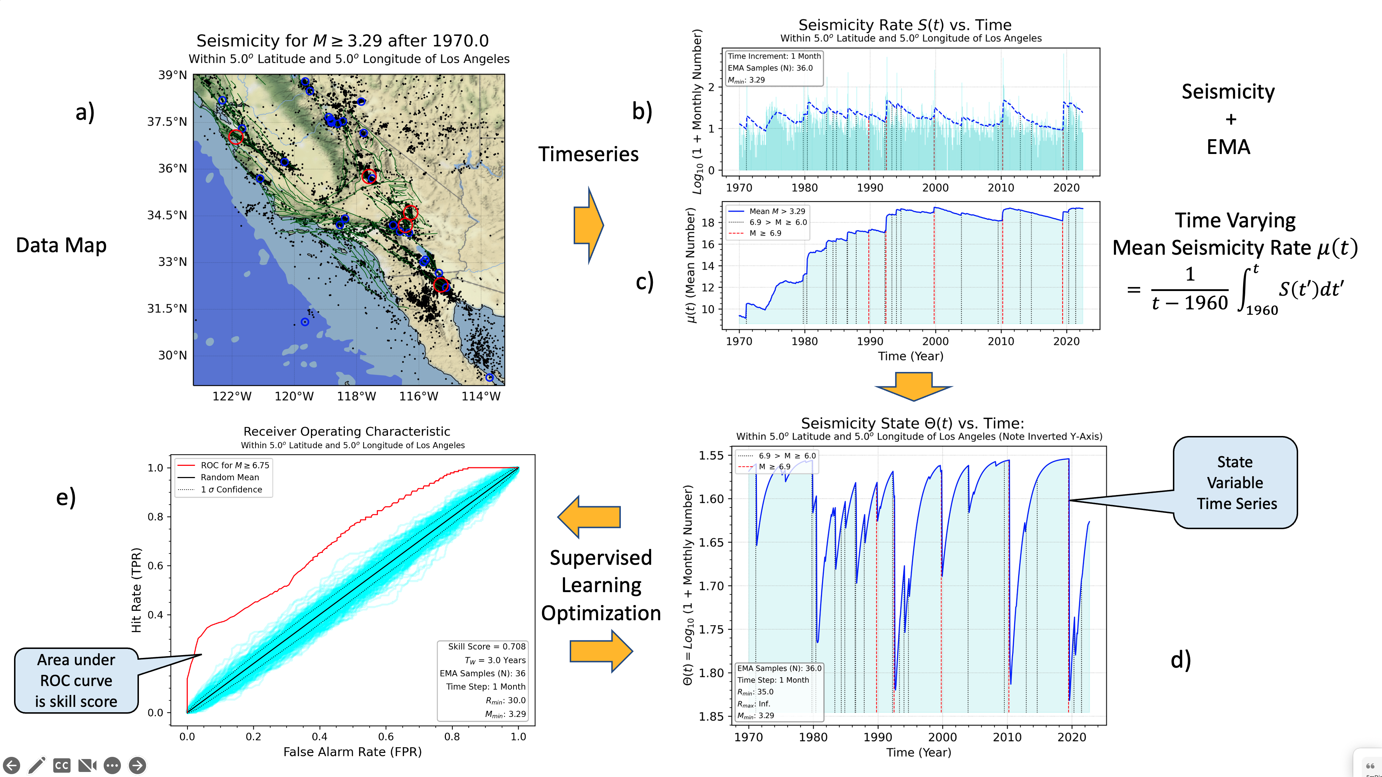
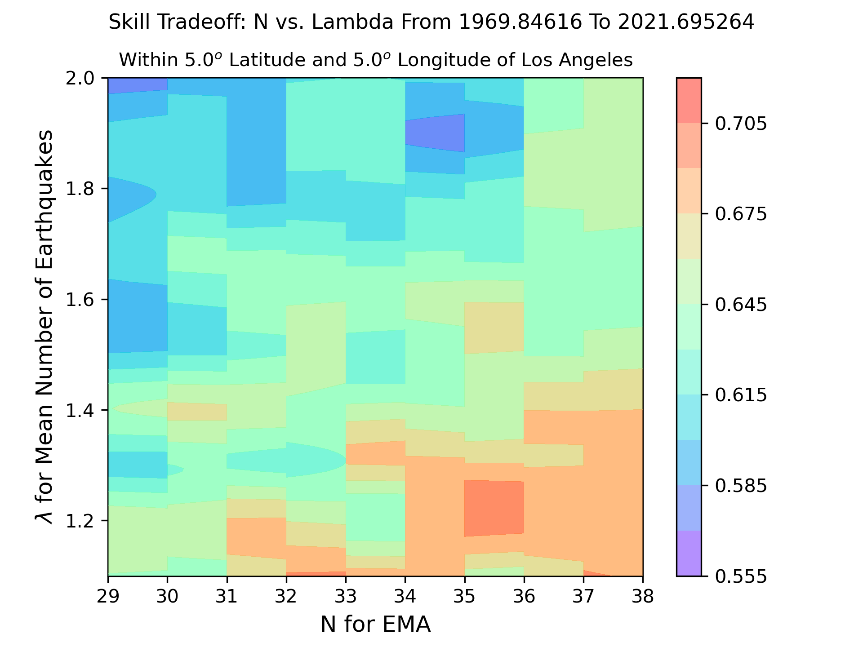
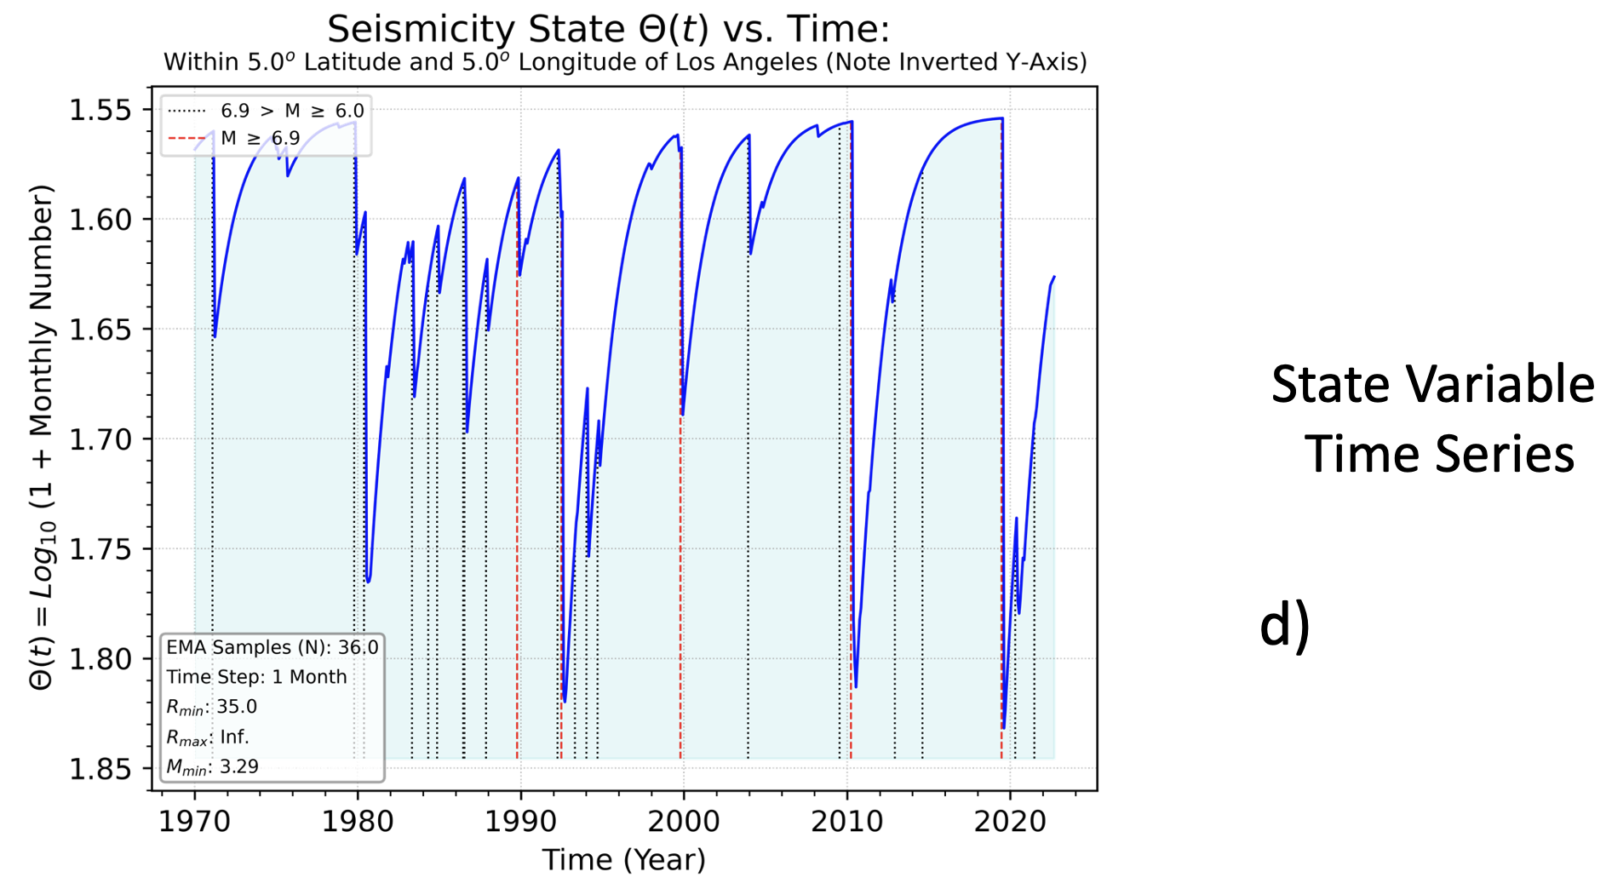
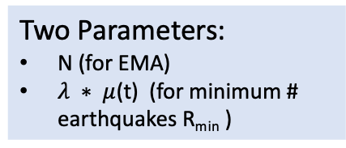
2. Nowcasting Earthquakes in Continuous Time
with Machine Learning
Supervised Learning
Optimization
(Skill Tradeoff Diagram)
Activation
Seisimicity +
EMA
Quiescence
Quiescence
Two Parameters:
N (for EMA)
$λ ∗ μ$(t) (for minimum # earthquakes R_{min} )
Activation
State variable time series represents the optimized, inverted, filtered small earthquake seismicity rate which we call the Earthquake Potential State

Slide 19
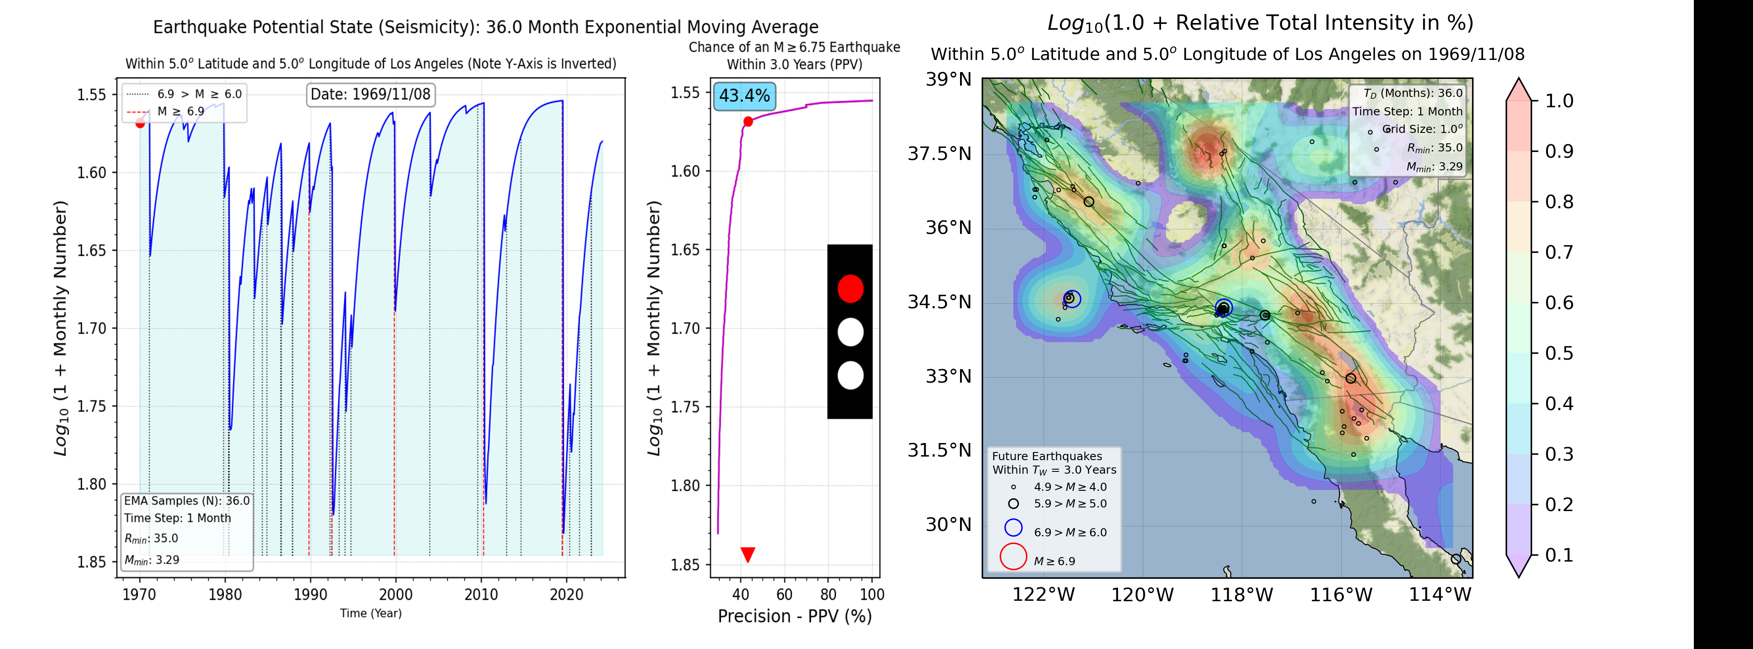
2. Nowcasting with Machine Learning: Movie
Contours represent the expected Intensity of earthquake activity during next T_{W} = 3 years
Red Dot: Current State
“Current” Date
Chance of a M>6.75 earthquake during next T_{W} = 3 years
Line: Earthquake Potential State from 1970-present
Seismic Traffic Light alert for hazard communication
Earthquake Potential State
Earthquake Potential State
Largest earthquakes are shown as dashed lines
Red: M>7
Black: 7>M>6
Future earthquakes that occur during next T_{W} = 3 years are shown as circles
Model is developed with supervised machine learning using
the Receiver Operating Characteristic to optimize the nowcast probability

Slide 20
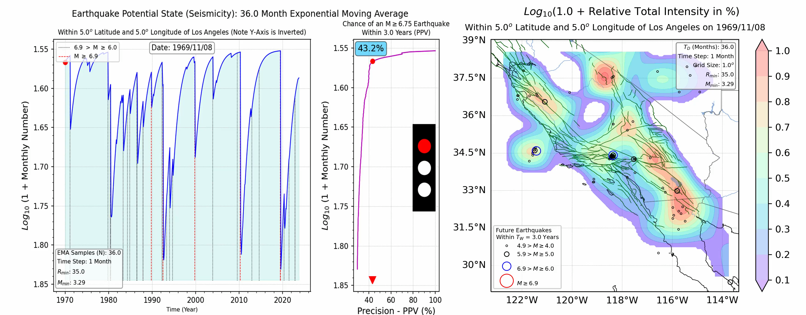
2. Nowcasting with Machine Learning: Movie
Earthquake Potential State
Earthquake Potential State
Time (Years)
M7 Probability for Next 3 Years (%)
Contours: Likely Locations in Next 3 Years. Circles: Actual Locations

Slide 21
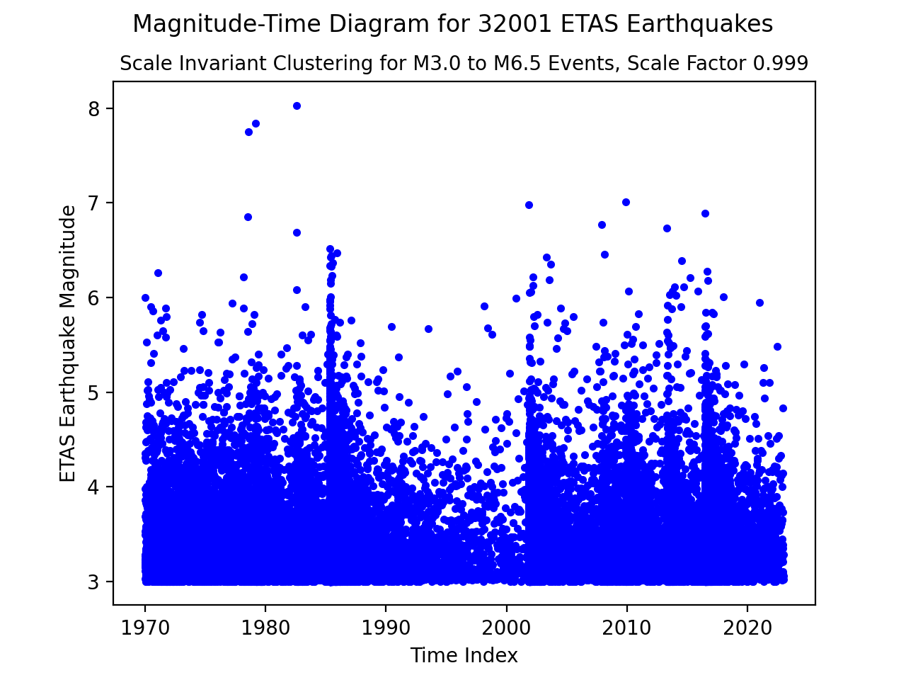
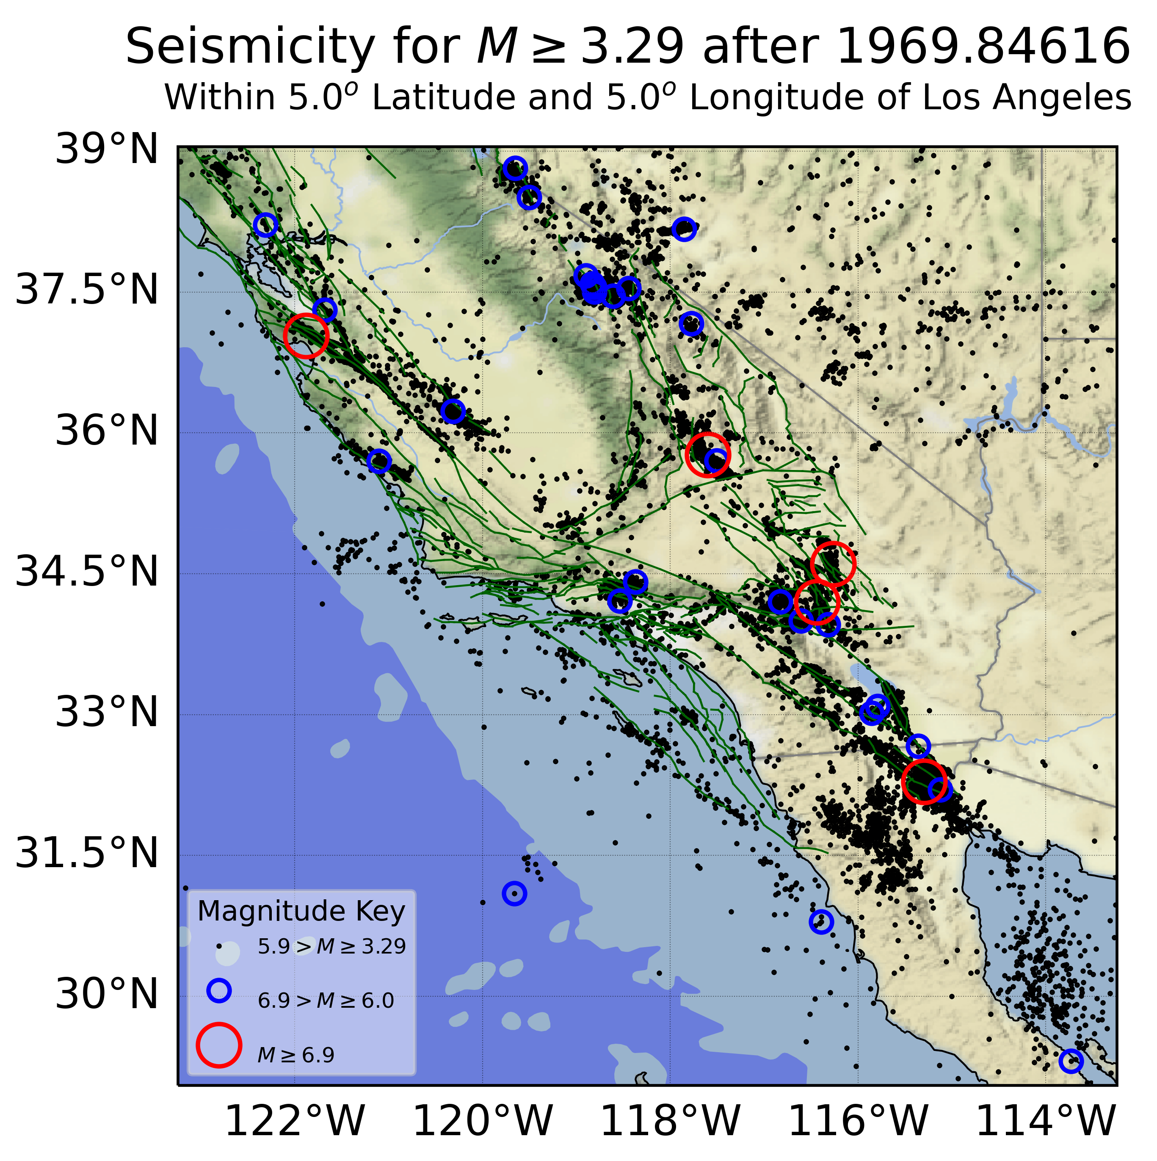
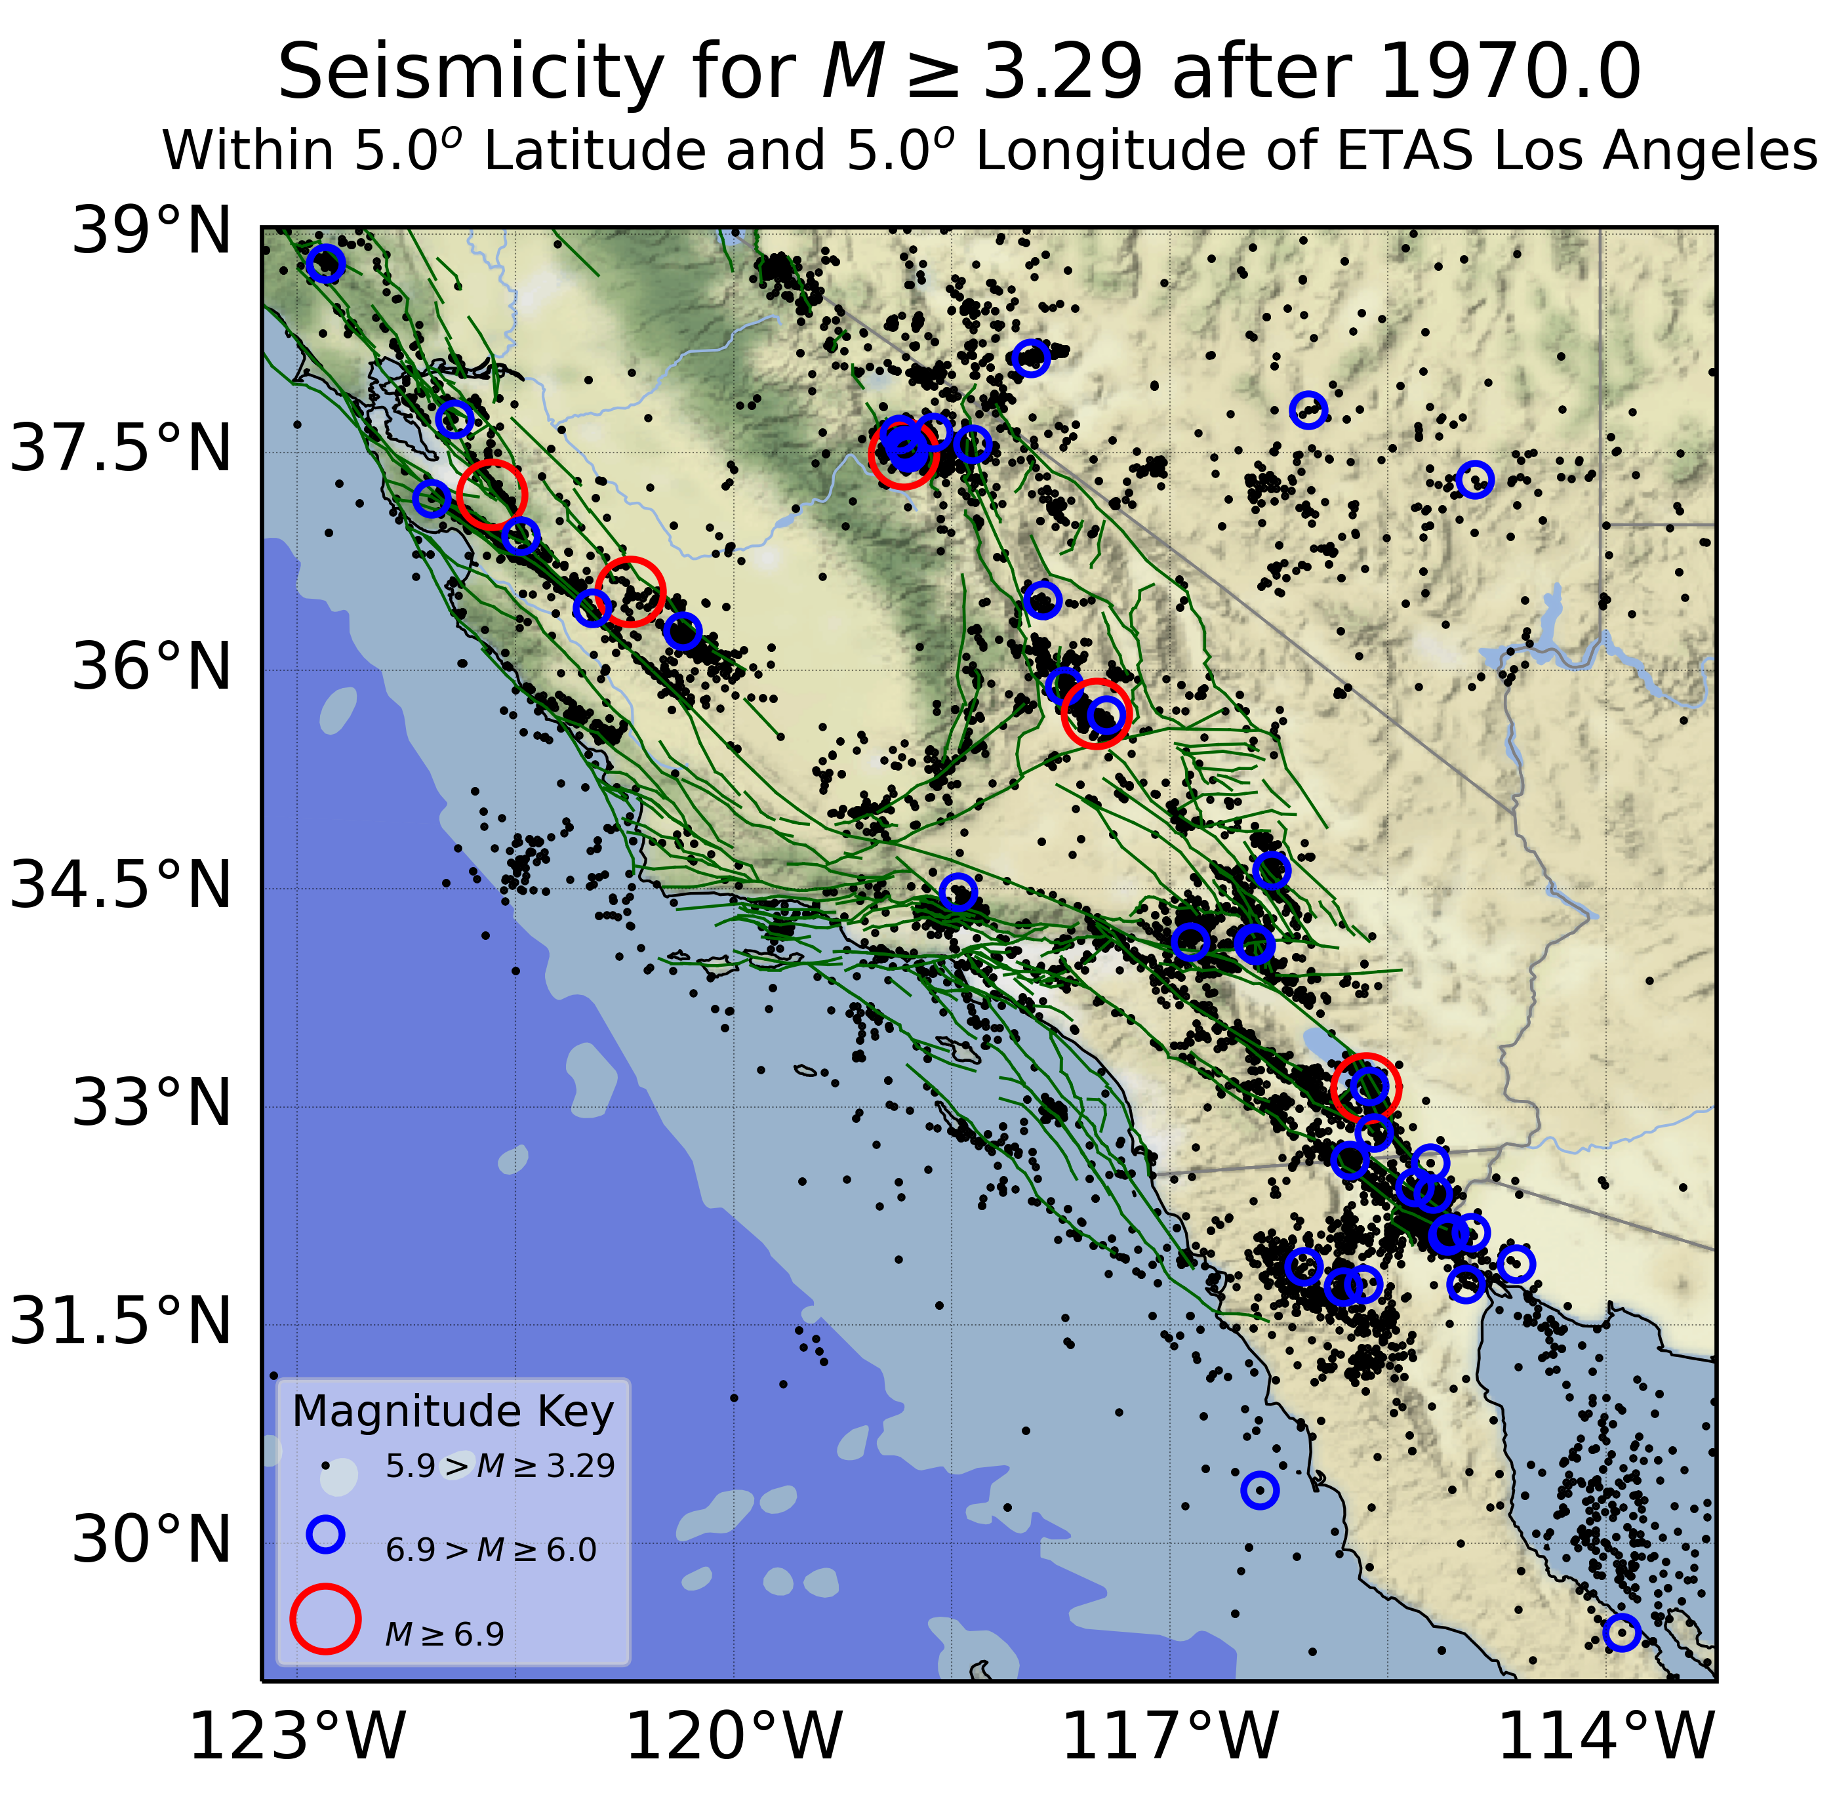
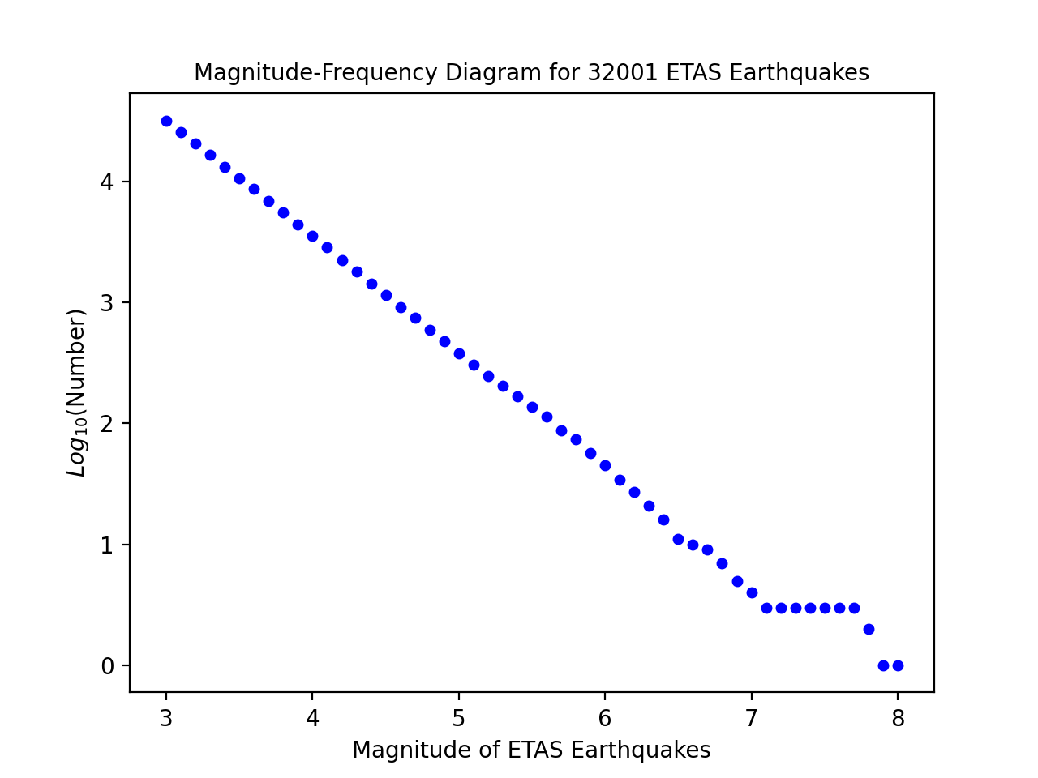
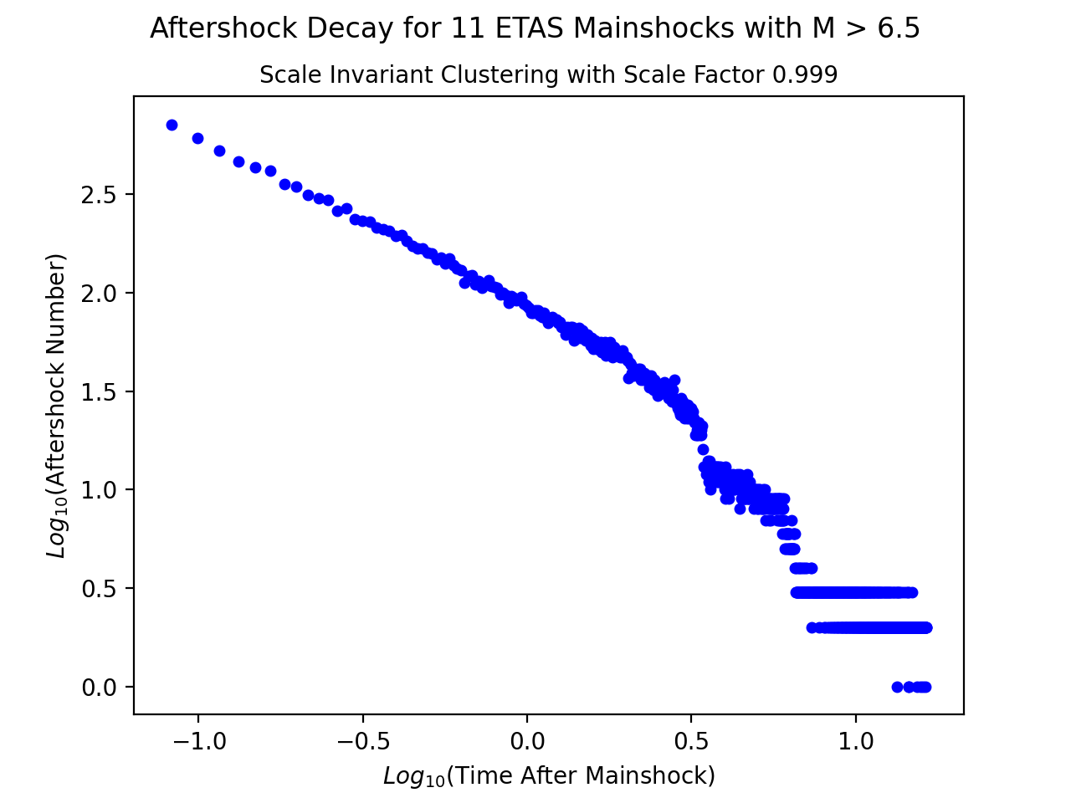
Generative Seismicity Models
The Epidemic-Type Aftershock Sequence
Model for Training Transformers
Magnitude vs. Time
ETAS Statistics
2.3"
2.3"
Magnitude-Frequency
Observed California Seismicity
A Generative ETAS Seismicity Simulation
ETAS: Y. Ogata (1988) https://www.tandfonline.com/doi/abs/10.1080/01621459.1988.10478560
Omori Decay
Number vs. Time

Slide 22
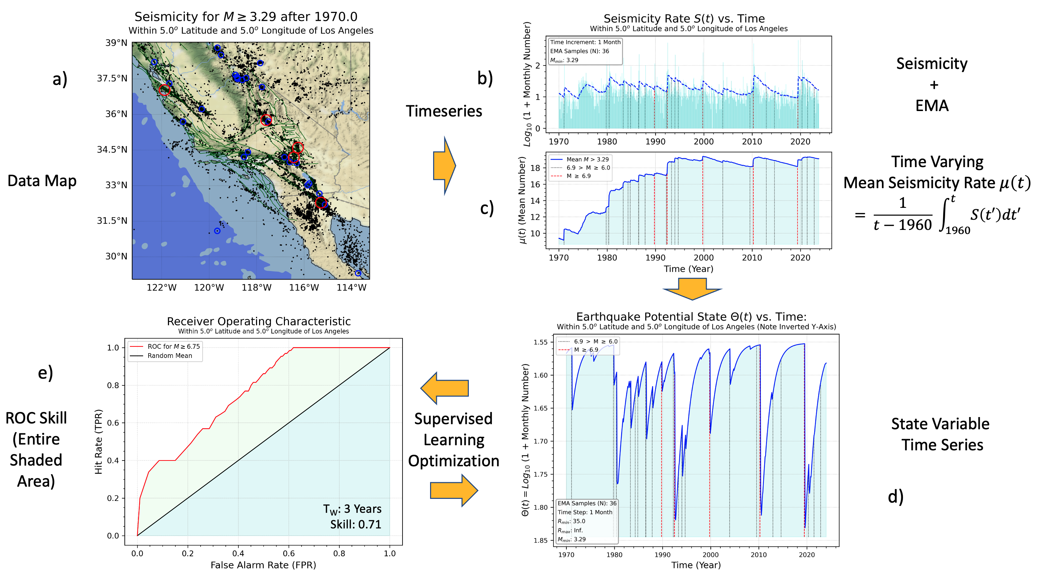
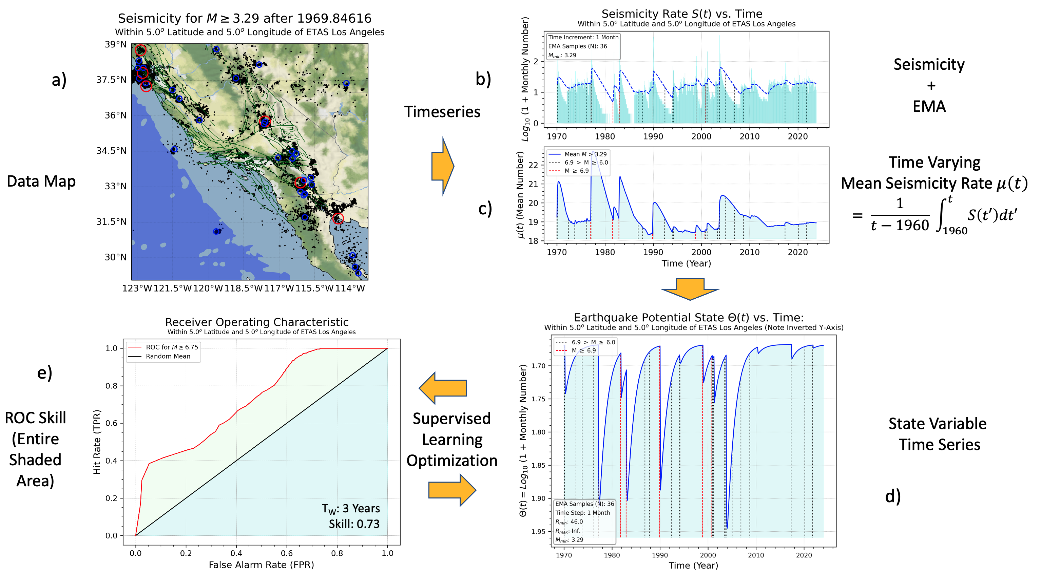
Building Nowcast Curves for ETAS Models
Uses the Same Procedure as Observed Data
Observed California Data
ETAS California Data

Slide 23
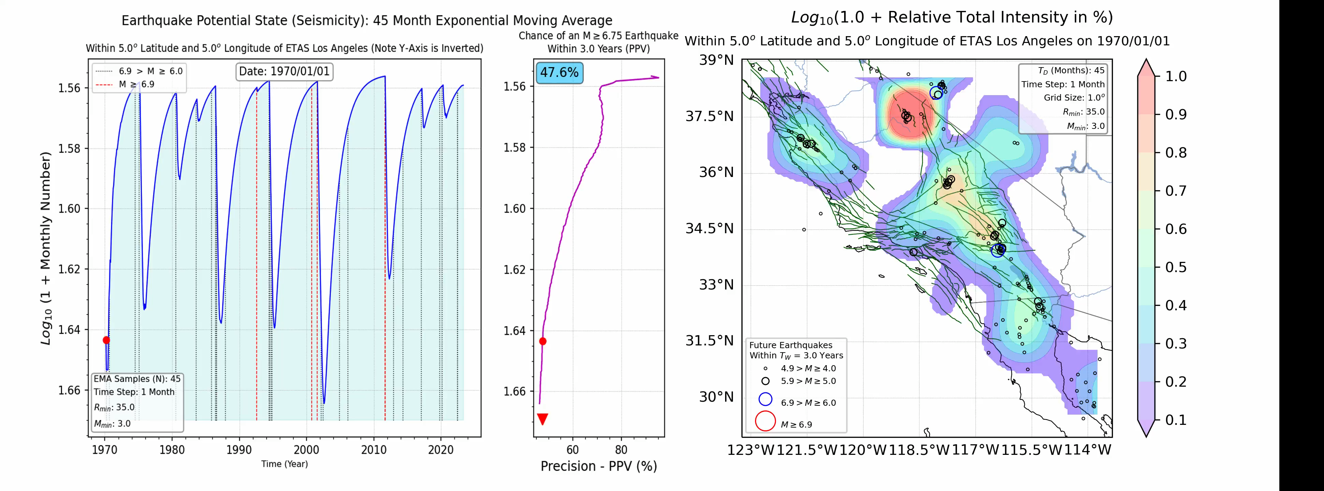
3. QuakeGPT: An Earthquake Generative Pretrained Transformer
1. Build a generative ETAS earthquake simulation.
2. Pretrain the Transformer model on a large ETAS dataset
3. Apply the trained model to data to be nowcasted (predicted).
Example of an ETAS simulation movie
Earthquake Potential State
Earthquake Potential State

Slide 24
3. Nowcasting Earthquakes in Continuous Time with Generative AI: “QuakeGPT”
Steps:
The Generative Model: Epidemic Type Aftershock Seismicity (ETAS)
  A “physically informed” statistical model of earthquake occurrence
  ETAS model obeys the observed statistical laws of earthquakes
  Additional physical processes are introduced (e.g., spatial-temporal triggering)
Use Deep Learning Model with Self-Attention for Time Series Prediction: Science Transformers (Vaswani et al., 2017)
Train the Model on Many Years of ETAS Data
Apply the Trained Model to Independent ETAS Validation/Test Data
Predict the Time Series Beyond the Validation/Test Data
Fit the ETAS Model to Observed Data, for Example, California
Apply the Trained Model to the Observed (e.g., California) Data
Feasibility Study Shown in the Following

Slide 25
Time Series Forecasting with Transformers
Time Series Input
Encoder: The Transformer model uses multiple encoder layers, each consisting of self-attention and feed-forward neural networks. These layers process the input sequence and capture the temporal dependencies between the data points.
Positional Encoding: Before passing the data through the encoder layers, positional encoding is added to the input sequence. It provides information about the order of the data points, as the Transformer model does not have an inherent notion of sequence order.
Global Average Pooling: After the encoder layers, global average pooling is applied to aggregate the information from all encoded data points into a fixed-size representation.
Decoder Linear Layer (Output): A linear layer is applied to the pooled representation to map it to the output dimension.
Predictions: The output of the linear layer represents the predictions made by the Transformer model for the next data point in the time series.
Encoder: N Layers each with M Self-Attention Heads
Position Encoding
Encoder: Feed-Forward Layers
Global Average Pooling
Decoder Linear Layer (Output)
Predictions

Slide 26
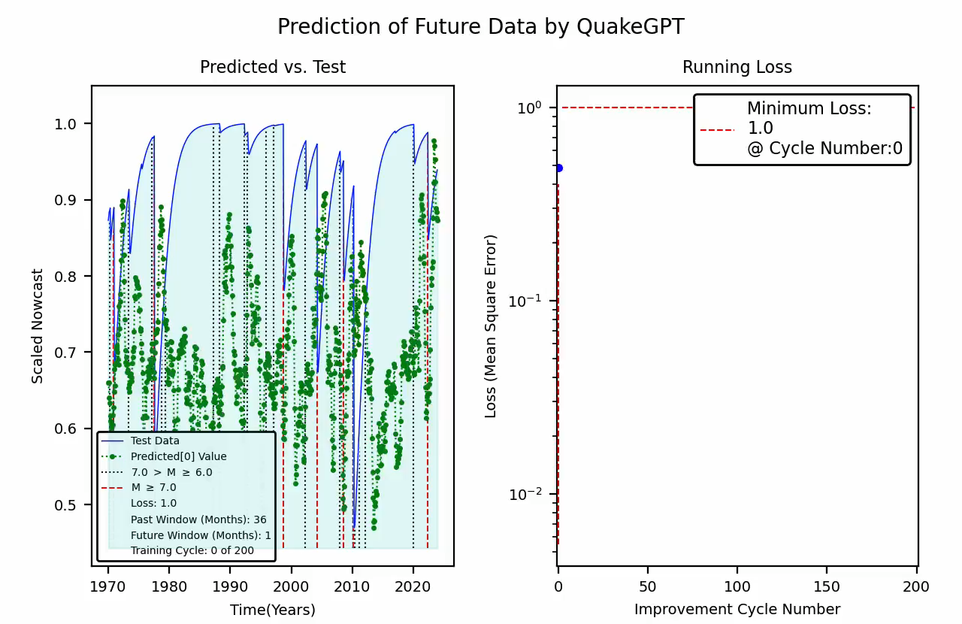
Training the Model
Preparing for Predicting Beyond Test Data
A Generative AI Model for Earthquake Nowcasting
Transformer model uses 2021 years of ETAS data for training
Trained model applied to 53 years of independent data for model testing and validation
Scaled Nowcast: Earthquake Potential State
Transformer Model
Input Dimension: 36 (months)
Output Dimension: 1 (month)
Hidden Dimension: 32 (Neurons/Layer)
Number of Encoder/Decoder Layers: 2
Number of Self-Attention Heads: 4
Dropout: 0.2
Learning Rate: 0.001
Model Size: 170KB

Slide 27
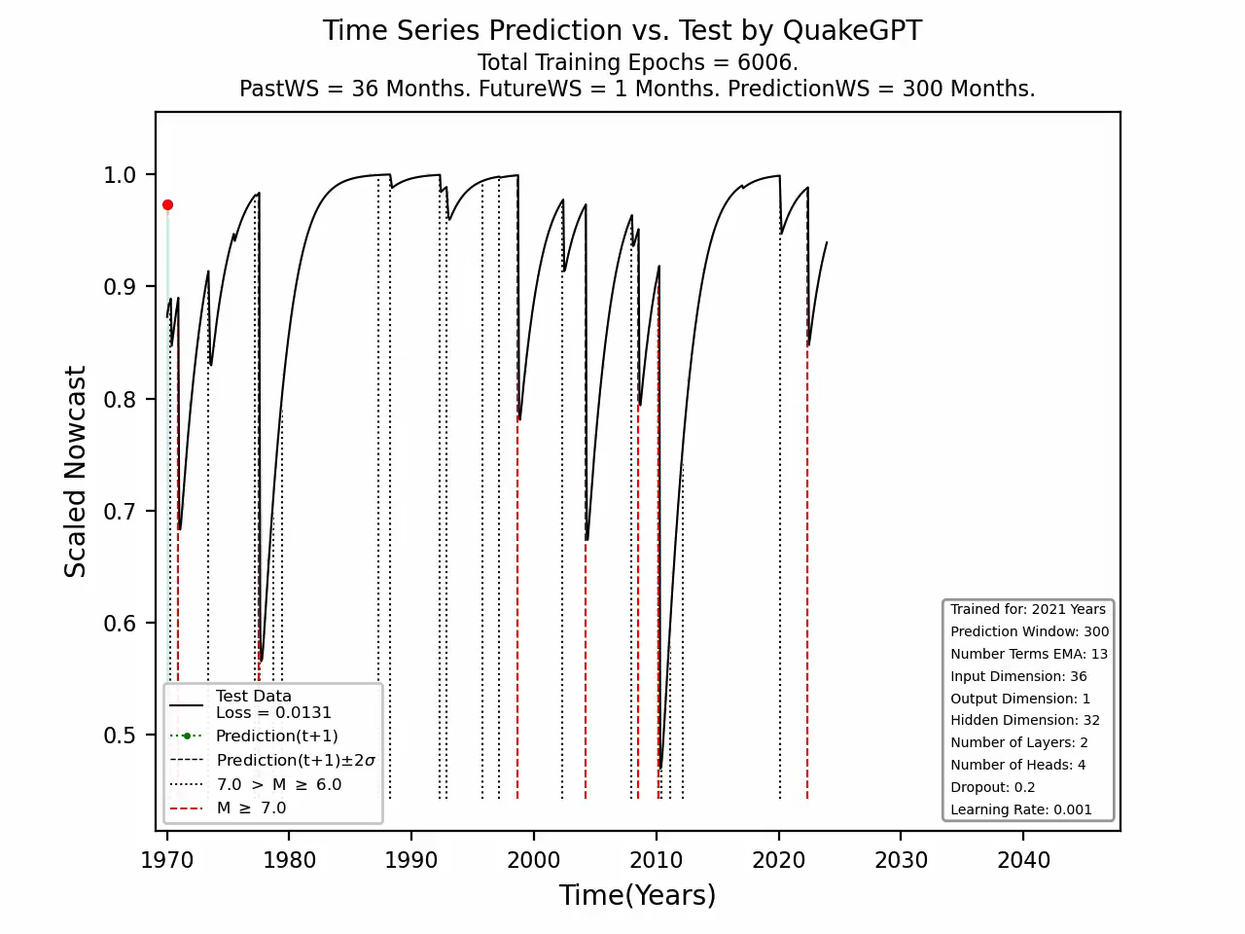
Trained Model
Predicting Beyond Test Data, A Feasibility Study
A Generative AI Model for Earthquake Nowcasting
Transformer model uses 2021 years of ETAS data for training
Trained model was applied to 53 years of independent data for model testing and validation
Prediction was then made for 100 months after the end of the nowcast data curve
Scaled Nowcast: Earthquake Potential State
Transformer Model
Input Dimension: 36 (months)
Output Dimension: 1 (month)
Hidden Dimension: 32 (Neurons/Layer)
Number of Encoder/Decoder Layers: 2
Number of Self-Attention Heads: 4
Dropout: 0.2
Learning Rate: 0.001
Model Size: 170KB

