Slide 1
Fractals, Chaos, Complexity
Physics-EPS 30
Lecture
Cellular Automata
https://en.wikipedia.org/wiki/State-space
https://en.wikipedia.org/wiki/Cellular_automaton

Slide 2
Web Based Apps
Game of Life:
http://www.bitstorm.org/gameoflife/
1 Space Dimension CAs:
http://www.cs.swan.ac.uk/~csandy/research/play/ca/
Wolfram Sites:
http://mathworld.wolfram.com/ElementaryCellularAutomaton.html

Slide 3
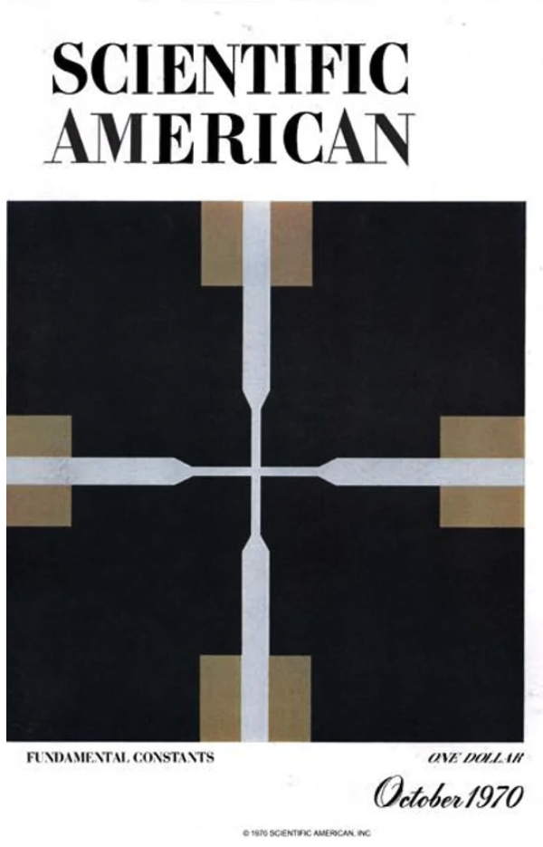
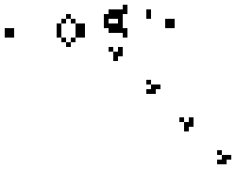
Basics
A cellular automaton (CA) is a discrete model studied in computer science, mathematics, physics, complexity science, theoretical biology and microstructure modeling.
Cellular automata are also called cellular spaces, tessellation automata, homogeneous structures, cellular structures, tessellation structures, and iterative arrays.
Game of Life: Gosper glider gun

Slide 4
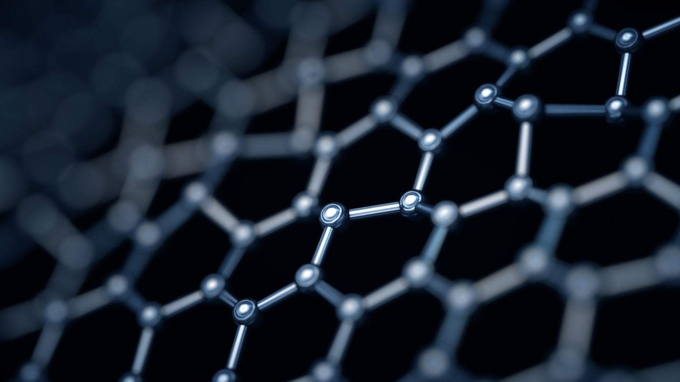
Basics
A cellular automaton consists of a regular grid of cells, each in one of a finite number of states, such as on and off (in contrast to a coupled map lattice).
The grid can be in any finite number of dimensions.
For each cell, a set of cells called its neighborhood is defined relative to the specified cell.
An initial state (time t = 0) is selected by assigning a state for each cell.
A new generation is created (advancing t by 1), according to some fixed rule (generally, a mathematical function) that determines the new state of each cell in terms of the current state of the cell and the states of the cells in its neighborhood.
Typically, the rule for updating the state of cells is the same for each cell and does not change over time, and is applied to the whole grid simultaneously

Slide 5
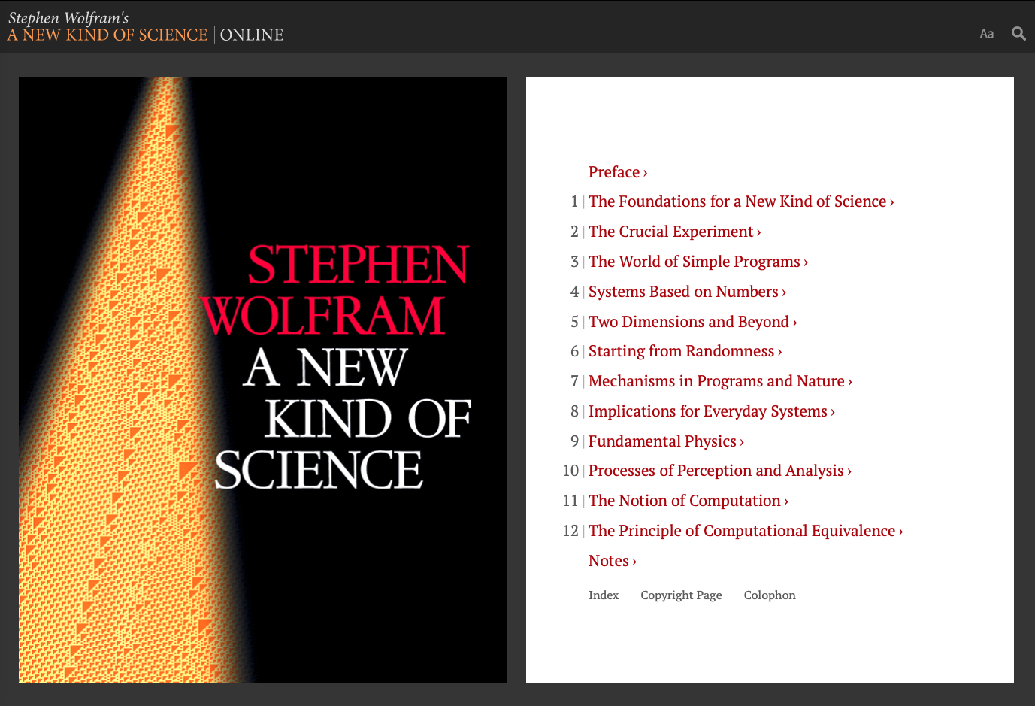
Basics
The concept was originally discovered in the 1940s by Stanislaw Ulam and John von Neumann while they were contemporaries at Los Alamos National Laboratory.
While studied by some throughout the 1950s and 1960s, it was not until the 1970s and Conway's Game of Life, a two-dimensional cellular automaton, that interest in the subject expanded beyond academia.
In the 1980s, Stephen Wolfram engaged in a systematic study of one-dimensional cellular automata, or what he calls elementary cellular automata.
His research assistant Matthew Cook showed that one of these rules is Turing-complete.
Wolfram published A New Kind of Science in 2002, claiming that cellular automata have applications in many fields of science.
These include computer processors and cryptography.
A universal cellular automaton (CA) rule means the system is "Turing complete" or computationally universal, capable of simulating any Turing machine or any other cellular automaton, given appropriate initial conditions.
Such rules can perform any computation that a modern computer can, essentially acting as a general-purpose computer using simple, local, and repetitive rules.

Slide 6
Basics
The primary classifications of cellular automata, as outlined by Wolfram, are numbered one to four.
They are, in order:
Automata in which patterns generally stabilize into homogeneity, (fixed points)
Automata in which patterns evolve into mostly stable or oscillating structures, (periodic or repetitive)
Automata in which patterns evolve in a seemingly chaotic fashion, and (chaos)
Automata in which patterns become extremely complex and may last for a long time, with stable local structures. (complex)
The last class are thought to be computationally universal, or capable of simulating a Turing machine.
Special types of cellular automata include totalistic, in which the future value of individual cells only depends on the total value of a group of neighboring cells.
For totalistic, a high degree of symmetry is required in the rules
Cellular automata can simulate a variety of real-world systems, including biological and chemical ones

Slide 7
Spatial Grid of Cells: The State Space
1 Space Dimension
2 Space Dimensions
Time
In the current generation, each cell can have the value 0 or 1. Or be colored “white” or “black”. Or be “occupied” or ”not occupied”. There are S possible states. In our case, S = 2 (0 or 1).
In general, a cell’s “neighborhood” is
defined to be the cells bordering it. The number of cells in the neighborhood is N (counts the central cell as well as the neighbors)

Slide 8
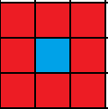
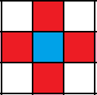
Neighborhoods
Moore
One way to simulate a two-dimensional cellular automaton is with an infinite sheet of graph paper along with a set of rules for the cells to follow.
Each square is called a "cell" and each cell has two possible states, black and white.
The neighborhood of a cell is the nearby, usually adjacent, cells.
The two most common types of neighborhoods are the von Neumann neighborhood and the Moore neighborhood.
Von Neumann
Blue cell is the central cell. Red cells are neighbors

Slide 9
Configurations
It is usually assumed that every cell in the CA state space or “universe” starts in the same state, except for a finite number of cells in other states
The assignment of state values is called a configuration.
More generally, it is sometimes assumed that the “universe” starts out covered with a periodic pattern, and only a finite number of cells violate that pattern.
The latter assumption is common in one-dimensional cellular automata.
Cellular automata are often simulated on a finite grid rather than an infinite one.
In two dimensions, the “universe” would be a rectangle instead of an infinite plane.
The obvious problem with finite grids is how to handle the cells on the edges.
How they are handled will affect the values of all the cells in the grid.
One possible method is to allow the values in those cells to remain constant.

Slide 10
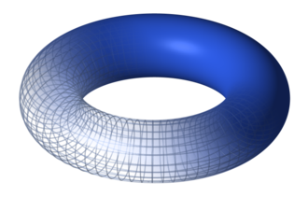
Boundary Conditions
Lattice of cells are usually handled with a toroidal arrangement
When one goes off the top, one comes in at the corresponding position on the bottom, and
When one goes off the left, one comes in on the right.
This essentially simulates an infinite periodic tiling.
CA lattices are often considered to be defined on a torus

Slide 11
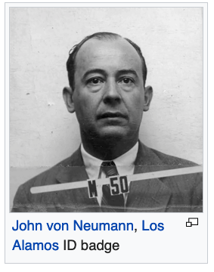
History
Stan Ulam and John von Neumann created a method for calculating liquid motion in the late 1950s.
The driving concept of the method was to consider a liquid as a group of discrete units and calculate the motion of each based on its neighbors' behaviors.
This was the first system of cellular automata.
Like Ulam's lattice network, von Neumann's cellular automata are two-dimensional, with his self-replicator (discussed next) implemented algorithmically.
The result was a universal copier and constructor

Slide 12
History
John von Neumann, Ulam's colleague at Los Alamos, was working on the problem of self-replicating systems.
Von Neumann's initial design was founded upon the notion of one robot building another robot (self-replicating).
As he developed this design, von Neumann came to realize the great difficulty of building a self-replicating robot, and of the great cost in providing the robot with a "sea of parts" from which to build its replicant.
Neumann wrote a paper entitled "The general and logical theory of automata" for the Hixon Symposium in 1948.
Ulam was the one who suggested using a discrete system for creating a reductionist model of self-replication.
Nils Aall Barricelli performed many of the earliest explorations of these models of artificial life, which was one of the first applications of the CA idea.

Slide 13
History
By the end of the 1950s it had been noted that cellular automata could be viewed as computers capable of parallel computation
In the 1960s a sequence of increasingly detailed and technical theorems—often analogous to ones about Turing machines—were proved about their formal computational capabilities.
In the 1960s, cellular automata were studied as a particular type of dynamical system
The connection with the mathematical field of symbolic dynamics was established for the first time.
In 1969, Gustav A. Hedlund compiled many results following this point of view in what is still considered as a seminal paper for the mathematical study of cellular automata.

Slide 14
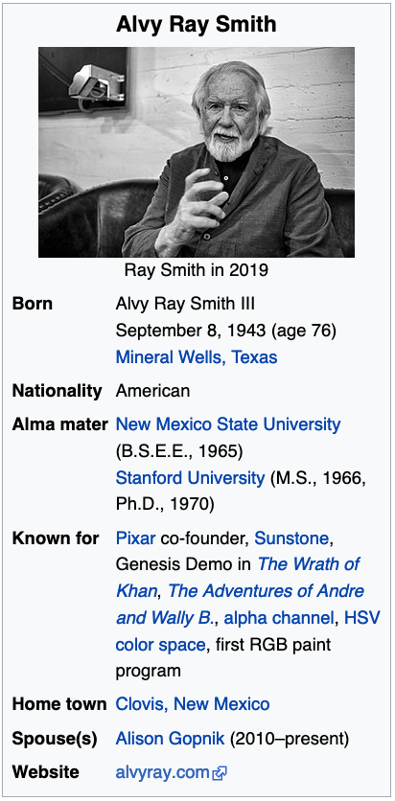
History
in 1969 computer scientist Alvy Ray Smith completed a Stanford PhD dissertation on Cellular Automata Theory, the first mathematical treatment of CA as a general class of computers.
He showed the equivalence of neighborhoods of various shapes, how to reduce a Moore to a von Neumann neighborhood or how to reduce any neighborhood to a von Neumann neighborhood.
He proved that two-dimensional CA are computationally universal, introduced 1-dimensional CA, and showed that they too are computationally universal, even with simple neighborhoods

Slide 15
Steven Wolfram
Wolfram got his PhD at Caltech working with Geoffrey Fox
Stephen Wolfram independently began working on cellular automata in mid-1981 after considering how complex patterns seemed formed in nature in apparent violation of the Second Law of Thermodynamics.
His investigations were initially spurred by an interest in modelling systems such as neural networks.
He published his first paper in Reviews of Modern Physics investigating elementary cellular automata (Rule 30 in particular) in June 1983.
The unexpected complexity of the behavior of these simple rules led Wolfram to suspect that complexity in nature may be due to similar mechanisms.
Additionally, during this period Wolfram formulated the concepts of intrinsic randomness and computational irreducibility, and suggested that rule 110 may be universal—a fact proved later by Wolfram's research assistant Matthew Cook in the 1990s.
A universal cellular automaton (CA) rule means the system is "Turing complete" or computationally universal, capable of simulating any Turing machine or any other cellular automaton, given appropriate initial conditions.
Such rules can perform any computation that a modern computer can, essentially acting as a general-purpose computer using simple, local, and repetitive rules

Slide 16
CA Rule Tables - I
Rule tables are used to specify the dynamics of how CAs evolve
As an example, consider a CA in 1 space dimension
We define a linear grid of cells as discussed
Consider a CA whose neighborhood is N = 3
Each N = 3 neighborhood is composed of a central cell and 2 neighbor cells
The state S of any cell is either a 0 or 1 (or empty or occupied, or white or black)
Thus 2 parameters specify the possible rules, S and N
N = 3 rule table looks like this:
111 | 110 | 101 | 100 | 011 | 010 | 001 | 000
0 or 1 | 0 or 1 | 0 or 1 | 0 or 1 | 0 or 1 | 0 or 1 | 0 or 1 | 0 or 1
Next Gen State

Slide 17
CA Rule Tables - II
The dynamics of the CA are total specified by:
    The initial state of the CA
    The neighborhood size
    The number of possible states
Note that there are S³ = 2³ = 8 possible current neighborhood configurations
For each of the S³ neighborhood configurations, there are 2 possible states of the central cell in the next generation.
Thus, there are S^{S} possible rules. Thus 2² = 2⁸ = 256 possible rules
N
3
N = 3 rule table looks like this:
111 | 110 | 101 | 100 | 011 | 010 | 001 | 000
0 or 1 | 0 or 1 | 0 or 1 | 0 or 1 | 0 or 1 | 0 or 1 | 0 or 1 | 0 or 1

Slide 18
Wolfram Codes
These 256 cellular automata are generally referred to by their Wolfram code, a standard naming convention invented by Wolfram that gives each rule a number from 0 to 255.
A number of papers have analyzed and compared these 256 cellular automata.
The rule 30 and rule 110 cellular automata are particularly interesting.
The images below show the history of each when the starting configuration consists of a 1 (at the top of each image) surrounded by 0’s.
Each row of pixels represents a generation in the history of the automaton, with t=0 being the top row.
Each pixel is colored white for 0 and black for 1
111 | 110 | 101 | 100 | 011 | 010 | 001 | 000
0 or 1 | 0 or 1 | 0 or 1 | 0 or 1 | 0 or 1 | 0 or 1 | 0 or 1 | 0 or 1

Slide 19
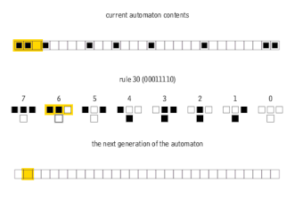
Elementary Cellular Automata
We designate the Rule by reading the binary number corresponding to the configuration of the central cell in the next generation
This is the Wolfram code
Rule 30 is designated by the binary digits” 00011110 (= 30 in decimal notation)
Note that a white box is a “0” and a black box is a “1”
At right is an animation of how the rules are applied
Current Generation
Rule 30
Next Generation
An animation of the way the rules of a 1D cellular automaton determine the next generation.

Slide 20
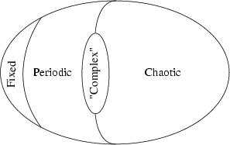
CA Classes
Wolfram, in A New Kind of Science and several papers dating from the mid-1980s, defined four classes into which cellular automata and several other simple computational models can be divided depending on their behavior:
  Class 1: Nearly all initial patterns evolve quickly into a stable, homogeneous state. Any randomness in the initial pattern disappears. (Fixed point)
  Class 2: Nearly all initial patterns evolve quickly into stable or oscillating structures. Some of the randomness in the initial pattern may filter out, but some remains. Local changes to the initial pattern tend to remain local. (periodic or repetitive)
  Class 3: Nearly all initial patterns evolve in a pseudo-random or chaotic manner. Any stable structures that appear are quickly destroyed by the surrounding noise. Local changes to the initial pattern tend to spread indefinitely. (chaotic)
  Class 4: Nearly all initial patterns evolve into structures that interact in complex and interesting ways, with the formation of local structures that are able to survive for long periods of time (edge of chaos)
4
1
2
3

Slide 21
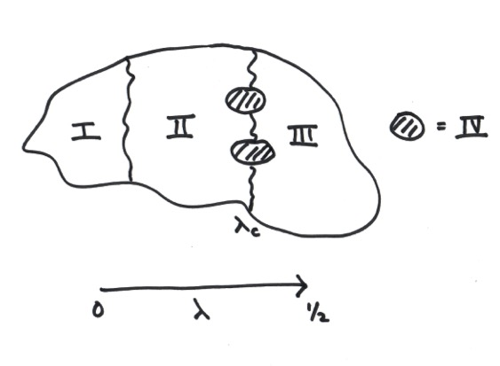

Classification of CAs: C. Langton
Chris Langton defined a “Lambda” ($λ$) parameter that characterized the types of patterns
$λ$ was defined as the fraction of configurations producing live cells relative to the total number of possible configurations
$λ$_{C} is a critical value, characterizing the “Edge of Chaos”

Slide 22
Classification of CAs: C. Langton
Class I CAs: Everything dies
Class II CAs: Patterns of live cells that repeat at regular intervals
Class III CAs: Patterns of live cells that grow in a chaotic fashion
Class IV CAs: Live cells that grow and contract in complicated ways, exhibiting fixed and moving patterns
Class IV CAs lie on the boundary between “predictable” class I and II CAs, and “chaotic” class III CAs.

Slide 23
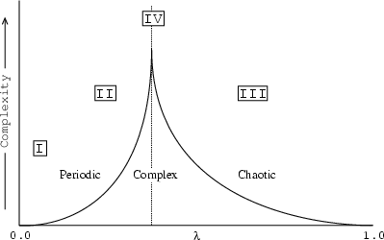
Phase Transitions in Complex Systems https://theory.org/complexity/cdpt/html/node5.html
$λ$ transition is reminiscent of the cusp seen in specific heat for thermal phase transitions

Slide 24
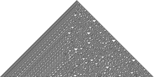
Rule 30
Starting from a single “on” cell
Rule 30 exhibits class 3 behavior, meaning even simple input patterns such as that shown lead to chaotic, seemingly random histories.
111 | 110 | 101 | 100 | 011 | 010 | 001 | 000
0 | 0 | 0 | 1 | 1 | 1 | 1 | 0

Slide 25
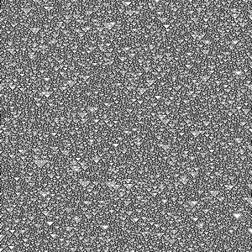
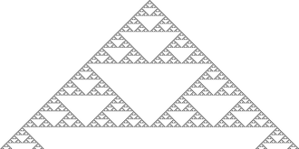
Rule 90
Both Class 3 and Class 2 depending on initial conditions
From a random initial condition
From a single “on” cell
111 | 110 | 101 | 100 | 011 | 010 | 001 | 000
0 | 1 | 0 | 1 | 1 | 0 | 1 | 0

Slide 26
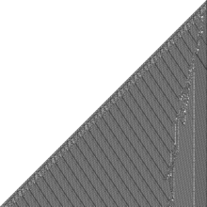
Rule 110
Starting from a single “on” cell
Rule 110, like the Game of Life, exhibits what Wolfram calls class 4 behavior, which is neither completely random nor completely repetitive.
111 | 110 | 101 | 100 | 011 | 010 | 001 | 000
0 | 1 | 1 | 0 | 1 | 1 | 1 | 0

Slide 27
Rule 110
Localized structures appear and interact in various complicated-looking ways.
In the course of the development of A New Kind of Science, as a research assistant to Wolfram in 1994, Matthew Cook proved that some of these structures were rich enough to support universality.
This result is interesting because rule 110 is an extremely simple one-dimensional system, and difficult to engineer to perform specific behavior.
This result therefore provides significant support for Wolfram's view that class 4 systems are inherently likely to be universal.
Rule 110 has been the basis for some of the smallest universal Turing machines

Slide 28
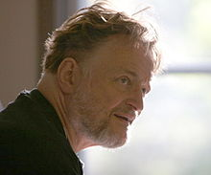
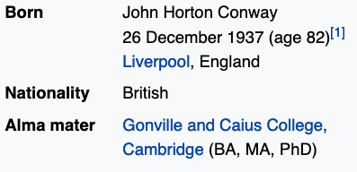
History – Game of Life
In the 1970s a two-state, two-dimensional cellular automaton named Game of Life became widely known, particularly among the early computing community.
Invented by John Conway and popularized by Martin Gardner in a Scientific American article, its rules are as follows:
  Any live cell with fewer than two live neighbors dies, as if caused by underpopulation.
  Any live cell with two or three live neighbors lives on to the next generation.
  Any live cell with more than three live neighbors dies, as if by overpopulation.
  Any dead cell with exactly three live neighbors becomes a live cell, as if by reproduction.
John Horton Conway died of COVID on April 11, 2020 in Brunswick, NJ

Slide 29
Game of Life
Despite its simplicity, the system achieves an impressive diversity of behavior, fluctuating between apparent randomness and order.
One of the most apparent features of the Game of Life is the frequent occurrence of gliders, arrangements of cells that essentially move themselves across the grid.
It is possible to arrange the automaton so that the gliders interact to perform computations, and after much effort it has been shown that the Game of Life can emulate a universal Turing machine.
It was viewed as a largely recreational topic, and little follow-up work was done outside of investigating the particularities of the Game of Life and a few related rules in the early 1970s

Slide 30
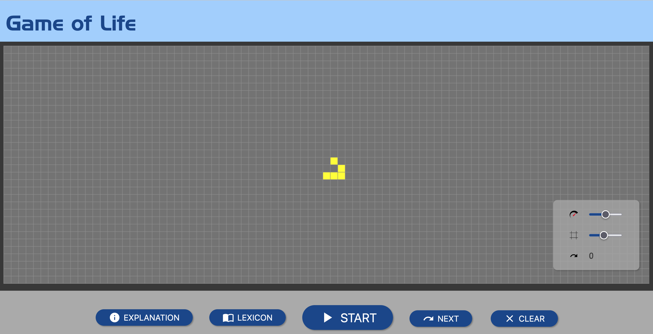
https://playgameoflife.com/

Slide 31
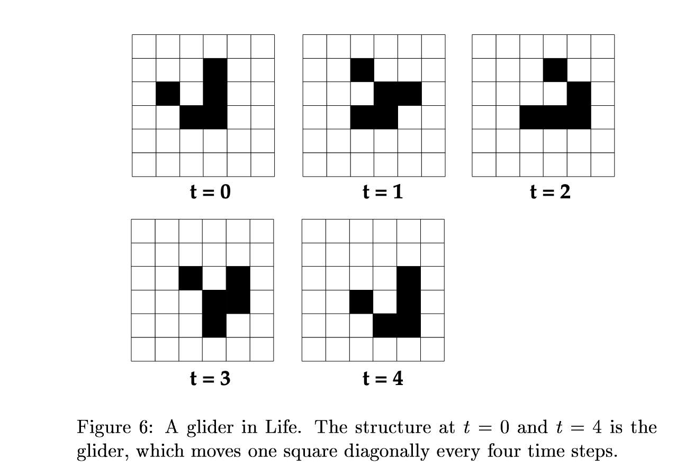

Slide 32
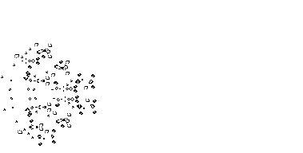
Conway’s Game of Life https://en.wikipedia.org/wiki/Conway%27s_Game_of_Life
A puffer-type breeder (red) that leaves glider guns (green) in its wake, which in turn create gliders (blue) (animation)

Slide 33
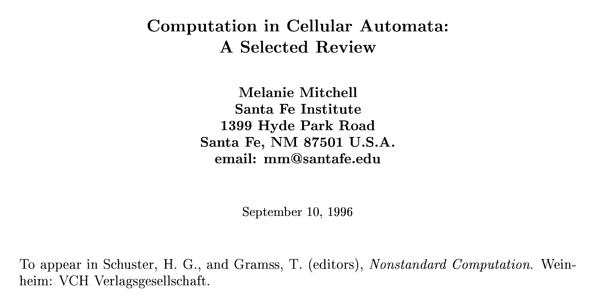

Slide 34
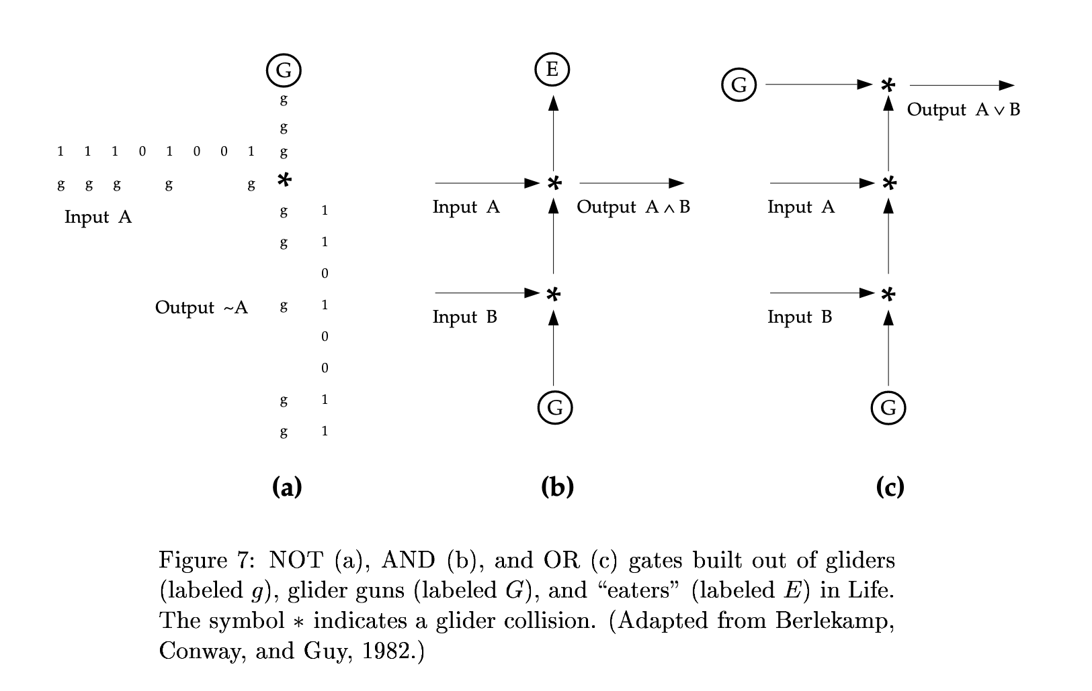
Gosper glider gun in the Game of Life
CA’s can perform computations!
(J. Crutchfield; M.Mitchell et al.)

Slide 35
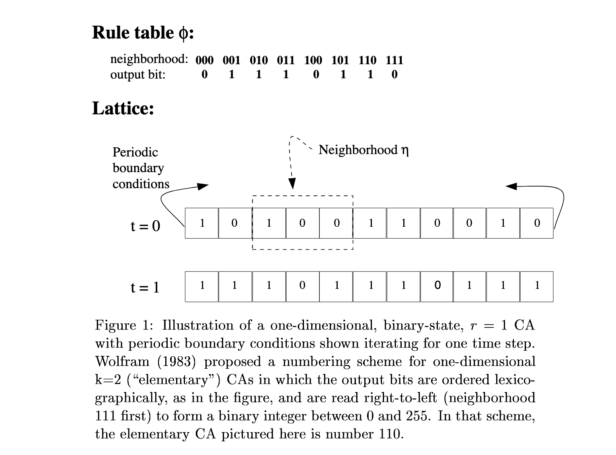
Rule 110

Slide 36
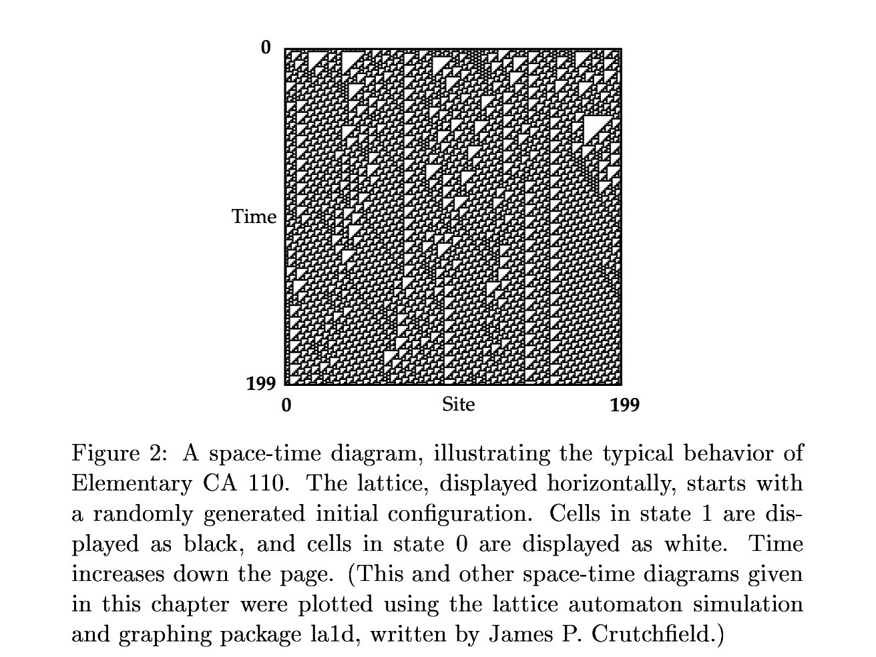

Slide 37
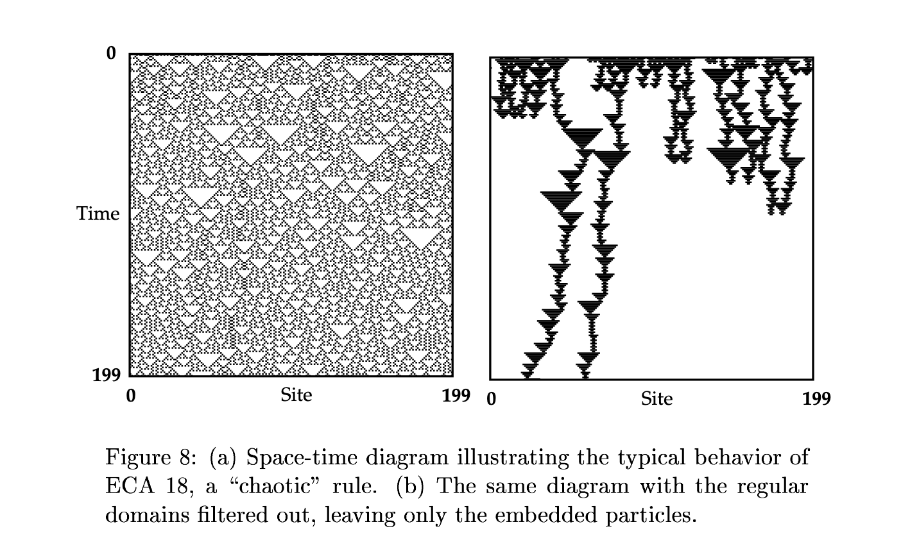

Slide 38
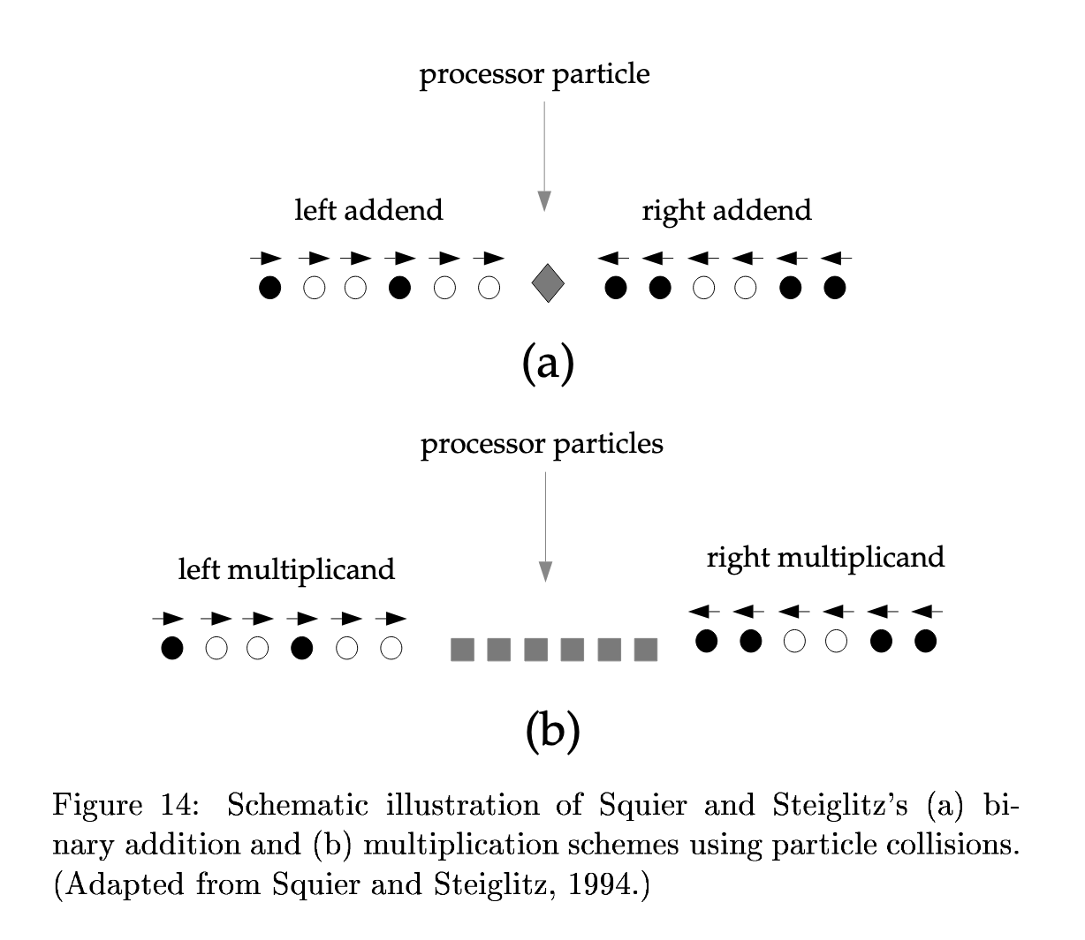

Slide 39
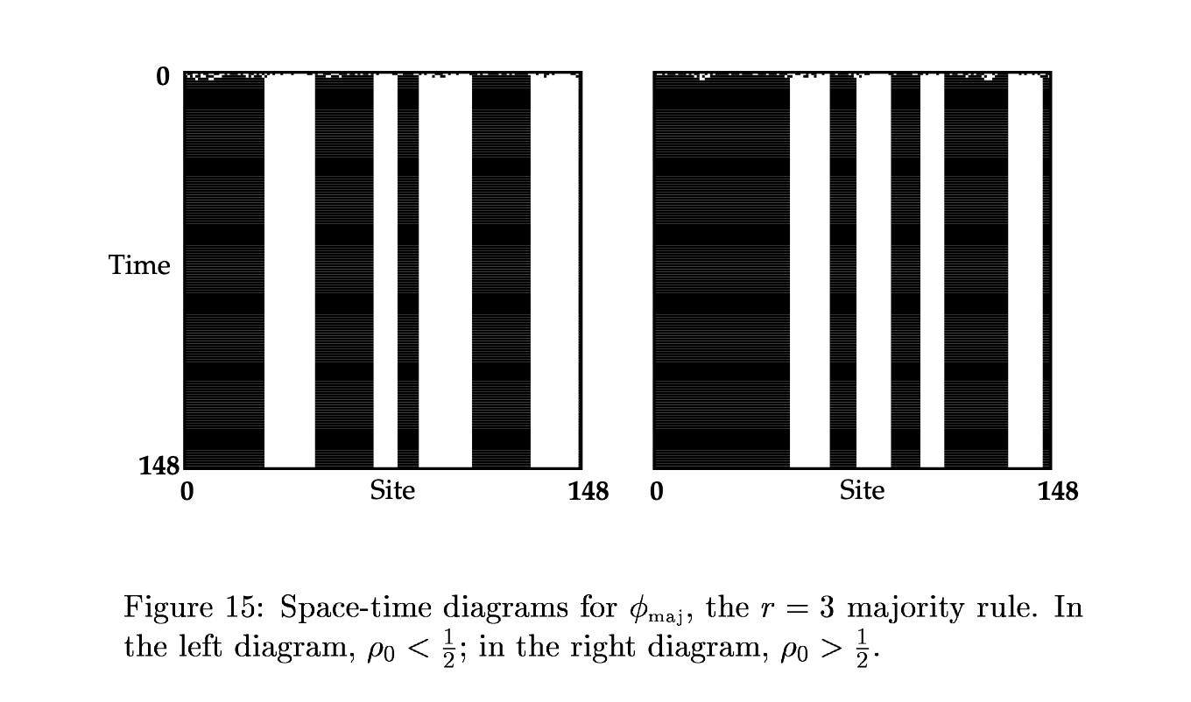

Slide 40
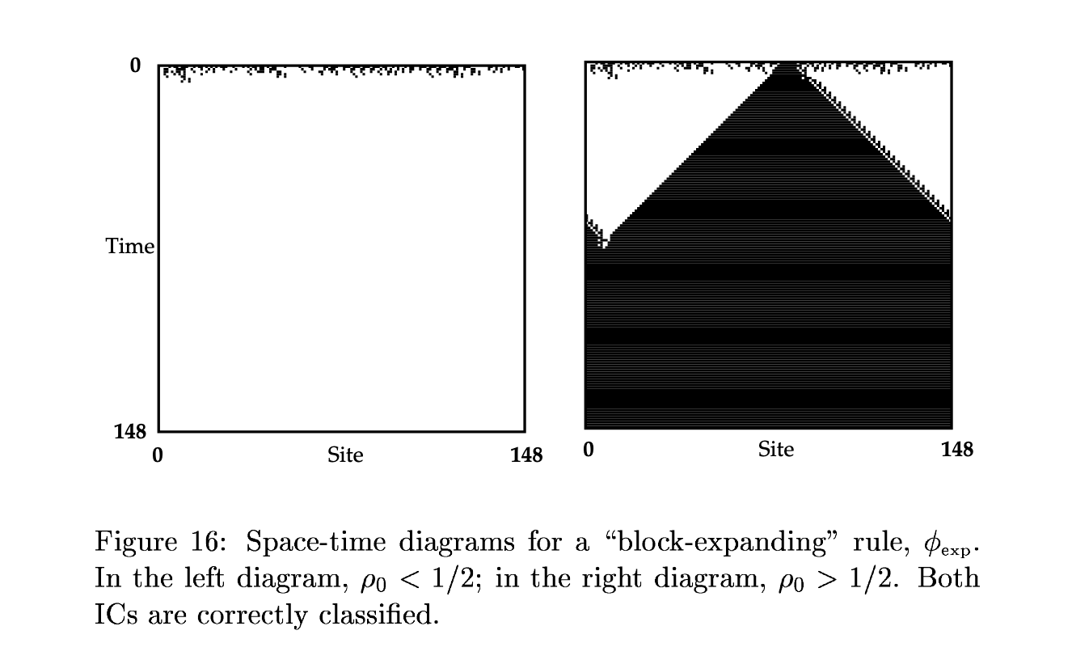

Slide 41
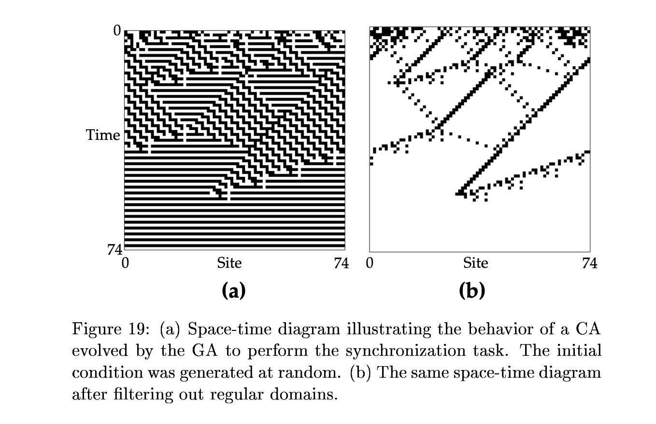
“GA” = Genetic Algorithm

Slide 42
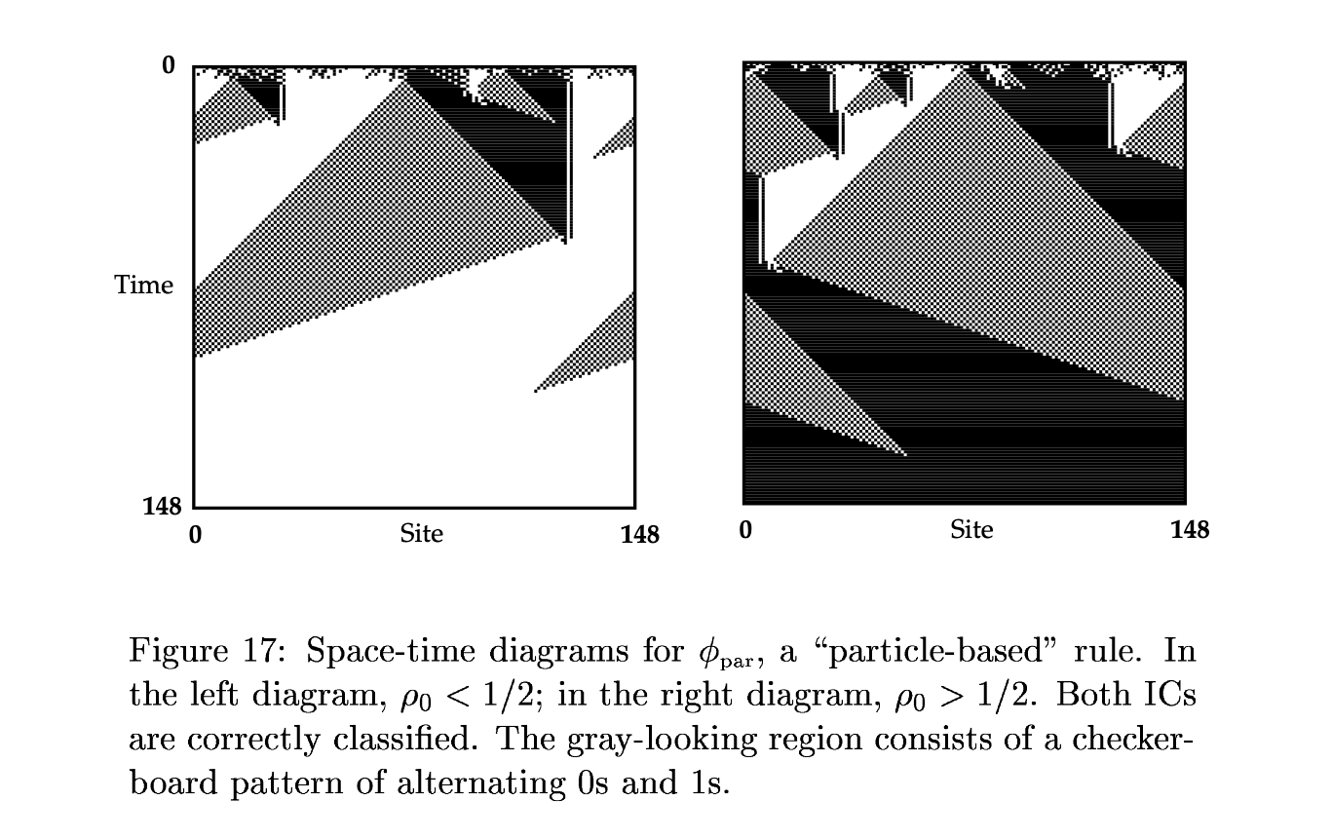

Slide 43
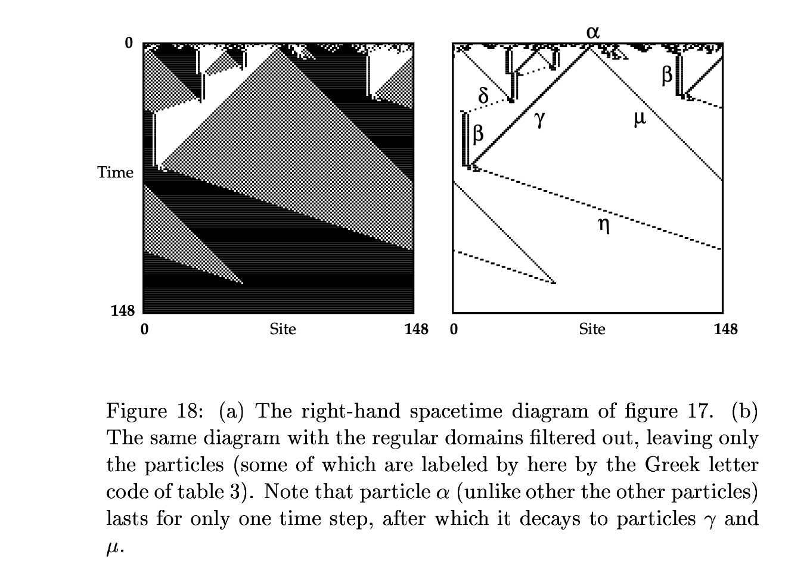

Slide 44
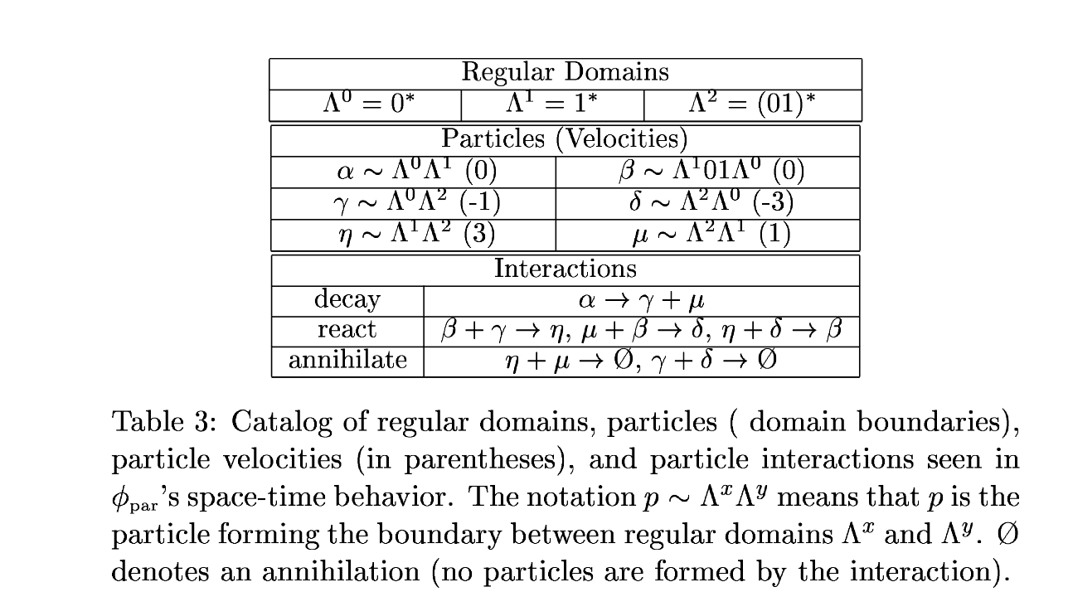

Slide 45
Outer Totalistic Rules (“OTR”)
Applies to CAs that have a high degree of symmetry
#
Number of “on” neighbors outside the current central cell
Check this box if the central cell is ”on” in the current generation and “on” in the next generation
Check this box if the central cell is ”on” in the current generation and “off” in the next generation

Slide 46
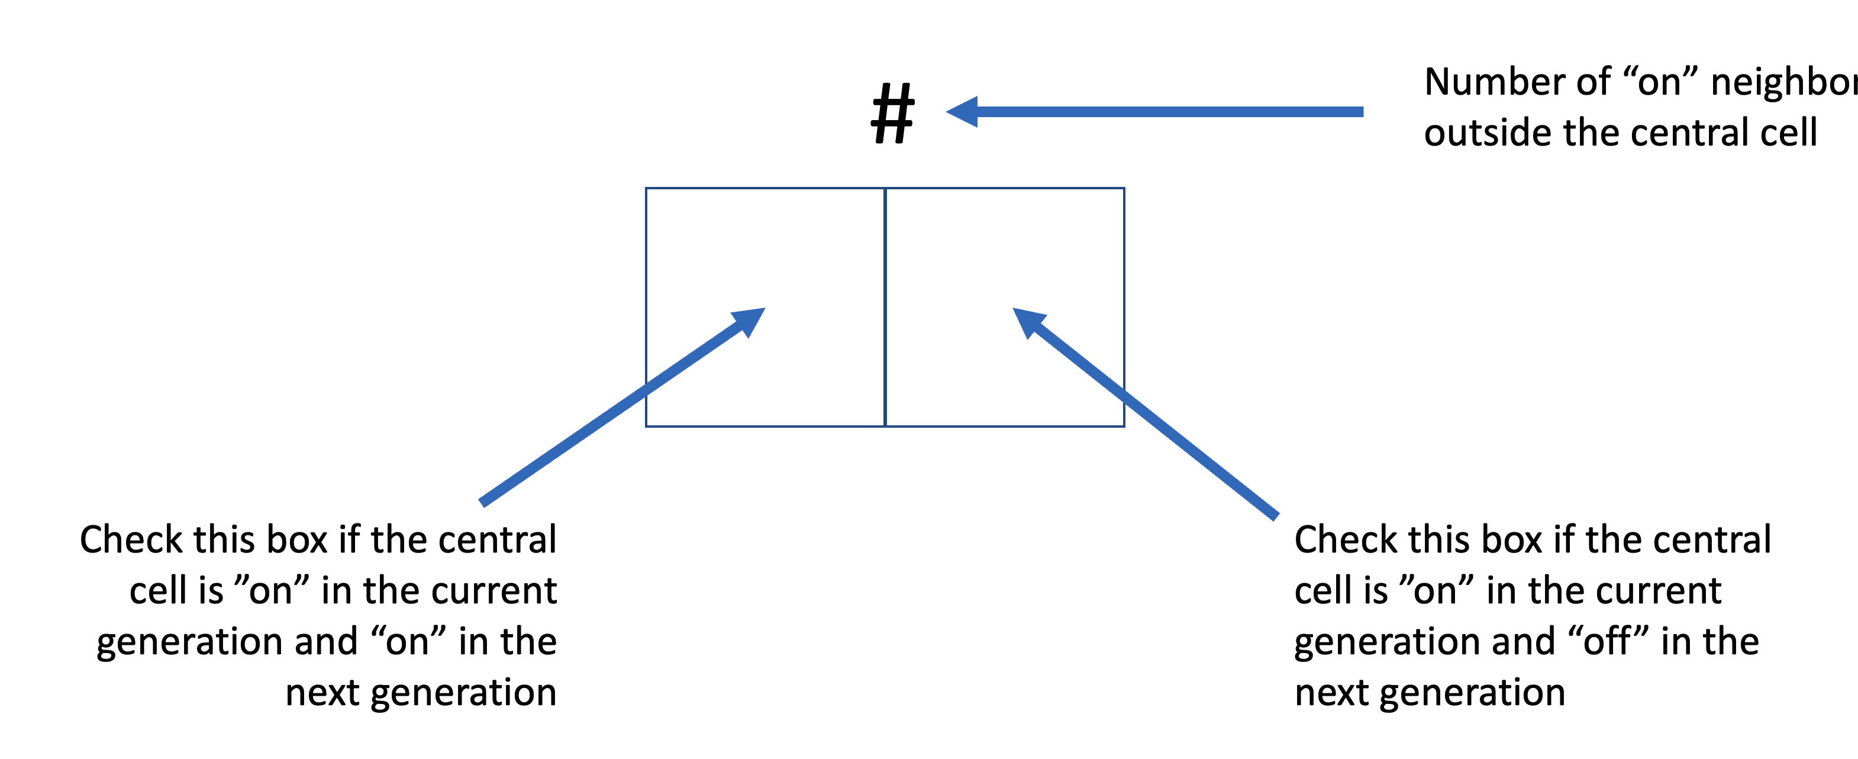
Example of OTR: N=3 Voter Rule
Rule Table Format
111 | 110 | 101 | 100 | 011 | 010 | 001 | 000
1 | 1 | 1 | 0 | 1 | 0 | 0 | 0
OTR Format
2
1
0
X
X
X

Slide 47
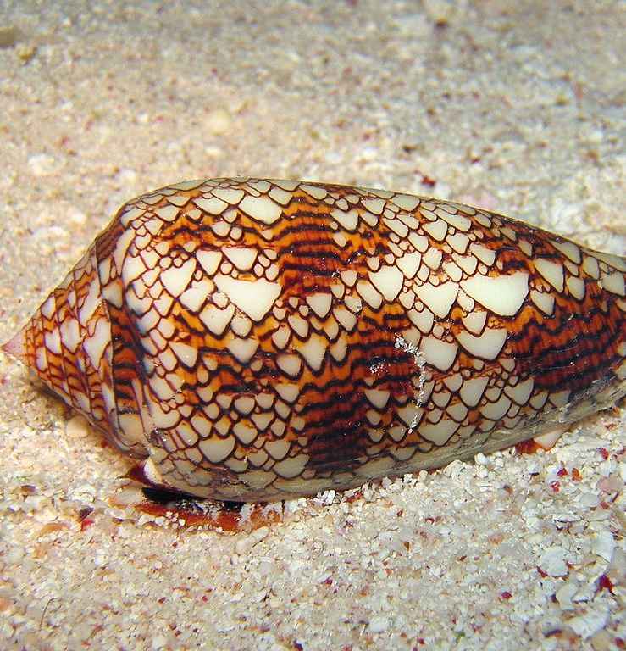
Applications: CAs in Nature
Some biological processes occur—or can be simulated—by cellular automata.
Patterns of some seashells, like the ones in the genera Conus and Cymbiola, are generated by natural cellular automata.
The pigment cells reside in a narrow band along the shell's lip.
Each cell secretes pigments according to the activating and inhibiting activity of its neighbor pigment cells, obeying a natural version of a mathematical rule.
The cell band leaves the colored pattern on the shell as it grows slowly.
For example, the widespread species Conus textile bears a pattern resembling Wolfram's rule 30 cellular automaton.

Slide 48
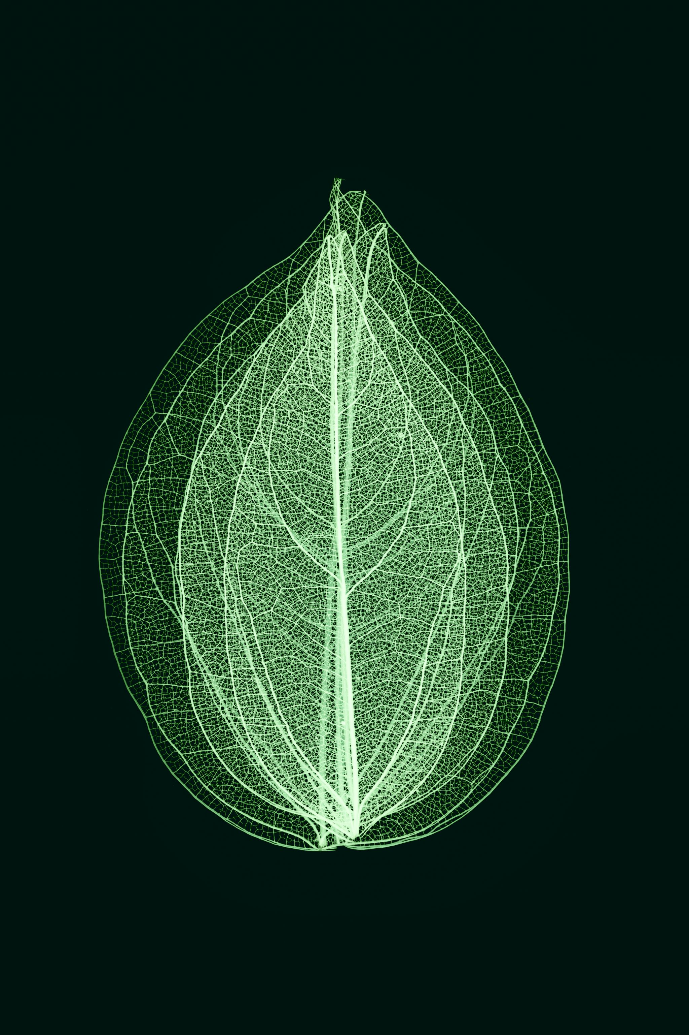
Other Applications
Plants regulate their intake and loss of gases via a cellular automaton mechanism. Each stoma on the leaf acts as a cell.
Moving wave patterns on the skin of cephalopods can be simulated with a two-state, two-dimensional cellular automata, each state corresponding to either an expanded or retracted chromatophore.
Threshold automata have been invented to simulate neurons, and complex behaviors such as recognition and learning can be simulated.
Fibroblasts bear similarities to cellular automata, as each fibroblast only interacts with its neighbors.

Slide 49
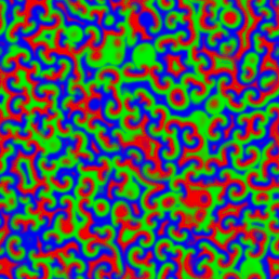
Belousov–Zhabotinsky Reaction https://en.wikipedia.org/wiki/Belousov-Zhabotinsky_reaction
A Belousov–Zhabotinsky reaction, or BZ reaction, is one of a class of reactions that serve as a classical example of non-equilibrium thermodynamics, resulting in the establishment of a nonlinear chemical oscillator.
The only common element in these oscillators is the inclusion of bromine and an acid.
The reactions are important to theoretical chemistry in that they show that chemical reactions do not have to be dominated by equilibrium thermodynamic behavior.
These reactions are far from equilibrium and remain so for a significant length of time and evolve chaotically.
In this sense, they provide an interesting chemical model of nonequilibrium biological[clarification needed] phenomena;
As such, mathematical models and simulations of the BZ reactions themselves are of theoretical interest, showing phenomenon as noise-induced order.
Computer simulation of the Belousov–Zhabotinsky reaction

Slide 50
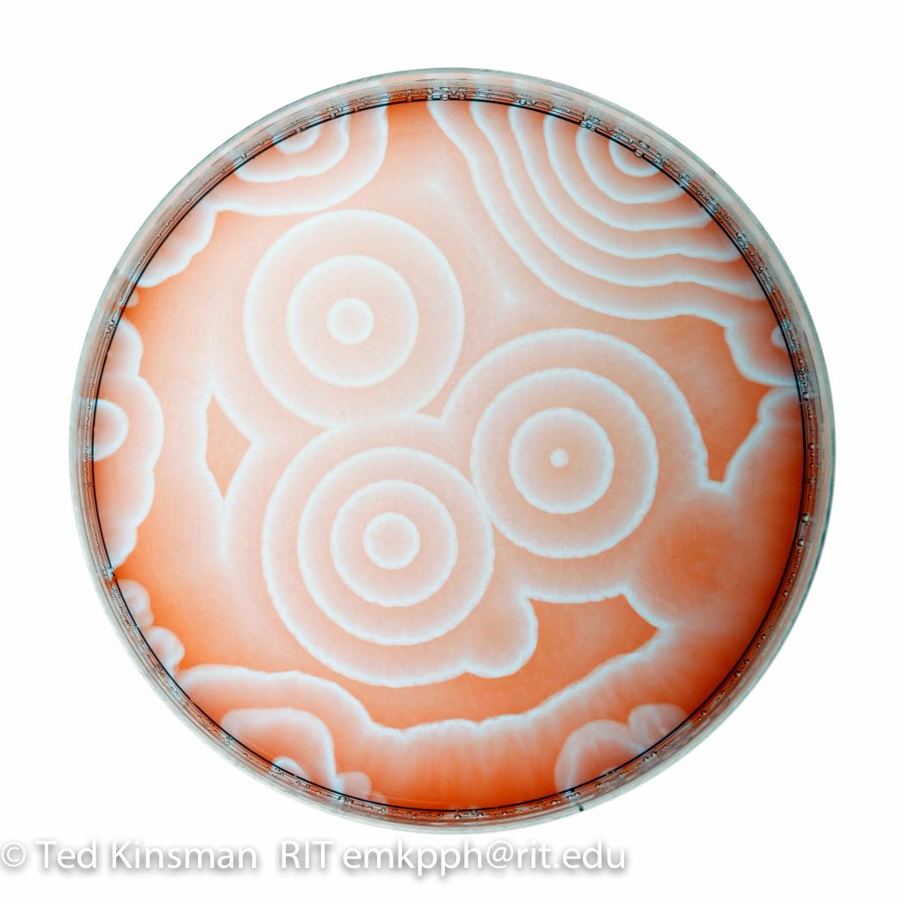
Other Applications: Belousov–Zhabotinsky Reaction
The Belousov–Zhabotinsky reaction is a spatio-temporal chemical oscillator that can be simulated by means of a cellular automaton.
In the 1950s A. M. Zhabotinsky (extending the work of B. P. Belousov) discovered that when a thin, homogenous layer of a mixture of malonic acid, acidified bromate, and a ceric salt were mixed together and left undisturbed, fascinating geometric patterns such as concentric circles and spirals propagate across the medium.
In the "Computer Recreations" section of the August 1988 issue of Scientific American, A. K. Dewdney discussed a cellular automaton developed by Martin Gerhardt and Heike Schuster of the University of Bielefeld (Germany).
This automaton produces wave patterns that resemble those in the Belousov-Zhabotinsky reaction.

Slide 51
Other Applications: Computer Processors
Cellular automaton processors are physical implementations of CA concepts, which can process information computationally.
Processing elements are arranged in a regular grid of identical cells.
The grid is usually a square tiling, or tessellation, of two or three dimensions; other tilings are possible, but not yet used.
Cell states are determined only by interactions with adjacent neighbor cells.
No means exists to communicate directly with cells farther away.
One such cellular automaton processor array configuration is the systolic array.
Cell interaction can be via electric charge, magnetism, vibration (phonons at quantum scales), or any other physically useful means.
This can be done in several ways, so no wires are needed between any elements.
This is very unlike processors used in most computers today (von Neumann designs) which are divided into sections with elements that can communicate with distant elements over wires.

Slide 52
Other Applications: Cryptography
Rule 30 was originally suggested as a possible block cipher for use in cryptography.
Two-dimensional cellular automata can be used for constructing a pseudorandom number generator.
Cellular automata have been proposed for public-key cryptography.
The one-way hash function is the evolution of a finite CA whose inverse is believed to be hard to find (and is the basis of cryptocurrencies)
Given the rule, anyone can easily calculate future states, but it appears to be very difficult to calculate previous states.

Slide 53
Modeling Physical Reality
While a complete theory along this line has not been developed, entertaining and developing this hypothesis led scholars to interesting speculation and fruitful intuitions on how we can make sense of our world within a discrete framework.
Marvin Minsky, the AI pioneer, investigated how to understand particle interaction with a four-dimensional CA lattice
Konrad Zuse—the inventor of the first working computer, the Z3—developed an irregularly organized lattice to address the question of the information content of particles.
More recently, Edward Fredkin exposed what he terms the "finite nature hypothesis", i.e., the idea that "ultimately every quantity of physics, including space and time, will turn out to be discrete and finite."
Fredkin and Wolfram are strong proponents of a CA-based physics.
In 2016 Gerard 't Hooft published a book-length development of the idea to rebuild quantum mechanics using cellular automata.

Slide 54
Modeling Physical Reality
As Andrew Ilachinski points out in his book Cellular Automata, many scholars have raised the question of whether the universe is a cellular automaton.
Ilachinski argues that the importance of this question may be better appreciated with a simple observation, which can be stated as follows.
  Consider the evolution of rule 110: if it were some kind of "alien physics", what would be a reasonable description of the observed patterns?[
  If an observer did not know how the images were generated, that observer might end up conjecturing about the movement of some particle-like objects.
  James Crutchfield (UC Davis Physics) constructed a rigorous mathematical theory out of this idea, proving the statistical emergence of "particles" from cellular automata. (discussed previously)

Slide 55
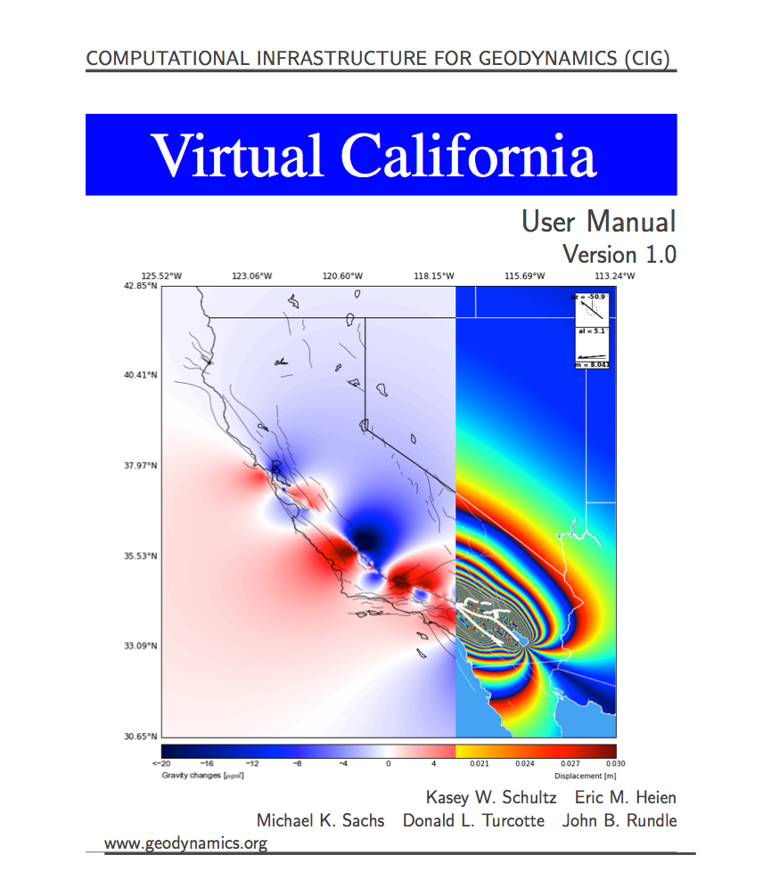
A Realistic CA: Earthquake Simulations
Any observable geophysical quantity can be computed and displayed from simulations
Includes earthquake histories, aftershock patterns, surface deformation, InSAR, and gravity changes
Virtual California simulations are in reasonable agreement with the aggregate of data
We have reached an era of big data (at least in the simulation sense)
geodynamics.org/software

Slide 56
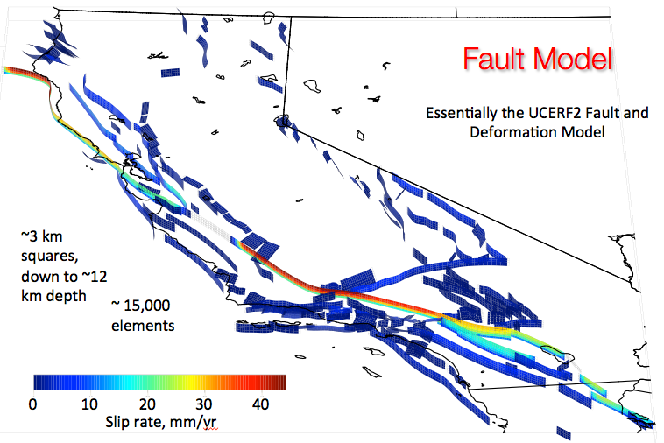

Slide 57
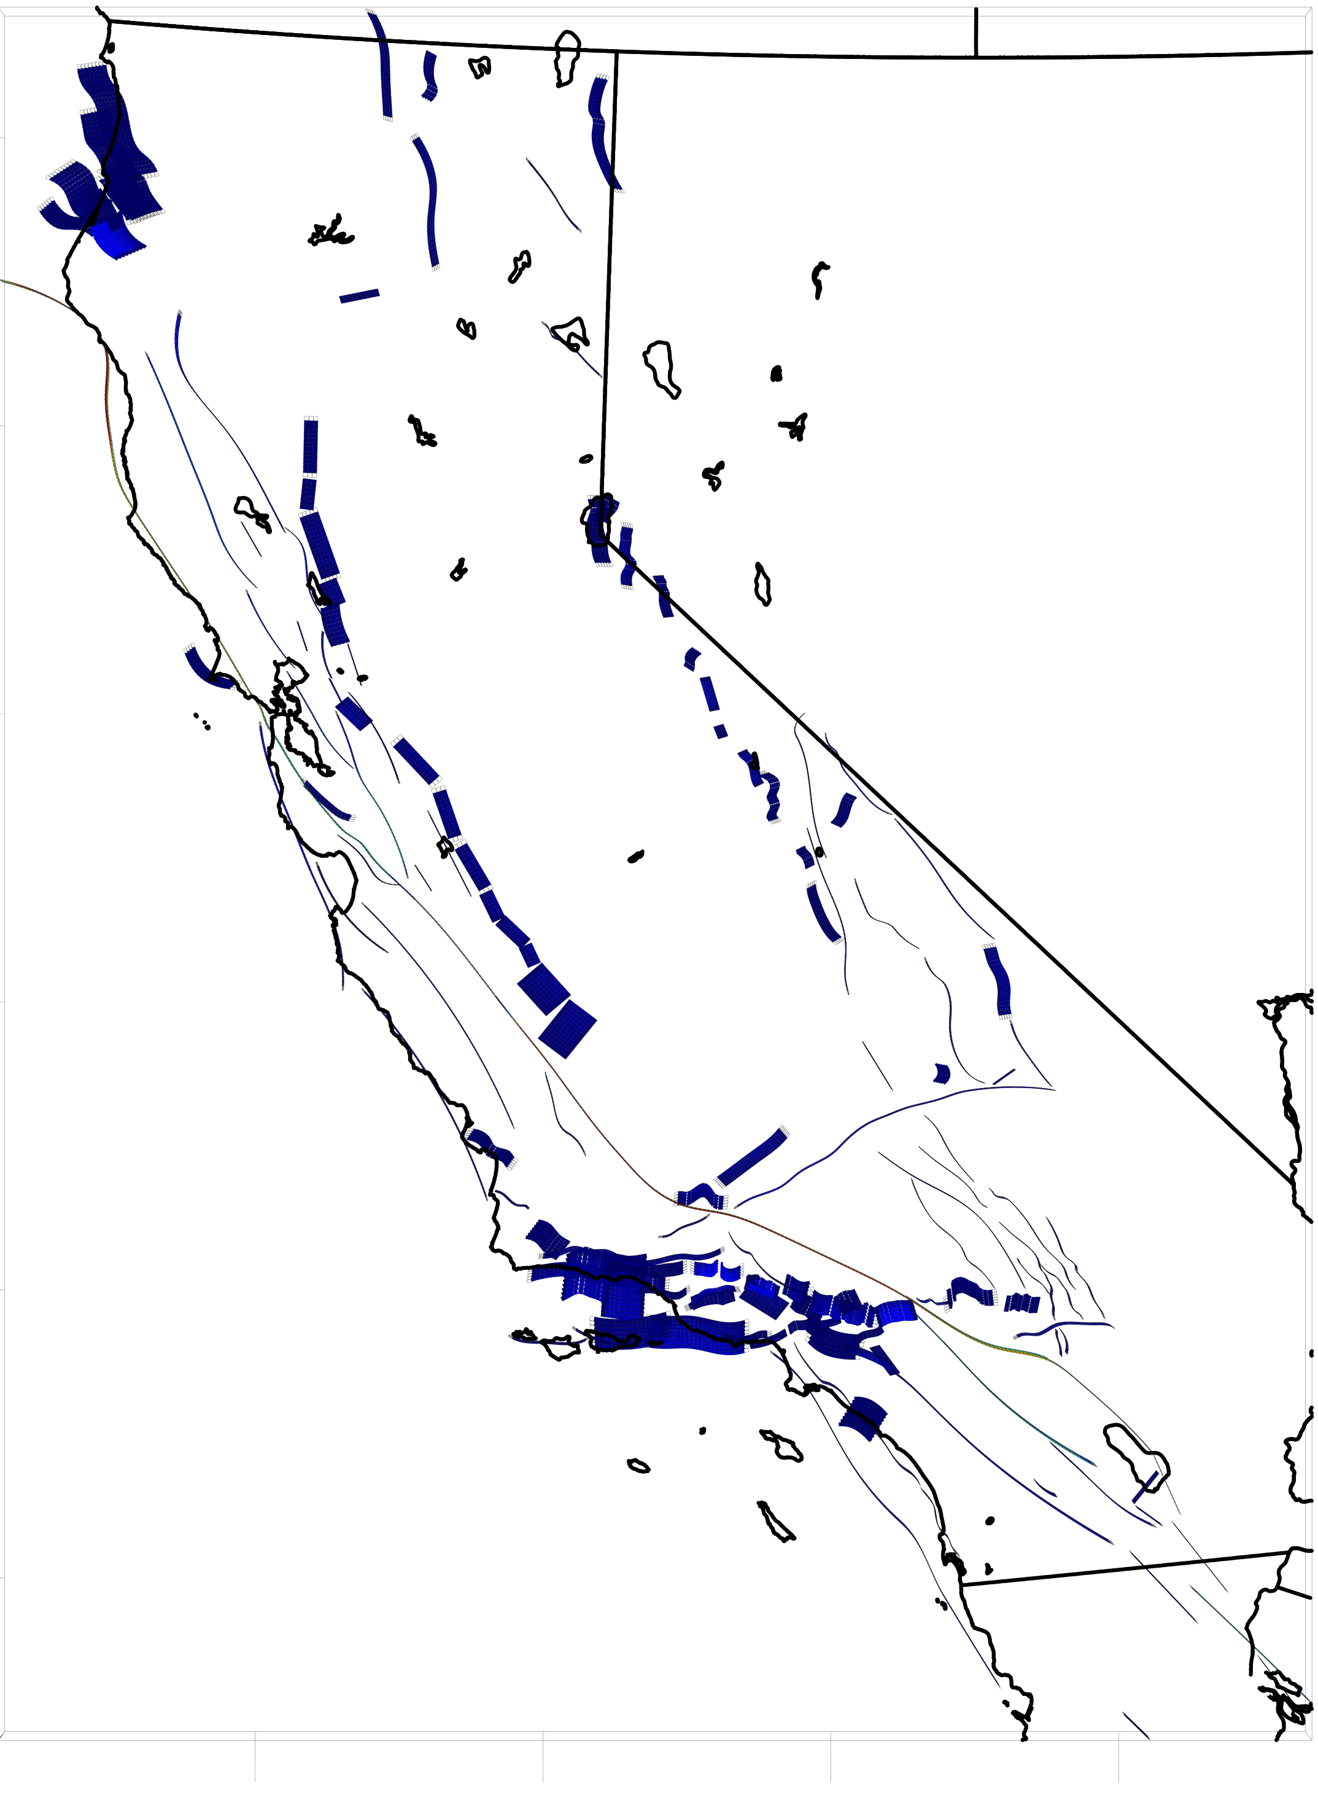
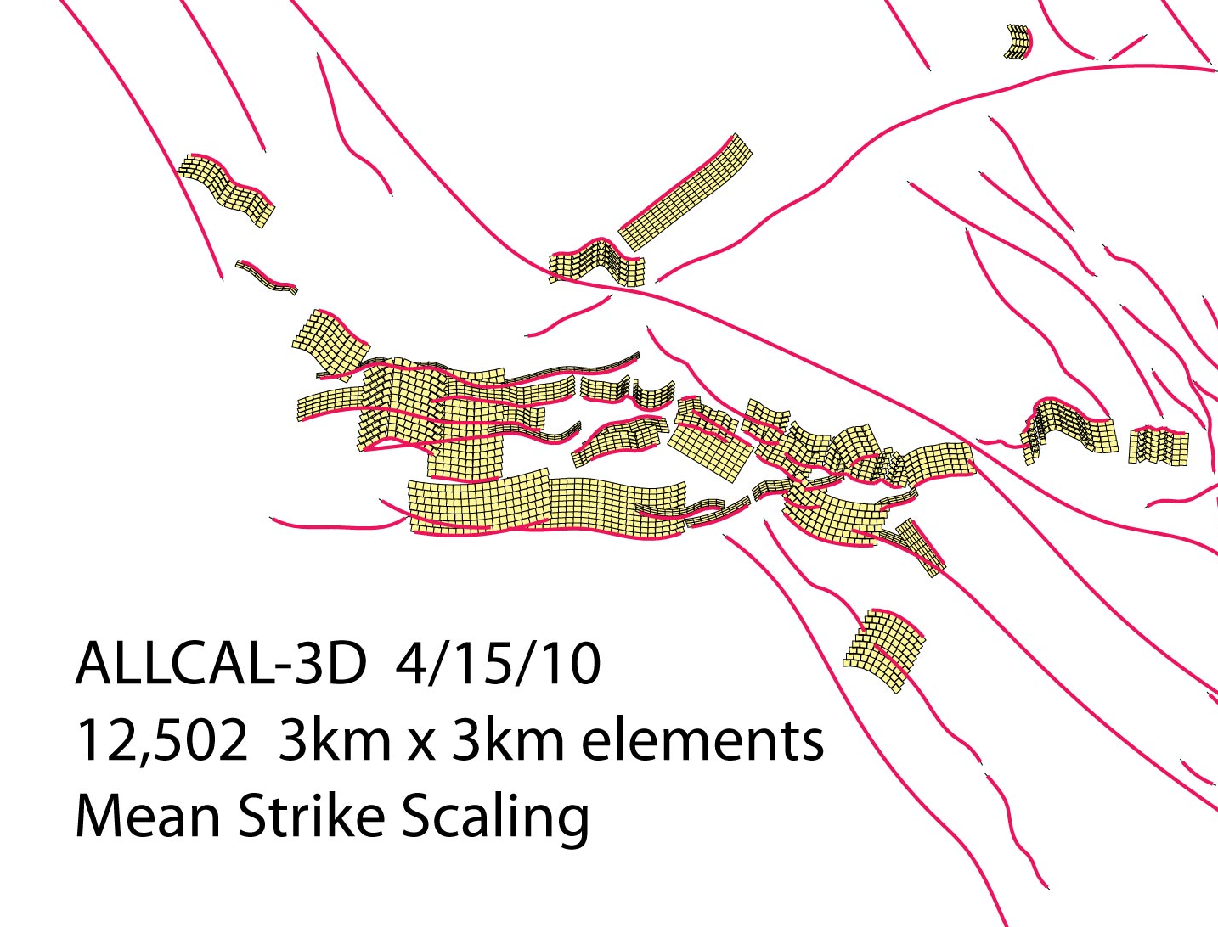
Fault Model
~3 km squares, down to ~12 km depth
Essentially the UCERF2 Fault and Deformation Model
~ 15,000 elements
Details of Southern CA
Few rips and tears down dip, since using rectangles rather than triangles to fit curved surfaces
0
10
20
30
40
Slip rate, mm/yr

Slide 58
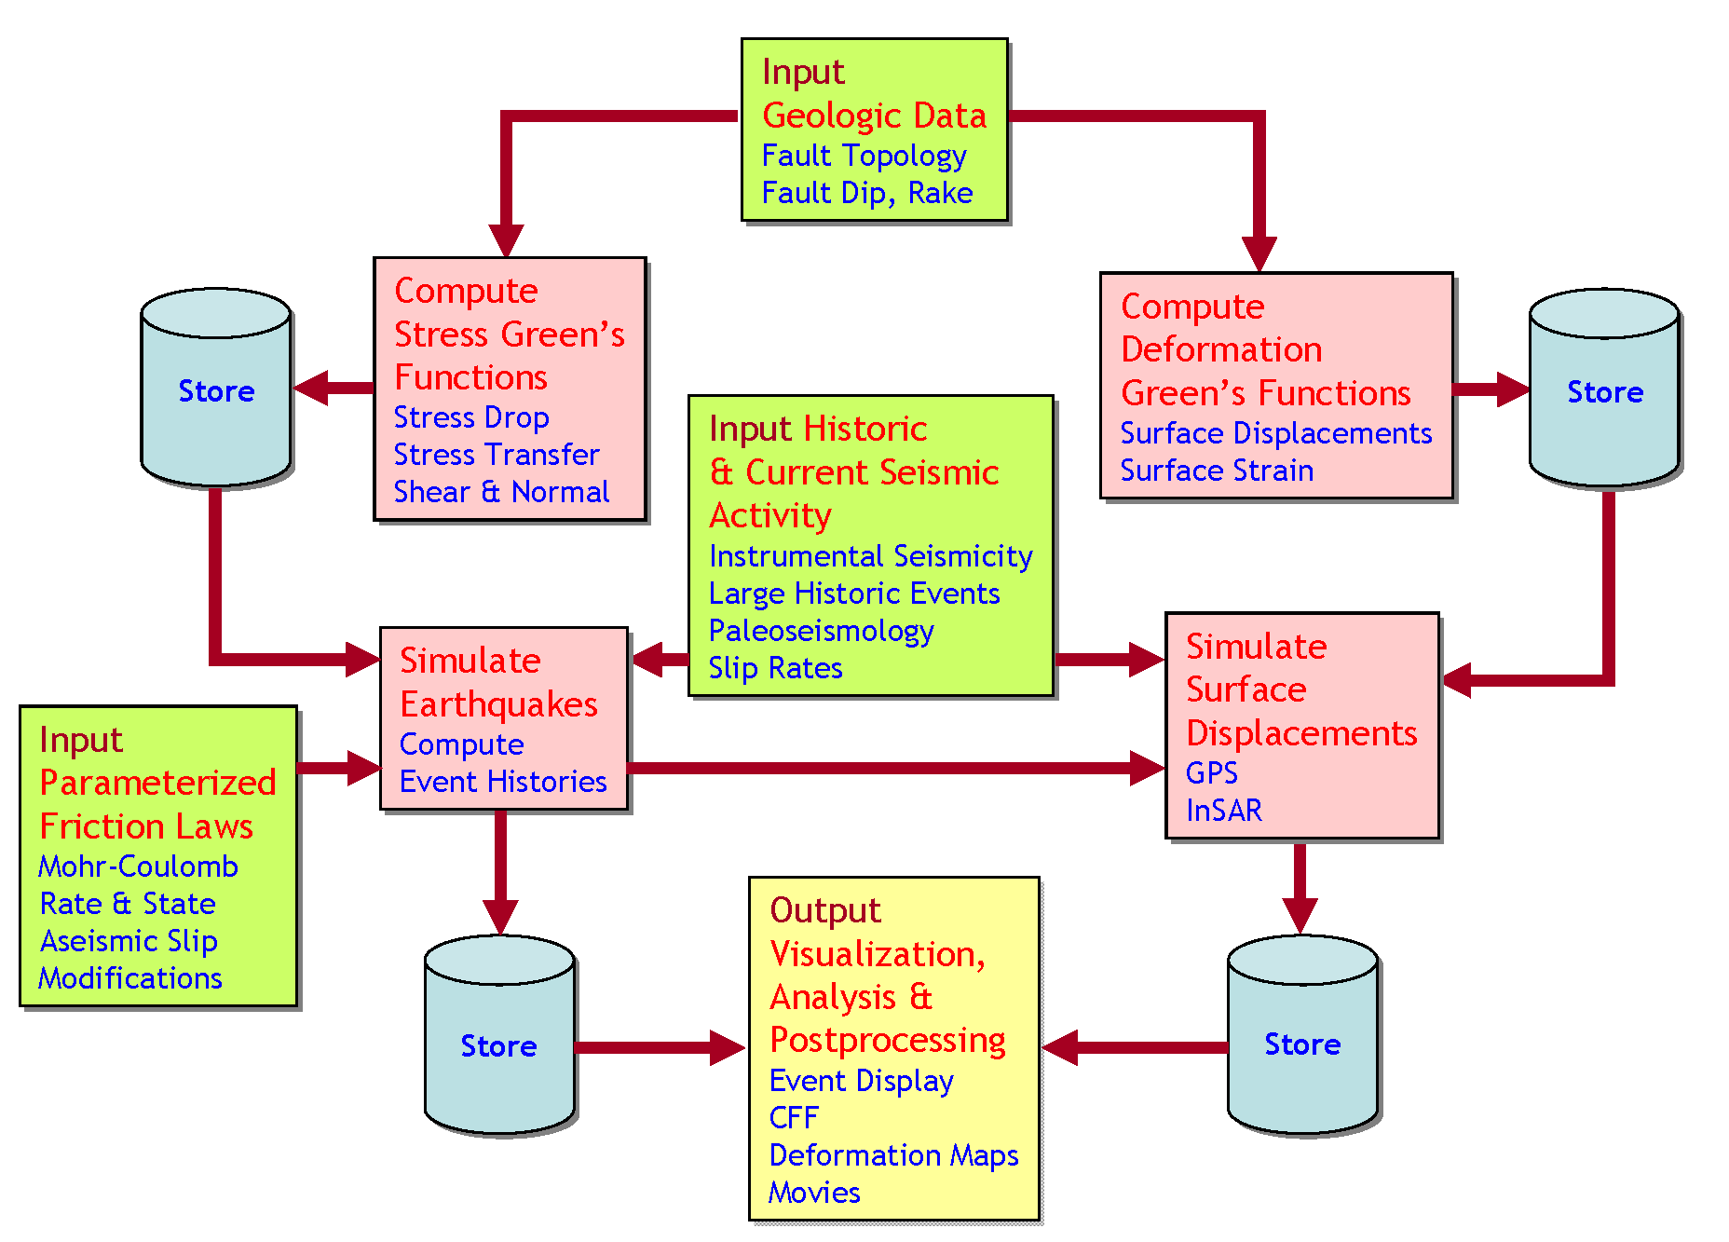
Structure of Virtual Quake Codes
JPL QuakeSim Project: http://quakesim.jpl.nasa.gov
Data Assimilation
The structure of a backslip code such as Virtual Quake uses boundary elements or finite elements only to compute the stress Green’s functions. The dynamics are computed, analyzed and visualized with codes of considerable generality. The advantage of a backslip model is that all faults are guaranteed to have an average slip rate equal to the observed long-term rate.

Slide 59
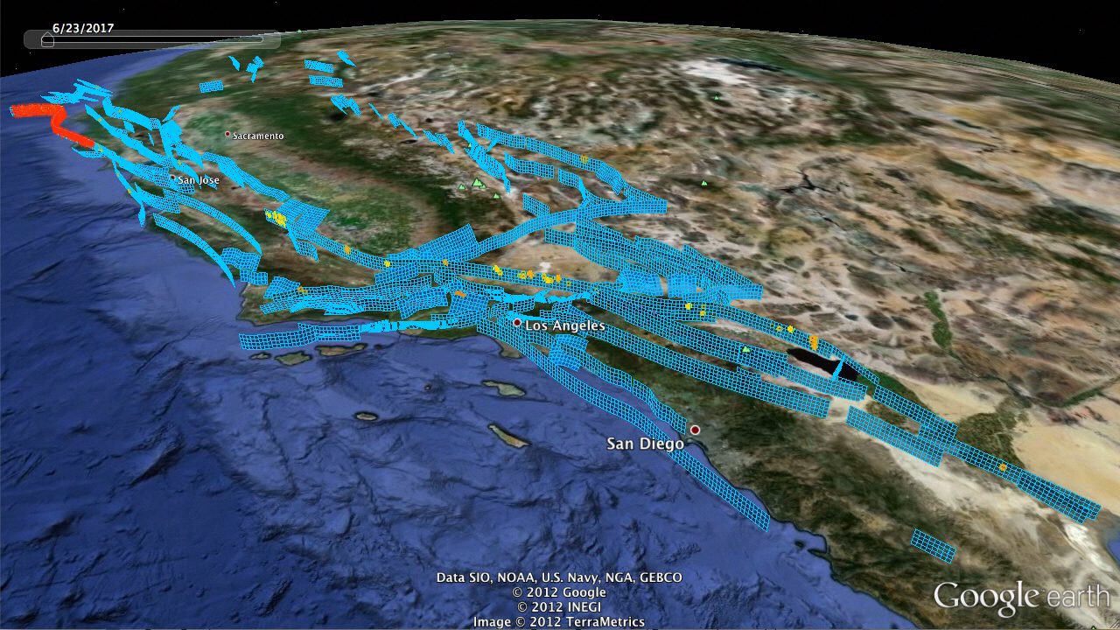

Slide 60
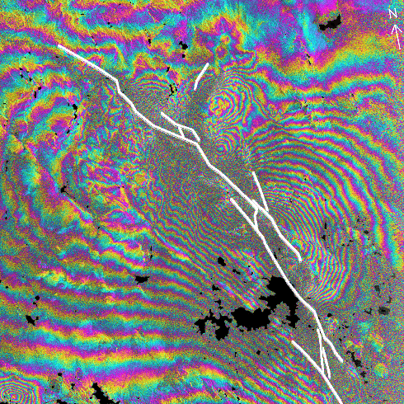
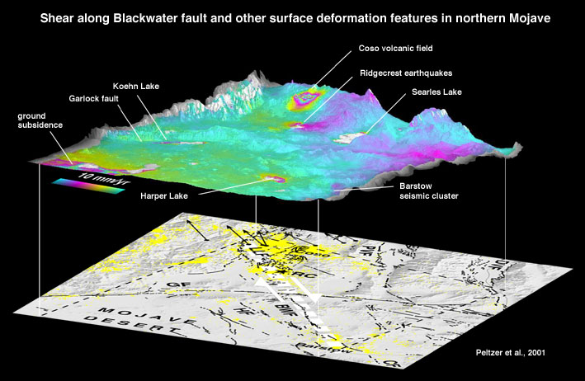
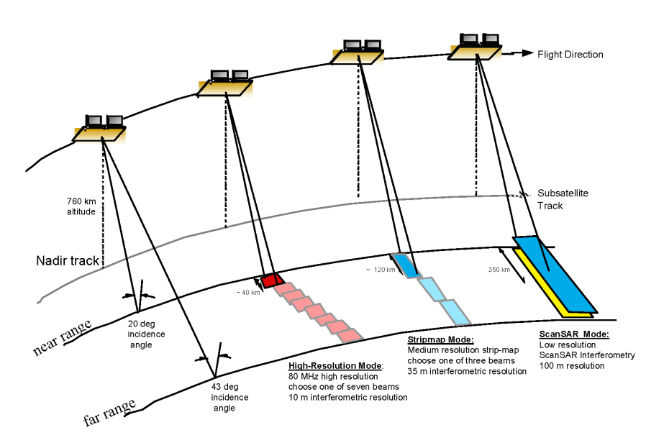
Synthetic Aperture Radar Interferometry (InSAR) can detect changes (both large and small) in surface deformation of the earth’s crust over synoptic scales.
At present we are limited to isolated, static images.
Deformation in the Eastern Mojave Shear Zone
(Courtesy G. Peltzer)
1992 Landers, California Earthquake
(Courtesy H. Zebker)
Courtesy Y. Kim

Slide 61
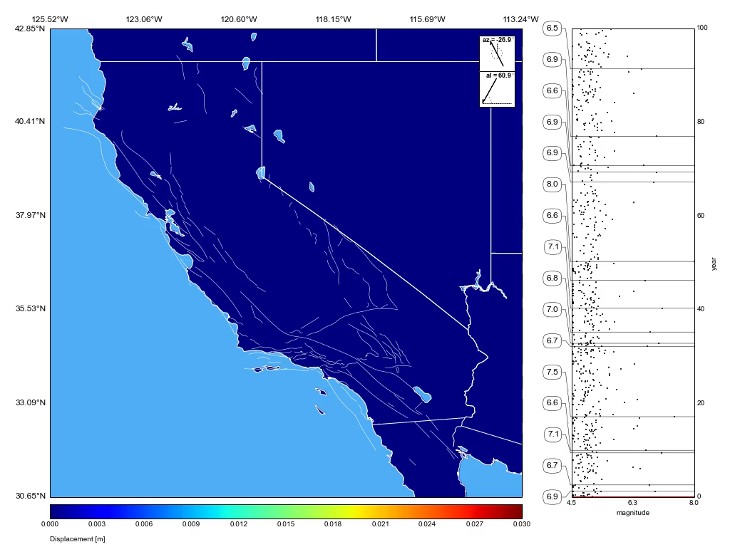
InSAR

