Slide 1
Fractals, Chaos, Complexity
Physics-EPS 30
Lecture
Landscapes

Slide 2
Credits
https://en.wikipedia.org/wiki/Phase_transition
https://en.wikipedia.org/wiki/Fitness_landscape
https://en.wikipedia.org/wiki/Energy_landscape
https://pubs.acs.org/doi/10.1021/jp0680544 (folding landscapes)
https://en.wikipedia.org/wiki/Artificial_life
Google on Fitness landscapes, free energy landscapes, evolutionary biology landscapes

Slide 3
Recall Discussion of Dynamical Stability
Unstable Fixed Point
Moves away from F.P.
if disturbed
Stable Fixed Point
Moves back to F.P.
if disturbed
Neutral or Marginal Stability
Stays where you place it
if disturbed

Slide 4
Introduction to Energy Landscapes
The concept is frequently used in physics, chemistry, engineering, and biochemistry, e.g. to describe:
  All possible conformations of a molecular entity,
  Or the spatial positions of interacting molecules in a system,
  Or parameters and their corresponding energy levels, typically Gibbs free energy.
  Geometrically, the energy landscape is the graph of the energy function across the configuration space of the system.
  The term is also used more generally in geometric perspectives to mathematical optimization, when the domain of the loss function is the parameter space of some system.

Slide 5
Landscapes are a Generalization
Concept is used widely in science
A landscape is a mapping of all possible states of a system.
In physics, we talk about Energy landscapes
  A potential energy surface consisting of hills and valleys
  Dynamics arises from tendency of system to evolve to minimum energy state
In biology/ecology, we talk about Fitness landscapes
  A generalized surface consisting of hills and valleys
  Species development arises from tendency to evolve to maximum fitness state
  In social systems, we talk about Cultural landscapes
  A generalized surface consisting of hills and valleys
  Not clear if an evolutionary dynamics has been defined for these as yet

Slide 6
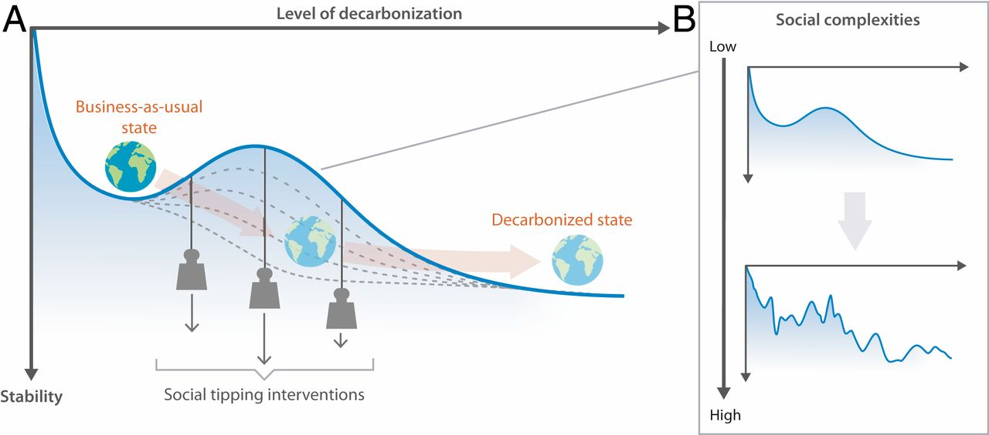
Example of Social Dynamics for Climate Change https://en.wikipedia.org/wiki/Energy_landscape
Simplified energy landscape of the world's socioeconomic system and social tipping dynamics at different levels of detail, highlighting factors that influence transitions

Slide 7
Applications
The term is useful when examining protein folding
While a protein can theoretically exist in a nearly infinite number of conformations along its energy landscape, in reality proteins fold (or "relax") into secondary and tertiary structures that possess the lowest possible free energy.
The key concept in the energy landscape approach to protein folding is the folding funnel hypothesis.
In catalysis, when designing new catalysts or refining existing ones, energy landscapes are considered to avoid low-energy or high-energy intermediates that could halt the reaction or demand excessive energy to reach the final products.
In “glassy models”, the local minima of an energy landscape correspond to metastable low temperature states of a thermodynamic system.[

Slide 8
Applications
In machine learning, artificial neural networks may be analyzed using analogous approaches.
For example, a neural network may be able to perfectly fit the training set, corresponding to a global minimum of zero loss, but overfitting the model ("learning the noise" or "memorizing the training set").
Understanding when this happens can be studied using the geometry of the corresponding energy landscape.
This is an example of “supervised learning”, in which a free energy function, or cost function, is minimized
Minimization is usually enabled by use of a gradient descent algorithm, in which the system state is assumed to evolve “down the gradient” of a valley

Slide 9
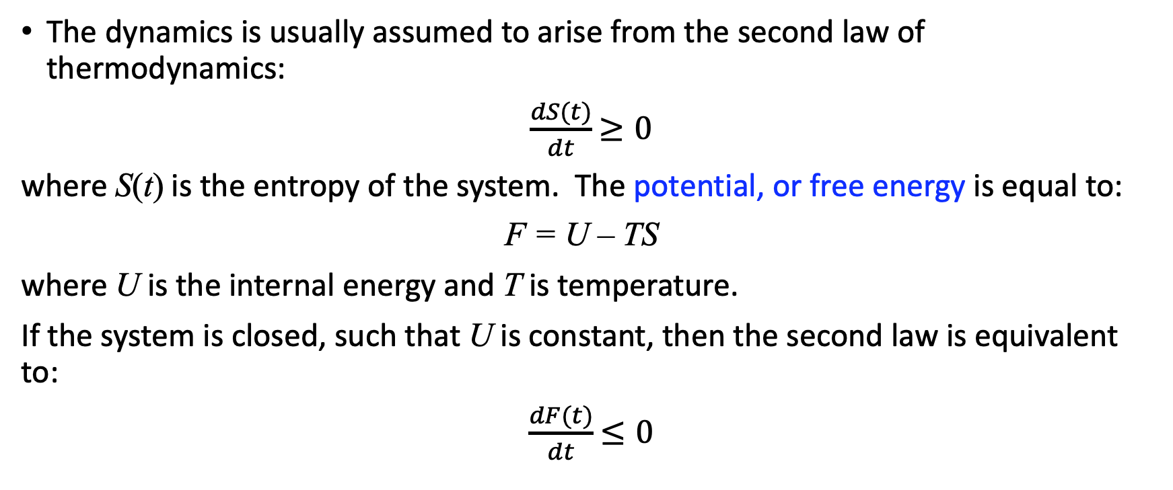
Dynamics on an Energy Landscape
The dynamics is usually assumed to arise from the second law of thermodynamics:
$\frac{dS(t)}{dt}$ $≥0$
where S(t) is the entropy of the system. The potential, or free energy is equal to:
F = U – TS
where U is the internal energy and T is temperature.
If the system is closed, such that U is constant, then the second law is equivalent to:
$\frac{dF(t)}{dt}$ $≤0$

Slide 10
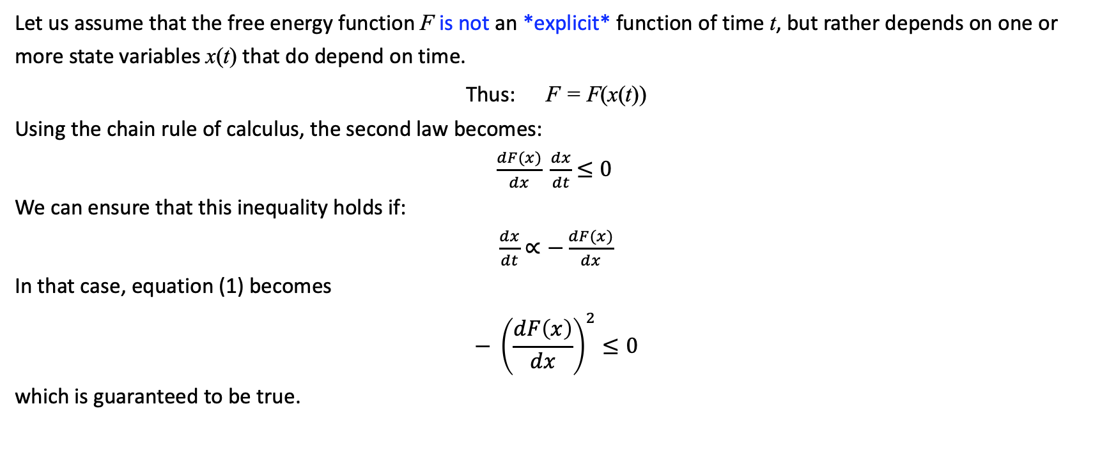
Dynamics on an Energy Landscape
Let us assume that the free energy function F is not an *explicit* function of time t, but rather depends on one or more state variables x(t) that do depend on time.
Thus: F = F(x(t))
Using the chain rule of calculus, the second law becomes:
$\frac{dF(x)}{dx} \frac{dx}{dt}$ $≤0$
We can ensure that this inequality holds if:
$\frac{dx}{dt}$ $∝−\frac{dF(x)}{dx}$
In that case, equation (1) becomes
$$− {\left(\frac{dF\left(x\right)}{dx}\right)}^{2}≤0$$
which is guaranteed to be true.
(1)
(2)
Equation (2) says that the state variable evolves down the minimum valley of the free energy.

Slide 11
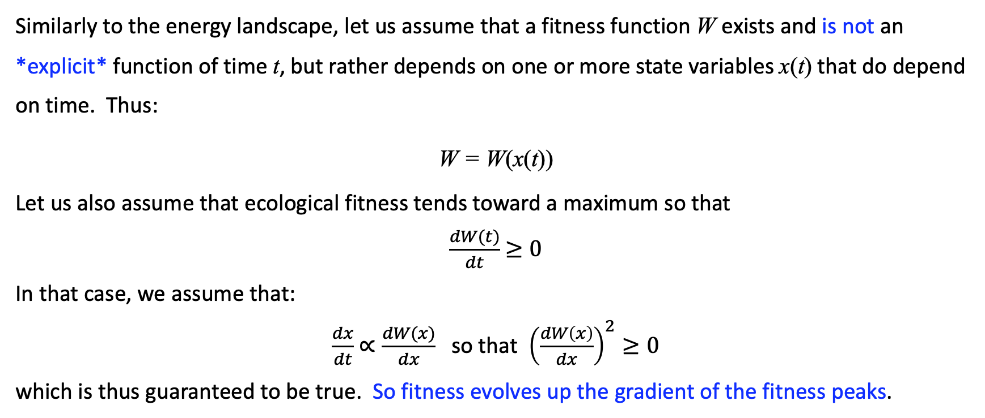
Dynamics on an Fitness Landscape
Similarly to the energy landscape, let us assume that a fitness function W exists and is not an *explicit* function of time t, but rather depends on one or more state variables x(t) that do depend on time. Thus:
W = W(x(t))
Let us also assume that ecological fitness tends toward a maximum so that
$\frac{dW(t)}{dt}$ $≥0$
In that case, we assume that:
$\frac{dx}{dt}$ $∝\frac{dW(x)}{dx}$ so that ${\left(\frac{dW\left(x\right)}{dx}\right)}^{2}≥0$
which is thus guaranteed to be true. So fitness evolves up the gradient of the fitness peaks.
(2)

Slide 12
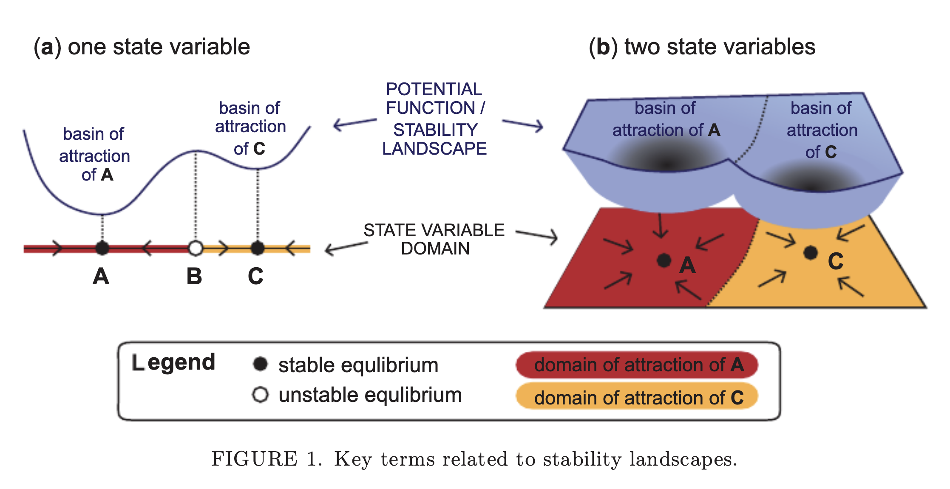
https://onlinelibrary.wiley.com/doi/epdf/10.1111/nrm.12097

Slide 13
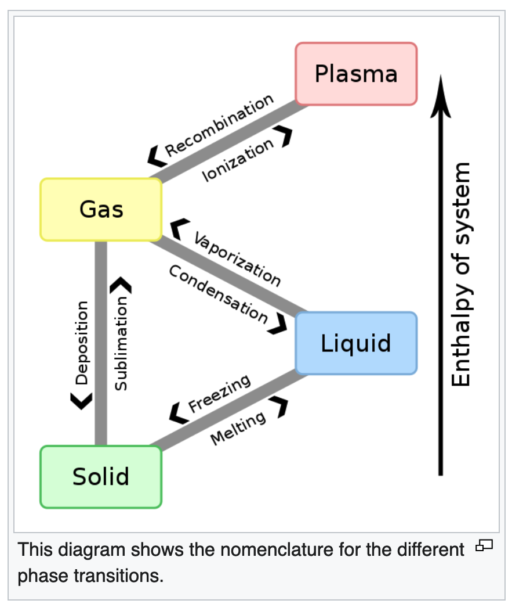
Phase Transitions
In chemistry, thermodynamics, and many other related fields, phase transitions (or phase changes) are the physical processes of transition between a macro-state of a medium to another macro-state with different values of parameters.
Commonly the term is used to refer to changes among the basic states of matter: solid, liquid, and gas, as well as plasma in rare cases.
Two basic types:
  Second Order
  First Order
Typical Thermodyamic phase transitions

Slide 14
Basic Point About Phase Transitions
Phases are states of a system
Phases can be stable, unstable, or metastable
For unstable and metastable states, a transition will occur to a new stable state
Transitions between phases can occur by changes in the control parameters or the environment of the system
Equilibrium transitions are reversible, if the conditions that caused the transition are reversed
Non-equilibrium transitions are irreversible even if the conditions that caused the transition are reversed – Hysteresis loops
Typically:
  Second order transitions are reversible and show power law scaling
  First order (“nucleation” or “tipping points”) transitions are irreversible, and power law scaling is generally not seen except in certain specific circumstances

Slide 15
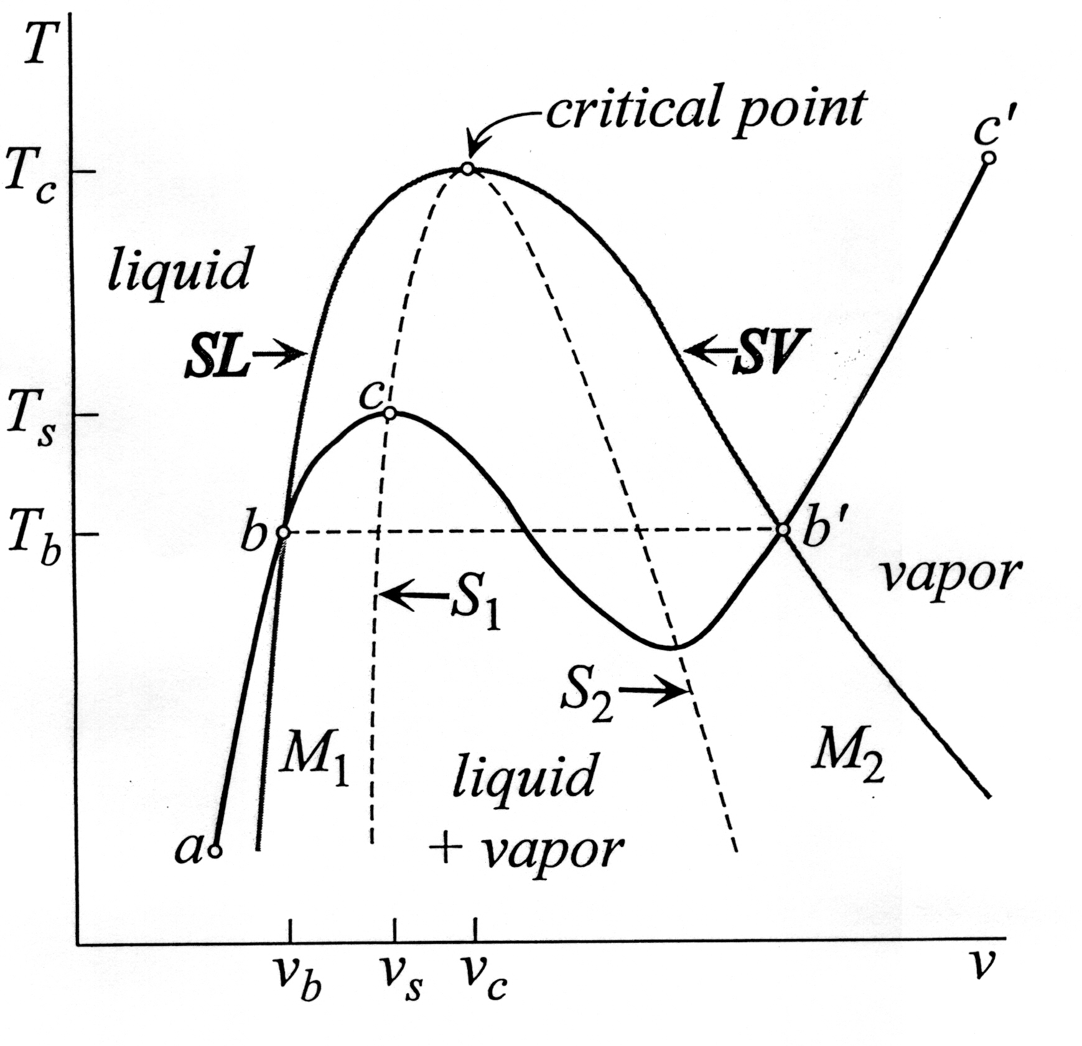
Ehrenfest Classification https://en.wikipedia.org/wiki/Phase_transition
Density is the order parameter field for thermal phase transitions
The order parameter is the first derivative of the free energy with respect to the external field
First-order phase transitions exhibit a discontinuity in the first derivative of the free energy with respect to pressure.
Second-order phase transitions are continuous in the first derivative but exhibit discontinuity in a second derivative of the free energy.
Coexistence Curve
Metastable Regions
Temperature
Volume
Spinodal Lines

Slide 16
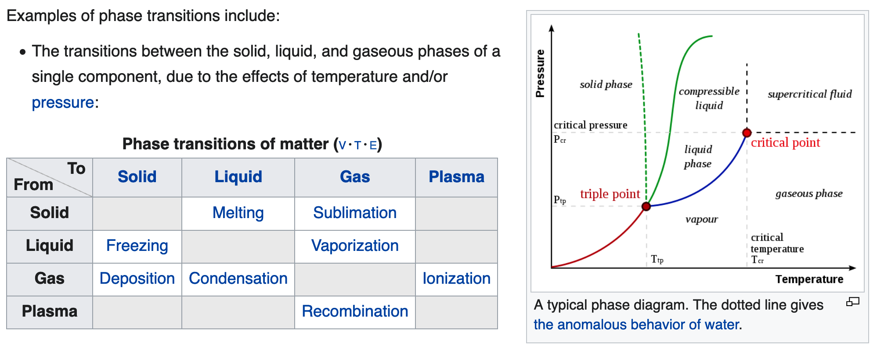
Phase Transitions
Phase Diagram

Slide 17
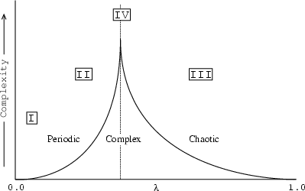
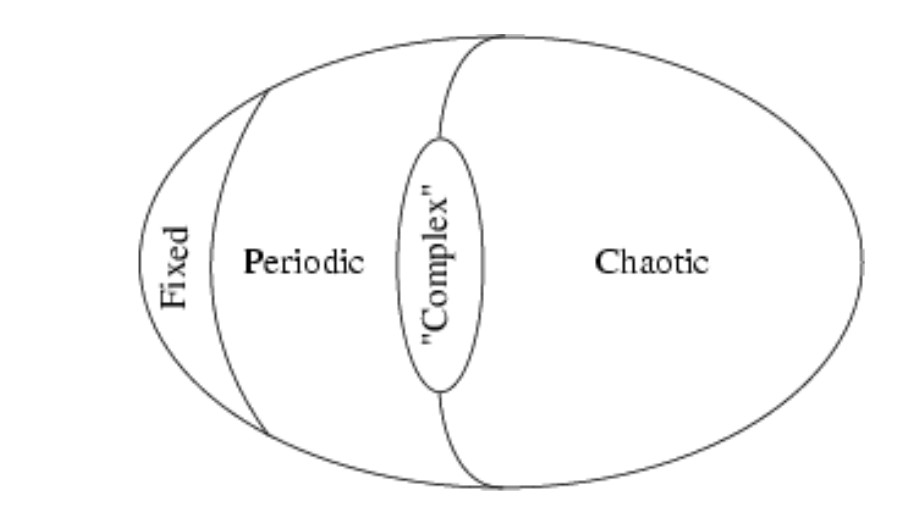
Phase Transitions in Complex Systems https://theory.org/complexity/cdpt/html/node5.html
III
II
I
IV
As we have discussed previously

Slide 18

Example: Atlantic Meridional Overturning Circulation (AMOC) https://www.livescience.com/gulf-stream-close-to-collapse
One of the most crucial ocean current systems for regulating the Northern Hemisphere's climate could be on the verge of total collapse due to climate change, a new study has revealed.
The Atlantic Meridional Overturning Circulation (AMOC), which includes the Gulf Stream and is responsible for moderating large parts of the world's climate, has undergone "an almost complete loss of stability over the last century", according to a new analysis.
The currents work like a conveyor belt to transport warm, salty water northward from the tropics and cold water back south along the seafloor.
This giant conveyor belt had already been shown to be at its weakest in more than a thousand years, but now it could be veering toward a total breakdown.
End 3/1/2022

Slide 19
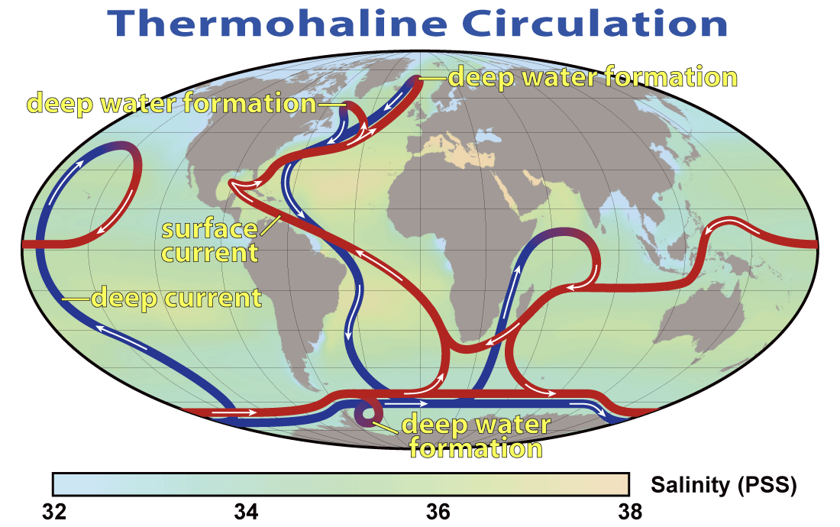
Example: Atlantic Meridional Overturning Circulation (AMOC) https://en.wikipedia.org/wiki/Shutdown_of_thermohaline_circulation#/media/File:Thermohaline_Circulation_2.png

Slide 20
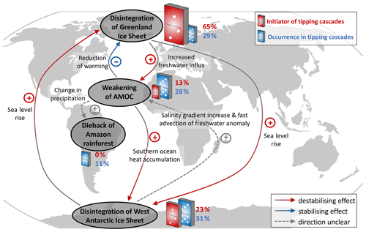
Example: Atlantic Meridian Overturning Circulation (AMOC) https://esd.copernicus.org/articles/12/601/2021/

Slide 21
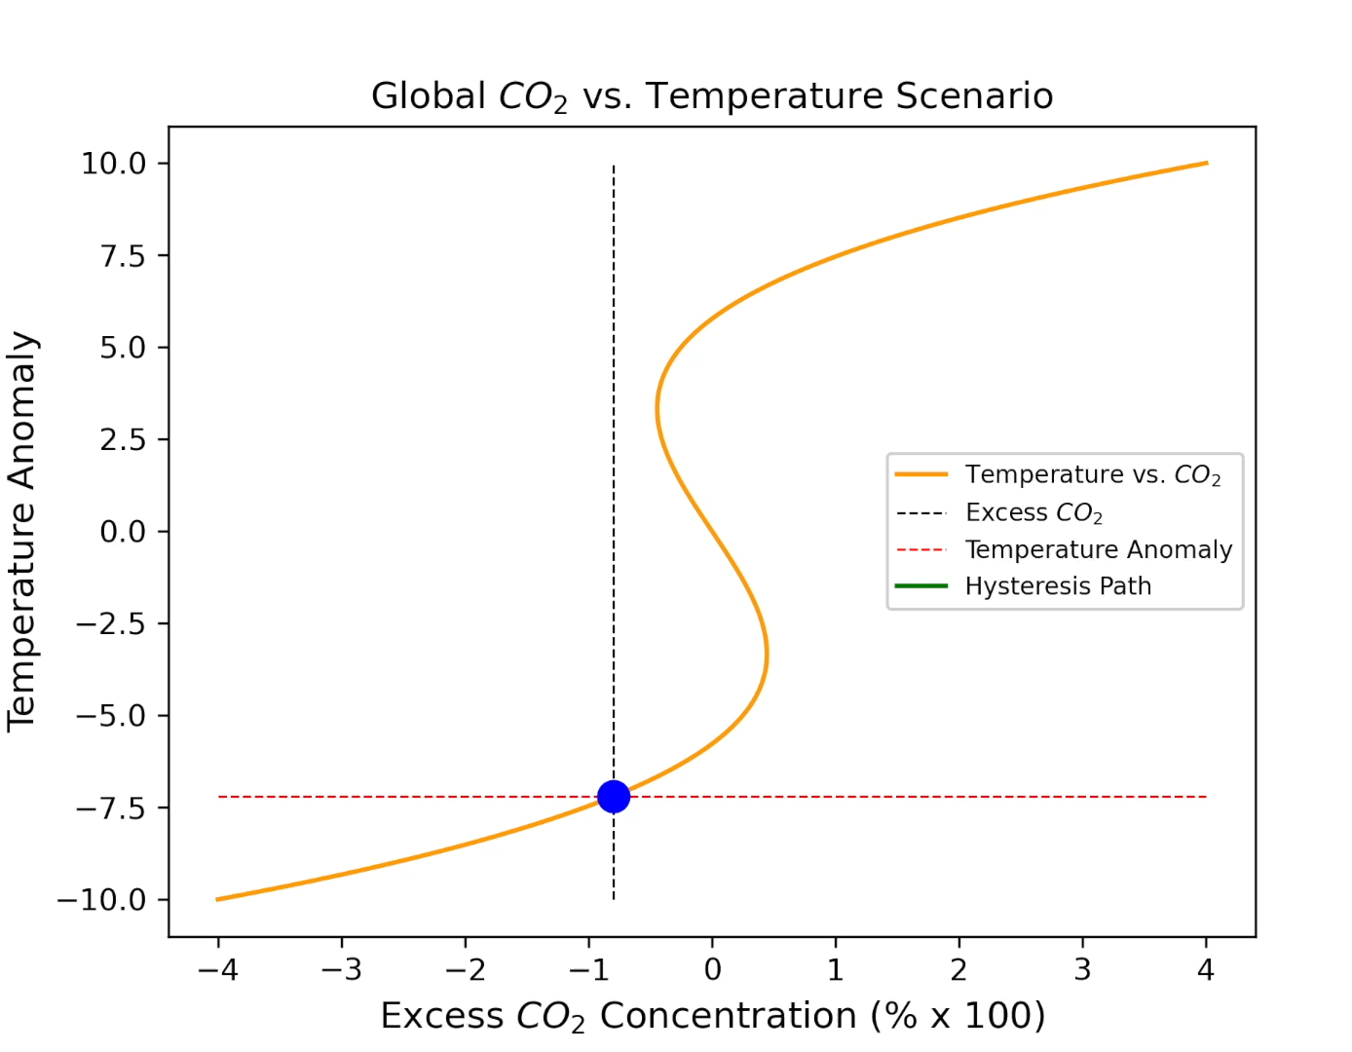
Possible Scenario for a Global Climate Tipping Point
Tipping points are first-order phase transitions, also called nucleation transitions
Nucleation occurs suddenly, not gradually when a critical value of a forcing parameter is reached

Slide 22
Hysteresis in Nonlinear Systems
Nomenclature for Phase Transitions
System gradually follows the blue-red path in response to the external forcing.
System becomes metastable along red dashed lines
At Tipping Points (spinodals), sudden large transitions to a new state will occur indicated by the green dashed arrows
System is unstable along the green dotted line
This is a first order phase transition
Response Variable
Or
System State
(“Order Parameter”)
Metastable State
Tipping Point
External Forcing
Also called a bifurcation transition

Slide 23
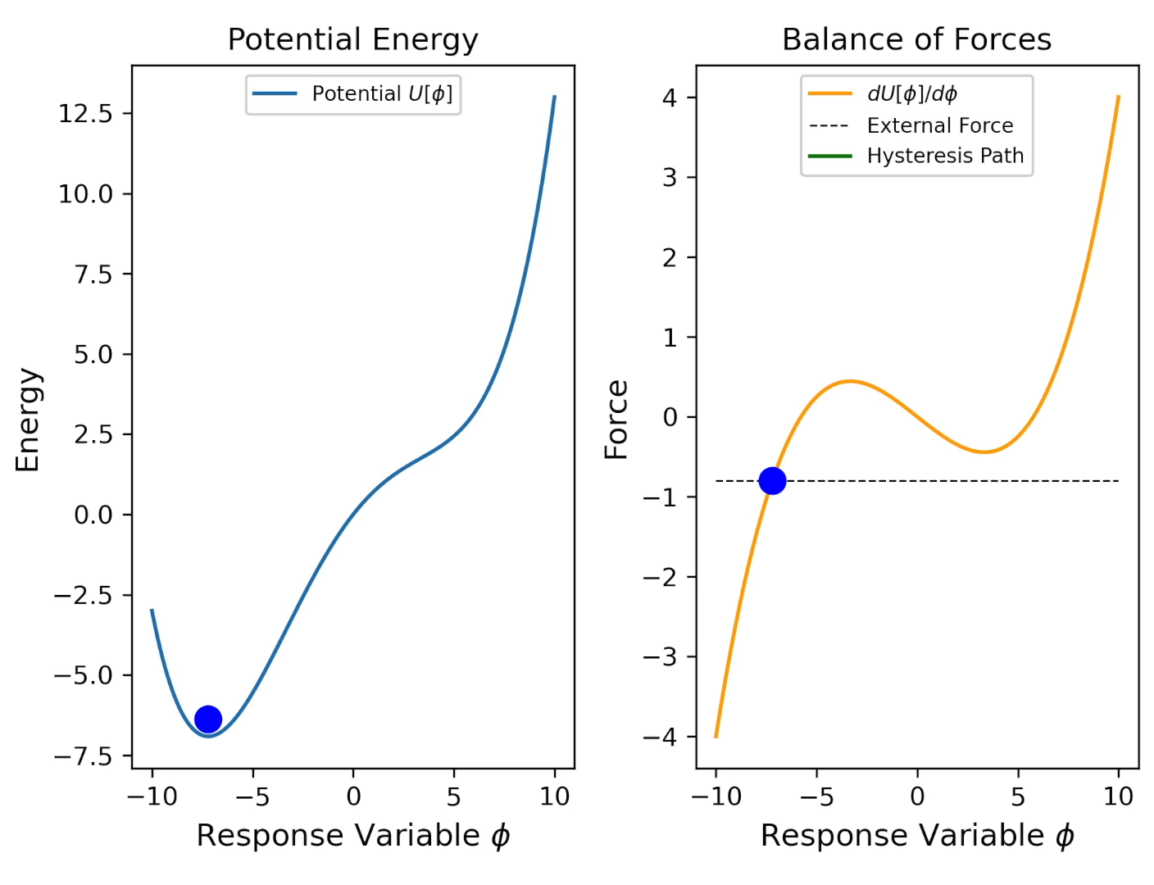
Hysteresis
Landau-Ginzburg-Wilson Potential
Stable
Metastable
Potential Energy:
U[φ] = ε φ² + α φ⁴ - h φ
Balance of Forces:
(Euler-Lagrange Equation)
dU[φ]/d φ = 0 = 2ε φ + 4α φ³ - h
or
2ε φ + 4α φ³ = h

Slide 24
Phase Transitions (Tipping Points) in Ocean Circulations http://oceantippingpoints.org/our-work/glossary

Slide 25
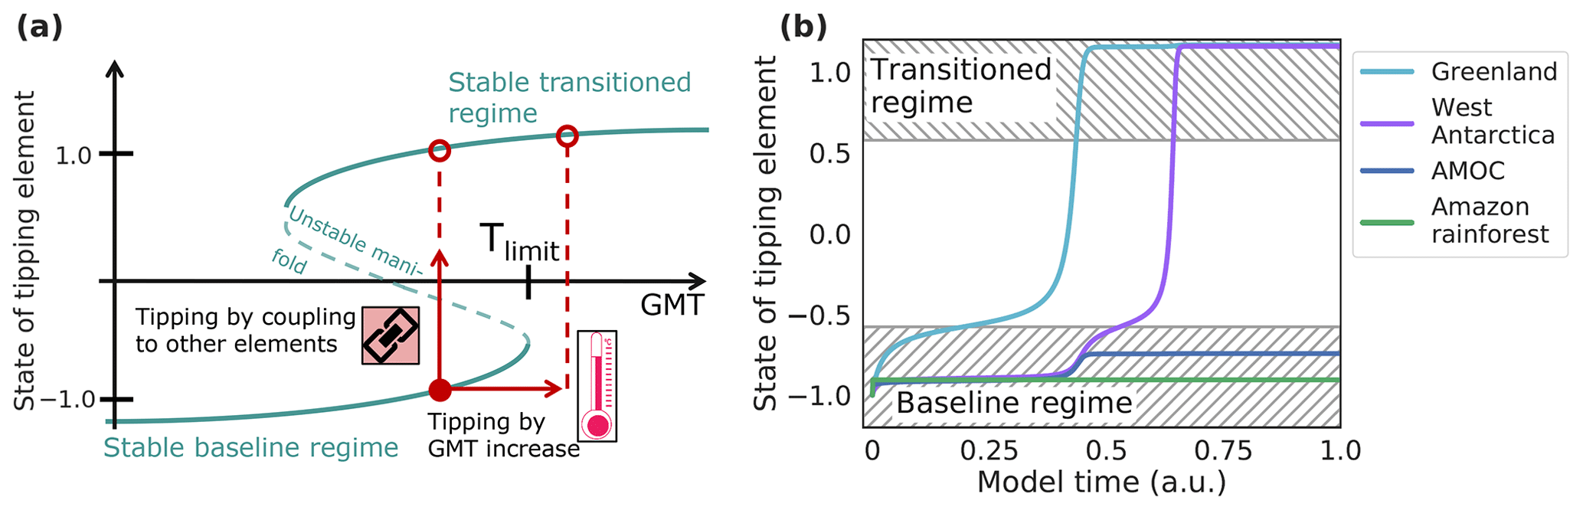
Example: Atlantic Meridian Overturning Circulation (AMOC) https://esd.copernicus.org/articles/12/601/2021/

Slide 26
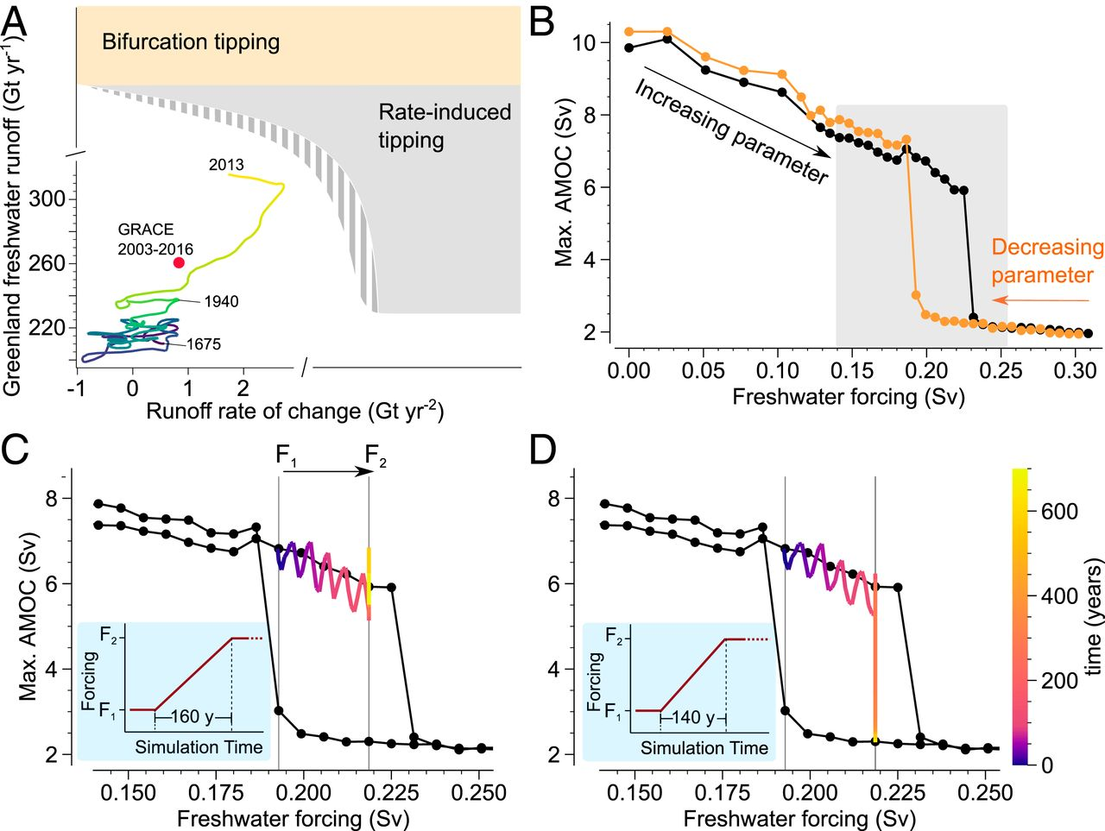
Example: Atlantic Meridian Overturning Circulation (AMOC) https://www.pnas.org/content/118/9/e2017989118
Simulations from General Circulation Models

Slide 27
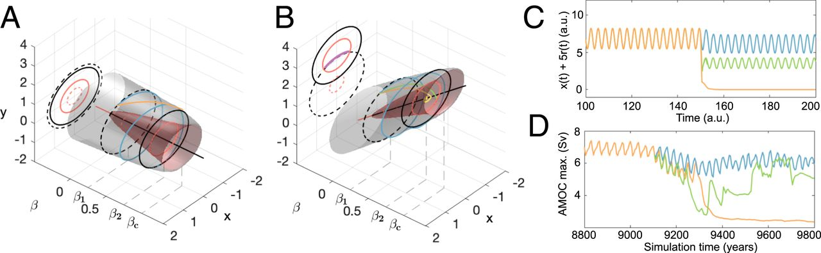
Example: Atlantic Meridian Overturning Circulation (AMOC) https://www.pnas.org/content/118/9/e2017989118

Slide 28
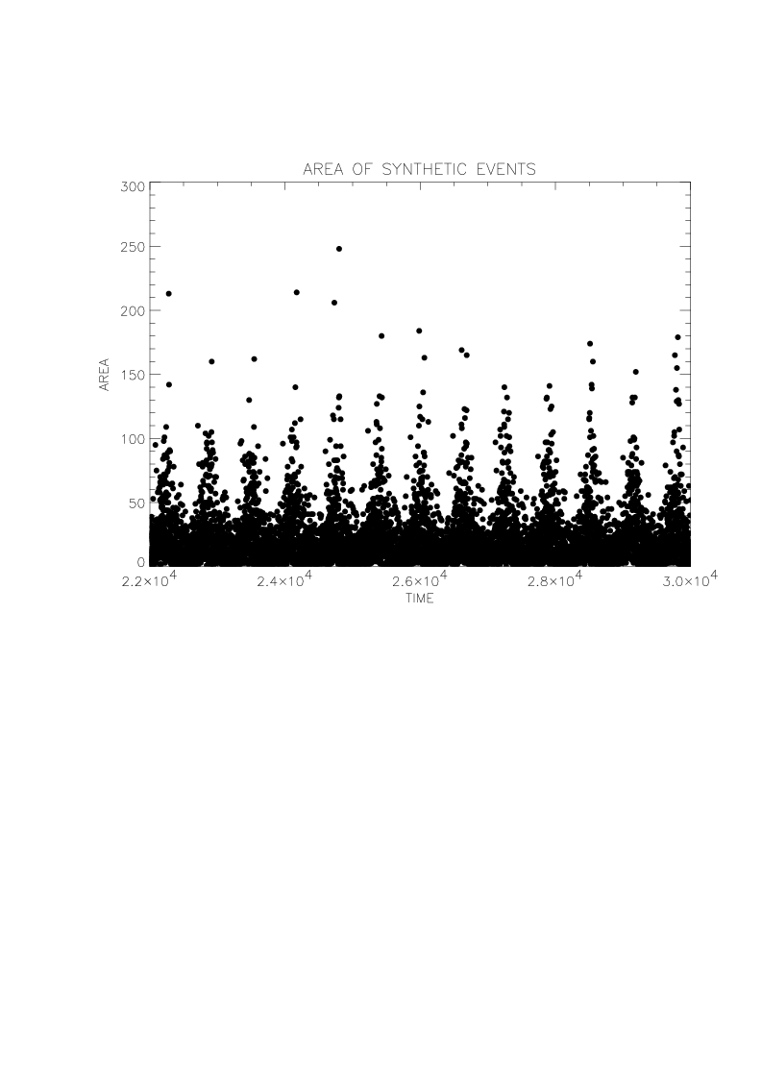
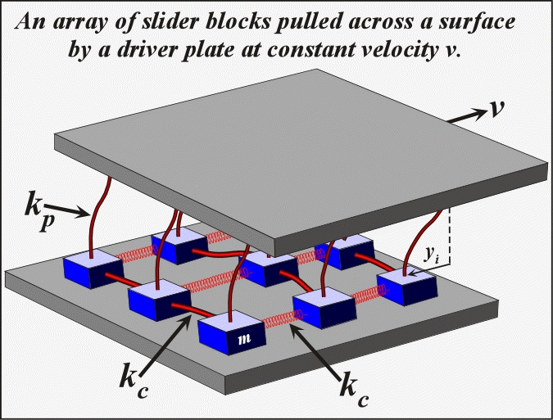
An Earthquake Model
V
Area of Earthquake
Burridge-Knopoff slider block model.
Time

Slide 29
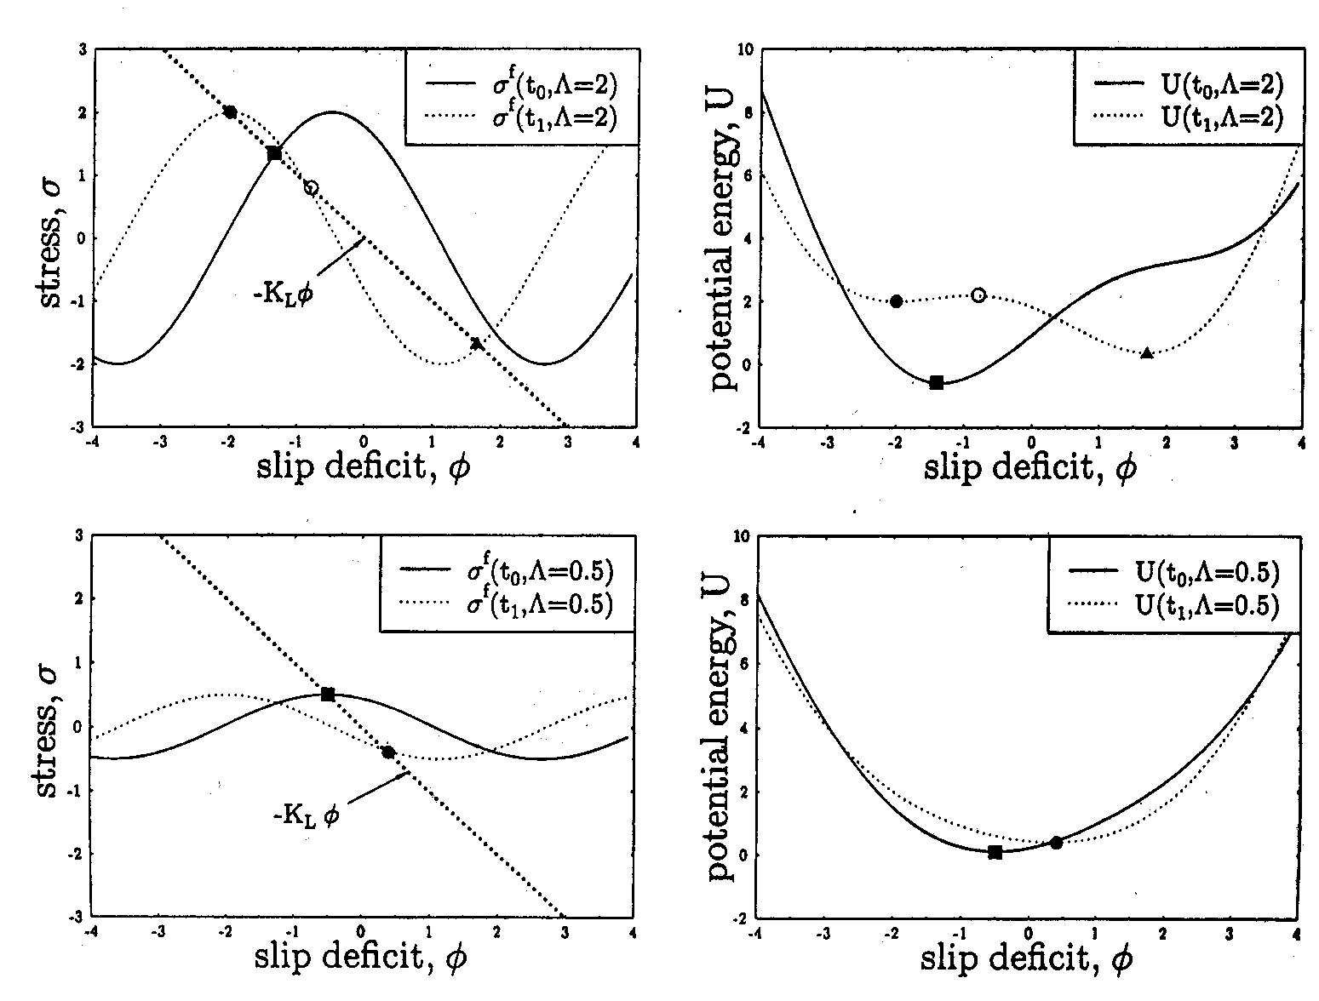
Traveling Density Wave Model of a Driven Threshold System
JBR et al., Phys. Rev. Lett., 76, 4285, 1996.
This model has the physics of a first order phase transition. It has a classical limit of stability, or spinodal. Here we show the mean field behavior of the model.
Λ>1
Unstable Earthquakes
Λ<1
Stable Slip
Physics
Minimum Energy
Sine/Cosine term represents a leftward moving wave

Slide 30
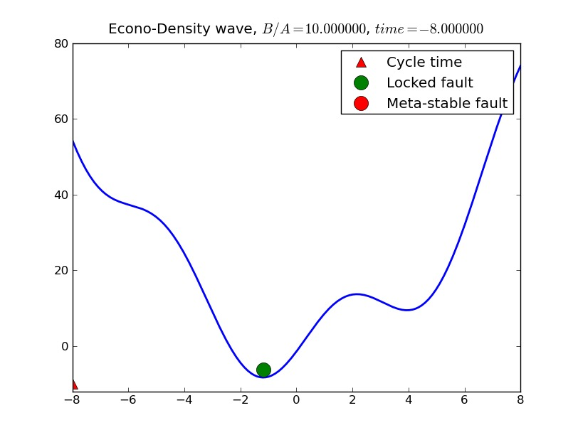
Earthquakes: Increase in Potential Energy
Driven by Large Scale Plate Tectonic Motions
Potential Energy
Deficit in Fault Slip

Slide 31
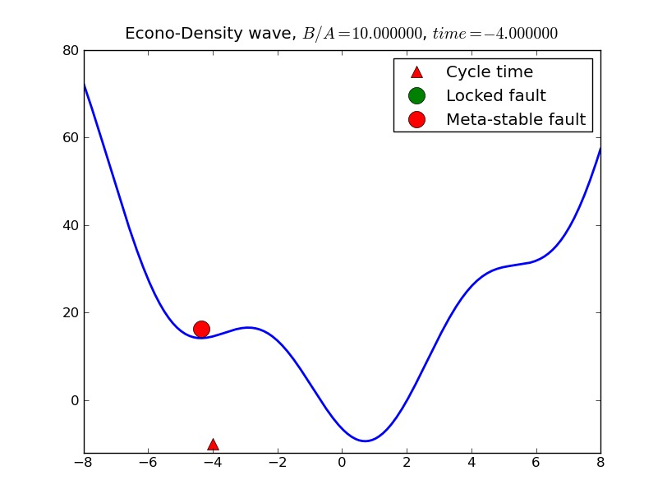
Potential Energy Accumulates Late in Cycle
Potential Energy
Earthquake
(Spontaneous Decay
in Potential Energy)
Deficit in Slip

Slide 32
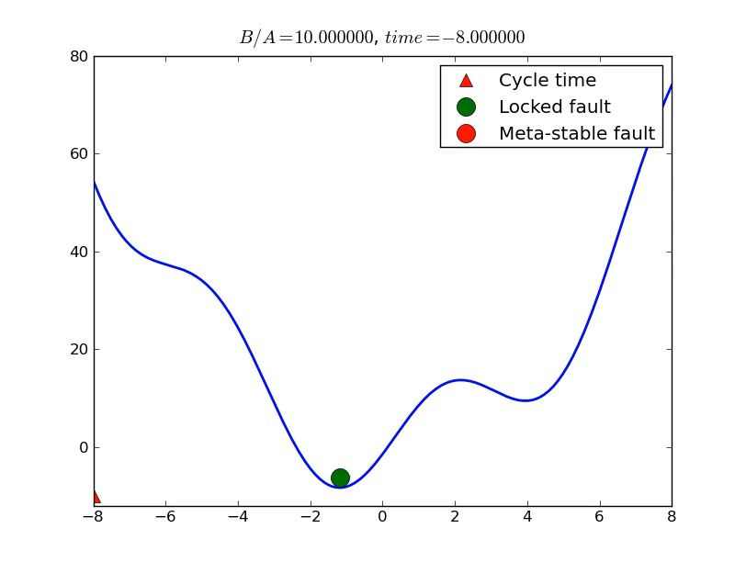
Animation
Potential Energy
Deficit in Slip

Slide 33
Phase Transitions in Social Systems: Resilience (Bifurcation) Transitions https://www.researchgate.net/figure/Bifurcation-diagrams-for-socio-hydrological-resilience-a-Stability-landscape-changes_fig1_309298243
“Hysteresis Loop”

Slide 34
Phase Transitions (Resilience Transitions) in Social Systems https://systemic2016.wordpress.com/resilience-characteritics-stability-landscape/

Slide 35
Phase Transitions (Resilience Transitions) in Social Systems https://www.pnas.org/content/112/32/10056/tab-figures-data

Slide 36
Phase Transitions in Innovation Regimes https://constructive.net/2013/07/29/visualizing-and-interacting-with-systems/

Slide 37
Phase Transitions in Ecological Systems https://www.ecologyandsociety.org/vol23/iss2/art5/figure1.html

Slide 38
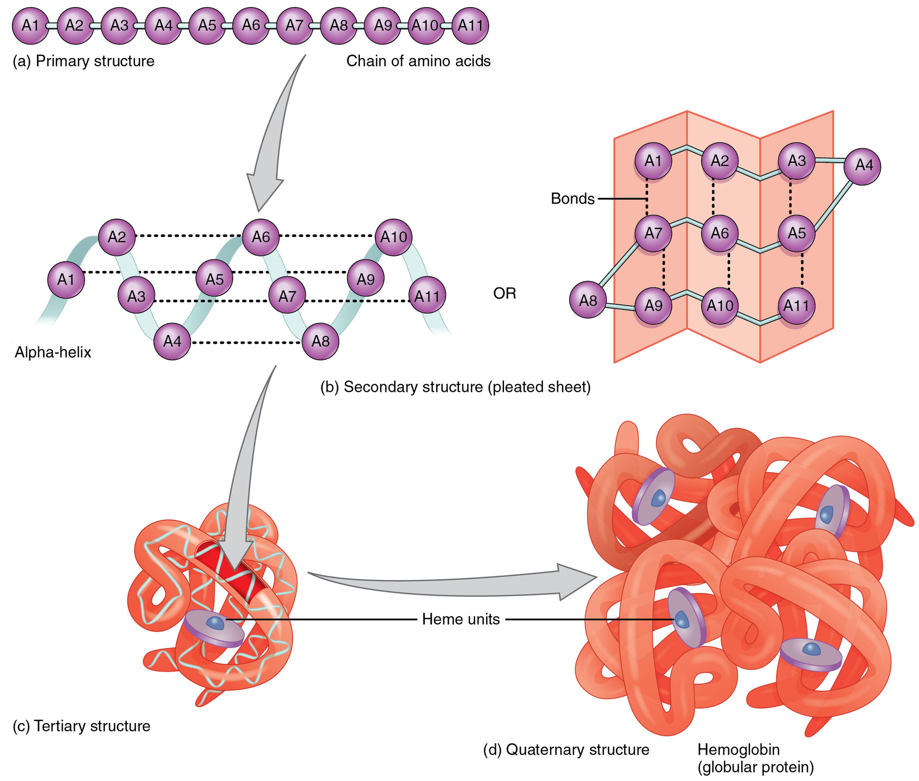
Protein Folding https://en.wikipedia.org/wiki/Protein_folding
Protein folding is the physical process by which a protein chain is translated to its native three-dimensional structure, typically a "folded" conformation by which the protein becomes biologically functional.
Via an expeditious and reproducible process, a polypeptide folds into its characteristic three-dimensional structure from a random coil.
Each protein exists first as an unfolded polypeptide or random coil after being translated from a sequence of mRNA to a linear chain of amino acids.
At this stage the polypeptide lacks any stable (long-lasting) three-dimensional structure (the left hand side of the first figure).
As the polypeptide chain is being synthesized by a ribosome, the linear chain begins to fold into its three-dimensional structure.

Slide 39
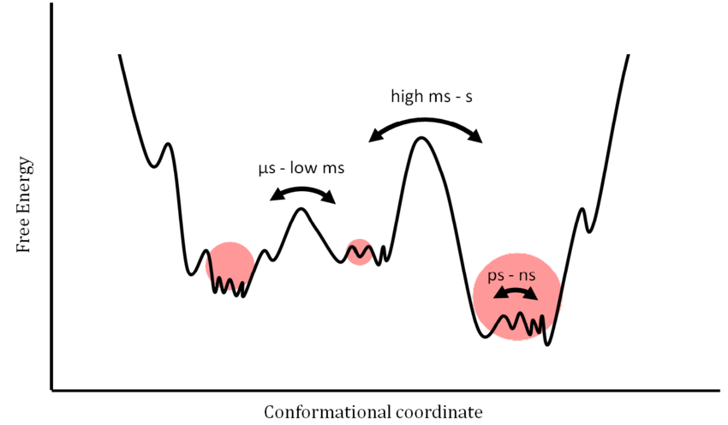
Protein Folding https://www.researchgate.net/figure/Schematic-free-energy-landscape-of-proteins-Dynamic-models-of-proteins-are-visualized-in_fig9_223996526
Schematic free-energy landscape of proteins.
Dynamic models of proteins are visualized in a free-energy landscape as a function of conformational coordinates.
This simplification involves a certain set of sample conditions.
Minima correspond to well-defined, stabilized states whereas maxima reflect short-lived transition states.
The height of the energy barriers is proportional to the timescale that is necessary to stochastically convert between states.
Any influence such as molecular interaction leads to redistribution within the energy landscape and/or modification of the profile.
The volume of the red spheres illustrates a hypothetical population of conformers.

Slide 40
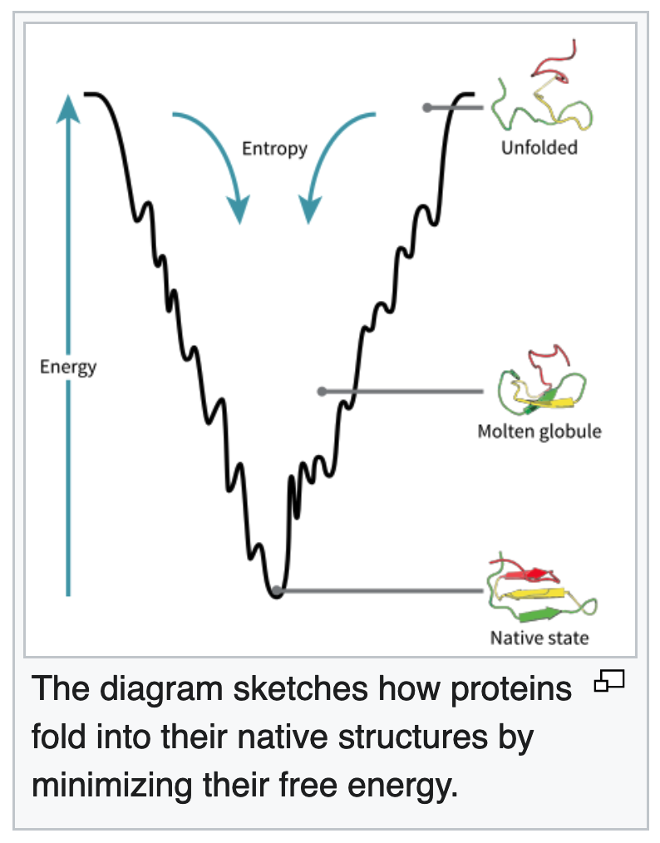
Folding Funnel https://en.wikipedia.org/wiki/Folding_funnel
The folding funnel hypothesis is a specific version of the energy landscape theory of protein folding, which assumes that a protein's native state corresponds to its free energy minimum.
Energy landscapes may be "rough", with many non-native local minima in which partially folded proteins can become trapped
The folding funnel hypothesis assumes that the native state is a deep free energy minimum with steep walls, corresponding to a single well-defined tertiary structure.
The term was introduced by Ken A. Dill in a 1987 article discussing the stabilities of globular proteins.

Slide 41
Protein Folding https://en.wikipedia.org/wiki/Folding_funnel
As protein folding process goes through a stochastic search of conformations before reaching its final destination, the vast number of possible conformations is considered irrelevant, while the kinetic traps begin to play a role.
The stochastic idea of protein intermediate conformations reveals the concept of an “energy landscape” or "folding funnel" in which folding properties are related to free energy and that the accessible conformations of a protein are reduced as it approaches native-like structure.
The y-axis of the funnel represents the "internal free energy" of a protein: the sum of hydrogen bonds, ion-pairs, torsion angle energies, hydrophobic and solvation free energies.
The many x-axes represent the conformational structures, and those that are geometrically similar to each other are close to one another in the energy landscape.

Slide 42
Protein Folding https://en.wikipedia.org/wiki/Folding_funnel
The protein folding problem is concerned with three questions, as stated by Ken A. Dill and Justin L. MacCallum:
  How can an amino acid sequence determine the 3D native structure of a protein?
  How can a protein fold so quickly despite a vast number of possible conformations (the Levinthal's Paradox)? How does the protein know what conformations not to search?
  Is it possible to create a computer algorithm to predict a protein's native structure based on its amino acid sequence alone?
Auxiliary factors inside the living cell such as folding catalysts and chaperones assist in the folding process but do not determine the native structure of a protein.
Studies during the 1980s focused on models that could explain the shape of the energy landscape, a mathematical function that describes the free energy of a protein as a function of the microscopic degrees of freedom.

Slide 43
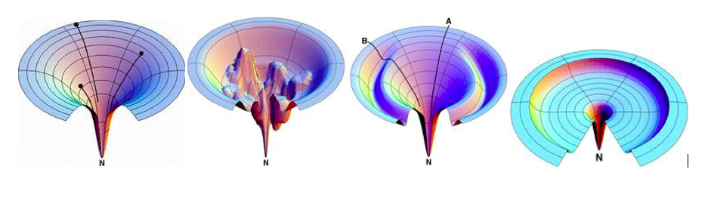
Types of Folding Funnels https://en.wikipedia.org/wiki/Folding_funnel
From left to right for proposed funnel-shaped energy landscape: the idealized smooth funnel, the rugged funnel, the Moat funnel, and the Champagne Glass funnel.

Slide 44
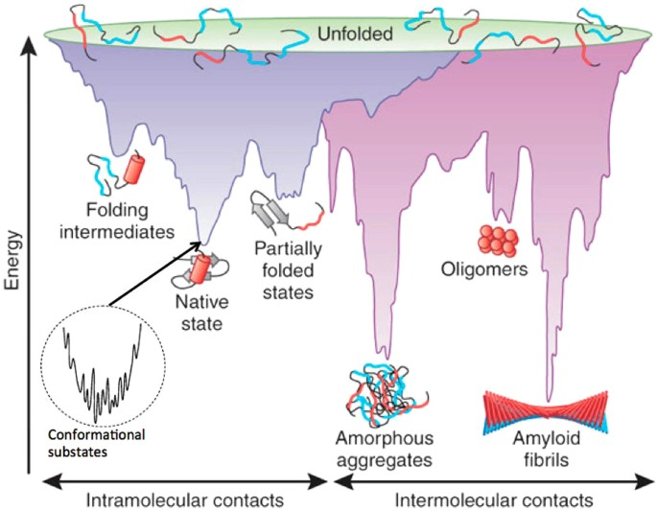
Protein Folding https://www.nature.com/articles/s41598-017-10525-5
Schematic energy landscape for protein folding and aggregation.
The surface shows the multitude of conformations “funneling” towards the native state via intramolecular contact formation, or towards the formation of amyloid fibrils via intermolecular contacts.
The landscape is represented by the free energy of the protein as a function of some reaction coordinate (planar slices through the 3D surface).
Entropy is schematized as width within any particular sub-funnel.

Slide 45
Protein Folding https://www.nature.com/articles/s41598-017-10525-5
Unfolded conformers possess the highest free energies and the largest entropies (top of funnel).
Folding occurs as conformers move within (i.e., explore) different regions of conformational space, experiencing progressive decreases in free energy and entropy until the native state is formed.
Within the minimum of the native state, a multitude of substrates exist (protein “breathing”).

Slide 46
Protein Folding https://pubs.acs.org/doi/10.1021/jp0680544
Time evolution of the occupation probabilities for three groups of local minima in met-enkephalin at 298 K. The initial state at t = 0 corresponds to a high-temperature distribution (800 K).
Schematic representation of changes in potential energy and entropy during protein folding (right), and some corresponding configurations (left).

Slide 47
Protein Folding https://pubs.acs.org/doi/10.1021/jp0680544
The ability to visualize potential and free energy surfaces is not essential for calculating any dynamic or thermodynamic properties, but it can certainly help in providing some intuition for what those properties might be.
For a potential energy surface (PES), the visualization problem is more acute, since V is generally a function of 3N coordinates for a system of N atoms.
The dimensionality can be reduced by coordinate transformations that exclude overall translations and rotations, but 3N − 6 internal coordinates still remain for an isolated molecule.
Nevertheless, it is possible to provide insight into the organization of the PES in a two-dimensional figure using disconnectivity graphs.^{8,32,109,158,160,165}
To construct such a figure we need a database of local minima of V and the transition states that connect them.
For larger systems this database should be a representative subset of the possible stationary points, since the number of local minima generally grows exponentially with N.

Slide 48
Disconnectivity Graphs https://pubs.acs.org/doi/10.1021/jp0680544
One-dimensional potential energy functions (left) and the corresponding disconnectivity graphs (right). The dotted lines indicate the energies at which a superbasin analysis was performed
Panels a−d illustrate “palm tree” disconnectivity graphs that arise in four different systems. Panels e and f illustrate the “willow tree” and “banyan tree” patterns. See URL above for details

Slide 49
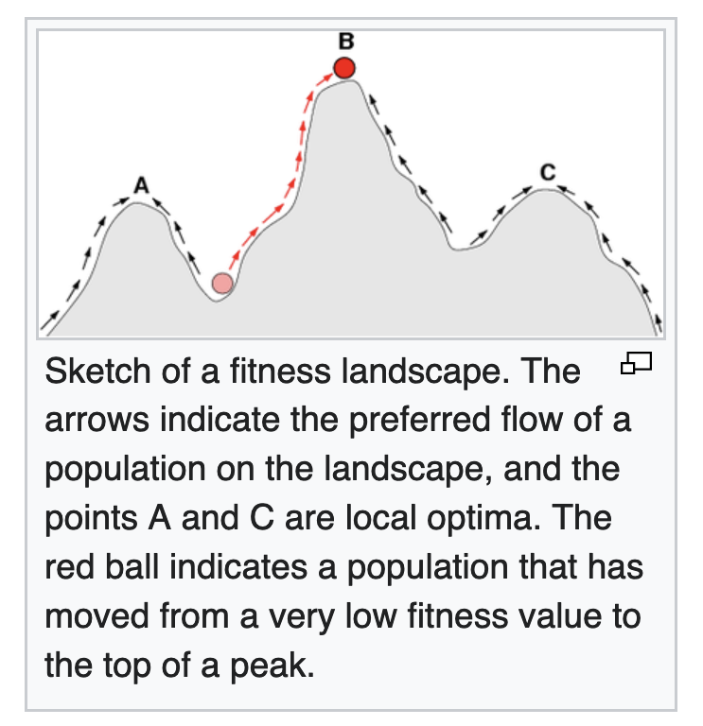
Fitness Landscapes https://en.wikipedia.org/wiki/Fitness_landscape
In evolutionary biology, fitness landscapes or adaptive landscapes (types of evolutionary landscapes) are used to visualize the relationship between genotypes and reproductive success.
It is assumed that every genotype has a well-defined replication rate (often referred to as fitness).
This fitness is the "height" of the landscape. Genotypes which are similar are said to be "close" to each other, while those that are very different are "far" from each other.
The set of all possible genotypes, their degree of similarity, and their related fitness values is then called a fitness landscape.
The idea of a fitness landscape is a metaphor to help explain flawed forms in evolution by natural selection, including exploits and glitches in animals like their reactions to supernormal stimuli.

Slide 50
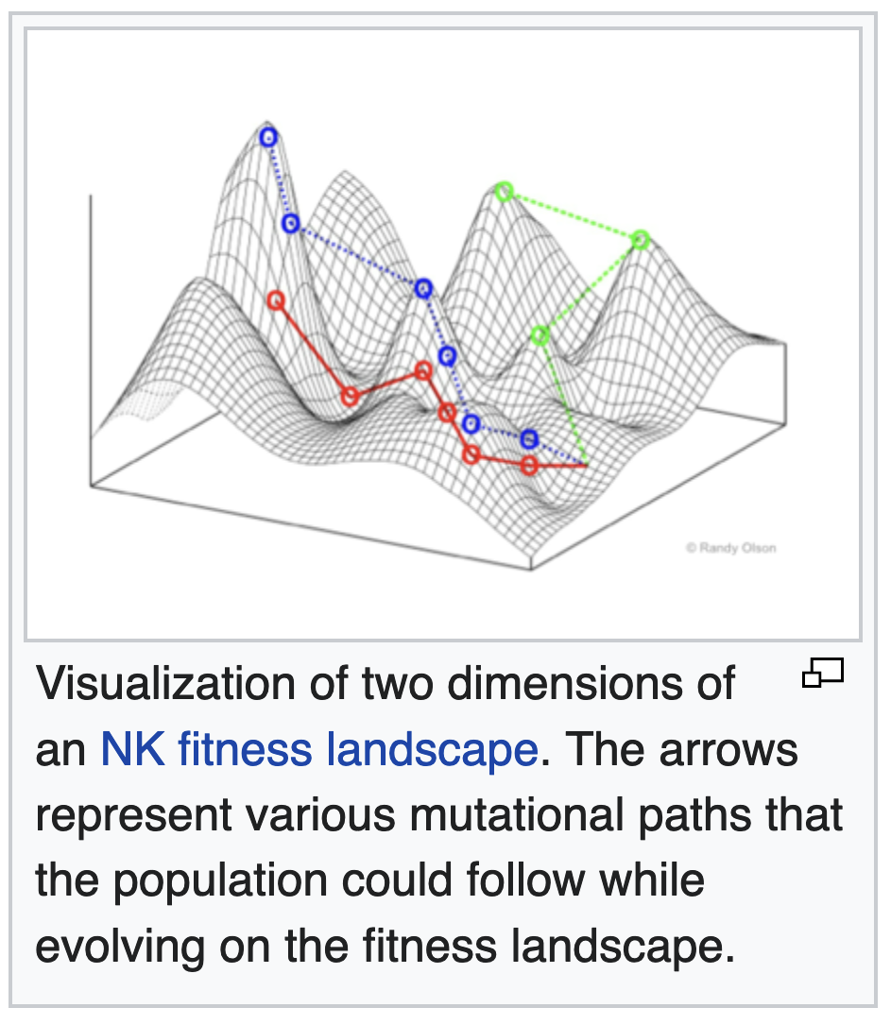
Fitness Landscapes https://en.wikipedia.org/wiki/Fitness_landscape
In all fitness landscapes, height represents and is a visual metaphor for fitness.
There are three distinct ways of characterizing the other dimensions, though in each case distance represents and is a metaphor for degree of dissimilarity.
Fitness landscapes are often conceived of as ranges of mountains.
There exist local peaks (points from which all paths are downhill, i.e. to lower fitness) and valleys (regions from which many paths lead uphill).
A fitness landscape with many local peaks surrounded by deep valleys is called rugged.
If all genotypes have the same replication rate, on the other hand, a fitness landscape is said to be flat.
An evolving population typically climbs uphill in the fitness landscape, by a series of small genetic changes, until – in the infinite time limit – a local optimum is reached.

Slide 51
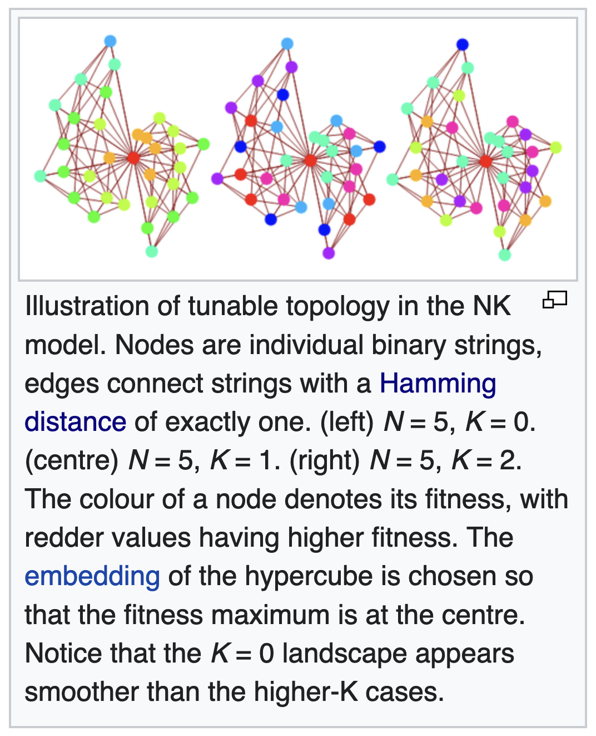
Stuart Kauffman’s NK Fitness Landscape Model https://en.wikipedia.org/wiki/NK_model
The NK model is a mathematical model described by its primary inventor Stuart Kauffman as a "tunably rugged" fitness landscape.
"Tunable ruggedness" captures the intuition that both the overall size of the landscape and the number of its local "hills and valleys" can be adjusted via changes to its two parameters, N and K , with N being the length of a string of evolution and K determining the level of landscape ruggedness.
The NK model has found application in a wide variety of fields, including the theoretical study of evolutionary biology, immunology, optimisation, technological evolution, and complex systems.
The model was also adopted in organizational theory, where it is used to describe the way an agent may search a landscape by manipulating various characteristics of itself.

Slide 52
Evolutionary Optimization https://en.wikipedia.org/wiki/Fitness_landscape
Apart from the field of evolutionary biology, the concept of a fitness landscape has also gained importance in evolutionary optimization methods such as genetic algorithms or evolution strategies.
In evolutionary optimization, one tries to solve real-world problems (e.g., engineering or logistics problems) by imitating the dynamics of biological evolution.
For example, a delivery truck with a number of destination addresses can take a large variety of different routes, but only very few will result in a short driving time.
In order to use many common forms of evolutionary optimization, one has to define for every possible solution s to the problem of interest (i.e., every possible route in the case of the delivery truck) how 'good' it is.
This is done by introducing a scalar-valued function f(s) (scalar valued means that f(s) is a simple number, such as 0.3, while s can be a more complicated object, for example a list of destination addresses in the case of the delivery truck), which is called the fitness function.

Slide 53
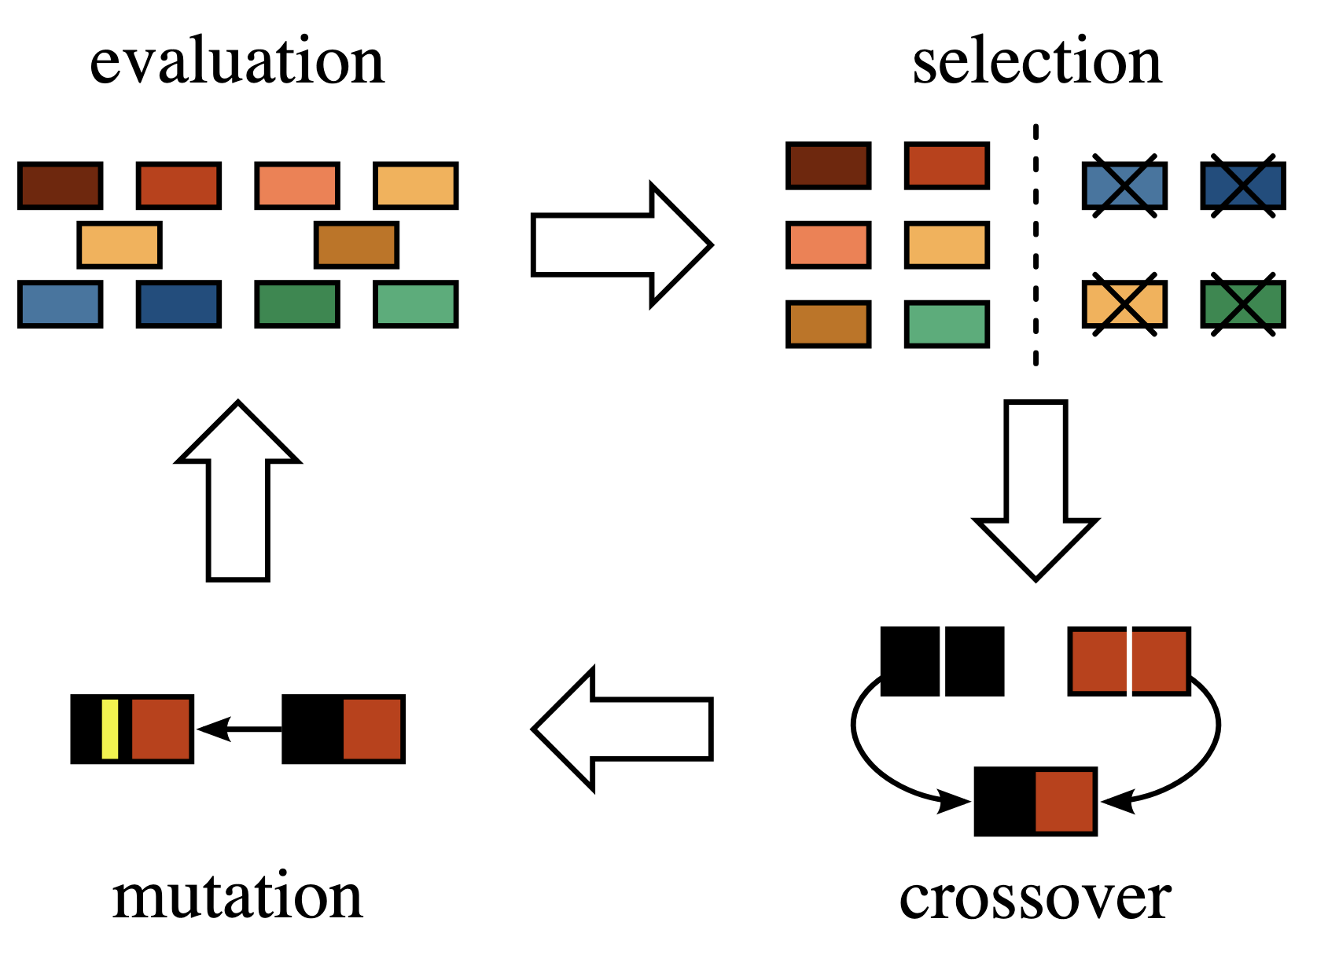
Evolutionary Optimization https://en.wikipedia.org/wiki/Fitness_landscape
The concept of a scalar valued fitness function f(s) also corresponds to the concept of a potential or energy function in physics.
The two concepts only differ in that:
  Physicists traditionally think in terms of minimizing the potential function
  Biologists prefer the notion that fitness is being maximized.
Therefore, taking the inverse of a potential function turns it into a fitness function, and vice versa
https://www.strong.io/blog/evolutionary-optimization
https://mpalaourg.me/project/optimization-algorithms/

Slide 54
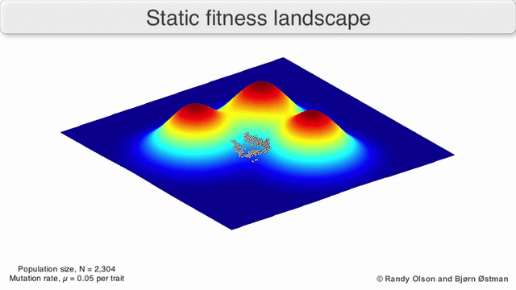
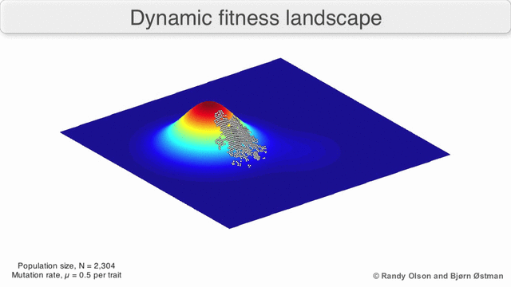
Dynamic vs. Static Fitness Landscape https://en.wikipedia.org/wiki/Fitness_landscape
Might apply if the external environment is not changing, and species is evolving in response
Might apply if the external environment is changing, and a species is co-evolving with other species

Slide 55
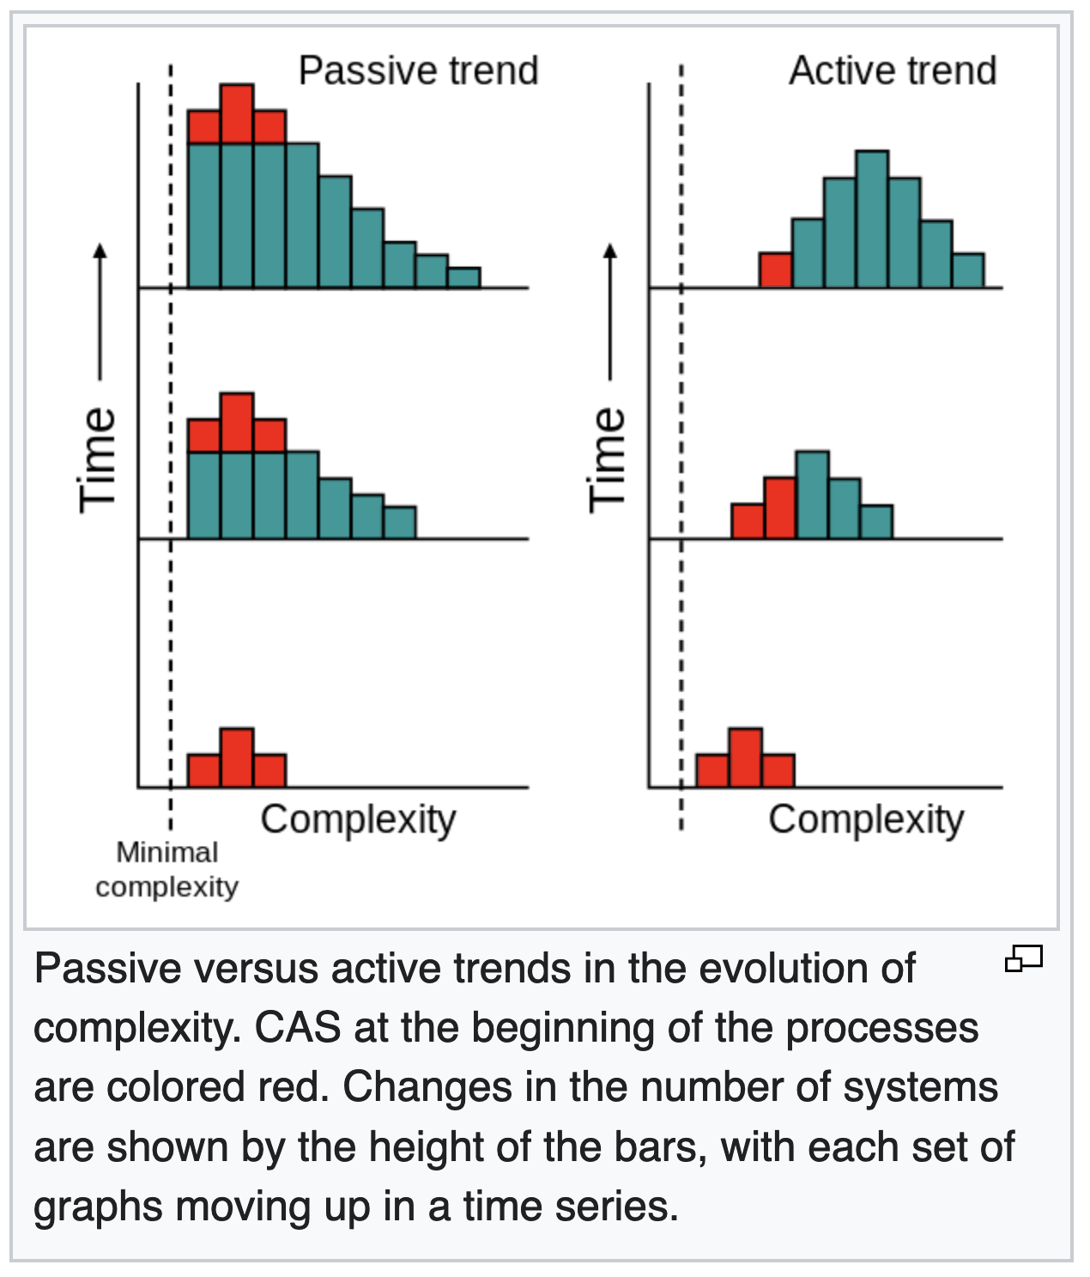
Complex Adaptive Systems https://en.wikipedia.org/wiki/Complex_adaptive_system
Living organisms are complex adaptive systems.
Although complexity is hard to quantify in biology, evolution has produced some remarkably complex organisms.
This observation has led to the common conception of evolution being progressive and leading towards what are viewed as "higher organisms".
If this were generally true, evolution would possess an active trend towards complexity.
Indeed, some artificial life simulations have suggested that the generation of CAS is an inescapable feature of evolution.
Fat Tail – Power Law
Gaussian – Bell Curve
Basic question: Are these trends
power law (passive) or Gaussian (active)?

Slide 56
Complex Adaptive Systems https://en.wikipedia.org/wiki/Complex_adaptive_system
The idea of a general trend towards complexity in evolution can also be explained through a passive process.
This involves an increase in variance but the most common value, the mode, does not change.
Thus, the maximum level of complexity increases over time, but only as an indirect product of there being more organisms in total.
The apparent trend towards more complex organisms may be an illusion resulting from concentrating on the small number of large, very complex organisms that inhabit the right-hand tail of the complexity distribution and ignoring simpler and much more common organisms.
If there is a lack of an overall trend towards complexity in biology, this would not preclude the existence of forces driving systems towards complexity in a subset of cases.
These minor trends would be balanced by other evolutionary pressures that drive systems towards less complex states.

Slide 57
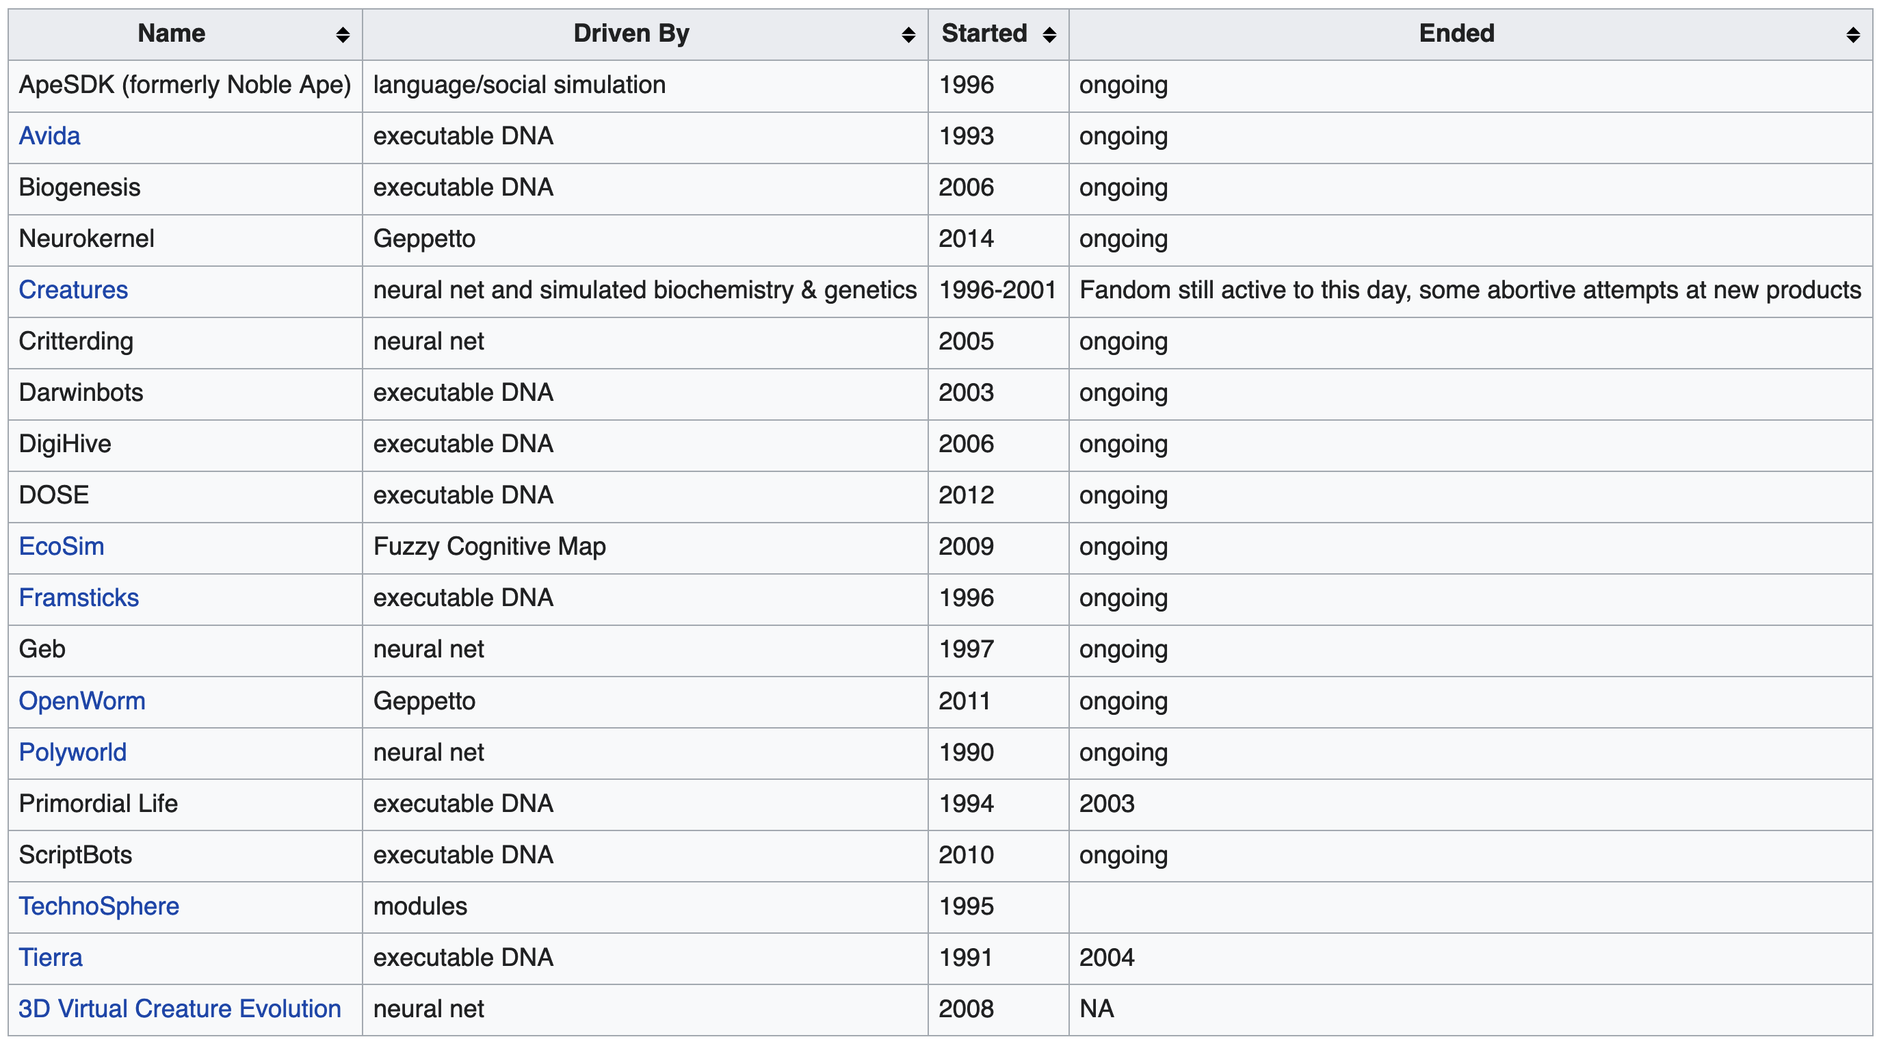
Software Alife Simulators https://en.wikipedia.org/wiki/Artificial_life

Slide 58
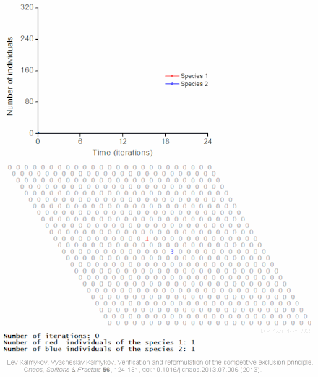
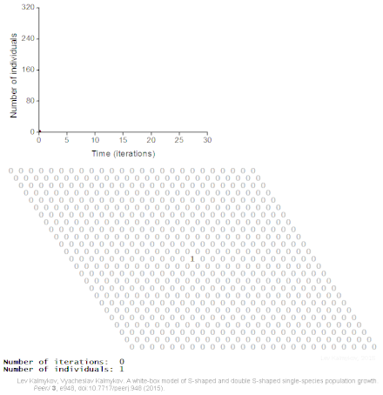
Complex Systems Modeling https://en.wikipedia.org/wiki/Artificial_life
Logical deterministic individual-based cellular automata model of interspecific competition for a single limited resource
Logical deterministic individual-based cellular automata model of single species population growth

Slide 59
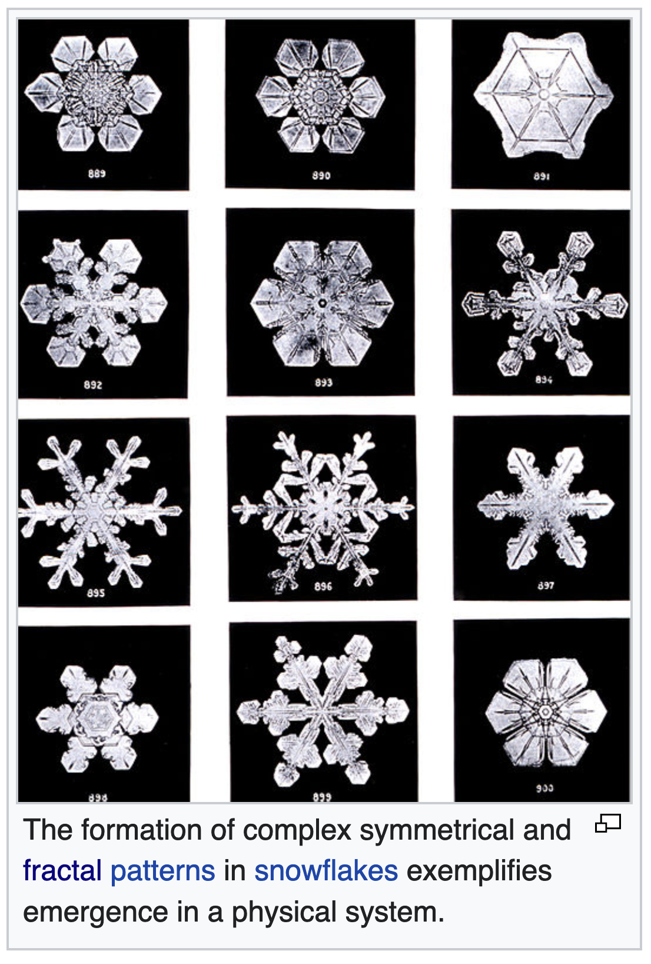
Emergence https://en.wikipedia.org/wiki/Emergence
In philosophy, systems theory, science, and art, emergence occurs when an entity is observed to have properties its parts do not have on their own, properties or behaviors which emerge only when the parts interact in a wider whole.
Emergence plays a central role in theories of integrative levels and of complex systems.
For instance, the phenomenon of life as studied in biology is an emergent property of chemistry, and many psychological phenomena are known to emerge from underlying neurobiological processes.

Slide 60
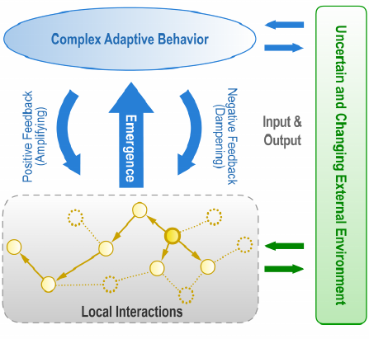
Emergence https://www.researchgate.net/figure/Emergence-in-Complex-Adaptive-Systems-Both-the-CAS-and-its-environment-simultaneously_fig1_225263914 https://en.wikipedia.org/wiki/Emergence
Emergence describes new properties arising in systems as a result of the interactions at an elemental level.
Properties can be determined only by observing or simulating the system, and not by any process of a reductionist analysis.
As a consequence, the emerging properties are scale dependent
They are only observable if the system is large enough to exhibit the phenomenon.
Chaotic, unpredictable behaviour can be seen as an emergent phenomenon, while at a microscopic scale the behavior of the constituent parts can be fully deterministic.

Slide 61
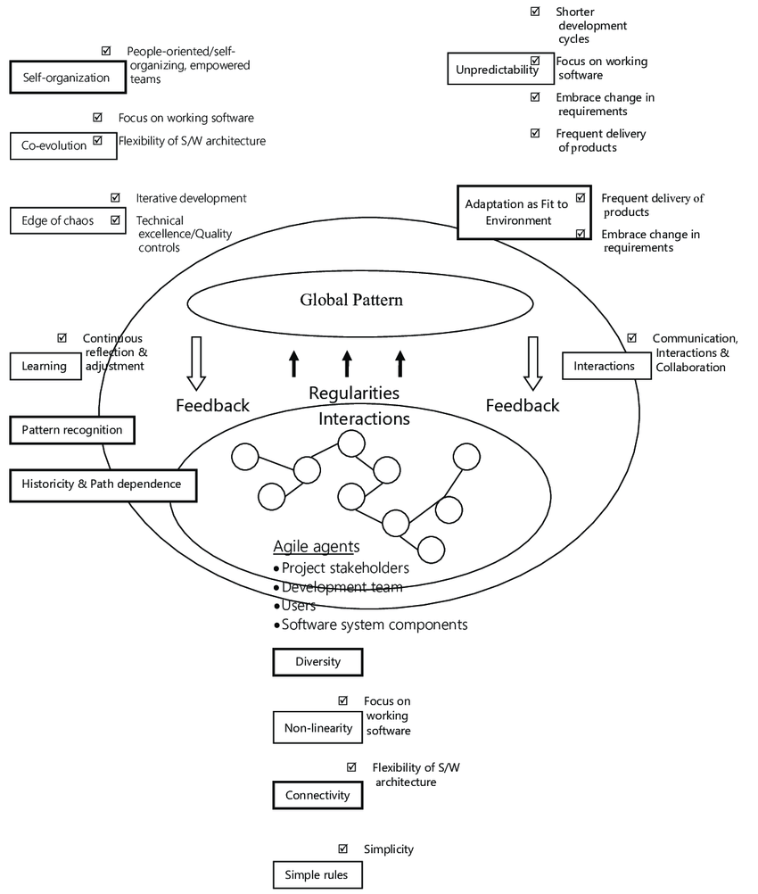
Emergence https://www.researchgate.net/figure/Emergence-in-Complex-Adaptive-Systems-Both-the-CAS-and-its-environment-simultaneously_fig1_225263914 https://en.wikipedia.org/wiki/Emergence
Emergent structures are patterns that emerge via the collective actions of many individual entities.
Emergent order will not arise if the various parts simply interact independently of one another.
According to this argument, the interaction of each part with its immediate surroundings causes a complex chain of processes that can lead to order in some form.
In fact, some systems in nature are observed to exhibit emergence based upon the interactions of autonomous parts, and some others exhibit emergence that at least at present cannot be reduced in this way.
In particular renormalization methods in theoretical physics enable scientists to study systems that are not tractable as the combination of their parts

Slide 62
Emergence in Swarms https://en.wikipedia.org/wiki/Swarm_behaviour
The concept of emergence—that the properties and functions found at a hierarchical level are not present and are irrelevant at the lower levels–is often a basic principle behind self-organizing systems.
An example of self-organization in biology leading to emergence in the natural world occurs in ant colonies, the queen does not give direct orders and does not tell the ants what to do.
Instead, each ant reacts to stimuli in the form of chemical scents from larvae, other ants, intruders, food and buildup of waste, and leaves behind a chemical trail, which, in turn, provides a stimulus to other ants.
Here each ant is an autonomous unit that reacts depending only on its local environment and the genetically encoded rules for its variety.
Despite the lack of centralized decision making, ant colonies exhibit complex behaviors and have even been able to demonstrate the ability to solve geometric problems.
For example, colonies routinely find the maximum distance from all colony entrances to dispose of dead bodies.

Slide 63
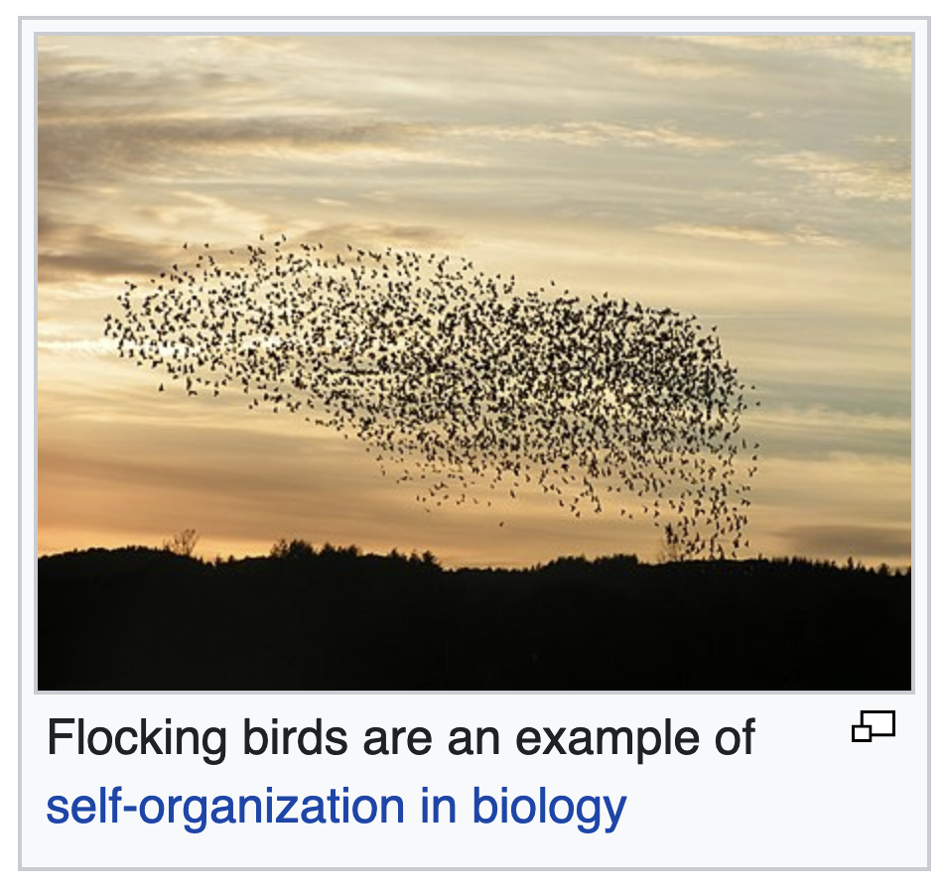
Swarming is an Example of Emergent Self-Organization https://en.wikipedia.org/wiki/Swarm_behaviour https://en.wikipedia.org/wiki/Biological_organisation
Biological organization is the hierarchy of complex biological structures and systems that define life.
The traditional hierarchy, as detailed below, extends from atoms to biospheres.
The higher levels of this scheme are often referred to as an ecological organization concept, or as the field, hierarchical ecology.
Each level in the hierarchy represents an increase in organizational complexity, with each "object" being primarily composed of the previous level's basic unit.
The basic principle behind the organization is the concept of emergence—the properties and functions found at a hierarchical level are not present and irrelevant at the lower levels.

Slide 64
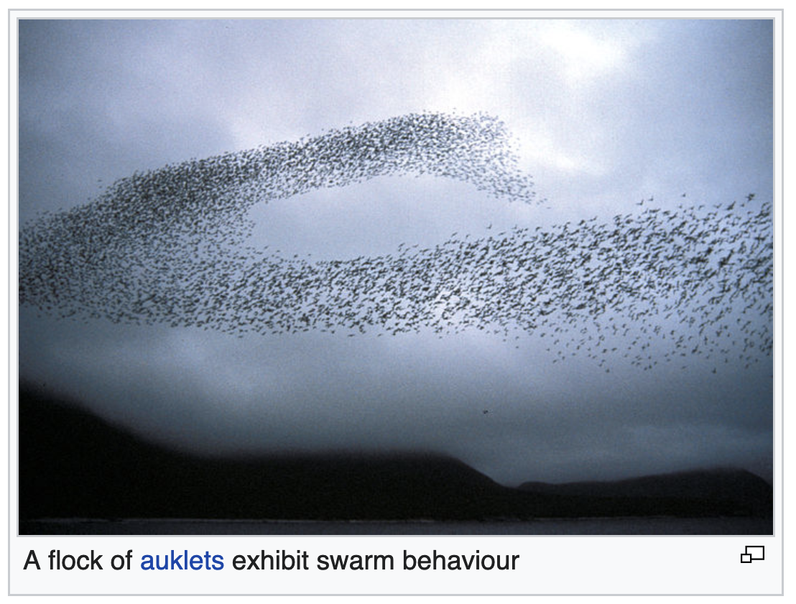
Swarm Behavior Models https://en.wikipedia.org/wiki/Swarm_behaviour
Swarm behavior, or swarming, is a collective behavior exhibited by entities, particularly animals, of similar size which aggregate together, perhaps milling about the same spot or perhaps moving en masse or migrating in some direction.
As a term, swarming is applied particularly to insects, but can also be applied to any other entity or animal that exhibits swarm behavior.
The term flocking or murmuration can refer specifically to swarm behavior in birds, herding to refer to swarm behavior in tetrapods, and shoaling or schooling to refer to swarm behavior in fish.
Phytoplankton also gather in huge swarms called blooms, although these organisms are algae and are not self-propelled the way animals are.
By extension, the term "swarm" is applied also to inanimate entities which exhibit parallel behaviors, as in a robot swarm, an earthquake swarm, or a swarm of stars.

Slide 65
Swarm Behavior Models https://en.wikipedia.org/wiki/Swarm_behaviour
From a more abstract point of view, swarm behaviour is the collective motion of a large number of self-propelled entities.
From the perspective of the mathematical modeller, it is an emergent behaviour arising from simple rules that are followed by individuals and does not involve any central coordination.
Swarm behavior is also studied by active matter physicists as a phenomenon which is not in thermodynamic equilibrium, and as such requires the development of tools beyond those available from the statistical physics of systems in thermodynamic equilibrium.
In this regard, swarming has been compared to the mathematics of superfluids, specifically in the context of starling flocks.
Swarm behavior was first simulated on a computer in 1986 with the simulation program Boids.
This program simulates simple agents (Boids) that are allowed to move according to a set of basic rules.
The model was originally designed to mimic the flocking behavior of birds, but it can be applied also to schooling fish and other swarming entities.

Slide 66
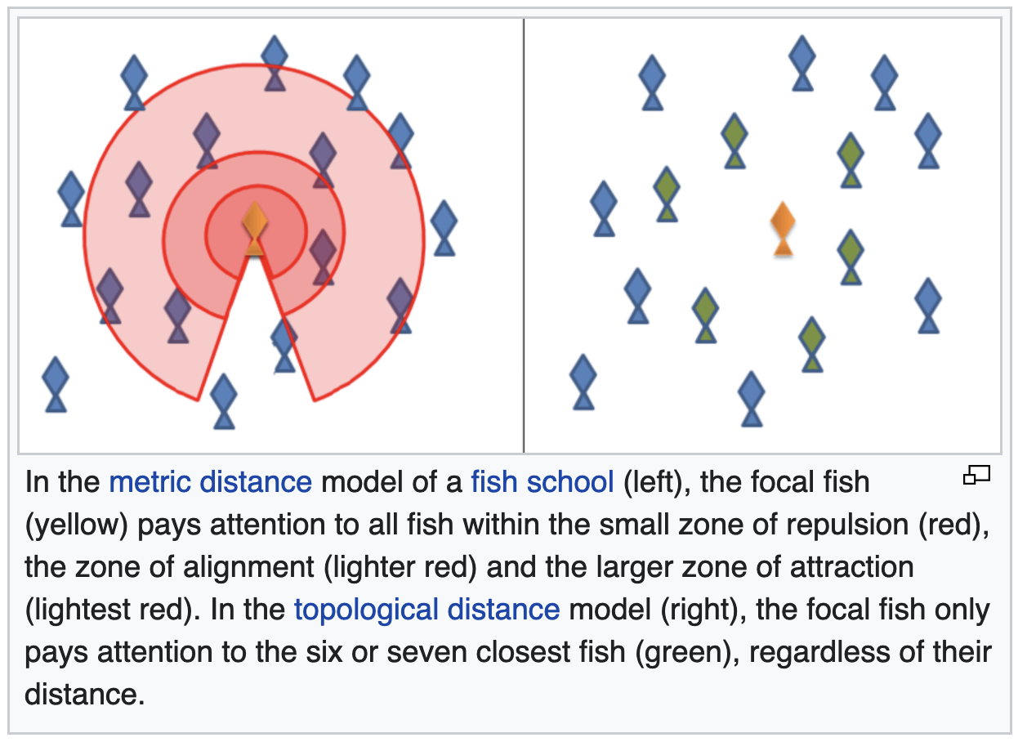
Swarm Behavior Models https://en.wikipedia.org/wiki/Swarm_behaviour
Early studies of swarm behavior employed mathematical models to simulate and understand the behaviour.
The simplest mathematical models of animal swarms generally represent individual animals as following three rules:
  Move in the same direction as their neighbors
  Remain close to their neighbors
  Avoid collisions with their neighbors
The Boids computer program, created by Craig Reynolds in 1986, simulates swarm behaviour following the above rules.
Schooling of fish

Slide 67
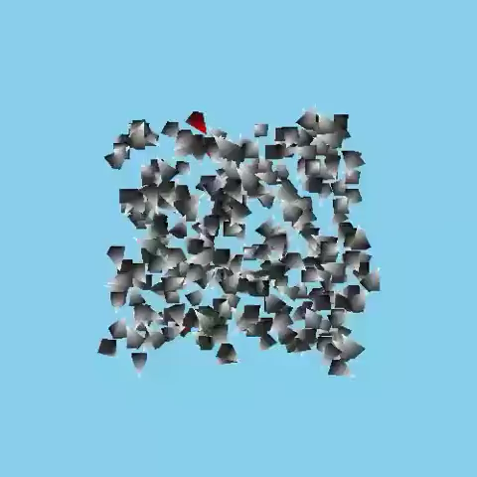
Alife: Boids Simulation https://en.wikipedia.org/wiki/Boids
Boids is an artificial life program, developed by Craig Reynolds in 1986, which simulates the flocking behaviour of birds.
As with most artificial life simulations, Boids is an example of emergent behavior
That is, the complexity of Boids arises from the interaction of individual agents (the boids, in this case) adhering to a set of simple rules.
The rules applied in the simplest Boids world are as follows:
  Separation: steer to avoid crowding local flockmates
  Alignment: steer towards the average heading of local flockmates
  Cohesion: steer to move towards the average position (center of mass) of local flockmates

Slide 68
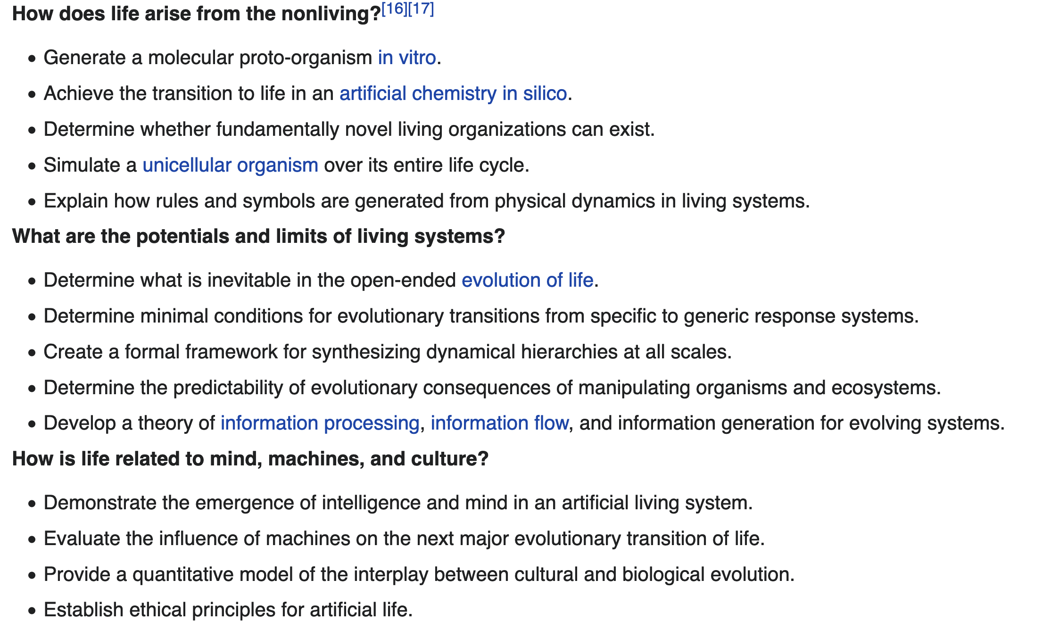
Open Problems in Alife https://en.wikipedia.org/wiki/Artificial_life

Slide 69
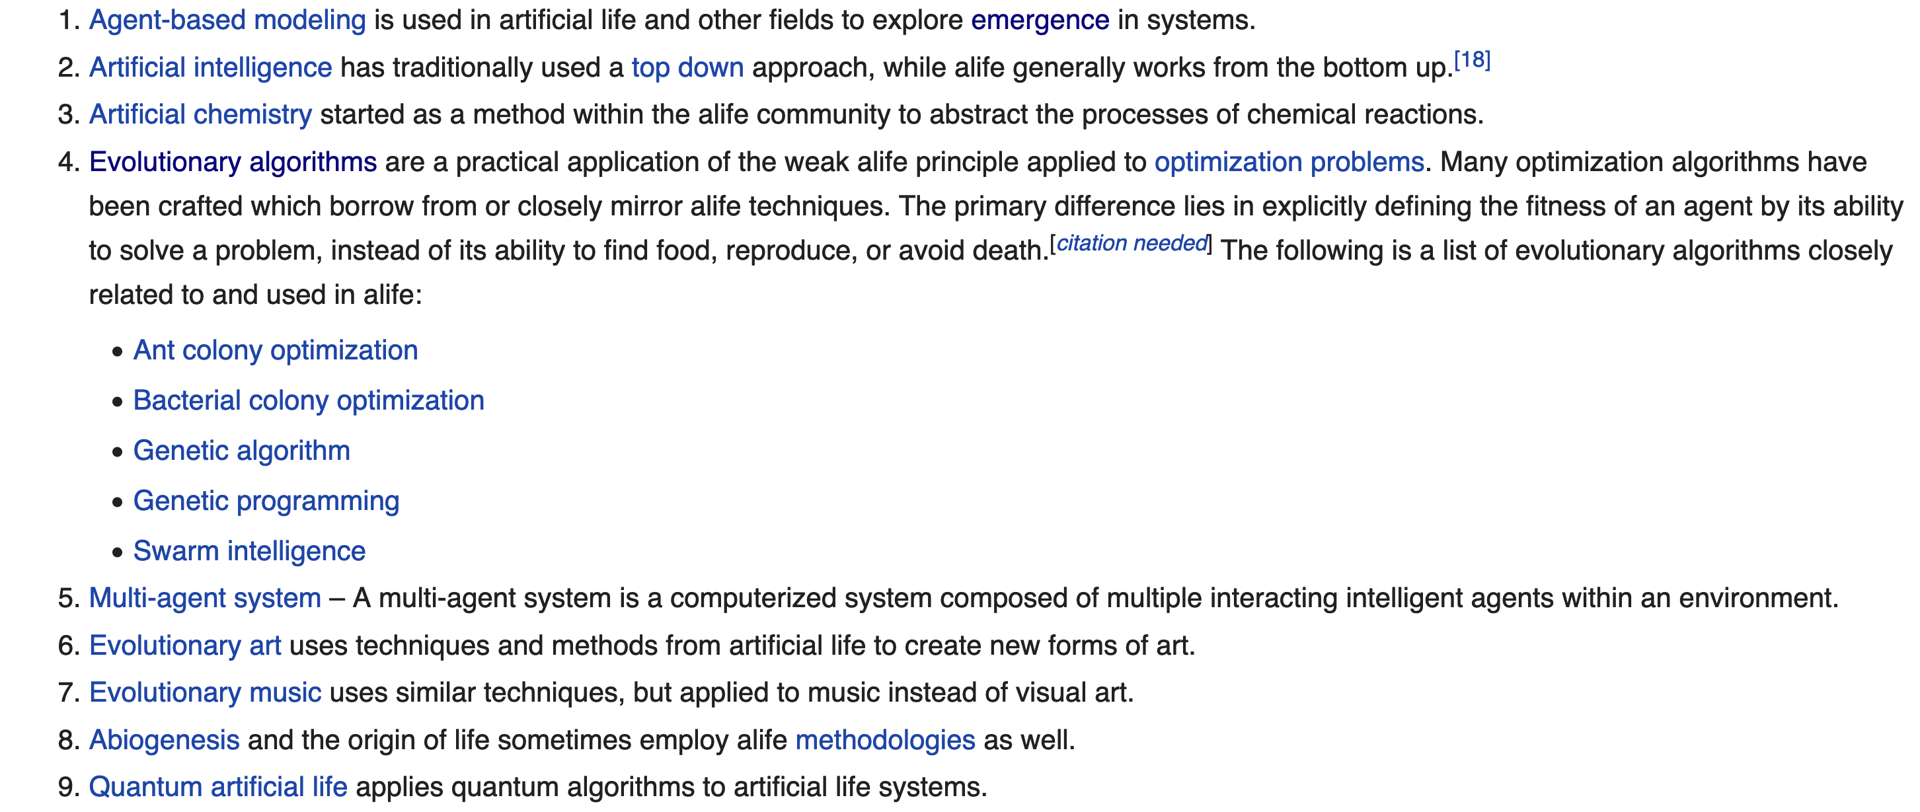
Other Topics in Alife https://en.wikipedia.org/wiki/Artificial_life

Slide 70
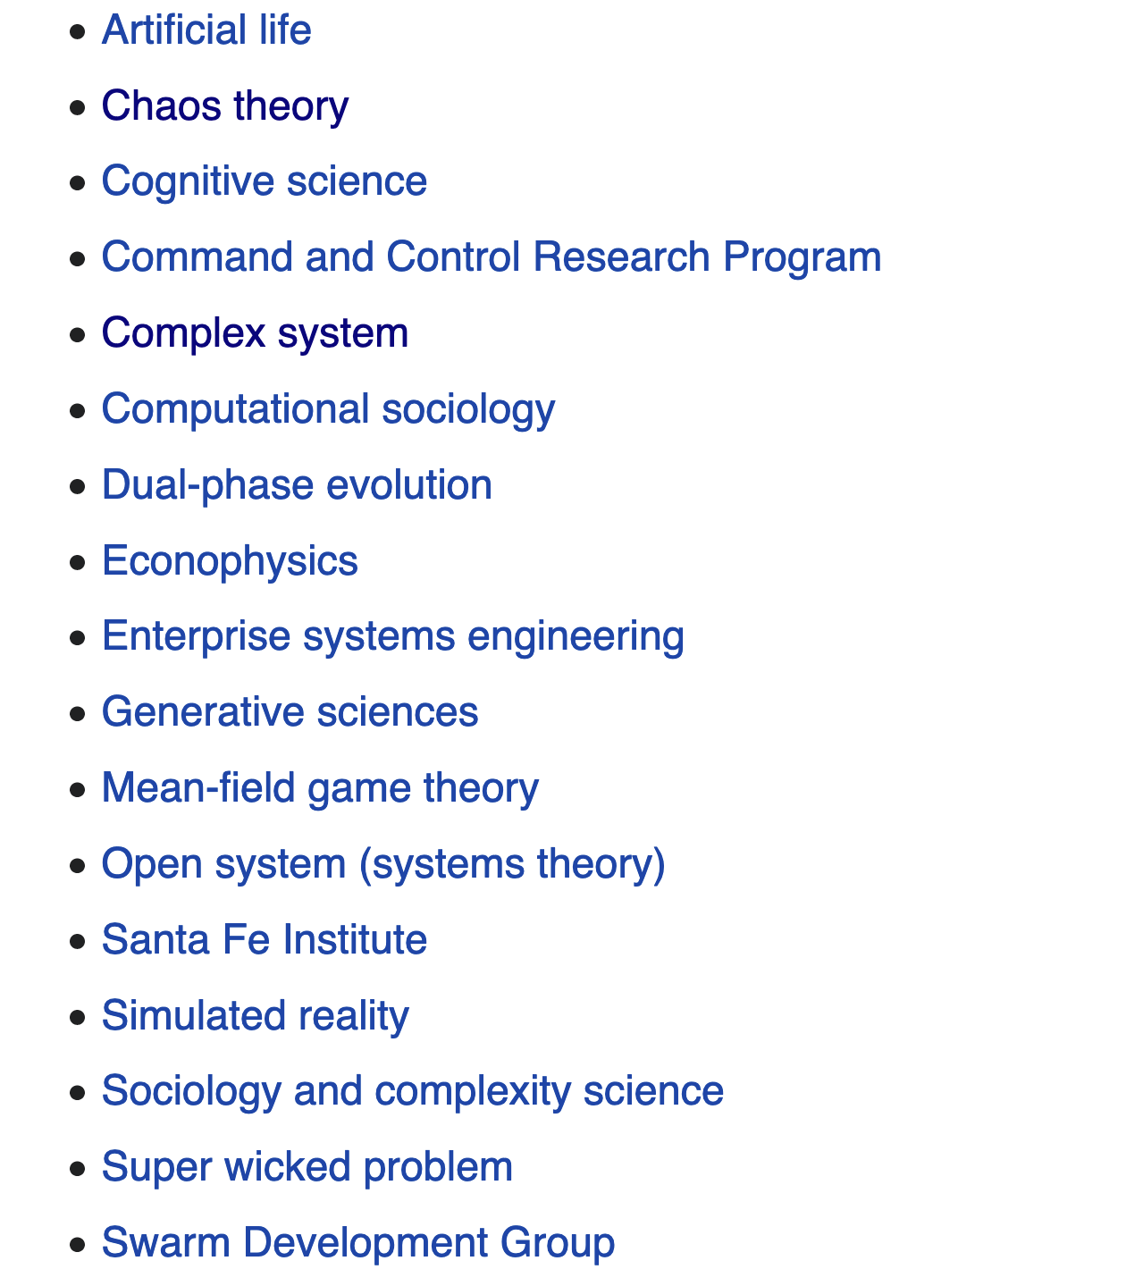
Complex Adaptive Systems https://en.wikipedia.org/wiki/Complex_adaptive_system
Additional Topics

