Slide 1
Lecture 17
Bitcoin, Altcoins, Crypto, and Money
https://en.wikipedia.org/wiki/Money
https://en.wikipedia.org/wiki/History_of_money

Slide 2
Santa Fe Institute Meeting on Money November 12-14, 2015

Slide 3
Properties of Money
Store of Value
Medium of Exchange
Ledger of Account
Fungible, meaning that one dollar is the same as every other dollar
Divisible into smaller units
Can’t be “Double Spent” (no counterfeiting by law)
It must be Scarce
Depends on “Trust”:
We trust the government to act responsibly and not inflate the money supply to cause bad inflation
We loan our money to the banks, and we trust the banks to return our money to us when we want it

Slide 4
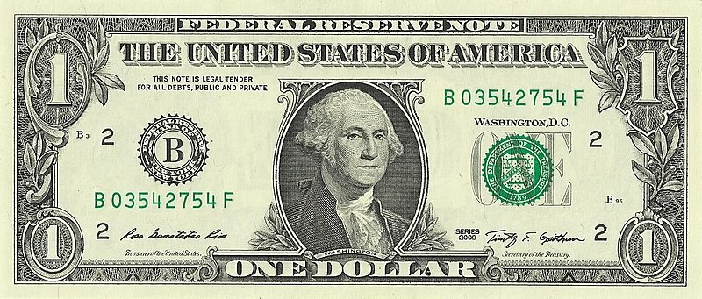
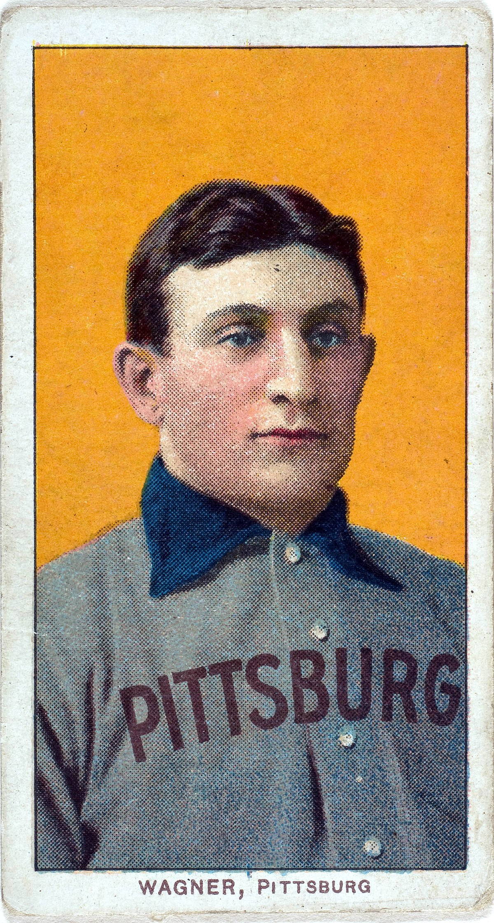
Below are shown pieces of paper with pictures of dead people on them
Worth $1 as per US Government
Honus Wagner baseball card. Sold for $7.25 Million in August 2022
Why is the one on the left worth $1 and the one on the right is worth $7.25 million?

Slide 5
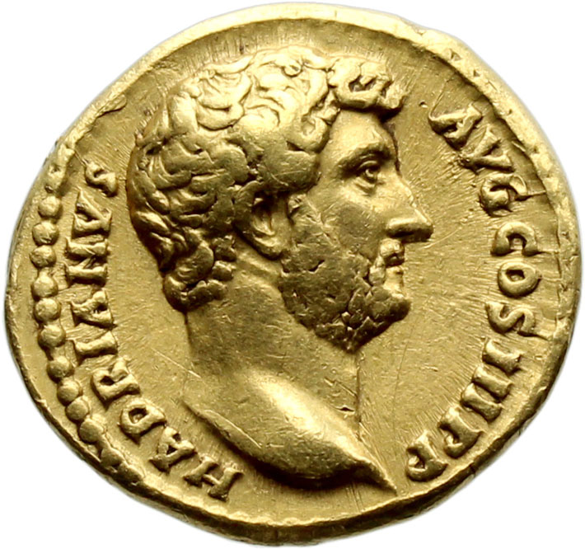
Three Stages of Money (as per Ray Dalio, “Principles for Dealing with the Changing World Order”)
The objects (coins) are themselves valuable
Pieces of paper are used to represent valuable objects, and can be exchanged for those objects (Bretton Woods 1944, “Gold Standard”)
Pieces of paper are declared to be themselves of value by the issuer, and are not backed by any valuable object (”fiat money”, Nixon takes us off the gold standard in 1971)
Roman coin

Slide 6
Crypto is Controversial!

Slide 7
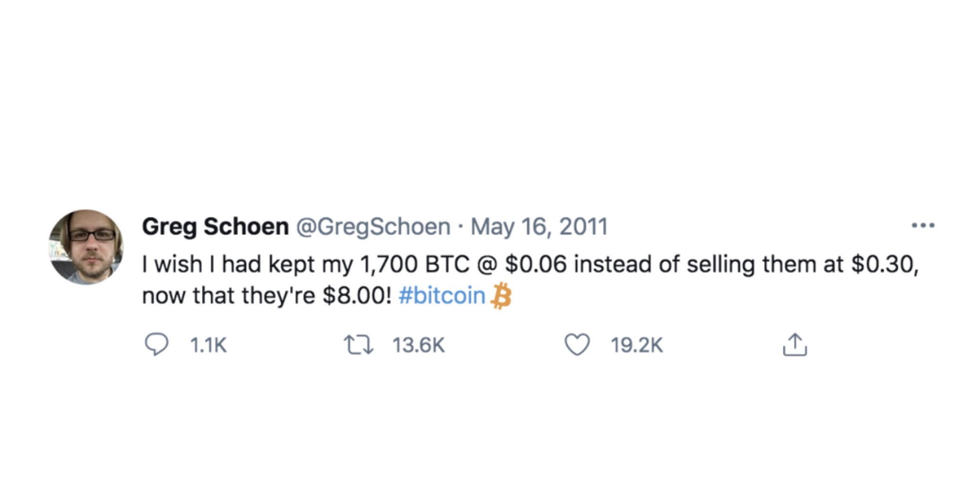
This fellow sold too early…
Worth
$102 at that time
At the current (2/27/2023) of $23,500, 1700 BTC is worth $40 Million
At the peak value of $69,000 it was worth $117 Million.
On 3/11/2024 1700 BTC is now worth $123 Million
This morning, 3/11/2024, BTC -> $72,307

Slide 9
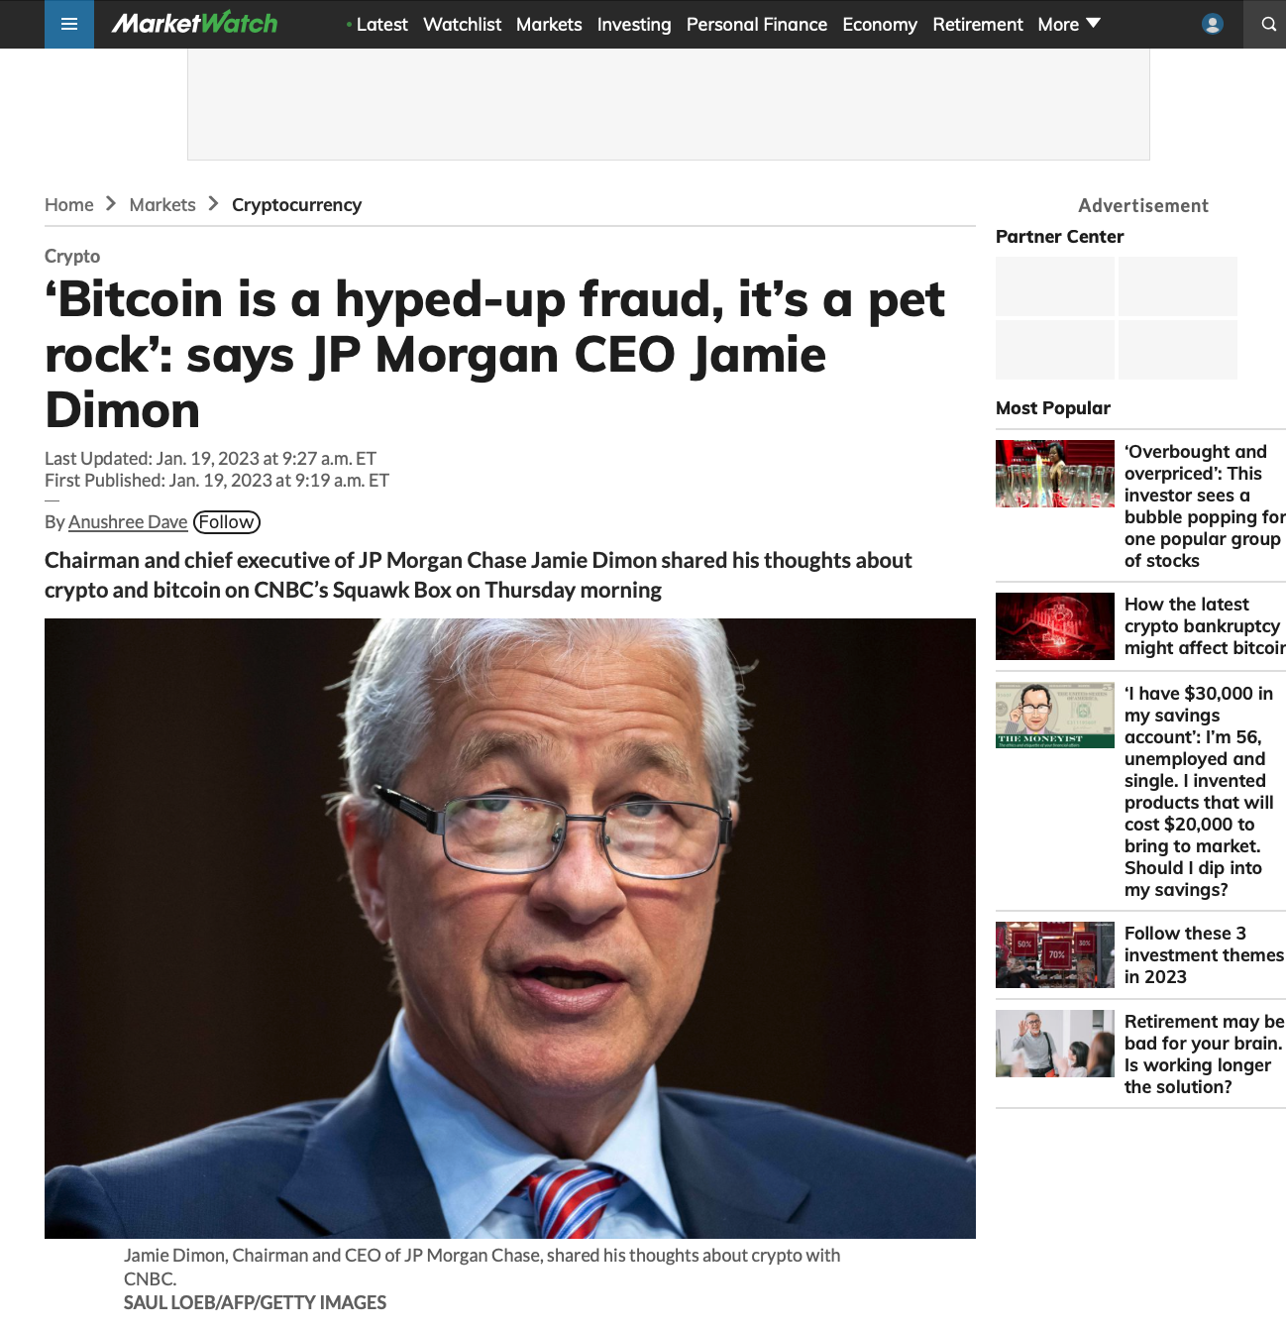

Slide 10
But Today (3/11/2024)

Slide 11
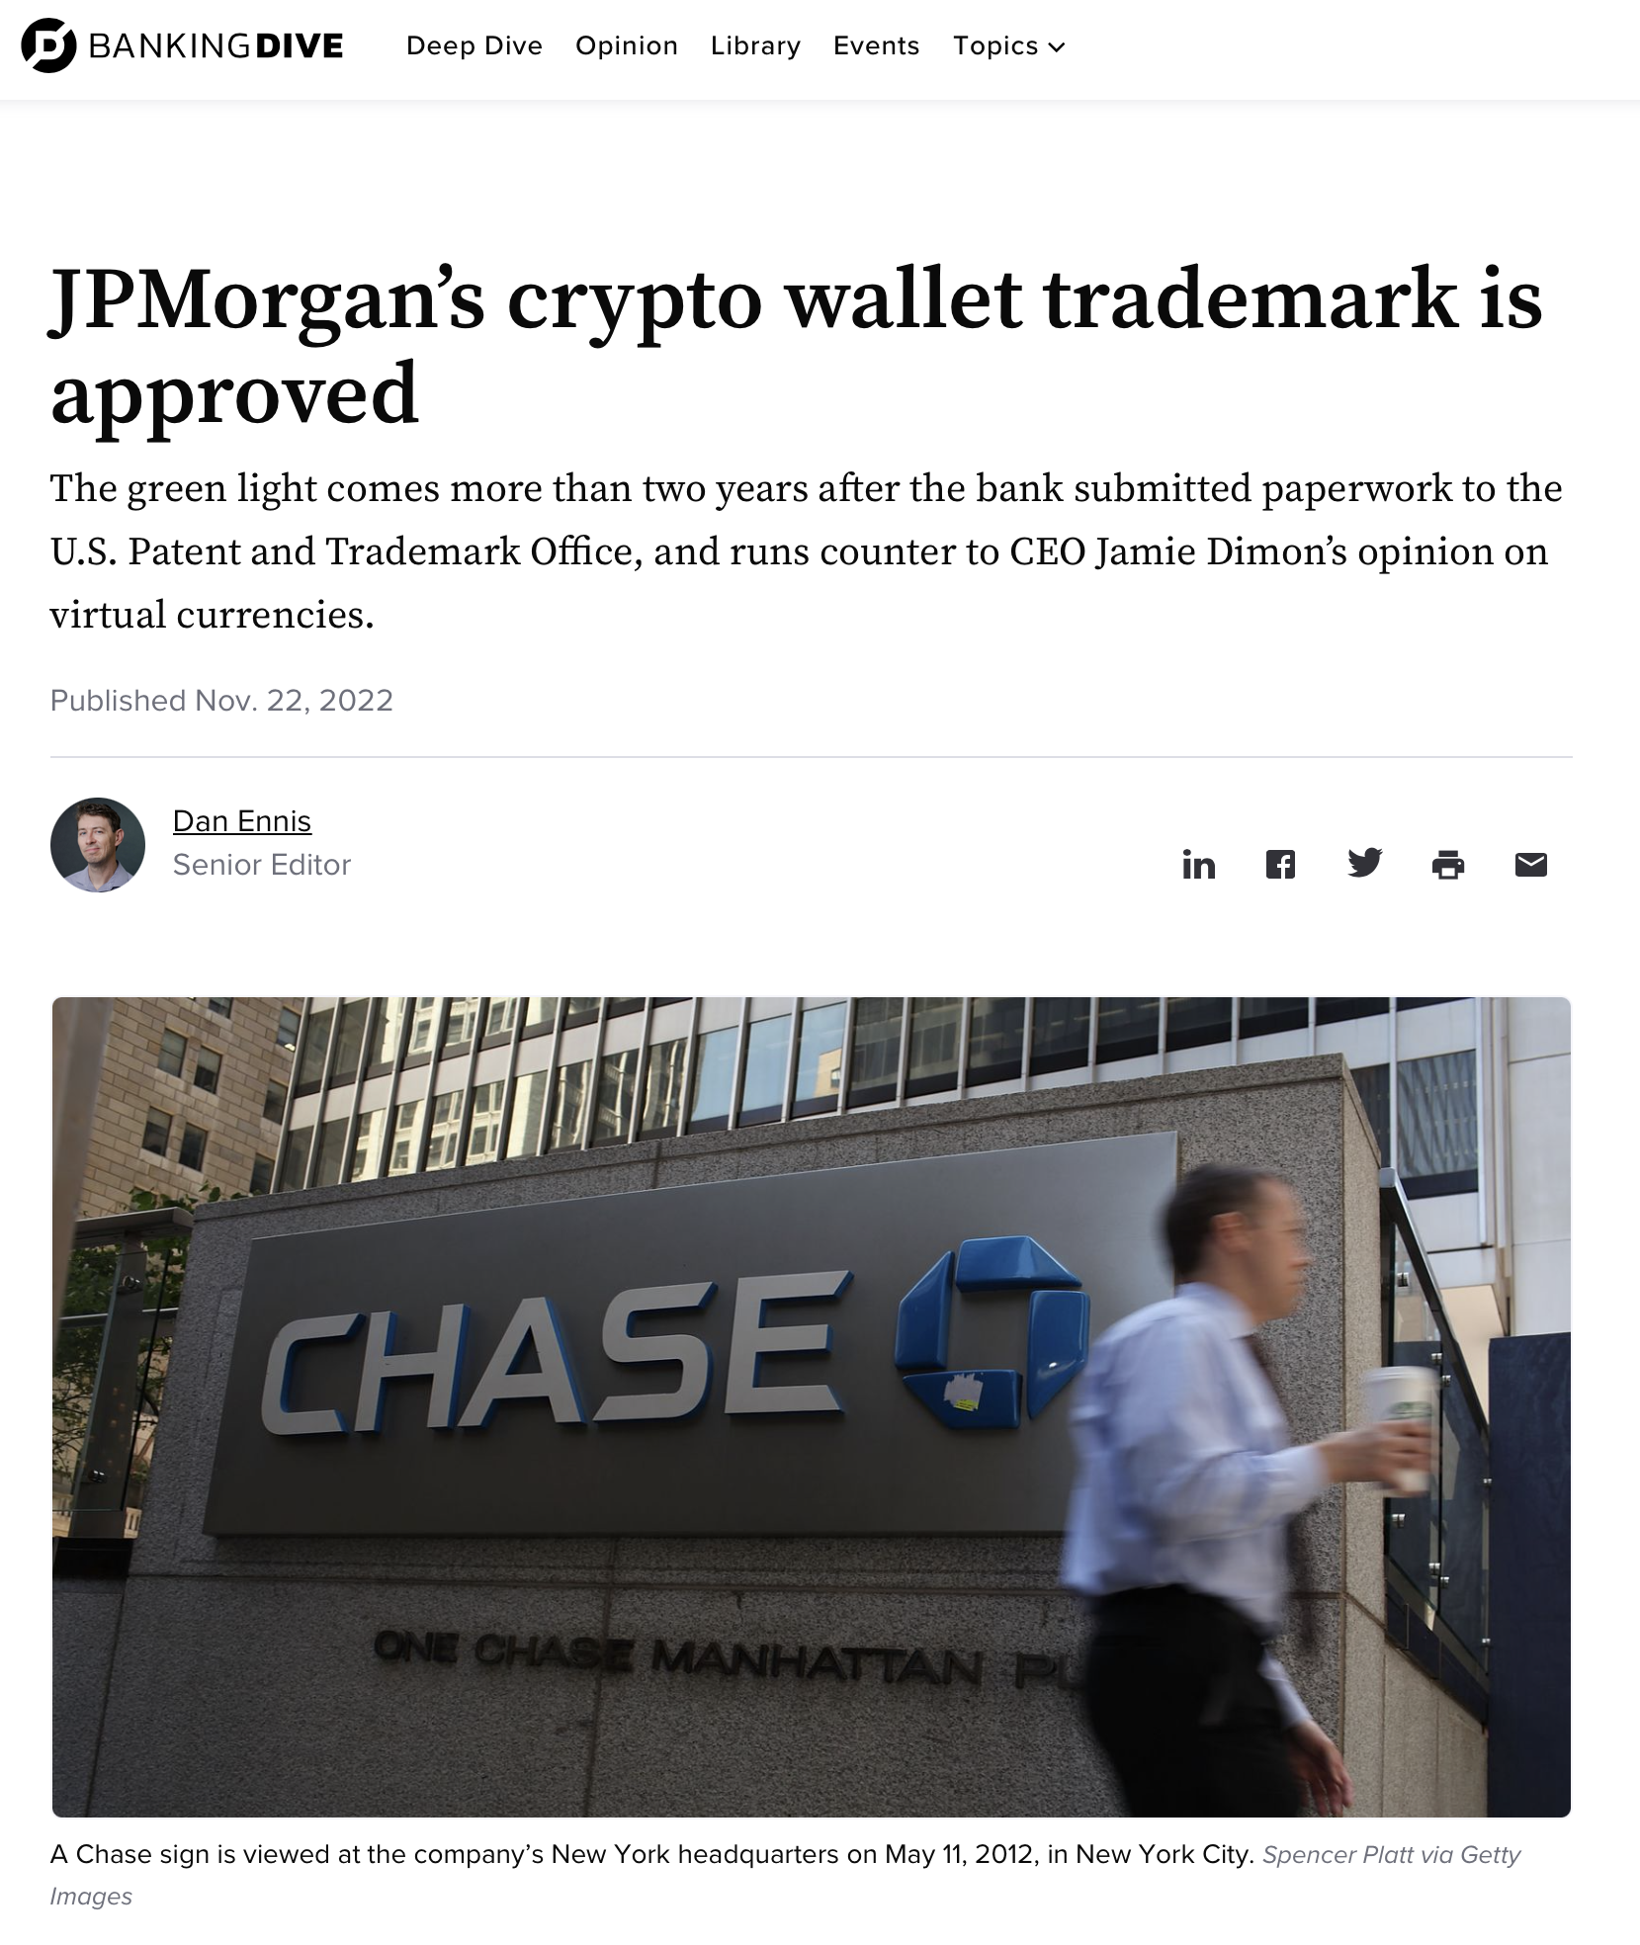

Slide 12
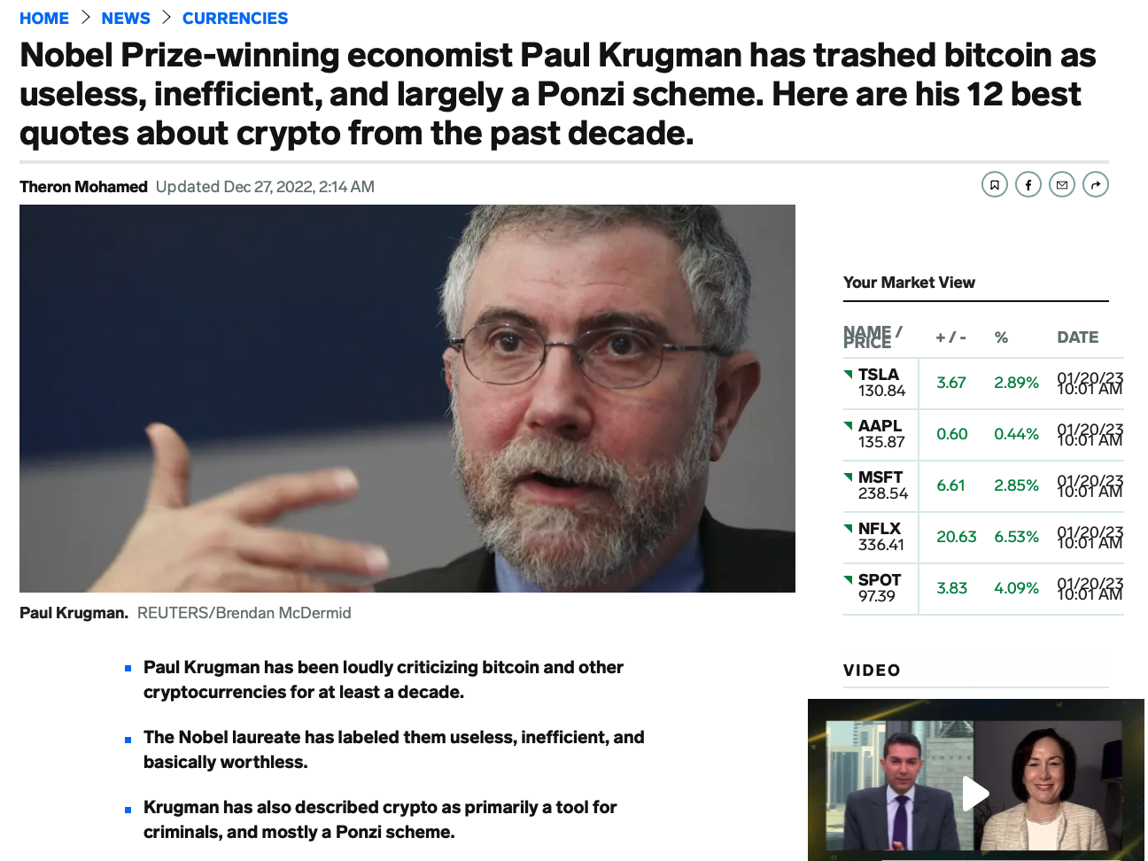

Slide 13
On the Value of Krugman’s (or Anyone’s) Predictions
Oops…

Slide 14
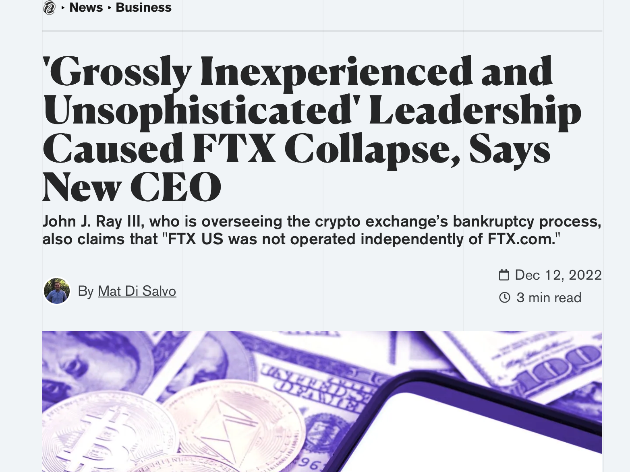

Slide 15
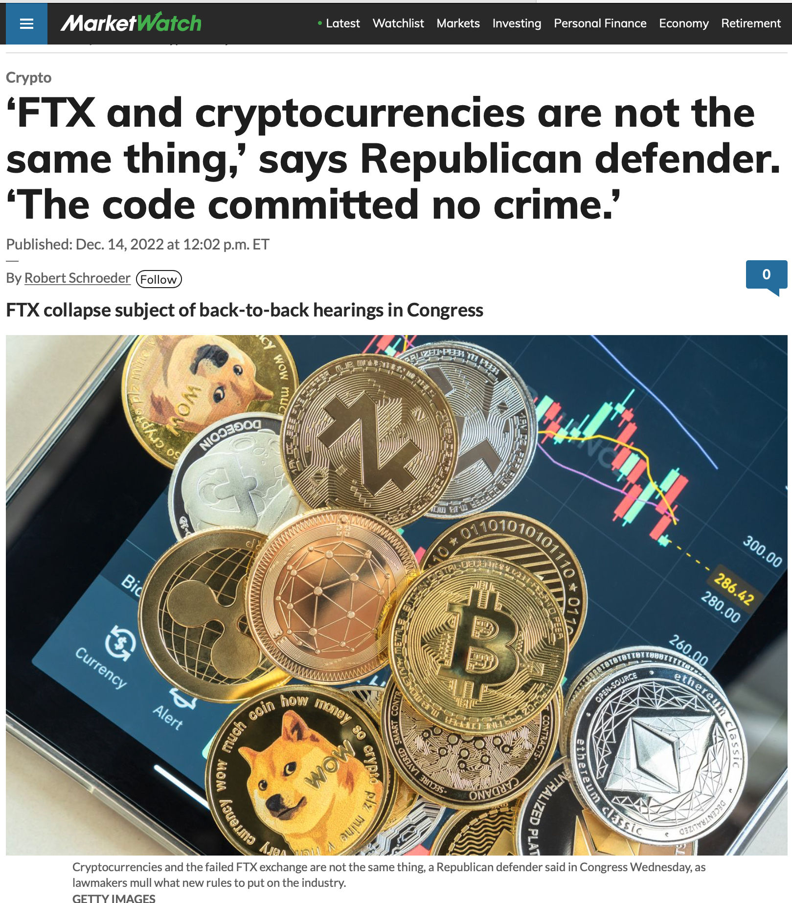

Slide 18
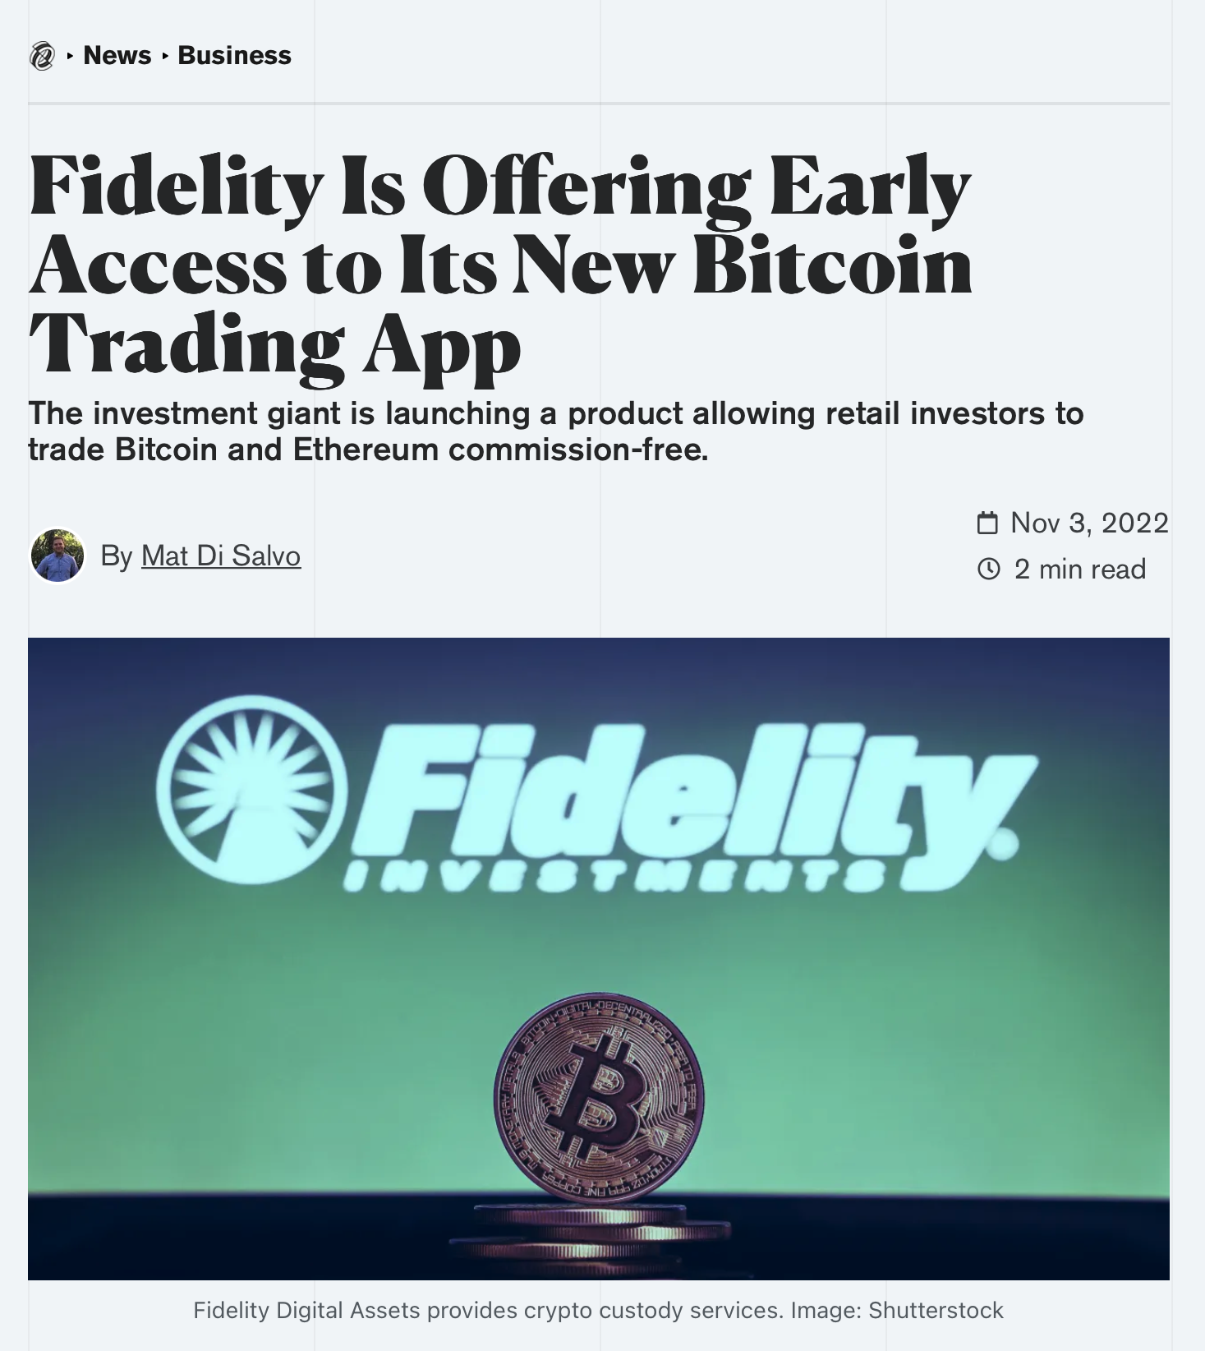

Slide 19
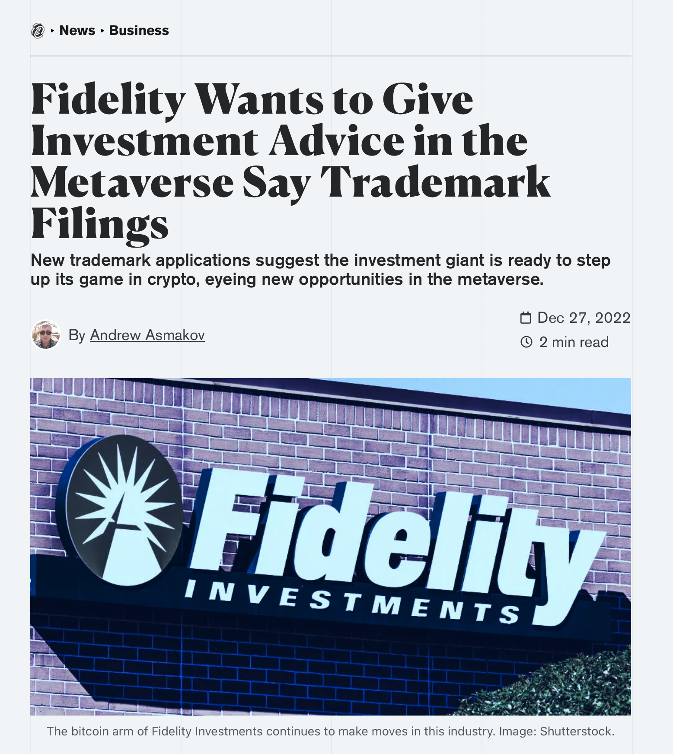

Slide 20
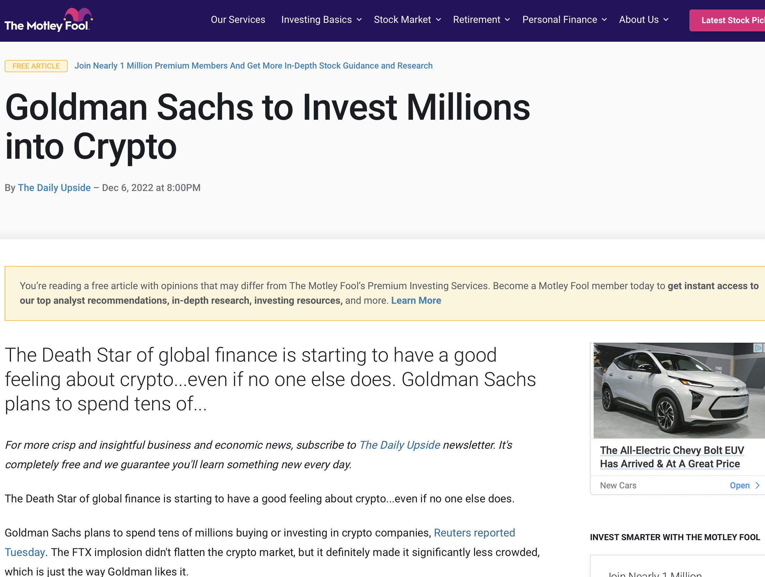

Slide 21
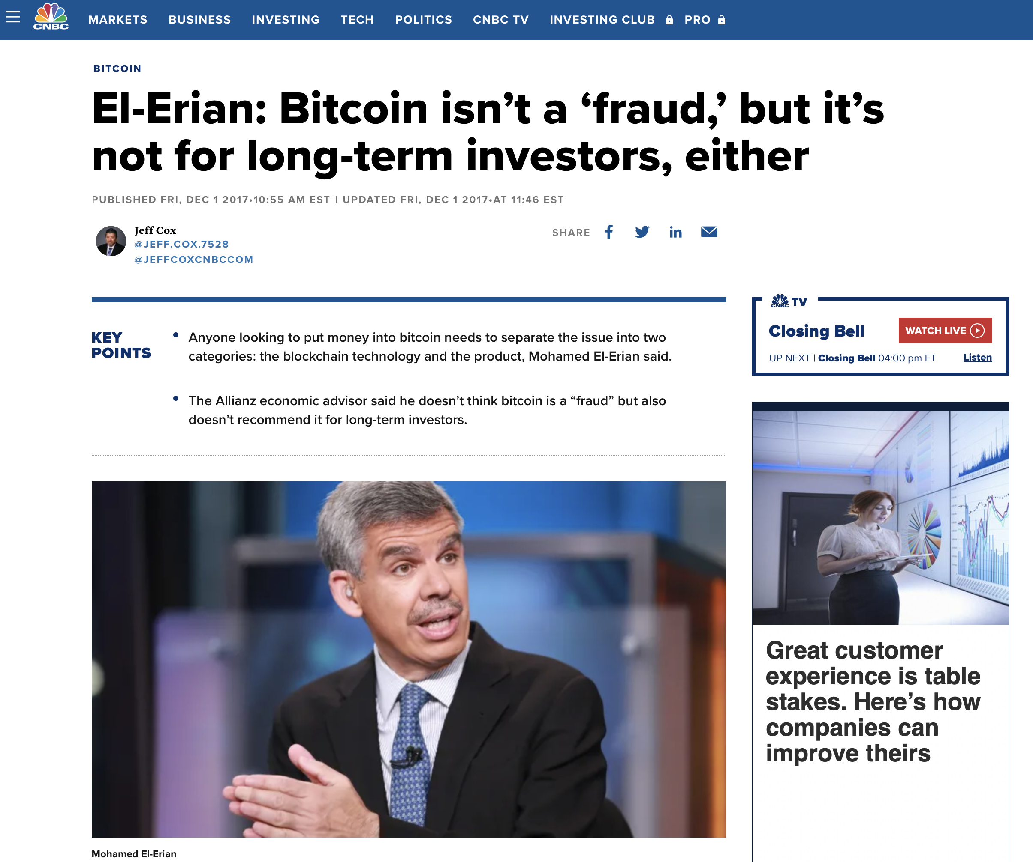

Slide 22
Cathie Wood on Bitcoin (2/3/2023)

Slide 23
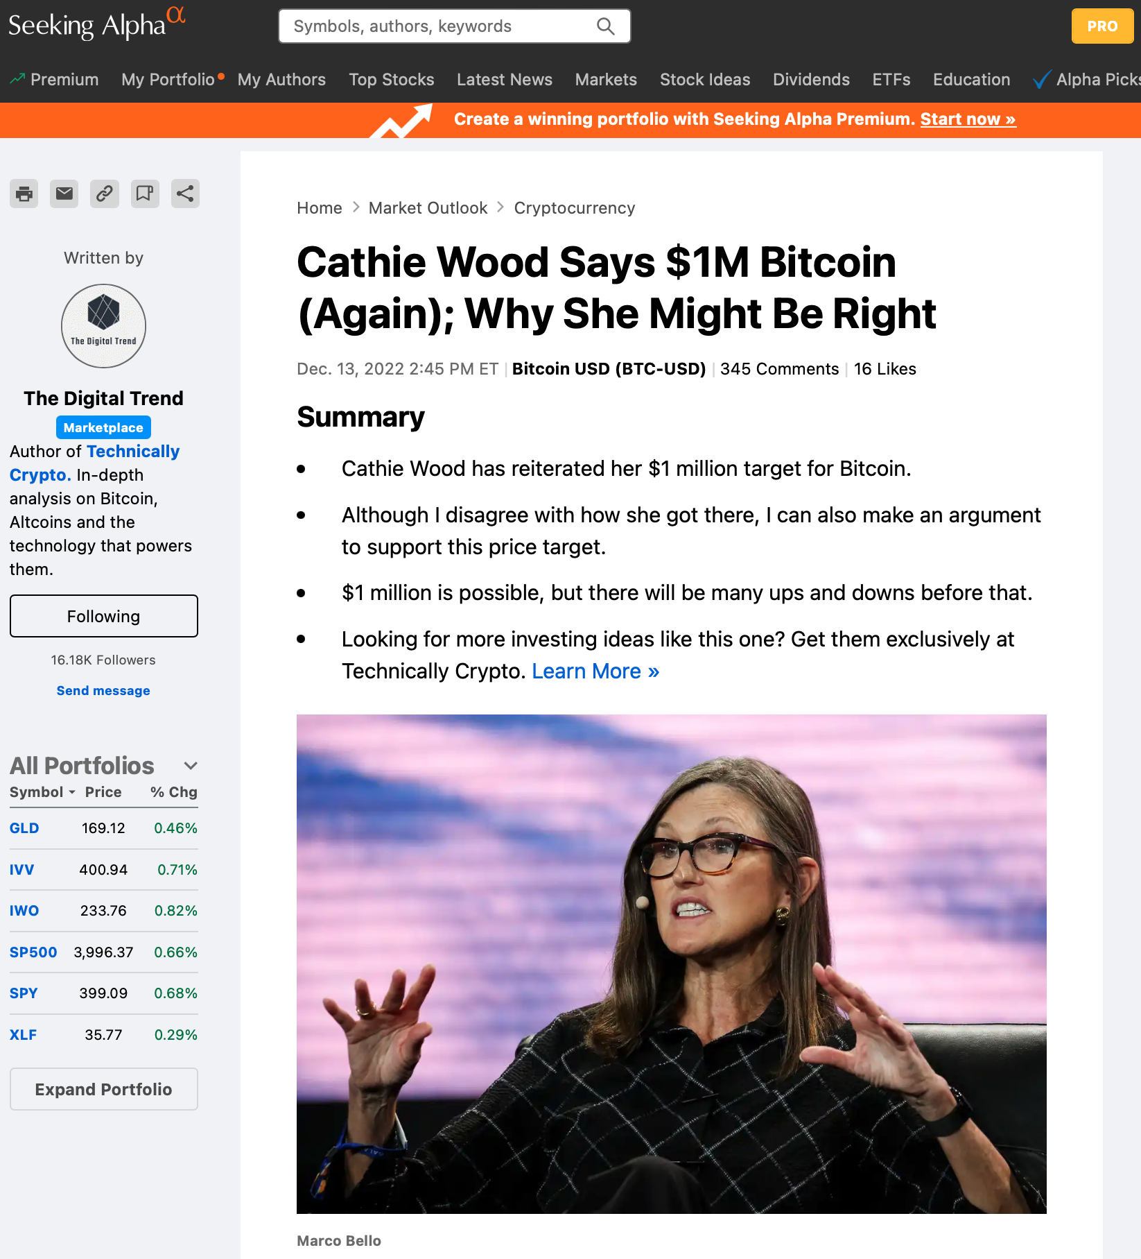

Slide 24
If You Read No Other Book, Read This One
(or read the short version at: https://medium.com/zen-and-the-art-of-crypto/the-reasons-why-fiat-money-is-already-on-its-way-out-745f73fec8d4)

Slide 25
Money https://en.wikipedia.org/wiki/Money
Money is any item or verifiable record that is generally accepted as payment for goods and services and repayment of debts, such as taxes, in a particular country or socio-economic context.
It is based on trust, that someone else will accept it as standard of value in place of a physical item
The main functions of money are distinguished as
A medium of exchange,
A unit of account or measure of value,
A store of value,
A standard of deferred payment.
It must be divisible into smaller units
It must be fungible, meaning that $1 is the same as any other $1
Scarce, or at least not easily produced
Any item or verifiable record that fulfills these functions can be considered as money.

Slide 26
Alternatively
Money must be:
Fungible, its individual units must be capable of mutual substitution (i.e., interchangeability).
Durable, able to withstand repeated use.
Divisible, divisible to small units.
Portable, easily carried and transported.
Acceptable, everyone must accept the money as payment
Uniform, all units of the same denomination have the same value
Limited, its supply in circulation must be restricted.

Slide 27
Example: A Simple form of Money
United Mileage Plus miles are a private form of money
Earned by flying United or partner airlines
Or purchasing items on a United-linked credit card
They can be accumulated without limit
They can be transferred to relatives or friends

Slide 28
United Miles Can be Used for Many Things
Travel on airlines
Hotel stays
Apple computer products
Housewares
Jewelry
Event tickets
Miles are fungible digital tokens
Miles are only valuable if United says they are
Their value can be inflated to zero
If United goes bankrupt, miles are worthless
So: Should we trust them?

Slide 29
Commodity Money
Many items have been used as commodity money such as naturally scarce precious metals, conch shells, barley, beads, etc., as well as many other things that are thought of as having value.
Commodity money value comes from the commodity out of which it is made.
The commodity itself constitutes the money, and the money is the commodity.
Examples of commodities that have been used as mediums of exchange include gold, silver, copper, rice, Wampum, salt, peppercorns, large stones, decorated belts, shells, alcohol, cigarettes, cannabis, candy, etc.
These items were sometimes used in a metric of perceived value in conjunction with one another, in various commodity valuation or price system economies.
The use of commodity money is similar to barter, but a commodity money provides a simple and automatic unit of account for the commodity which is being used as money.

Slide 30
Fiat Money
Money is historically an emergent market phenomenon establishing a commodity money, but nearly all contemporary money systems are based on fiat money
Fiat money, like any check or note of debt, is without use value as a physical commodity.
It derives its value by being declared by a government to be legal tender
There is an element of trust!!
That is, it must be accepted as a form of payment within the boundaries of the country, for "all debts, public and private".
Counterfeit money can cause good money to lose its value.
Printing money indiscriminately can cause inflation such as what happened in the Weimar Republic (Germany, 1920’s), Venezuela, and Turkey

Slide 31
Money Supply
The money supply of a country consists of currency (banknotes and coins)
Depending on the particulars of the definition used, money supply consists in part of one or more types of bank money (the balances held in checking accounts, savings accounts, and other types of bank accounts).
Bank money, which consists only of records (mostly computerized in modern banking), forms by far the largest part of broad money in developed countries

Slide 32
Types of Money (US)
Modern monetary theory distinguishes among different ways to measure the stock of money or money supply.
The most commonly used monetary aggregates (or types of money) are conventionally designated M1, M2, and M3.
These are successively larger aggregate categories:
M1 is currency (coins and bills) plus demand deposits (such as checking accounts);
M2 is M1 plus savings accounts and time deposits under $100,000;
M3 is M2 plus larger time deposits and similar institutional accounts.
M1 includes only the most liquid financial instruments, and M3 relatively illiquid instruments.
The precise definition of M1, M2, etc. may be different in different countries.

Slide 33
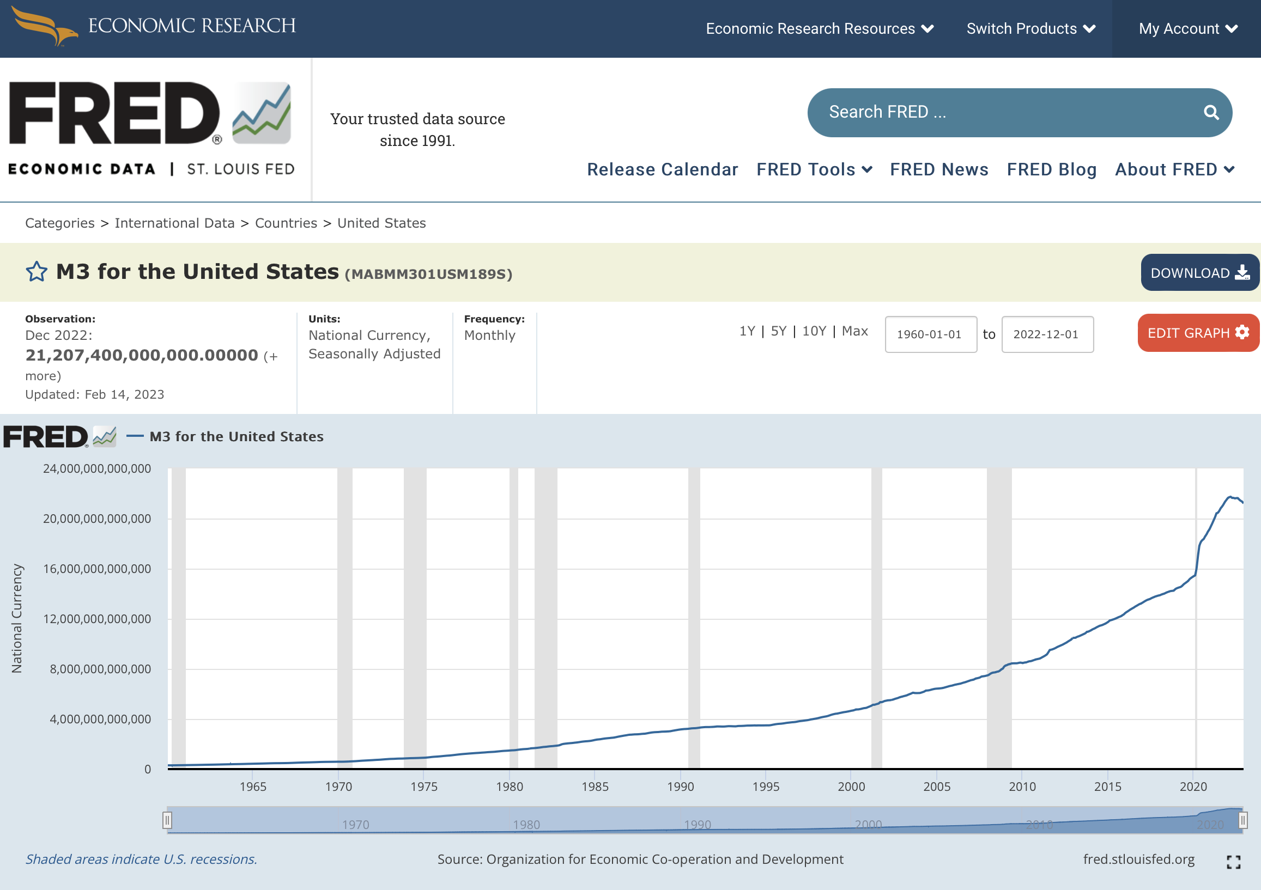
Money Supply is Shrinking (2022) First Time Ever!
https://fred.stlouisfed.org/series/MABMM301USM189S
https://schiffgold.com/exploring-finance/money-supply-shrinks-in-2022-for-the-first-time-on-record/

Slide 34
Money Supply is Shrinking (2022) First Time Ever!
https://schiffgold.com/exploring-finance/money-supply-shrinks-in-2022-for-the-first-time-on-record/

Slide 35
Money Supply is Shrinking (2022)
https://schiffgold.com/exploring-finance/money-supply-shrinks-in-2022-for-the-first-time-on-record/
And possibly bitcoin

Slide 36
M3 Money Supply to 3/2024 (and the shrinking continues…) https://fred.stlouisfed.org/series/MABMM301USM189S

Slide 37
What Could Go Wrong?
On September 17, 2019, interest rates on overnight repurchase agreements (or "repos"), which are short-term loans between financial institutions, experienced a sudden and unexpected spike.
A measure of the interest rate on overnight repos in the United States, the Secured Overnight Financing Rate (SOFR), increased from 2.43 percent on September 16 to 5.25 percent on September 17.
During the trading day, interest rates reached as high as 10 percent.
The activity also affected the interest rates on unsecured loans between financial institutions, and the Effective Federal Funds Rate (EFFR), which serves as a measure for such interest rates, moved above its target range determined by the Federal Reserve.
https://en.wikipedia.org/wiki/September_2019_events_in_the_U.S._repo_market

Slide 38
Money: Rai Stones in Micronesia
A rai stone (Yapese: raay), or fei stone, is one of many large artifacts that were manufactured and treasured by the native inhabitants of the Yap islands in Micronesia.
They are also known as Yapese stone money or similar names.
The typical rai stone is carved out of crystalline limestone and is shaped as a disk with a hole in the center.
The smallest may be 3.5 centimetres (1.4 in) in diameter.
The largest extant stone is located on Rumung island, near the Riy village, it is 3.6 metres (12 ft) in diameter and 50 centimetres (20 in) thick, and weighs 4,000 kilograms (8,800 lb)

Slide 39
History of Money Barter
The use of barter-like methods may date back to at least 100,000 years ago, though there is no evidence of a society or economy that relied primarily on barter.
Instead, non-monetary societies operated largely along the principles of gift economy and debt.
When barter did in fact occur, it was usually between either complete strangers or potential enemies.
Many cultures around the world eventually developed the use of commodity money.

Slide 40
History of Money Representative Money
The system of commodity (“hard”) money eventually evolved into a system of representative money (promissory notes).
This occurred because gold and silver merchants or banks would issue receipts to their depositors – redeemable for the commodity money deposited.
Eventually, these receipts became generally accepted as a means of payment and were used as money.
Paper money or banknotes were first used in China during the Song dynasty.
These banknotes, known as "jiaozi", evolved from promissory notes that had been used since the 7th century.
However, they did not displace commodity money and were used alongside coins.
In the 13th century, paper money became known in Europe through the accounts of travelers, such as Marco Polo and William of Rubruck

Slide 41
History of Money: Coins
The Mesopotamian shekel was a unit of weight and relied on the mass of something like 160 grains of barley.
The first usage of the term came from Mesopotamia circa 3000 BC. Societies in the Americas, Asia, Africa and Australia used shell money – often, the shells of the cowry (Cypraea moneta L. or C. annulus L.).
According to Herodotus, the Lydians were the first people to introduce the use of gold and silver coins.
It is thought by modern scholars that these first stamped coins were minted around 650 to 600 BC

Slide 42
History of Money Gold Standard
After World War II and the Bretton Woods Conference (1944), most countries adopted fiat currencies that were fixed to the U.S. dollar.
The U.S. dollar was in turn fixed to gold.
In 1971 President Nixon had the U.S. government suspend the convertibility of the U.S. dollar to gold.
After this many countries de-pegged their currencies from the U.S. dollar
Most of the world's currencies became unbacked by anything except the governments' fiat of legal tender and the ability to convert the money into goods via payment.
According to proponents of modern money theory, fiat money is also backed by taxes. (but see the next slide!)
By imposing taxes, states create demand for the currency they issue

Slide 43
History of Money Rise of the Petrodollar Standard
After the Bretton Woods agreement in 1944 until 1971, the value of the US dollar was determined by its value relative to gold.
But since fiat currencies are much harder to define their value, you need some sort of threshold or element to which to compare their value
You can compare its value to other fiat currencies to get an idea, but if you want to retain the title as the ‘world’s reserve currency’ you might need something more.
The US government knew this…while also acknowledging the critical importance oil was going to have over the next several decades (for the economy, wars, etc.).
Consequently, in 1979, they reached an agreement with Saudi Arabia so that all oil exports from that country — and all Middle-East oil-exporting countries today — had the value of oil denominated in dollars.
In very simple terms, if you need oil, you must own dollars to acquire it.
This created the concept of the ‘petrodollar’ which forged the US dollar as the world’s reserve currency.
https://medium.com/@ignacio.de.gregorio.noblejas/crypto-is-the-path-to-digital-world-domination-3dd42176266f

Slide 44
Monetary Policy: Federal Reserve
Modern-day monetary systems are based on fiat money and are no longer tied to the value of gold since the Bretton Woods agreement in 1944.
The control of the amount of money in the economy is known as monetary policy.
Monetary policy is the process by which a government, central bank, or monetary authority manages the money supply to achieve specific goals.
Usually, the goal of monetary policy is to accommodate economic growth in an environment of stable prices.
For example, it is clearly stated in the Federal Reserve Act that the Board of Governors and the Federal Open Market Committee should seek "to promote effectively the goals of maximum employment, stable prices, and moderate long-term interest rates.

Slide 45
Monetary Policy Inflation and Deflation
When gold and silver are used as money, the money supply can grow only if the supply of these metals is increased by mining.
This rate of increase will accelerate during periods of gold rushes and discoveries, such as when Columbus traveled to the New World and brought back gold and silver to Spain, or when gold was discovered in California in 1848.
This caused inflation, as the value of gold went down (briefly).
However, if the rate of gold mining cannot keep up with the growth of the economy, gold becomes relatively more valuable, and prices (denominated in gold) must drop, causing deflation.
Deflation was the more typical situation for over a century when gold and paper money backed by gold were used as money in the 18th and 19th centuries, which is when many “panics” and “recessions” occurred

Slide 46
Control of Money Supply
Some of the tools used to control the money supply include:
Changing the interest rate at which the central bank loans money to (or borrows money from) the commercial banks
Currency purchases or sales
Increasing or lowering government borrowing (“monetary policy”)
Increasing or lowering government spending (“fiscal policy”)
Manipulation of exchange rates
Raising or lowering bank reserve requirements
In the US, the Federal Reserve (FED) is responsible for controlling the money supply, while in the Euro area the respective institution is the European Central Bank (ECB)
Other central banks with a significant impact on global finances are the Bank of Japan (BoJ), People's Bank of China (PBoC) and the Bank of England (BoE).

Slide 47
Self Organizing Monetary Systems
In the aftermath of the Great Financial Crisis of 2008, a mysterious person, never identified, by the name of “Satoshi Nakamoto”, proposed a new monetary system that satisfied the major requirements of a monetary system, but was not under any central control
Nakamoto wrote a white paper and sent it to a selected list of email recipients, following which he placed the software in open access on the world wide web, encouraging others to download it and join the network
Since that time, many other alternative coins have been proposed, including Ethereum, Cardano, XRP, Terra, Solana, Avalanche, Polkadot…
All of these make use of the most novel development of Bitcoin (BTC), which is the idea of the blockchain, a means of verifying BTC transactions by mechanisms that prevent the double spending of coins
Blockchains have now been investigated as a means of legitimizing the authenticity of ledger entries that are required for all monetary transactions, thereby establishing the trust that is needed for any monetary system to be accepted

Slide 48
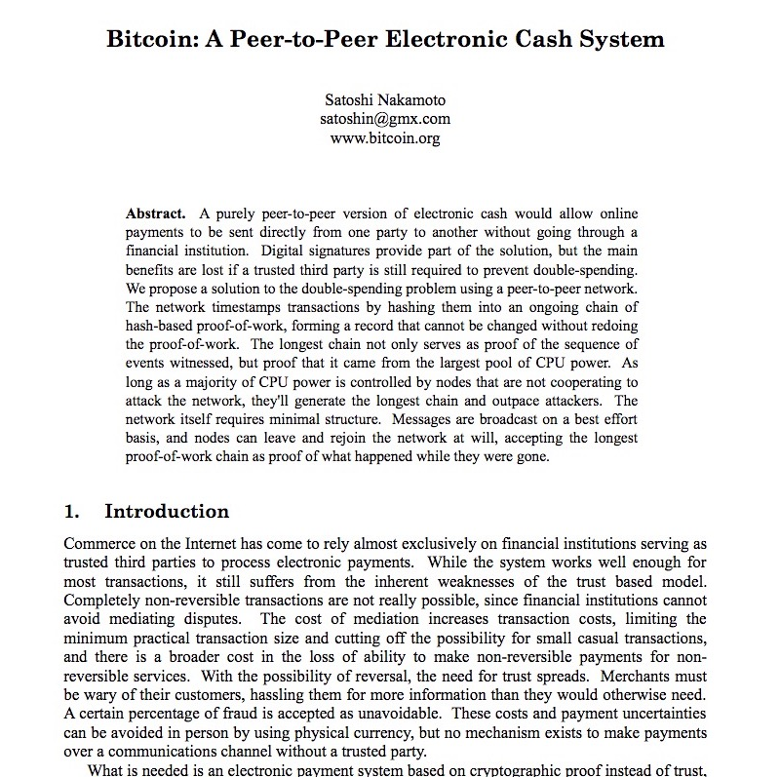
https://bitcoin.org/bitcoin.pdf

Slide 49
Bitcoin
Bitcoin is a cryptocurrency, a digital asset that uses cryptography to control its creation and management, rather than relying on central authorities.
Originally designed as a medium of exchange, Bitcoin is now primarily regarded as a store of value, often called “digital gold”.
Over the course of bitcoin's history, it has undergone rapid growth to become a significant store of value both on- and offline.
From the mid-2010s, some businesses began accepting bitcoin in addition to traditional currencies.

Slide 50
Bitcoin
Prior to the release of bitcoin, there were a number of digital cash technologies starting with the issuer based ecash protocols of David Chaum and Stefan Brands.
The idea that solutions to computational puzzles could have some value was first proposed by cryptographers Cynthia Dwork and Moni Naor in 1992.
The idea was independently rediscovered by Adam Back who developed hashcash, a proof-of-work scheme for spam control in 1997.

Slide 51
Bitcoin
The first proposals for distributed digital scarcity-based cryptocurrencies were Wei Dai's b-money and Nick Szabo's bitgold.
Hal Finney developed reusable proof of work (RPOW) using hashcash as its proof of work algorithm.
In the bitgold proposal which proposed a collectible market-based mechanism for inflation control, Nick Szabo also investigated some additional aspects including a Byzantine fault-tolerant agreement protocol based on quorum addresses to store and transfer the chained proof-of-work solutions

Slide 52
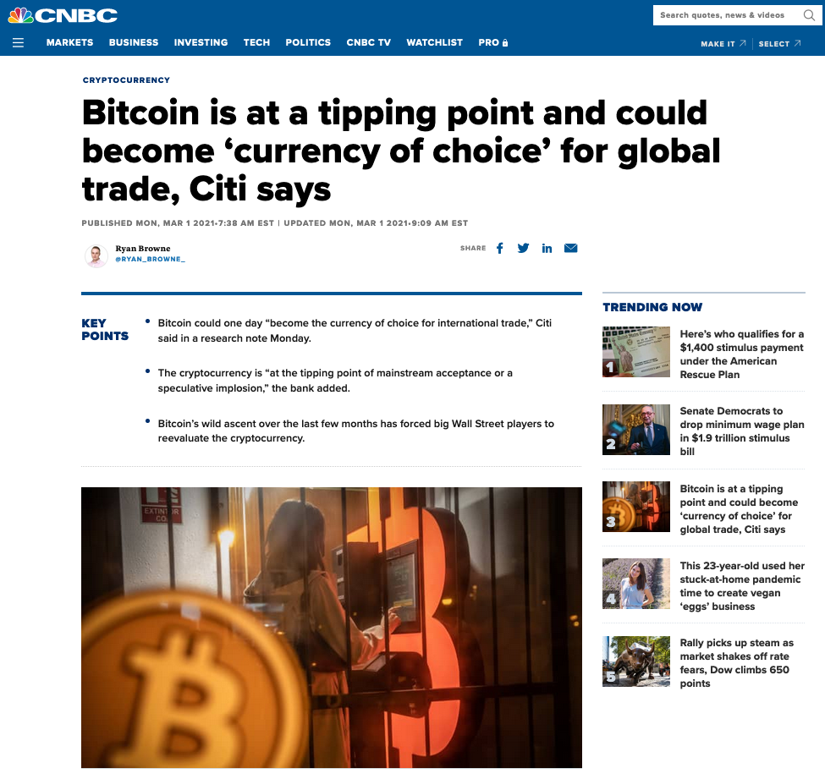
https://www.cnbc.com/2021/03/01/bitcoin-btc-is-at-a-tipping-point-citi-says.html

Slide 53
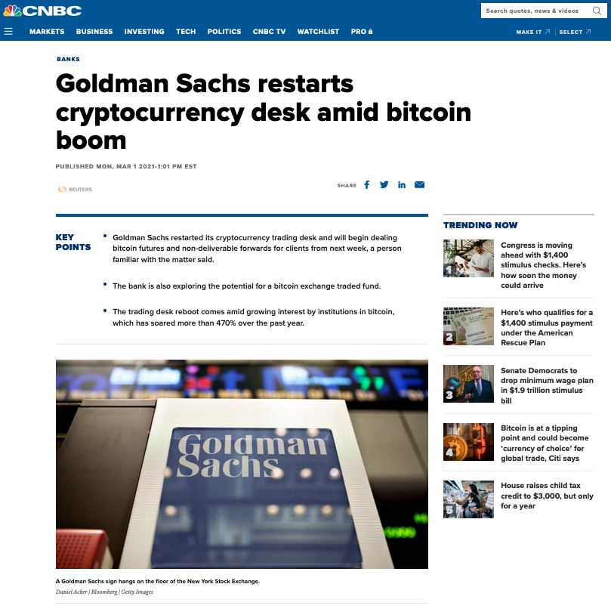
https://www.cnbc.com/2021/03/01/goldman-sachs-restarts-cryptocurrency-desk-amid-bitcoin-boom.html

Slide 54
Cryptocurrencies https://en.wikipedia.org/wiki/Cryptocurrency
A cryptocurrency (or crypto currency) is a digital asset designed to work as a medium of exchange that uses cryptography to secure its transactions, to control the creation of additional units, and to verify the transfer of assets.
Cryptocurrencies are a type of digital currencies, alternative currencies and virtual currencies.
Cryptocurrencies use decentralized control as opposed to centralized electronic money and central banking systems.
The decentralized control of each cryptocurrency works through a blockchain, which is a public transaction database, functioning as a distributed ledger.
Bitcoin, created in 2009, was the first decentralized cryptocurrency.
Since then, numerous other cryptocurrencies have been created.
These are frequently called altcoins, as a blend of alternative coin.

Slide 55
Cryptocurrencies https://en.wikipedia.org/wiki/List_of_cryptocurrencies
The number of cryptocurrencies available over the internet as of 19 August 2018 is over 1600 and growing.
A new cryptocurrency can be created at any time.
By market capitalization, Bitcoin is currently (December 15, 2018) the largest blockchain network, followed by Ripple, Ethereum and Tether.
As of 15 December 2018, total cryptocurrencies market capitalization is $100bn and larger than GDP of 127 countries.
99% of cryptocurrencies are probably scams!

Slide 56
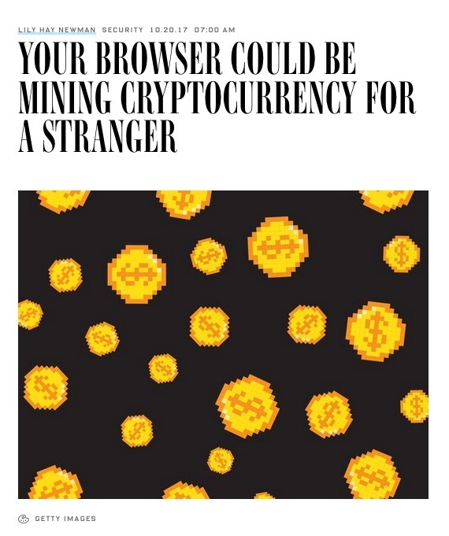
But the scammers are coming out of the woodwork!
Wired October 20,2017

Slide 57
Bitcoin Summary https://en.wikipedia.org/wiki/Bitcoin

Slide 58
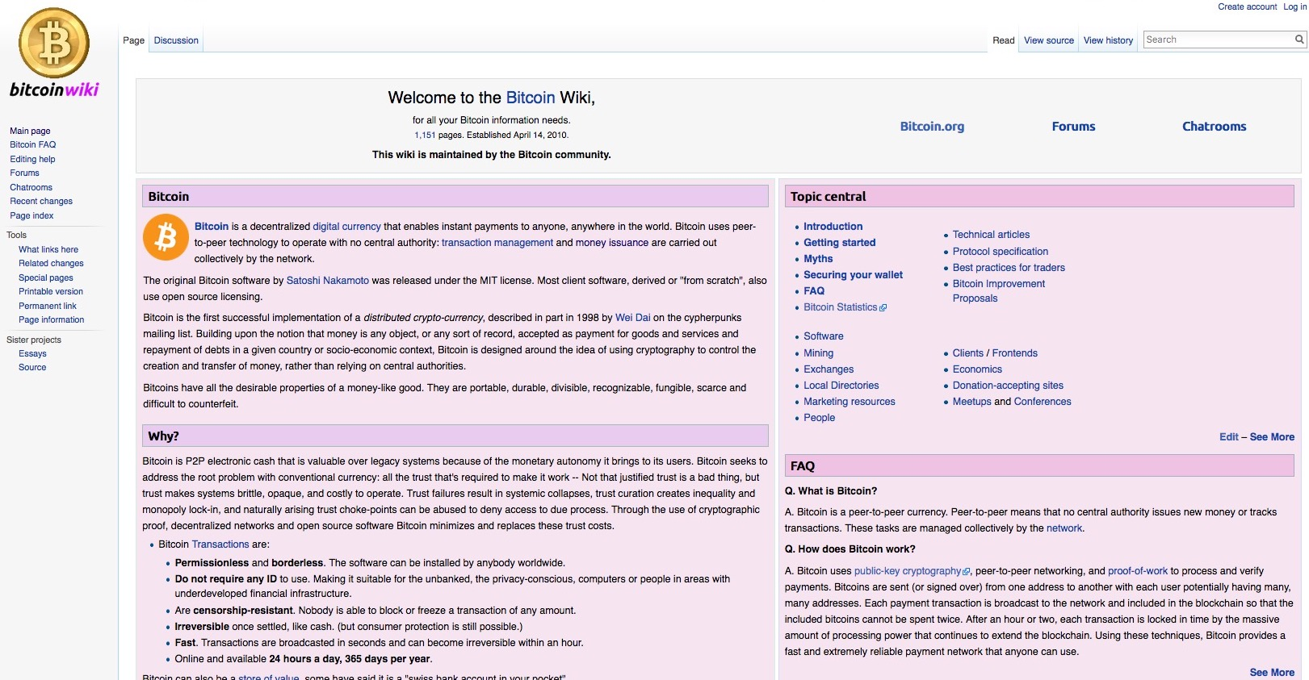
Bitcoin Wiki https://en.bitcoin.it/wiki/Main_Page

Slide 59
Bitcoin Wiki https://en.bitcoin.it/wiki/Main_Page
Edit – See More
FAQ
Q. What is Bitcoin? A. Bitcoin is a peer-to-peer currency. Peer-to-peer means that no central authority issues new money or tracks transactions. These tasks are managed collectively by the network. Q. How does Bitcoin work? A. Bitcoin uses public-key cryptography, peer-to-peer networking, and proof-of-work to process and verify payments. Bitcoins are sent (or signed over) from one address to another with each user potentially having many, many addresses. Each payment transaction is broadcast to the network and included in the blockchain so that the included bitcoins cannot be spent twice. After an hour or two, each transaction is locked in time by the massive amount of processing power that continues to extend the blockchain. Using these techniques, Bitcoin provides a fast and extremely reliable payment network that anyone can use.

Slide 60
Bitcoin Approached a Record Value http://www.cnbc.com/2017/02/23/bitcoin-is-surging--but-that-might-not-mean-what-you-think.html
From February 23, 2017

Slide 61
Bitcoin Approaches a Record Value http://www.cnbc.com/2017/02/23/bitcoin-is-surging--but-that-might-not-mean-what-you-think.html
From February 23, 2017

Slide 62
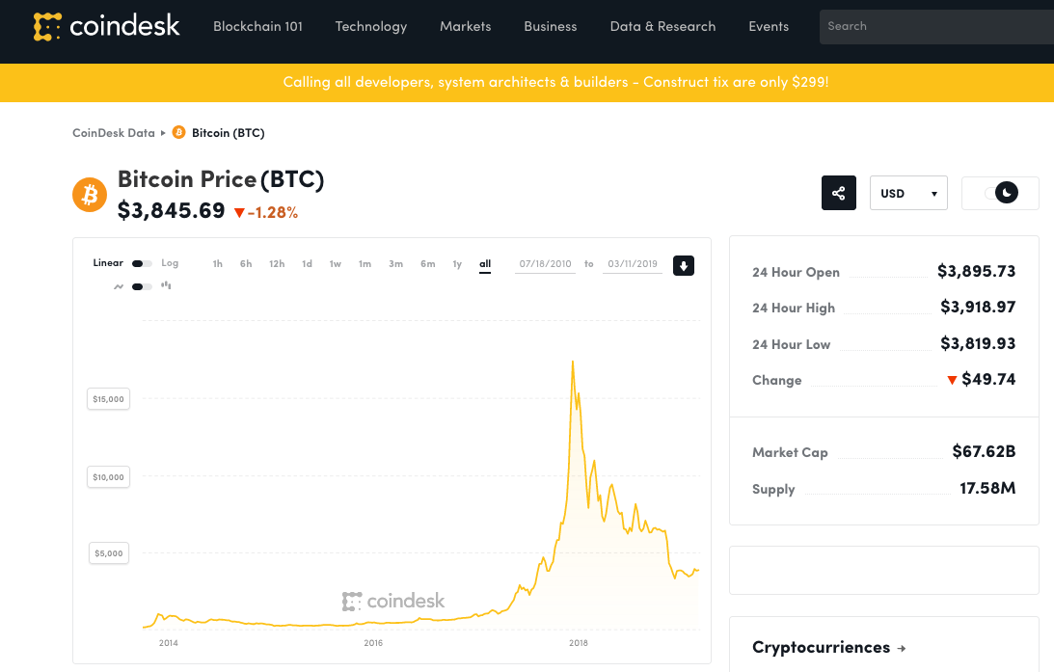
But then came the crash!
$17,394.97
On 12/11/2017
7/18/2010 – 3/11/2019

Slide 63
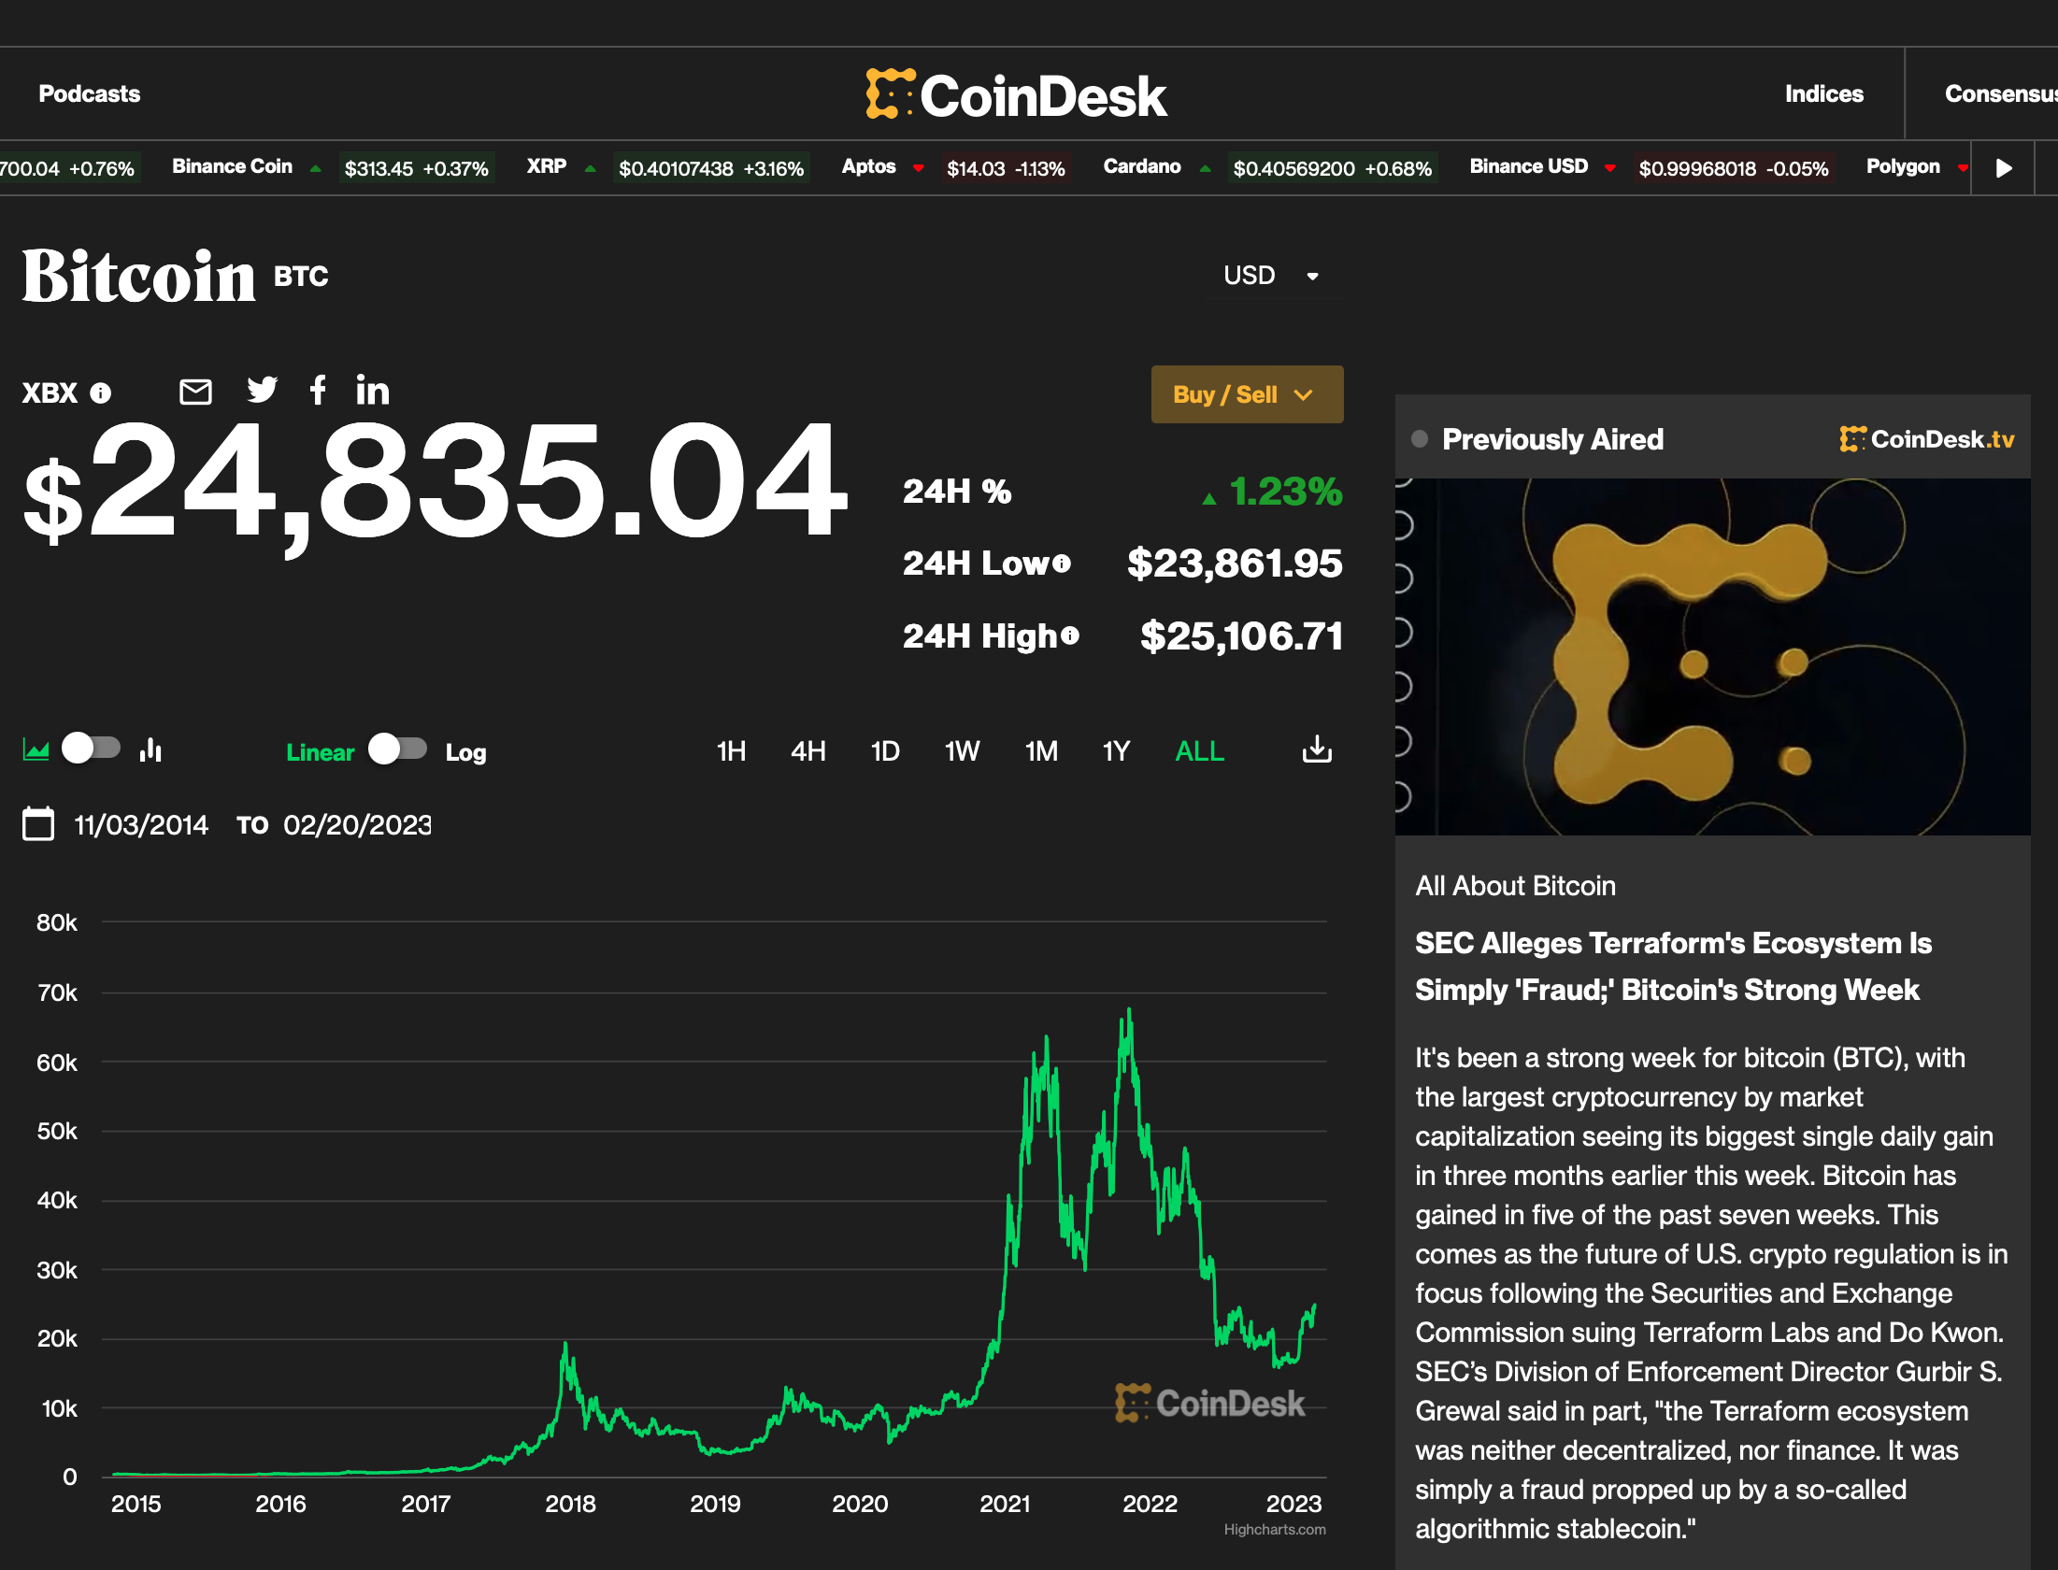
2/21/2023

Slide 64
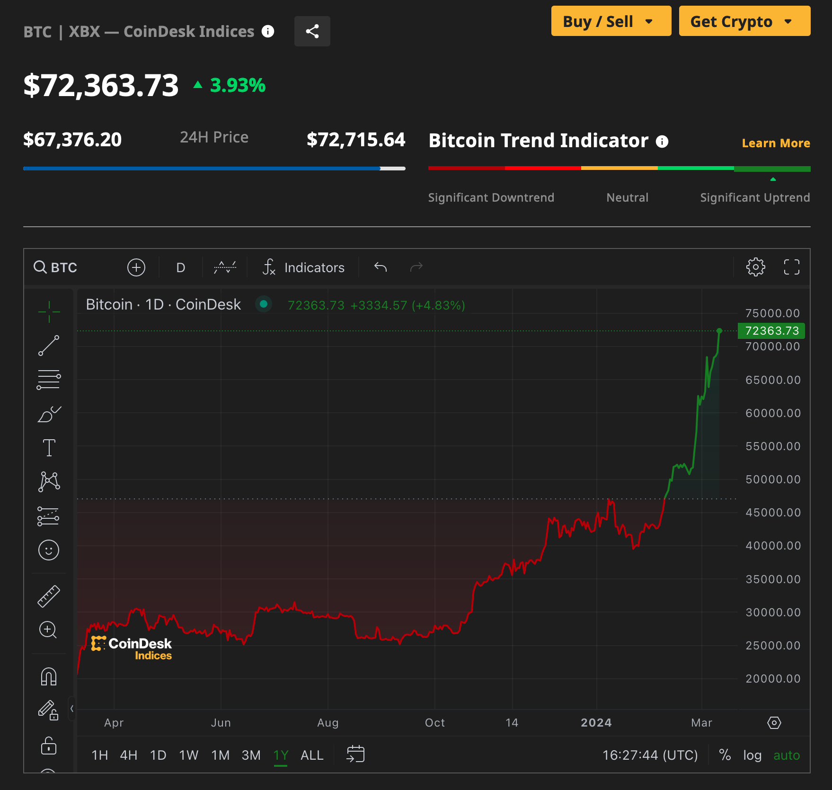
3/11/2024
To3/8/2024

Slide 65
How Isaac Newton went Broke The South Sea Bubble
https://www.sovereignman.com/finance/how-isaac-newton-went-flat-broke-chasing-a-stock-bubble-13268/
An early example is the case of Sir Isaac Newton and the South Sea Company, which was established in the early 18th Century and granted a monopoly on trade in the South Seas in exchange for assuming England’s war debt.
It was one of the first companies whose shares were actively traded
Newton proceeded to lose £20,000, which, in 1720, amounted to almost all his life savings.
Newton died in 1727

Slide 66
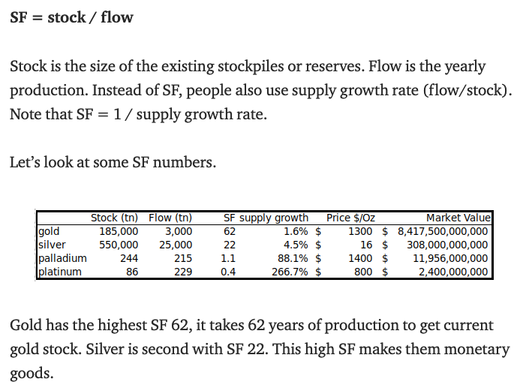
Model for Bitcoin Future Values https://medium.com/@100trillionUSD/modeling-bitcoins-value-with-scarcity-91fa0fc03e25
Model is based on the ratio of the current stock of a commodity to its possible production rate (“flow”)
A high SF ratio means that if the price drops suddenly, additional quantities cannot be produced that would lower the price further
The underlying idea is scarcity of the basic commodity
Follow PlanB: PlanB@100trillionUSD or PlanBTC.com

Slide 67
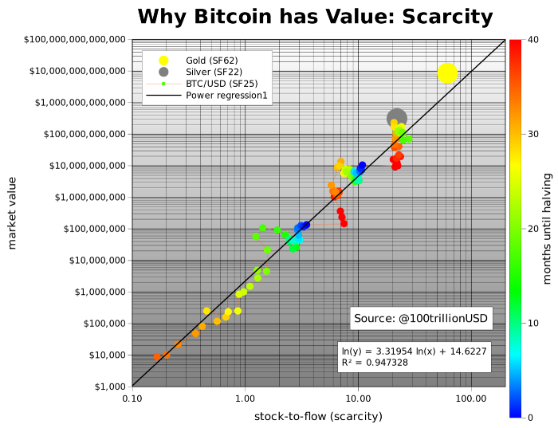
Model for Bitcoin Future Values https://medium.com/@100trillionUSD/modeling-bitcoins-value-with-scarcity-91fa0fc03e25
BTC has the properties that it is scarce, can be easily transferred electronically, and has a built-in Proof-of-Work property so that it cannot be easily counterfeited

Slide 68
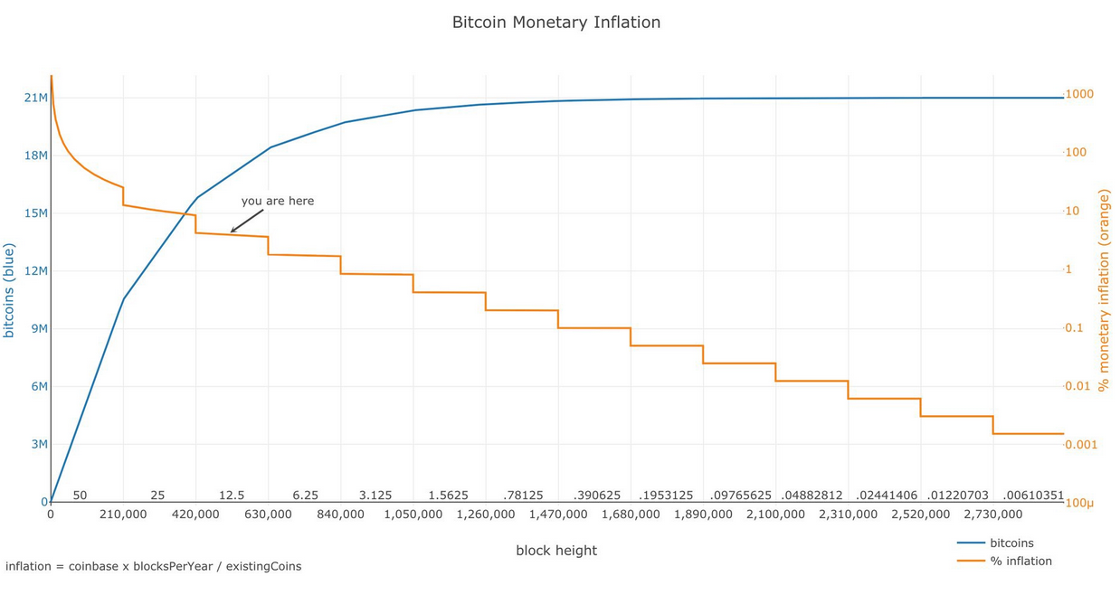
Bitcoin is Inherently Deflationary (Meaning that a unit is worth more over time) https://medium.com/@100trillionUSD/modeling-bitcoins-value-with-scarcity-91fa0fc03e25

Slide 69
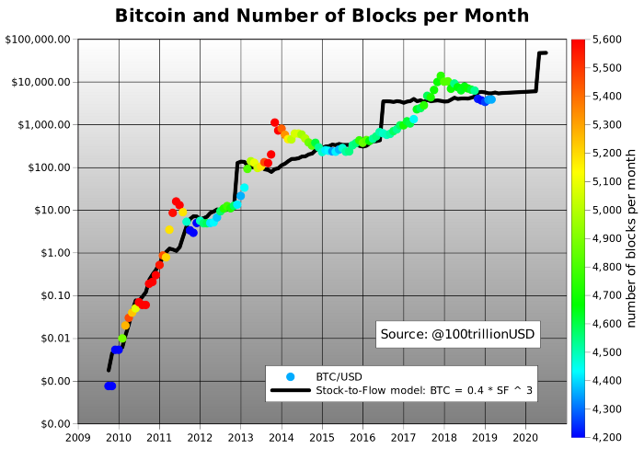
Model for Bitcoin Future Values https://medium.com/@100trillionUSD/modeling-bitcoins-value-with-scarcity-91fa0fc03e25
Based on the hash rate
Published March 22, 2019
The model, which was first published in 2019 to substantial derision, projected that BTC would be worth $55,000 USD in early 2021.
In fact, the high achieved this year was $58,332.36
Model projects that by the end of 2021, BTC could double in value from its current valuation
Follow PlanB: PlanB@100trillionUSD or PlanBTC.com

Slide 70
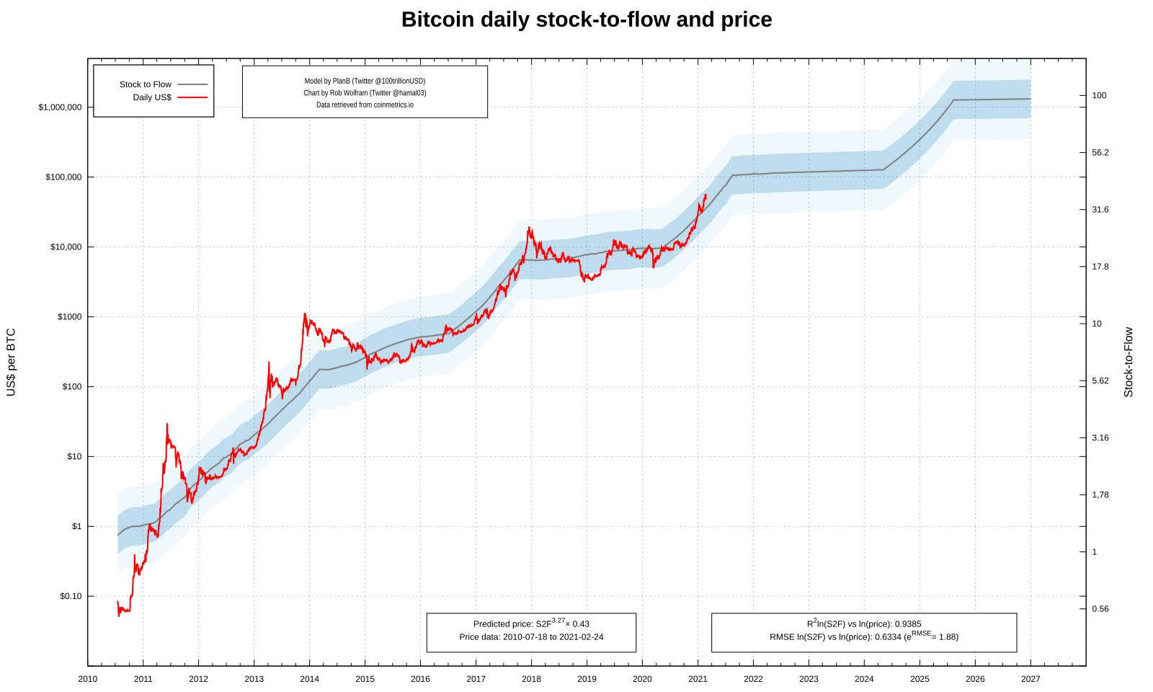
Bitcoin S2F Model Validation https://medium.com/@100trillionUSD/modeling-bitcoins-value-with-scarcity-91fa0fc03e25
Status as of 2/25/2021
$1,000,000 USD
2/25/2021
$100,000 USD
$10,000 USD
Model projects that by the end of 2021, BTC could double in value from its current valuation of ~$50,000 USD
7/1/2010
1/1/2021
1/1/2027
Follow PlanB: PlanB@100trillionUSD or PlanBTC.com

Slide 71
Bitcoin S2F Model Validation https://medium.com/@100trillionUSD/modeling-bitcoins-value-with-scarcity-91fa0fc03e25
Status as of 3/07/2022
3/07/2022
$1,000,000 USD
$100,000 USD
$10,000 USD
$1,000 USD
Model projected that by the end of 2021, BTC could double in value from its current valuation of ~$50,000 USD:
Model was wrong (for now)!
7/1/2010
1/1/2021
1/1/2026
Follow PlanB: PlanB@100trillionUSD or PlanBTC.com

Slide 72
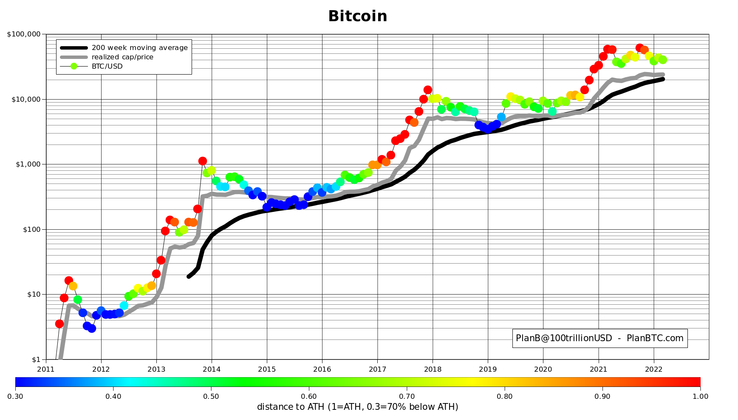
Bitcoin S2F Model Validation https://medium.com/@100trillionUSD/modeling-bitcoins-value-with-scarcity-91fa0fc03e25
Status as of 3/11/2022
3/11/2022
$100,000 USD
$10,000 USD
$1,000 USD
Model projected that by the end of 2021, BTC could double in value from its current valuation of ~$50,000 USD:
Model was wrong (for now)!
7/1/2011
1/1/2021
Follow PlanB: PlanB@100trillionUSD or PlanBTC.com

Slide 73
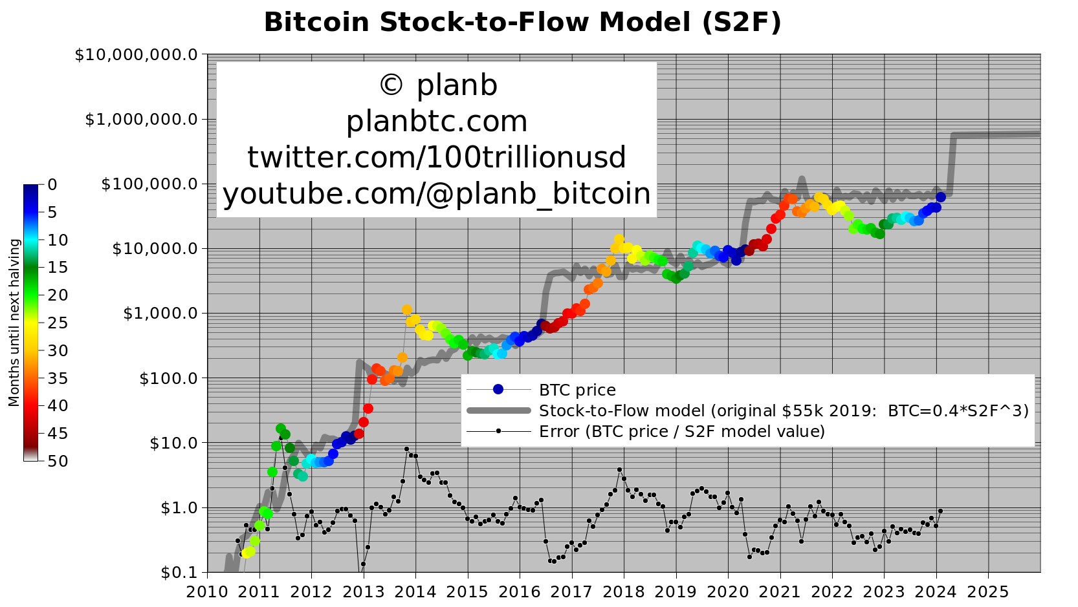
Bitcoin S2F Model Validation https://medium.com/@100trillionUSD/modeling-bitcoins-value-with-scarcity-91fa0fc03e25
https://twitter.com/100trillionUSD/status/1764306883815305693/photo/1
Status as of 3/8/2024
3/8/2024
Follow PlanB: PlanB@100trillionUSD or PlanBTC.com

Slide 74
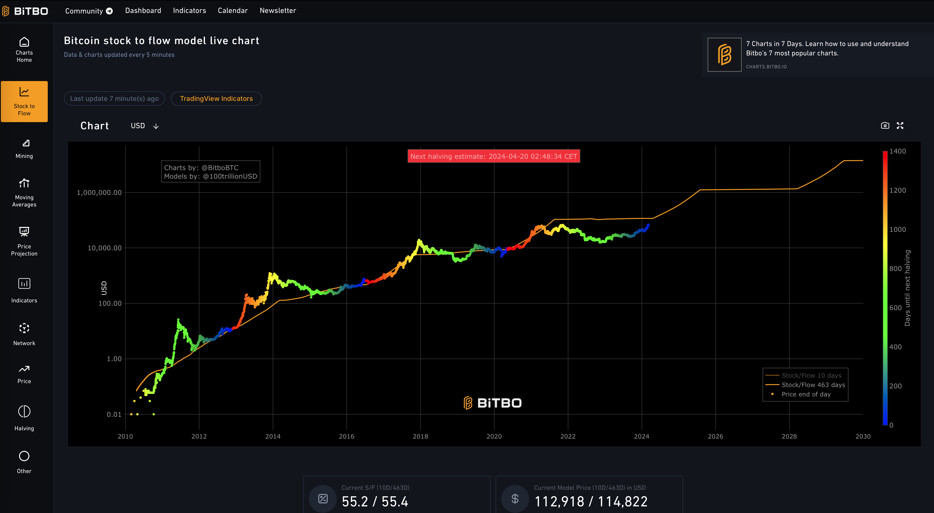
S2F Live Chart Price Projection https://buybitcoinworldwide.com/stats/stock-to-flow/
3/8/2024

Slide 75
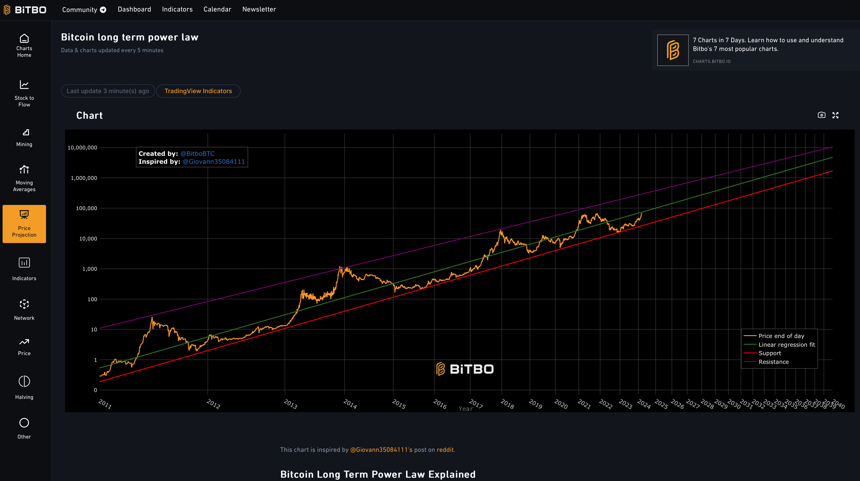
S2F Live Long-Term Power Law https://buybitcoinworldwide.com/stats/stock-to-flow/
3/8/2024

Slide 76
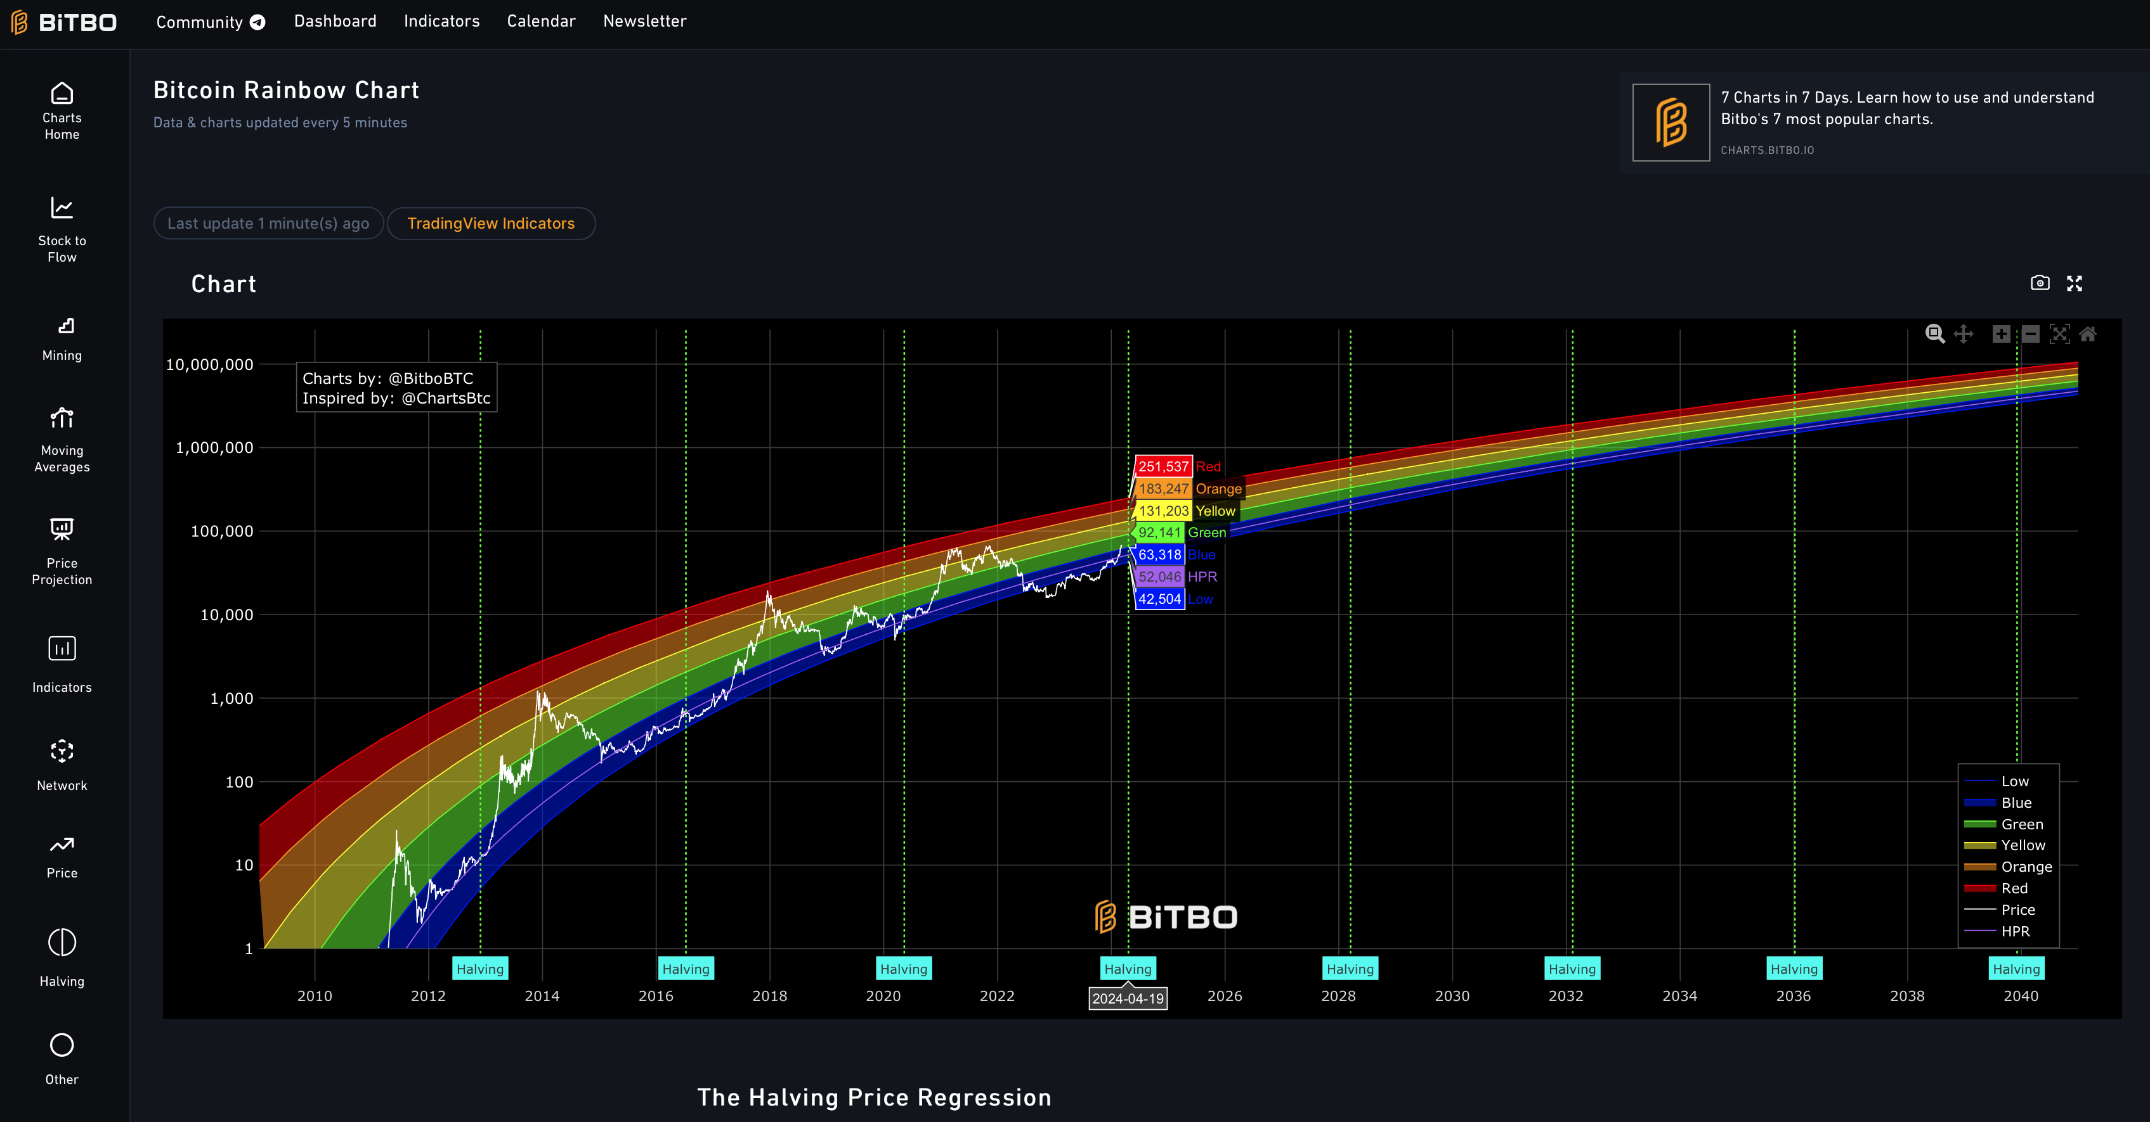
S2F Live Long Term Rainbow Chart https://buybitcoinworldwide.com/stats/stock-to-flow/
3/8/2024

Slide 77
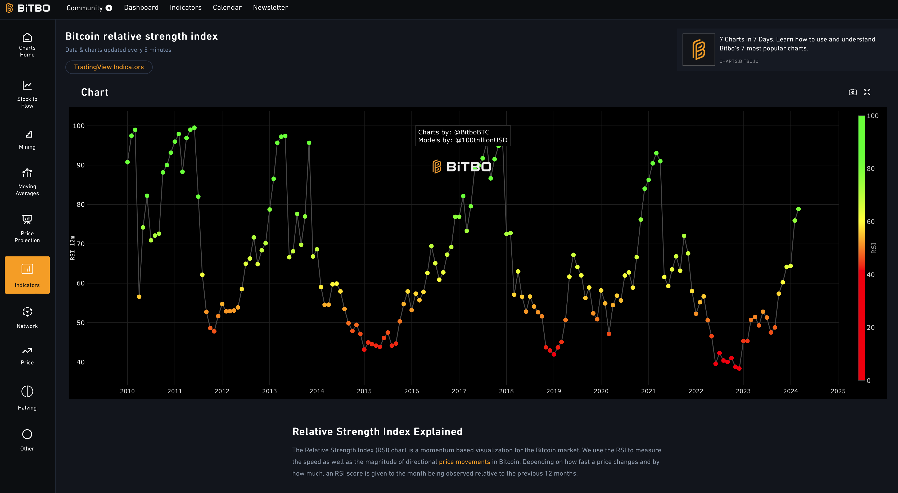
S2F Live Relative Strength Index https://buybitcoinworldwide.com/stats/monthly-rsi/
3/8/2024

Slide 78
Bitcoin is Highly Volatile, But…
Prediction. Maybe(?):
2027: “Bitcoin crashes to $300,000”

Slide 79
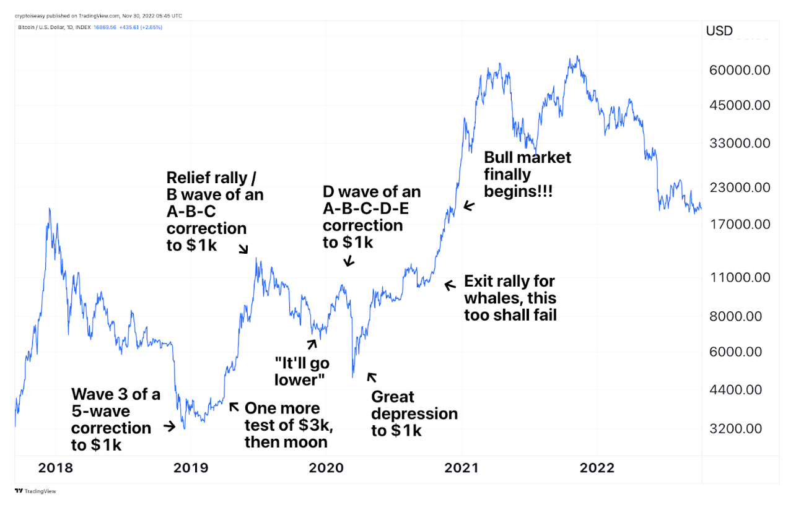
https://medium.com/coinmonks/the-truth-about-this-crypto-bear-market-that-everybody-seems-to-deny-1a7f636e8a13
The history of bitcoin pricing is highly volatile, which creates opportunity according to Tom Lee of Fundstrat

Slide 80
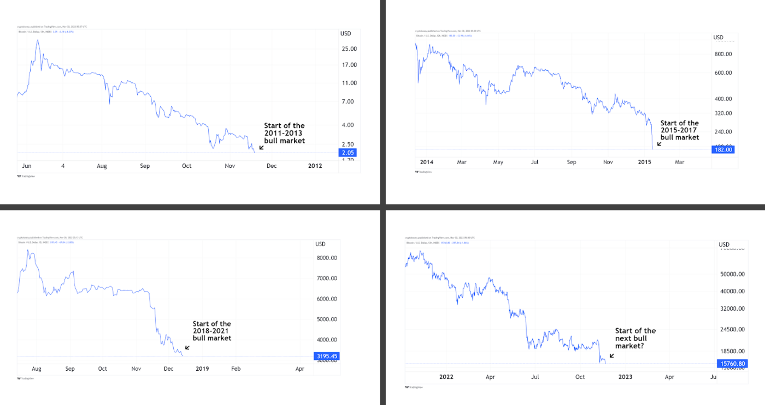
https://medium.com/coinmonks/the-truth-about-this-crypto-bear-market-that-everybody-seems-to-deny-1a7f636e8a13
Past and current bitcoin pricing patterns

Slide 81
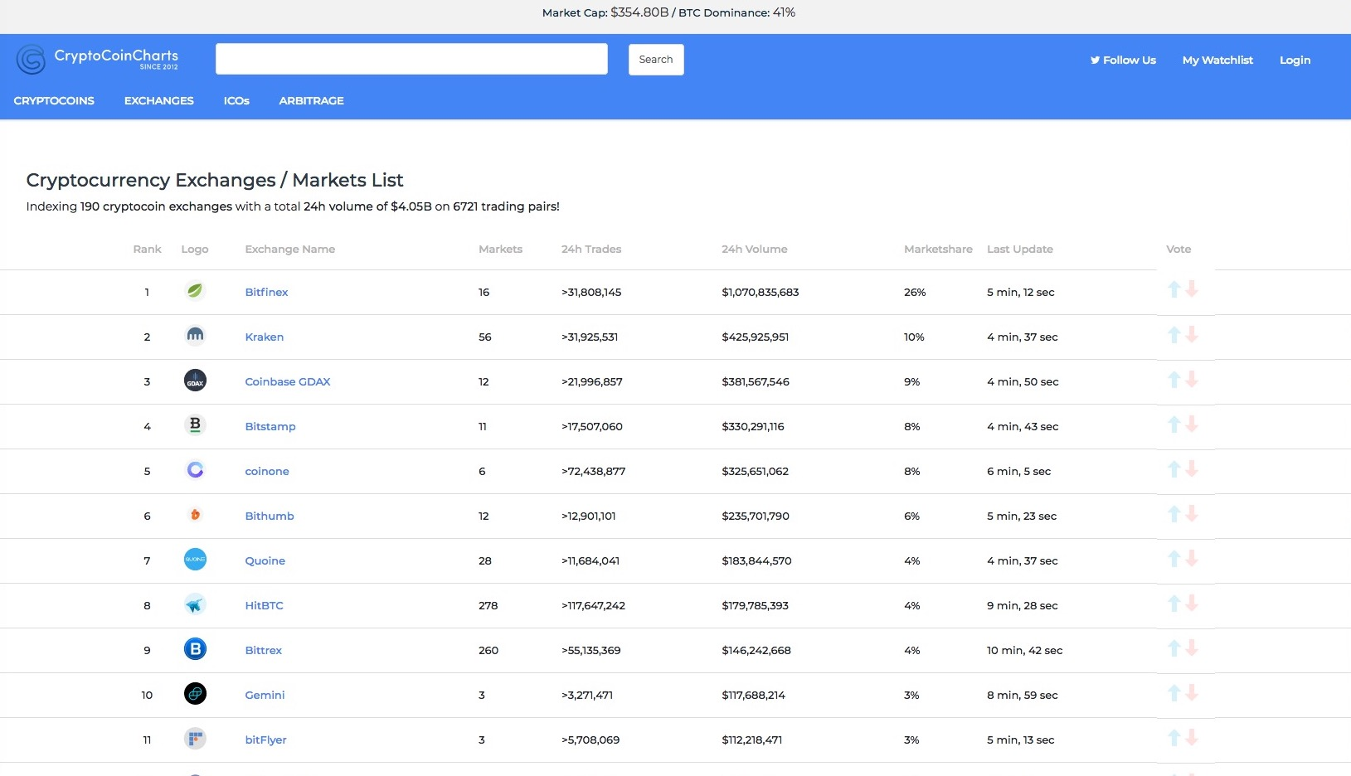
Crypto Currency Exchanges https://cryptocoincharts.info/markets/info
Went public in a direct listing

Slide 82
Curious Facts: First Bitcoin Transaction http://www.coindesk.com/bitcoin-pizza-day-celebrating-pizza-bought-10000-btc/
Start Here 3/8/2021

Slide 83
And The Adoption Wave Still Grows…

Slide 84
Blockchain and Crypto Adoption Wave https://chaindebrief.com/cryptocurrency-adoption-curve-is-the-fastest-in-human-history/
Mass adoption of the internet began in 1994 when governments around the world expanded its usage to individuals and private entities.
What followed in the late 1990s is the internet boom, giving birth to some of the most valuable internet companies in the world today, such as Amazon, Apple, Google, Facebook and more.
Blockchain technology and cryptocurrency are seeing a faster growth trajectory than the growth of Internet in the late 1990s.
As far as adoption is concerned, Bitcoin had approximately the same number of users as the Internet in 1997.
What is different however, is that Bitcoin’s adoption rate is much higher as compared to the Internet.
It is projected that in the next four years, Bitcoin will have around 1 billion users.

Slide 85
Bitcoin https://en.wikipedia.org/wiki/Bitcoin
Bitcoin is a cryptocurrency and a payment system invented by an unidentified programmer, or group of programmers, under the name of Satoshi Nakamoto.
Bitcoin was introduced on 31 October 2008 to a cryptography mailing list, and released as open-source software in 2009.
There have been various claims and speculation concerning the identity of Nakamoto, none of which are confirmed.
The system is peer-to-peer and transactions take place between users directly, without an intermediary.
These transactions are verified by network nodes and recorded in a public distributed ledger called the blockchain, which uses bitcoin as its unit of account.
Since the system works without a central repository or single administrator, the U.S. Treasury categorizes bitcoin as a decentralized virtual currency.

Slide 86
Bitcoin https://en.wikipedia.org/wiki/Bitcoin
Bitcoin is often called the first cryptocurrency, although prior systems existed, and it is more correctly described as the first decentralized digital currency.
Bitcoin is the largest of its kind in terms of total market value.
Bitcoins are created as a reward in a competition in which users offer their computing power to verify and record bitcoin transactions into the blockchain.
This activity is referred to as mining and successful miners are rewarded with transaction fees and newly created bitcoins.
Besides being obtained by mining, bitcoins can be exchanged for other currencies, products, and services.
When sending bitcoins, users can pay an optional transaction fee to the miners.
This may expedite the transaction being confirmed.

Slide 87
Bitcoin https://en.wikipedia.org/wiki/Bitcoin
In February 2015, the number of merchants accepting bitcoin for products and services passed 100,000.
Instead of 2–3% typically imposed by credit card processors, merchants accepting bitcoins often pay fees in the range from 0% to less than 2%.
Despite the fourfold increase in the number of merchants accepting bitcoin in 2014, the cryptocurrency did not have much momentum in retail transactions.
The European Banking Authority and other sources have warned that bitcoin users are not protected by refund rights or chargebacks.
The use of bitcoin by criminals has attracted the attention of financial regulators, legislative bodies, law enforcement, and media.
Criminal activities are primarily focused on darknet markets and theft, though officials in countries such as the United States also recognize that bitcoin can provide legitimate financial services.

Slide 88
Pre-History
Prior to the release of bitcoin, there were a number of digital cash technologies starting with the issuer based ecash protocols of David Chaum and Stefan Brands.
The idea that solutions to computational puzzles could have some value was first proposed by cryptographers Cynthia Dwork and Moni Naor in 1992.
The idea was independently rediscovered by Adam Back who developed hashcash, a proof-of-work scheme for spam control in 1997.
The first proposals for distributed digital scarcity based cryptocurrencies were Wei Dai's b-money and Nick Szabo's bit gold.
Hal Finney developed reusable proof of work (RPOW) using hashcash as its proof of work algorithm.
In the bit gold proposal which proposed a collectible market-based mechanism for inflation control, Nick Szabo also investigated some additional aspects including a Byzantine fault-tolerant agreement protocol based on quorum addresses to store and transfer the chained proof-of-work solutions, which was vulnerable to Sybil attacks, though.

Slide 89
Creation
On 18 August 2008, the domain name bitcoin.org was registered.
Later that year, on 31 October, a link to a paper authored by “Satoshi Nakamoto” titled Bitcoin: A Peer-to-Peer Electronic Cash System was posted to a cryptography mailing list.
This paper detailed methods of using a peer-to-peer network to generate what was described as "a system for electronic transactions without relying on trust".
On 3 January 2009, the bitcoin network came into existence with Satoshi Nakamoto mining the genesis block of bitcoin (block number 0), which had a reward of 50 bitcoins.
Embedded in the coinbase of this block was the text:
The Times Jan/03/2009 Chancellor on brink of second bailout for banks.
The text refers to a headline in The Times published on 3 January 2009.
This note has been interpreted as both a timestamp of the genesis date and a derisive comment on the instability caused by fractional-reserve banking.

Slide 90
History https://en.wikipedia.org/wiki/Bitcoin
Bitcoin was implemented as open-source code and released in January 2009.
Bitcoin is often called the first cryptocurrency although prior systems existed.
Bitcoin is more correctly described as the first decentralized digital currency.
One of the first supporters, adopters, contributor to bitcoin and receiver of the first bitcoin transaction was programmer Hal Finney.
Finney downloaded the bitcoin software the day it was released and received 10 bitcoins from Nakamoto in the world's first bitcoin transaction.

Slide 91
Satoshi Nakamoto
"Satoshi Nakamoto" is presumed to be a pseudonym for the person or people who designed the original bitcoin protocol in 2008 and launched the network in 2009.
Nakamoto was responsible for creating the majority of the official bitcoin software and was active in making modifications and posting technical information on the bitcoin forum.
There has been much speculation as to the identity of Satoshi Nakamoto with suspects including Dai, Szabo, and Finney – and accompanying denials.
The possibility that Satoshi Nakamoto was a computer collective in the European financial sector has also been discussed.

Slide 92
History https://en.wikipedia.org/wiki/Bitcoin
Other early supporters were Wei Dai, creator of bitcoin predecessor b-money, and Nick Szabo, creator of bitcoin predecessor bit gold.
In the early days, Nakamoto is estimated to have mined 1 million bitcoins
Before disappearing from any involvement in bitcoin, Nakamoto in a sense handed over the reins to developer Gavin Andresen, who then became the bitcoin lead developer at the Bitcoin Foundation, the 'anarchic' bitcoin community's closest thing to an official public face.
Other cryptocurrencies started to emerge in 2011.
In March 2013, a technical glitch caused a fork in the blockchain, with one half of the network adding blocks to one version of the chain and the other half adding to another.
For six hours two bitcoin networks operated at the same time, each with its own version of the transaction history.
The core developers called for a temporary halt to transactions, sparking a sharp sell-off.
Normal operation was restored when the majority of the network downgraded to version 0.7 of the bitcoin software.

Slide 93
History https://en.wikipedia.org/wiki/Bitcoin
In 2013 some mainstream websites began accepting bitcoins.
WordPress had started in November 2012, followed by OKCupid in April 2013, TigerDirect and Overstock.com in January 2014, Expedia in June 2014, Newegg and Dell in July 2014, and Microsoft in December 2014.
The Electronic Frontier Foundation, a non-profit group, started accepting bitcoins in January 2011, stopped accepting them in June 2011, and began again in May 2013.
In May 2013, the Department of Homeland Security seized assets belonging to the Mt. Gox exchange.
The U.S. Federal Bureau of Investigation (FBI) shut down the Silk Road website in October 2013.

Slide 94
History https://en.wikipedia.org/wiki/Bitcoin
In October 2013, Chinese internet giant Baidu had allowed clients of website security services to pay with bitcoins.
During November 2013, the China-based bitcoin exchange BTC China overtook the Japan-based Mt. Gox and the Europe-based BitStamp to become the largest bitcoin trading exchange by trade volume.
On 19 November 2013, the value of a bitcoin on the Mt. Gox exchange soared to a peak of US$900 after a United States Senate committee hearing was told by the FBI that virtual currencies are a legitimate financial service.
On the same day, one bitcoin traded for over RMB¥6780 (US$1,100) in China.
On 5 December 2013, the People's Bank of China prohibited Chinese financial institutions from using bitcoins.
Buying real-world goods with any virtual currency has been illegal in China since at least 2009.

Slide 95
History https://en.wikipedia.org/wiki/Bitcoin
The first bitcoin ATM was installed in October 2013 in Vancouver, British Columbia, Canada.
With about 12 million existing bitcoins in November 2013, the new price increased the market cap for bitcoin to at least US$7.2 billion.
By 23 November 2013, the total market capitalization of bitcoin exceeded US$10 billion for the first time.
In early February 2014, one of the largest bitcoin exchanges, Mt. Gox, suspended withdrawals citing technical issues.
By the end of the month, Mt. Gox had filed for bankruptcy protection in Japan amid reports that 744,000 bitcoins had been stolen.
Months before the filing, the popularity of Mt. Gox had waned as users experienced difficulties withdrawing funds.

Slide 96
History https://en.wikipedia.org/wiki/Bitcoin
Less than one year after the collapse of Mt. Gox, United Kingdom-based exchange Bitstamp announced that their exchange would be taken offline while they investigate a hack which resulted in about 19,000 bitcoins (equivalent to roughly US$5 million at that time) being stolen from their hot wallet.
The exchange remained offline for several days amid speculation that customers had lost their funds.
Bitstamp resumed trading on 9 January after increasing security measures and assuring customers that their account balances would not be impacted.
In August 2015 Barclays announced that they would become the first UK high street bank to start accepting bitcoin, with a plan to facilitate users to make charitable donations using the cryptocurrency outside their systems.
They partnered in April 2016 with mobile payment startup Circle Internet Financial.

Slide 97
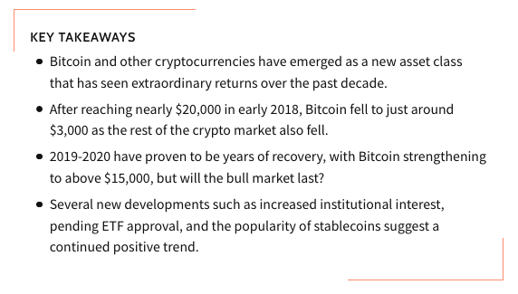
Fast Forward to 2021…
https://www.investopedia.com/where-are-cryptocurrencies-headed-2019-4580342

Slide 98
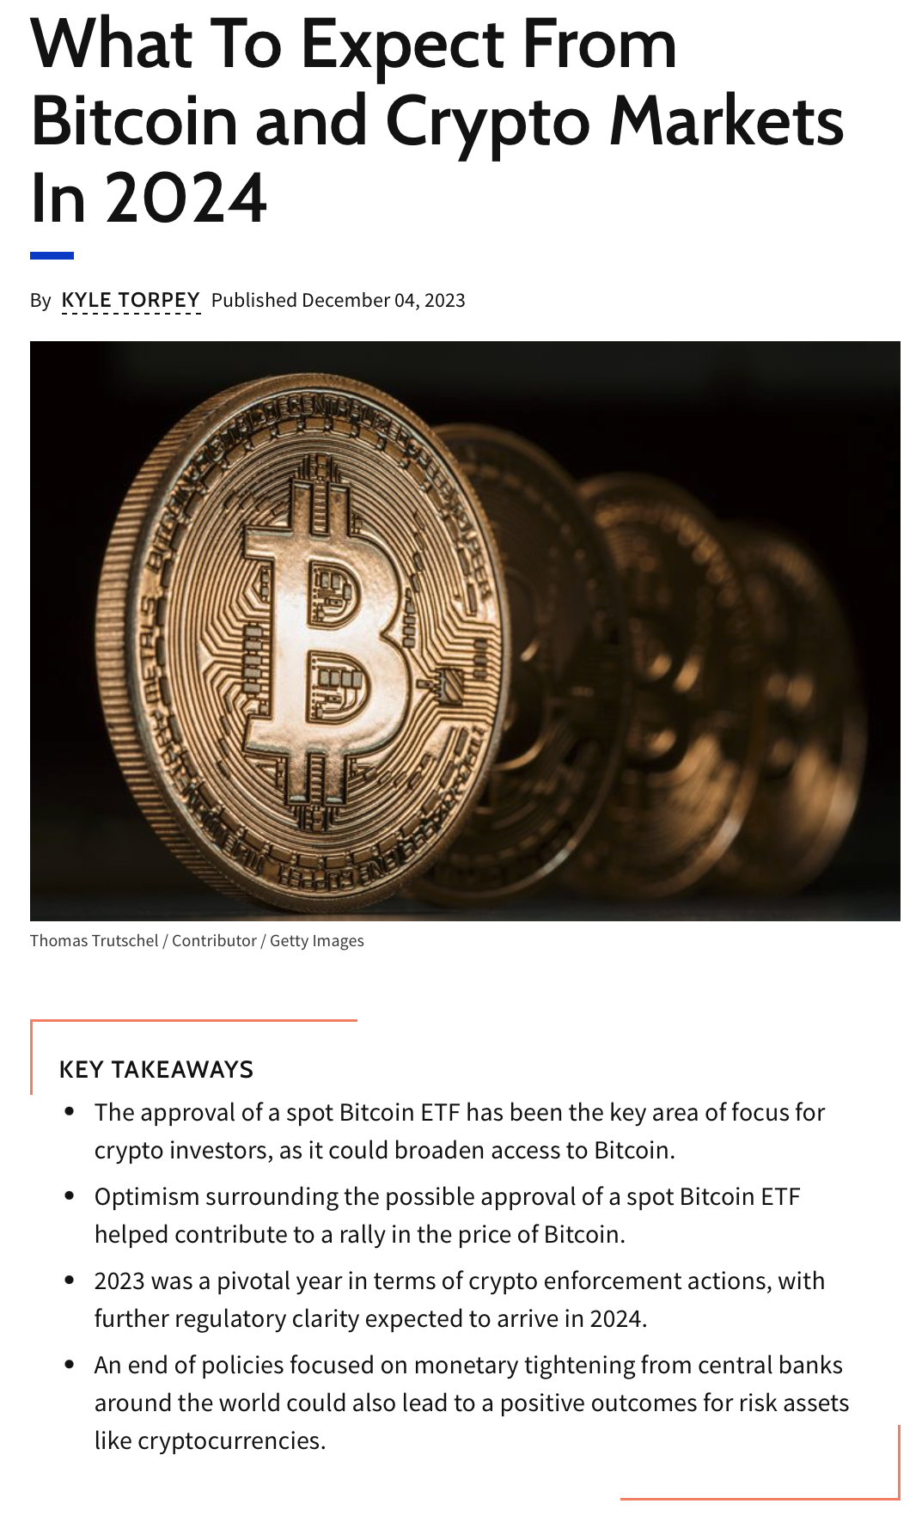
And Onward to 2024…
https://www.investopedia.com/what-to-expect-from-bitcoin-and-crypto-markets-in-2024-8404514

Slide 99
And Now (3/8/2024), Spot Bitcoin ETFs

Slide 100
The Network Effect (Metcalfe’s Law) https://en.wikipedia.org/wiki/Metcalfe%27s_law
Metcalfe's law states that the value of a telecommunications network is proportional to the square of the number of connected users of the system (n²).
First formulated in this form by George Gilder in 1993, and attributed to Robert Metcalfe in regard to Ethernet, Metcalfe's law was originally presented, c. 1980, not in terms of users, but rather of "compatible communicating devices" (e.g., fax machines, telephones).
Only later with the globalization of the Internet did this law carry over to users and networks as its original intent was to describe Ethernet connections.

Slide 101
Network Effects https://en.wikipedia.org/wiki/Metcalfe%27s_law
Metcalfe's law characterizes many of the network effects of communication technologies and networks such as the Internet, social networking and the World Wide Web.
Former Chairman of the U.S. Federal Communications Commission Reed Hundt said that this law gives the most understanding to the workings of the Internet.
Metcalfe's Law is related to the fact that the number of unique possible connections in a network of n nodes can be expressed mathematically as the triangular number n(n-1)/2, which is asymptotically proportional to n²

Slide 102
Bitcoin and the Network Effect https://river.com/learn/bitcoins-network-effect/
Network effects have huge implications on Bitcoin’s utility as a currency and as a store of value.
Like all major currencies, Bitcoin’s value depends on somebody else being willing to accept it as payment or buy it as an investment.
As more people accept Bitcoin, it becomes more valuable to somebody looking to spend Bitcoin.
However, every other currency is also affected by network effects.
This powerful phenomenon favors whichever product has the largest user base, regardless of the underlying utility of the product.

Slide 103
Bitcoin and the Network Effect https://river.com/learn/bitcoins-network-effect/
This means that currencies that are well-established with large user bases have strong lock-in effects, incentivizing people to continue using them.
Bitcoin is intended to disrupt fiat currencies with several million users.
More directly, many people expect Bitcoin to largely replace gold, a global store of value and one of the oldest currencies still in use.
To compete with established currencies, Bitcoin must overcome the lock-in effect that they currently benefit from.
This is why Bitcoin adoption has taken a long time, despite having much better characteristics of money than its existing competitors.
Ended here 3/13/2024

Slide 104
Bitcoin Units https://en.wikipedia.org/wiki/Bitcoin
As of 2014, symbols used to represent bitcoin are BTC, XBT, and .
Small amounts of bitcoin used as alternative units are millibitcoin (mBTC), microbitcoin (µBTC, sometimes referred to as bit), and satoshi.
Named in homage to bitcoin's creator, a satoshi is the smallest amount within bitcoin representing 0.00 000 001 bitcoin, one hundred millionth of a bitcoin.
A millibitcoin equals to 0.001 bitcoin, one thousandth of a bitcoin.
One microbitcoin equals to 0.000001 bitcoin, one millionth of a bitcoin.
A proposal was submitted to the Unicode Consortium in October 2015 to add a codepoint for the symbol.

Slide 105
Bitcoin Transactions https://en.wikipedia.org/wiki/Bitcoin
A valid transaction must have one or more inputs.
Every input must be an unspent output of a previous transaction.
The transaction must carry the digital signature of every input owner.
The use of multiple inputs corresponds to the use of multiple coins in a cash transaction.
A transaction can also have multiple outputs, allowing one to make multiple payments in one transaction.
As in a cash transaction, the sum of inputs (coins used to pay) can exceed the intended sum of payments.
In such a case, an additional output is used, returning the change back to the payer.
Any input satoshis not accounted for in the transaction outputs become the transaction fee.

Slide 106
Bitcoin Fees https://en.wikipedia.org/wiki/Bitcoin
Paying a transaction fee is optional.
Miners can choose which transactions to process and prioritize those that pay higher fees.
Fees are based on the storage size of the transaction generated, which in turn is dependent on the number of inputs used to create the transaction.
Furthermore, priority is given to older unspent inputs.

Slide 107
Bitcoin Hash https://en.wikipedia.org/wiki/Bitcoin
A Central Factor in Bitcoin is the Hash Function
A hash function is any function that can be used to map data of arbitrary size to data of fixed size.
The values returned by a hash function are called hash values, hash codes, digests, or simply hashes.
One use is a data structure called a hash table, widely used in computer software for rapid data lookup.
Hash functions accelerate table or database lookup by detecting duplicated records in a large file.
They are also useful in cryptography.

Slide 108
Cryptographic Hash https://en.wikipedia.org/wiki/Cryptographic_hash_function
Cryptographic hash functions have many information-security applications, notably in digital signatures, message authentication codes (MACs), and other forms of authentication.
They can also be used as ordinary hash functions, to index data in hash tables, for fingerprinting, to detect duplicate data or uniquely identify files, and as checksums to detect accidental data corruption.
In information-security contexts, cryptographic hash values are sometimes called (digital) fingerprints, checksums, or just hash values, even though all these terms stand for more general functions with rather different properties and purposes.

Slide 109
Cryptographic Hash https://en.wikipedia.org/wiki/Cryptographic_hash_function
The ideal cryptographic hash function has five main properties:
It is deterministic so the same message always results in the same hash
It is quick to compute the hash value for any given message
It is infeasible to generate a message from its hash value except by trying all possible messages
A small change to a message should change the hash value so extensively that the new hash value appears uncorrelated with the old hash value
It is infeasible to find two different messages with the same hash value

Slide 110
Cryptographic Hash (“One-way Hash”) https://en.wikipedia.org/wiki/Cryptographic_hash_function
Most cryptographic hash functions are designed to take a string of any length as input and produce a fixed-length hash value.
In theoretical cryptography, the security level of a cryptographic hash function has been defined using the following properties:
Pre-image resistance Given a hash value h it should be difficult to invert the hash and find any message m such that h = hash(m). This concept is related to that of one-way function. Functions that lack this property are vulnerable to preimage attacks.
Second pre-image resistance Given an input m₁ it should be difficult to find different input m₂ such that hash(m₁) = hash(m₂). Functions that lack this property are vulnerable to second pre-image attacks.
Collision resistance It should be difficult to find two different messages m₁ and m₂ such that hash(m₁) = hash(m₂). Such a pair is called a cryptographic hash collision. This property is sometimes referred to as strong collision resistance

Slide 111
Crypographic Hash https://en.wikipedia.org/wiki/Bitcoin
As stated, cryptographic hash function is a special class of hash function that has certain properties which make it suitable for use in cryptography.
It is a mathematical algorithm that maps data of arbitrary size to a bit string of a fixed size (a hash function) which is designed to also be a one-way function, that is, a function which is infeasible to invert.
The only way to recreate the input data from an ideal cryptographic hash function's output is to attempt a brute-force search of possible inputs to see if they produce a match, or use a "rainbow table" of matched hashes.
Bruce Schneier has called one-way hash functions "the workhorses of modern cryptography”.
The input data is often called the message, and the output (the hash value or hash) is often called the message digest or simply the digest.
Block transaction data string
Note: Bitcoin uses the SHA-256 hash algorithm

Slide 112
Note: A Hash is a Hexidecimal Number https://en.wikipedia.org/wiki/Hexadecimal
In almost all modern use, the letters A–F or a–f represent the values 10–15, while the numerals 0–9 are used to represent their usual values.
There is no universal convention to use lowercase or uppercase, so each is prevalent or preferred in particular environments by community standards or convention
Even mixed case is often used. Seven-segment displays use mixed-case AbCdEF to make digits that can be distinguished from each other.
There is some standardization of using spaces (rather than commas or another punctuation mark) to separate hex values in a long list.
For instance, in the following hexdump each 8-bit byte is a 2-digit hex number, with spaces between them
57 is Letter W is 57 in hexidecimal
2c is Comma symbol in hexidecimal

Slide 113
Bitcoin Hash https://en.wikipedia.org/wiki/Bitcoin
How much information can a SHA-256 Hash store?
There is technically a limit, but it's quite large.
The padding scheme used for SHA-256 requires that the size of the input (in bits) be expressed as a 64-bit number.
Therefore, the maximum size is (2⁶⁴-1)/8 bytes
$≈$ 2,091,752 terabytes

Slide 114
Hash Tables: Used to Locate Records https://en.wikipedia.org/wiki/Bitcoin
Hash functions are used in hash tables, to quickly locate a data record (e.g., a dictionary definition) given its search key (the headword).
Specifically, the hash function is used to map the search key to an index; the index gives the place in the hash table where the corresponding record should be stored.
Typically, the domain of a hash function (the set of possible keys) is larger than its range (the number of different table indices), and so it will map several different keys to the same index.
Therefore, each slot of a hash table is associated with (implicitly or explicitly) a set of records, rather than a single record.
For this reason, each slot of a hash table is often called a bucket, and hash values are also called bucket indices.
Thus, the hash function only hints at the record's location — it tells where one should start looking for it. Still, in a half-full table, a good hash function will typically narrow the search down to only one or two entries.

Slide 115
Uses of the Hash - Example https://en.wikipedia.org/wiki/Cryptographic_hash_function
An illustration of the potential use of a cryptographic hash is as follows:
Alice poses a tough math problem to Bob and claims she has solved it.
Bob would like to try it himself but would yet like to be sure that Alice is not bluffing.
Therefore, Alice writes down her solution, computes its hash and tells Bob the hash value (while keeping the solution secret).
Then, when Bob comes up with the solution himself a few days later, Alice can prove that she had the solution earlier by revealing it and having Bob hash it and check that it matches the hash value given to him before.
(This is an example of a simple commitment scheme, in actual practice, Alice and Bob will often be computer programs, and the secret would be something less easily spoofed than a claimed puzzle solution).

Slide 116
Uses of the Hash in Bitcoin http://www.coindesk.com/information/how-bitcoin-mining-works/
For the blockchain, when a block of transactions is created, miners put it through the hashing process.
They take the information in the block, and apply a mathematical formula to it, turning it into a hash
This hash is stored along with the block, at the end of the blockchain at that point in time.
It’s easy to produce a hash from a collection of data like a bitcoin block, but it’s practically impossible to work out what the data was just by looking at the hash.
And while it is very easy to produce a hash from a large amount of data, each hash is unique.

Slide 117
Purpose of the Hash http://www.coindesk.com/information/how-bitcoin-mining-works/
As we have said, if you change just one character in a bitcoin block, its hash will change completely.
Miners don’t just use the transactions in a block to generate a hash. Some other pieces of data are used too, one of these pieces of data is the hash of the last block stored in the blockchain.
Because each block’s hash is produced using the hash of the block before it, it becomes a digital version of a wax seal.
It confirms that this block – and every block after it – is legitimate, because if you tampered with it, everyone would know.
If you tried to fake a transaction by changing a block that had already been stored in the blockchain, that block’s hash would change.

Slide 118
Purpose of the Hash: False Blocks http://www.coindesk.com/information/how-bitcoin-mining-works/
If someone checked the false block’s authenticity by running the hashing function on it, they would find that the hash was different from the one already stored along with that block in the blockchain.
The block would be instantly spotted as a fake.
Because each block’s hash is used to help produce the hash of the next block in the chain, tampering with a block would also make the subsequent block’s hash wrong too.
That would continue all the way down the chain, throwing everything out of whack.

Slide 119
Simple Explanation of Hash https://99bitcoins.com/what-is-bitcoin-hash/

Slide 120
Bitcoin Hash Rate https://www.blockchain.com/explorer/charts/hash-rate

Slide 121
Bitcoin Mining https://en.wikipedia.org/wiki/Bitcoin
Mining is a record-keeping service.
Miners keep the blockchain consistent, complete, and unalterable by repeatedly verifying and collecting newly broadcast transactions into a new group of transactions called a block.
Each block contains a cryptographic hash of the previous block, using the SHA-256 hashing algorithm
This links it to the previous block, thus giving the blockchain its name.

Slide 122
Bitcoin Mining https://en.wikipedia.org/wiki/Bitcoin
In order to be accepted by the rest of the network, a new block must contain a so-called proof-of-work.
The proof-of-work requires miners to find a random number called a nonce, such that when the block content is hashed along with the nonce, the result is numerically smaller number than the network's difficulty target.
This proof is easy for any node in the network to verify, but extremely time-consuming to generate, as for a secure cryptographic hash, miners must try many different nonce values (usually the sequence of tested values is 0, 1, 2, 3, …) before meeting the difficulty target.

Slide 123
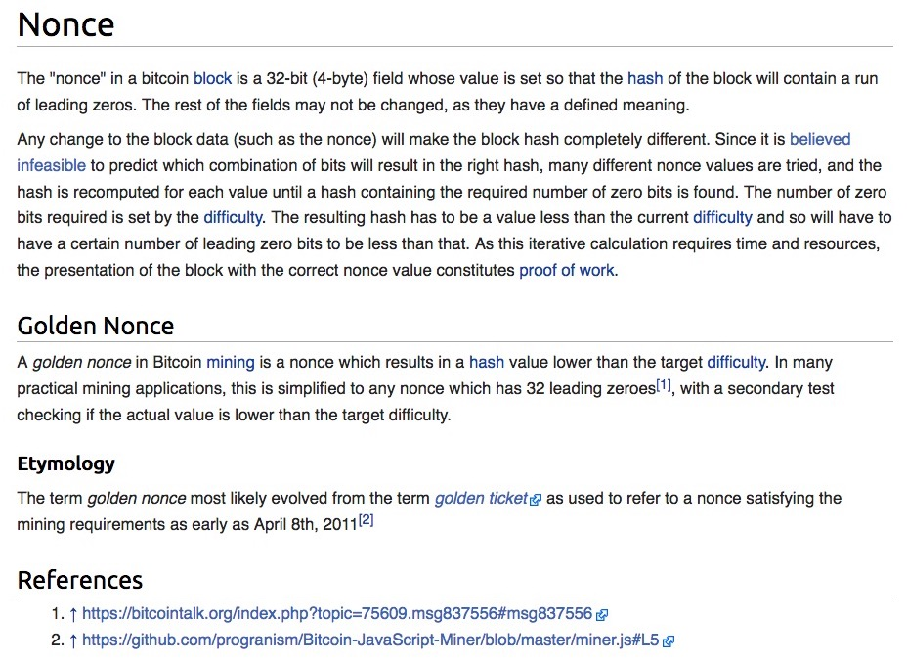
Meaning of a “Nonce” https://en.bitcoin.it/wiki/Nonce
i.e, Miners have to find the string of random integers that will lead to the required number of leading zeros in the hash by using random trials

Slide 124
Example of a Hashed Block https://blockexplorer.com/block/00000000000000001e8d6829a8a21adc5d38d0a473b144b6765798e61f98bd1d
This is the required number of 0’s

Slide 125
Bitcoin Blockchain https://en.wikipedia.org/wiki/Bitcoin
The blockchain is a public ledger that records bitcoin transactions.
A novel solution accomplishes this without any trusted central authority: maintenance of the blockchain is performed by a network of communicating nodes running bitcoin software.
Transactions of the form payer X sends Y bitcoins to payee Z are broadcast to this network using readily available software applications.
Network nodes can validate transactions, add them to their copy of the ledger, and then broadcast these ledger additions to other nodes.

Slide 126
Bitcoin Blockchain https://en.wikipedia.org/wiki/Bitcoin
The blockchain is a distributed database – to achieve independent verification of the chain of ownership of any and every bitcoin (amount), each network node stores its own copy of the blockchain.
Approximately six times per hour, a new group of accepted transactions, a block, is created, added to the blockchain, and quickly published to all nodes.
This allows bitcoin software to determine when a particular bitcoin amount has been spent, which is necessary in order to prevent double-spending in an environment without central oversight.
Whereas a conventional ledger records the transfers of actual bills or promissory notes that exist apart from it, the blockchain is the only place that bitcoins can be said to exist in the form of unspent outputs of transactions.
(However, the lightning network upgrade (2020), a layer-2 improvement, allows millions of transactions per second, in theory)

Slide 127
Building the Blockchain https://99bitcoins.com/bitcoin-blocks-confirmations/

Slide 128
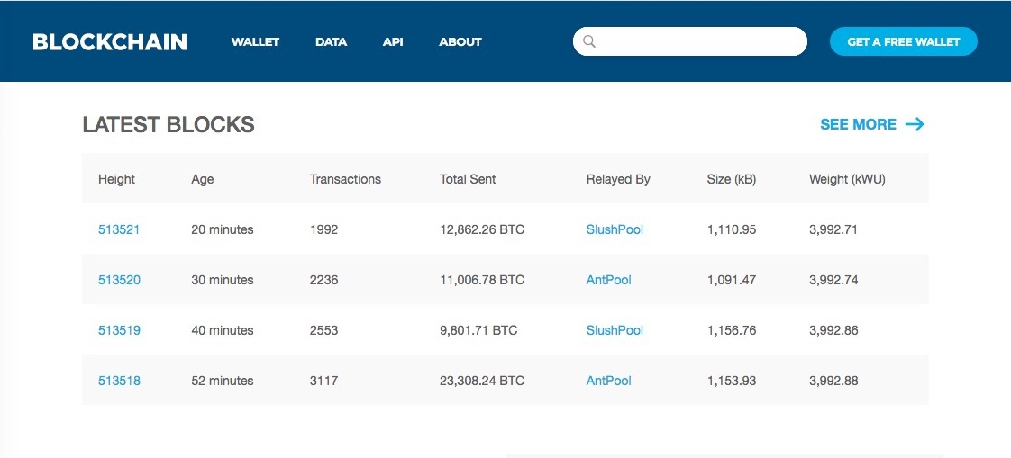
Blockchain https://www.blockchain.com/

Slide 129
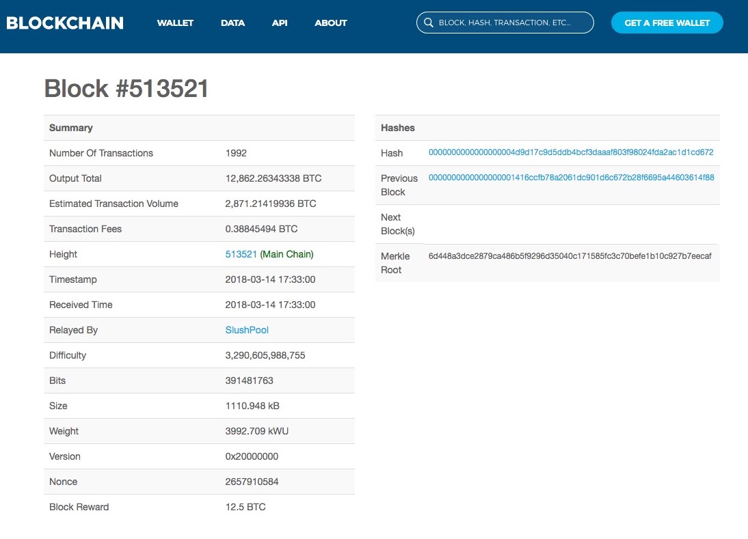

Slide 130
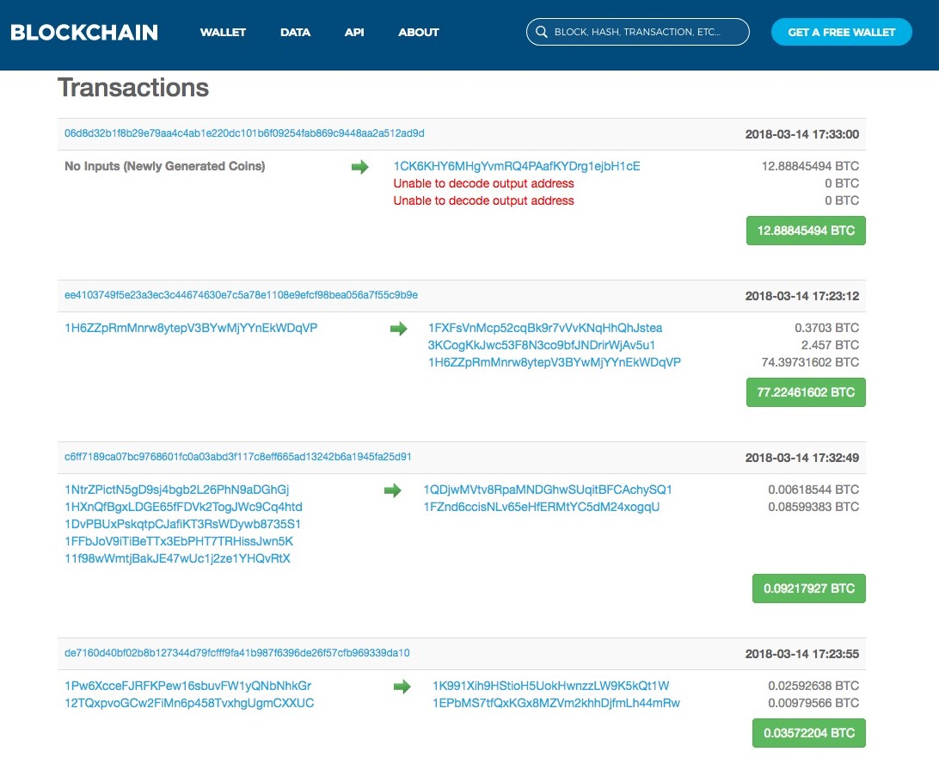
Block #513521 Transactions
…and many more

Slide 131
Blockchain https://blockexplorer.one/bitcoin/mainnet

Slide 132
Blockchain https://blockexplorer.one/bitcoin/mainnet

Slide 133
Blockchain https://blockexplorer.one/bitcoin/mainnet

Slide 134
Bitcoin Mining https://en.wikipedia.org/wiki/Bitcoin
Every 2016 blocks (approximately 14 days), the difficulty target is adjusted based on the network's recent performance, with the aim of keeping the average time between new blocks at ten minutes.
In this way the system automatically adapts to the total amount of mining power on the network.
Between 1 March 2014 and 1 March 2015, the average number of nonces miners had to try before creating a new block increased from 16.4 quintillion to 200.5 quintillion.
The proof-of-work system, alongside the chaining of blocks, makes modifications of the blockchain extremely hard, as an attacker must modify all subsequent blocks in order for the modifications of one block to be accepted.
As new blocks are mined all the time, the difficulty of modifying a block increases as time passes and the number of subsequent blocks (also called confirmations of the given block) increases.

Slide 135
Bitcoin Mining Practicalities https://en.wikipedia.org/wiki/Bitcoin
It has become common for miners to join mining pools which combine the computational resources of their members in order to increase the frequency of generating new blocks.
The reward for each block is then split proportionately among the members, creating a more predictable stream of income for each miner without necessarily changing their long-term average income, although a fee may be charged for the service.
The competitive nature of mining has led to ever-more-specialized technology being utilized (GPU’s and ASIC chips)
The most efficient mining hardware makes use of custom designed application-specific integrated circuits, which outperform general-purpose CPUs while using less power.
As of 2015, a miner who is not using purpose-built hardware is unlikely to earn enough to cover the cost of the electricity used in their efforts, even if they are a member of a pool.

Slide 136
Cryptojacking https://www.wired.com/story/cryptojacking-cryptocurrency-mining-browser/
There’s something new to add to your fun mental list of invisible internet dangers.
Joining classic favorites like adware and spyware comes a new, tricky threat called “cryptojacking,” which secretly uses your laptop or mobile device to mine cryptocurrency when you visit an infected site.
Cryptojacking has exploded in popularity over the past few weeks (as of 2018), because it offers a clever twist.
The latest technique uses Javascript to start working instantly when you load a compromised web page.
There's no immediate way to tell that the page has a hidden mining component, and you may not even notice any impact on performance

Slide 137
Bitcoin Energy Consumption https://en.wikipedia.org/wiki/Bitcoin
In 2013, Mark Gimein estimated electricity use to be about 40.9 megawatts (982 megawatt-hours a day).
In 2014, Hass McCook estimated 80.7 megawatts (80,666 kW).
As of 2015, The Economist estimated that even if all miners used modern facilities, the combined electricity consumption would be 166.7 megawatts (1.46 terawatt-hours per year).
Journalist Matt O'Brien opined that it is not obvious whether bitcoin is lowering transaction costs, since the costs are transformed into pollution costs, which he characterizes as "environmental spillovers on everyone else, or what economists call negative externalities.”
To lower the costs, bitcoin miners have set up in places like Iceland where geothermal energy is cheap and cooling Arctic air is free.
Chinese bitcoin miners are known to use hydroelectric power in Tibet to reduce electricity costs.

Slide 138
Energy Consumption Statistics https://bitcoinmagazine.com/business/bitcoin-energy-use-compare-industry
Putting BTC Mining in Perspective
Bitcoin Mining

Slide 139
Energy Consumption Statistics https://bitcoinminingcouncil.com/wp-content/uploads/2022/07/2022.07.19-BMC-Presentation-Q2-22-Presentation.pdf Also: https://docsend.com/view/adwmdeeyfvqwecj2
Putting BTC Mining in Perspective
Bitcoin Mining

Slide 140
Vast swaths of the United States are at risk of running short of power as electricity-hungry data centers and clean-technology factories proliferate around the country, leaving utilities and regulators grasping for credible plans to expand the nation’s creaking power grid.

Slide 141
Bitcoin Supply https://en.wikipedia.org/wiki/Bitcoin
The successful miner finding the new block is rewarded with newly created bitcoins and transaction fees.
As of 9 July 2016, the reward amounted to 12.5 newly created bitcoins per block added to the blockchain, and in May 11, 2020 the reward dropped to 6.25 coins
To claim the reward, a special transaction called a coinbase is included with the processed payments.
All bitcoins in existence have been created in such coinbase transactions.
The bitcoin protocol specifies that the reward for adding a block will be halved every 210,000 blocks (approximately every four years).
Eventually, the reward will decrease to zero, and the limit of 21 million bitcoins will be reached ca. 2140
The record keeping will then be rewarded by transaction fees solely.
In other words, bitcoin's inventor Nakamoto set a monetary policy based on artificial scarcity at bitcoin's inception that there would only ever be 21 million bitcoins in total.
Their numbers are being released roughly every ten minutes and the rate at which they are generated would drop by half every four years until all were in circulation.
As of 3/2023 there are a little over 19 million bitcoins have been mined

Slide 142
Wallets https://en.wikipedia.org/wiki/Bitcoin
A wallet stores the information necessary to transact bitcoins.
While wallets are often described as a place to hold or store bitcoins,due to the nature of the system, bitcoins are inseparable from the blockchain transaction ledger.
A better way to describe a wallet is something that "stores the digital credentials for your bitcoin holdings” and allows you to access (and spend) them.
Bitcoin uses public-key cryptography, in which two cryptographic keys, one public and one private, are generated.
At its most basic, a wallet is a collection of these keys.

Slide 143
Wallets https://en.wikipedia.org/wiki/Bitcoin
There are several types of wallets.
Software wallets connect to the network and allow spending bitcoins in addition to holding the credentials that prove ownership.
Software wallets can be split further in two categories: full clients and lightweight clients:
Full clients verify transactions directly on a local copy of the blockchain (over 80 GB as of November 2016, or a subset of the blockchain (around 2 GB).
Lightweight clients on the other hand consult a full client to send and receive transactions without requiring a local copy of the entire blockchain (see simplified payment verification – SPV).
Because of its size / complexity, the entire blockchain is not suitable for all computing devices.

Slide 144
Wallets https://en.wikipedia.org/wiki/Bitcoin
Lightweight clients are much faster to set up and can be used on low-power, low-bandwidth devices such as smartphones.
When using a lightweight wallet however, the user must trust the server to a certain degree.
When using a lightweight client, the server can not steal bitcoins, but it can report faulty values back to the user.
With both types of software wallets, the users are responsible for keeping their private keys in a secure place.

Slide 145
Wallets https://en.wikipedia.org/wiki/Bitcoin
Besides software wallets, Internet services called online wallets offer similar functionality but may be easier to use.
In this case, credentials to access funds are stored with the online wallet provider rather than on the user's hardware.
As a result, the user must have complete trust in the wallet provider.
A malicious provider or a breach in server security may cause entrusted bitcoins to be stolen.
An example of such security breach occurred with Mt. Gox in 2011.
Physical wallets store the credentials necessary to spend bitcoins offline.
Examples combine a novelty coin with these credentials printed on metal

Slide 146
Ownership https://en.wikipedia.org/wiki/Bitcoin
Ownership of bitcoins implies that a user can spend bitcoins associated with a specific address.
To do so, a payer must digitally sign the transaction using the corresponding private key.
Without knowledge of the private key, the transaction cannot be signed, and bitcoins cannot be spent.
The network verifies the signature using the public key.
If the private key is lost, the bitcoin network will not recognize any other evidence of ownership
The coins are then unusable, and thus effectively lost.
For example, in 2013 one user claimed to have lost 7,500 bitcoins, worth $7.5 million at the time, when he accidentally discarded a hard drive containing his private key.

Slide 147
Governance https://en.wikipedia.org/wiki/Bitcoin
Nakamoto stepped back in 2010 and handed governance of the bitcoin network alert key to Gavin Andresen.
Andresen stated he subsequently sought to decentralize control stating:
"As soon as Satoshi stepped back and threw the project onto my shoulders, one of the first things I did was try to decentralize that. So, if I get hit by a bus, it would be clear that the project would go on.”
This left opportunity for controversy to develop over the future development path of bitcoin.
The reference implementation of the bitcoin protocol called Bitcoin Core obtained competing versions that propose to solve various governance and blocksize debates
The alternatives are called Bitcoin XT, Bitcoin Classic, and Bitcoin Unlimited.

Slide 148
Governance https://en.wikipedia.org/wiki/Bitcoin
Since bitcoin is pseudo-anonymous, funds are not tied to real-world entities but rather bitcoin addresses.
Owners of bitcoin addresses are not explicitly identified, but all transactions on the blockchain are public.
In addition, transactions can be linked to individuals and companies through "idioms of use" (e.g., transactions that spend coins from multiple inputs indicate that the inputs may have a common owner) and corroborating public transaction data with known information on owners of certain addresses.
Additionally, bitcoin exchanges, where bitcoins are traded for traditional currencies, may be required by law to collect personal information.
According to Dan Blystone, "Ultimately, bitcoin resembles cash as much as it does credit cards.”

Slide 149
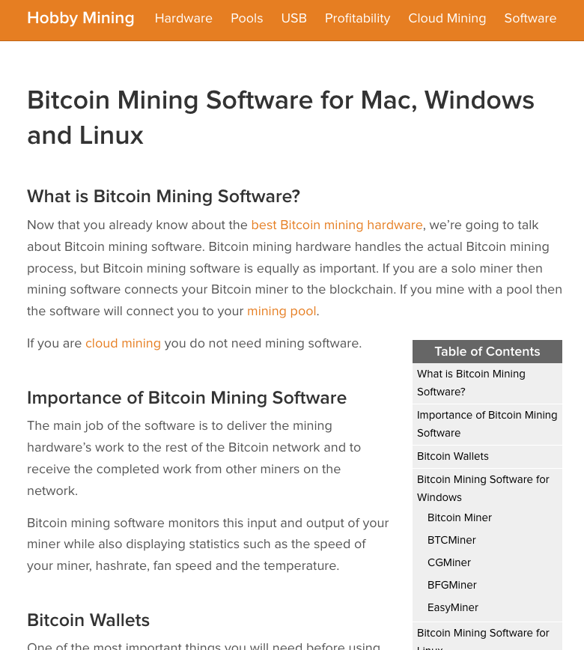
https://www.hobbymining.com/bitcoin-mining-software/

Slide 150
Applications of Blockchain https://www.nytimes.com/2017/03/04/business/dealbook/blockchain-ibm-bitcoin.html?hp&action=click&pgtype=Homepage&clickSource=story-heading&module=second-column-region&region=top-news&WT.nav=top-news

Slide 151
Recent Advances in Bitcoin Technology: Lightning Network
The Lightning Network (LN) is a "layer 2" payment protocol layered on top of a blockchain-based cryptocurrency such as bitcoin or litecoin.
It is intended to enable fast transactions among participating nodes and has been proposed as a solution to the bitcoin scalability problem.
It features a peer-to-peer system for making micropayments of cryptocurrency through a network of bidirectional payment channels without delegating custody of funds.

Slide 152
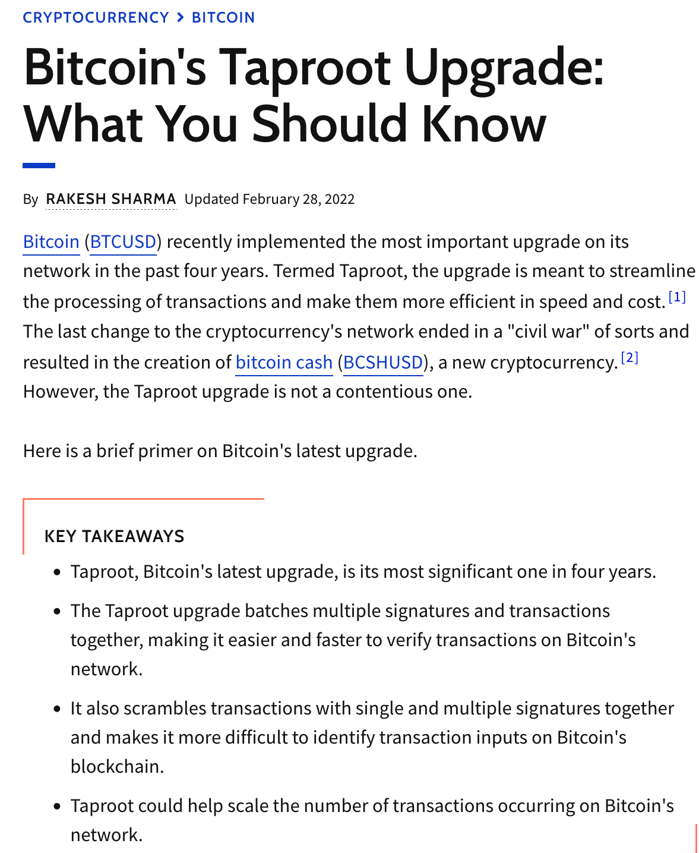
Recent Advances in Bitcoin Technology: Taproot Upgrade
Taproot has led to the
introduction of “Ordinals” on the
BTC blockchain, which are similiar to NFTs
on the Ether blockchain (3/2023)
https://www.investopedia.com/bitcoin-taproot-upgrade-5210039

Slide 153
Bitcoin Ordinals (2/17/2023)
Bitcoin developers have worked to bring non-fungible tokens or NFTs to the number one blockchain for nearly a decade
The Inscription process writes or inscribes the data of the content stored into the witness of the Bitcoin transaction.
The witness was introduced in the SegWit upgrade to the Bitcoin network in 2017.
“What the team came up with Ordinals is genius,” Alex Miller, CEO of Hiro, a developer for layer-2 smart contract platform Stacks, told Decrypt in an interview.
“It’s super core to the Bitcoin ethos in that they basically took several different things and pieced them together in a way the original creators did not foresee or expect.”
https://decrypt.co/resources/what-are-ordinals-a-beginners-guide-to-bitcoin-nfts
https://cryptobullsclub.com/ordinals-bitcoin-nfts/

Slide 154
…And the Adoption Wave Continues (CNBC: 3/9/2022) https://www.cnbc.com/2022/03/09/heres-whats-in-bidens-executive-order-on-crypto.html

Slide 155
Decentralized Finance (DeFi) https://en.wikipedia.org/wiki/Decentralized_finance
Decentralized finance (DeFi) offers financial instruments without relying on intermediaries such as brokerages, exchanges, or banks by using smart contracts on a blockchain.
DeFi platforms allow people to lend or borrow funds from others, speculate on price movements on assets using derivatives, trade cryptocurrencies, insure against risks, and earn interest in savings-like accounts.
DeFi uses a layered architecture and highly composable building blocks.
Some applications promote high interest rates but are subject to high risk.
As of October 2021, the value of assets used in decentralized finance amounted to $100 billion

Slide 156
History of DeFi
Decentralized exchanges (abbreviated DEXs) as alternative payment ecosystems with new protocols for financial transactions emerged within the framework of decentralized finance, which is part of blockchain technology and FinTech.
Centralized cryptocurrency exchanges (CEXs), such as Coinbase, Huobi or Binance, use order books to match buyers and sellers on the open market and keep crypto assets in an exchange-based wallet
DEXs are non-custodial and leverage the functionality of self-executing smart contracts for peer-to-peer trading, while users retain control of their private keys and funds.

Slide 157
Aggregators
Most recently, DEX aggregators have begun to play a more distinctive part in the DEX segment.
DEX aggregators form user-centric hubs that compose to several applications and protocols, also providing tools to compare and rate services, which allow users to perform otherwise complex tasks by connecting to several protocols simultaneously.
CEXs, DEXs and DEX aggregators are all built on the multi-layered DeFi architecture or components, where each layer serves a well-defined purpose
While they share common components of the first four layers, such as Settlement layer, Asset layer, Protocol layer and Application layer, DEX aggregators have an additional component or Aggregator layer, which allows them to connect and interact with other DEXs via smart contracts.
The Ethereum blockchain popularized smart contracts, which are the basis of DeFi, in 2017.
Other blockchains such as the BTC blockchain have now implemented smart contracts

Slide 158
And Finally…Volcanoes can be Useful!

