Slide 1
Fractals, Chaos, Complexity Physics-EPS 30
Lecture
Agent Based Models and Simulations
Lattice Gas Models

Slide 2
Credits
https://en.wikipedia.org/wiki/Agent-based_model
https://www.fitzner.nl/simulator/

Slide 3
Agent Based Modeling

Slide 4
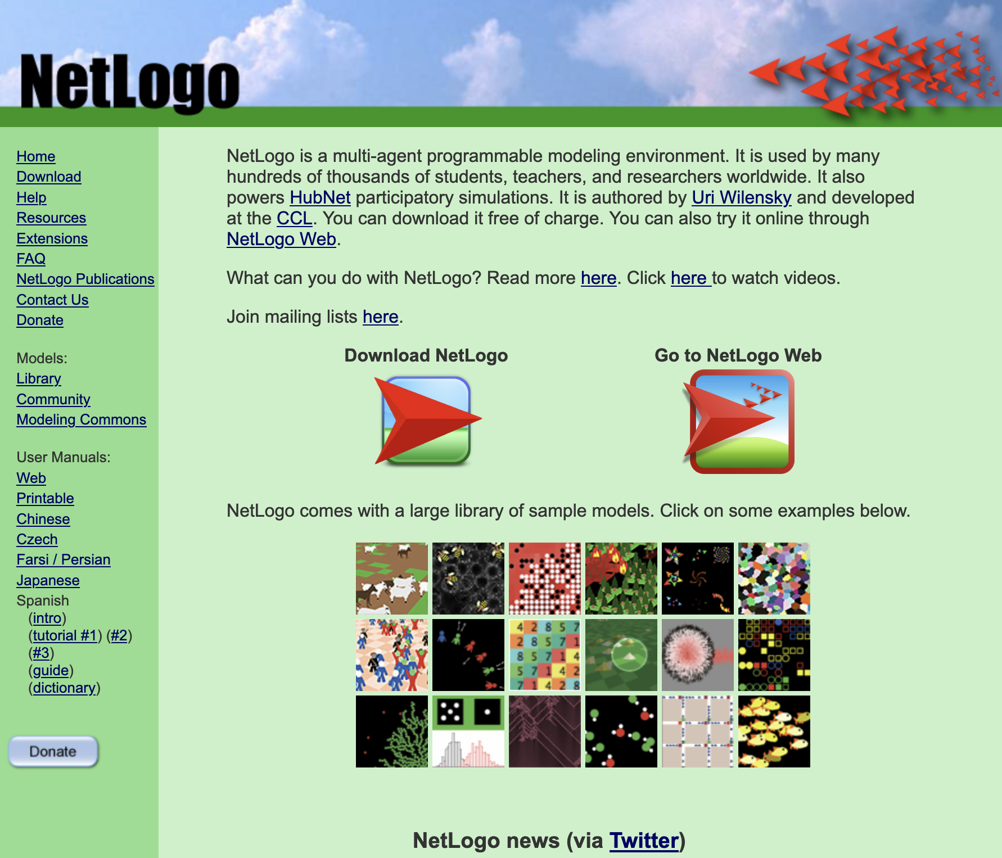
Netlogo https://ccl.northwestern.edu/netlogo/
A simulation library

Slide 5
Agent Based Models
An agent-based model (ABM) is a computational model for simulating the actions and interactions of autonomous agents (both individual or collective entities such as organizations or groups) in order to understand the behavior of a system and what governs its outcomes.
It combines elements of game theory, complex systems, emergence, computational sociology, multi-agent systems, and evolutionary programming.
Monte Carlo methods are used to understand the stochasticity of these models. Particularly within ecology, ABMs are also called individual-based models (IBMs
A review of recent literature on individual-based models, agent-based models, and multiagent systems shows that ABMs are used in many scientific domains including biology, ecology and social science.
Agent-based modeling is related to, but distinct from, the concept of multi-agent systems or multi-agent simulation in that the goal of ABM is to search for explanatory insight into the collective behavior of agents obeying simple rules, typically in natural systems, rather than in designing agents or solving specific practical or engineering problems.
Abstracting from the real world to a series of layers to be used in the artificial world upon which the agent-based model is based
https://www.gisagents.org/2019/01/agent-based-modelling-and-geographical.html

Slide 6
Example https://www.anylogic.com/resources/articles/agent-based-modeling-and-simulation/
Computational advances have made possible a growing number of agent-based models across a variety of application domains.
Applications range from modeling agent behavior in the stock market, supply chains, and consumer markets, to predicting the spread of epidemics, mitigating the threat of bio-warfare, and understanding the factors that may be responsible for the fall of ancient civilizations.
Such progress suggests the potential of ABMS to have far-reaching effects on the way that businesses use computers to support decision-making and researchers use agent-based models as electronic laboratories.
Some contend that ABMS “is a third way of doing science” and could augment traditional deductive and inductive reasoning as discovery methods.

Slide 7
Example https://peerj.com/articles/cs-36/

Slide 8
Example https://mosimtec.com/agent-based-modeling-examples/
An Example of ABM in Agriculture Pest Control Studies. Source: University of Surrey

Slide 9
Example https://www.nature.com/articles/s41562-020-0931-9/figures/1
a) Schematic illustration of the weighted multilayer synthetic population built from mobility data in the metropolitan area of Boston. The agent-based system comprises around 64,000 adults and 21,000 children.
b) Geographical distribution of the agents in a. MA, Massachusetts. Nodes in a are connected by more than five million weighted edges. Community layers (which include workplaces), are further classified into categories according to Foursquare’s taxonomy of places.
c) The compartmental model used to describe the natural history of the disease and the transition rates (represented alongside the connecting arrows, and described in Methods, “Stochastic simulations of COVID-19 dynamics”) between the different states.
Specifically, we consider susceptible (S), latent asymptomatic (LA), latent symptomatic (LS), presymptomatic (PS), infectious asymptomatic (IA), infectious symptomatic (IS), hospitalized (H), hospitalized in intensive care (ICU) and recovered (R) individuals.
From: Modelling the impact of testing, contact tracing and household quarantine on second waves of COVID-19

Slide 10
Example https://www.sciencedirect.com/science/article/pii/S1755436517300221

Slide 11
Example https://www.gisagents.org/2018/01/place-based-simulation-modelling.html

Slide 12
Example: COVID Simulator from the Washington Post https://www.washingtonpost.com/graphics/2020/world/corona-simulator/
Run simulations on the web site

Slide 13
Example: Simulating the COVID Epidemic https://softologyblog.wordpress.com/category/agent-based-modeling/
Simulation Version 1
This version is a blatant ripoff the Washington Post simulation but allows more settings to be tweaked and larger population sizes to be experimented with.
People (shown as circles) move around in random directions bouncing off each other.
The simulation starts with all the people healthy (not infected) and a single person set as infected in the middle of the world.
These are the settings for the simulation that can be tweaked.

Slide 14
Example: Infectious Disease https://softologyblog.wordpress.com/category/agent-based-modeling/
Simulation Version 1

Slide 15
Changing the Simulation https://softologyblog.wordpress.com/category/agent-based-modeling/
This run had increased population density so people are much closer together. The virus now spreads much faster and ends the same as the previous run with a 50/50 dead/recovered ratio.

Slide 16
Changing the Simulation https://softologyblog.wordpress.com/category/agent-based-modeling/
Now with the density lowered so people are not as packed together. This time the virus does not infect all healthy people. This is a good example of “social distancing” helping.

Slide 17
Changing the Simulation https://softologyblog.wordpress.com/category/agent-based-modeling/
Lowering the speed at which people move. If infected and healthy people move slower then the virus has less chances to spread. In the end about a third of al people never get infected and another third recover from infection

Slide 18
Changing the Simulation https://softologyblog.wordpress.com/category/agent-based-modeling/
Lowering the probability that people will move each step of the simulation to 10%. This could represent the majority of the population staying home and people only going out for essentials. With this change the virus dies out and the impact on the population is minimal.

