Slide 1
Complexity and the Future
Lecture 19
Physics-EPS 30

Slide 2
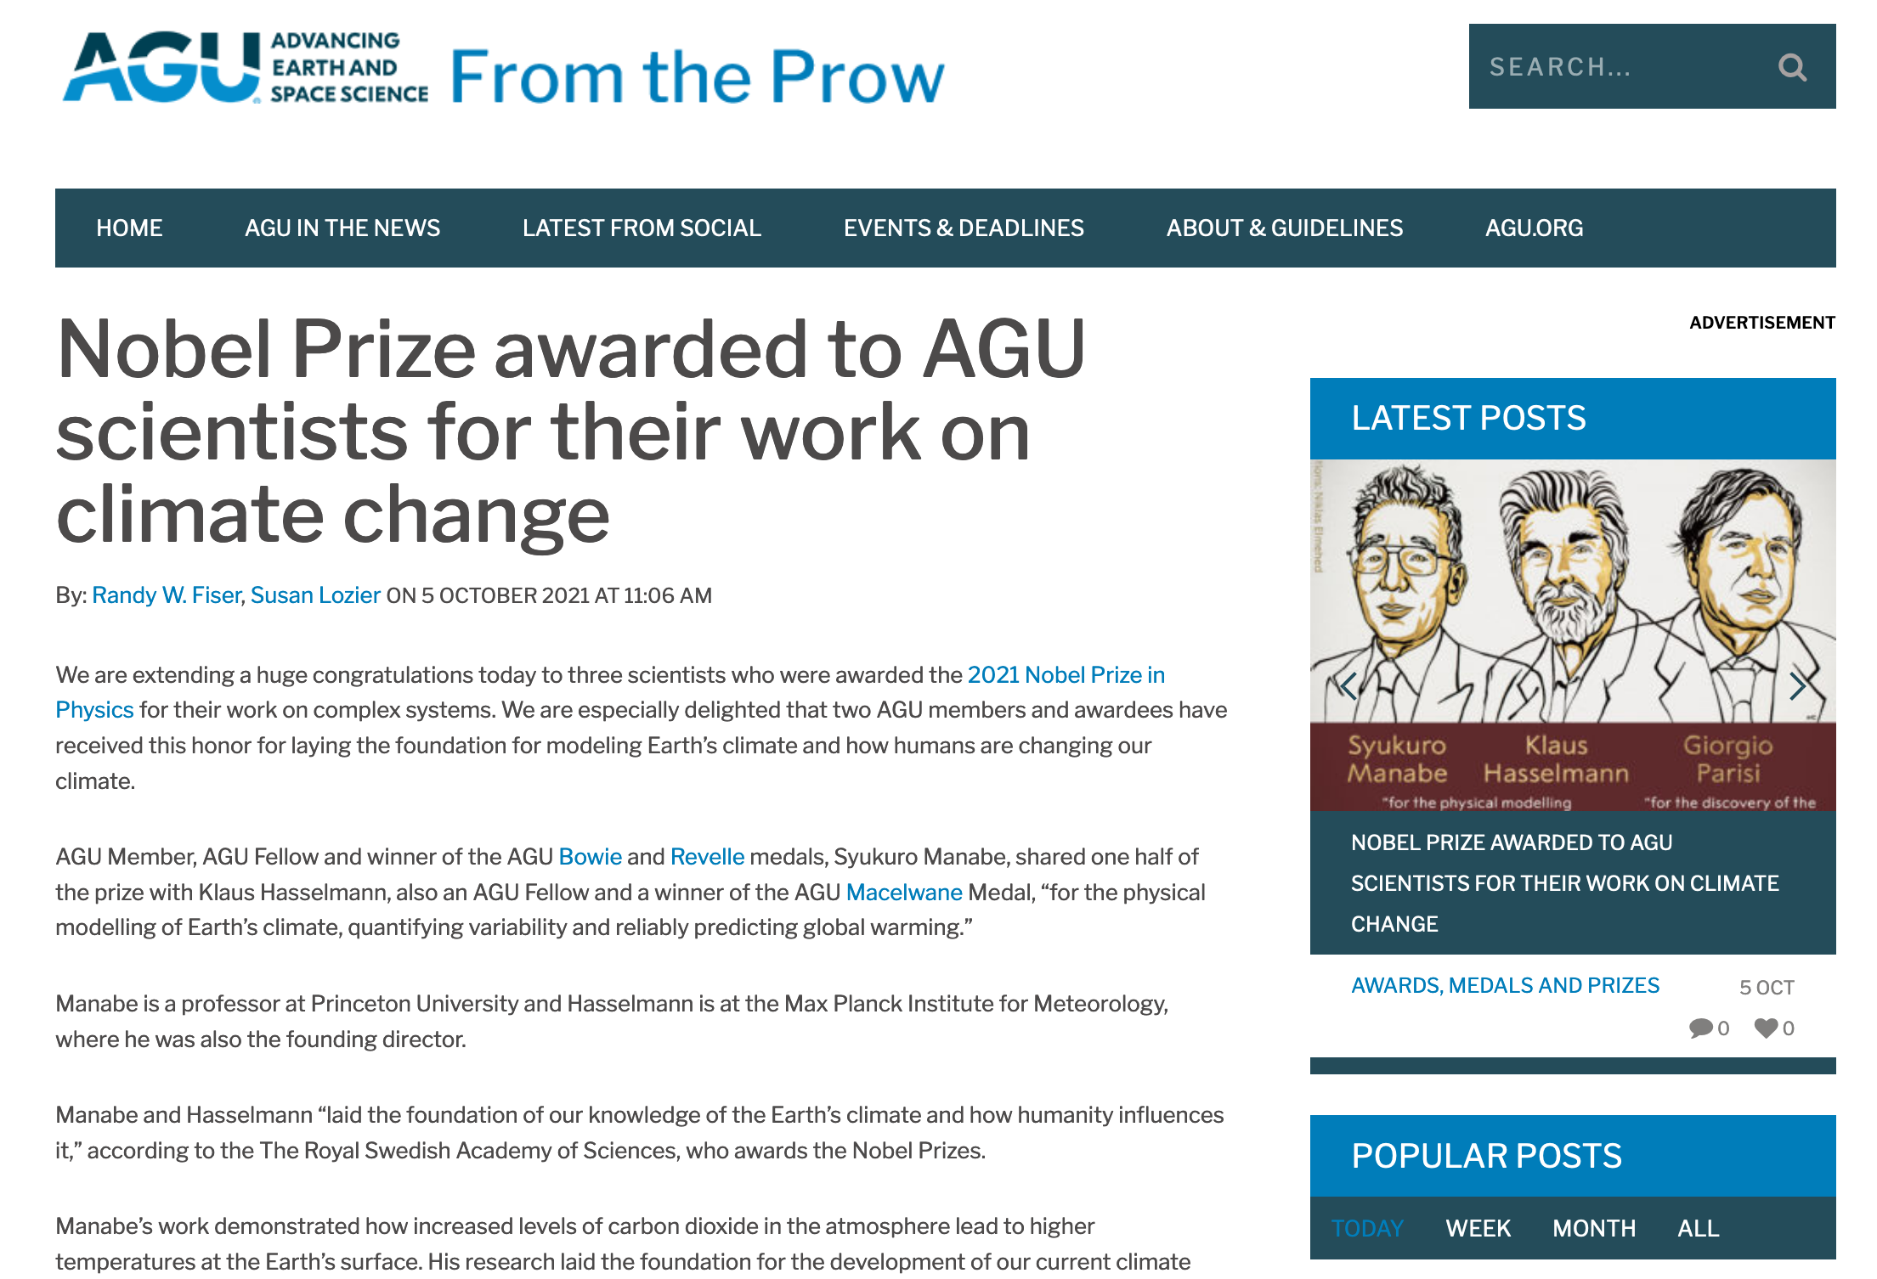

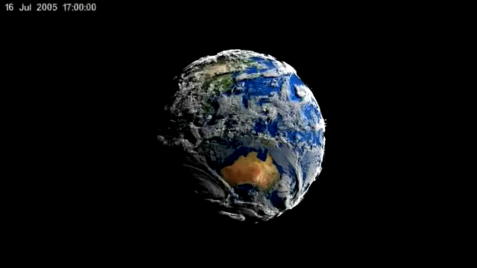
Physics and Complexity Science
https://en.wikipedia.org/wiki/General_circulation_model

Slide 3
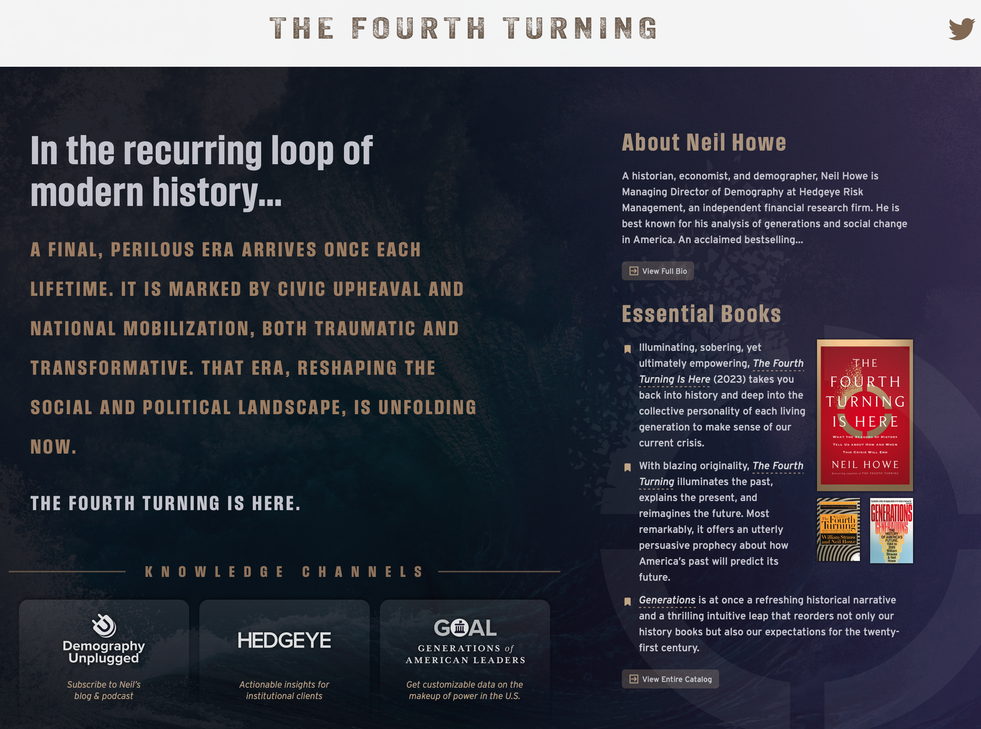
The Fourth Turning & Complex Systems
Historical cycles viewed as system dynamics
High
Crisis
Awakening
Unraveling
https://www.fourthturning.com
Notes:
Introduce social systems as evolving regimes.

Slide 4
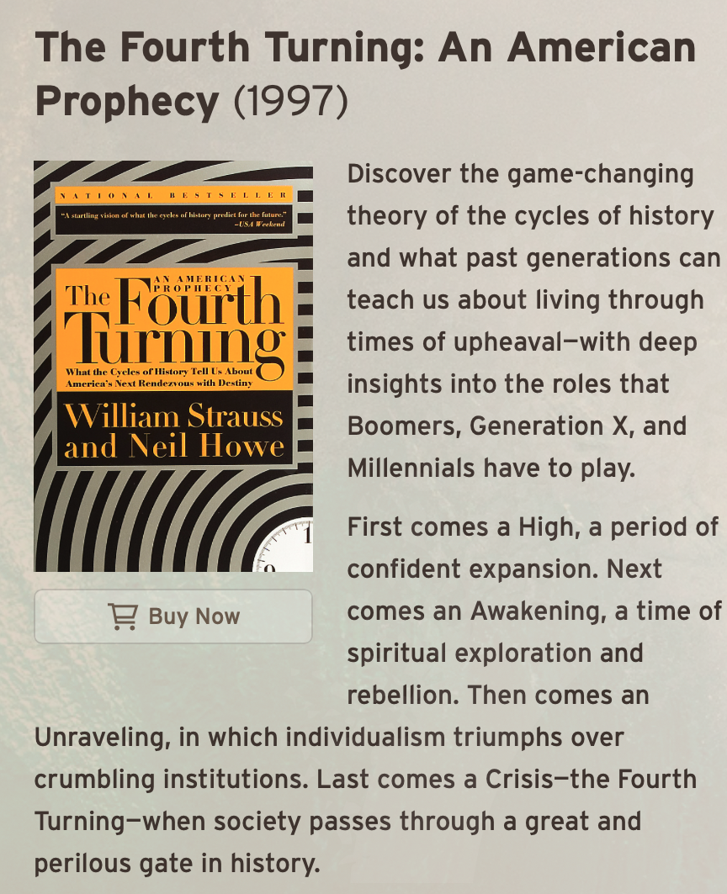
Why This Fits a Complex Systems Course
Societies as adaptive systems
Slow variables, fast shocks
High
Crisis
Awakening
Unraveling
Notes:
Highlight systems thinking.

Slide 5
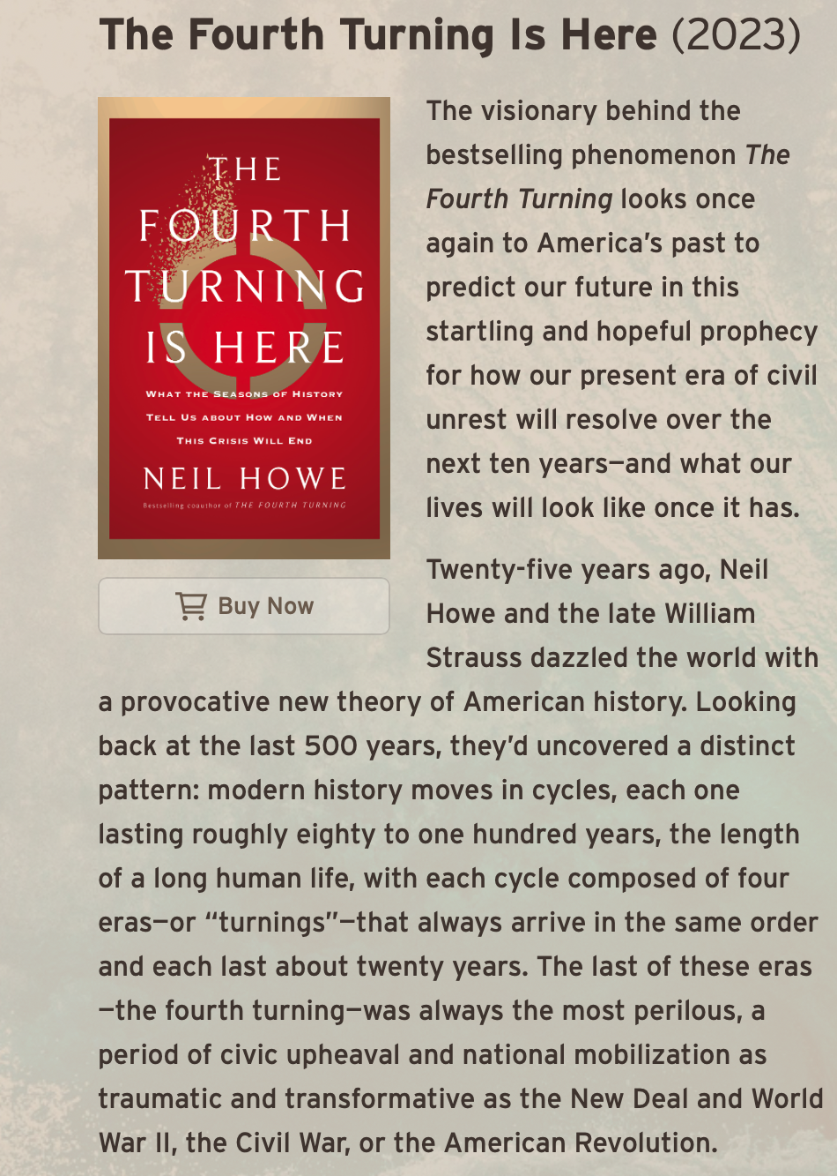
The Saeculum
≈80–100 year system cycle
Comparable to self-adaptive cycles
High
Crisis
Awakening
Unraveling
Notes:
Long-period cycle.

Slide 6

Four Turnings = System Phases
High
High
Awakening
Unraveling
Crisis
Crisis
Awakening
Unraveling
Notes:
Phase model.

Slide 7
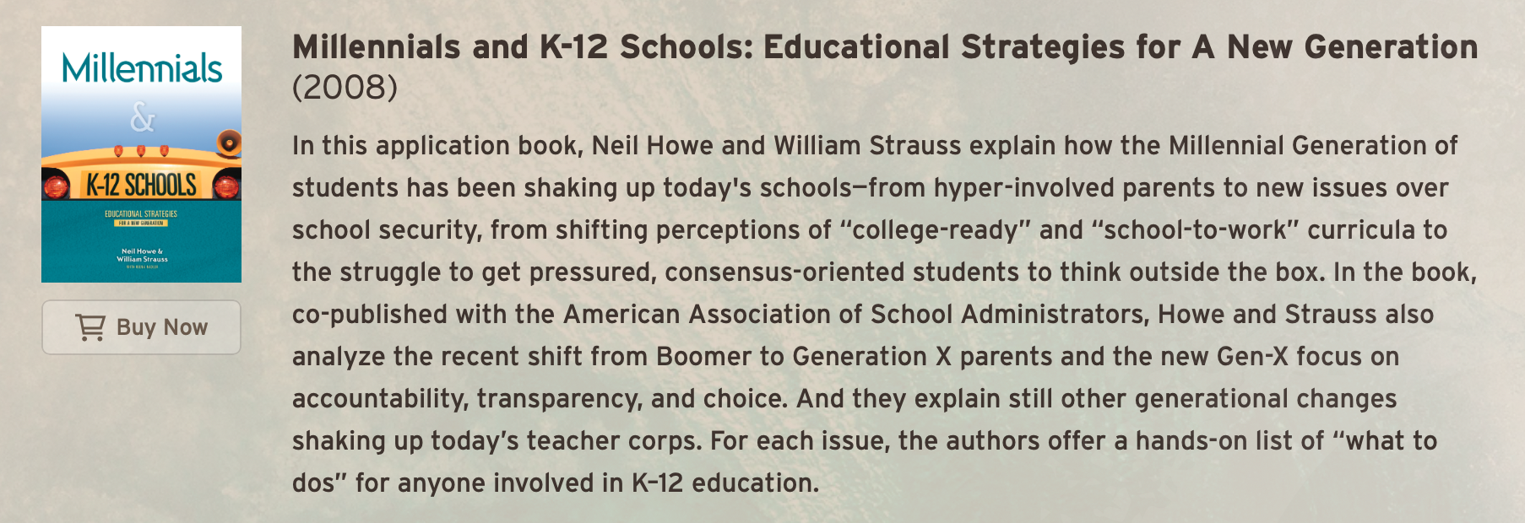
High: Stable Regime
High
Strong institutions
Low variance
High predictability
Crisis
Awakening
Unraveling
Notes:
Stable equilibrium.

Slide 8
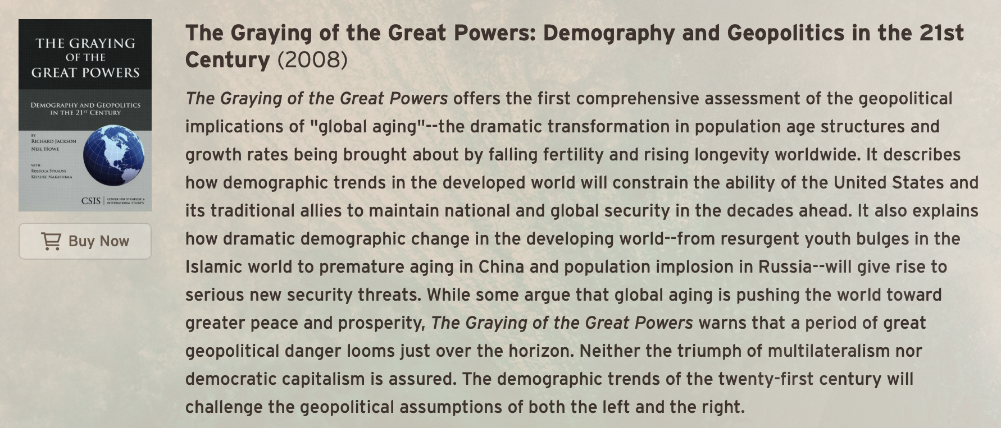
Awakening: Perturbation Phase
High
Rising feedback
Cultural stress-testing
Crisis
Awakening
Unraveling
Notes:
Perturbations grow.

Slide 9

Unraveling: Loss of Coupling
High
Institutional decay
Fragmentation
Crisis
Awakening
Unraveling
Notes:
Network breakdown.

Slide 10
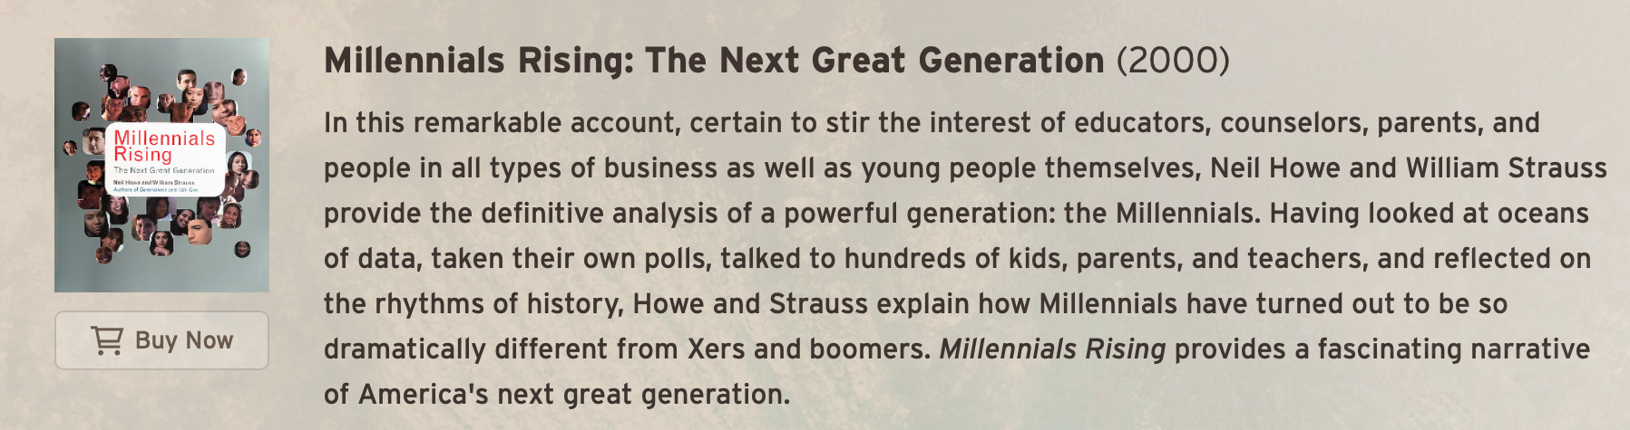
Crisis: Phase Transition
Shock event
Rapid reorganization
SHOCK
Notes:
System shock.

Slide 11

Generations as Agents
High
Different roles over time
Memory and adaptation
Crisis
Awakening
Unraveling
Notes:
Agent heterogeneity.

Slide 12
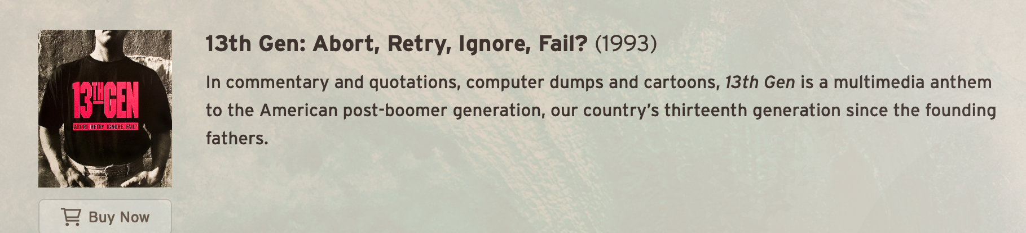
Historical Examples
High
American Revolution
Civil War
Great Depression / WWII
Crisis
Awakening
Unraveling
Notes:
Observed transitions.

Slide 13
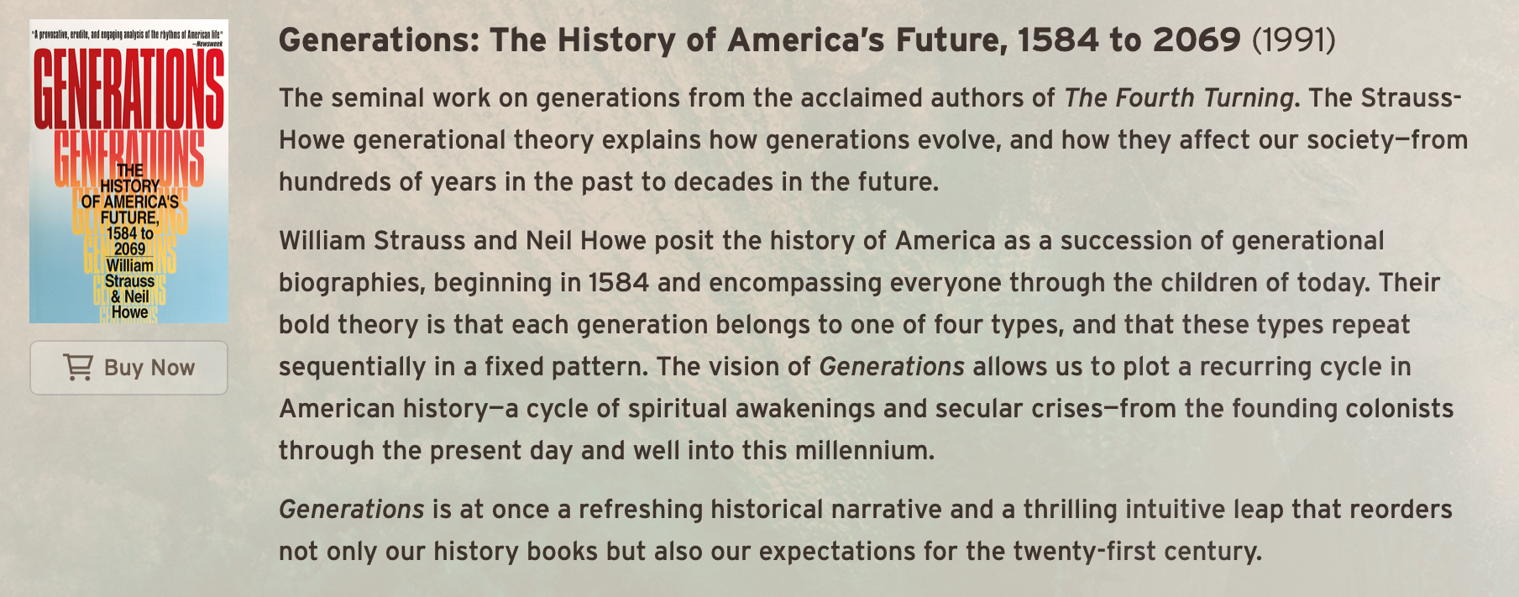
Key Takeaways
High
Patterns = predictions (?)
Crises reshape systems
Crisis
Awakening
Unraveling
Notes:
Summary.

Slide 14
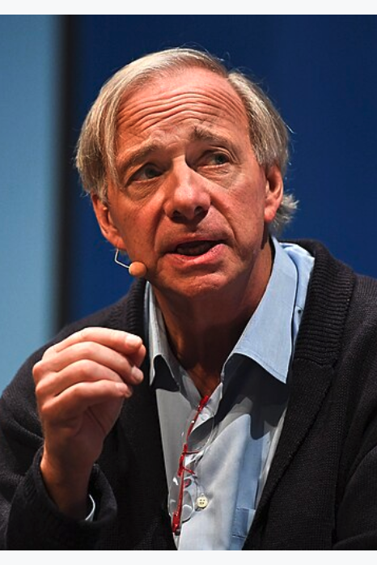
Ray Dalio https://en.wikipedia.org/wiki/Ray_Dalio
Raymond Thomas Dalio (born August 8, 1949) is an American billionaire and founder of one of the world's largest hedge funds, Bridgewater Associates.
Dalio is the author of the 2017 book, Principles: Life & Work, about corporate management and investment philosophy and The Changing World Order on why nations succeed and fail.
As of February 2026, he has a net worth of $20 billion, which ranks 128th on the Bloomberg Billionaire Index.

Slide 15
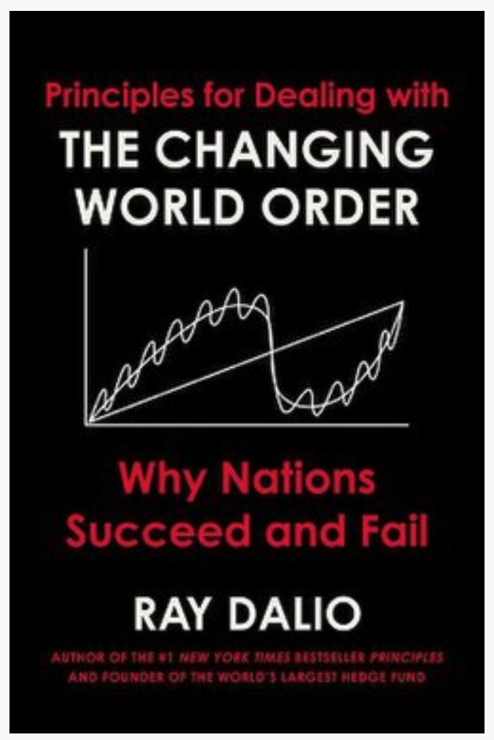
The Book https://en.wikipedia.org/wiki/The_Changing_World_Order
Principles for Dealing with the Changing World Order: Why Nations Succeed and Fail is a 2021 book by Ray Dalio.
The book examines the cyclical patterns underlying the rise and fall of major empires over the past 500 years.
In the book, Dalio introduces and discussed for the first time the concept of "Big Cycle."
The book was on The New York Times Best Seller list and has sold over one million copies globally.

Slide 16
And Now…
We have reached the end of the course.
The future belongs to you.
What will you do with it?

