Slide 1
Fractals, Chaos, Complexity
Physics-EPS 30
Lecture 2
Fractals
https://en.wikipedia.org/wiki/fractals
Also, lectures by Bruce Malamud, Professor, Kings College London

Slide 2
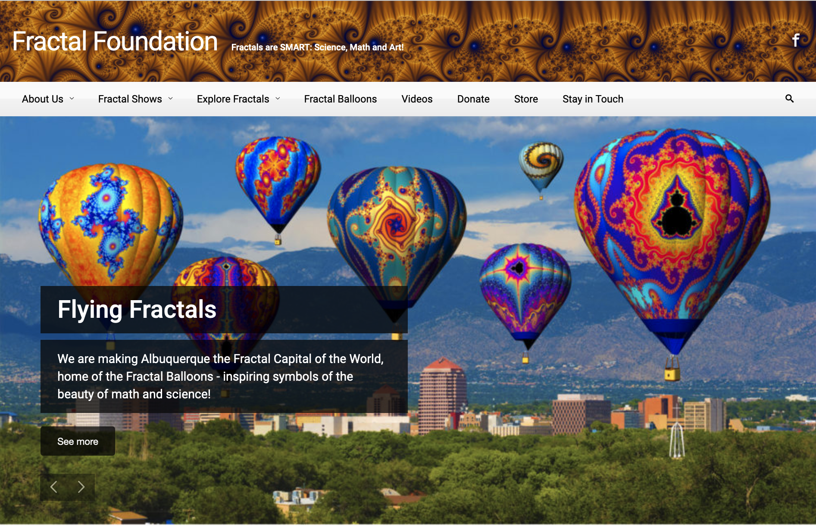

Slide 3
Definitions
In mathematics, a fractal is a subset of Euclidean space with a fractal dimension that strictly exceeds its topological dimension.
Fractals appear the same at different scales, as illustrated in successive magnifications of the Mandelbrot set. (next slides)
Fractals often exhibit similar patterns at increasingly smaller scales, a property called self-similarity, also known as expanding symmetry or unfolding symmetry
If this replication is exactly the same at every scale, as in the Sierpinski Triangle, it is called affine self-similar. (next slides)
Fractal geometry lies within the mathematical branch of measure theory.

Slide 4
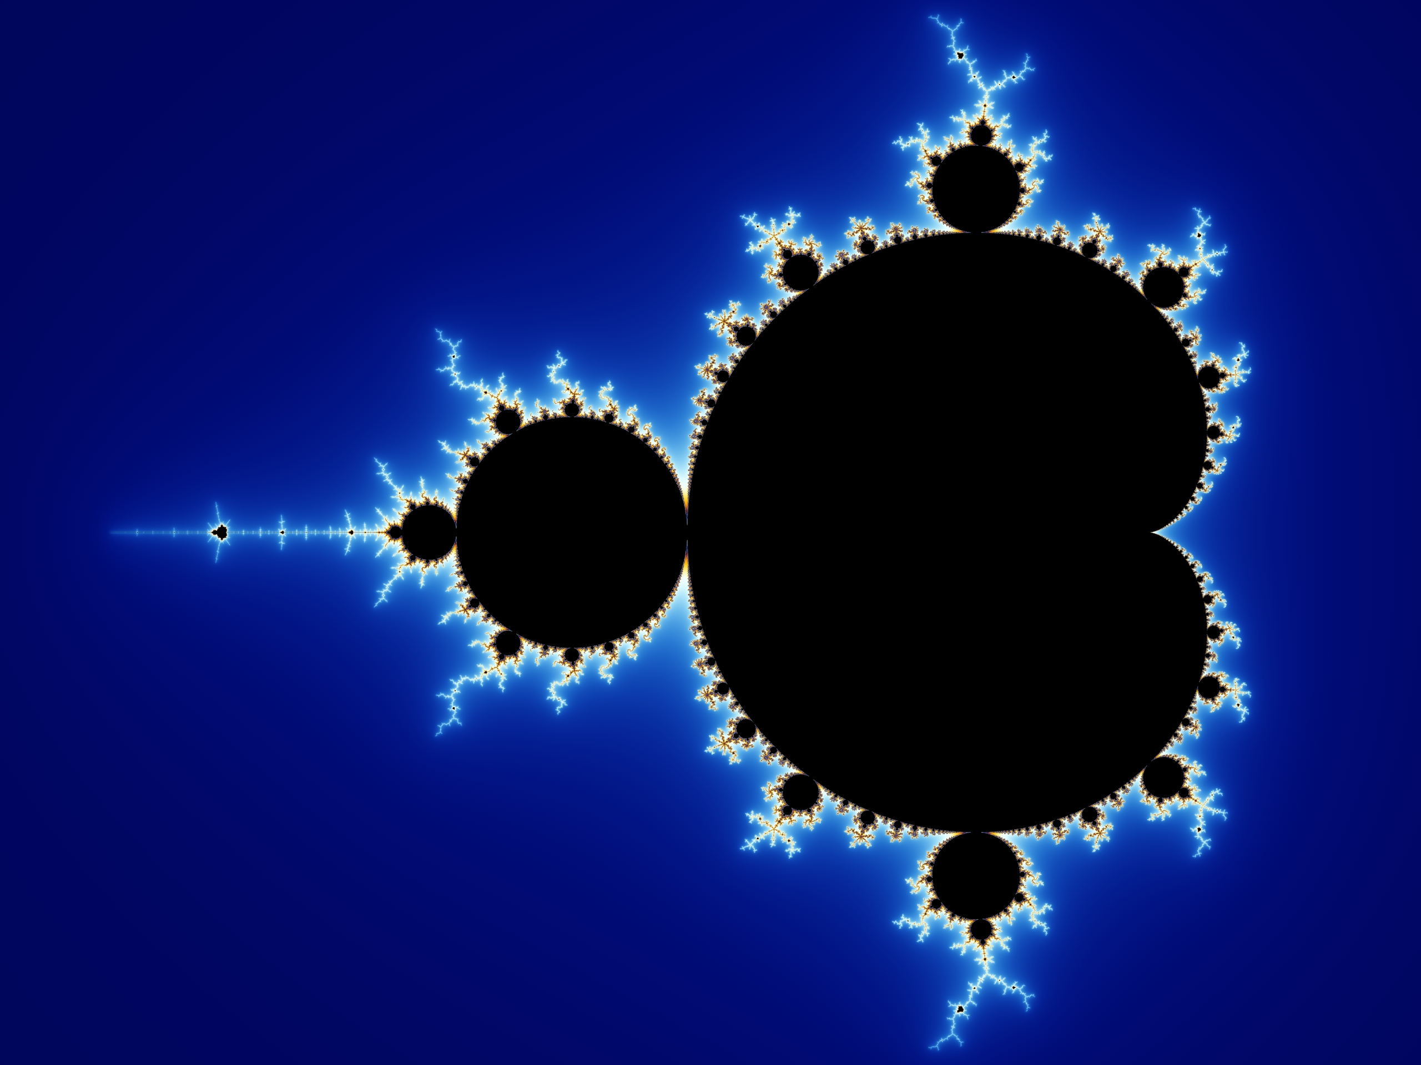
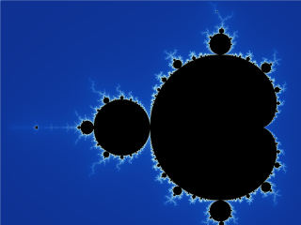
Example: Mandelbrot Set
Mandelbrot Set
Zoom of Mandelbrot Set

Slide 5
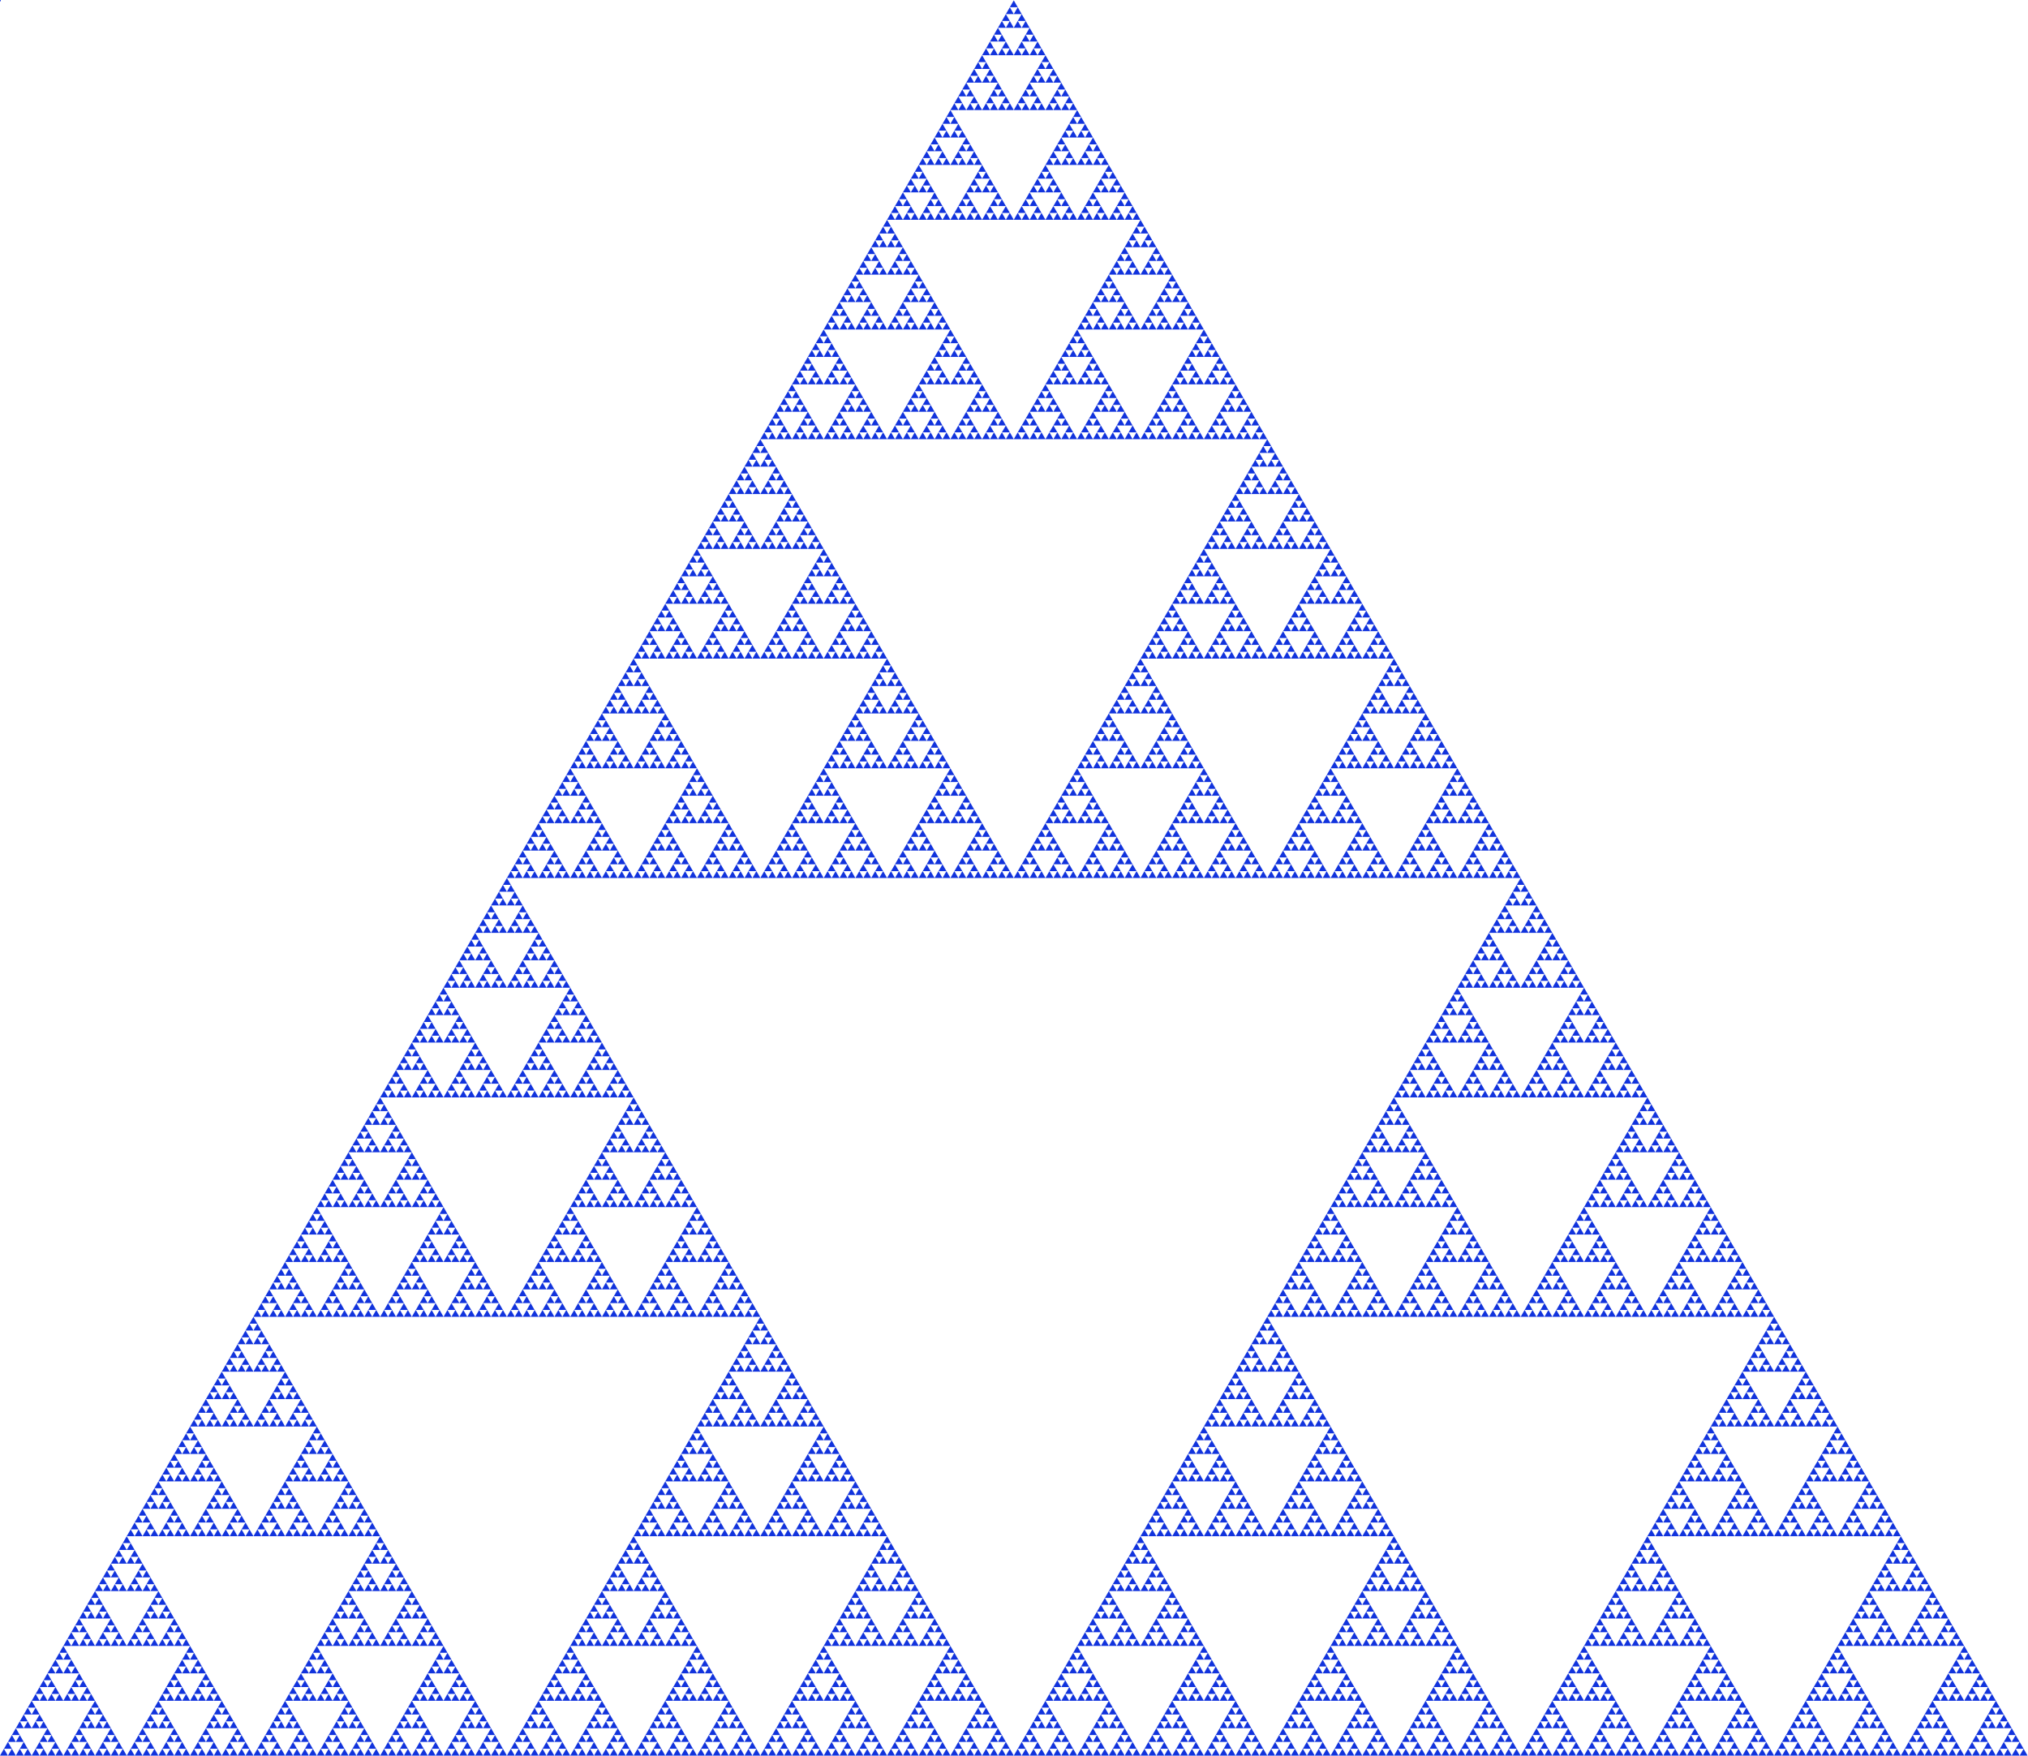

Example: Sierpinski Triangle – Menger Sponge
Sierpinski Triangle
Menger Sponge

Slide 6
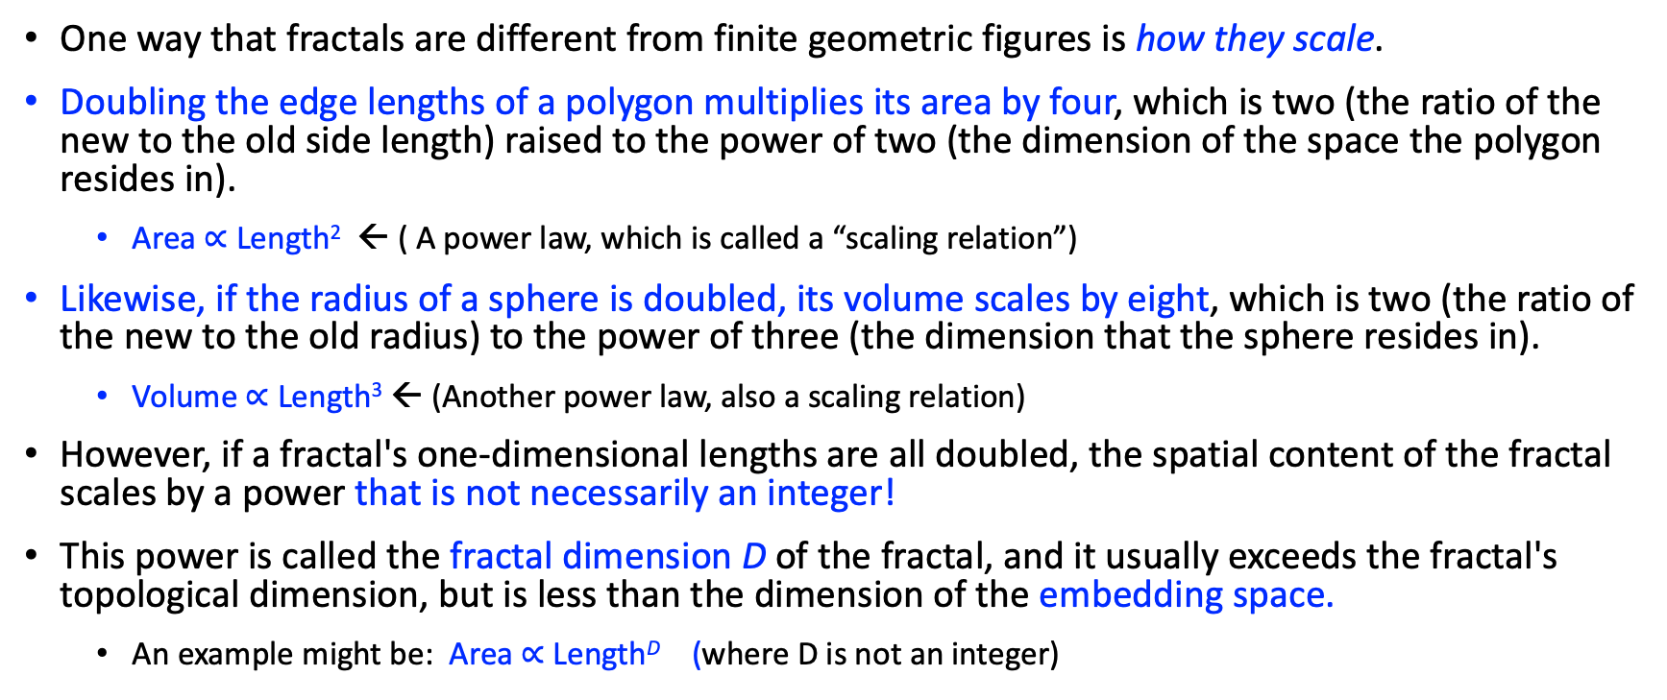
Fractal Basics (In Words)
One way that fractals are different from finite geometric figures is how they scale.
Doubling the edge lengths of a polygon multiplies its area by four, which is two (the ratio of the new to the old side length) raised to the power of two (the dimension of the space the polygon resides in).
  Area $∝$ Length² ← ( A power law, which is called a “scaling relation”)
Likewise, if the radius of a sphere is doubled, its volume scales by eight, which is two (the ratio of the new to the old radius) to the power of three (the dimension that the sphere resides in).
  Volume $∝$ Length³ ← (Another power law, also a scaling relation)
However, if a fractal's one-dimensional lengths are all doubled, the spatial content of the fractal scales by a power that is not necessarily an integer!
This power is called the fractal dimension D of the fractal, and it usually exceeds the fractal's topological dimension, but is less than the dimension of the embedding space.
  An example might be: Area $∝$ Length^{D} (where D is not an integer)

Slide 7
Fractal Basics
Analytically, most fractal curves are nowhere differentiable, i.e., they have no unique slope at any point
An infinite fractal curve can be conceived of as winding through space differently from an ordinary line – although it is still topologically 1-dimensional, its fractal dimension indicates that it also resembles a surface
Starting in the 17th century with notions of recursion, fractals have moved through increasingly rigorous mathematical treatment to the study of continuous but not differentiable functions in the 19th century by the seminal work of Bernard Bolzano, Bernhard Riemann, Georg Cantor, and Karl Weierstrass
The word fractal was coined in the 20th century by Benoit Mandelbrot with a subsequent burgeoning of interest in fractals and computer-based modelling in the 20th century.

Slide 8
Fractal Basics
There is some disagreement among mathematicians about how the concept of a fractal should be formally defined.
Mandelbrot himself summarized it as "beautiful, damn hard, increasingly useful. That's fractals."
More formally, in 1982 Mandelbrot defined fractal as follows: "A fractal is by definition a set for which the Hausdorff (– Besicovitch) dimension strictly exceeds the topological dimension."
Later, seeing this as too restrictive, he simplified and expanded the definition to this: "A fractal is a shape made of parts similar to the whole in some way."
Still later, Mandelbrot proposed "to use fractal without a pedantic definition, to use fractal dimension as a generic term applicable to all the variants".

Slide 9
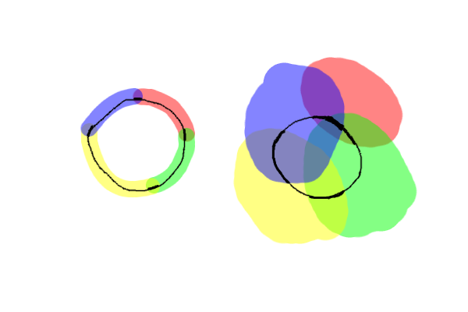
Topological Dimension
The diagram shows a refinement (on the left) of a cover (on the right) of a circular line (black).
Notice how in the refinement no point on the line is contained in more than two sets.
Note also how the sets link to each other to form a "chain".
Thus the circle has a topological dimension of 1

Slide 10
Topological Dimension
For ordinary Euclidean spaces, the “Lebesgue covering dimension” is just the ordinary Euclidean dimension: zero for points, one for lines, two for planes, and so on.
However, not all topological spaces have this kind of "obvious" dimension, and so a precise definition is needed in such cases.
The definition proceeds by examining what happens when the space is covered by open sets.
In general, a topological space X can be covered by open sets, in that one can find a collection of open sets such that X lies inside of their union.
The covering dimension is the smallest number n such that for every cover, there is a refinement in which every point in X lies in the intersection of no more than n + 1 covering sets.
The goal of the definition is to provide a number (an integer) that describes the space, and does not change as the space is continuously deformed
The general idea is illustrated in the diagram, which show a cover and refinements of a circle.

Slide 11
Fractal Basics
The consensus among mathematicians is that theoretical fractals are infinitely self-similar, iterated, and detailed mathematical constructs having fractal dimensions, of which many examples have been formulated and studied.
Fractals are not limited to geometric patterns, but can also describe processes in time (for example, intermittency)
Fractal patterns with various degrees of self-similarity have been rendered or studied in visual, physical, and aural media and found in nature, technology, art, architecture and law. (we will see examples)
Fractals are of particular relevance in the field of chaos theory because the graphs of most chaotic processes are fractals.
Many real and model networks have been found to have fractal features such as self similarity.

Slide 12
Benoit Mandelbrot
The term "fractal" was coined by the mathematician Benoît Mandelbrot in 1975.
Mandelbrot based it on the Latin frāctus, meaning "broken" or "fractured", and used it to extend the concept of theoretical fractional dimensions to geometric patterns in nature

Slide 13
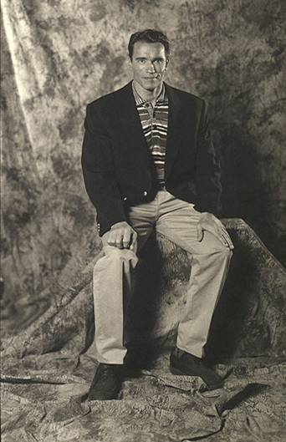
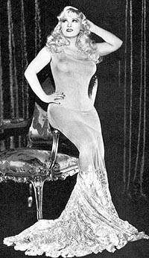
Example: Characteristic Scale
Notes:
Arne and Mae West, Discuss characteristic scales, how lots of people at an average height, and then very few small ones and very few big ones. There is a given standard deviation.
Average = la media, el promedio.
Standard Deviation = desviación estándar

Slide 14
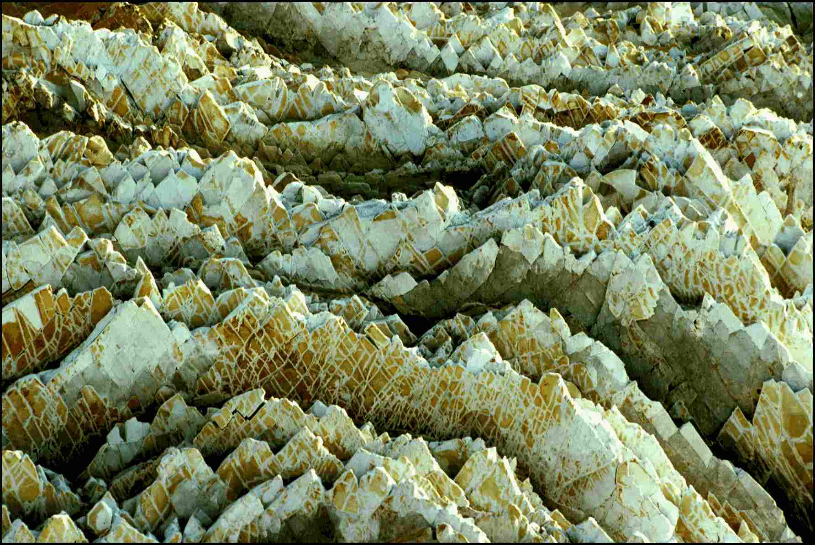
Scale Invariance
Independent of scale.
The shape does not define its size.
What is the size of these objects?
Notes:
la invariancia de escala
Escala invariante
Independete de escala.
La forma/la figura
To define:
(= give definition for) definir (also computing)
(= characterize) caracterizar
(= delimit) determinar; delimitar
(= outline) destacar
Tamaño

Slide 15
Scale Invariance
10 m
Rocks off Point Lobos, California
Notes:
Not sure if this photo will help or not. A good “geological” picture to show scale invariance (i.e. Could be a thin section, could be much larger). Picture taken at Morro Bay, California, of rocks. NO, MIGHT BE POINT LOBOS. If memory serves, width is about 10 meters. (Photo Bruce Malamud).
Para tomar una foto de un afloramiento, un grupo de montañas, una red de drenaje o ondulaciones de arena en un río, es necesario algún objeto en la foto para indicar una dimensión característica…una persona, una casa, una moneda, una regla.

Slide 16
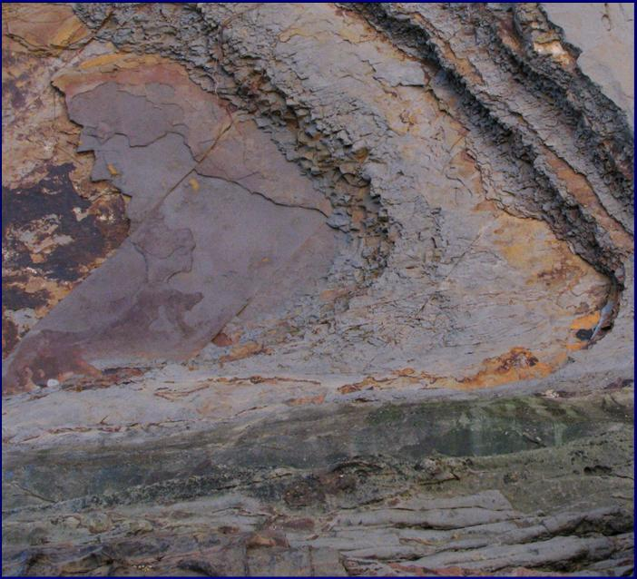
What is the Scale of This Image?

Slide 17
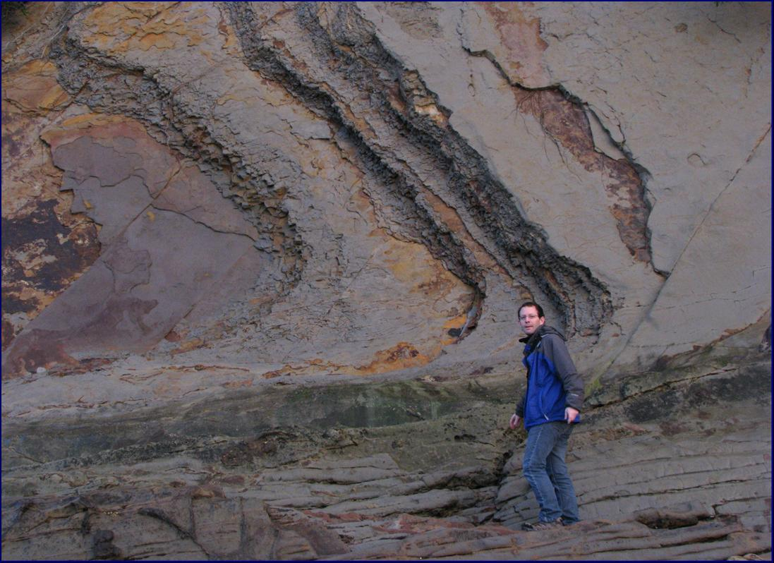
Bruce Malamud

Slide 18
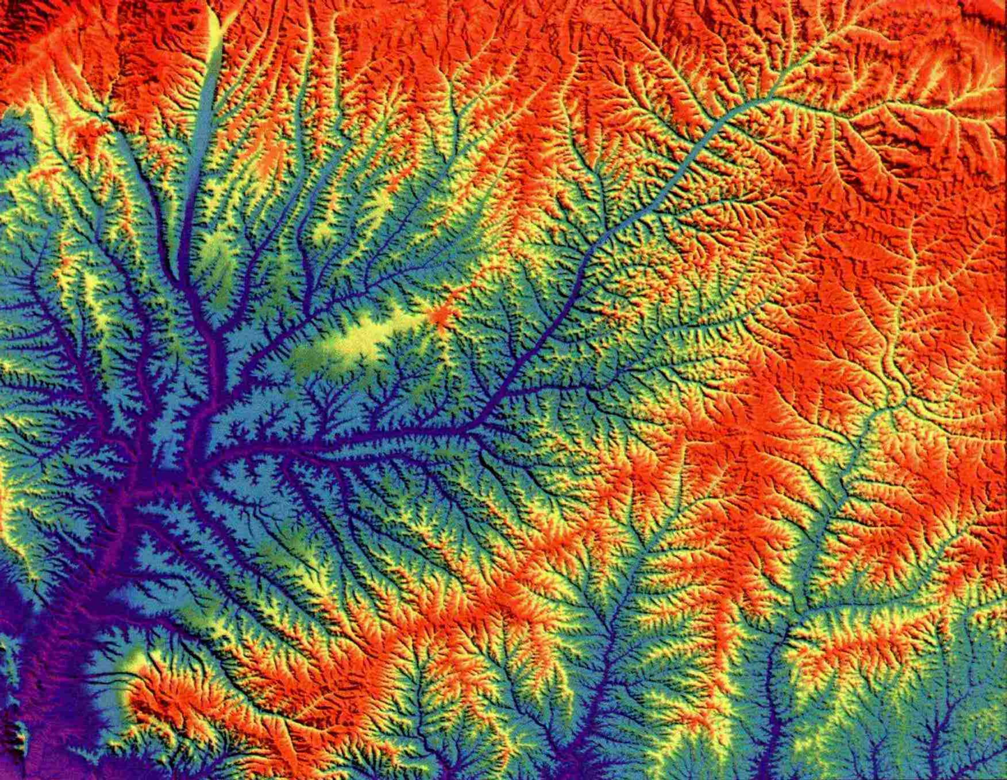
What is the Scale of This Image?

Slide 19
False-color topography of the Shanxi Province, China.
300 km
Notes:
Another “geologic” image to demonstrate scale invariance. [A good figure to show after this would be a “determininistic fractal construction of trees”. Do you have this already? I have some that might be usable.]
False-color topography of the Shanxi Proince, China. This ninth-order drainage network has incised into the Loess Plateau of Central China. Total basin relief is about 1 km. Approximate scale is 220 x 300 km. (Image credit: Malamud, Turcotte, and Pelletier).
En el Gráfico 1, a cada diferente escala, las formas son parecidas; eso se llama la invariancia de escala. En actualidad, el Gráfico 1 tiene una media de 300 km por 220 km, y es una imagen topográfica de colores falsos de la Provincia de Shanxi en la China. Es una red de drenaje de orden nueve (hay ocho niveles de afluentes que aportan al principal) en la platea de loess de la China Central, con un relieve de altitud aproximadamente de 1 km. Cada uno de los diferentes órdenes de drenaje en esta foto no son exactamente los mismos que el orden principal, pero tienen una forma que es similar.

Slide 20
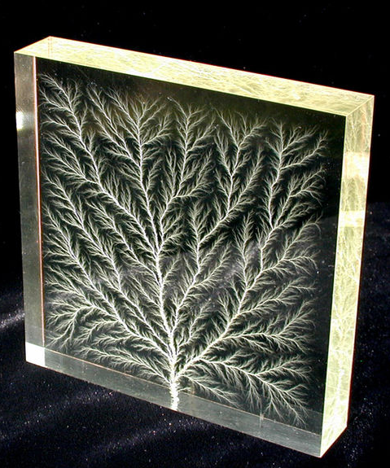
High voltage dielectric breakdown in plexiglass (Bert Hickman)
5 cm
300 km
Notes:
20
Another “geologic” image to demonstrate scale invariance. [A good figure to show after this would be a “determininistic fractal construction of trees”. Do you have this already? I have some that might be usable.]
False-color topography of the Shanxi Proince, China. This ninth-order drainage network has incised into the Loess Plateau of Central China. Total basin relief is about 1 km. Approximate scale is 220 x 300 km. (Image credit: Malamud, Turcotte, and Pelletier).
En el Gráfico 1, a cada diferente escala, las formas son parecidas; eso se llama la invariancia de escala. En actualidad, el Gráfico 1 tiene una media de 300 km por 220 km, y es una imagen topográfica de colores falsos de la Provincia de Shanxi en la China. Es una red de drenaje de orden nueve (hay ocho niveles de afluentes que aportan al principal) en la platea de loess de la China Central, con un relieve de altitud aproximadamente de 1 km. Cada uno de los diferentes órdenes de drenaje en esta foto no son exactamente los mismos que el orden principal, pero tienen una forma que es similar.

Slide 21
Definitions: Self-Similarity
The feature of "self-similarity” can be understood by analogy to zooming in with a lens or other device that zooms in on digital images to uncover finer, previously invisible, new structure.
If this is done on fractals, however, no new detail appears
Nothing changes and the same pattern repeats over and over, or for some fractals, nearly the same pattern reappears over and over.
Self-similarity itself is not necessarily counter-intuitive (e.g., people have pondered self-similarity informally such as in the infinite regression in parallel mirrors...).
The difference for fractals is that the pattern reproduced must be detailed.

Slide 22
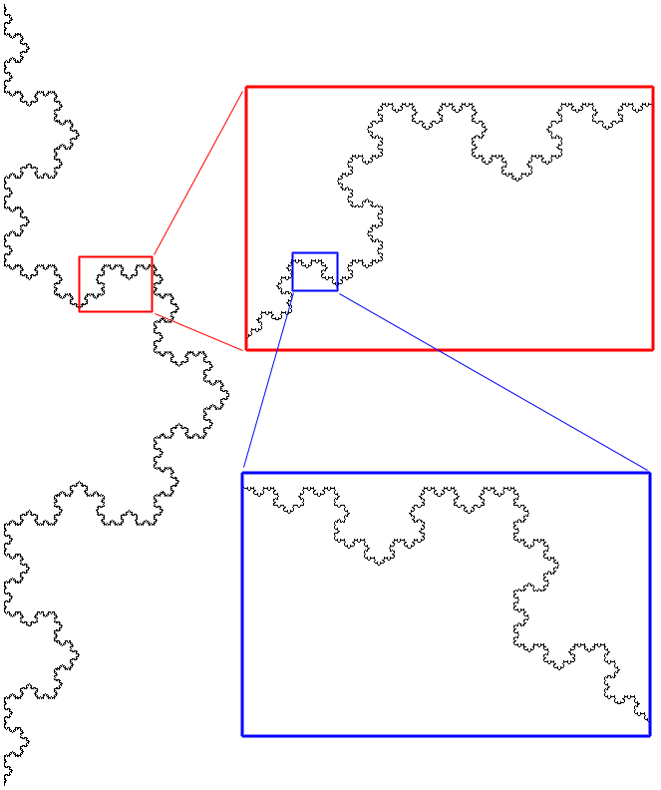
Self-similar: Same pattern repeats itself at different scales.
Example of Von Koch curve
(No unique slope at any point)
Notes:
Need to discuss mathematical vs. real world.
Autosemejanza: El que puede descomponerse en partes, cada una de las cuales es semejante al conjunto total.
Hay muchos diferentes lugares en la Naturaleza donde se pueden ver la invariancia de escala, donde un objeto tiene formas semejantes en muchas escalas diferentes; por ejemplo, las nubes, las costas de las continentes, una curva topográfica a un nivel de elevación, los helechos, las coliflores. Podemos pensar también de la invariancia de escala como una distribución de objetos de un solo tipo que tienen diferentes tamaños donde hay muy pocos de grandes, más de medianos, y muchos más de pequeños, y donde es necesario una medida para tener una idea del tamaño verdadero; por ejemplo, en la red de drenaje del Gráfico 1, hay muy pocos ríos con un ancho grande, más con medianos, y muchos más con un ancho pequeño. Podemos hablar también de los largos de los ríos en el Gráfico 1. Otros ejemplos incluyen las áreas o diámetros de lagos en la Argentina, los volúmenes de rocas en una zona bien definida de los Andes, las áreas de los deslizamientos de tierras en la Precordillera, los espesores de los anillos de arboles; por cada uno de esos existe una invariancia de escala y hay una gran cantidad a un tamaño pequeño, menos de medianos, y muy pocos de los grandes.

Slide 23
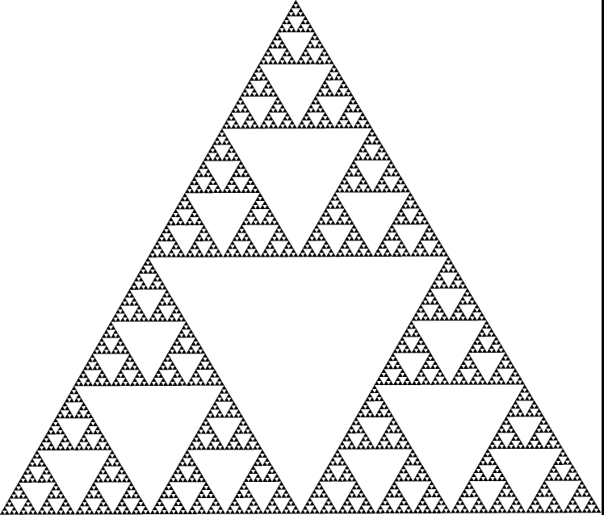
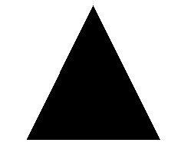
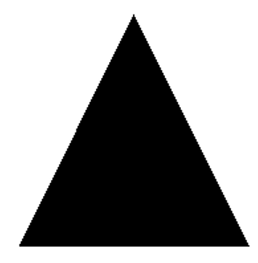
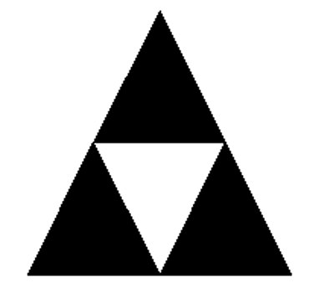
Self-similar: Construction of self-similar object (Sierpinski Gasket, Wacław Sierpiński, 1915).
Initiator
The solid triangle is the “Initiator”
Generator
A “generator” is then applied to create the Sierpinski triangle
Notes:
23
Need to discuss mathematical vs. real world.
Autosemejanza: El que puede descomponerse en partes, cada una de las cuales es semejante al conjunto total.
Hay muchos diferentes lugares en la Naturaleza donde se pueden ver la invariancia de escala, donde un objeto tiene formas semejantes en muchas escalas diferentes; por ejemplo, las nubes, las costas de las continentes, una curva topográfica a un nivel de elevación, los helechos, las coliflores. Podemos pensar también de la invariancia de escala como una distribución de objetos de un solo tipo que tienen diferentes tamaños donde hay muy pocos de grandes, más de medianos, y muchos más de pequeños, y donde es necesario una medida para tener una idea del tamaño verdadero; por ejemplo, en la red de drenaje del Gráfico 1, hay muy pocos ríos con un ancho grande, más con medianos, y muchos más con un ancho pequeño. Podemos hablar también de los largos de los ríos en el Gráfico 1. Otros ejemplos incluyen las áreas o diámetros de lagos en la Argentina, los volúmenes de rocas en una zona bien definida de los Andes, las áreas de los deslizamientos de tierras en la Precordillera, los espesores de los anillos de arboles; por cada uno de esos existe una invariancia de escala y hay una gran cantidad a un tamaño pequeño, menos de medianos, y muy pocos de los grandes.

Slide 24
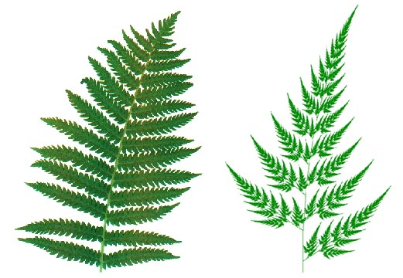
Self Similarity
Natural vs. Mathematical.
Notes:
Autosemejanza: El que puede descomponerse en partes, cada una de las cuales es semejante al conjunto total.
La naturaleza contra las matemáticas.
Self Similarity. Written by Paul Bourke. October 2002. http://astronomy.swin.edu.au/~pbourke/fractals/selfsimilar/

Slide 25
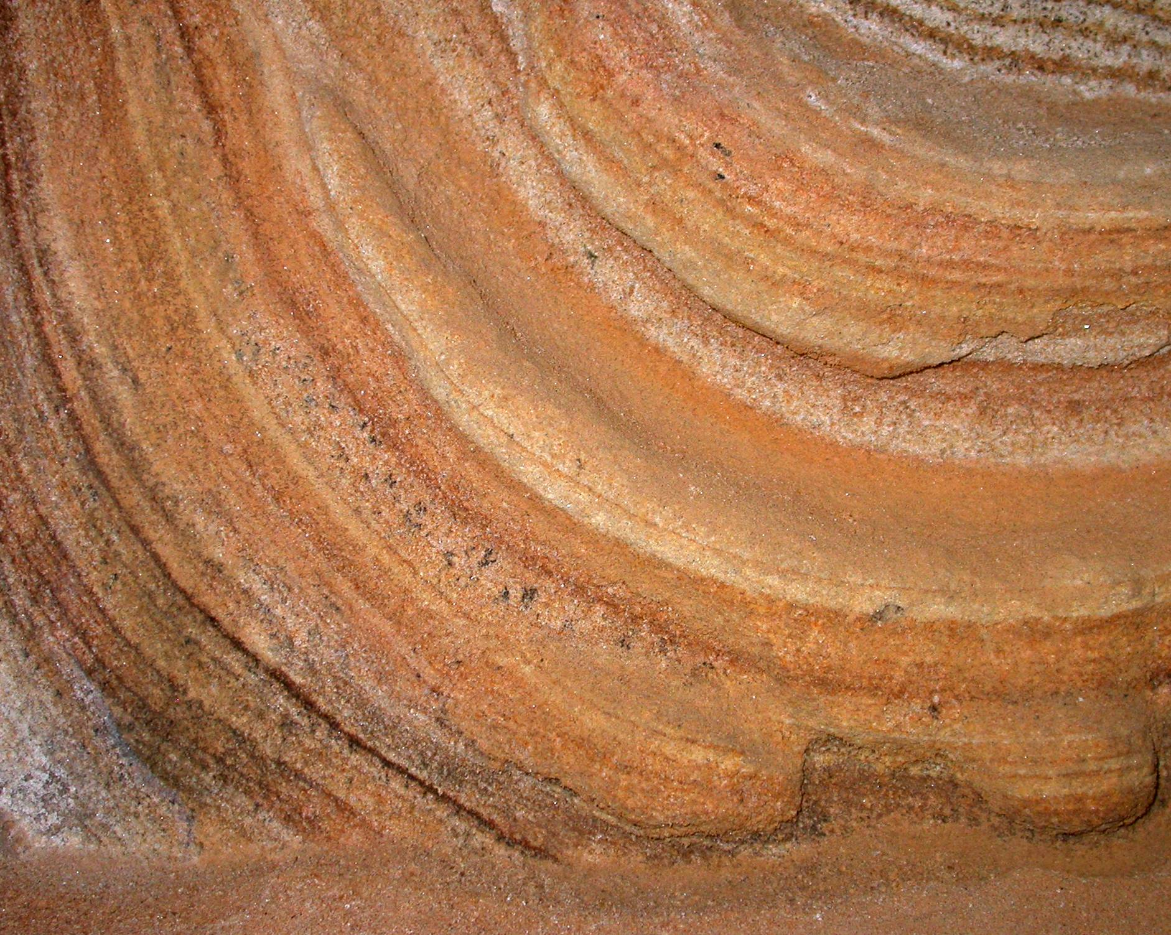
Self-Similarity
“For a stone, when it is examined, will be found a mountain in miniature. The fineness of Nature’s work is so great, that, into a single block, a foot or two in diameter, she can compress as many changes of form and structure, on a small scale, as she needs for her mountains on a large one.”
—John Ruskin (1819–1900)
Modern Painters (1856), “Of Mountain Beauty”, Ch.18. v.4.
Notes:
Autosemejanza:
Idea of scale invariance has been know for many hundreds of years.

Slide 26
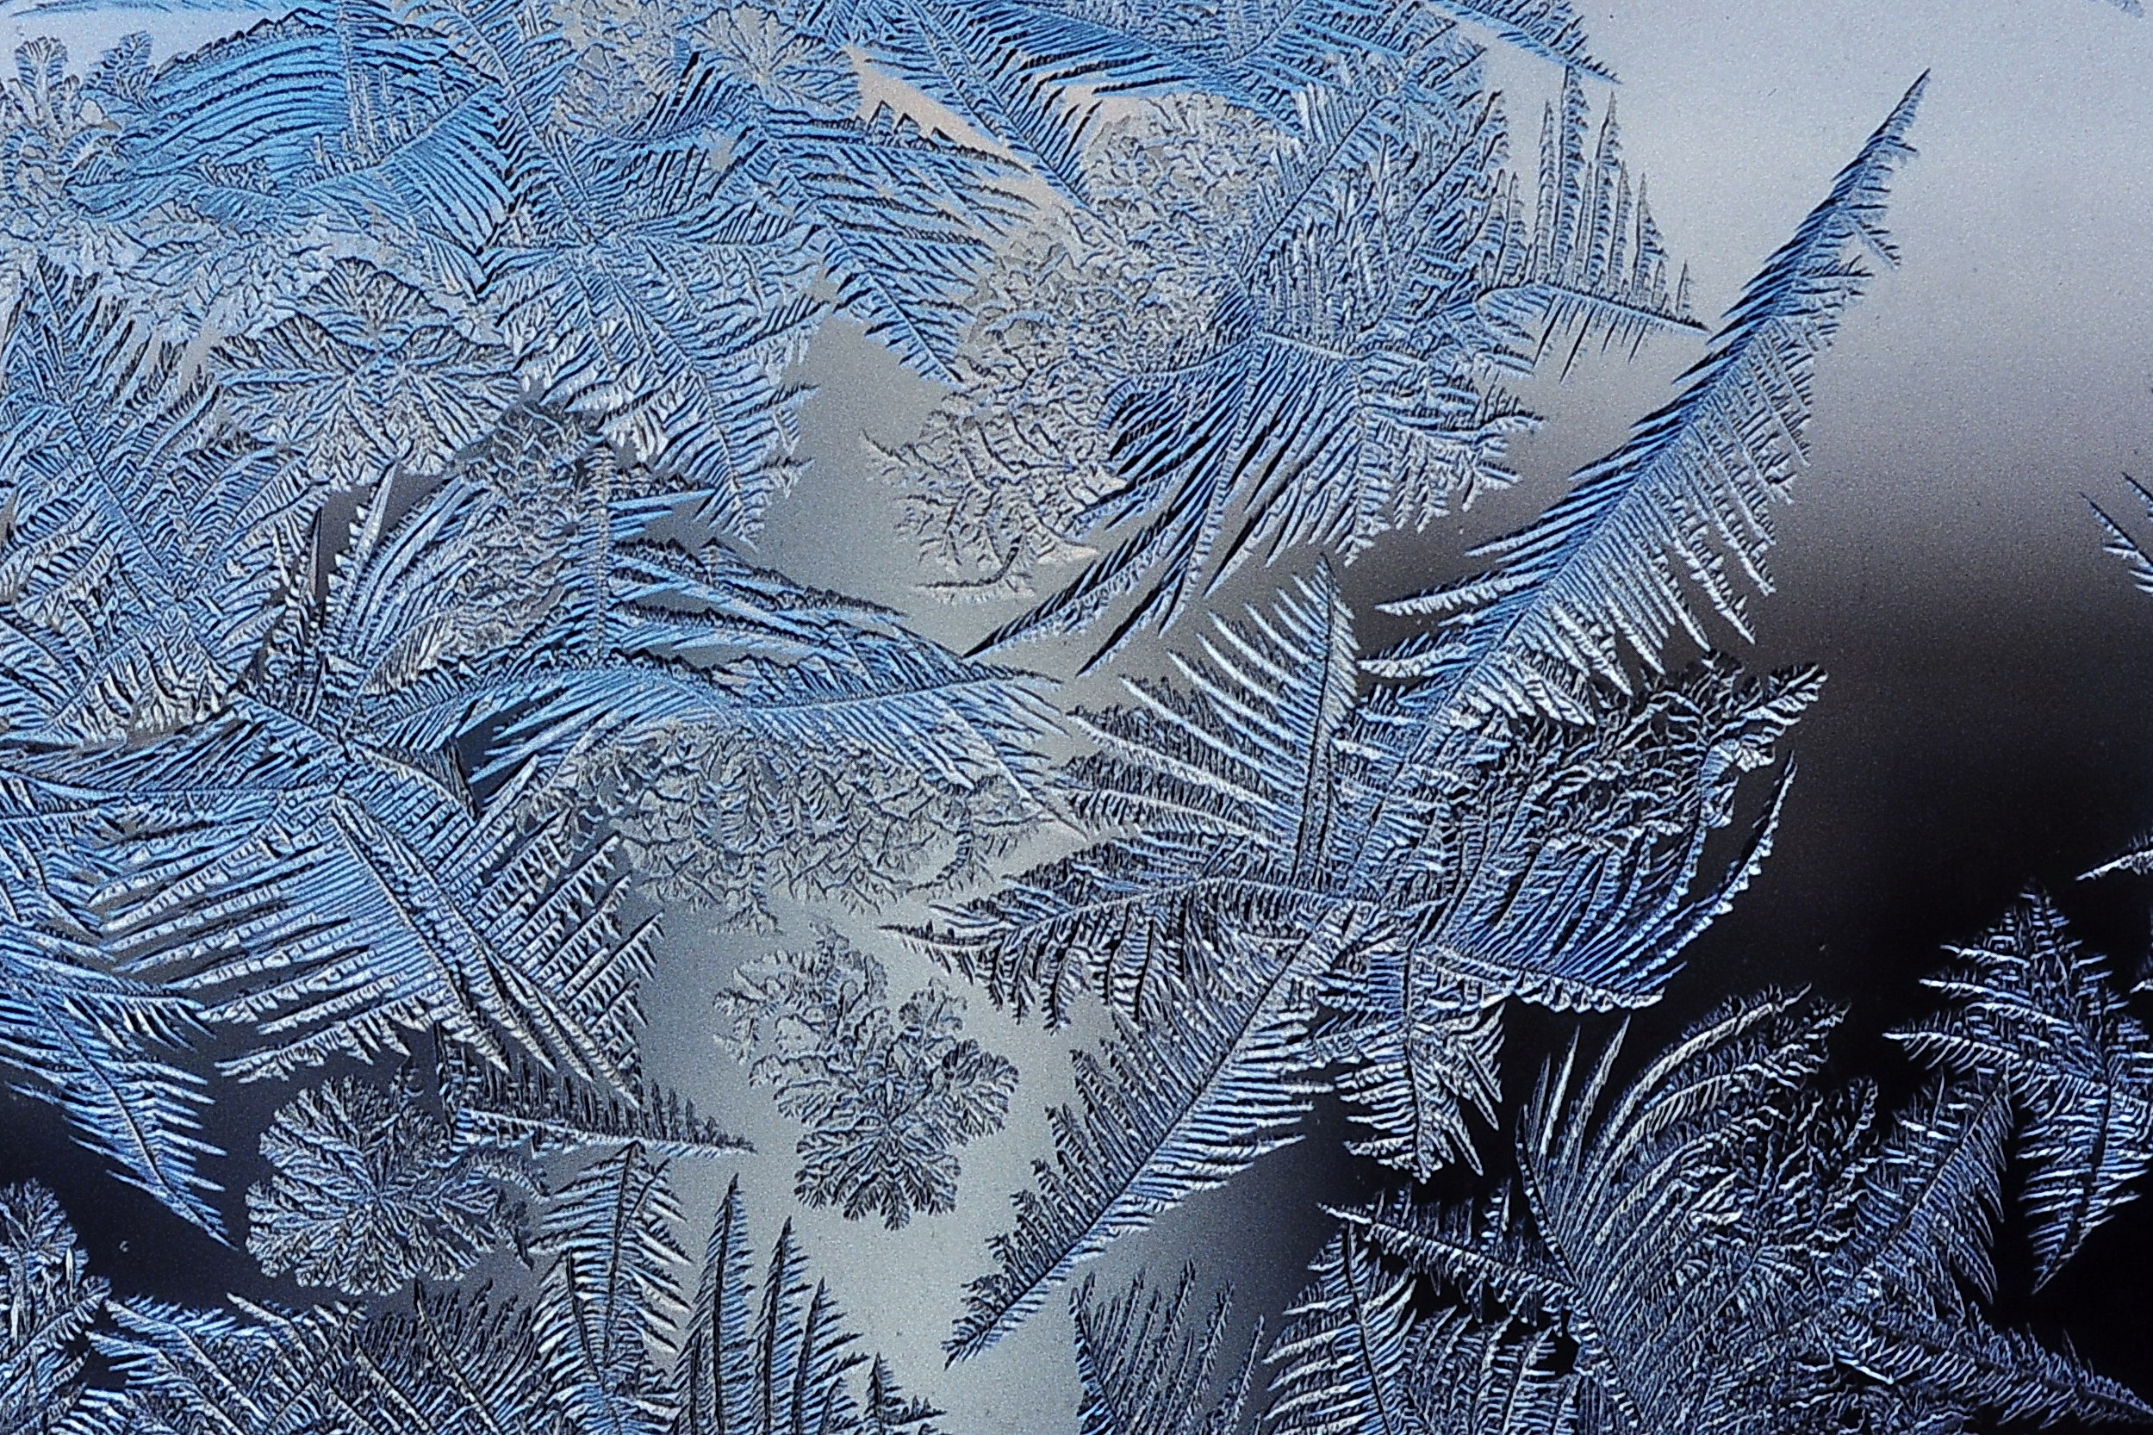
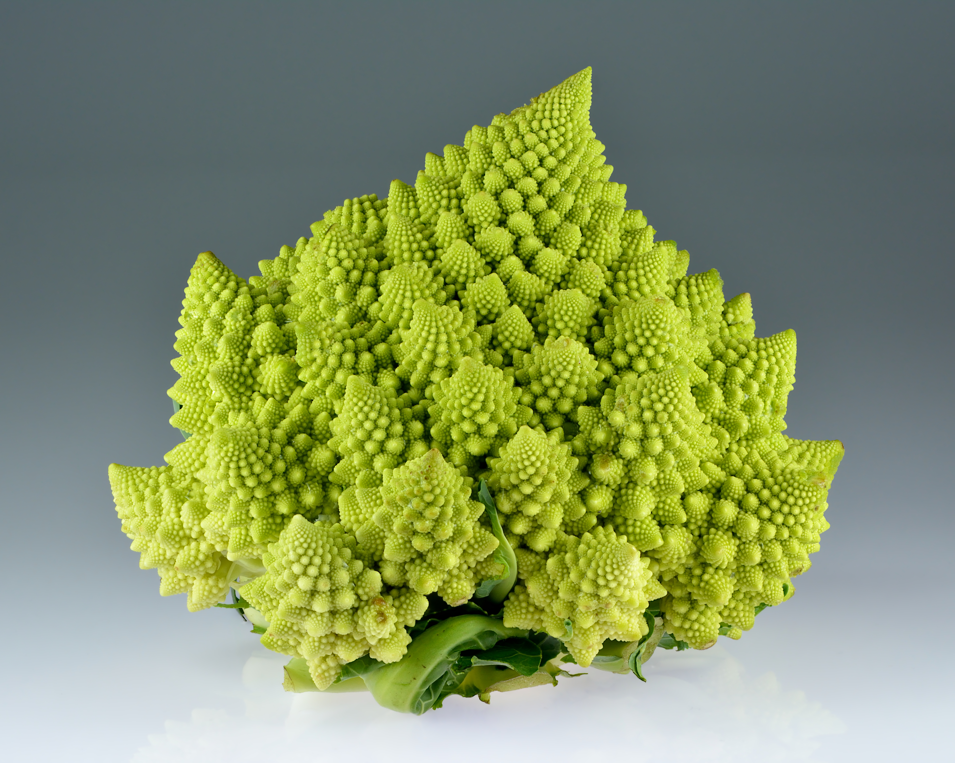
Examples: Fractals in Nature
Ice Crystals on Glass
Romanescu

Slide 27
Notes:
Los pulmones humanos
tubo

Slide 28
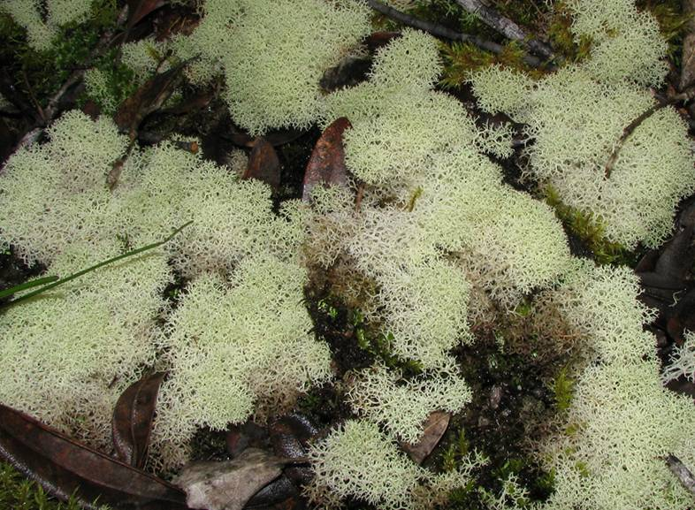
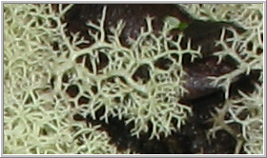
A sponge: Cladina Confusa Lichen (Rangitoto Island, New Zealand)

Slide 29
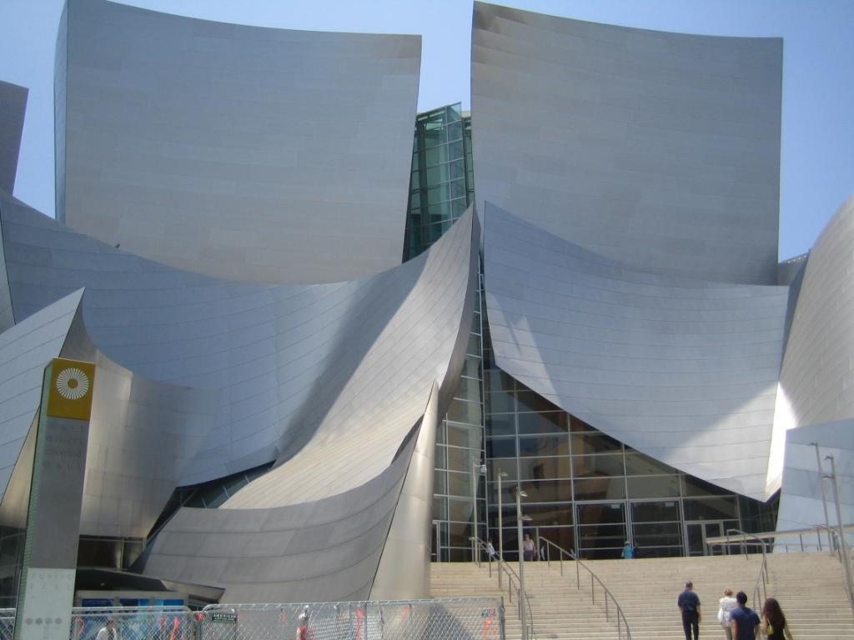
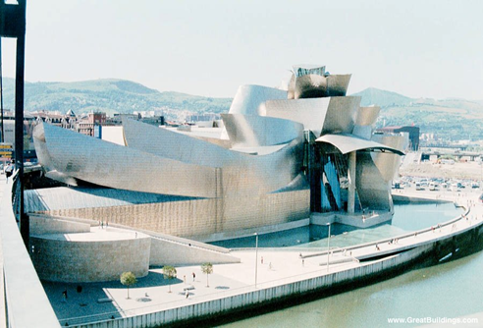
Example: Guggenheim Museum Bilbao
Design by Frank Gehry, based on self-similarity, 1997.
Notes:
El museo guggenhein en neuva york.

Slide 30
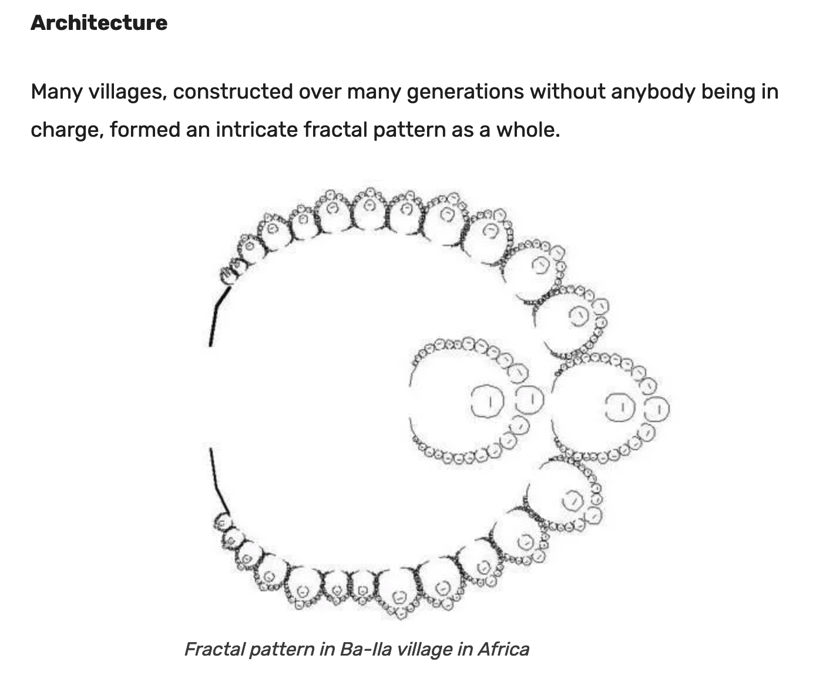
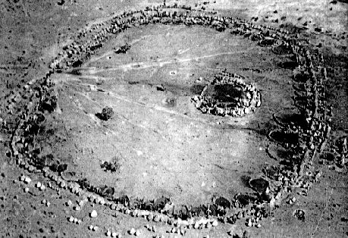
Example: African Architecture
A common theme in traditional African architecture is the use of fractal scaling, whereby small parts of the structure tend to look similar to larger parts, such as a circular village made of circular houses.

Slide 31
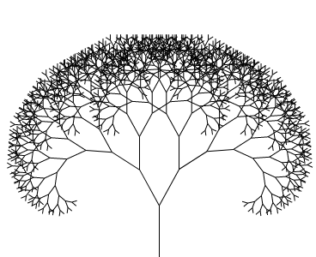

Example: A Fractal Tree
The fractal “tree” to eleven iterations or repetitions (affine transformations)

Slide 32
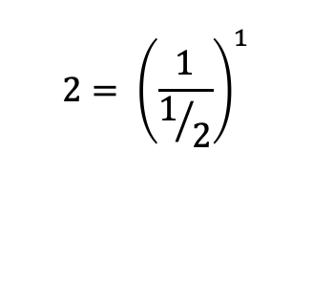
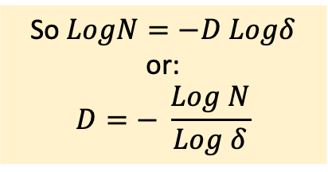
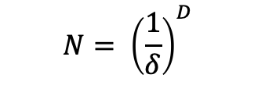
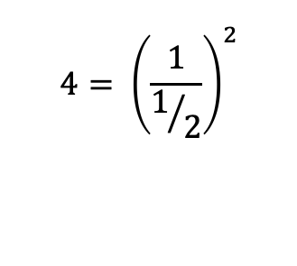
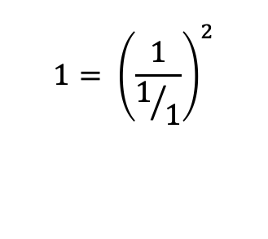
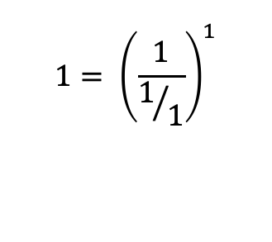
$$N= {\left(\frac{1}{δ}\right)}^{D}$$
Dimension
Basic Equation
The Meaning of Dimension
Number of pieces
Scale
So $LogN=−D Logδ$
or:
$$D=− \frac{Log N}{Log δ}$$
D = 1
$$1= {\left(\frac{1}{1/1}\right)}^{2}$$
$$1= {\left(\frac{1}{1/1}\right)}^{1}$$
D = 2
$$4= {\left(\frac{1}{1/2}\right)}^{2}$$
$$2= {\left(\frac{1}{1/2}\right)}^{1}$$
Familiar Examples with Integer Dimension

Slide 33
Dividing, Scaling and Repetition
This idea of being detailed relates to another feature that can be understood without much mathematical background
Having a fractal dimension greater than its topological dimension, for instance, refers to how a fractal scales compared to how geometric shapes are usually perceived.
A straight line, for instance, is conventionally understood to be one-dimensional
If such a figure is repeatedly divided (“rep-tiled”) and scaled into pieces each 1/3 the length of the original, then there are always three equal pieces.
A solid square is understood to be two-dimensional
If such a figure is rep-tiled into pieces each scaled down by a factor of 1/3 in both dimensions, there are a total of 32 = 9 pieces.

Slide 34
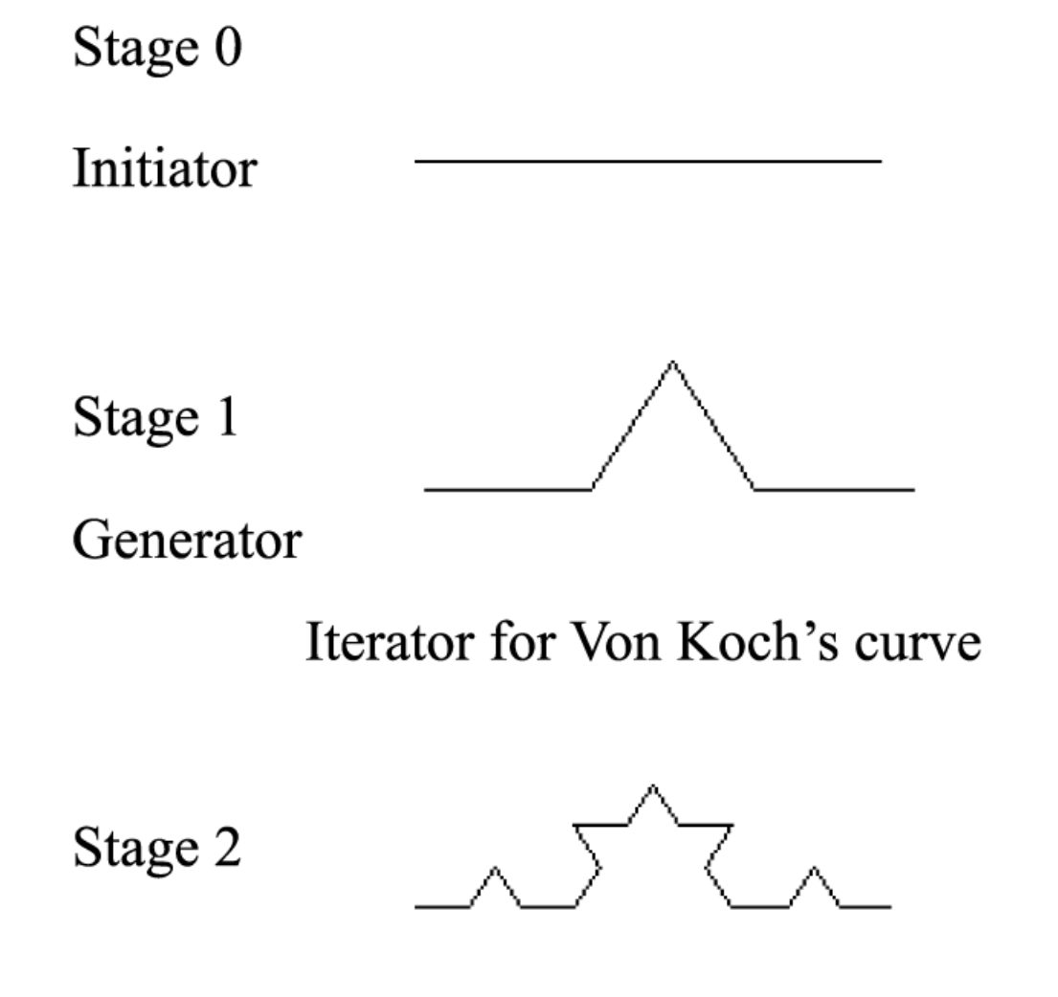
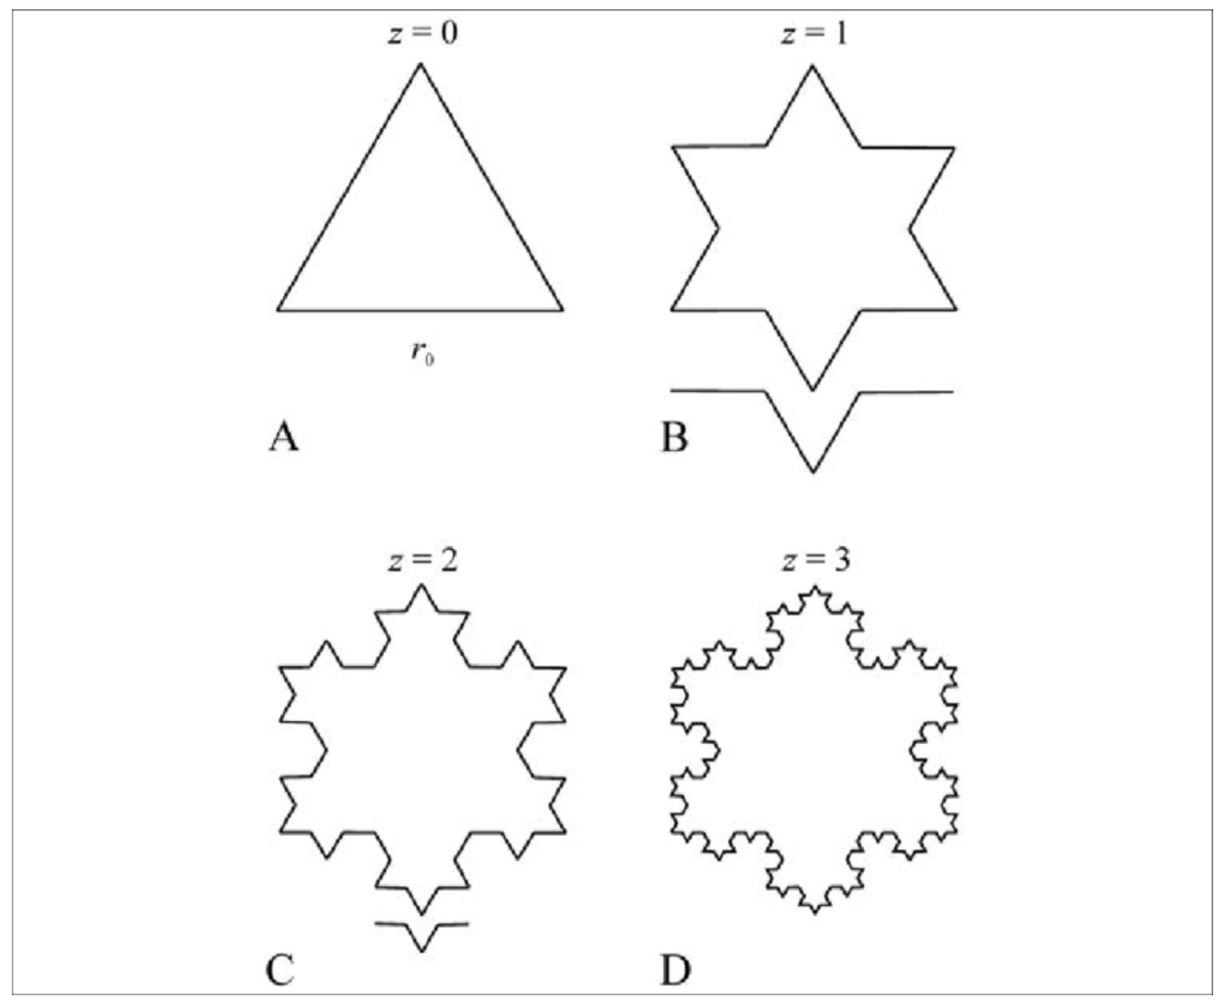
Von Koch Curve https://courseworkbank.info/coursework/IB/Maths/math-portfolio-the-koch-snowflake-investigation.pdf https://www.researchgate.net/figure/Sequential-construction-of-the-von-Koch-curve-set-A-The-initiator-is-the-equilateral_fig1_261985071

Slide 35
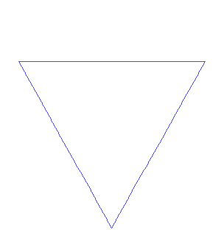
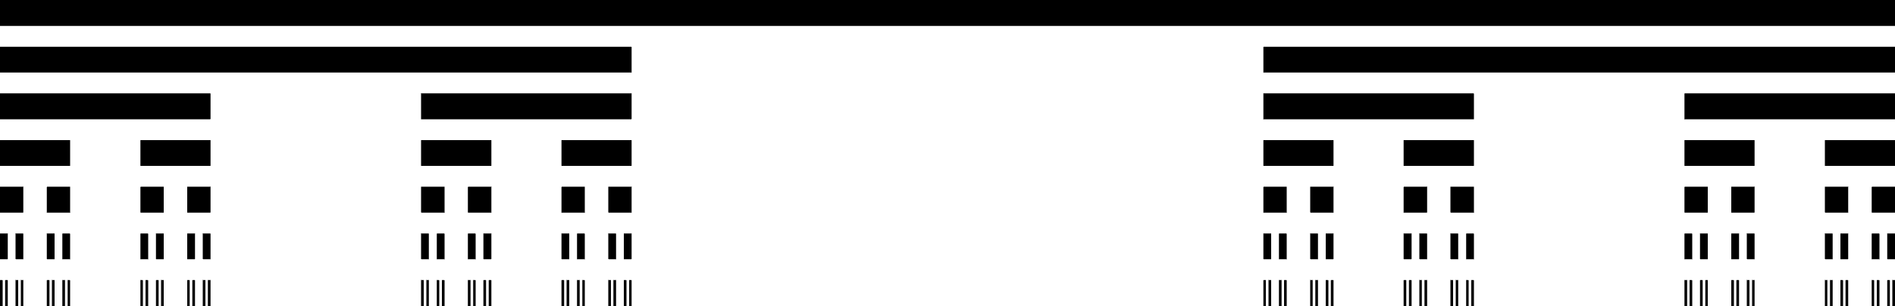
Example: Scaling and Repetition (“Iteration”)
Von Koch Snowflake
Cantor Middle Thirds Set
Initiator
Generator

Slide 36
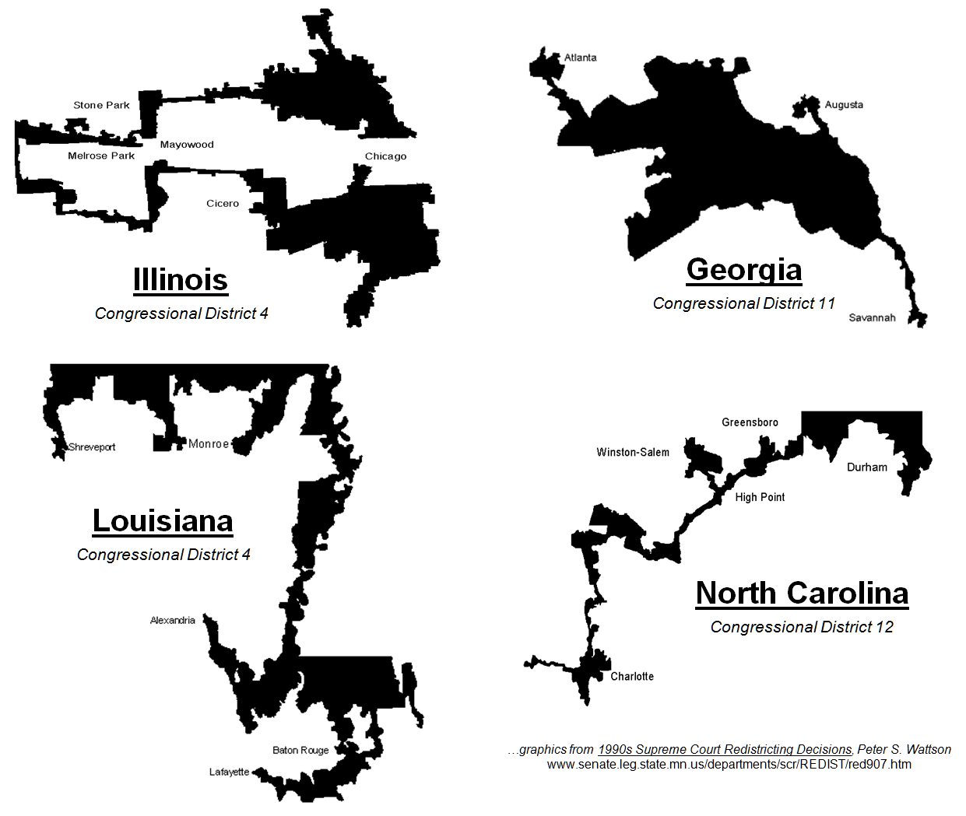
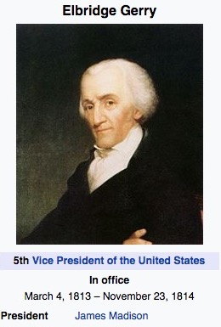
“Gerrymandering” (Elbridge Gerry, 1744-1814)
Fractal (?) Congressional Districts
Possible Fractals?

Slide 37
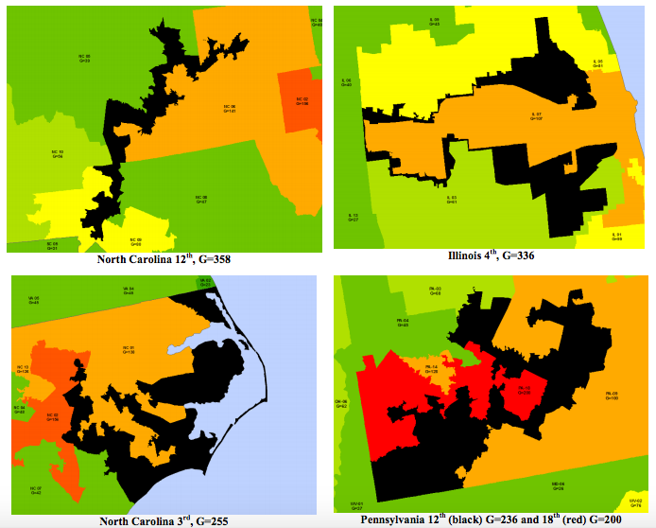
“Gerrymandering” (Elbridge Gerry, 1744-1814)
Fractal (?) Congressional Districts

Slide 38
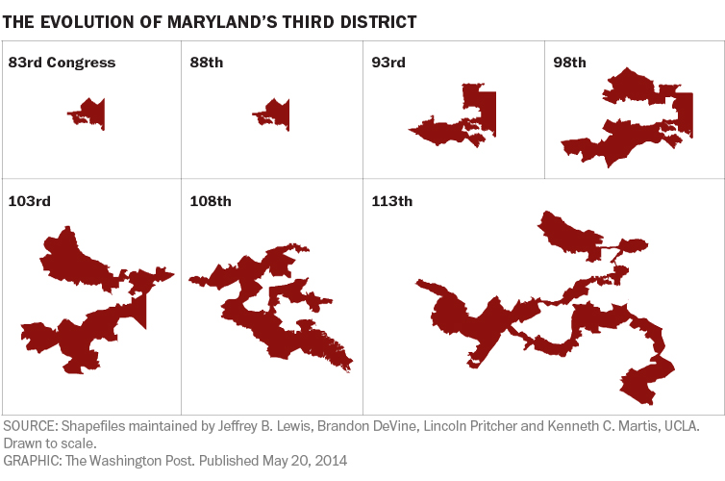
“Gerrymandering” (Elbridge Gerry, 1744-1814)
Fractal (?) Congressional Districts
D = 1

Slide 39
Iteration (Scaling and Repetition)
We see that for ordinary self-similar objects, being n-dimensional means that when it is repetitively tiled (“rep-tiled”) into pieces each scaled down by a scale-factor of 1/r, there are a total of r^{n} pieces.
Now, consider the Von Koch curve. It can be rep-tiled into four sub-copies, each scaled down by a scale-factor of 1/3.
So, strictly by analogy, we can consider the "dimension" of the Koch curve as being the unique real number D that satisfies 3^{D} = 4 (this will be discussed in more detail later: D = 1.26186…)
This number is what mathematicians call the fractal dimension of the Koch curve; it is certainly not what is conventionally perceived as the dimension of a curve (this number is not even an integer!).
The fact that the Koch curve has a fractal dimension differing from its conventionally understood dimension (that is, its topological dimension) is what makes it a fractal.

Slide 40
Measuring Fractals
This also leads to understanding a third feature, that fractals as mathematical equations are "nowhere differentiable".
In a concrete sense, this means fractals cannot be measured in traditional ways.
To elaborate, in trying to find the length of a wavy non-fractal curve, one could find straight segments of some measuring tool small enough to lay end to end over the waves, where the pieces could get small enough to be considered to conform to the curve in the normal manner of measuring with a tape measure.
But in measuring an infinitely "wiggly" fractal curve such as the Koch snowflake, one would never find a small enough straight segments to conform to the curve, because the jagged pattern would always re-appear, at arbitrarily small scales, essentially pulling a little more of the tape measure into the total length measured each time one attempted to fit it tighter and tighter to the curve.
The result is that one must need an infinitely long tape to perfectly cover the entire curve, i.e. the snowflake has an infinite perimeter

Slide 41
Aside: Measuring Sizes of a “Normal” Euclidean Geometric Object
Measuring the length of a line L:
  Use a ruler of length L_{Ruler}
  Cover the line of length L with N_{Ruler} non-overlapping rulers as best as possible
  Then N_{Ruler} L_{Ruler} --> L , as L_{Ruler} --> 0
  Measuring the area of a shape A:
    Use a box of area A_{Box}
    Cover the area A with with N_{Box} non-overlapping boxes as best as possible
    Then Then N_{Box} A_{Box} --> A , as A_{Box} --> 0

Slide 42
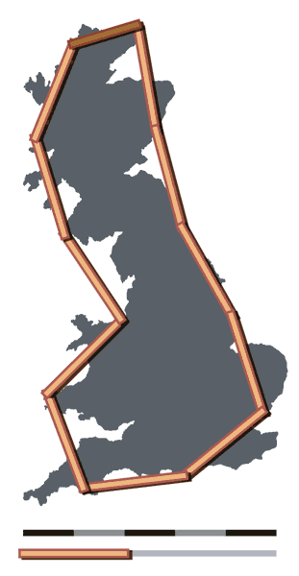
How Long is the Coastline of Britain?
Result: As the unit of length (“ruler” or unit of measure) decreases, the total length of the coastline (number of rulers it takes to cover the coastline) always increases.
This would not be true for a smooth curve.
Unit = 200 km, length = 2400 km (approx.)
Unit = 50 km, length = 3400 km (approx.)

Slide 43
History
In his writings, Leibniz used the term "fractional exponents", but lamented that "Geometry" did not yet know of them.
Indeed, according to various historical accounts, after that point few mathematicians tackled the issues and the work of those who did remained obscured largely because of resistance to such unfamiliar emerging concepts, which were sometimes referred to as mathematical "monsters".
Thus, it was not until two centuries had passed that on July 18, 1872 Karl Weierstrass presented the first definition of a function with a graph that would today be considered a fractal, having the non-intuitive property of being everywhere continuous but nowhere differentiable at the Royal Prussian Academy of Sciences.

Slide 44
History
Not long after that, in 1883, Georg Cantor, who attended lectures by Weierstrass, published examples of subsets of the real line known as Cantor sets, which had unusual properties and are now recognized as fractals.
Also in the last part of that century, Felix Klein and Henri Poincaré introduced a category of fractal that has come to be called "self-inverse" fractals.
Cantor Middle Thirds Set

Slide 45
History
One of the next milestones came in 1904, when Helge von Koch, extending ideas of Poincaré and dissatisfied with Weierstrass's abstract and analytic definition, gave a more geometric definition including hand-drawn images of a similar function, which is now called the Koch snowflake.
Another milestone came a decade later in 1915, when Wacław Sierpiński constructed his famous triangle then, one year later, his carpet.
By 1918, two French mathematicians, Pierre Fatou and Gaston Julia, though working independently, arrived essentially simultaneously at results describing what is now seen as fractal behavior associated with mapping complex numbers and iterative functions and leading to further ideas about attractors and repellors (i.e., points that attract or repel other points under some dynamical rule), which have become very important in the study of fractals.

Slide 46
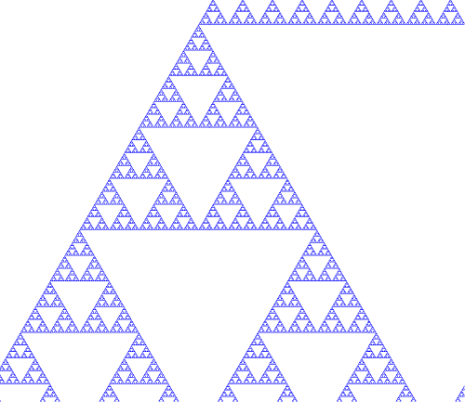
History: Sierpinski Triangle and Koch Snowflake
(next lecture will explore in more detail several methods to create these )

Slide 47
History
Very shortly after that work was submitted, by March 1918, Felix Hausdorff expanded the definition of "dimension", significantly for the evolution of the definition of fractals, to allow for sets to have non-integer dimensions.
Hausdorff dimensions are particularly important in time series analysis
Different researchers have postulated that without the aid of modern computer graphics, early investigators were limited to what they could depict in manual drawings, so lacked the means to visualize the beauty and appreciate some of the implications of many of the patterns they had discovered (the Julia set, for instance, could only be visualized through a few iterations as very simple drawings).
That changed, however, in the 1960s, when Benoit Mandelbrot started writing about self-similarity in papers such as How Long Is the Coast of Britain? Statistical Self-Similarity and Fractional Dimension, which built on earlier work by Lewis Fry Richardson.

Slide 48
History
In 1975, Mandelbrot solidified hundreds of years of thought and mathematical development in coining the word "fractal" and illustrated his mathematical definition with striking computer-constructed visualizations.
These images, such as of his canonical Mandelbrot set, captured the popular imagination; many of them were based on recursion, leading to the popular meaning of the term "fractal".
The Mandelbrot Set, which is a complex number extension of the Logistic Map)

Slide 49
Definitions and Characteristics
One often cited description that Mandelbrot published to describe geometric fractals is "a rough or fragmented geometric shape that can be split into parts, each of which is (at least approximately) a reduced-size copy of the whole"
Authors disagree on the exact definition of fractal, but most usually elaborate on the basic ideas of self-similarity and the unusual relationship fractals have with the space they are embedded in.
One point agreed on is that fractal patterns are characterized by fractal dimensions, but whereas these numbers quantify complexity (i.e., changing detail with changing scale), they neither uniquely describe nor specify details of how to construct particular fractal patterns.
In 1975 when Mandelbrot coined the word "fractal", he did so to denote an object whose Hausdorff–Besicovitch dimension is greater than its topological dimension.
However, this requirement is not met by space-filling curves such as the Hilbert curve, which we will discuss

Slide 50
Definitions and Characteristics
Fractals are “Self Similar”, which may include:
Exact self-similarity: identical at all scales, such as the Koch snowflake
Quasi self-similarity: approximates the same pattern at different scales; may contain small copies of the entire fractal in distorted and degenerate forms. For example, the Mandelbrot set's satellites are approximations of the entire set, but not exact copies.
Statistical self-similarity: repeats a pattern stochastically so numerical or statistical measures are preserved across scales; e.g., randomly generated fractals like the well-known example of the coastline of Britain for which one would not expect to find a segment scaled and repeated as neatly as the repeated unit that defines fractals like the Koch snowflake.
Qualitative self-similarity: as in a time series
Multifractal scaling: characterized by more than one fractal dimension or scaling rule

Slide 51
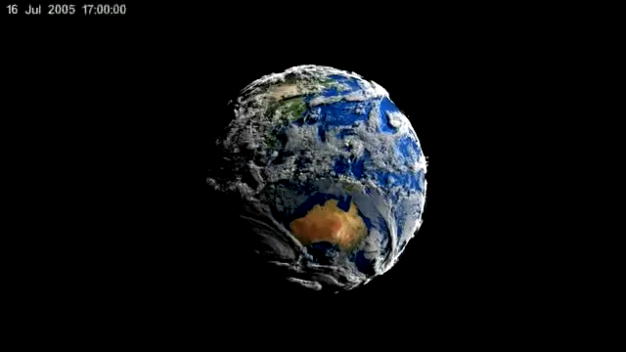
Other Characteristics
Fine or detailed structure at arbitrarily small scales.
A consequence of this structure is fractals may have emergent properties , which arise from the dynamics or structure of the system as a whole, rather than from its constituent parts
Irregularity locally and globally also can occur that is not easily described in traditional Euclidean geometric language.
For images of fractal patterns, this has been expressed by phrases such as "smoothly piling up surfaces" and "swirls upon swirls”, which is common in the process of turbulence in fluids
Simple and "perhaps recursive" definitions, which are common techniques for generating fractals.
As a group, these criteria form guidelines for excluding certain cases, such as those that may be self-similar without having other typically fractal features. A straight line, for instance, is self-similar but not fractal because it lacks detail, is easily described in Euclidean language, has the same Hausdorff dimension as topological dimension, and is fully defined without a need for recursion

Slide 52
Sensitive Dependence
Sensitive dependence is a characteristic of both fractals and chaos
The butterfly effect is the sensitive dependence on initial conditions in which a small change in one state of a deterministic nonlinear system can result in large differences in a later state.
The term is closely associated with the work of mathematician and meteorologist Edward Lorenz.
He noted that butterfly effect is derived from the metaphorical example of the details of a tornado (the exact time of formation, the exact path taken) being influenced by minor perturbations such as a distant butterfly flapping its wings several weeks earlier.
Lorenz discovered the effect when he observed runs of his weather model with initial condition data that were rounded in a seemingly inconsequential manner.
He noted that the weather model would fail to reproduce the results of runs with the unrounded initial condition data.
A very small change in initial conditions had created a significantly different outcome.

Slide 53
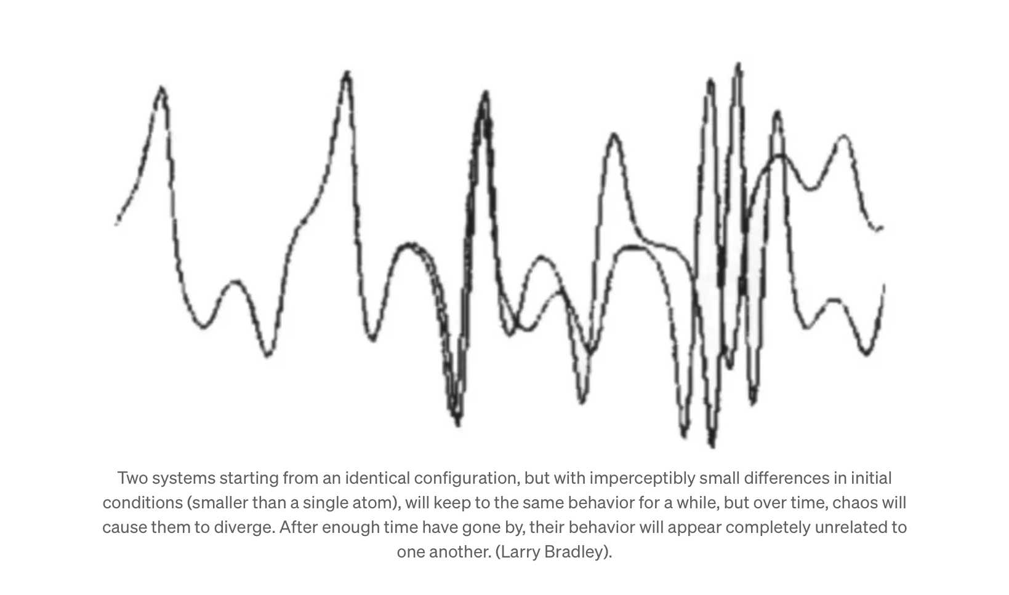
Ed Lorenz Discovered Sensitive Dependence in his Computer Output https://medium.com/starts-with-a-bang/chaos-theory-the-butterfly-effect-and-the-computer-glitch-that-started-it-all-6460bac8ad6a

Slide 54
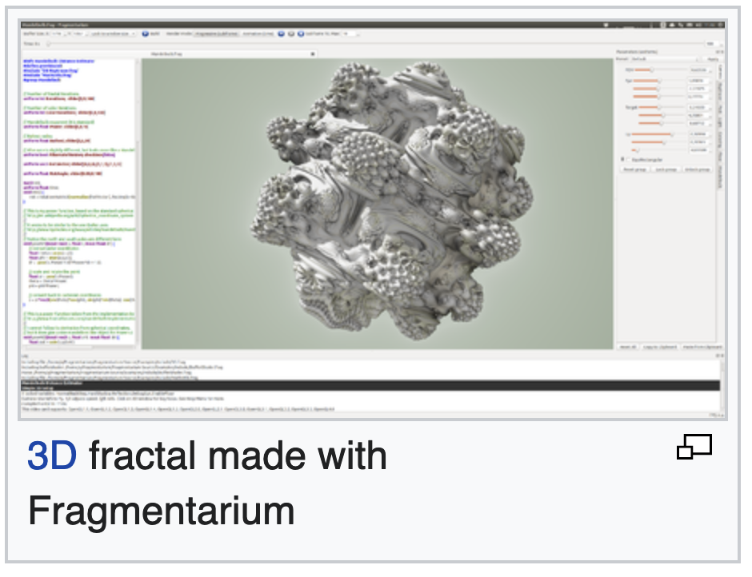
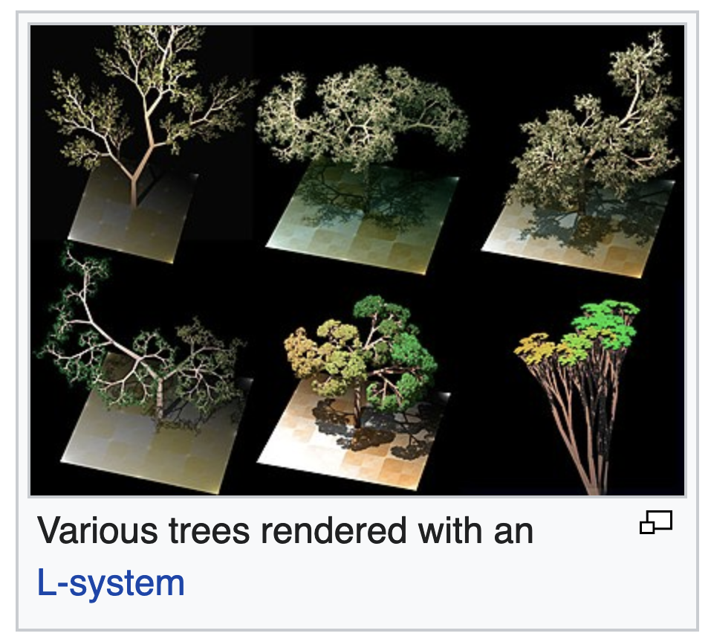
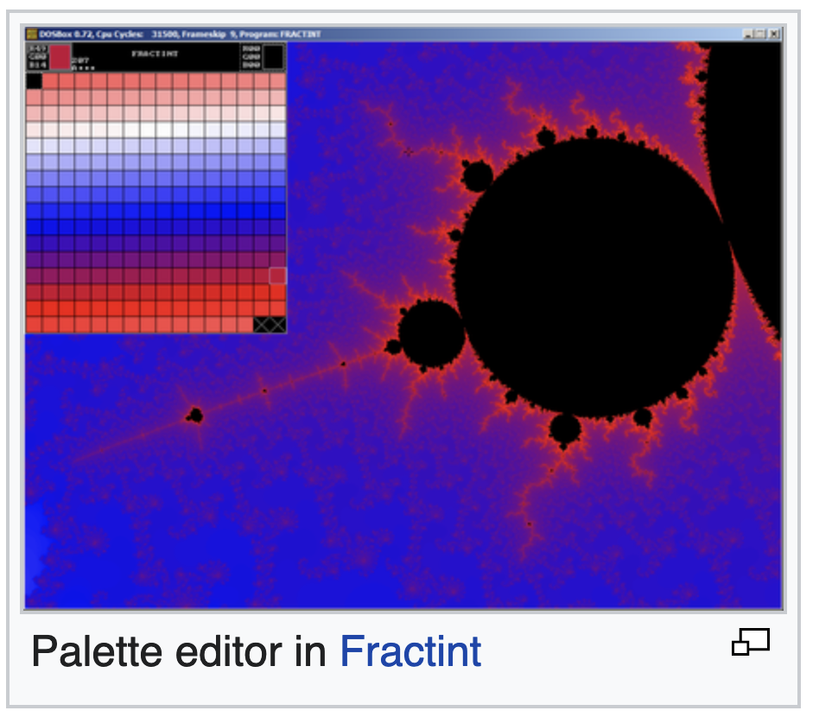
Generating Fractals – Methods https://en.wikipedia.org/wiki/Fractal-generating_software

Slide 55


Simulated Fractals: Diffusion Limited Aggregation https://en.wikipedia.org/wiki/Diffusion-limited_aggregation
Diffusion-limited aggregation (DLA) is the process whereby particles undergoing a random walk due to Brownian motion cluster together to form aggregates of such particles.
This theory, proposed by T.A. Witten Jr. and L.M. Sander in 1981,[1] is applicable to aggregation in any system where diffusion is the primary means of transport in the system.
DLA can be observed in many systems such as electrodeposition, Hele-Shaw flow, mineral deposits, and dielectric breakdown.

Slide 56


Simulated Fractals
Simulated River Network.
Ecology and Evolution, Volume: 10, Issue: 14, Pages: 7537-7550, First published: 30 June 2020, DOI: (10.1002/ece3.6479)
Simulated Mountain Range

Slide 57

Simulated River Networks
Simulated River Network.
Ecology and Evolution, Volume: 10, Issue: 14, Pages: 7537-7550, First published: 30 June 2020, DOI: (10.1002/ece3.6479)

Slide 58
Generating Fractals – Methods https://en.wikipedia.org/wiki/Fractal-generating_software
Iterated function systems (IFS):
  Use fixed geometric replacement rules;
  May be stochastic or deterministic
  Examples include Koch snowflake, Cantor set, Haferman carpet, Sierpinski carpet, Sierpinski gasket, Peano curve, Harter-Heighway dragon curve, T-square, Menger sponge
Strange attractors:
  Use iterations of a map or solutions of a system of initial-value differential or difference equations that exhibit chaos
  Examples include multifractal images, or the logistic map
  L-systems:
    Use string rewriting;
    May resemble branching patterns, such as in plants, biological cells
    Examples include neurons and immune system cells, blood vessels, pulmonary structure
    Or turtle graphics patterns such as space-filling curves and tilings

Slide 59
Generating Fractals - Methods
Random fractals:
  Use stochastic rules
  Examples include Lévy flight, percolation clusters, self avoiding walks, fractal landscapes, trajectories of Brownian motion and the Brownian tree, which are dendritic fractals generated by modeling diffusion-limited aggregation or reaction-limited aggregation clusters
Finite subdivision rules:
  Use a recursive topological algorithm for refining tilings
  They are similar to the process of cell division.
  The iterative processes used in creating the Cantor set and the Sierpinski carpet are examples of finite subdivision rules

Slide 60
Simulating Fractals
Fractal patterns have been modeled extensively, albeit within a range of scales rather than infinitely, owing to the practical limits of physical time and space.
Models may simulate theoretical fractals or natural phenomena with fractal features. The outputs of the modelling process may be highly artistic renderings, outputs for investigation, or benchmarks for fractal analysis.
Some specific applications of fractals to technology are listed elsewhere.
Images and other outputs of modelling are normally referred to as being "fractals" even if they do not have strictly fractal characteristics, such as when it is possible to zoom into a region of the fractal image that does not exhibit any fractal properties.
Also, these may include calculation or display artifacts which are not characteristics of true fractals.

Slide 61

https://en.wikipedia.org/wiki/Fractal

