Slide 1
Fractals, Chaos, Complexity
Physics-EPS 30
Lecture 3
Fractal Dimensions
https://en.wikipedia.org/wiki/Fractal_dimension

Slide 2
Symmetry
Symmetry in everyday language refers to a sense of harmonious and beautiful proportion and balance.
In mathematics, "symmetry" has a more precise definition, and is usually used to refer to an object that is invariant under some transformations; including translation, reflection, rotation or scaling.
Although these two meanings of "symmetry" can sometimes be told apart, they are intricately related, and here are discussed together.
In geometry, an object has symmetry if there is an operation or transformation (such as translation, scaling, rotation or reflection) that maps the figure/object onto itself (i.e., the object has an invariance under the transform).
Scale invariance is a type of symmetry

Slide 3
Symmetry
A geometric shape or object is symmetric if it can be divided into two or more identical pieces that are arranged in an organized fashion.
This means that an object is symmetric if there is a transformation that moves individual pieces of the object but doesn't change the overall shape. The type of symmetry is determined by the way the pieces are organized, or by the type of transformation:
An object has reflection symmetry (line or mirror symmetry) if there is a line (or in 3D a plane) going through it which divides it into two pieces that are mirror images of each other.
An object has rotational symmetry if the object can be rotated about a fixed point (or in 3D about a line) without changing the overall shape.
An object has translational symmetry if it can be translated (moving every point of the object by the same distance) without changing its overall shape
An object has scale symmetry if it does not change shape when it is expanded or contracted.
Fractals also exhibit a form of scale symmetry, where smaller portions of the fractal are similar in shape to larger portions.

Slide 4
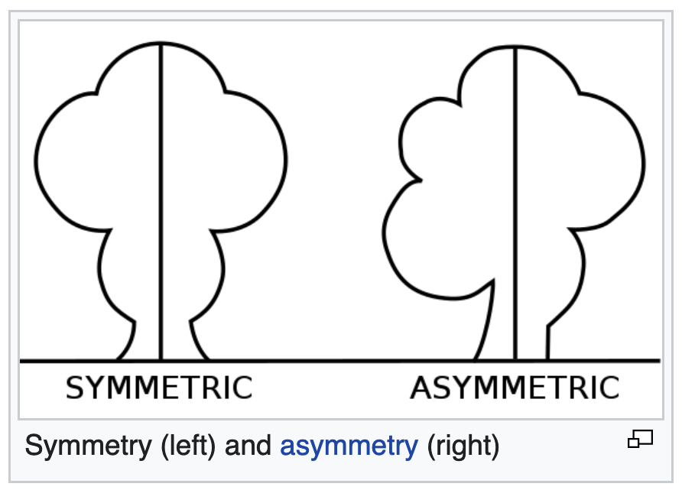
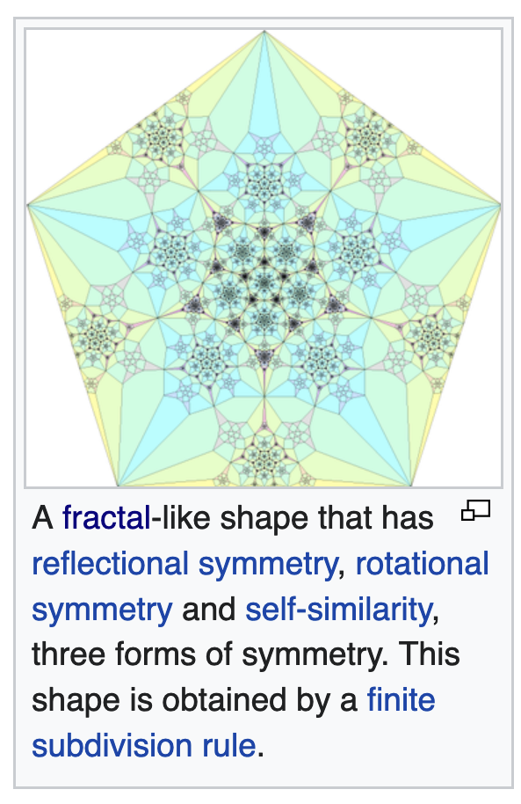
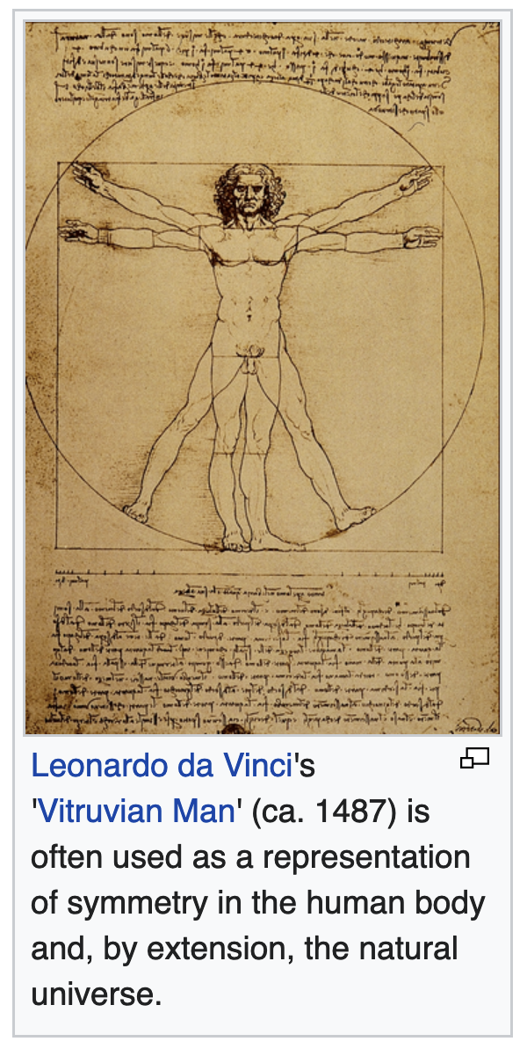
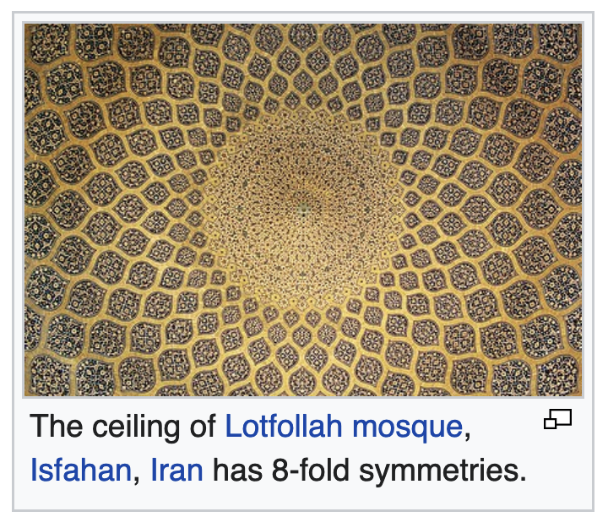
Examples of Symmetries

Slide 5
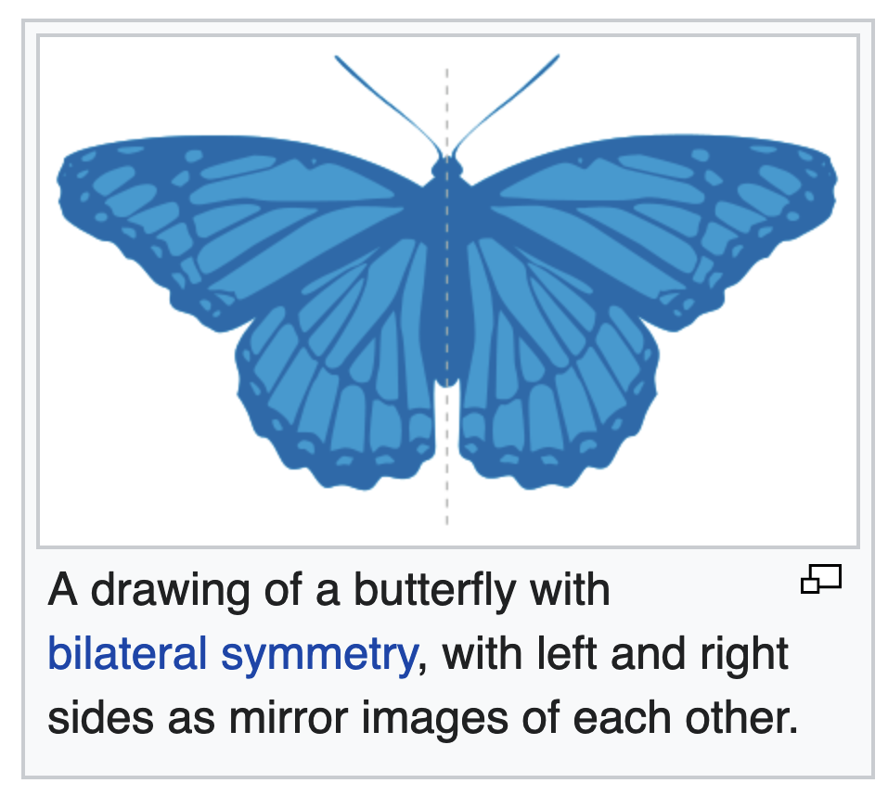
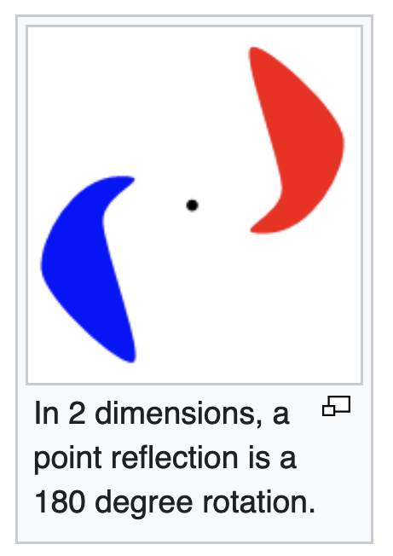
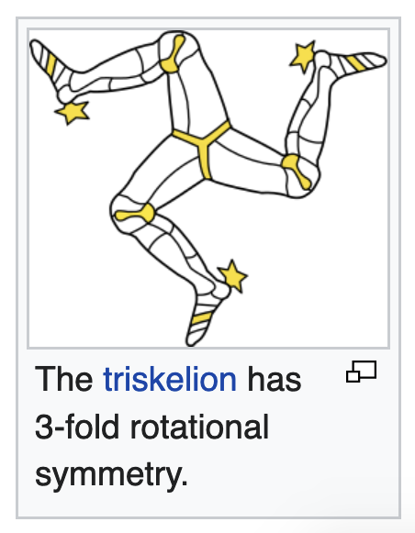
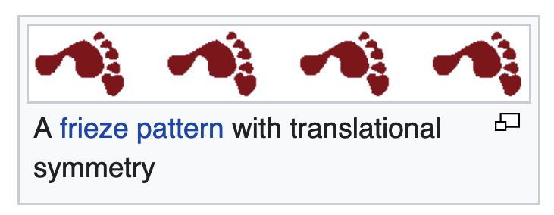
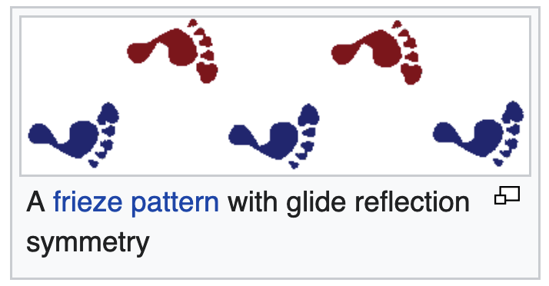
Examples of Symmetries https://en.wikipedia.org/wiki/Symmetry_(geometry)

Slide 6
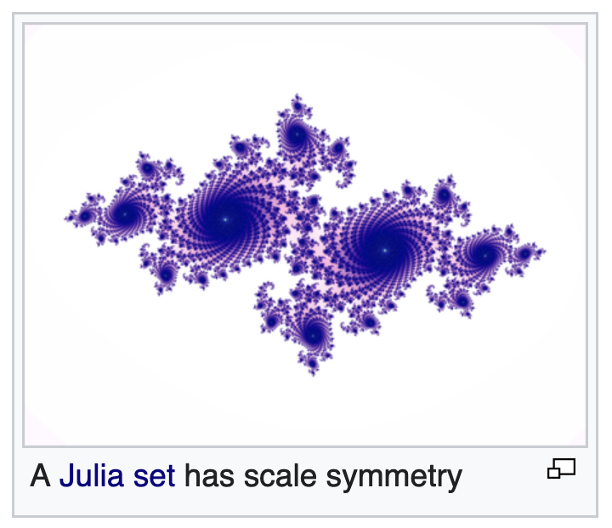
Scaling Symmetries
Scale symmetry means that if an object is expanded or reduced in size, the new object has the same properties as the original.
This is not true of most physical systems, as witness the difference in the shape of the legs of an elephant and a mouse (so-called allometric scaling).
Similarly, if a soft wax candle were enlarged to the size of a tall tree, it would immediately collapse under its own weight.
A more subtle form of scale symmetry is demonstrated by fractals.
As conceived by Benoît Mandelbrot, fractals are a mathematical concept in which the structure of a complex form looks similar at any degree of magnification, well seen in the Mandelbrot set.
A coast is an example of a naturally occurring fractal, since it retains similar-appearing complexity at every level from the view of a satellite to a microscopic examination of how the water laps up against individual grains of sand.
The branching of trees, which enables small twigs to stand in for full trees in dioramas, is another example.

Slide 7
Fractal Dimensions
A fractal dimension D is an index for characterizing fractal patterns or sets by quantifying their complexity as a ratio of the change in detail to the change in scale.
Several types of fractal dimension can be measured theoretically and empirically
Fractal dimensions are used to characterize a broad spectrum of objects ranging from the abstract to practical phenomena, including turbulence, river networks, urban growth, human physiology, medicine, and market trends.
As we have seen, the essential idea of fractional or fractal dimensions has a long history in mathematics that can be traced back to the 1600s, but the terms fractal and fractal dimension were coined by mathematician Benoit Mandelbrot in 1975.

Slide 8
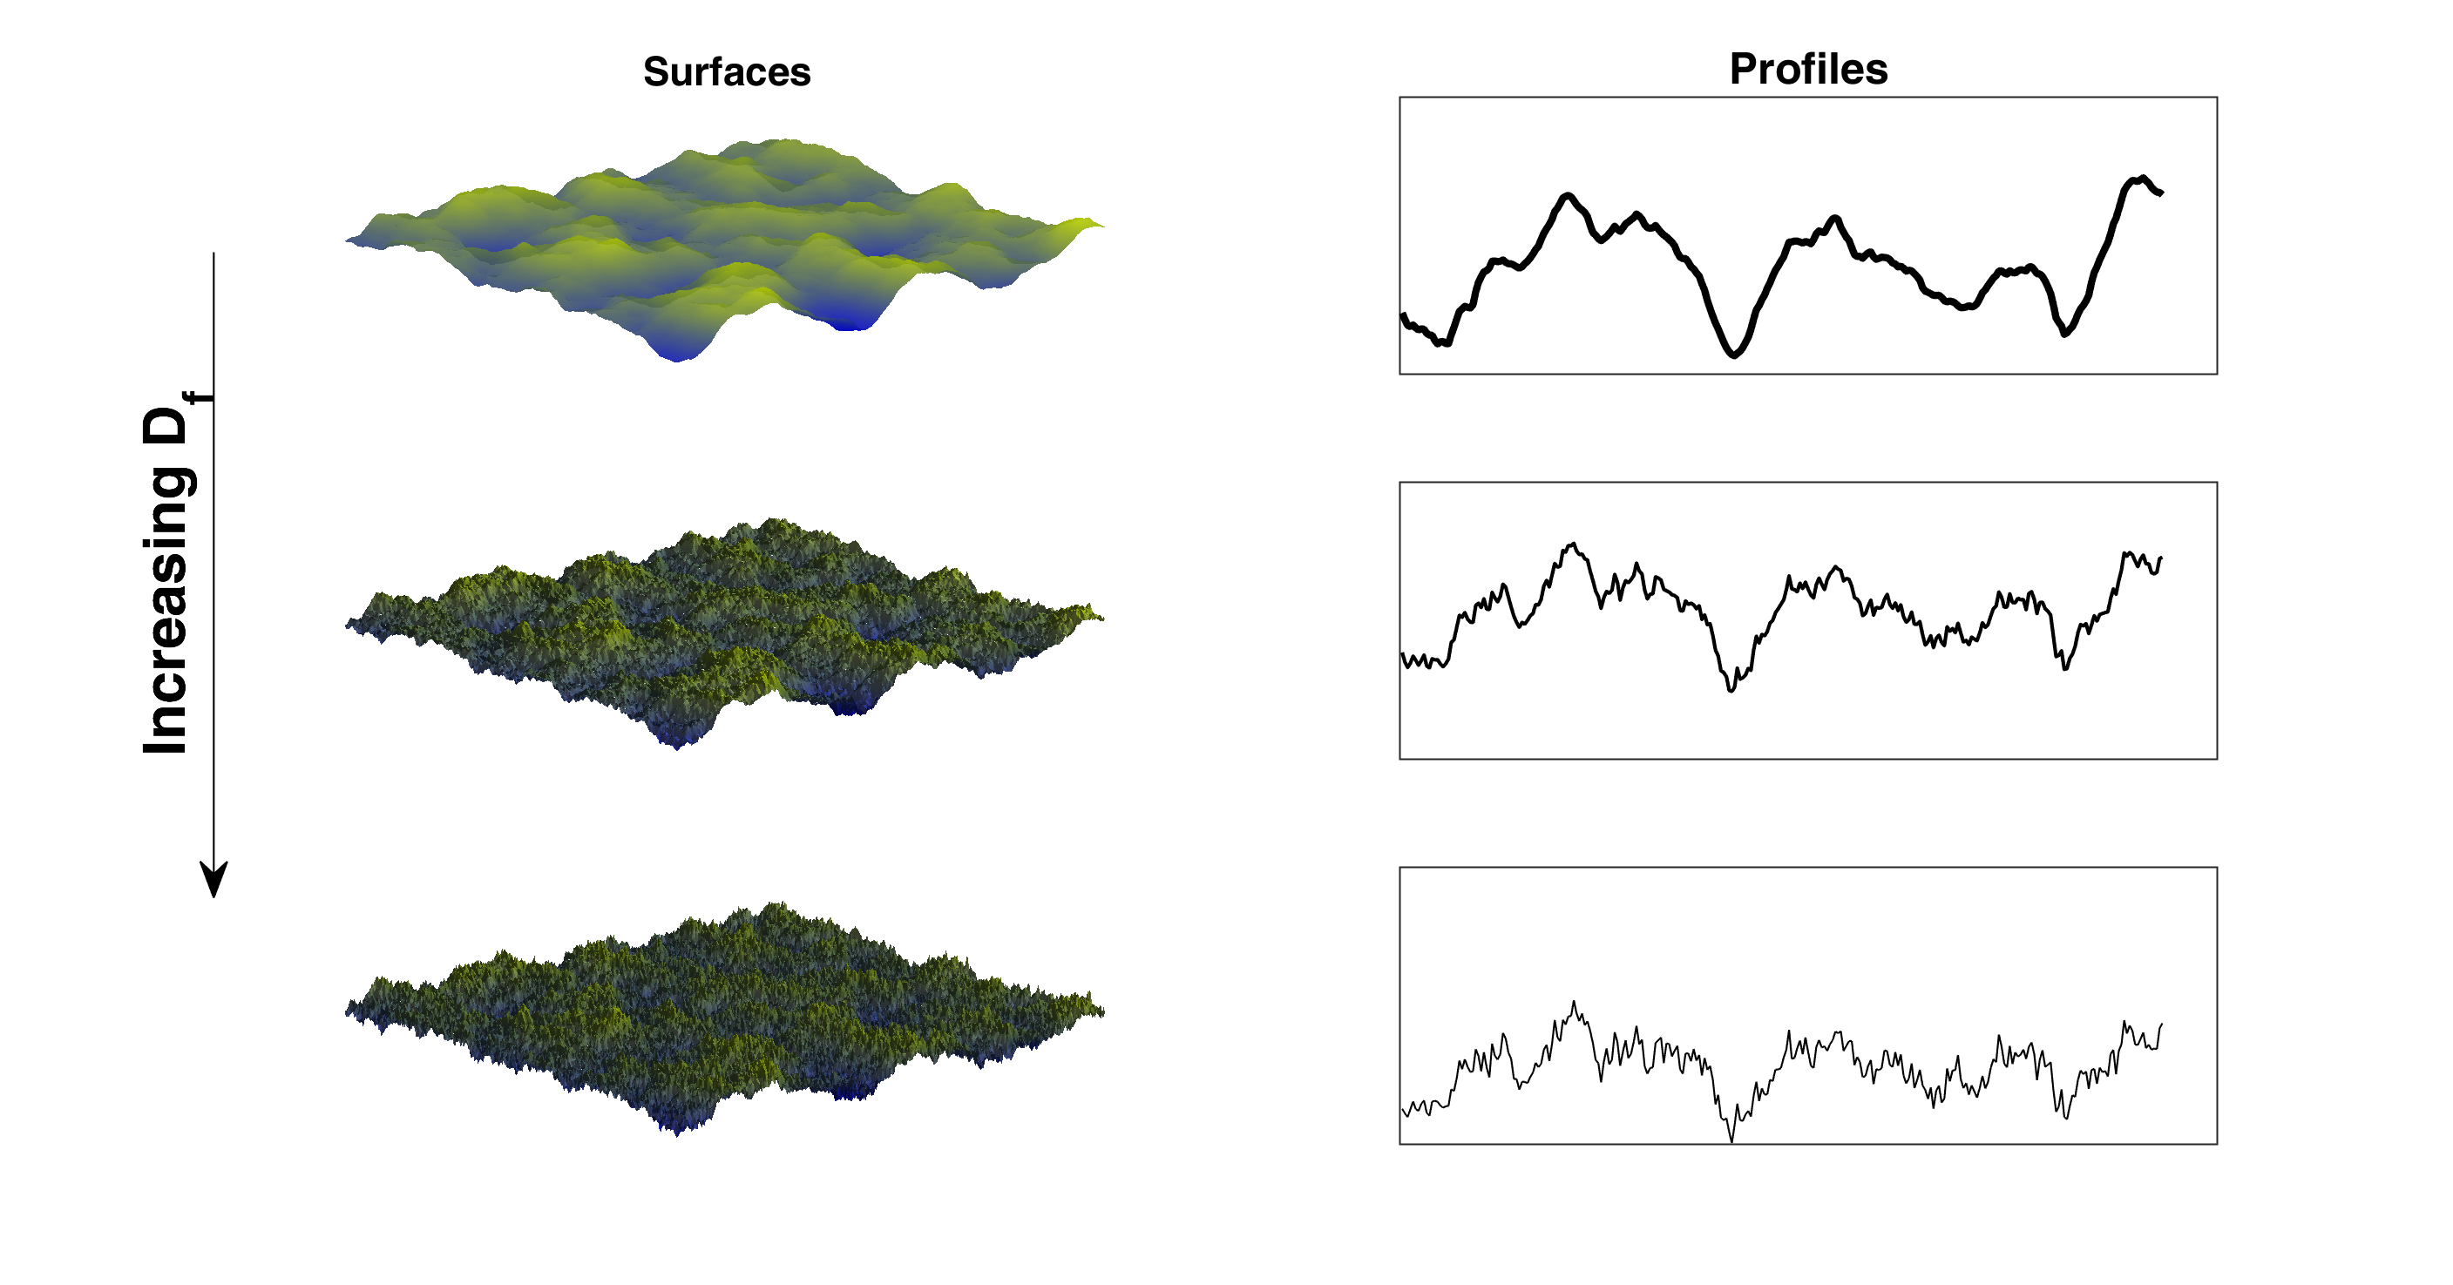
Fractal Dimensions
Unlike topological dimensions, the fractal dimension can take non-integer values, indicating that a set fills its space qualitatively and quantitatively differently from how an ordinary geometrical set does.
For instance, a curve with a fractal dimension very near to 1, say 1.10, behaves quite like an ordinary line, but a curve with fractal dimension 1.9 winds convolutedly through space very nearly like a surface.
Similarly, a surface with fractal dimension of 2.1 fills space very much like an ordinary surface, but one with a fractal dimension of 2.9 folds and flows to fill space rather nearly like a volume.
Illustration of increasing surface fractality. Self-affine surfaces (left) and corresponding surface profiles (right) showing increasing fractal dimension D

Slide 9
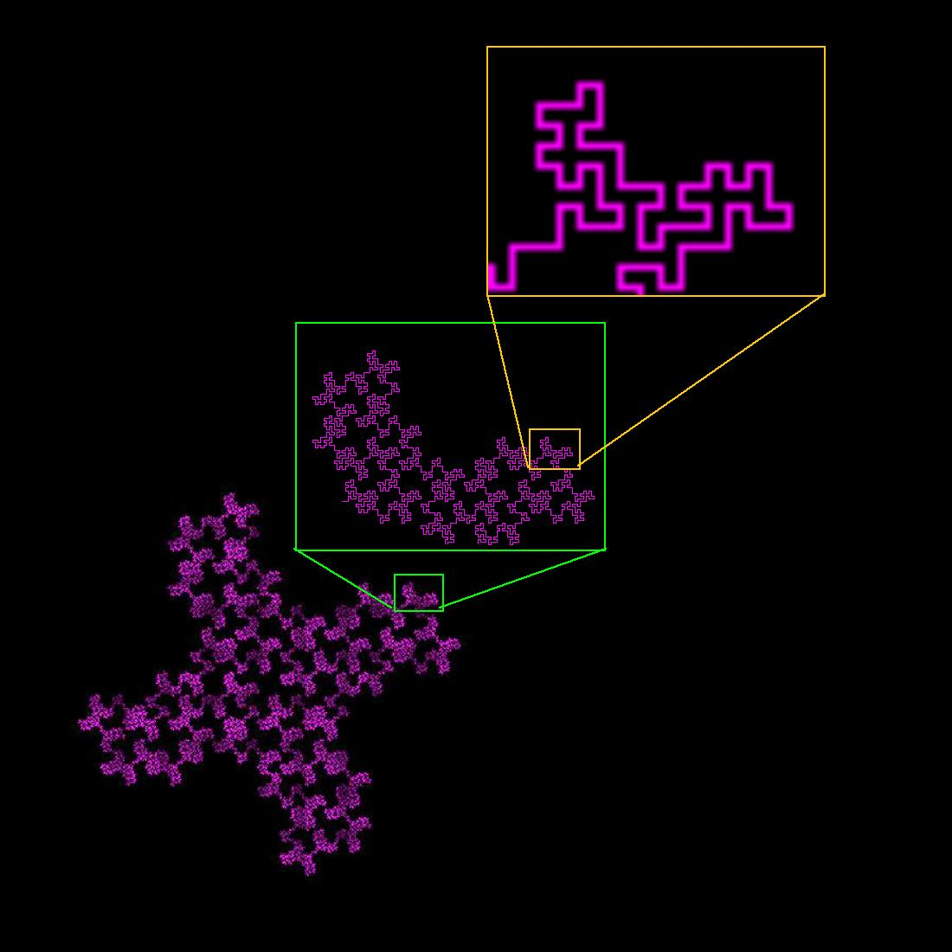
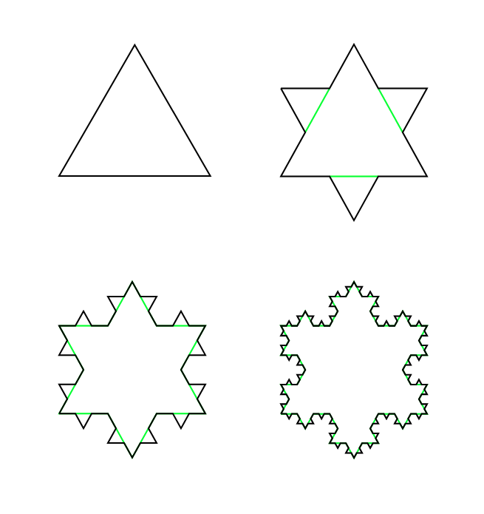
Fractal Dimensions
This general relationship can be seen in the image of fractal curves at right
The 32-segment contour at top is convoluted and space filling, and has a fractal dimension D of 1.67
  Each linear segment of length 8 is replaced by 32 smaller segments at each finer scale
  Fractal dimension D is defined as 8^{D} = 32
Compared to the perceptibly less complex Koch curve below, which has a fractal dimension D of 1.26
  Each linear segment of length 3 is replaced by 4 smaller segments at each finer scale
  Fractal dimension D is defined so that 3^{D} = 4
For example, it is thought that the surface of the human brain might be a fractal: https://pubmed.ncbi.nlm.nih.gov/16671080/

Slide 10
Fractal Dimensions
The relationship of an increasing fractal dimension with space-filling might be taken to mean fractal dimensions measure density, but that is not so
Instead, a fractal dimension measures complexity, a concept related to certain key features of fractals, self-similarity and detail or irregularity.
These features are evident in the two examples of fractal curves at right
Both are curves with topological dimension of 1 (they consist of many line segments)
One might therefore hope to be able to measure their length and derivative in the same way as with ordinary curves. (NOT!)

Slide 11
Fractal Dimensions
Fractal curves have complexity in the form of self-similarity and detail that ordinary curves lack.
The self-similarity lies in the infinite scaling, and the detail in the defining elements of each set.
The length between any two points on these curves is infinite, no matter how close together the two points are, which means that it is impossible to approximate the length of such a curve by partitioning the curve into many small segments.
Every smaller piece is composed of an infinite number of scaled segments that look exactly like the first iteration.
These are not rectifiable curves, meaning they cannot be measured by being broken down into many segments approximating their respective lengths.
They cannot be meaningfully characterized by finding their lengths and derivatives.
However, their fractal dimensions can be determined, which shows that both fill space more than ordinary lines but less than surfaces

Slide 12
Fractal Dimensions
Overall, fractals show several types and degrees of self-similarity and detail that may not be easily visualized.
These include, as examples
  Strange attractors that characterizes chaotic dynamics
  Julia sets, which can be seen to be complex swirls upon swirls
  Heart rates, which are patterns of rough spikes repeated and scaled in time.
  The coastline of Britain, for instance, exhibits self-similarity of an approximate pattern with approximate scaling
Fractal complexity may not always be resolvable into easily grasped units of detail and scale without complex analytic methods, but it is still quantifiable through fractal dimensions

Slide 13
Euclidean Dimension and Embedding Dimension
For sets describing ordinary geometric shapes, the theoretical fractal dimension equals the set's familiar (integer) Euclidean dimension.
Thus:
  D = 0 for sets describing points (0-dimensional sets);
  D = 1 for sets describing lines (1-dimensional sets having length only);
  D = 2 for sets describing surfaces (2-dimensional sets having length and width);
  D = 3 for sets describing volumes (3-dimensional sets having length, width, and height).
But this changes for fractal sets.
If the fractal dimension of a set is not an integer, the set is considered to have fractal geometry.
The Embedding Dimension is the (integer) dimension of the space in which the fractal is contained

Slide 14
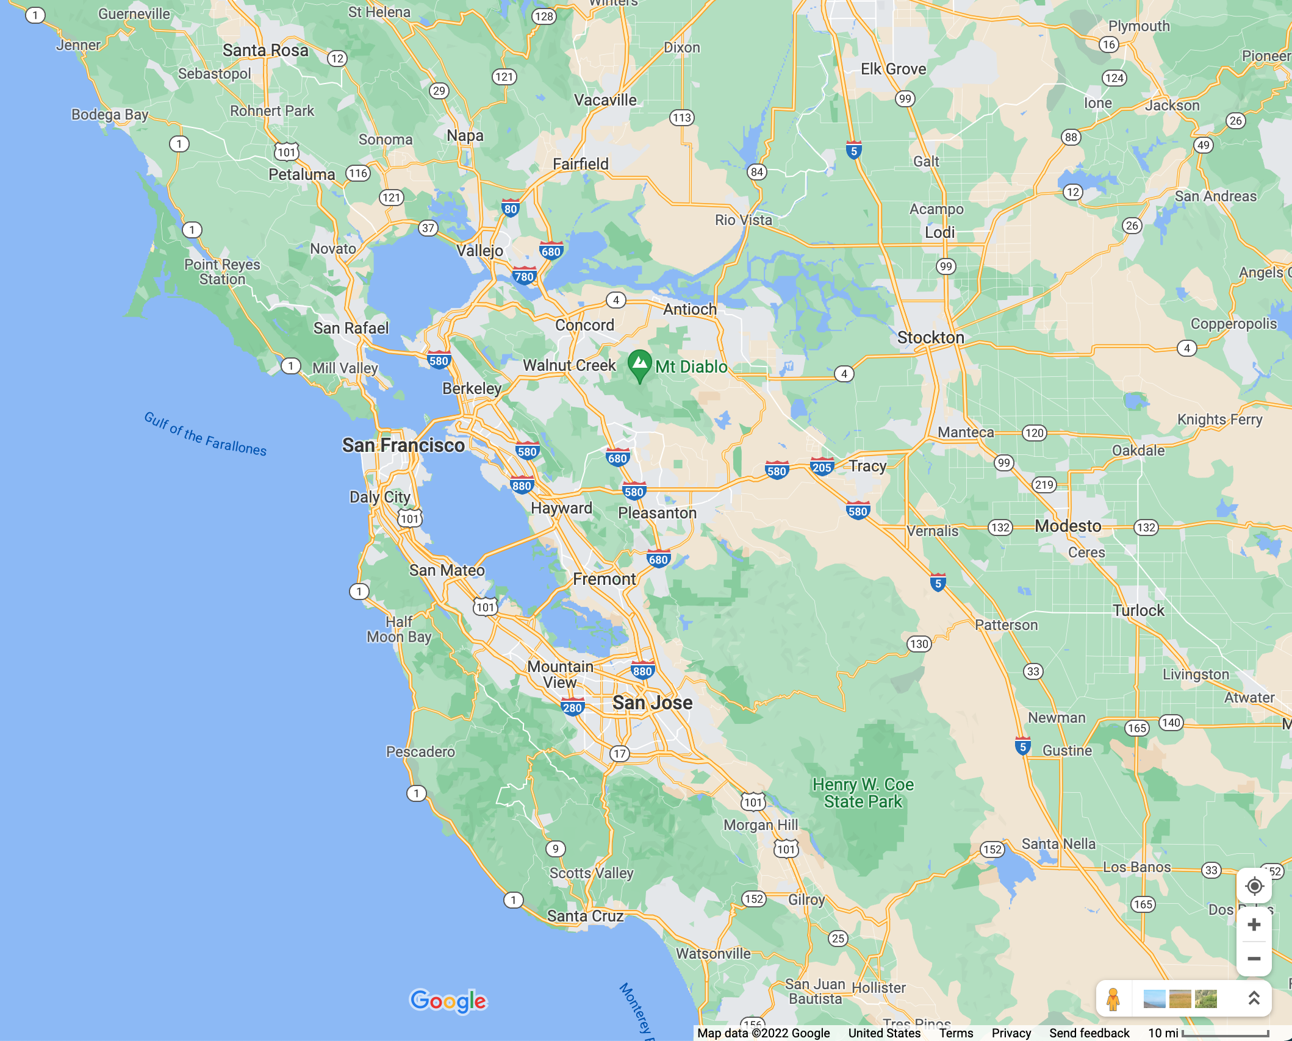
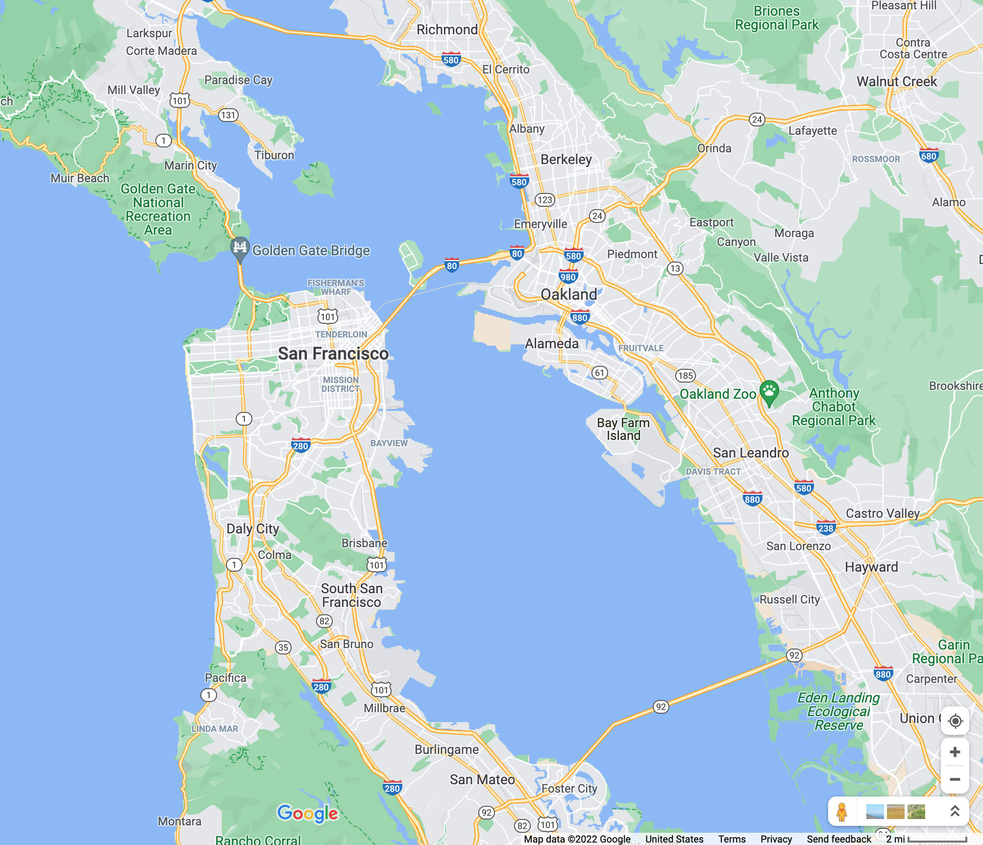
Change of Scale: A Symmetry of Fractals
Zoom In
Scale Bar δ_{Α}
= 10 Miles
Scale Bar δ_{Β}
= 2 Miles
A
B
Change of length for the scale bar:
δ_{Α} (i.e., = 10 miles) = (1/S) ∗ δ_{Β} (i.e., = 2 miles)
Here S = 1/5. A value S < 1 represents a Zoom in (magnification). S > 1 represents a Zoom out (contraction).
S is called a “scale factor”

Slide 15
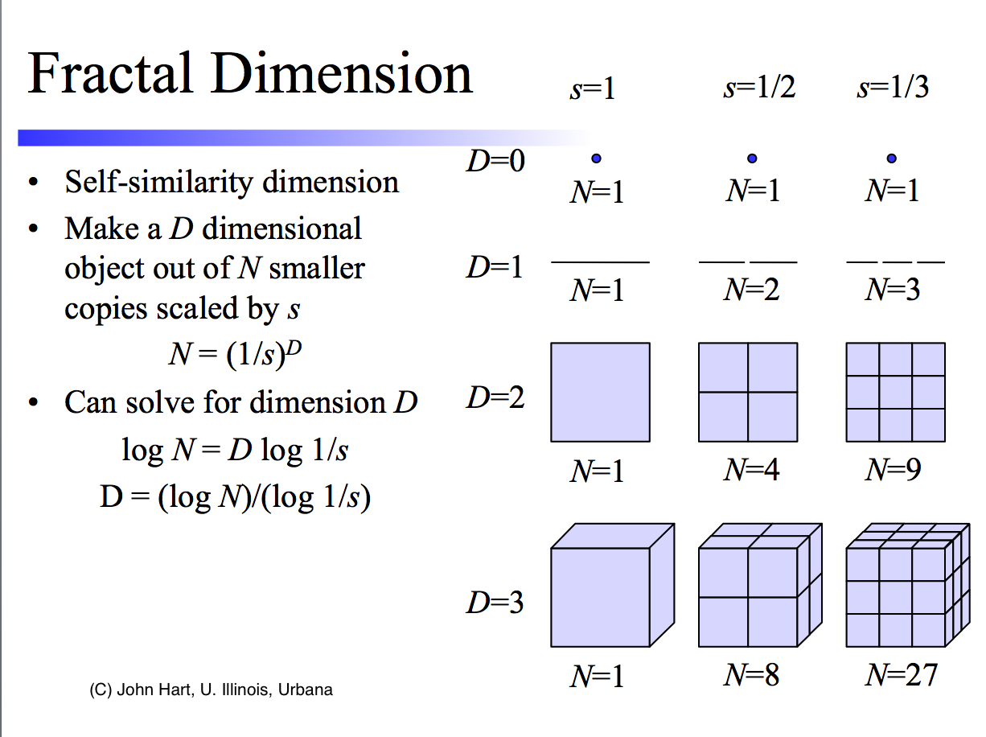
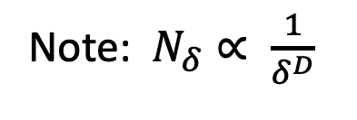
Fractal Dimensions
Note: $N_{δ}∝ \frac{1}{\begin{aligned}δ^{D} \\ \end{aligned}}$
A fractal dimension is an index for characterizing fractal patterns or sets by quantifying their complexity as a ratio of the change in detail to the change in scale.
Fractal dimensions are used to characterize a broad spectrum of objects ranging from the abstract to practical phenomena, including turbulence, river networks, urban growth, human physiology, medicine, and market trends
As we have noted, the essential idea of fractional or fractal dimensions has a long history in mathematics that can be traced back to the 1600s, but the terms fractal and fractal dimension were coined by mathematician Benoit Mandelbrot in 1975

Slide 16
Scale Invariance
In physics, mathematics and statistics, scale invariance is a feature of objects or laws that do not change if scales of length, energy, or other variables, are multiplied by a common factor, and thus represent a universality.
In mathematics, scale invariance usually refers to an invariance of individual functions or curves. A closely related concept is self-similarity, where a function or curve is invariant under a discrete subset of the dilations. It is also possible for the probability distributions of random processes to display this kind of scale invariance or self-similarity.
In statistical mechanics, scale invariance is a feature of phase transitions.
The key observation is that near a phase transition or critical point, fluctuations occur at all length scales, and thus one should look for an explicitly scale-invariant theory to describe the phenomena.

Slide 17
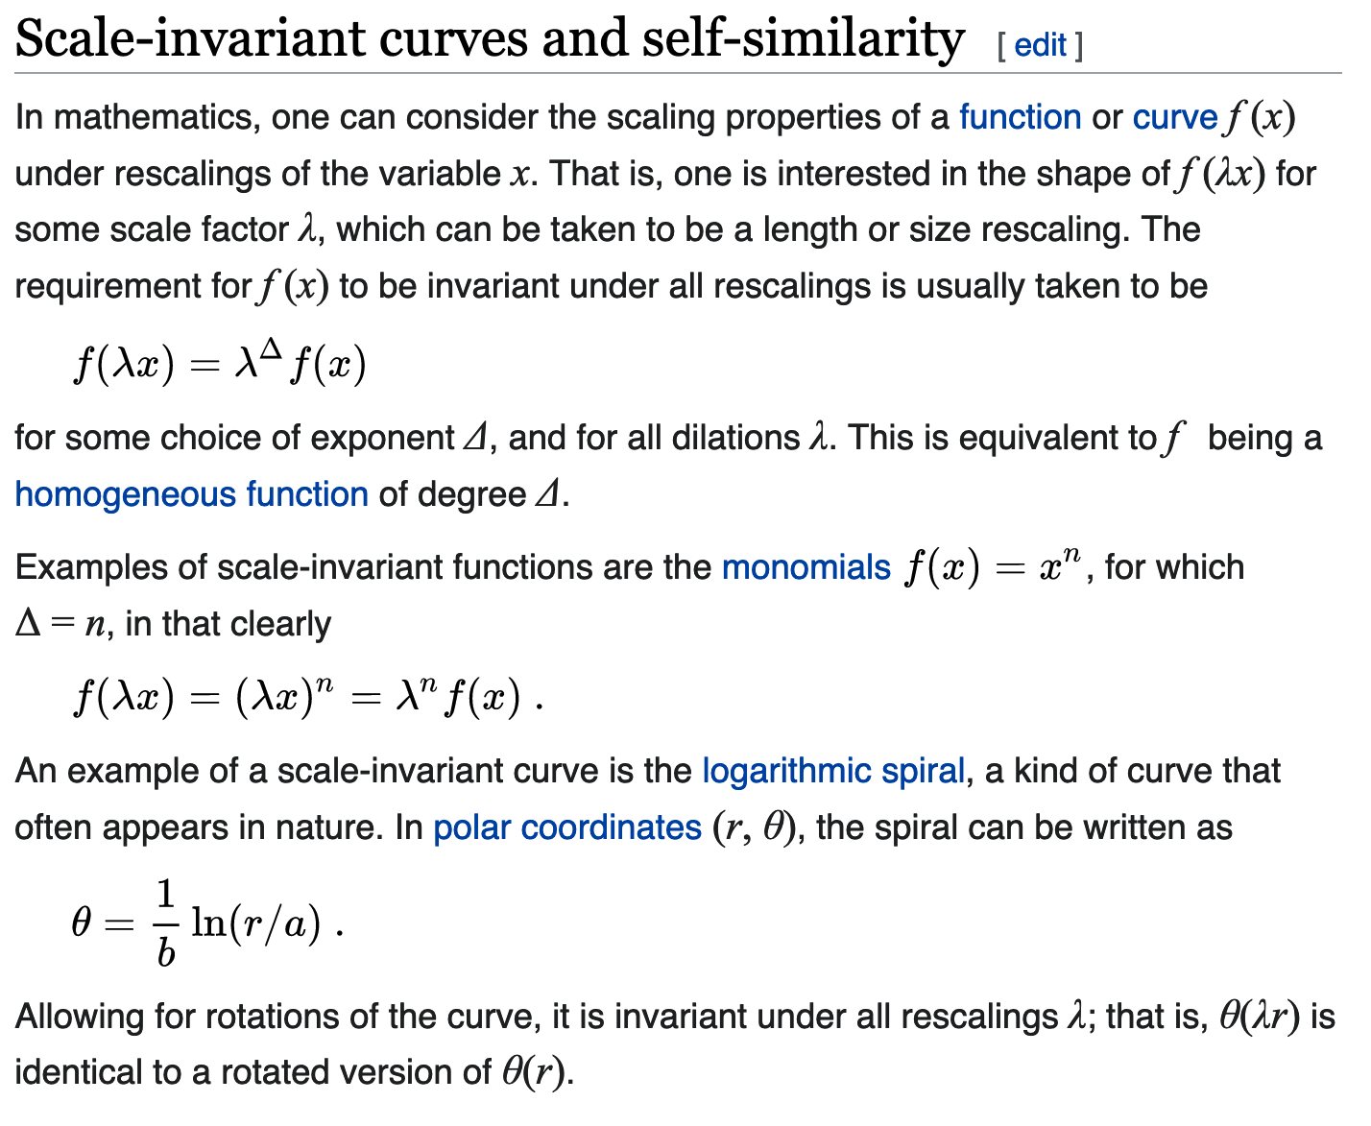
Scale Invariance
Power-law functions are also called homogeneous functions
and are characteristic of thermodynamic quantities near a critical point
https://en.wikipedia.org/wiki/Scale_invariance

Slide 18
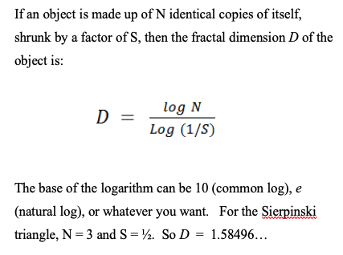
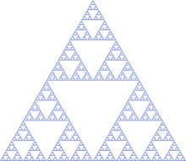
Fractal Dimensions Summary
Note: $N_{δ}∝ \frac{1}{\begin{aligned}δ^{D} \\ \end{aligned}}$
Original length scale δ₁ . New length scale δ₂ = S δ₁

Slide 19
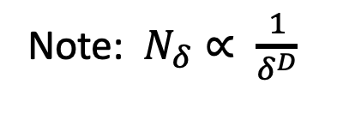
Aside: Measuring Sizes of a “Normal” Euclidean Geometric Object
Measuring the length of a line L:
  Use a ruler (“divider”) of length δ
  Cover the line of length L with N_{δ} non-overlapping rulers as best as possible
  Then N_{δ} δ --> L , as δ --> 0
  Measuring the area of an shape A:
    Use a box of area A_{box} = δ ²
    Cover the area A with with N_{δ} non-overlapping boxes as best as possible
    Then Then N_{δ} δ ² --> A , as δ --> 0
Note: $N_{δ}∝ \frac{1}{\begin{aligned}δ^{D} \\ \end{aligned}}$

Slide 20
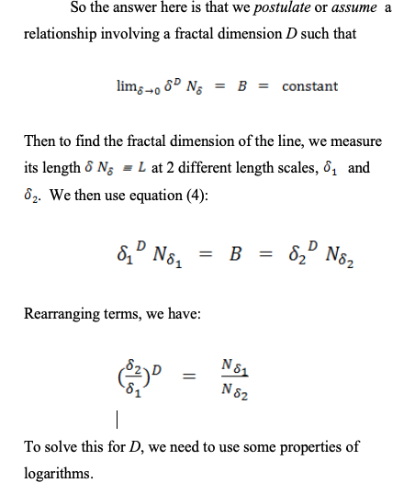
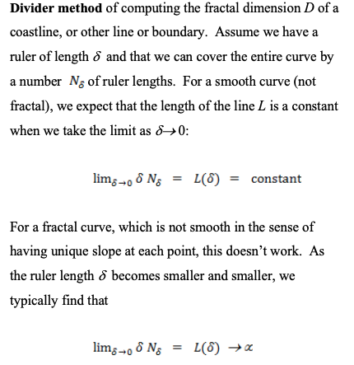
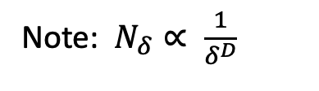
Divider Method
Note: $N_{δ}∝ \frac{1}{\begin{aligned}δ^{D} \\ \end{aligned}}$

Slide 21
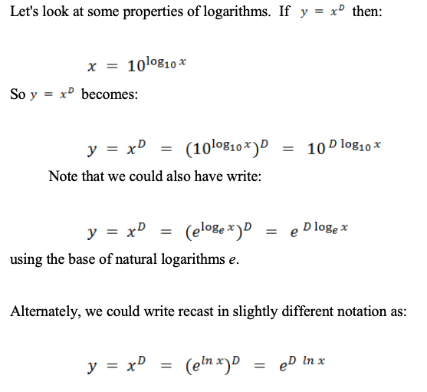
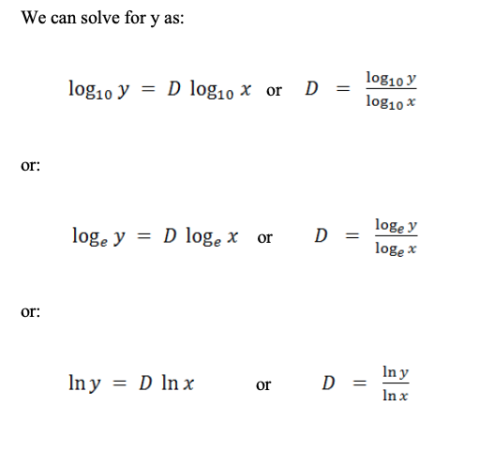
Logarithms
This slide demonstrates that we don’t have to use any particular base of logarithms.

Slide 22
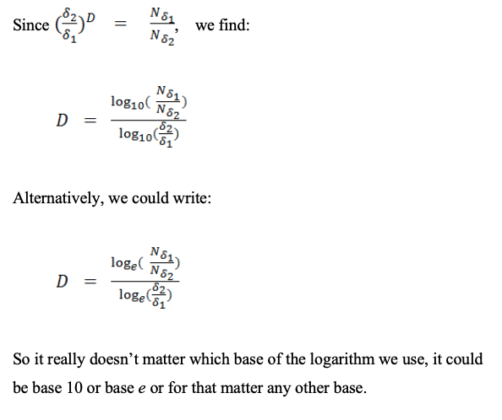
Solving for D
Note: $N_{δ}∝ \frac{1}{\begin{aligned}δ^{D} \\ \end{aligned}}$
.

Slide 23
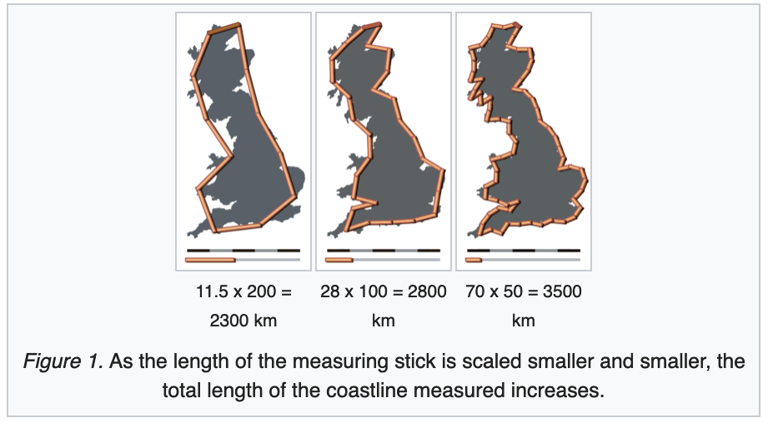
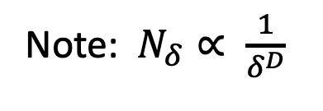
Fractal Dimensions
The essential idea of "fractured" dimensions has a long history in mathematics
The term itself was brought to the fore by Benoit Mandelbrot based on his 1967 paper on self-similarity in which he discussed fractional dimensions.
In that paper, Mandelbrot cited previous work by Lewis Fry Richardson describing the counter-intuitive notion that a coastline's measured length changes with the length of the measuring stick used
In terms of that notion, the fractal dimension of a coastline quantifies how the number of scaled measuring sticks required to measure the coastline changes with the scale applied to the stick
Note: $N_{δ}∝ \frac{1}{\begin{aligned}δ^{D} \\ \end{aligned}}$
Ended here 1/11/2022

Slide 24
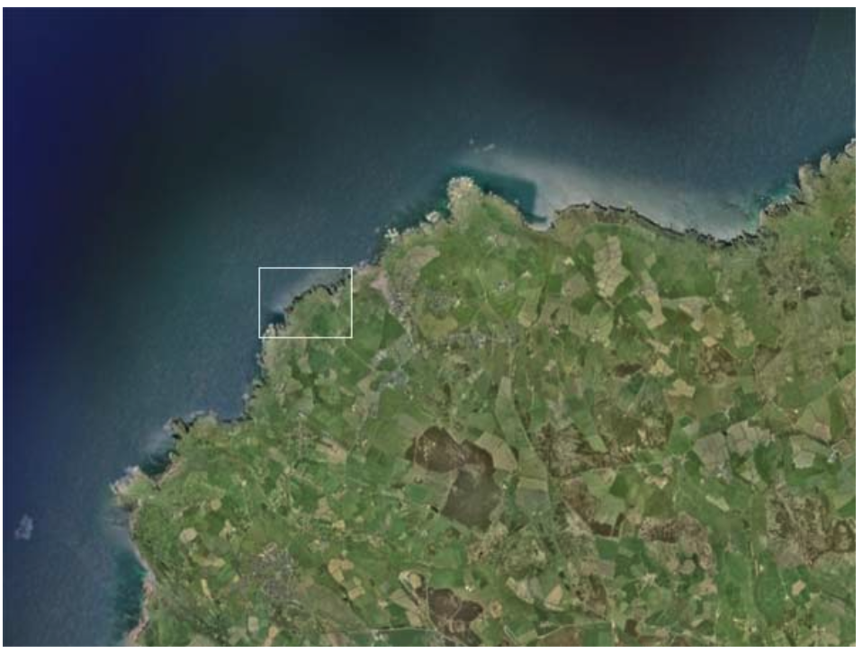
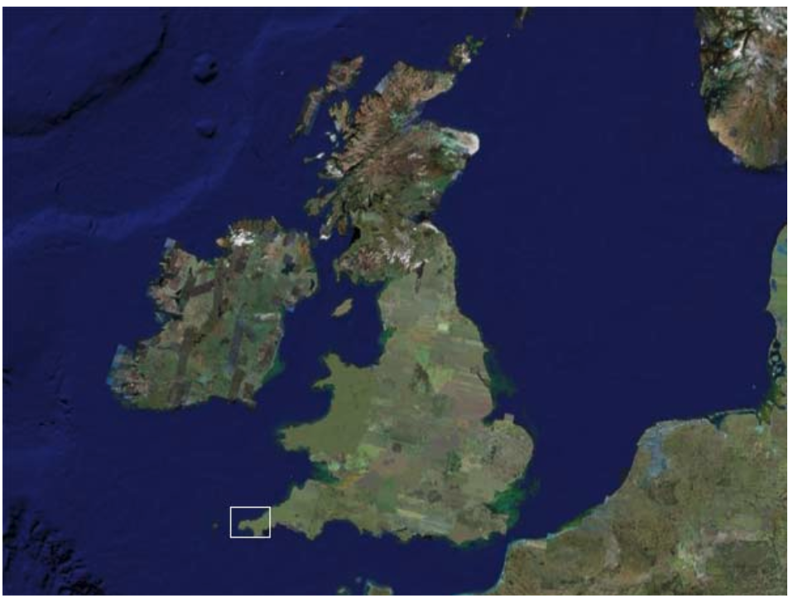
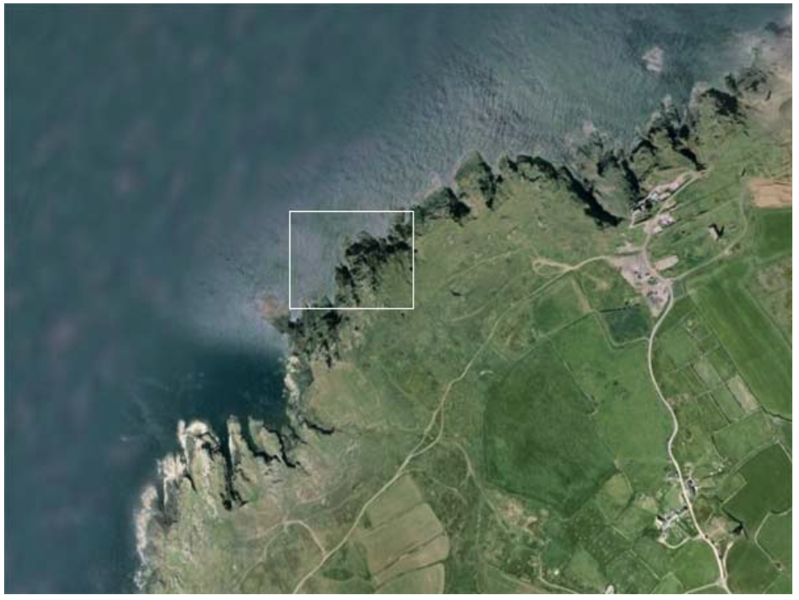
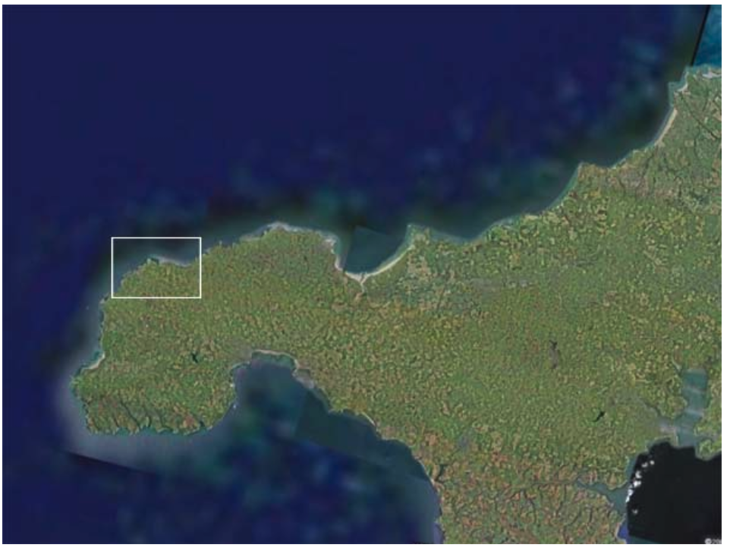
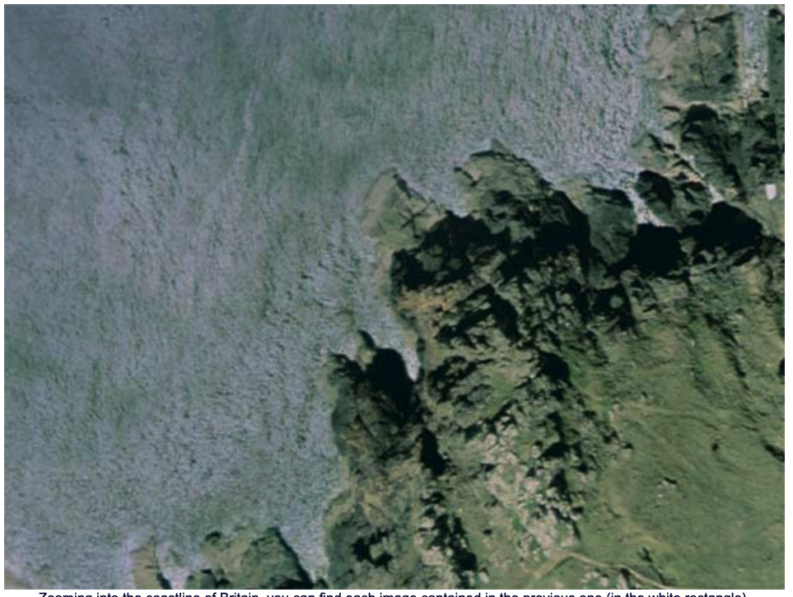
Coastlines are Self-Similar
http://fractalfoundation.org/OFC/OFC-9-4.html
Most coastlines are self-similar, that is they show he same kind of detail at different scales. This is one of the characteristics of fractals. One of the other things all fractals have in common is that they are created by repeating a somple process over and over again.
What are the simple, repetitive processes that are responsible for creating the fractal shapes of coastlines?
There are several, operating over a range of timescales:
First, there is the repetitive crashing of the waves on the beach, with a period of a few seconds between waves.
Second, there is the daily rise and fall of the water based on the tides, with a period of roughly 12 hours.
Third, there is the seasonal pattern of storms which batter the coasts with a period of months.
Then there is the long-term rise and fall of the sea level, which happens on a timescale of thousands of years, due to climate change and the amount of water that is frozen in the icecaps.
Finally, there is the very slow tectonic rise and fall of the contintents that we saw in the last chapter in Indonesia, for example and which occurs over millions of years.

Slide 25
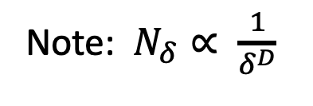
(a)
(b)
(c)
From (b) and (c) we find:
(70/28) = (100/50)^{D}
or D = 1.322
(A much better measurement is D ~ 1.256
Note: $N_{δ}∝ \frac{1}{\begin{aligned}δ^{D} \\ \end{aligned}}$

Slide 26
Fractal Dimension D and Embedding Dimension d
If you apply these methods to compute the fractal dimension of a normal smooth line or shape, you will find that the fractal dimension D that you compute is the normal “embedding” dimension d of the space the space in which it appears.
For example, the embedding dimension of the space in which the Sierpinski triangle is embedded is d = 2.
So if you use these methods to compute the fractal dimension of an ordinary right triangle, you will find D = d = 2.

Slide 27
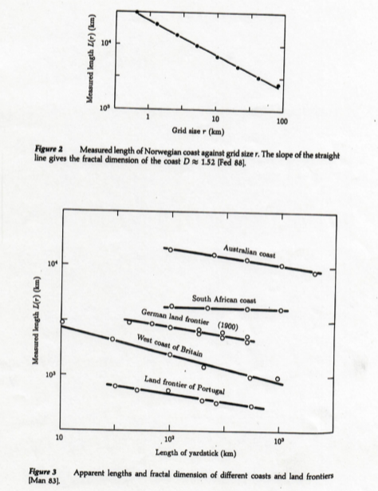
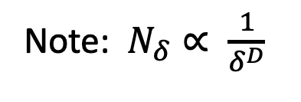
Measured Lengths of Several Coastlines at Different Scales
(from Manfred Schroeder)
The coastlines have different slopes and therefore different fractal dimensions D at scale δ, since:
L(δ) = δ N_{δ} ∝ δ ^{1-D}
So when D > 1, L(δ) → infinity as δ → 0
Note: $N_{δ}∝ \frac{1}{\begin{aligned}δ^{D} \\ \end{aligned}}$

Slide 28
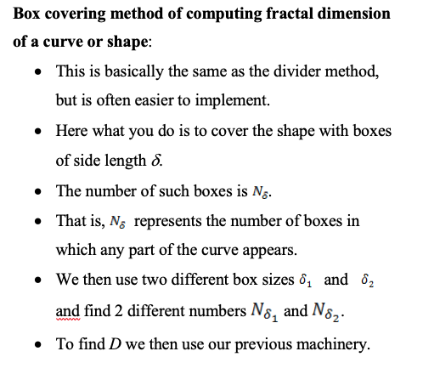
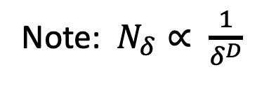
Box Counting
Method
.
Note: $N_{δ}∝ \frac{1}{\begin{aligned}δ^{D} \\ \end{aligned}}$

Slide 29
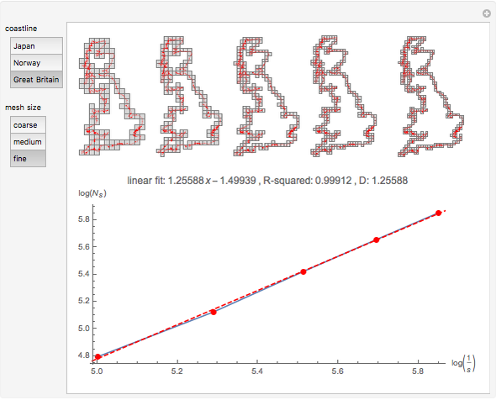
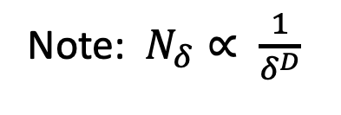
Box Counting to Determine the Fractal Dimension of the Coastline of Britain https://en.wikipedia.org/wiki/Box_counting
D_{Box} = 1.25588
From the divider method, D = 1.256
Note: $N_{δ}∝ \frac{1}{\begin{aligned}δ^{D} \\ \end{aligned}}$

Slide 30
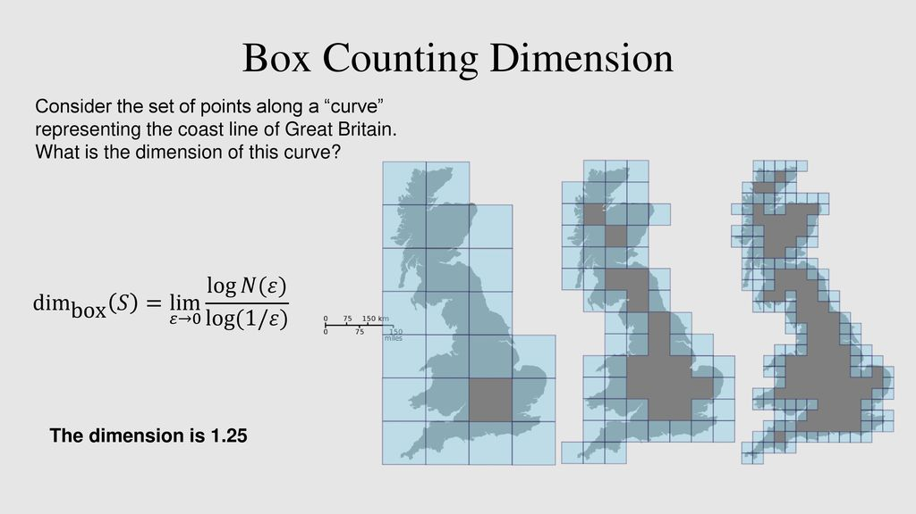
Fractal dimension of Britain by Box Counting

Slide 31
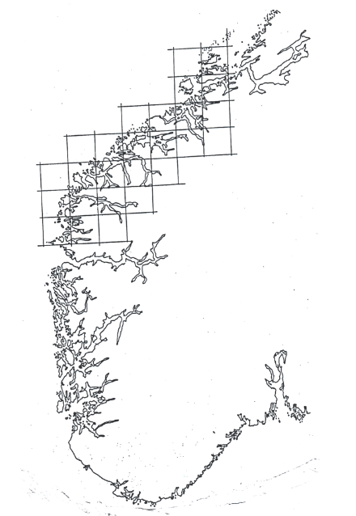
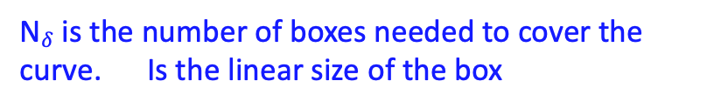

Box Counting Method for D
Classical example of the coast of Norway
Box counting is a method of gathering data for analyzing complex patterns by breaking a dataset, object, image, etc. into smaller and smaller pieces, typically "box"-shaped, and analyzing the pieces at each smaller scale.
The essence of the process has been compared to zooming in or out using optical or computer-based methods to examine how observations of detail change with scale.
In box counting, however, rather than changing the magnification or resolution of a lens, the investigator changes the size of the element used to inspect the object or pattern
N$δ$ is the number of boxes needed to cover the curve. Is the linear size of the box
$$δ$$

Slide 32
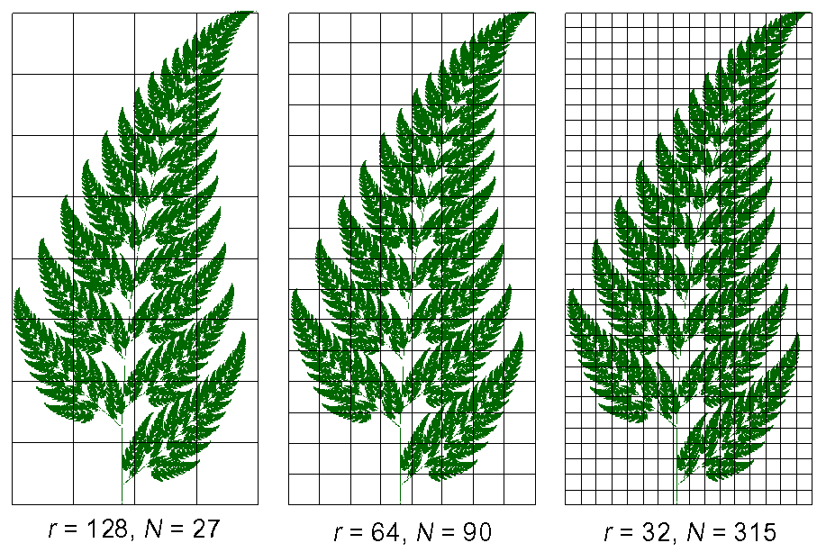
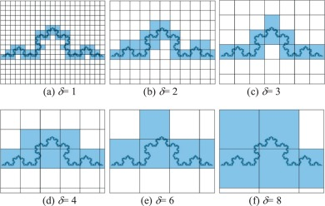
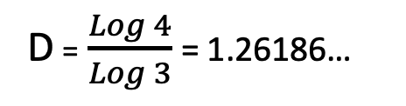
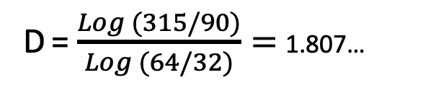
Ferns and Koch Curve
D = $\frac{Log (315/90)}{Log (64/32)}=$1.807…
D = $\frac{Log 4}{Log 3}$= 1.26186…

Slide 33
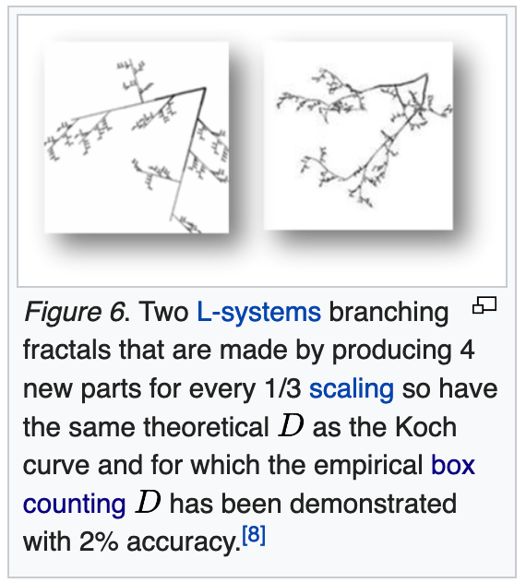
Many Different Objects can have the Same Fractal Dimension https://en.wikipedia.org/wiki/L-system
As is the case with dimensions determined for lines, squares, and cubes, fractal dimensions are general descriptors that do not uniquely define patterns.
The value of D for the Koch fractal discussed above, for instance, quantifies the pattern's inherent scaling, but does not uniquely describe nor provide enough information to reconstruct it.
Many fractal structures or patterns could be constructed that have the same scaling relationship but are dramatically different from the Koch curve, as is illustrated at right

Slide 34
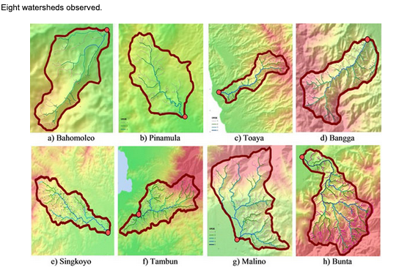

Fractal Dimensions of River Networks in Indonesia https://benthamopen.com/FULLTEXT/TOCIEJ-10-706

Slide 35

Box Counting Dimension https://benthamopen.com/FULLTEXT/TOCIEJ-10-706
Watershed | Fractal Dimension (D)
Bahomoleo | 1.196
Pinamula | 1.173
Toaya | 1.217
Bangga | 1.283
Singkoyo | 1.253
Tambun | 1.290
Malino | 1.298
Bunta | 1.293
Indonesian watersheds

Slide 36



Box Counting for Areas and Volume
Note: $N_{δ}∝ \frac{1}{\begin{aligned}δ^{D} \\ \end{aligned}}$
D = 1.58496…
Area = 0
D = 2.0
Volume = 0

Slide 37

Fractals: Initiators and Generators
http://fractalfoundation.org/
One way to guarantee self-similarity is to build a shape by applying the same process over smaller and smaller scales.
This idea can be realized with a process called initiators and generators.
  The initiator is the starting shape.
  The generator is a collection of scaled copies of the initiator.
The rule is this: in the generator, replace each copy of the initiator with a scaled copy of the generator (specifying orientations where necessary).
https://users.math.yale.edu/public_html/People/frame/Fractals/IntroToFrac/InitGen/InitGen.html

Slide 38


http://fractalfoundation.org/OFC/OFC-10-3.html
Note: $N_{δ}∝ \frac{1}{\begin{aligned}δ^{D} \\ \end{aligned}}$

Slide 39


http://fractalfoundation.org/OFC/OFC-10-3.html
Note: $N_{δ}∝ \frac{1}{\begin{aligned}δ^{D} \\ \end{aligned}}$

Slide 40



Note: $N_{δ}∝ \frac{1}{\begin{aligned}δ^{D} \\ \end{aligned}}$
(Similar for the other shapes shown)
N=32
δ =1/6
D=Log 32/Log 6
N=8
δ =1/4
D=Log 8/Log 4
N=32
δ =1/8
D=Log 32/Log 8
D = 1.5
D = 1.6131…
D = 1.6666…
From Mandelbrot: The Fractal Geometry of Nature

Slide 41
N=32
r=1/8
D=Log 32/Log 6
N=8
r=1/4
D=Log 8/Log 4
N=32
r=1/8
D=Log 32/Log 8
D = 1.5
D = 1.6131…
D = 1.6666…
From Mandelbrot: The Fractal Geometry of Nature

Slide 42


Hilbert Curve is Space Filling
Note: $N_{δ}∝ \frac{1}{\begin{aligned}δ^{D} \\ \end{aligned}}$
D = Log 2^{2n}/Log 2^{n} = 2n/n = 2
D = 2

Slide 43


Fractal Methods have been Used to Generate Topography and Landforms Used in Movies https://en.wikipedia.org/wiki/Computer-generated_imagery
CGI Mountains in Movies

Slide 44
Other Examples of Scaling and Fractal Dimensions
(Courtesy Bruce Malamud, Kings College)

Slide 45



Fractal Dimension
Notes:
Cantor Dust, D = 0.683.
Koch Snowflake, D = 1.262
Sierpinski Carpet, D = 1.893
Menger Sponge, D = 2.727
En los Gráficos 4a hasta 4i, están representados 9 ejemplos de fractales con dimensiones de D = 0,631 hasta D = 2,73. En los Gráficos 4a hasta 4f, son construcciones determinísticas de fractales; cada una de éstas fractales están construídas con la aplicación del mismo “reglamento” a cada paso u orden. Por ejemplo, en los Gráficos 4a y 4b, hay un ejemplo de los primeros 5 y 4 órdenes de la construcción de una fractal que se llama el polvo de Cantor, donde el “reglamento” es dividir la línea por r, y a cada orden, de sacar la misma cantidad de pedazos. En el Gráfico 4a, dividimos la línea en el orden 0 por r = 3, y en el orden 1, sacamos el segundo de esos 3 pedazos. En el orden 2 del Gráfico 4a, dividimos los dos pedazos del orden 1 por r = 3, y sacamos en cada uno, el pedazo centrado. A cada orden del Gráfico 4a, dividimos los pedazos por r = 3, y tenemos n = 2 pedazos que se quedan, por una dimensión fractal de D = log(2)/log(3) = 0,631. El Gráfico 4b, también un polvo de Cantor, es semejante, pero con r = 5, n = 3, y D = log(3)/log(5) = 0,683. Cada una de estas dos construcciones tiene la propiedad de invariancia de escala. Esos dos polvos de Cantor no son puntos ni líneas, tienen una dimensión fractal entre un punto (D = 0) y una línea (D = 1). Cuando seguimos esta construcción a un orden infinito, hay una cantidad infinita de pedazos, cada uno tiene un tamaño muy cerca de cero; entonces aclaramos que de acá viene el nombre de “polvo” del polvo de Cantor.
La alfombra de Sierpinski (Gráfico 4d) y la esponja de Menger (Gráfico 4e) son los análogos de la construcción en el Gráfico 4a del polvo de Cantor, pero en dos y tres dimensiones. La alfombra de Sierpinski tiene una dimensión fractal, D = 1,893, entre una línea (D = 1) y un cuadro (D = 2). La esponja de Menger tiene una dimensión fractal, D = 2,727, entre un cuadro (D = 2) y un cubo (D = 3). Construcciones semejantes a la alfombra de Sierpinski y la esponja de Menger son utilizadas para estudiar el movimiento de fluidos en el subsuelo. El polvo de Cantor, la alfombra de Sierpinski, y la esponja de Menger, son todos ejemplos de construcciones fractales donde se empiezan con una línea, un cuadrado, o un cubo, y se sacan pedazos de los objetos, para tener una dimensión menos que el objeto original.
Otro tipo de construcción está dado en el Gráfico 4c, donde empezamos con un triángulo en el orden 0, y en el orden 1, sumamos más triángulos que son tercios del tamaño del triángulo del orden 0, a cada lado del triángulo del orden 0. Ahora, dividimos los triángulos cada vez por r = 3, y sumamos los triángulos sobre los lados del orden anterior. Cada vez que dividimos por r = 3, quedan n = 4 nuevos pedazos, por una dimensión fractal de D = log(4)/log(3) = 1,262, entre una línea (D = 1) y un cuadrado (D = 2). El Gráfico 4f es otro ejemplo de una construcción donde se suman sobre el original. En este caso, empezamos con una cruz, y a cada orden, sumamos otras cruces, a una mitad del tamaño de las cruces del orden anterior. Esta construcción tiene una dimensión fractal de D = 2, y a orden infinito, se llenaría el espacio en dos dimensiones. Esta construcción es un modelo para estudiar drenajes de ríos.
El Gráfico 4g es uno de muchos ejemplos de fractales en la Naturaleza. En este ejemplo, hay una relación potencial entre el perímetro y el área de las nubes, resultando en una dimensión fractal de D = 1,36. Una nota, un conjunto geométrico (como en los Gráficos 4a hasta 4f) tiene una invariancia de escala sobre todas las escalas, pero los objetos de la Naturaleza tienen limites mayores y menores; los objetos naturales tienen una dimensión fractal (una relación potencial) sobre muchas órdenes de magnitudes, pero no todas.
El Gráfico 4h es un ejemplo de las aplicaciones de fractales a las series de tiempos. Esta serie de 512 puntos es un movimiento Browniano, un fractal auto-afin (donde el “x” y “y” no se escalen la misma, como en los ejemplos de los Gráficos 4a hasta 4f), con D = 1,5. Hay muchos ejemplos de las aplicaciones de fractales a las series de tiempos (ver Sección 1.5 de este artículo por referencias).
Finalmente, en el Gráfico 4i, la distribución de los tamaños de objetos puede tener una relación potencial (fractal) entre la frecuencia acumulativa y los tamaños del objeto (en este caso, las áreas de mil círculos). En la misma manera, se puede ver la distribución frecuencia acumulativa por los tamaños de los eventos extremos en los riesgos naturales. Algunos ejemplos de los “tamaños” de objetos y eventos, que en la literatura a veces están mostrados como que tienen una distribución fractal, son (objeto o evento: medida [unidades]):

Slide 46
Measuring D, Ruler Technique
Mandelbrot, B. B. (1967) How long is the coast of Britain? Statistical self-similarity and fractional dimension. Science: 156: 636-638.
r = ruler segment length
N = # ruler segments
L = r × N
= total length
Coastline of Brazil
Notes:
Bring in fact that now we will look at data series where x and y axis have different units.
Un ejemplo de la técnica de reglas aplicada a un trozo de la costa marítima de Argentina está presentado en el Gráfico 2. El punto de arriba es Buenos Aires, el de abajo: Río Gallegos de la provincia de Santa Cruz. Empezamos con una regla grande, de tamaño r = 64 unidades. Ponemos el borde delantero de la regla en Buenos Aires y giráramos la regla hasta que el otro borde hace una intersección con la costa. Tomamos esta intersección, y ponemos allí el borde delantero de la regla, girando nuevamente la regla hasta lograr otra intersección con la costa. Seguimos de esta manera hasta Río Gallegos. Necesitamos N = 7,9 reglas, de Buenos Aires hasta Río Gallegos, por una longitud total de L(r) = r N(r) = (64 unidades)(7,9) = 504 unidades.
Usando una regla de menor tamaño, r = 32 unidades, operando de la misma manera, necesitamos N(r) = 17 reglas, por una longitud total de L(r) = (32 unidades)(17) = 544 unidades. Con r = 16, 8, 4, y 2 unidades, la longitud total es de L(r) = 615, 705, 786 y 840 unidades. Cada vez que utilizamos una regla de menor tamaño, la longitud total es mayor. La ley potencial de arriba, N(r) = C r -D, es equivalente a
log N(r) = -D log r + C´,
donde el logaritmo es común con base 10 (pero podemos utilizar otras bases, como 2 o e), y C´ es un constante, C´ = log(C). Si la gráfica de nuestros datos, log N(r) vs log r, es una línea recta, significa que hay una relación potencial (una relación fractal) entre N(r) y r; la pendiente de la línea recta es -D, la dimensión fractal, y C´ es la intersección.
En el Gráfico 3, los logaritmos de la longitud efectiva, L(r), y el número de reglas, N(r), están graficados contra los logaritmos del tamaño de la regla utilizada, r. En el espacio logaritmo-logaritmo, ambos conjuntos de puntos trazan una línea casi recta con una pendiente; la pendiente de log L(r) vs log r es (-1-D) y la pendiente de log N(r) vs log r es (-D). La línea recta con mejor ajuste a estos puntos tiene una dimensión fractal de D = 1,16 [log N(r) = -1,16 log r + 1.000, r2 = 0,999 y log L(r) = -0,16 log r + 1.000, r2 = 0,991]. Entonces, la geometría de la costa de Argentina puede ser bien descripta por una relación potencial (fractal). La dimensión fractal D = 1,16 por Argentina es menos que D = 1,25 por Bretaña; podemos decir que la costa de Argentina es más parecida a una línea recta que la de Bretaña, donde hay más accidentes geográficos.

Slide 47
Measuring D, Ruler Technique
r = ruler segment length
N = # ruler segments
L = r × N = total length
Coastline of Brazil
D ~ Log(420/196.4)/Log(20/10) = 1.097
(Compare to D ~ 1.16 from the slope)
Notes:
Bring in fact that now we will look at data series where x and y axis have different units.

Slide 48

Measuring D, Box Counting
Notes:
Fuego de bosque.
Contra de Caja

Slide 49

Box Counting Demonstration Program
http://www.fch.vutbr.cz/lectures/imagesci/harfa.htm

Slide 50

Box Counting Demonstration Program
http://www.fch.vutbr.cz/lectures/imagesci/harfa.htm

Slide 51

Box Counting Demonstration Program
http://www.fch.vutbr.cz/lectures/imagesci/harfa.htm

Slide 52

Box Counting Demonstration Program
http://www.fch.vutbr.cz/lectures/imagesci/harfa.htm

Slide 53
Measuring D, Box Counting
Venables Valley Fire
Notes:
Mediando D

Slide 54
Measuring D, Box Counting
  London’s urban boundary:
  (a) 1888 (“A to Z” atlas)
  (b) 2000 (Ordinance Survey map)
  Small squares represent 1 km².
  Coursework essay by J. Bridgen [AR/3031, Geography, KCL].

Slide 55
Measuring D, Box Counting
  London’s urban boundary:
  (a) 1888 (“A to Z” atlas)
  (b) 2000 (Ordinance Survey map)
  Coursework essay by J. Bridgen [AR/3031, Geography, KCL].
  See also: work by Michael Batty [e.g. (2005) Cities and Complexity: Understanding cities with cellular automata, agent-based models and fractals]

Slide 56

Turns out, COVID is a fractal

Slide 57


Slide 58

Fractal Dimension of the COVID Virus https://www.ncbi.nlm.nih.gov/pmc/articles/PMC7809895/
The fractal dimension of TEM, SEM, and AFM images of more than 40 coronaviruses represented at different scales—1 μm, 5 μm, 100 nm, 200 nm, and 500 nm—is found out by the box-counting method.
The superimposition of grids of varying dimension on to the TEM, SEM, and AFM images of CoVs (COVID particles) and counting the number of boxes N(s) of dimension ‘s’ required to cover the image, gives the fractal dimension D ~ 1.816.
The higher value of D close to 2 suggests the complexity of the system, CoVs.
The value of the Hurst exponent H calculated from the value of D can also give information about the surface morphology of the virus. (Note: H = 2 – D)
When a higher value of H indicates a smooth surface, the lower value indicates rough surface .
The analysis of CoVs shows a low value of H = 0.184, as shown in the NBP (Fig. ​(Fig.2b)2b) indicating a rough surface as evidenced by the SEM, TEM, and AFM images.
The various elements in the NBP of D and H are given in Table ​Table11.

Slide 59

Epidemics and Fractals https://www.sciencedirect.com/science/article/pii/S0960077920304707
Epidemic curves can be approached from a fractal interpolation point of view.
Looking at the Covid-19 epidemic curves from a fractal point of view might benefit the medical community to understand better the dynamics and evolution of the pandemic.
Fractal interpolation of data regarding Covid-19 can help retrieve missing pieces of information due to limited testing.
Analyzing maps of the spreading of Covid-19 in different countries from a fractal dimension point of view can be a useful tool in assessing the complexity of the pandemic on the territory of a country.

Slide 60


Mapping the spread of COVID with Fractal Interpolation https://www.sciencedirect.com/science/article/pii/S0960077920304707

