Slide 1
Fractals, Chaos, Complexity Physics-EPS 30
Lecture 4
Building Sierpinski and Von Koch Fractals
https://en.wikipedia.org/wiki/Sierpinski_triangle
https://en.wikipedia.org/wiki/Koch_snowflake

Slide 2
Building Sierpinski Fractals
The Sierpiński triangle is a fractal attractive fixed set with the overall shape of an equilateral triangle, subdivided recursively into smaller equilateral triangles.
Originally constructed as a curve, this is one of the basic examples of self-similar sets
That is, it is a mathematically generated pattern that is reproducible at any magnification or reduction.
It is named after the Polish mathematician Wacław Sierpiński, but appeared as a decorative pattern many centuries before the work of Sierpiński.

Slide 3
Construction by Repeated Removal of Areas
The Sierpinski triangle may be constructed from an equilateral triangle by repeated removal of triangular subsets:
Start with an equilateral triangle.
Subdivide it into four smaller congruent equilateral triangles and remove the central triangle.
Repeat step 2 with each of the remaining smaller triangles infinitely.
Each removed triangle is a topologically an open set.
This process of recursively removing triangles is an example of a finite subdivision rule
Initiator
Generator

Slide 4
Construction by Shrinking and Placement Beginning from a triangle
The same sequence of shapes, converging to the Sierpinski triangle, can alternatively be generated by the following steps:
Start with any triangle in a plane (any closed, bounded region in the plane will actually work).
The canonical Sierpinski triangle uses an equilateral triangle with a base parallel to the horizontal axis (first image).
Shrink the triangle to 1/2 height and 1/2 width, make three copies, and place the three shrunken triangles so that each triangle touches the two other triangles at a corner (image 2).
Note the emergence of the central hole—because the three shrunken triangles can between them cover only 3/4 of the area of the original. (Holes are an important feature of Sierpinski's triangle.)
Then join (“collage”) the three smaller triangles
Repeat step 2 with each of the smaller triangles (image 3 and so on).

Slide 5
Construction by Shrinking and Placement Beginning from a square
The same sequence of shapes, converging to the Sierpinski triangle, can alternatively be generated by the following steps:
Start with any square in a plane (any closed, bounded region in the plane will actually work).
Shrink the square to 1/2 height and 1/2 width, make three copies, and place the three shrunken squares so that each square touches the two other squares at a corner (image 2).
Note the emergence of the central hole—because the three shrunken squaress can between them cover only 3/4 of the area of the original. (Holes are an important feature of Sierpinski's triangle.)
Then join (“collage”) the three smaller squares
Repeat step 2 with each of the smaller squares (image 3 and so on).

Slide 6
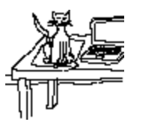
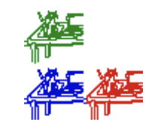
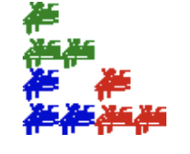
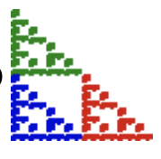
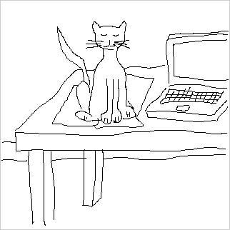
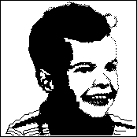
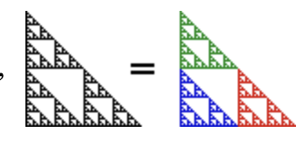
Other Examples of Shrinking and Placement
https://users.math.yale.edu/public_html/People/frame/Fractals/

Slide 7
Construction by Chaos Game https://math.bu.edu/DYSYS/chaos-game/node1.html
First pick three points at the vertices of a triangle (any triangle works---right, equilateral, isosceles, whatever).
Color one of the vertices red, the second blue, and the third green.
Next, take a die and color two of the faces red, two blue, and two green.
Now start with any point in the triangle, this point is the seed for the game.
(Actually, the seed can be anywhere in the plane, even miles away from the triangle.)
Then roll the die.
Depending on what color comes up, move the seed half the distance to the appropriately colored vertex.
That is, if red comes up, move the point half the distance to the red vertex.
Now erase the original point and begin again, using the result of the previous roll as the seed for the next.
That is, roll the die again and move the new point half the distance to the appropriately colored vertex, and then erase the starting point. See Figure 1.

Slide 8
Alternatively (Chaos Game)
Take three points in a plane to form a triangle, you need not draw it.
Randomly select any point inside the triangle and consider that your current position.
Randomly select any one of the three vertex points.
Move half the distance from your current position to the selected vertex.
Plot the current position.
Repeat from step 3.
This method is also called the chaos game, and is an example of an iterated function system.
You can start from any point outside or inside the triangle, and it would eventually form the Sierpinski Gasket with a few leftover points (if the starting point lies on the outline of the triangle, there are no leftover points).
With pencil and paper, a brief outline is formed after placing approximately one hundred points, and detail begins to appear after a few hundred. An interactive version of the chaos game can be found at: https://scratch.mit.edu/projects/170702288/#player

Slide 9
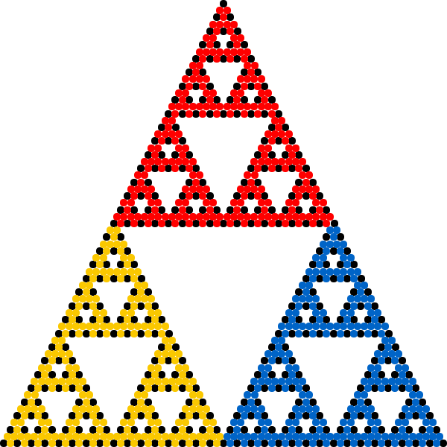
Realization of the Chaos Game https://en.wikipedia.org/wiki/Chaos_game
See also Excel spreadsheet
implementation

Slide 10
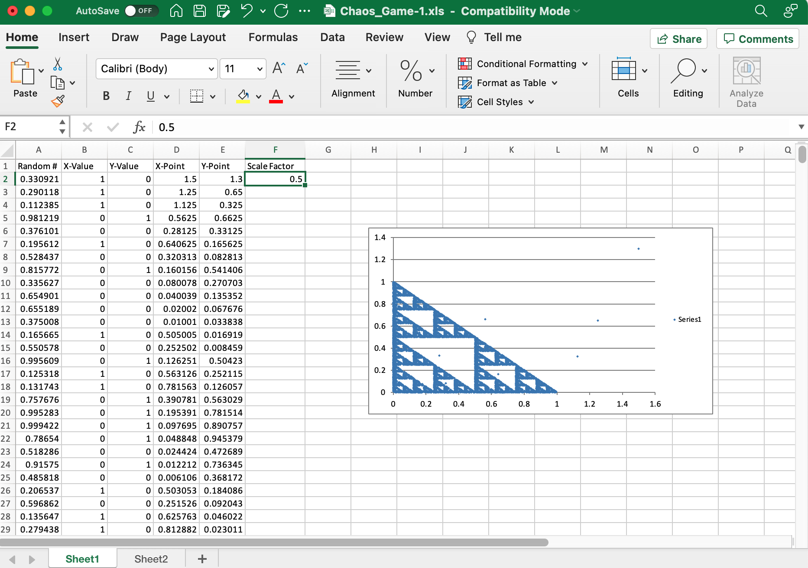
Excel Spreadsheet: https://rundle.physics.ucdavis.edu/PHYGEO30/Chaos_Game.xls
Enter a new Scale Factor a see what kind of different triangles you can generate

Slide 11
Restricting the Points in the Chaos Game
If the chaos game is run with a square, no fractal appears and the interior of the square fills evenly with points.
However, if restrictions are placed on the choice of vertices, fractals will appear in the square.
For example, if the current vertex cannot be chosen in the next iteration, the fractal at right appears

Slide 12
Construction by Sierpinski Arrowhead Method
Start with a single line segment in the plane
Repeatedly replace each line segment of the curve with three shorter segments, forming 120° angles at each junction between two consecutive segments, with the first and last segments of the curve either parallel to the original line segment or forming a 60° angle with it.
At every iteration, this construction gives a continuous curve.
In the limit, these approach a curve that traces out the Sierpinski triangle by a single continuous directed (infinitely wiggly) path, which is called the Sierpinski arrowhead.
In fact, the aim of the original article by Sierpinski of 1915, was to show an example of a curve (a Cantorian curve), as the title of the article itself declares.

Slide 13
Details of Arrowhead Construction

Slide 14
Construction by Cellular Automata (to be discussed in more detailed later)
The Sierpinski triangle also appears in certain cellular automata (such as Rule 90), including those relating to Conway's Game of Life.
For instance, the Life-like cellular automaton B1/S12 when applied to a single cell will generate four approximations of the Sierpinski triangle.
A very long one cell thick line in standard life will create two mirrored Sierpinski triangles.
The time-space diagram of a replicator pattern in a cellular automaton also often resembles a Sierpinski triangle, such as that of the common replicator in HighLife.
The Sierpinski triangle can also be found in the Ulam-Warburton automaton and the Hex-Ulam-Warburton automaton.

Slide 15
Properties of Sierpinski Triangle
In mathematics, Hausdorff dimension is a measure of roughness, or more specifically, fractal dimension, that was first introduced in 1918 by mathematician Felix Hausdorff.
For instance, the Hausdorff dimension of a single point is zero, of a line segment is 1, of a square is 2, and of a cube is 3.
In measure theory, a branch of mathematics, the Lebesgue measure, named after French mathematician Henri Lebesgue, is the standard way of assigning a measure to subsets of n-dimensional Euclidean space.
For n = 1, 2, or 3, it coincides with the standard measure of length, area, or volume. In general, it is also called n-dimensional volume, n-volume, or simply volume.[

Slide 16
Sierpinski Tetrahedron

Slide 17
Koch Curve, Snowflake, Star, Island
The Koch snowflake (also known as the Koch curve, Koch star, or Koch island) is a fractal curve and one of the earliest fractals to have been described.
It is based on the Koch curve, which appeared in a 1904 paper titled "On a Continuous Curve Without Tangents, Constructible from Elementary Geometry"by the Swedish mathematician Helge von Koch.
The Koch snowflake can be built up iteratively, in a sequence of stages.

Slide 18
Construction by Stages
The first stage is an equilateral triangle, and each successive stage is formed by adding outward bends to each side of the previous stage, making smaller equilateral triangles.
The areas enclosed by the successive stages in the construction of the snowflake converge to 8/5 times the area of the original triangle, while the perimeters of the successive stages increase without bound.
Consequently, the snowflake encloses a finite area, but has an infinite perimeter

Slide 19
Construction
The Koch snowflake can be constructed by starting with an equilateral triangle, then recursively altering each line segment as follows:
divide the line segment into three segments of equal length.
draw an equilateral triangle that has the middle segment from step 1 as its base and points outward.
remove the line segment that is the base of the triangle from step 2.
The first iteration of this process produces the outline of a hexagram.
The Koch snowflake is the limit approached as the above steps are followed indefinitely.

Slide 20
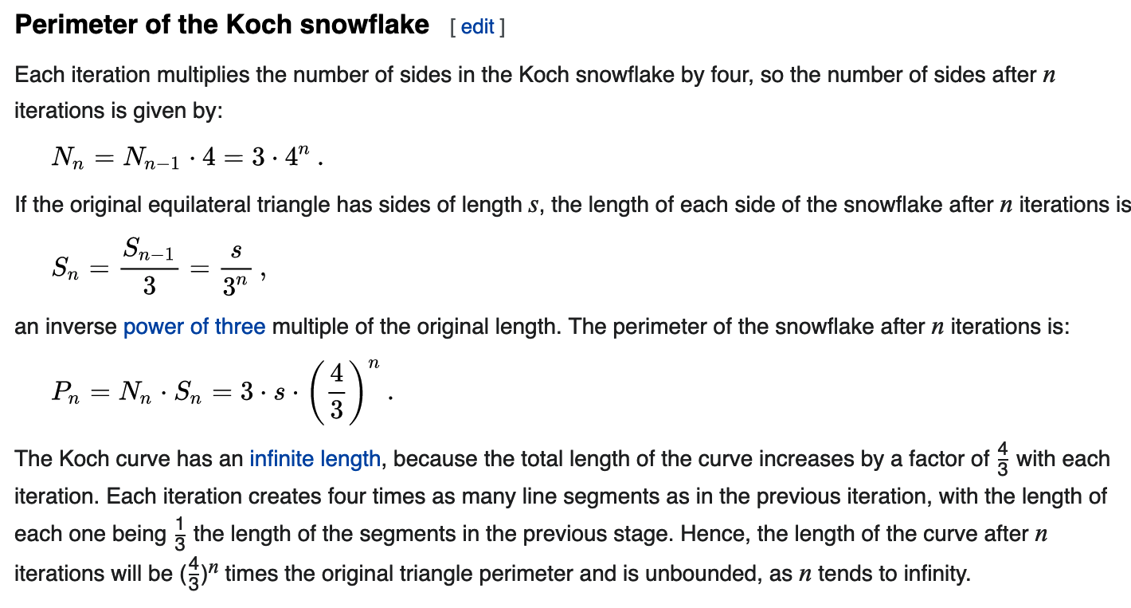
Perimeter of the Koch Snowflake

Slide 21
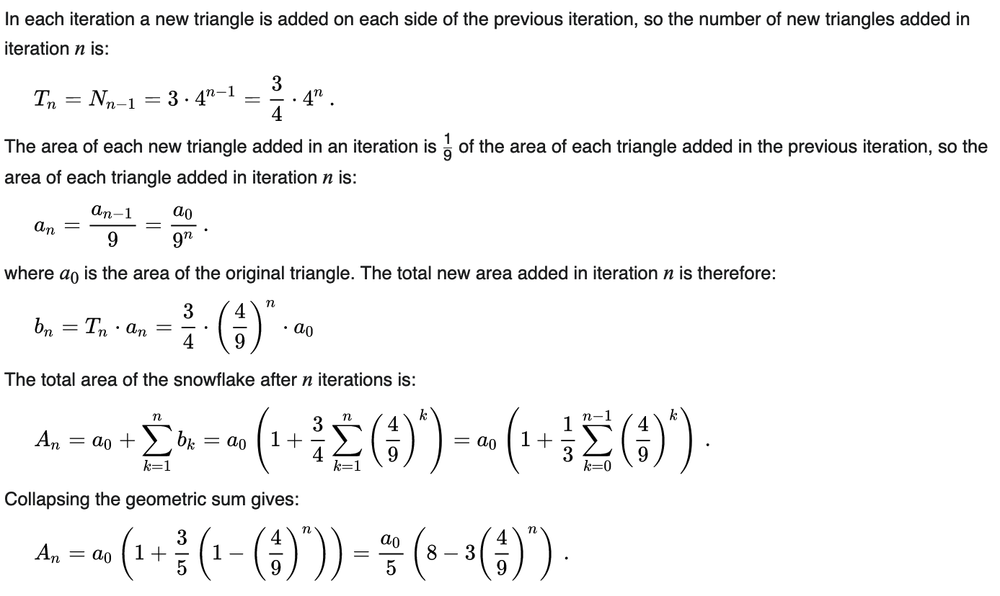
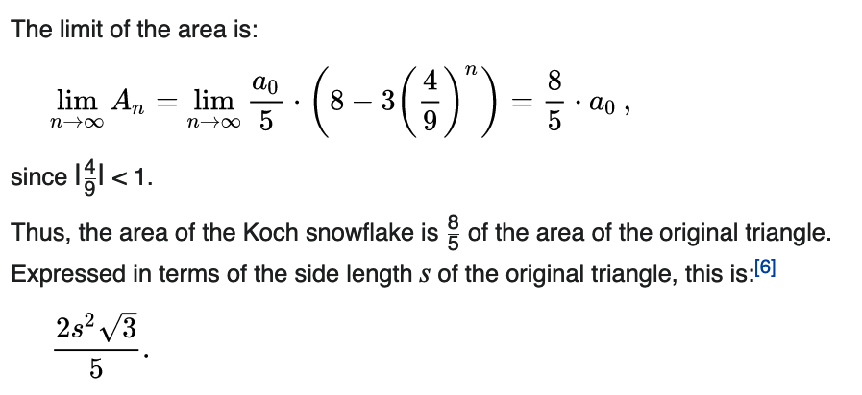
Area of Snowflake

Slide 22
Area and Perimeter Video https://www.youtube.com/watch?v=GaXn3zqfvLY

Slide 23
Other Properties
The fractal dimension of the Koch curve is ln 4/ln 3 ≈ 1.26186.
This is greater than that of a line (D = 1) but less than that of Peano's space-filling curve (D = 2).
The Koch curve is continuous everywhere, but differentiable nowhere.
It is possible to tessellate the plane by copies of Koch snowflakes in two different sizes.
However, such a tessellation is not possible using only snowflakes of one size.
Since each Koch snowflake in the tessellation can be subdivided into seven smaller snowflakes of two different sizes, it is also possible to find tessellations that use more than two sizes at once

Slide 24
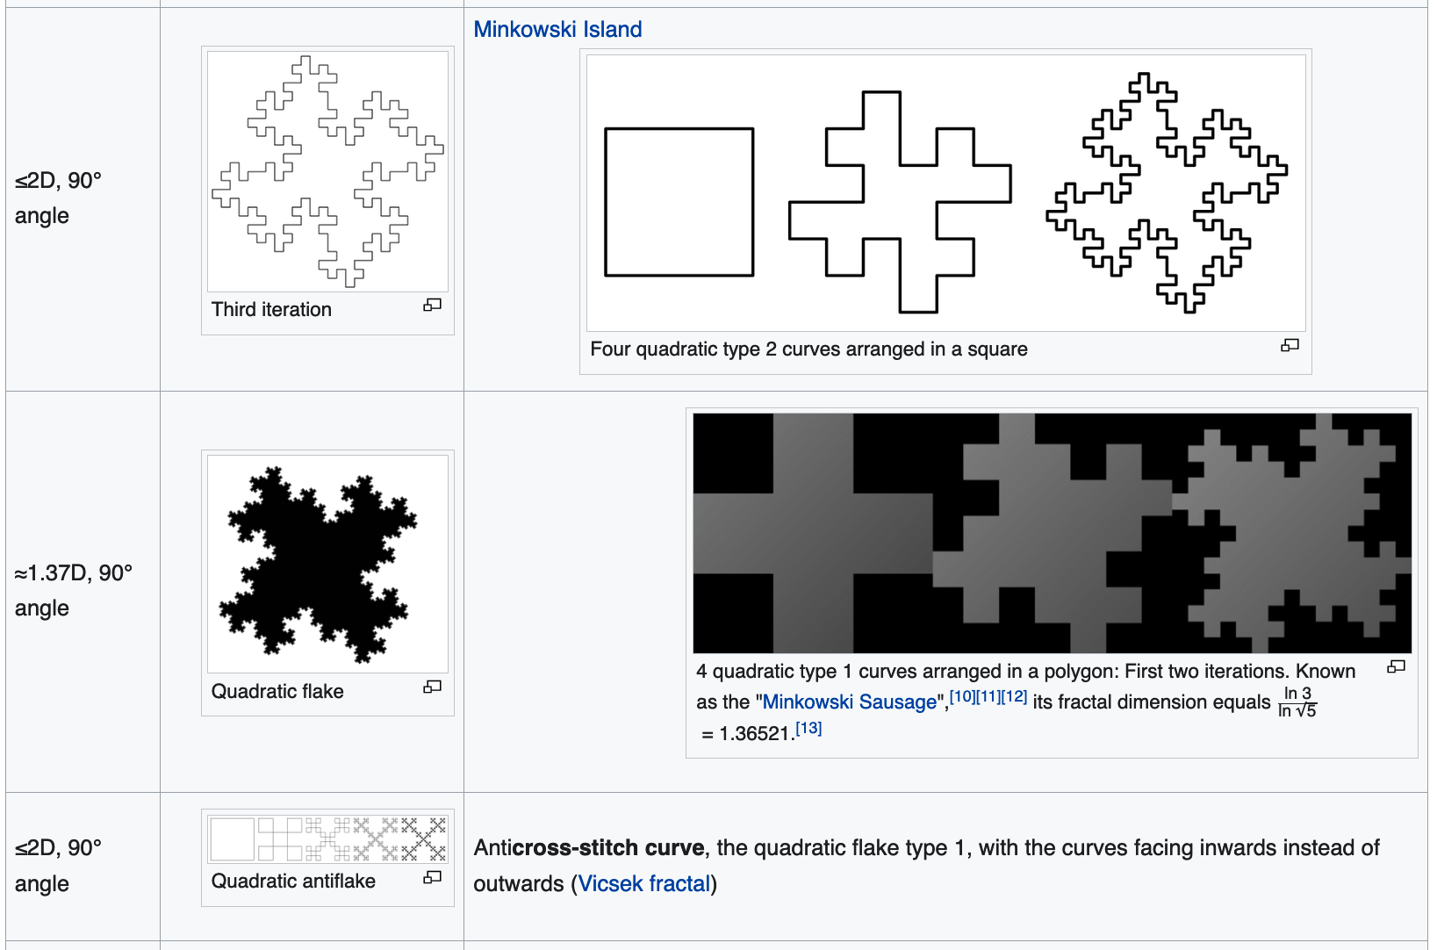
Variations

Slide 25
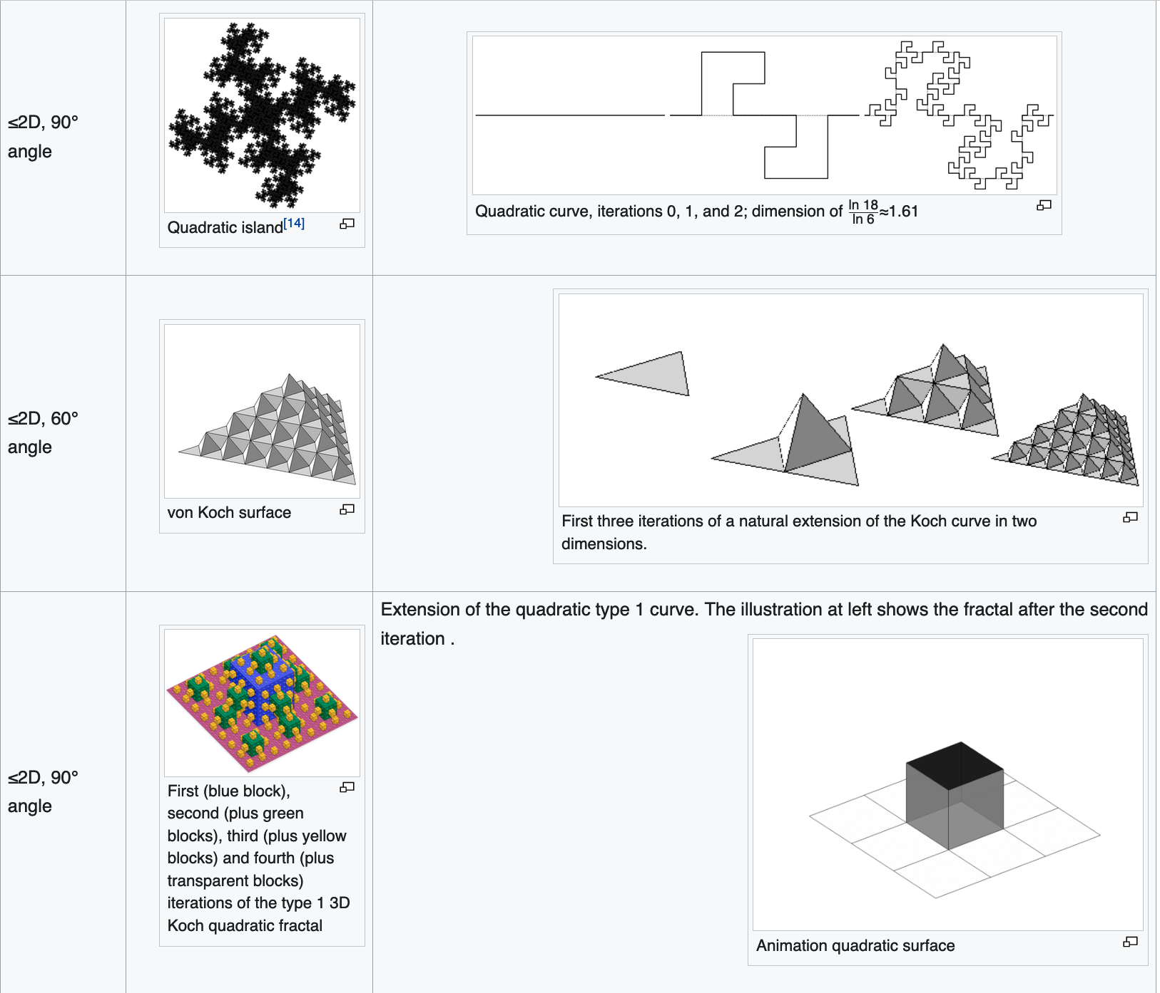
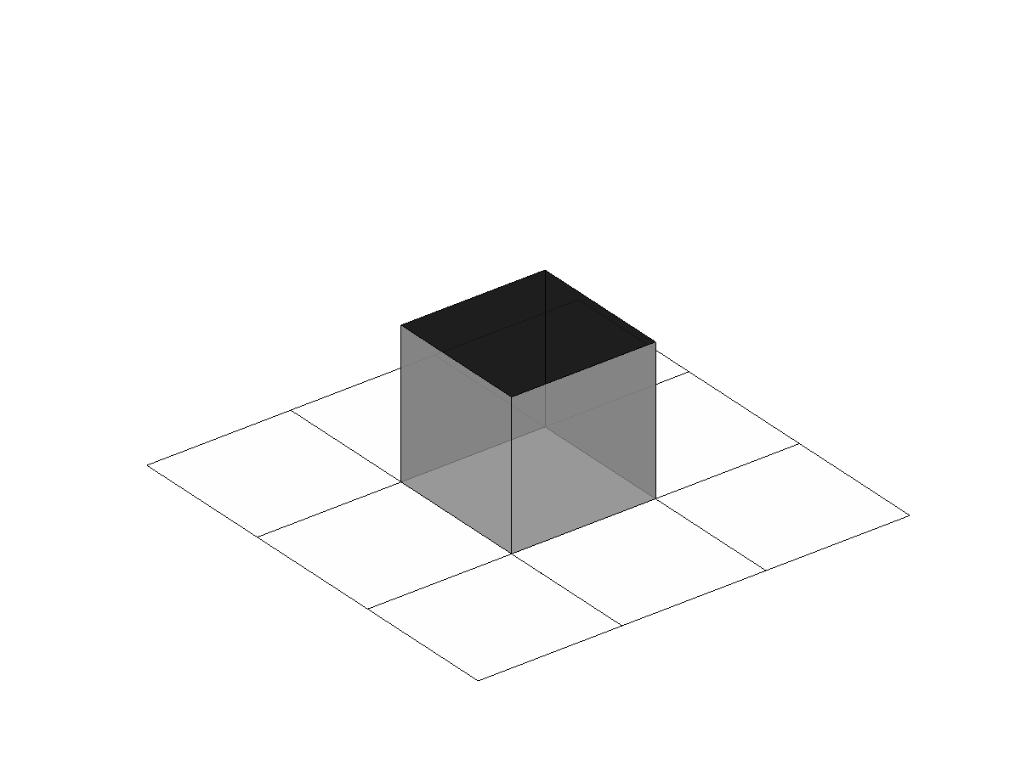
Variations

Slide 26
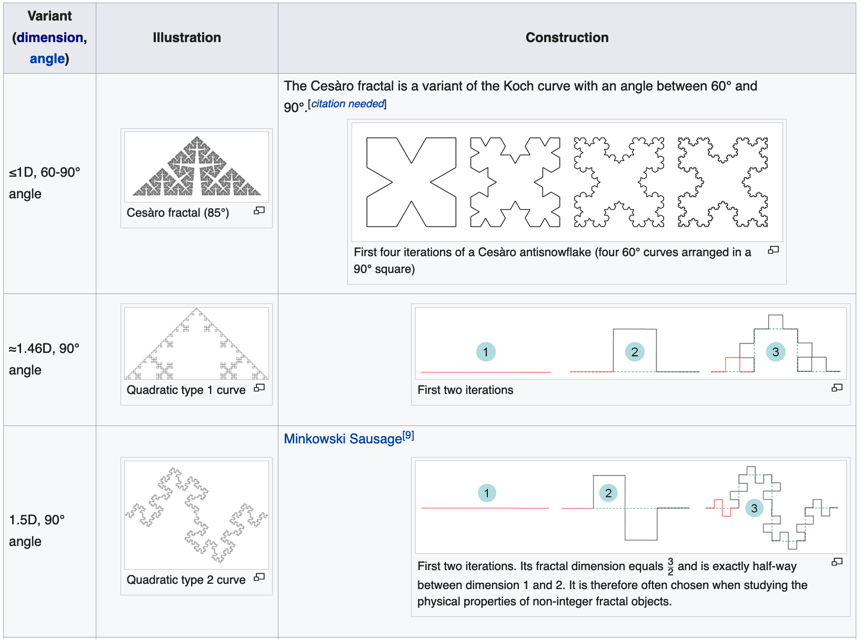
Variations

Slide 27
Variations

