Slide 1
Fractals, Chaos, Complexity
Physics-EPS 30
Lecture 5
Introduction to Chaos
https://en.wikipedia.org/wiki/Chaos_theory
https://www.complexity-explorables.org/flongs/logistic/
https://en.wikipedia.org/wiki/Feigenbaum_constants

Slide 2
Introduction
Chaos theory is an interdisciplinary scientific theory and branch of mathematics focused on underlying patterns and deterministic laws highly sensitive to initial conditions in dynamical systems that were thought to have completely random states of disorder and irregularities.
Chaos theory states that within the apparent randomness of chaotic complex systems, there are underlying patterns, interconnectedness, constant feedback loops, repetition, self-similarity, fractals, and self-organization.
The butterfly effect, an underlying principle of chaos, describes how a small change in one state of a deterministic nonlinear system can result in large differences in a later state (meaning that there is sensitive dependence on initial conditions).
A metaphor for this behavior is that a butterfly flapping its wings in Brazil can cause a tornado in Texas.

Slide 3
Introduction
Small differences in initial conditions, such as those due to errors in measurements or due to rounding errors in numerical computation, can yield widely diverging outcomes for such dynamical systems, rendering long-term prediction of their behavior impossible in general (positive Lyapunov exponent)
This can happen even though these systems are deterministic, meaning that their future behavior follows a unique evolution and is fully determined by their initial conditions, with no random elements involved.
In other words, the deterministic nature of these systems does not make them predictable.
This behavior is known as deterministic chaos, or simply chaos. The theory was summarized by Edward Lorenz as:
Chaos: When the present determines the future, but the approximate
present does not approximately determine the future.

Slide 4
Introduction
Chaotic behavior exists in many natural systems, including fluid flow, heartbeat irregularities, weather and climate.
It also occurs spontaneously in some systems with artificial components, such as the stock market and road traffic.
This behavior can be studied through the analysis of a chaotic mathematical model, or through analytical techniques such as recurrence plots and Poincaré maps.
Chaos theory has applications in a variety of disciplines, including meteorology, anthropology, sociology, environmental science, computer science, engineering, economics, ecology, pandemic crisis management.
The theory formed the basis for such fields of study as complex dynamical systems, edge of chaos theory, and self-assembly processes.

Slide 5
Introduction
Chaos theory concerns deterministic systems whose behavior can, in principle, be predicted.
Chaotic systems are predictable for a while and then 'appear' to become random.
The amount of time that the behavior of a chaotic system can be effectively predicted depends on three things:
  How much uncertainty can be tolerated in the forecast,
  How accurately its current state can be measured,
  And a time scale depending on the dynamics of the system, called the Lyapunov time.
Some examples of Lyapunov times are chaotic electrical circuits, about 1 millisecond; weather systems, a few days (unproven); the inner solar system, 4 to 5 million years.

Slide 6
Introduction
In chaotic systems, the uncertainty in a forecast increases exponentially with elapsed time.
Mathematically, doubling the forecast time more than squares the proportional uncertainty in the forecast.
This means, in practice, a meaningful prediction cannot be made over an interval of more than two or three times the Lyapunov time.
When meaningful predictions cannot be made, the system appears random.
Chaos theory is a method of qualitative and quantitative analysis to investigate the behavior of dynamic systems that cannot be explained and predicted by single data relationships, but must be explained and predicted by whole, continuous data relationships.

Slide 7
Definition: Chaotic Dynamics
In common usage, "chaos" means "a state of disorder".
However, in chaos theory, the term is defined more precisely.
Although no universally accepted mathematical definition of chaos exists, a commonly used definition, originally formulated by Robert L. Devaney, says that to classify a dynamical system as chaotic, it must have these properties:
  It must be sensitive to initial conditions,
  It must be topologically transitive (i.e., mixing)
  It must have dense periodic orbits.
In some cases, the last two properties above have been shown to also imply sensitivity to initial conditions.
In these cases, while it is often the most practically significant property, "sensitivity to initial conditions" need not be stated in the definition.

Slide 8
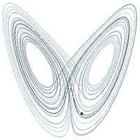
Definition: Chaotic Dynamics
Sensitive dependence or “butterfly effect”
State space (“phase space”) of the Lorenz system. Curves represent the attractor
In chaos theory, the butterfly effect is the sensitive dependence on initial conditions in which a small change in one state of a deterministic nonlinear system can result in large differences in a later state.
As we will see, this is consistent with the idea of a positive Lyapunov Exponent, which means that small differences in initial state can grow large as time passes
A plot of Lorenz's strange attractor for values ρ=28, σ = 10, β = 8/3. The butterfly effect or sensitive dependence on initial conditions is the property of a dynamical system that, starting from any of various arbitrarily close alternative initial conditions on the attractor, the iterated points will become arbitrarily spread out from each other.

Slide 9
Sensitivity to Initial Conditions
Sensitivity to initial conditions means that each point in a chaotic system is arbitrarily closely approximated by other points that have significantly different future paths or trajectories.
Thus, an arbitrarily small change or perturbation of the current trajectory may lead to significantly different future behavior.
Sensitivity to initial conditions is popularly known as the "butterfly effect", so-called because of the title of a paper given by Edward Lorenz in 1972 to the American Association for the Advancement of Science in Washington, D.C., entitled:
Predictability: Does the Flap of a Butterfly's Wings in Brazil set off a Tornado in Texas?.
The flapping wing represents a small change in the initial condition of the system, which causes a chain of events that prevents the predictability of large-scale phenomena.
Had the butterfly not flapped its wings, the trajectory of the overall system could have been vastly different.

Slide 10
Sensitivity to Initial Conditions
A consequence of sensitivity to initial conditions is that if we start with a limited amount of information about the system (as is usually the case in practice), then beyond a certain time, the system would no longer be predictable.
This is most prevalent in the case of weather, which is generally predictable only about a week ahead.
This does not mean that one cannot assert anything about events far in the future, only that some restrictions on the system are present.
For example, we know that the temperature of the surface of the earth will not naturally reach 100 °C (212 °F) or fall below −130 °C (−202 °F) on earth (during the current geologic era), but we cannot predict exactly which day will have the hottest temperature of the year.

Slide 11
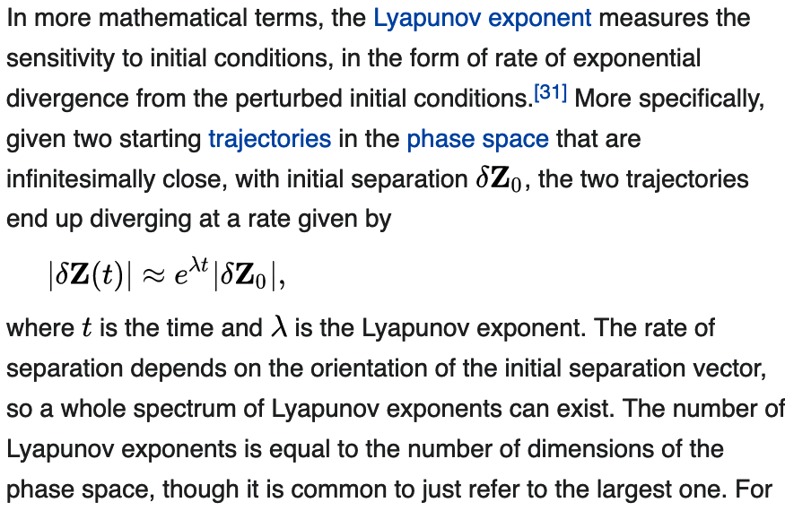
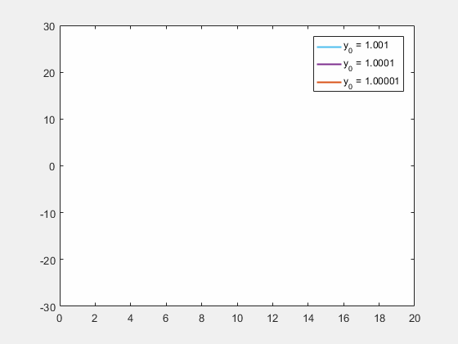
Sensitivity to Initial Conditions
Lorenz equations used to generate plots for the y variable. The initial conditions for x and z were kept the same but those for y were changed between 1.001, 1.0001 and 1.00001. The values for $ρ, σ, β$were 45.92, 16 and 4 respectively. As can be seen from the graph, even the slightest difference in initial values causes significant changes after about 12 seconds of evolution in the three cases. This is an example of sensitive dependence on initial conditions.

Slide 12
Attractors
A dynamical system is generally described by one or more differential or difference equations.
The equations of a given dynamical system specify its behavior over any given short period of time.
To determine the system's behavior for a longer period, it is often necessary to integrate the equations, either through analytical means or through iteration, often with the aid of computers.
Dynamical systems in the physical world tend to arise from dissipative systems, if it were not for some driving force, the motion would cease.
Dissipation may come from internal friction, thermodynamic losses, or loss of material, among many causes.
The dissipation and the driving force tend to balance, killing off initial transients and settle the system into its typical behavior.
The subset of the phase space of the dynamical system corresponding to the typical behavior is the attractor, also known as the attractor

Slide 13
Attractors
Invariant sets and limit sets are similar to the attractor concept.
An invariant set is a set that evolves into itself under the dynamics, and attractors may contain invariant sets.
A limit set is a set of points such that there exists some initial state that ends up arbitrarily close to the limit set (i.e., to each point of the set) as time goes to infinity.
Attractors are limit sets, but not all limit sets are attractors
It is possible to have some points of a system converge to a limit set, but different points when perturbed slightly off the limit set may get knocked off and never return to the vicinity of the limit set.

Slide 14
Strange Attractors
Some attractors are known to be chaotic, in which case the evolution of any two distinct points of the attractor result in exponentially diverging trajectories, which complicates prediction when even the smallest noise is present in the system
An attractor is called strange if it has a fractal structure.
This is often the case when the dynamics on it are chaotic, but strange nonchaotic attractors also exist.
If a strange attractor is chaotic, exhibiting sensitive dependence on initial conditions, then any two arbitrarily close alternative initial points on the attractor will lead to points that are arbitrarily far apart
After any of more iterations (i.e., after more time), the dynamics will lead to points that are arbitrarily close together.
Thus, a dynamic system with a strange attractor is locally unstable yet globally stable
Once some sequences have entered the attractor, nearby points may diverge from one another, but never depart from the attractor

Slide 15
Strange Attractors
The term strange attractor was coined by David Ruelle and Floris Takens to describe the attractor resulting from a series of bifurcations of a system describing fluid flow.
Strange attractors are often differentiable in a few directions, but some are like a Cantor dust, and therefore not differentiable.
Strange attractors may also be found in the presence of noise.
Examples of strange attractors include the double-scroll attractor, Hénon attractor, Rössler attractor, and Lorenz attractor.

Slide 16
Strange Attractors
Some dynamical systems, like the one-dimensional Logistic Map(to be discussed) with parameter 4, and defined by:
  x_{n+1} = 4 x_{n} (1 – x_{n})
  are chaotic everywhere
In many cases chaotic behavior is found only in a subset of phase space.
The cases of most interest arise when the chaotic behavior takes place on an attractor, since then a large set of initial conditions leads to orbits that converge to this chaotic region.
Strange attractors are typically fractals
A plot of Lorenz's strange attractor for values ρ=28, σ = 10, β = 8/3. The butterfly effect or sensitive dependence on initial conditions is the property of a dynamical system that, starting from any of various arbitrarily close alternative initial conditions on the attractor, the iterated points will become arbitrarily spread out from each other.

Slide 17
Strange Attractors
Unlike fixed-point attractors and limit cycles, the attractors that arise from chaotic systems, known as strange attractors, have great detail and complexity.
Strange attractors occur in both continuous dynamical systems (such as the Lorenz system) and in some discrete systems (such as the Hénon map).
Other discrete dynamical systems have a repelling structure called a Julia set, which forms at the boundary between basins of attraction of fixed points.
Julia sets can be thought of as strange repellers.
Both strange attractors and Julia sets typically have a fractal structure, and the fractal dimension can be calculated for them.

Slide 18
Basin of Attraction
An attractor's basin of attraction is the region of the phase space, over which iterations are defined, such that any point, for any initial condition in that region, will asymptotically be iterated into the attractor.
For a stable linear system, every point in the phase space is in the basin of attraction.
However, in nonlinear systems, some points may map directly or asymptotically to infinity, while other points may lie in a different basin of attraction and map asymptotically into a different attractor
Other initial conditions may be in or map directly into a non-attracting point or cycle.

Slide 19
Dynamical Stability
Unstable Fixed Point
Moves away from F.P.
if disturbed
Stable Fixed Point
Moves back to F.P.
if disturbed
Neutral or Marginal Stability
Stays where you place it
if disturbed

Slide 20
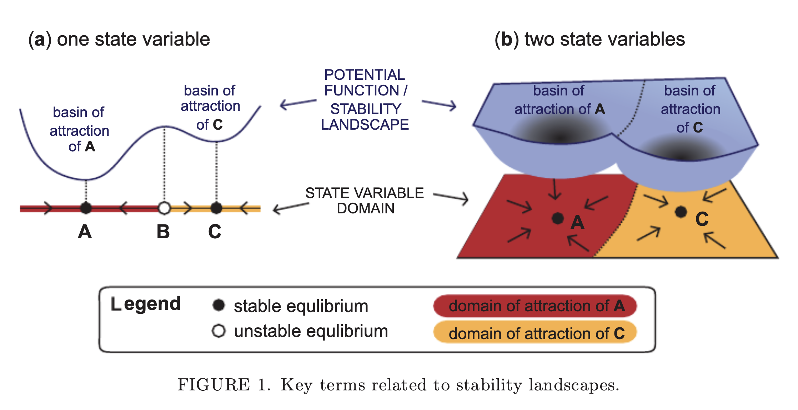
Stability Landscapes https://onlinelibrary.wiley.com/doi/epdf/10.1111/nrm.12097

Slide 21
Definition: Chaotic Dynamics
“Dense” periodic orbits
In topology and related areas of mathematics, a subset A of an embedding space X is called dense (in X) if every point x in X either belongs to A or is a limit point of A
That is, the closure of A constitutes the whole set X.
Informally, for every point in X, the point is either in A or arbitrarily "close" to a member of A
For instance, the rational numbers are a dense subset of the real numbers because every real number either is a rational number or has a rational number arbitrarily close to it

Slide 22
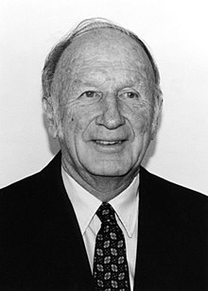
Ed Lorenz https://en.wikipedia.org/wiki/Edward_Norton_Lorenz
Edward Norton Lorenz (May 23, 1917 – April 16, 2008) was an American mathematician and meteorologist who established the theoretical basis of weather and climate predictability, as well as the basis for computer-aided atmospheric physics and meteorology.
He is best known as the founder of modern chaos theory, a branch of mathematics focusing on the behavior of dynamical systems that are highly sensitive to initial conditions.
His discovery of deterministic chaos "profoundly influenced a wide range of basic sciences and brought about one of the most dramatic changes in mankind's view of nature since Sir Isaac Newton," according to the committee that awarded him the 1991 Kyoto Prize for basic sciences in the field of earth and planetary sciences.

Slide 23
Discovery of Chaos
In the 1950s, Lorenz became interested in and started work on numerical weather prediction, which relied on computers to forecast weather by processing observational data on such things as temperature, pressure, and wind.
This interest was sparked, in part, after a visit to the Institute for Advanced Study in Princeton, New Jersey, where he met Jule Charney, then head of the IAS's Meteorological Research Group and a leading dynamical meteorologist at the time.
Charney would later join Lorenz at MIT in 1957 as a professor of meteorology.
In 1953, Lorenz took over leadership of a project at MIT that ran complex simulations of weather models that he used to evaluate statistical forecasting techniques.
By the late 1950s, Lorenz was skeptical of the appropriateness of the linear statistical models in meteorology, as most atmospheric phenomena involved in weather forecasting are non-linear.
It was during this time that his discovery of deterministic chaos came about.

Slide 24
Discovery of Chaos
In 1961, Lorenz was using a simple digital computer, a Royal McBee LGP-30, to simulate weather patterns by modeling 12 variables, representing things like temperature and wind speed.
He wanted to see a sequence of data again, and to save time he re-started the simulation in the middle of its previous calculation.
He did this by entering a printout of the data that corresponded to conditions in the middle of the original simulation.
To his surprise, the weather that the machine began to predict was completely different from the previous calculation.
The culprit: a rounded decimal number on the computer printout.
The computer worked with 6-digit precision, but the printout rounded variables off to a 3-digit number, so a value like 0.506127 printed as 0.506.
This difference is tiny, and the consensus at the time would have been that it should have no practical effect.
However, Lorenz discovered that small changes in initial conditions produced large changes in long-term outcome.

Slide 25
Discovery of Chaos
Lorenz's discovery, which gave its name to Lorenz attractors, showed that even detailed atmospheric modelling cannot, in general, make precise long-term weather predictions.
His work on the topic, assisted by Ellen Fetter, culminated in the publication of his 1963 paper "Deterministic Nonperiodic Flow" in Journal of the Atmospheric Sciences, and with it, the foundation of chaos theory.
He states in that paper:
"Two states differing by imperceptible amounts may eventually evolve into two considerably different states . If there is any error whatever in observing the present state, and in any real system such errors seem inevitable, an acceptable prediction of an instantaneous state in the distant future may well be impossible.
In view of the inevitable inaccuracy and incompleteness of weather observations, precise very-long-range forecasting would seem to be nonexistent."
His description of the butterfly effect, the idea that small changes can have large consequences, followed in 1969.

Slide 26
Discovery of Chaos
Lorenz's insights on deterministic chaos resonated widely starting in the 1970s and 80s, when it spurred new fields of study in virtually every branch of science, from biology to geology to physics.
In meteorology, it led to the conclusion that it may be fundamentally impossible to predict weather beyond two or three weeks with a reasonable degree of accuracy.
However, the recognition of chaos has led to improvements in weather forecasting, as now forecasters recognize that measurements are imperfect and thus run many simulations starting from slightly different conditions, called ensemble forecasting.
Of the seminal significance of Lorenz's work, Kerry Emanuel, a prominent meteorologist and climate scientist at MIT, has stated:
"By showing that certain deterministic systems have formal predictability limits, Ed put the last nail in the coffin of the Cartesian universe and fomented what some have called the third scientific revolution of the 20th century, following on the heels of relativity and quantum physics."

Slide 27
Lorenz Attractor
An easy way to visualize a chaotic attractor is to start with a point in the basin of attraction of the attractor, and then simply plot its subsequent orbit.
Because of the topological transitivity condition (“mixing”), this is likely to produce a picture of the entire final attractor, and indeed both orbits shown in the figure on the right give a picture of the general shape of the Lorenz attractor.
This attractor results from a simple three-dimensional model of the Lorenz weather system.
The Lorenz attractor is perhaps one of the best-known chaotic system diagrams, probably because it is not only one of the first, but it is also one of the most complex, and as such gives rise to a very interesting pattern that, with a little imagination, looks like the wings of a butterfly.

Slide 28
Lorenz Attractor
Unlike fixed-point attractors and limit cycles, strange attractors that arise from chaotic systems have great detail and complexity.
Strange attractors occur in both continuous dynamical systems (such as the Lorenz system) and in some discrete systems (such as the Hénon map).
Other discrete dynamical systems have a repelling structure called a Julia set, which forms at the boundary between basins of attraction of fixed points, as near the boundaries of the Mandelbrot set
Julia sets can be thought of as strange repellers.
Both strange attractors and Julia sets typically have a fractal structure, and the fractal dimension can be calculated for them.
Ended here 1/24/2024

Slide 29


Slide 30
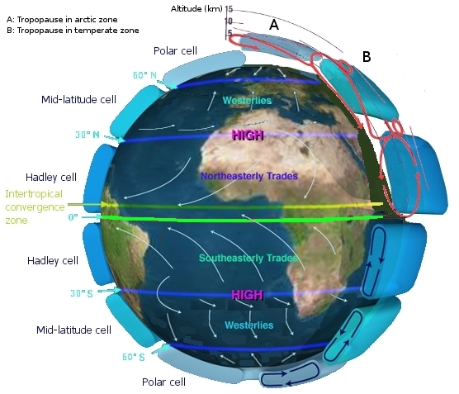
Atmospheric Circulations:
Origin of the Lorenz Equations
Atmospheric circulation is the large-scale movement of air, and the means (together with the smaller ocean circulation) by which thermal energy is distributed on the surface of the Earth.
The large-scale structure of the atmospheric circulation varies from year to year, but the basic climatological structure remains fairly constant.
Individual weather systems – mid-latitude depressions, or tropical convective cells – occur "randomly", and it is accepted that weather cannot be predicted beyond a fairly short limit: perhaps a month in theory, or (currently) about ten days in practice (see Chaos theory and Butterfly effect).
As a rule, the "cells" of Earth's atmosphere shift polewards in warmer climates (interglacials compared to glacials), but remain largely constant even due to continental drift
They are, fundamentally, a property of the Earth's size, rotation rate, heating and atmospheric depth, all of which change little.
Tectonic uplift can significantly alter major elements of the circulation patterns, i.e., the jet stream.
Plate tectonics shift ocean currents.
http://en.wikipedia.org/wiki/Atmospheric_circulation

Slide 31
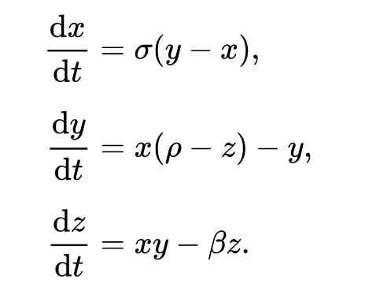
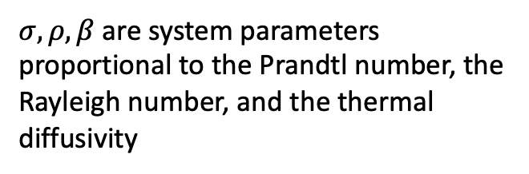
Lorenz Equations
In 1963, Edward Lorenz, with the help of Ellen Fetter, developed his simplified mathematical model for atmospheric convection, based on a mode expansion of fluid convection (Saltzman equations)
The model is a system of three ordinary differential equations now known as the Lorenz equations
Here x(t) is proportional to the convective velocity, y(t) is proportional to the horizontal temperature variation, and z(t) is proportional to the vertical temperature variation
$σ, ρ, β$are system parameters proportional to the Prandtl number, the Rayleigh number, and the thermal diffusivity

Slide 32
Derivation of Lorenz Equations
The Lorenz equations are derived from the Oberbeck–Boussinesq approximation to the equations describing fluid circulation in a shallow layer of fluid, heated uniformly from below and cooled uniformly from above, equations known as Rayleigh–Bénard convection.
The fluid is assumed to circulate in two dimensions (vertical and horizontal) with periodic rectangular boundary conditions.
The partial differential equations modeling the system's stream function and temperature are subjected to a spectral “Galerkin approximation”:
  The hydrodynamic fields are expanded in Fourier series
  Then severely truncated to a single term for the stream function and two terms for the temperature.
This reduces the model equations to a set of three coupled, nonlinear ordinary differential equations.
The Lorenz system is a reduced version of a larger system studied earlier by Barry Saltzman.

Slide 33
Examples of Solutions to the Lorenz Equations
Stable Fixed Point
ρ=14, σ= 10, ß = 8/3, initial point (20,41,20)
ρ=13, σ= 10, ß = 8/3
Stable Fixed Point
Unstable Fixed Points
(Repellors)
ρ=15, σ= 10, ß = 8/3
ρ=28, σ= 10, ß = 8/3

Slide 34
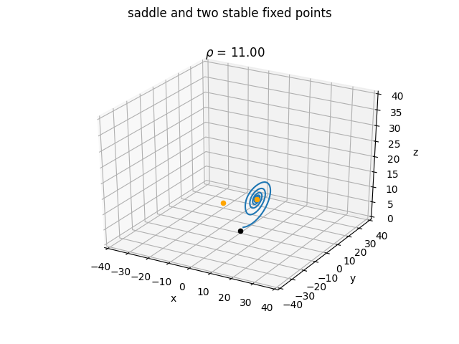

Lorenz Attractor
Increasing the Rayleigh number $ρ$from stability to instability

Slide 35
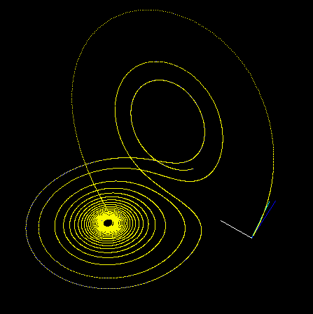
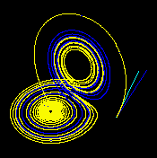
Examples of Sensitive Dependence
These figures — made using ρ = 28, σ = 10 and β = 8/3 — show three time segments of the 3-D evolution of two trajectories (one in blue, the other in yellow) in the Lorenz attractor starting at two initial points that differ only by 10⁻⁵ in the x-coordinate. Initially, the two trajectories seem coincident (only the yellow one can be seen, as it is drawn over the blue one) but, after some time, the divergence is obvious.

Slide 36
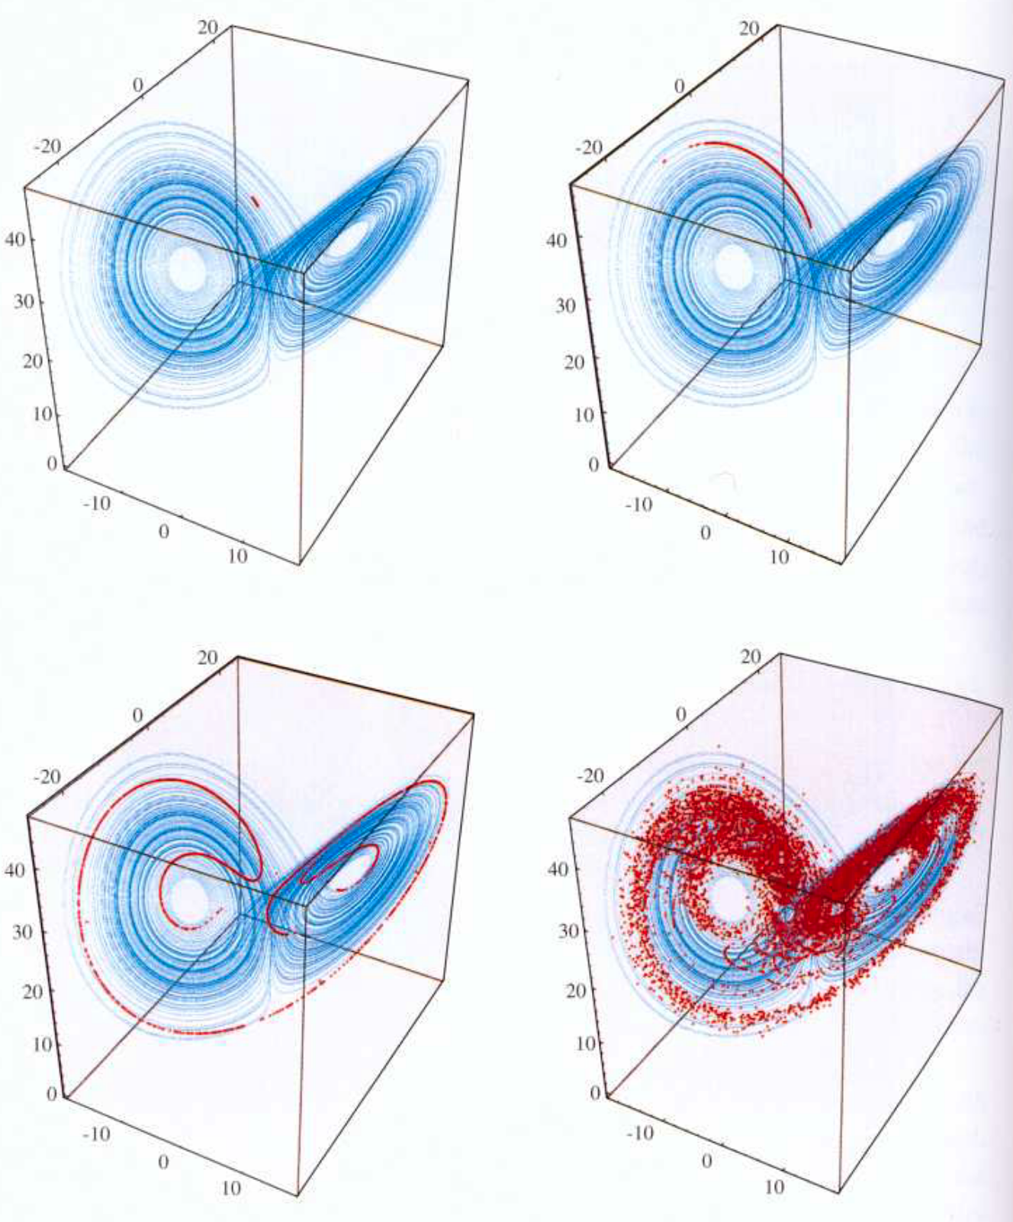
Another View of Sensitive Dependence
10,000 particles at slightly different initial conditions, dynamical system made using:
ρ = 28, σ = 10 and β = 8/3

Slide 37
Yet Another View of Sensitive Dependence
(Click on image)
https://upload.wikimedia.org/wikipedia/commons/9/9c/Lorenz.ogv

Slide 38
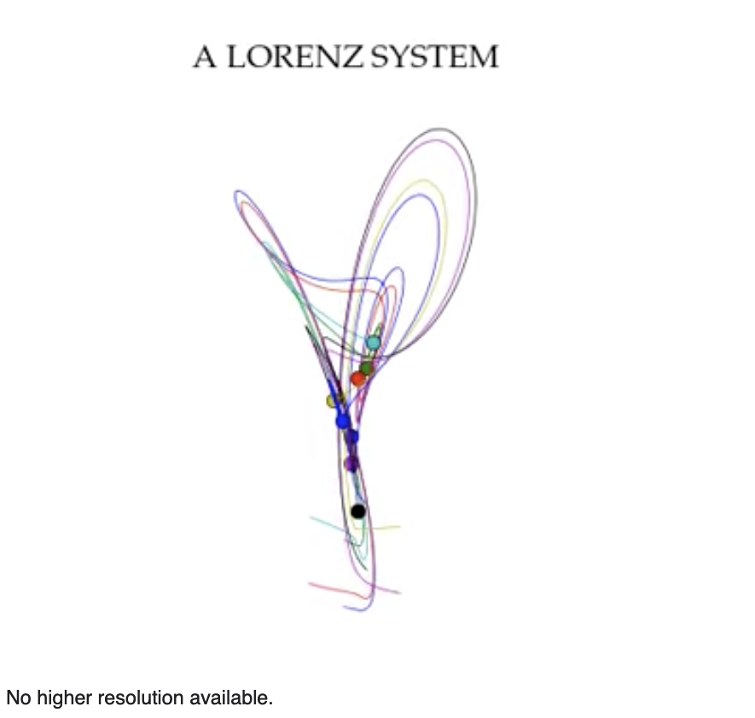
Yet Another View of Sensitive Dependence
Click on the image
https://upload.wikimedia.org/wikipedia/commons/e/ea/A_Lorenz_system.ogv

Slide 39
Iterated Maps
State space: Points move around in their state space via the map dynamics
1
Dynamical System (“Map”):
x_{n+1} = F(x_{n})
Iteration:
x₁ = F(x₀)
x₂ = F(x₁)
x₃ = F(x₂)
x₄ = F(x₃)
…
(x_{0,} x₁)
(x_{3,} x₄)
(x_{4,} x₅)
x_{n+1}
(x_{5,} x₆)
Etc.
(x_{2,} x₃)
(x_{1,} x₂)
0
0
x_{n}
1
Terminology: The path through the state space is called an “orbit”

Slide 40
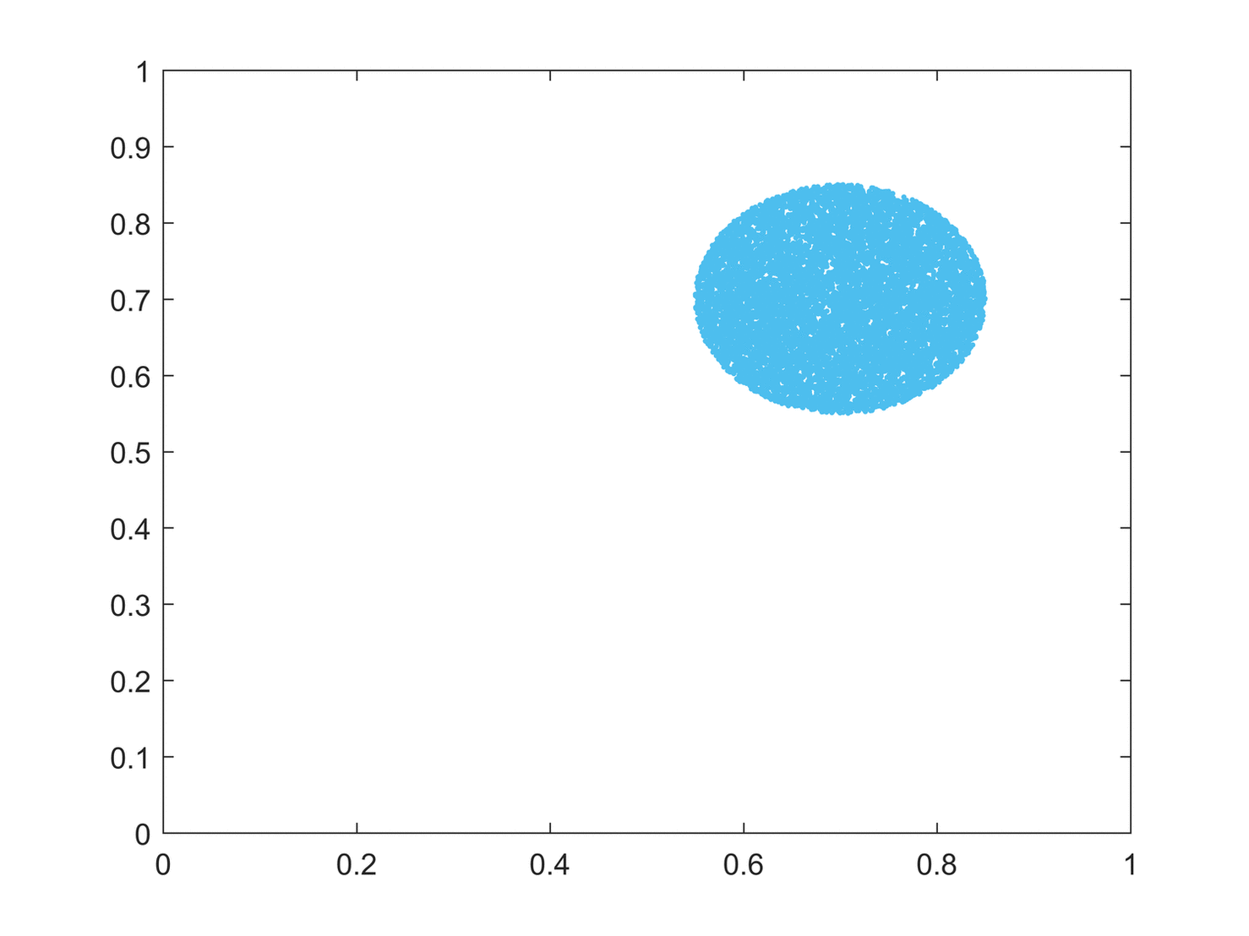

(Topological) Mixing in Maps
Topological mixing means that the system evolves over time so that any given region or open set of its phase space eventually overlaps with any other given region.
This mathematical concept of "mixing" corresponds to the standard intuition, and the mixing of colored dyes or fluids is an example of a chaotic system.
Topological mixing is often omitted from popular accounts of chaos, which equate chaos with only sensitivity to initial conditions.
Logistic map:
$x_{n+1}= λ{{ x}_{n} (1−x}_{n}),$ $0 ≤x_{n} ≤1$
Six iterations of a set of states passed through the logistic map. The first iterate (blue) is the initial condition, which essentially forms a circle. Animation shows the first to the sixth iteration of the circular initial conditions.
It can be seen that mixing occurs as we progress in iterations.
The sixth iteration shows that the points are almost completely scattered in the phase space.
Had we progressed further in iterations, the mixing would have been homogeneous and irreversible.

Slide 41
(Topological) Mixing in Maps
Sensitive dependence on initial conditions alone does not give chaos.
For example, consider the simple dynamical system produced by repeatedly doubling an initial value:
  This system has sensitive dependence on initial conditions everywhere, since any pair of nearby points eventually becomes widely separated.
  However, this example has no topological mixing, and therefore has no chaos.
Indeed, it has extremely simple behavior: all points except 0 tend to positive or negative infinity.
Six iterations of a set of states passed through the logistic map. The first iterate (blue) is the initial condition, which essentially forms a circle. Animation shows the first to the sixth iteration of the circular initial conditions.
It can be seen that mixing occurs as we progress in iterations.
The sixth iteration shows that the points are almost completely scattered in the phase space.
Had we progressed further in iterations, the mixing would have been homogeneous and irreversible.

Slide 42
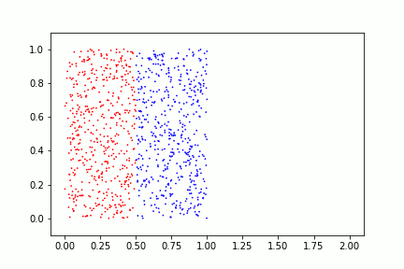
Chaotic Dynamics in the Bakers’ Map
Topological transitivity or “mixing”
In dynamical systems theory, the baker's map is a chaotic map from the unit square into itself.
It is named after a kneading operation that bakers apply to dough:
  The dough is cut in half, and the two halves are stacked on one another, and compressed.
As with many deterministic dynamical systems, the baker's map is studied by its action on the space of functions defined on the unit square.
The baker's map is an exactly solvable model of deterministic chaos, in that the eigenfunctions and eigenvalues of the transfer operator can be explicitly determined.
Repeated application of the baker's map to points colored red and blue, initially separated. The baker's map is mixing, shown by the red and blue points being completely mixed after several iterations.

Slide 43
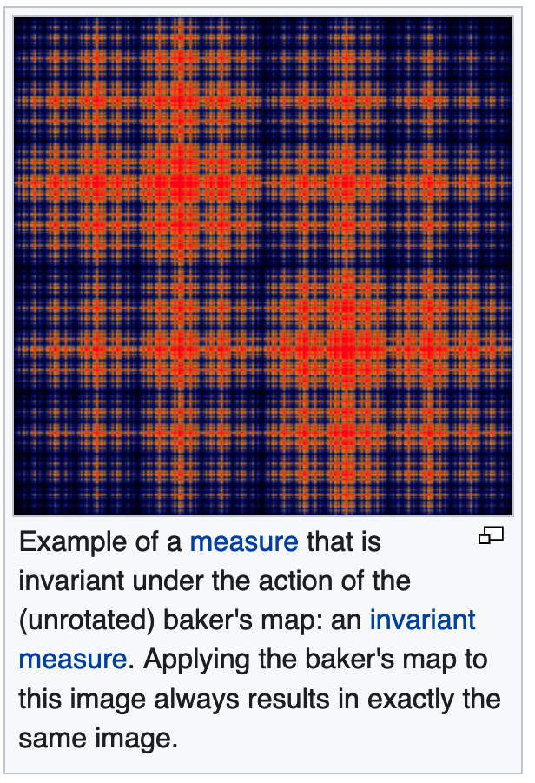
Chaotic Dynamics
Topological transitivity or “mixing”
In mathematics, mixing is an abstract concept originating from physics: the attempt to describe the irreversible thermodynamic process of mixing in the everyday world: mixing paint, mixing drinks, industrial mixing, etc.
The concept appears in ergodic theory, which is the study of stochastic (dynamic probabilistic) processes and measure-preserving dynamical systems.
Several different definitions for mixing exist, including strong mixing, weak mixing and topological mixing, with the last not requiring a measure to be defined.

Slide 44
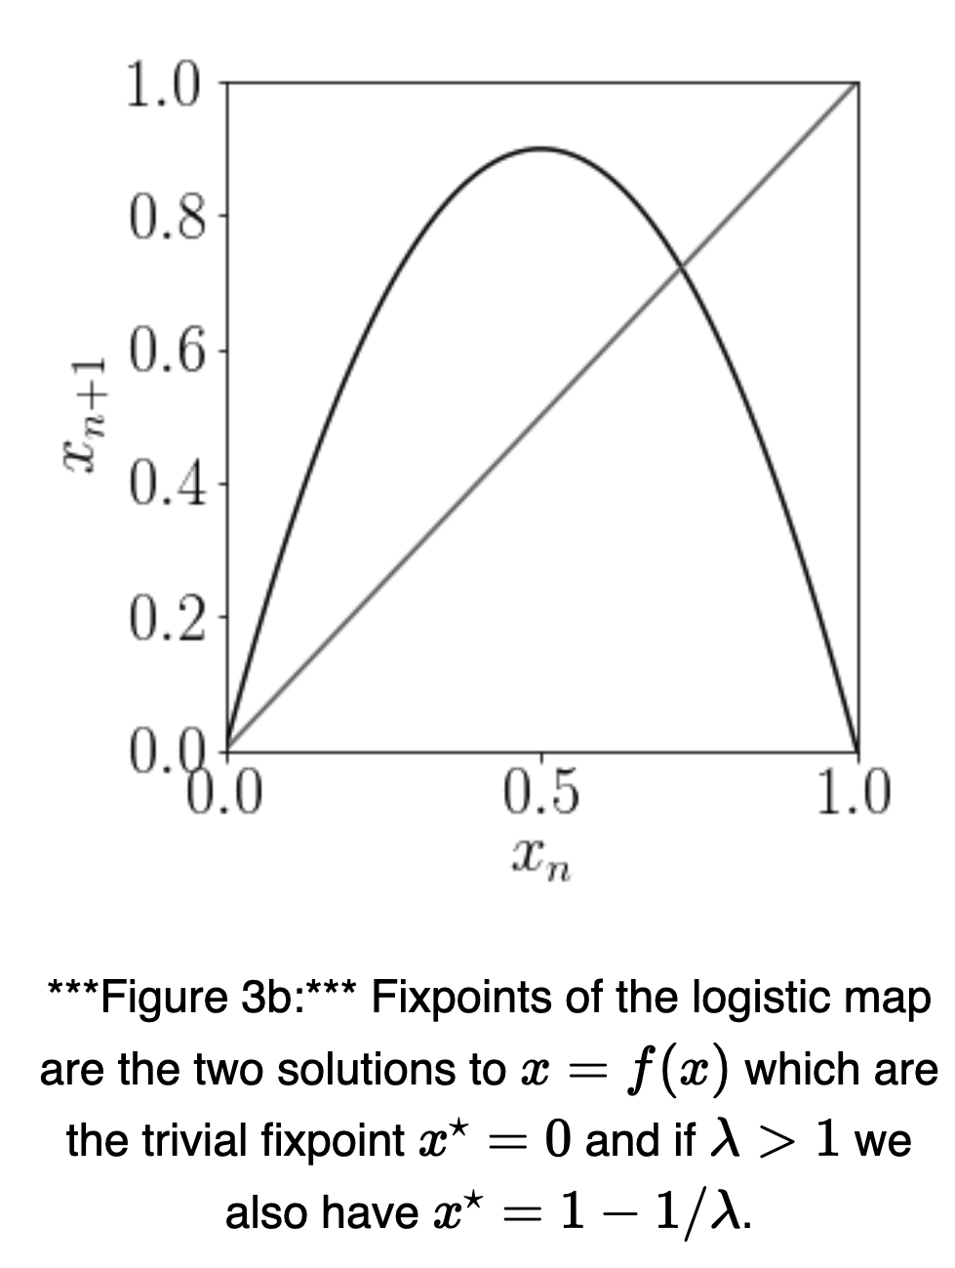

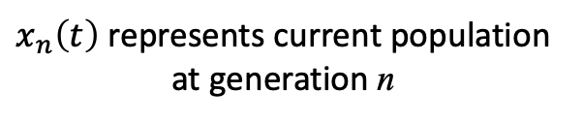
A Different Dynamical System:
The Logistic Map
$x_{n}\left(t\right)$ represents current population at generation n
The logistic map is a polynomial mapping (equivalently, recurrence relation) of degree 2, often cited as an archetypal example of how complex, chaotic behaviour can arise from very simple non-linear dynamical equations.
The map was popularized in a 1976 paper by the biologist Robert May, in part as a discrete-time demographic model analogous to the logistic equation written down by Pierre François Verhulst.
Mathematically, the logistic map is written:
$x_{n+1}= λ{{ x}_{n} (1−x}_{n}),$ $0 ≤x_{n} ≤1$
$$x_{n+1}= x_{n}$$

Slide 45
A Different Dynamical System:
The Logistic Map
x_{n} is a number between zero and one, that represents the ratio of existing population to the maximum possible population. The values of interest for the parameter𝜆 are those in the interval [0, 4], so that x_{n} remains bounded on [0, 1].
This nonlinear difference equation is intended to capture two effects:
  Reproduction (birth) where the population will increase at a rate proportional to the current population when the population size is small.
  Starvation (density-dependent death) where the growth rate will decrease at a rate proportional to the value obtained by taking the theoretical "carrying capacity" of the environment less the current population.

Slide 46
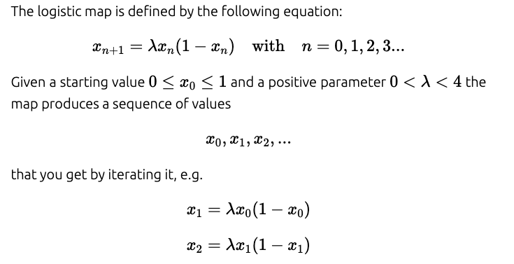
Logistic Map https://www.complexity-explorables.org/flongs/logistic/
Despite its formal simplicity, the logistic map exhibits an unexpected degree of complexity.
Historically it has been one of the most important and paradigmatic systems during the early days of research on deterministic chaos.

Slide 47
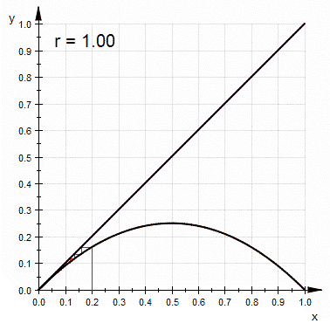
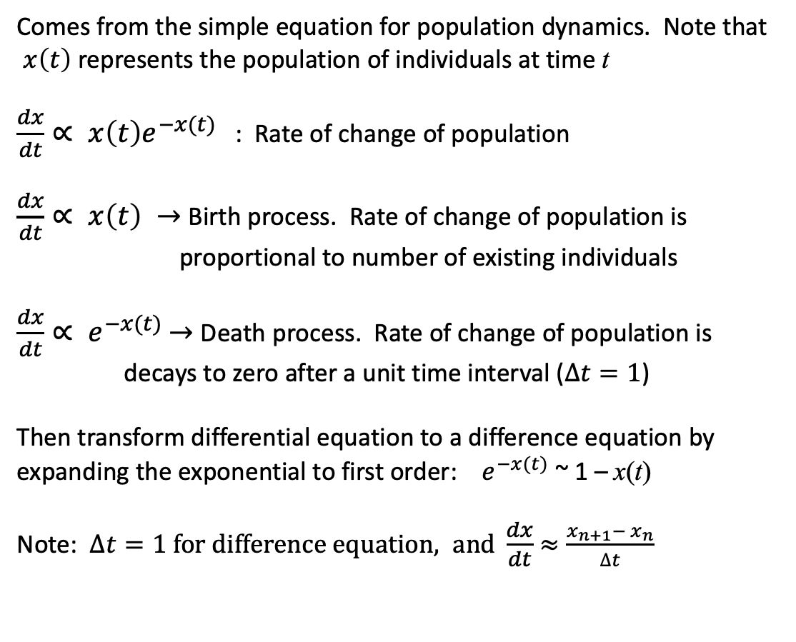

Origin of the Logistic Map:
Population Dynamics
$x_{n}\left(t\right)$ represents current population at generation n
Comes from the simple equation for population dynamics. Note that
$x\left(t\right)$ represents the population of individuals at time t
$\frac{dx}{dt}∝ x\left(t\right)e^{−x(t)}$ : Rate of change of population
$\frac{dx}{dt}∝ x\left(t\right) →$ Birth process. Rate of change of population is proportional to number of existing individuals
$\frac{dx}{dt}∝ e^{−x(t)}$ $→$ Death process. Rate of change of population is decays to zero after a unit time interval ($∆t=1$)
Then transform differential equation to a difference equation by expanding the exponential to first order: $e^{−x(t)}$ ~ 1 – x(t)
Note: $∆t=1 for difference equation, and \frac{dx}{dt}$ $≈\frac{x_{n+1}− x_{n}}{∆t}$
$x_{n+1}= λ{{ x}_{n} (1−x}_{n}),$ $0 ≤x_{n} ≤1$

Slide 48


Logistic Map https://en.wikipedia.org/wiki/Logistic_map
Terminology: $λ$ = r = s depending on the notation used
$x_{n+1}=r{{ x}_{n} (1−x}_{n}),$ $0 ≤x_{n} ≤1$
The usual values of interest for the parameter are those in the interval [0, 4], so that x_{n} remains bounded on [0, 1].
The r = 4 case of the logistic map is a nonlinear transformation of both the bit-shift map and the μ = 2 case of the tent map.
If r > 4 this leads to negative population sizes.
With r between 0 and 1, the population will eventually die, independent of the initial population.
With r between 1 and 2, the population will quickly approach the value r − 1/r, independent of the initial population.
With r between 2 and 3, the population will also eventually approach the same value r − 1/r, but first will fluctuate around that value for some time.
The rate of convergence is linear, except for r = 3, when it is dramatically slow, less than linear
$$x_{n+1}$$
$$x_{n}$$
“Cobweb diagram”

Slide 49



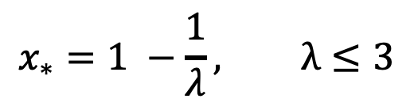
Example of the Iteration Process
Assume $λ=2.5$
$$x_{n+1}= λ{{ x}_{n} (1−x}_{n}),$$
n | x_{n} | x_{n+1}
0 | 0.5 | 0.625
1 | 0.625 | 0.5859375
2 | 0.5859375 | 0.606536865234375
3 | 0.606536865234375 | 0.5966247408650815
4 | 0.5966247408650815 | 0.6016591486318896
5 | 0.6016591486318896 | 0.5991635437485985
… | 0.6 | 0.6
$$x_{∗}=1 −\frac{1}{λ}, λ≤3$$
Final value (“Fixed Point”):
Put: $x_{∗}= λ x_{∗} (1 −x_{∗})$ →

Slide 50
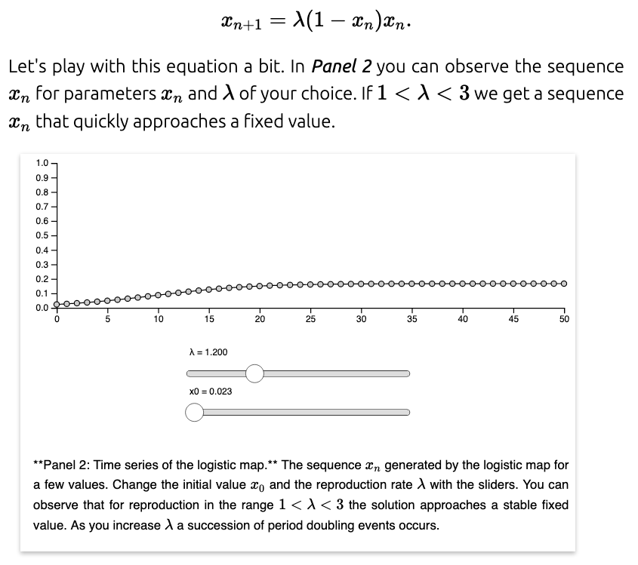
See: https://www.complexity-explorables.org/flongs/logistic/

Slide 51
Logistic Map: Properties https://en.wikipedia.org/wiki/Logistic_map
With r between 3 and 3.44949 the population will approach permanent oscillations between two values.
With r between 3.44949 and 3.54409 (approximately), from almost all initial conditions the population will approach permanent oscillations among four values.
With r increasing beyond 3.54409, from almost all initial conditions the population will approach oscillations among 8 values, then 16, 32, etc.
The lengths of the parameter intervals that yield oscillations of a given length decrease rapidly
The ratio between the lengths of two successive bifurcation intervals approaches the Feigenbaum constant δ ≈ 4.66920.

Slide 52
Logistic Map: Properties https://en.wikipedia.org/wiki/Logistic_map
This behavior is an example of a period-doubling cascade, at r ≈ 3.56995 is the onset of chaos, at the end of the period-doubling cascade.
From almost all initial conditions, we no longer see oscillations of finite period. Slight variations in the initial population yield dramatically different results over time, a prime characteristic of chaos.
Most values of r beyond 3.56995 exhibit chaotic behavior, but there are still certain isolated ranges of r that show non-chaotic behavior; these are sometimes called islands of stability.
For instance, beginning at approximately 3.82843 there is a range of parameters r that show oscillation among three values, and for slightly higher values of r oscillation among 6 values, then 12 etc.

Slide 53
Logistic Map: Properties https://en.wikipedia.org/wiki/Logistic_map
From almost all initial conditions, we no longer see oscillations of finite period.
Slight variations in the initial population yield dramatically different results over time, a prime characteristic of chaos.
Most values of r beyond 3.56995 exhibit chaotic behavior, but there are still certain isolated ranges of r that show non-chaotic behavior
These are sometimes called islands of stability
For instance, beginning at approximately 3.82843… there is a range of parameters r that show oscillation among three values, and for slightly higher values of r oscillation among 6 values, then 12 etc.
There are other ranges that yield oscillation among 5 values, etc.
All oscillation periods occur for some values of r
A period-doubling window with parameter c is a range of r-values consisting of a succession of subranges. The kth subrange contains the values of r for which there is a stable cycle of period 2^{k}c.

Slide 54
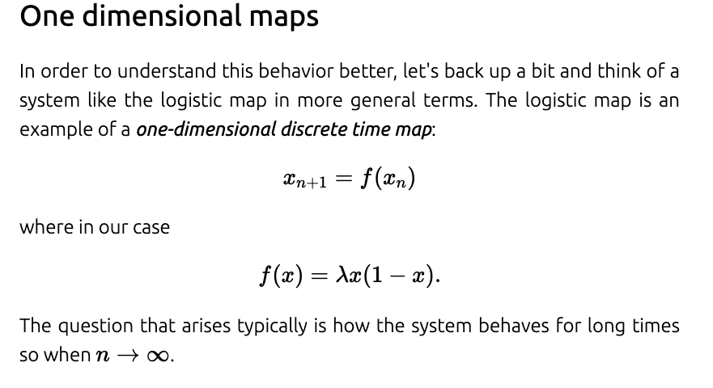

Slide 55
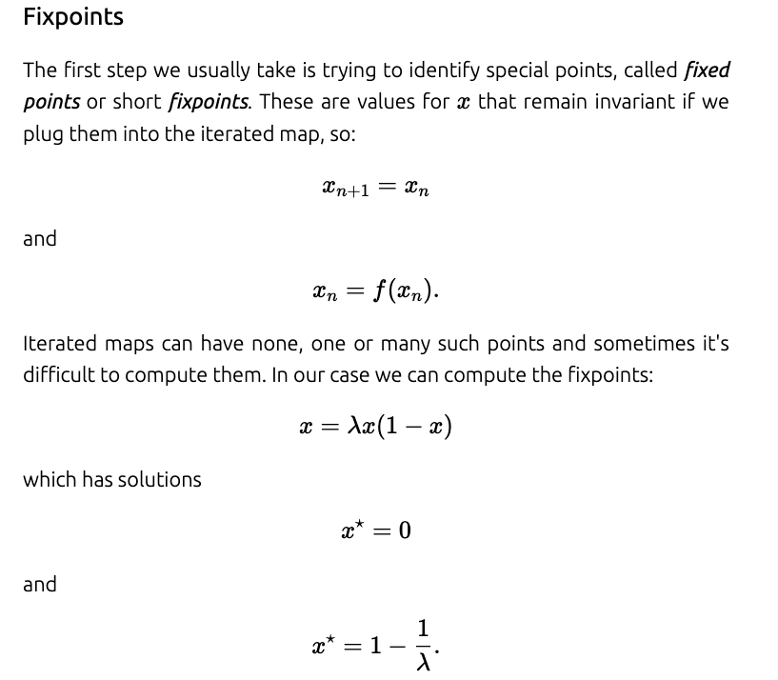




Calculation of Fixed Points
x_{n+1} = x_{n}
$$x_{n+1}=λ x_{n} \left(1 −x_{n}\right)$$
Exists if $λ>0$
Fixed Points $x_{∗}$
$$x_{∗}=λ x_{∗} \left(1 −x_{∗}\right)$$
x = 0 is always a fixed point, but it can be stable or unstable

Slide 56
Stability
Unstable Fixed Point
Moves away from F.P.
if disturbed
Stable Fixed Point
Moves back to F.P.
if disturbed
Neutral or Marginal Stability
Stays where you place it
if disturbed

Slide 57
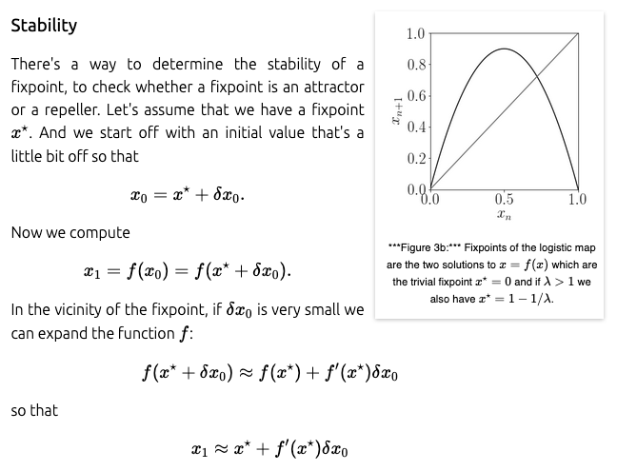
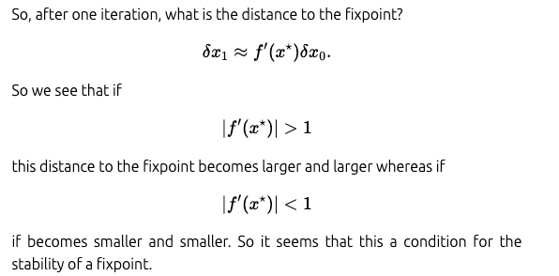
Stability and Fixed Points of the Logistic Map

Slide 58
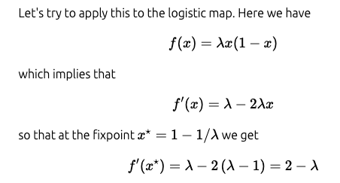

Stability of the Logistic Map
For Reference:
So if $1< λ<3$ the nonzero fixed point is stable
Note: The fixed point x* = 0 is stable as long as $λ<1$, since f ’(x* = 0) = $λ$

Slide 59
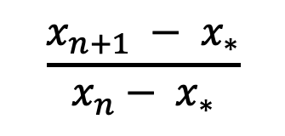
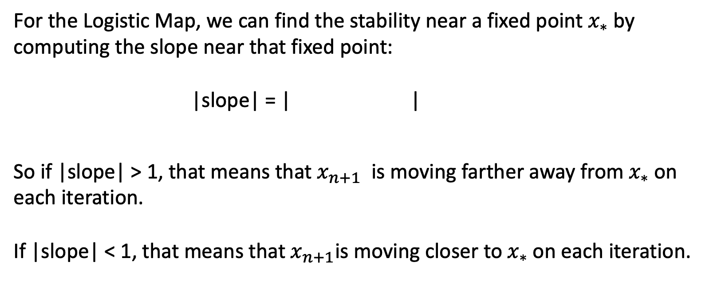
Stability of Logistic Map
See also: https://people.uleth.ca/~roussel/nld/stability_maps.pdf
For the Logistic Map, we can find the stability near a fixed point$x_{∗}$ by computing the slope near that fixed point:
|slope| = | |
So if |slope| > 1, that means that $x_{n+1}$ is moving farther away from $x_{∗}$ on each iteration.
If |slope| < 1, that means that${ x}_{n+1}$is moving closer to $x_{∗}$ on each iteration.
$$\frac{x_{n+1} − x_{∗}}{x_{n}− x_{∗}}$$

Slide 60
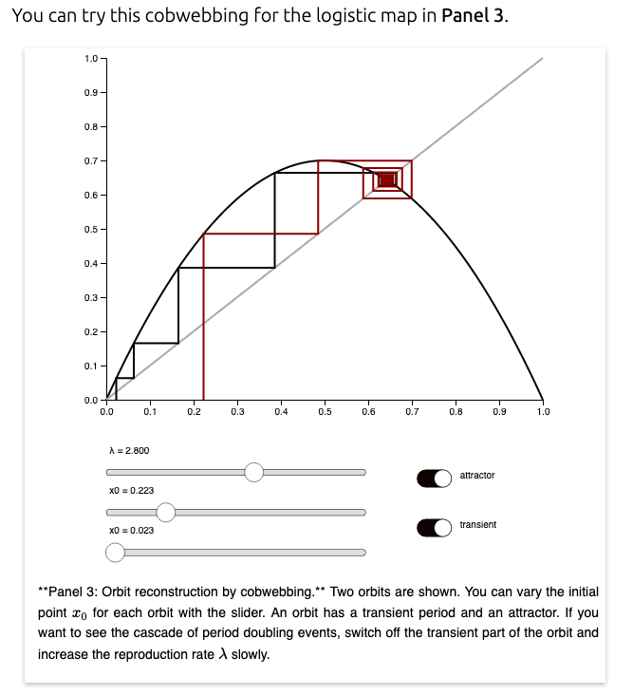
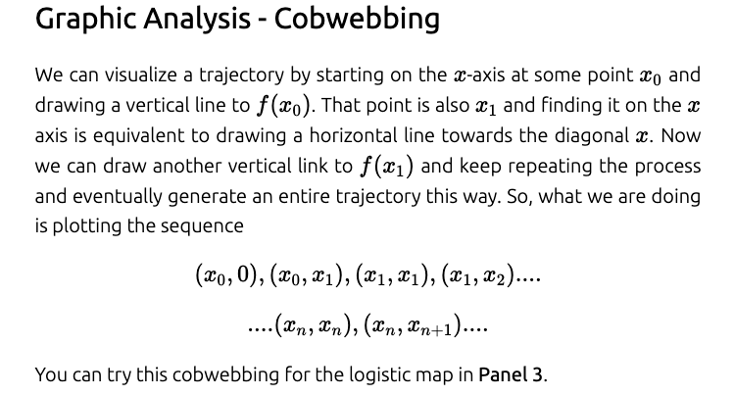
Cobweb Diagrams
See: https://www.complexity-explorables.org/flongs/logistic/

Slide 61
Examples: https://www.complexity-explorables.org/flongs/logistic/
Iterations: Panel 1
Sensitive dependence: Panel 2
Cobweb diagrams: Panel 3
Bifurcation diagrams: Panel 4
Lyapunov separation of time series: Panel 5
Bifurcations for a different map: Panel 6

Slide 62
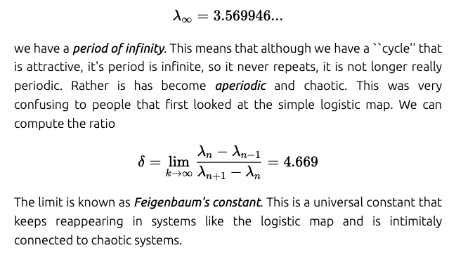
The Road to Chaos
At the value:

Slide 63
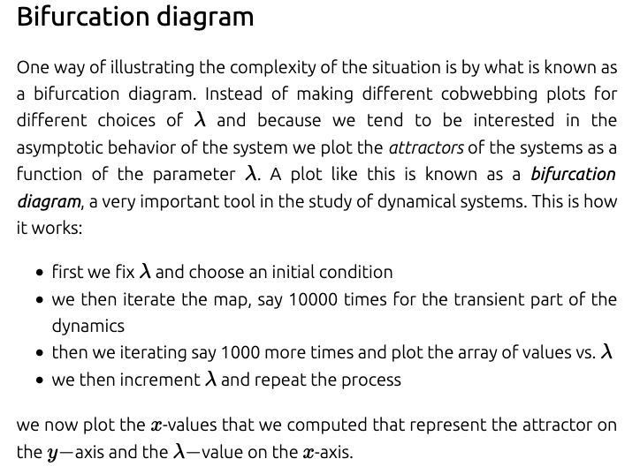
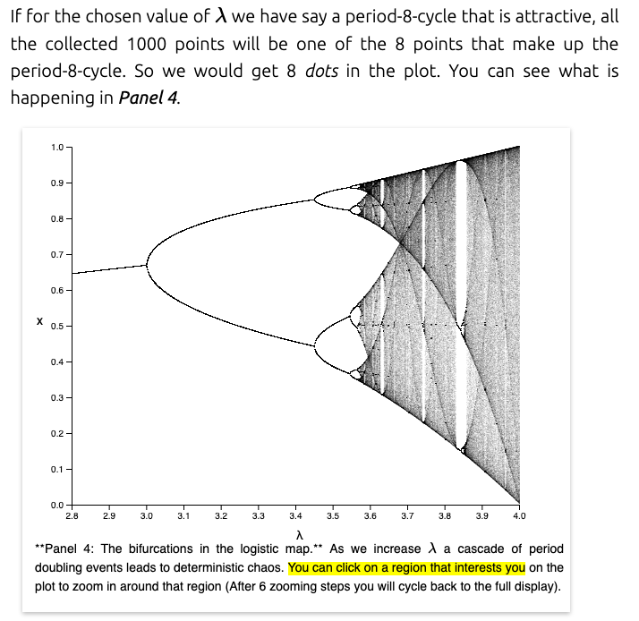
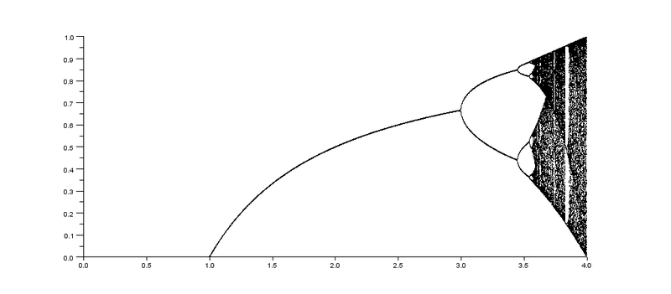


1
$λ<3$ (stable F.P.)
$$λ$$
0
0
1
2
3
4
See: https://www.complexity-explorables.org/flongs/logistic/
https://commons.wikimedia.org/wiki/File:Bifurcation_diagram_logistic_map_lambda_0_to_4.png

Slide 64
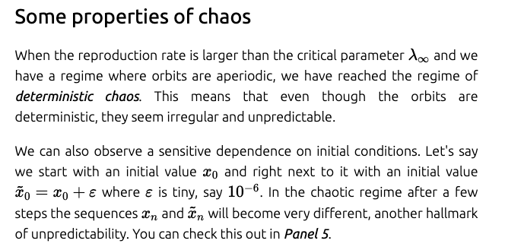
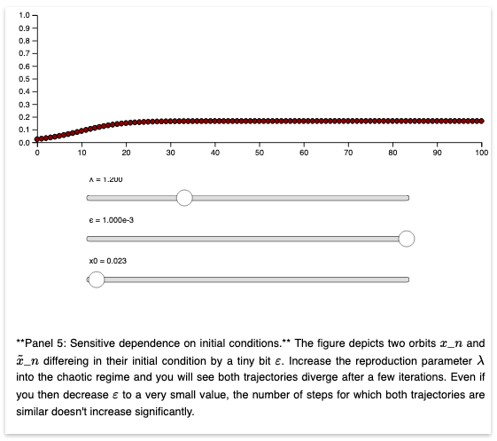

Sensitive Dependence on Initial Conditions
See: https://www.complexity-explorables.org/flongs/logistic/

Slide 65




Second Iterate of the Logistic Map
First Iterate:
$$X_{n+1}=F(X_{n})$$
Or
$$X_{n+1}= λ X_{n} (1− X_{n})$$
(Substitute)
Since also:
$$X_{n+2}= λ X_{n+1} (1− X_{n+1})$$
We can obtain the Second Iterate:
$$X_{n+2}=F(X_{n})$$
$$X_{n+2}= λ^{2} X_{n}−λ^{2}\left(λ+1\right)X_{n}^{2}+2λ^{3}X_{n}^{3}−λ^{3}X_{n}^{4}$$
The second iterate is a quartic equation and its slope is
Slope $= λ^{2} −{2 λ}^{2}\left(λ+1\right) X_{n}+6λ^{3}X_{n}^{2}−{4λ}^{3}X_{n}^{3}$

Slide 66
Second Iterate Map
X_{n+2}
The Second Iterate map represents the bifurcation of the period doubling cascade to chaos
X_{n}
X_{n+1}
First Iterate Map
X_{n}

Slide 67
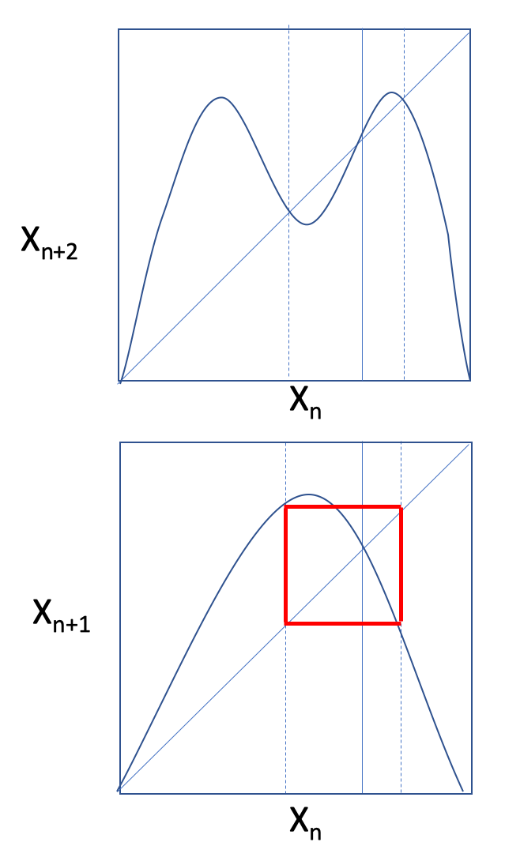

Period Doubling Cascade
Second Iterate Map
X₂
X₀
X₁
Here we show the first and second iterate maps of the period doubling route to chaos. At top is the second iterate map. At bottom is the original logistic map
Fixed points of the second iterate map for a value of the parameter slightly greater than 3.
The second iterate map shows 2 fixed points at the values X₁ and X₂.
The original and now unstable fixed point is X_{0.}
$$λ$$
X₁
X₀
X₂
First Iterate Map

Slide 68
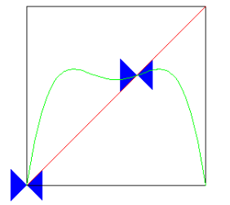
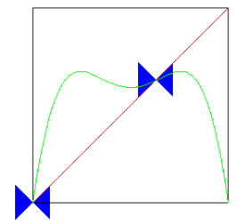
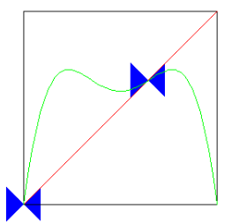
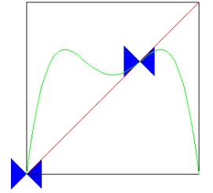
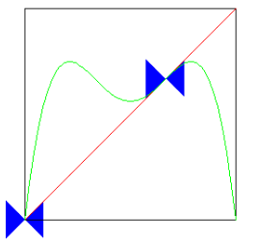
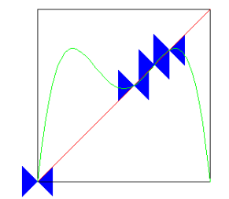
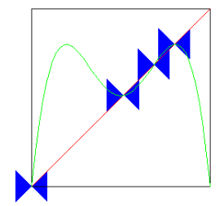
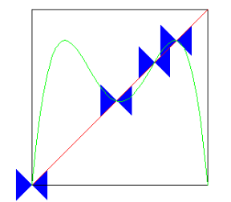
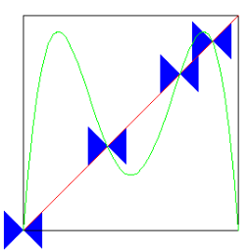
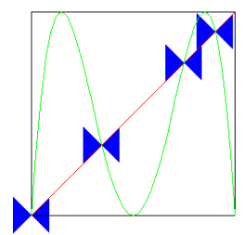



Behavior of the Second Iterate as $λ$Increases https://users.math.yale.edu/public_html/People/frame/Fractals/
$λ$increasing
$λ$increasing
Diagonals in the blue “butterfly” shapes are reference lines of slope = $±$1, to measure onset of instability

Slide 69
Examples: https://www.complexity-explorables.org/flongs/logistic/
Iterations: Panel 1
Sensitive dependence: Panel 2
Cobweb diagrams: Panel 3
Bifurcation diagrams: Panel 4
Lyapunov separation of time series: Panel 5
Bifurcations for a different map: Panel 6

Slide 70
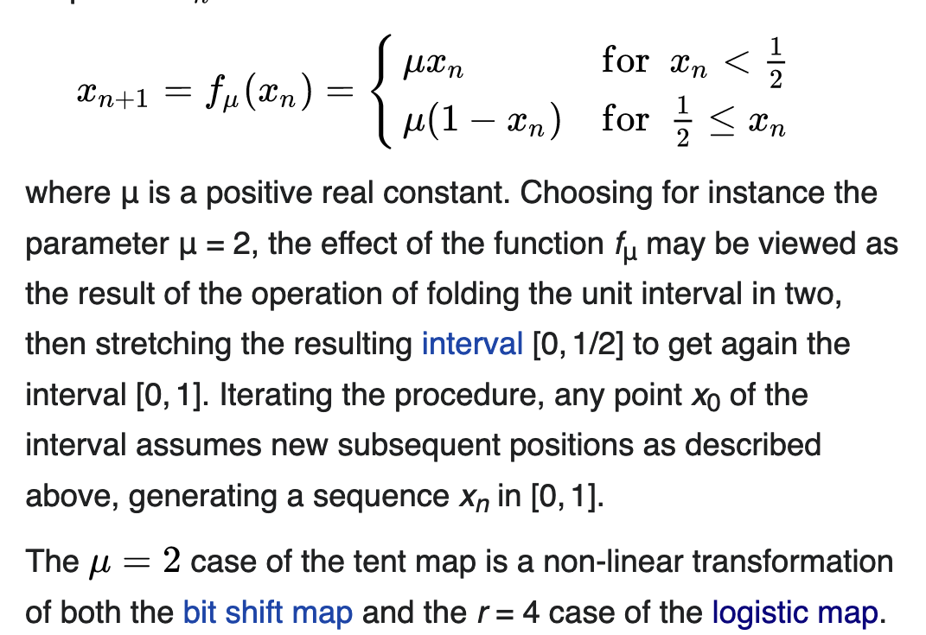
Tent Map: Another
Iterative Map
In mathematics, the tent map with parameter μ is the real-valued function defined by:

Slide 71


Dynamics and Attractor
https://www.researchgate.net/figure/The-tent-map-including-a-cobweb-plot_fig4_268444274

Slide 72
Feigenbaum Numbers
In mathematics, specifically bifurcation theory, the Feigenbaum constants are two mathematical constants which both express ratios in a bifurcation diagram for a non-linear map.
They are named after the physicist Mitchell J. Feigenbaum.
Feigenbaum originally related the first constant to the period-doubling bifurcations in the logistic map, but also showed it to hold for all one-dimensional maps with a single quadratic maximum.
As a consequence of this generality, every chaotic system that corresponds to this description will bifurcate at the same rate.
Feigenbaum made this discovery in 1975, and he officially published it in 1978.

Slide 73


Feigenbaum’s $δ$ number
For Logistic Map, $a= λ$

Slide 74




Feigenbaum’s $δ$ number for the Logistic Map
$$f\left(x\right)=ax(1 −x)$$

Slide 75


Feigenbaum’s $δ$ number for the Logistic Map
Here, L $≡ λ$
This diagram shows graphically how the ratio of values of $λ$converges to the Feigenbaum number

Slide 76



Feigenbaum’s $δ$ number for other maps
$$f\left(x\right)=a −x^{2}$$

Slide 77



Feigenbaum’s $δ$ number for the Mandelbrot Set
Self-similarity in the Mandelbrot set shown by zooming in on a round feature while panning in the negative-x direction. The display center pans from (−1, 0) to (−1.31, 0) while the view magnifies from 0.5 × 0.5 to 0.12 × 0.12 to approximate the Feigenbaum ratio.

Slide 78


Feigenbaum’s $α$ number for the Logistic Map
$α$measures the distance between fixed points and the value x = ½
α ◊ 2.502907876…

