Slide 1
Fractals, Chaos, Complexity Physics-EPS 30
Lecture
Complex Iterations
Mandelbrot Set, Julia Sets, Fractal Basin Boundaries
https://en.wikipedia.org/wiki/Complex_number
https://en.wikipedia.org/wiki/Benoit_Mandelbrot
https://en.wikipedia.org/wiki/Mandelbrot_set
https://en.wikipedia.org/wiki/Julia_set

Slide 2
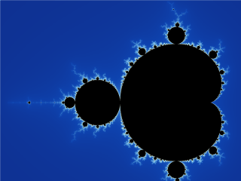
The Mandelbrot Set

Slide 3
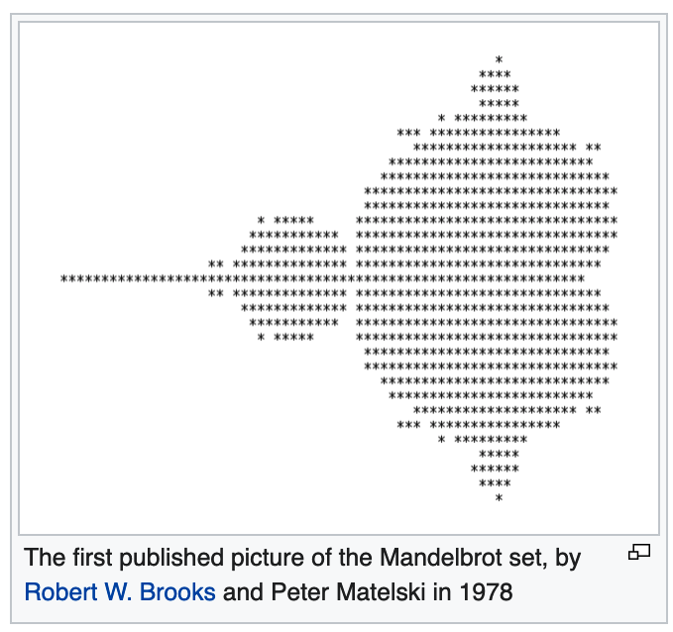
History of the Mandelbrot Set or M-Set
The Mandelbrot set has its origin in complex dynamics, a field first investigated by the French mathematicians Pierre Fatou and Gaston Julia at the beginning of the 20th century.
This fractal was first defined and drawn in 1978 by Robert W. Brooks and Peter Matelski as part of a study of Kleinian groups.
On 1 March 1980, at IBM's Thomas J. Watson Research Center in Yorktown Heights, New York, Benoit Mandelbrot first saw a visualization of the set.
Mandelbrot studied the parameter space of quadratic polynomials in an article that appeared in 1980.
The mathematical study of the Mandelbrot set really began with work by the mathematicians Adrien Douady and John H. Hubbard (1985), who established many of its fundamental properties and named the set in honor of Mandelbrot for his influential work in fractal geometry.

Slide 4
History of the Mandelbrot Set
The mathematicians Heinz-Otto Peitgen and Peter Richter became well known for promoting the set with photographs, books (1986), and an internationally touring exhibit of the German Goethe-Institut (1985).
The cover article of the August 1985 Scientific American introduced a wide audience to the algorithm for computing the Mandelbrot set.
The cover featured an image located at complex number = −0.909 + −0.275 i and was created by Peitgen et al.
The Mandelbrot set became prominent in the mid-1980s as a computer graphics demo, when personal computers became powerful enough to plot and display the set in high resolution.
The work of Douady and Hubbard coincided with a huge increase in interest in complex dynamics and abstract mathematics, and the study of the Mandelbrot set has been a centerpiece of this field ever since.
An exhaustive list of all who have contributed to the understanding of this set since then is long but would include Jean-Christophe Yoccoz, Mitsuhiro Shishikura, Curt McMullen, John Milnor and Mikhail Lyubich.

Slide 5
Benoit Mandelbrot
Benoit B. Mandelbrot (20 November 1924 – 14 October 2010) was a Polish-born French-American mathematician and polymath
He had broad interests in the practical sciences, especially regarding what he labeled as "the art of roughness" of physical phenomena and "the uncontrolled element in life".
He referred to himself as a "fractalist" and is recognized for his contribution to the field of fractal geometry, which included coining the word "fractal", as well as developing a theory of "roughness and self-similarity" in nature.

Slide 6
Benoit Mandelbrot - Career
From 1949 to 1958, Mandelbrot was a staff member at the Centre National de la Recherche Scientifique. During this time he spent a year at the Institute for Advanced Study in Princeton, New Jersey, where he was sponsored by John von Neumann.
In 1955 he married Aliette Kagan and moved to Geneva, Switzerland (to collaborate with Jean Piaget at the International Centre for Genetic Epistemology) and later to the Université Lille Nord de France.
In 1958 the couple moved to the United States where Mandelbrot joined the research staff at the IBM Thomas J. Watson Research Center in Yorktown Heights, New York.
He remained at IBM for 35 years, becoming an IBM Fellow, and later Fellow Emeritus.
From 1951 onward, Mandelbrot worked on problems and published papers not only in mathematics but in applied fields such as information theory, economics, and fluid dynamics.

Slide 7
Benoit Mandelbrot
Mandelbrot has been called an artist, and a visionary and a maverick.
His informal and passionate style of writing and his emphasis on visual and geometric intuition (supported by the inclusion of numerous illustrations) made The Fractal Geometry of Nature accessible to non-specialists.
The book sparked widespread popular interest in fractals and contributed to chaos theory and other fields of science and mathematics.

Slide 8
Benoit Mandelbrot
Mandelbrot was born in a Lithuanian Jewish family, in Warsaw during the Second Polish Republic.
His father made his living trading clothing; his mother was a dental surgeon.
During his first two school years, he was tutored privately by an uncle who despised rote learning: "Most of my time was spent playing chess, reading maps and learning how to open my eyes to everything around me."
In 1936, when he was 11, the family emigrated from Poland to France.
The move, the war, and the influence of his father's brother, the mathematician Szolem Mandelbrojt (who had moved to Paris around 1920), further prevented a standard education.
"The fact that my parents, as economic and political refugees, joined Szolem in France saved our lives," he writes.

Slide 9
Benoit Mandelbrot
Mandelbrot attended the Lycée Rollin (now the Collège-lycée Jacques-Decour) in Paris until the start of World War II, when his family moved to Tulle, France.
He was helped by Rabbi David Feuerwerker, the Rabbi of Brive-la-Gaillarde, to continue his studies.
Much of France was occupied by the Nazis at the time, and Mandelbrot recalls this period:
“Our constant fear was that a sufficiently determined foe might report us to an authority and we would be sent to our deaths. This happened to a close friend from Paris, Zina Morhange, a physician in a nearby county seat. Simply to eliminate the competition, another physician denounced her. We escaped this fate. Who knows why?”

Slide 10
Benoit Mandelbrot
After World War II ended, Mandelbrot studied mathematics, graduating from universities in Paris and the United States and receiving a master's degree in aeronautics from the California Institute of Technology.
He spent most of his career in both the United States and France, having dual French and American citizenship.
In 1958, he began a 35-year career at IBM, where he became an IBM Fellow, and periodically took leaves of absence to teach at Harvard University.
At Harvard, following the publication of his study of U.S. commodity markets in relation to cotton futures, he taught economics and applied sciences.

Slide 11
Benoit Mandelbrot
Because of his access to IBM's computers, Mandelbrot was one of the first to use computer graphics to create and display fractal geometric images, leading to his discovery of the Mandelbrot set in 1980.
He showed how visual complexity can be created from simple rules. He said that things typically considered to be "rough", a "mess", or "chaotic", such as clouds or shorelines, actually had a "degree of order".
His math and geometry-centered research career included contributions to such fields as statistical physics, meteorology, hydrology, geomorphology, anatomy, taxonomy, neurology, linguistics, information technology, computer graphics, economics, geology, medicine, physical cosmology, engineering, chaos theory, econophysics, metallurgy, and the social sciences.

Slide 12
Benoit Mandelbrot
Toward the end of his career, he was Sterling Professor of Mathematical Sciences at Yale University, where he was the oldest professor in Yale's history to receive tenure.
Mandelbrot also held positions at the Pacific Northwest National Laboratory, Université Lille Nord de France, Institute for Advanced Study and Centre National de la Recherche Scientifique.
During his career, he received over 15 honorary doctorates and served on many science journals, along with winning numerous awards.
His autobiography, The Fractalist: Memoir of a Scientific Maverick, was published posthumously in 2012.

Slide 13
Mandelbrot on Financial Markets
Mandelbrot saw financial markets as an example of "wild randomness", characterized by concentration and long range dependence. He developed several original approaches for modelling financial fluctuations.
In his early work, he found that the price changes in financial markets did not follow a Gaussian distribution, but rather Lévy stable distributions having infinite variance.
He found, for example, that cotton prices followed a Lévy stable distribution with parameter α equal to 1.7 rather than 2 as in a Gaussian distribution.
"Stable" distributions have the property that the sum of many instances of a random variable follows the same distribution but with a larger scale parameter.

Slide 14
Mandelbrot on Financial Markets
The latter work from the early 60s was done with daily data of cotton prices from 1900, long before he introduced the word 'fractal’.
In later years, after the concept of fractals had matured, the study of financial markets in the context of fractals became possible only after the availability of high frequency data in finance.
In the late 80s Mandelbrot used intra-daily tick data supplied by Olsen & Associates in Zurich to apply fractal theory to market microstructure.
This cooperation lead to the publication of the first comprehensive papers on scaling law in finance which demonstrates similar properties at different time scales confirming Mandelbrot's insight of the fractal nature of market microstructure.
Mandelbrot's own research in this area is presented in his books 'Fractals and Scaling in Finance' and 'The (Mis)behavior of Markets'.

Slide 15
Developing ”Fractal Geometry" and the Mandelbrot Set
As a visiting professor at Harvard University, Mandelbrot began to study fractals called Julia sets that were invariant under certain transformations of the complex plane.
Building on previous work by Gaston Julia and Pierre Fatou, Mandelbrot used a computer to plot images of the Julia sets.
While investigating the topology of these Julia sets, he studied the Mandelbrot set which was introduced by him in 1979.
In 1982, Mandelbrot expanded and updated his ideas in The Fractal Geometry of Nature.
This influential work brought fractals into the mainstream of professional and popular mathematics, as well as silencing critics, who had dismissed fractals as "program artifacts".

Slide 16
Developing ”Fractal Geometry" and the Mandelbrot Set
In 1975, Mandelbrot coined the term fractal to describe these structures and first published his ideas, and later translated, Fractals: Form, Chance and Dimension.
According to computer scientist and physicist Stephen Wolfram, the book was a "breakthrough" for Mandelbrot, who until then would typically "apply fairly straightforward mathematics ... to areas that had barely seen the light of serious mathematics before".
Wolfram adds that as a result of this new research, he was no longer a "wandering scientist", and later called him "the father of fractals":
“Mandelbrot ended up doing a great piece of science and identifying a much stronger and more fundamental idea—put simply, that there are some geometric shapes, which he called "fractals", that are equally "rough" at all scales. No matter how close you look, they never get simpler, much as the section of a rocky coastline you can see at your feet looks just as jagged as the stretch you can see from space.”

Slide 17
Developing ”Fractal Geometry" and the Mandelbrot Set
Mandelbrot used the term "fractal" as it derived from the Latin word "fractus", defined as broken or shattered glass.
Using the newly developed IBM computers at his disposal, Mandelbrot was able to create fractal images using graphics computer code, images that an interviewer described as looking like "the delirious exuberance of the 1960s psychedelic art with forms hauntingly reminiscent of nature and the human body".
He also saw himself as a "would-be Kepler", after the 17th-century scientist Johannes Kepler, who calculated and described the orbits of the planets.
A Mandelbrot Set

Slide 18
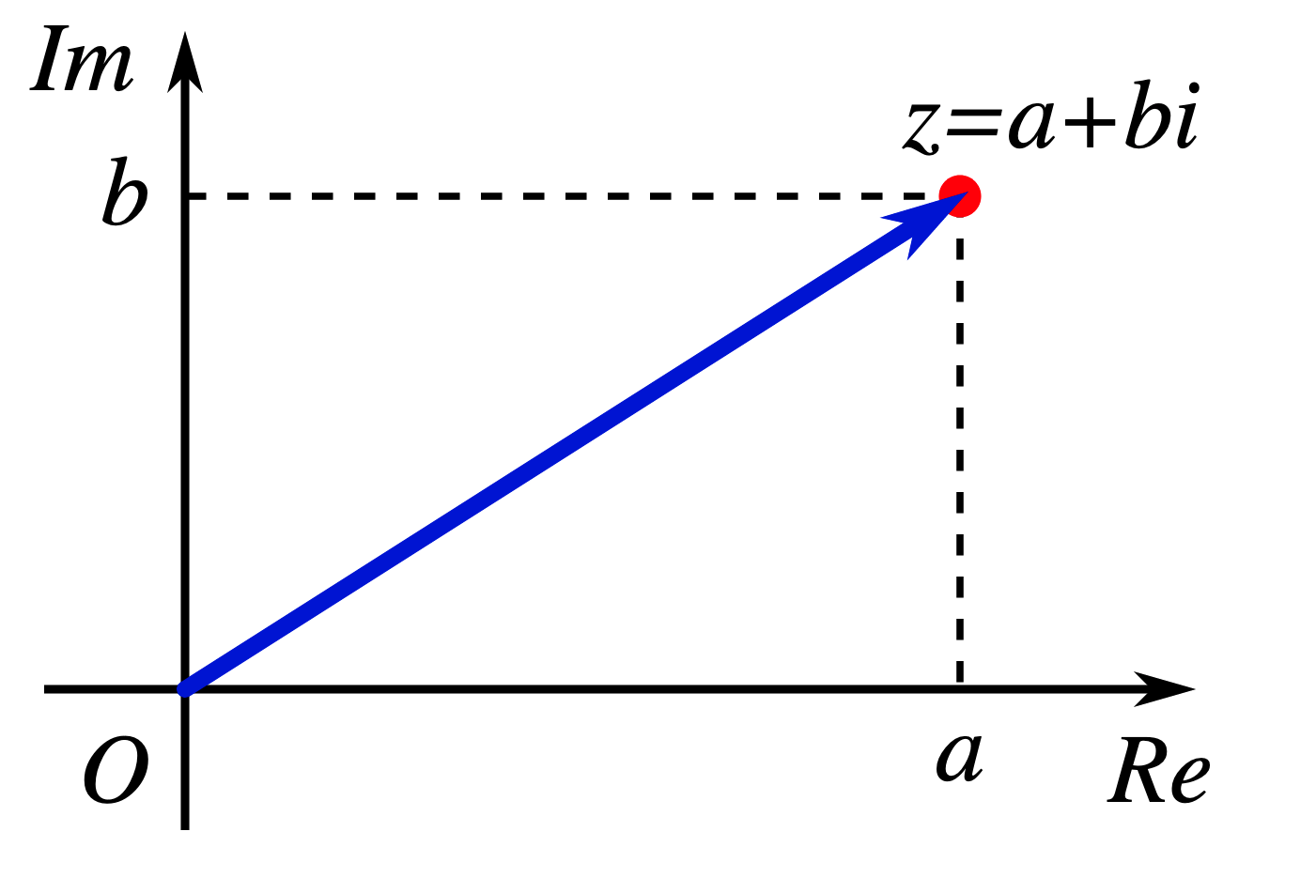
Complex Numbers – Basis for M-set
In mathematics, a complex number is a number that can be expressed in the form a + bi, where a and b are real numbers, and i is a symbol, called the imaginary unit, that satisfies the equation i² = −1.
Because no real number satisfies this equation, i was called an imaginary number by René Descartes.
For the complex number a + bi, a is called the real part and b is called the imaginary part.
Despite the historical nomenclature "imaginary", complex numbers are regarded in the mathematical sciences as just as "real" as the real numbers
They are fundamental in many aspects of the scientific description of the natural world.

Slide 19
Complex Numbers are Solutions to Polynomial Equations
Complex numbers allow solutions to all polynomial equations, even those that have no solutions in real numbers. More precisely, the fundamental theorem of algebra asserts that every polynomial equation with real or complex coefficients has a solution which is a complex number.
For example, the equation ${\left(x+1\right)}^{2}=−9$ has no real solution, since the square of a real number cannot be negative but has the two nonreal complex solutions: x = −1 + 3i and x = −1 − 3i.
Addition, subtraction and multiplication of complex numbers can be naturally defined by using the rule i² = −1 combined with the associative, commutative and distributive laws. Every nonzero complex number has a multiplicative inverse.
The complex numbers form a real vector space of dimension d = 2, with {1, i} as a standard basis.
This standard basis makes the complex numbers a Cartesian plane, called the complex plane. This allows a geometric interpretation of the complex numbers and their operations, and conversely expressing in terms of complex numbers some geometric properties and constructions.

Slide 20
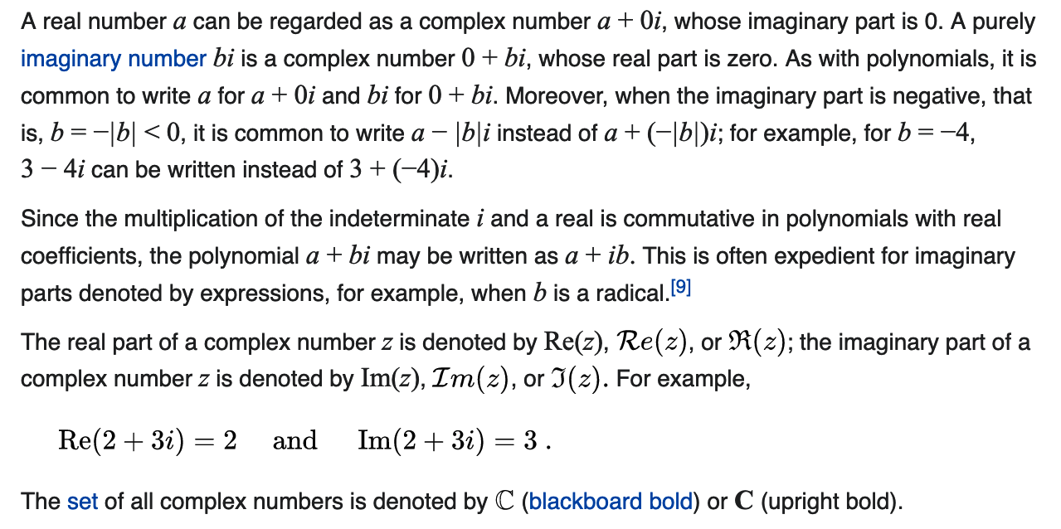
Notation

Slide 21
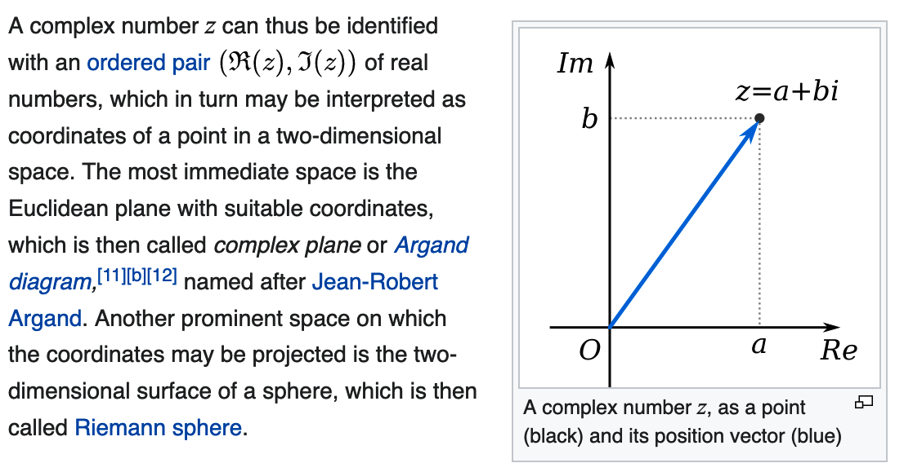
Visualization

Slide 22
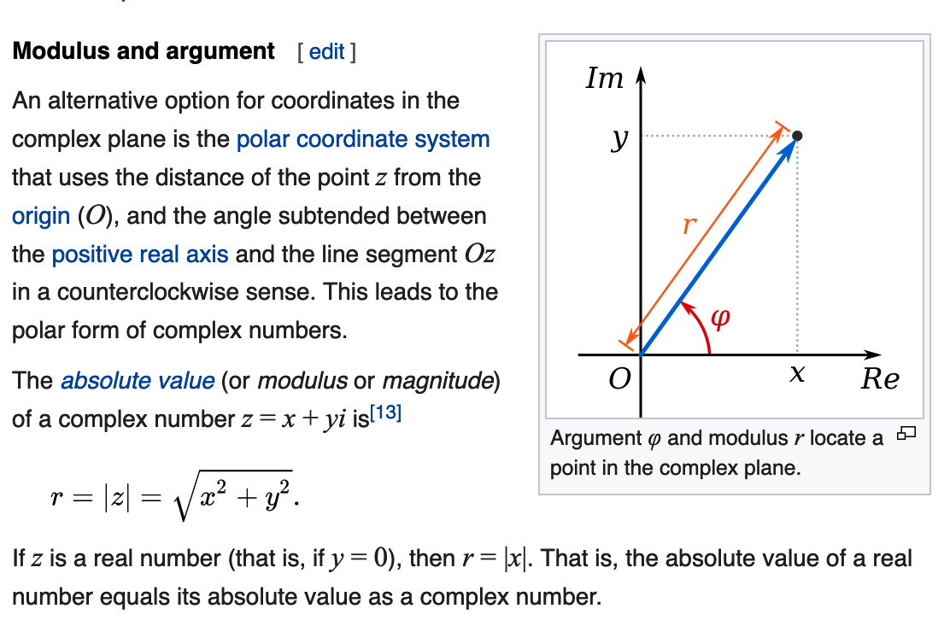
Polar Coordinates

Slide 23
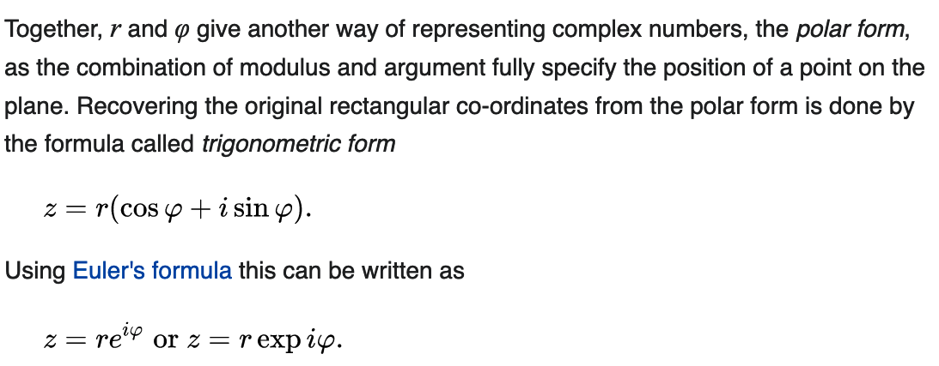
Polar Coordinates

Slide 24
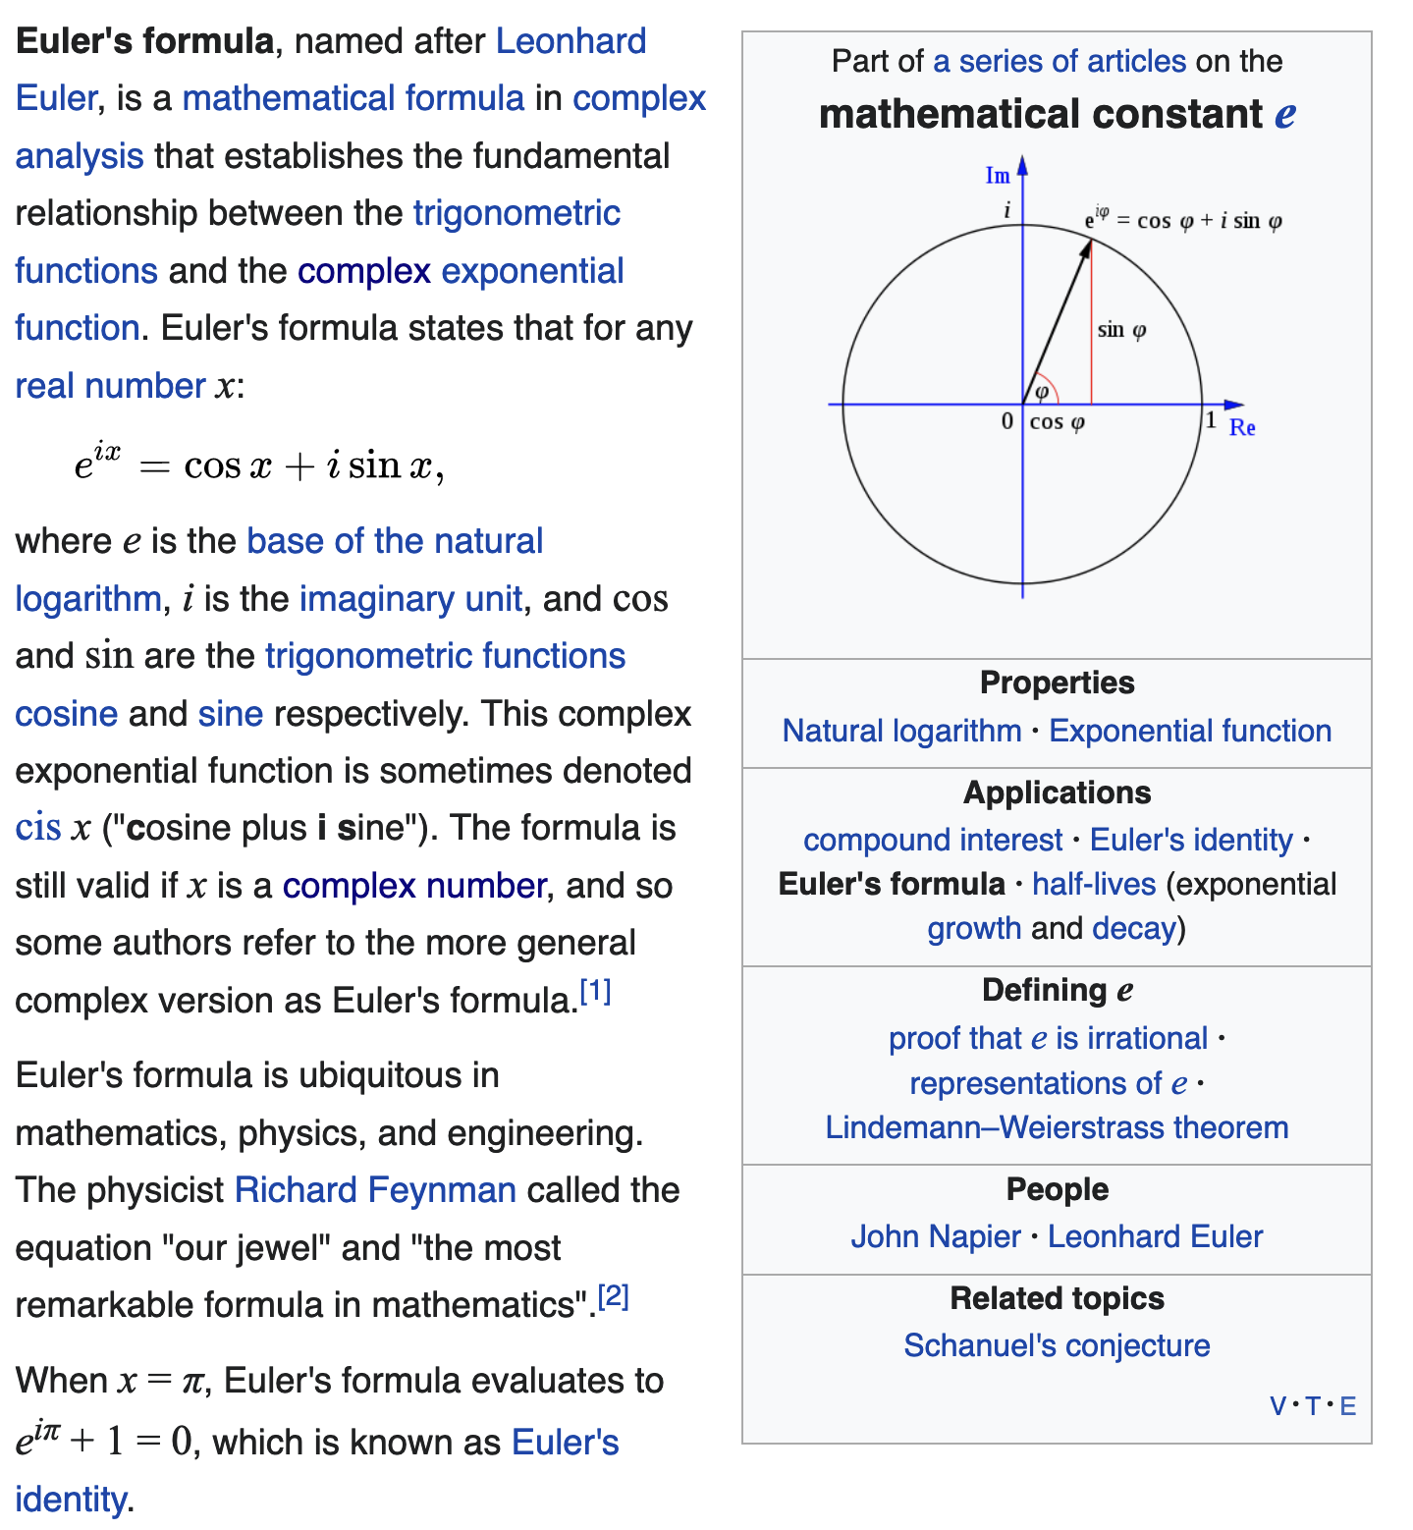
Euler’s Formula

Slide 25
Proof of Euler’s Formula

Slide 26
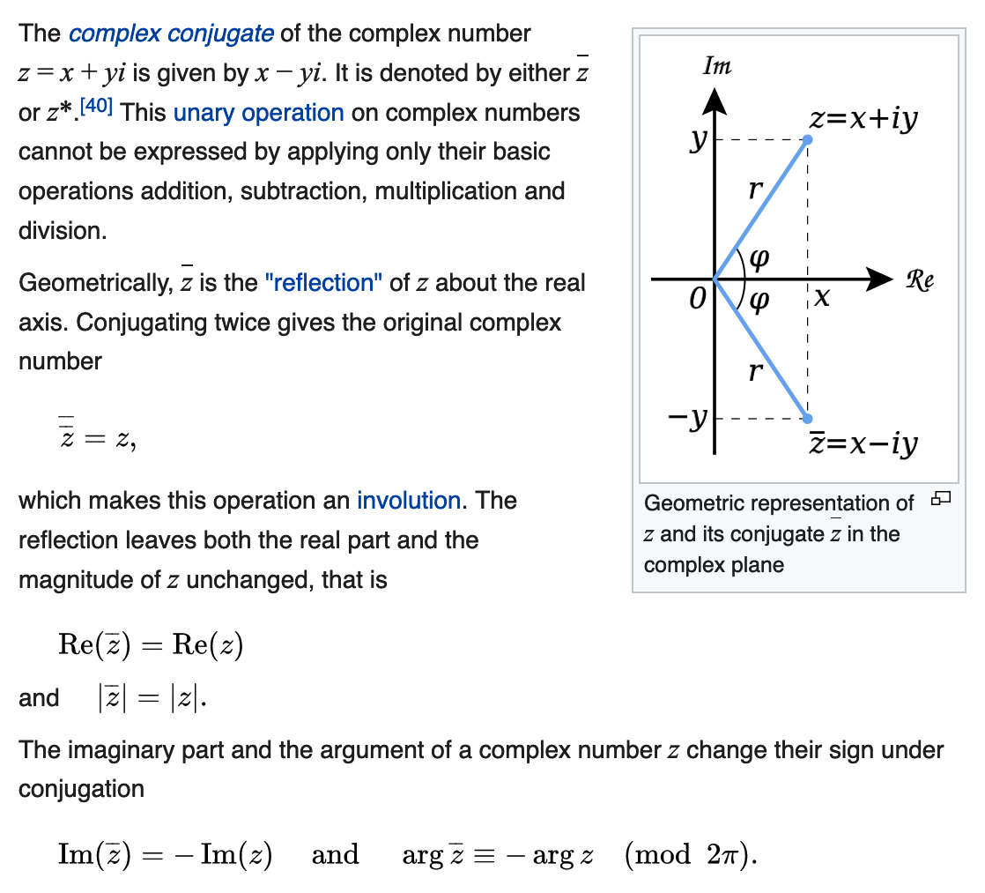
Complex Conjugate

Slide 27
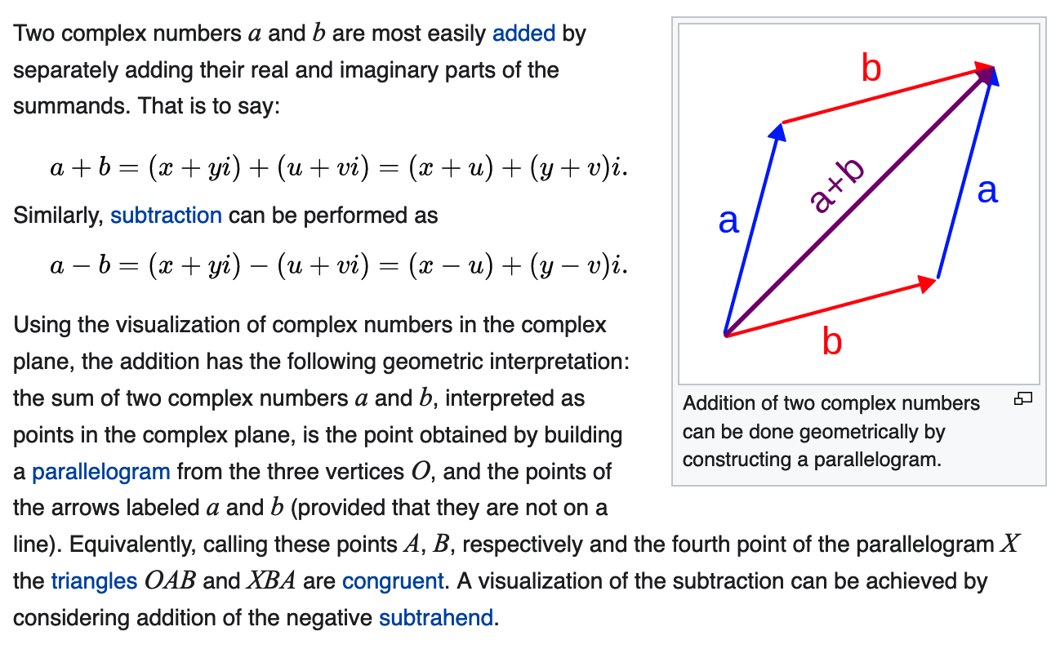
Addition and Subtraction

Slide 28
Multiplication and Square

Slide 29
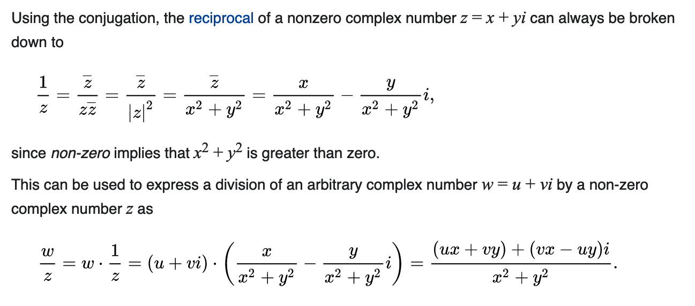
Reciprocal and Division

Slide 30
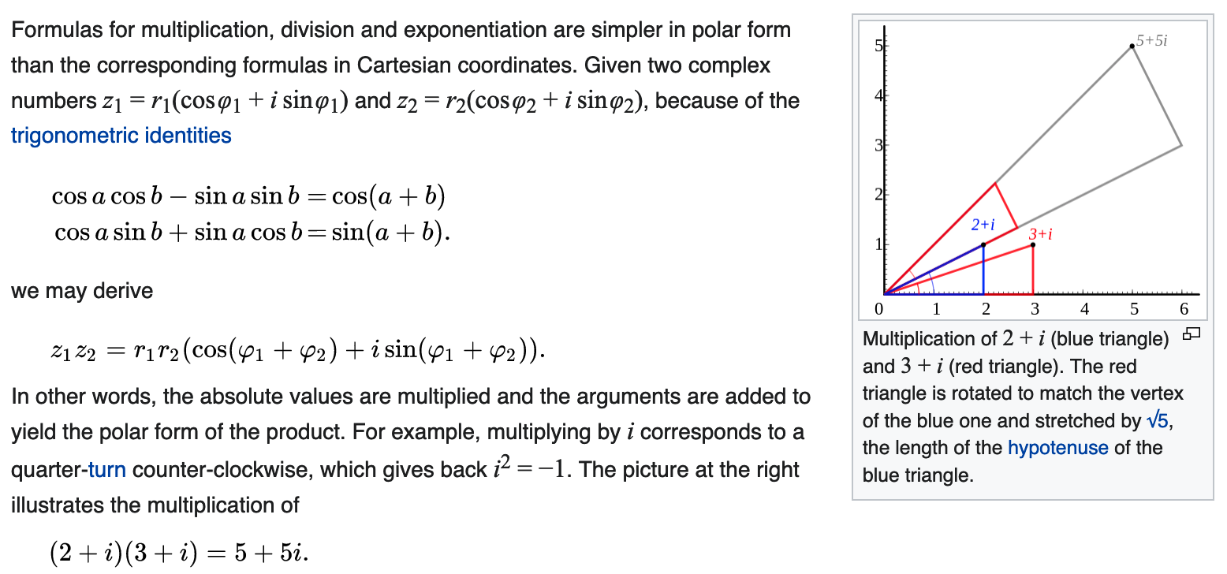
Multiplication and Division in Polar Form

Slide 31
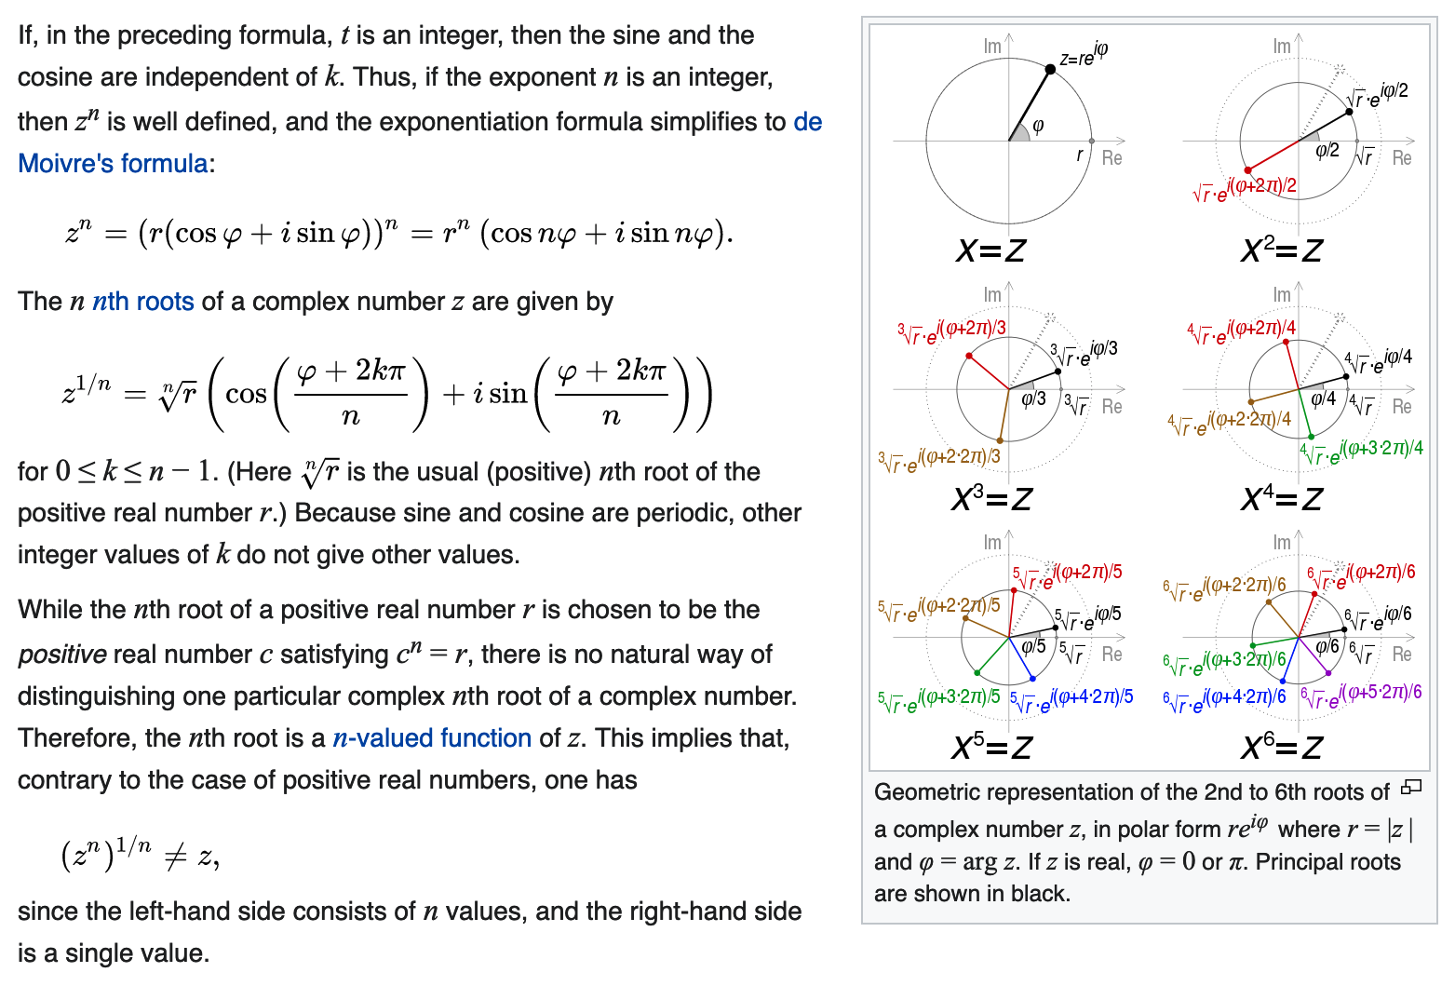
Fractional Exponents
Note: ${\left(e^{iφ}\right)}^{n}=\left(e^{inφ}\right)$
Examples:
Cube roots of 1:
1, $\frac{−1±\sqrt{3}}{2}$
Cube roots of -1:
-1, $\frac{1±\sqrt{3}}{2}$

Slide 32
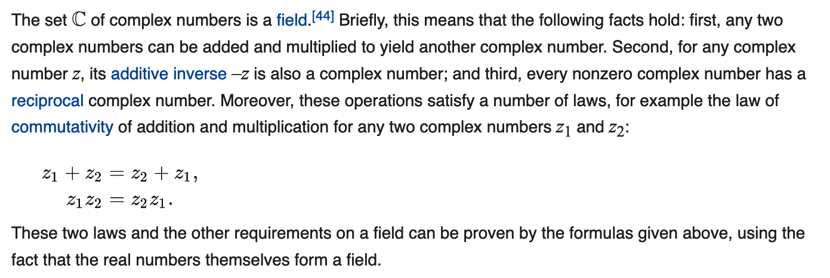
Structure of Complex Numbers

Slide 33
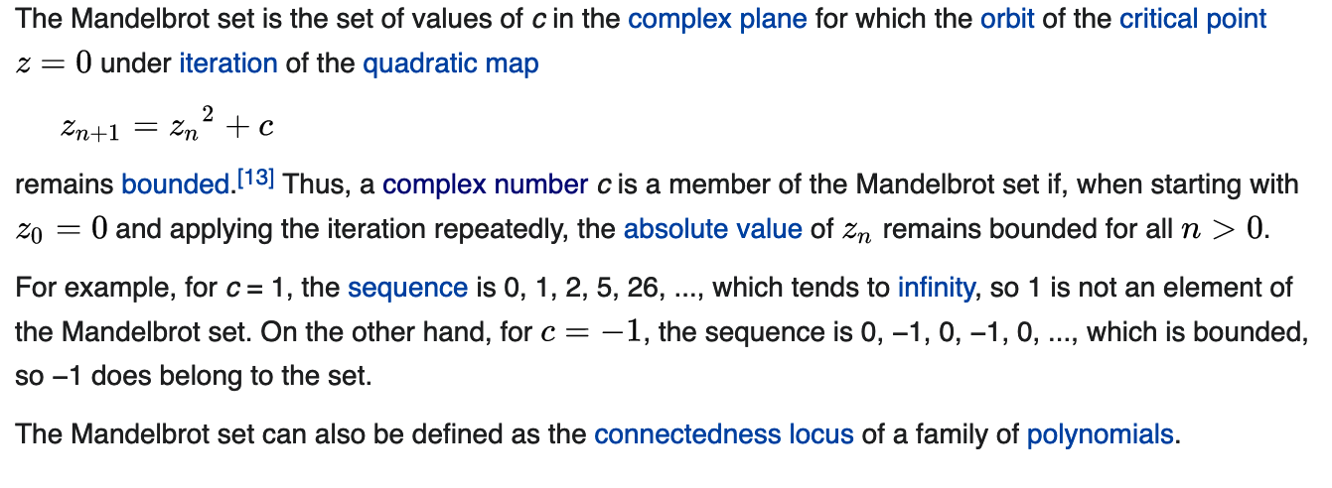
Mandelbrot Set
We test points c to determine if they are in M
Note that the M-set is the set of points that do not diverge to infinity under the iteration

Slide 34
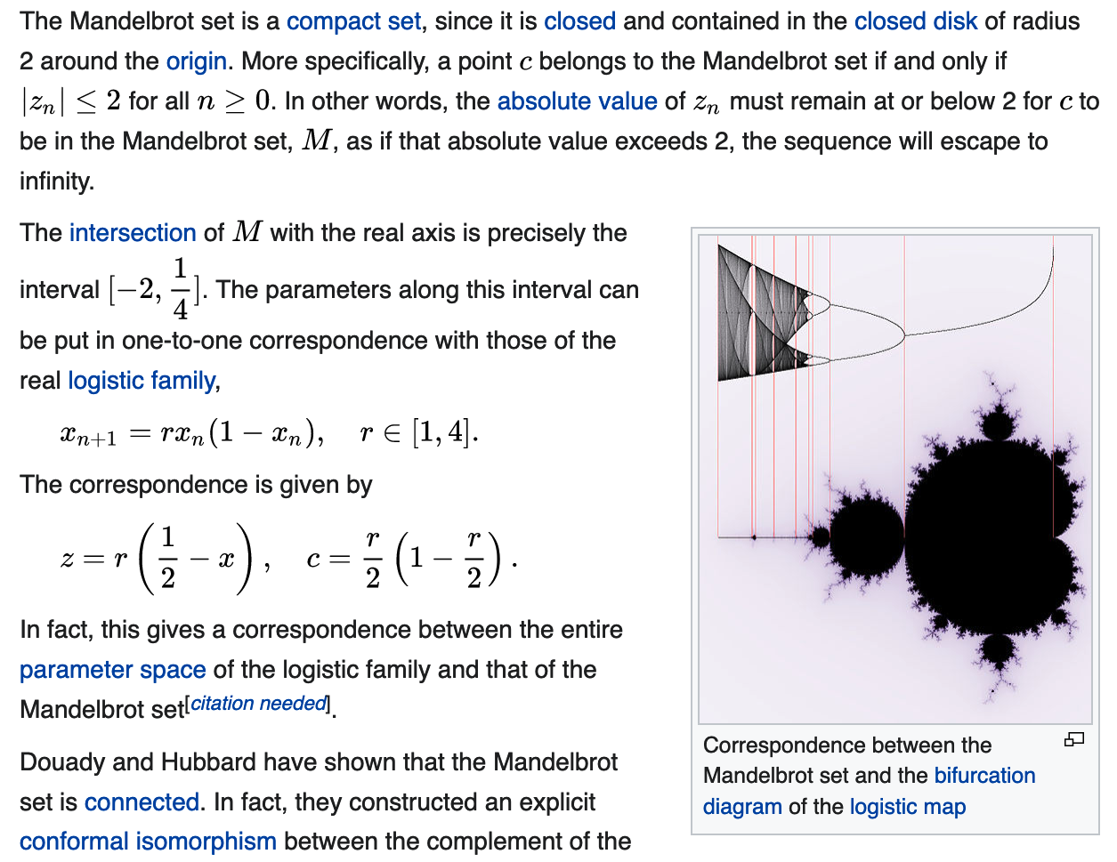
Correspondence to the Logistic Map
(1/4,0)
(-2,0)
To emphasize: It can be proved that the M-set is entirely contained within the circle of radius = 2 around the origin.

Slide 35
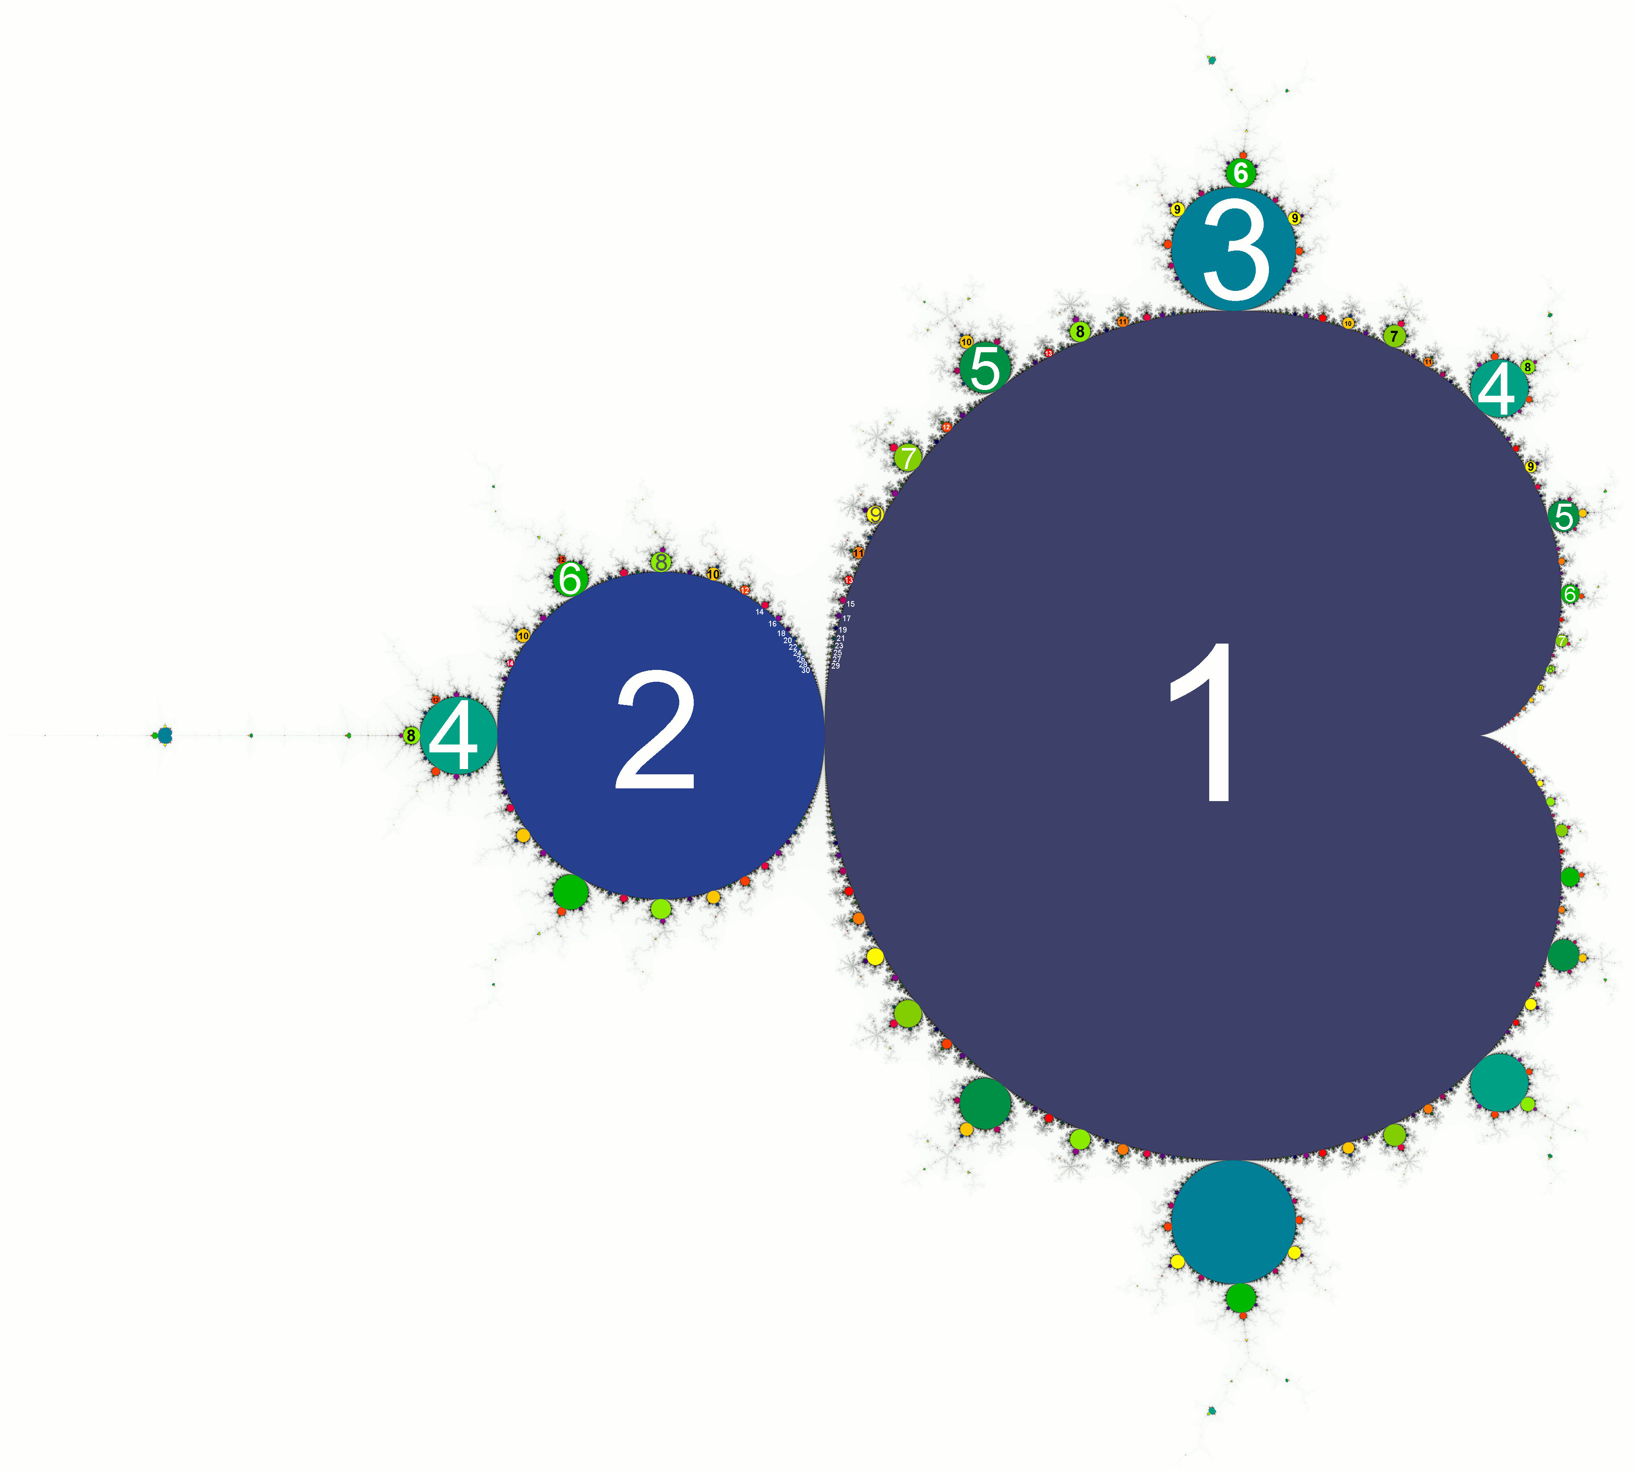
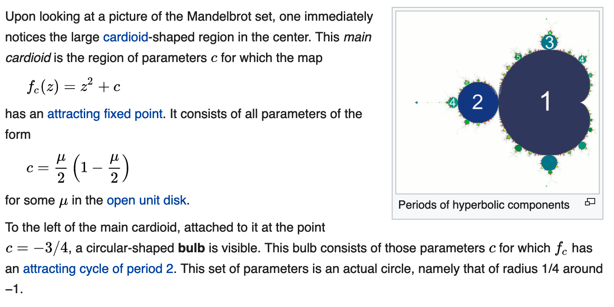
Main Cardiod and Periodic Bulbs

Slide 36
Order in the M-set: Pascals’ Triangle
Period 8
Period 7
https://en.wikipedia.org/wiki/Pascals_triangle
Recall: Fibonacci Series - 1,1,2,3,5,8,13…

Slide 37
Pascal’s Triangle
In mathematics, Pascal's triangle is a triangular array of the binomial coefficients that arises in probability theory, combinatorics, and algebra.
In much of the Western world, it is named after the French mathematician Blaise Pascal, although other mathematicians studied it centuries before him in India, Persia, China, Germany, and Italy.
The triangle may be constructed in the following manner:
In row 0 (the topmost row), there is a unique nonzero entry 1.
Each entry of each subsequent row is constructed by adding the number above and to the left with the number above and to the right, treating blank entries as 0.

Slide 38
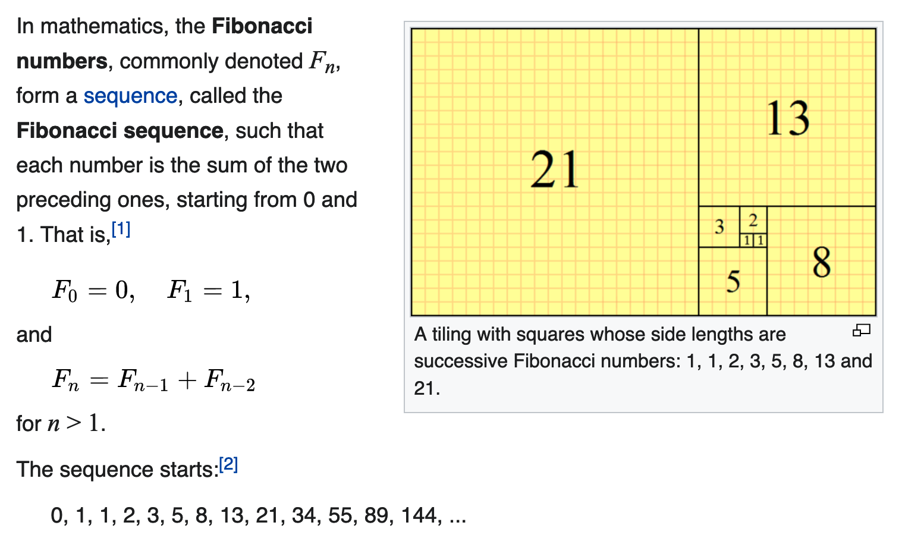
Pascal’s Triangle is Related to a Fibonacci Sequence
https://en.wikipedia.org/wiki/Fibonacci_number

Slide 39
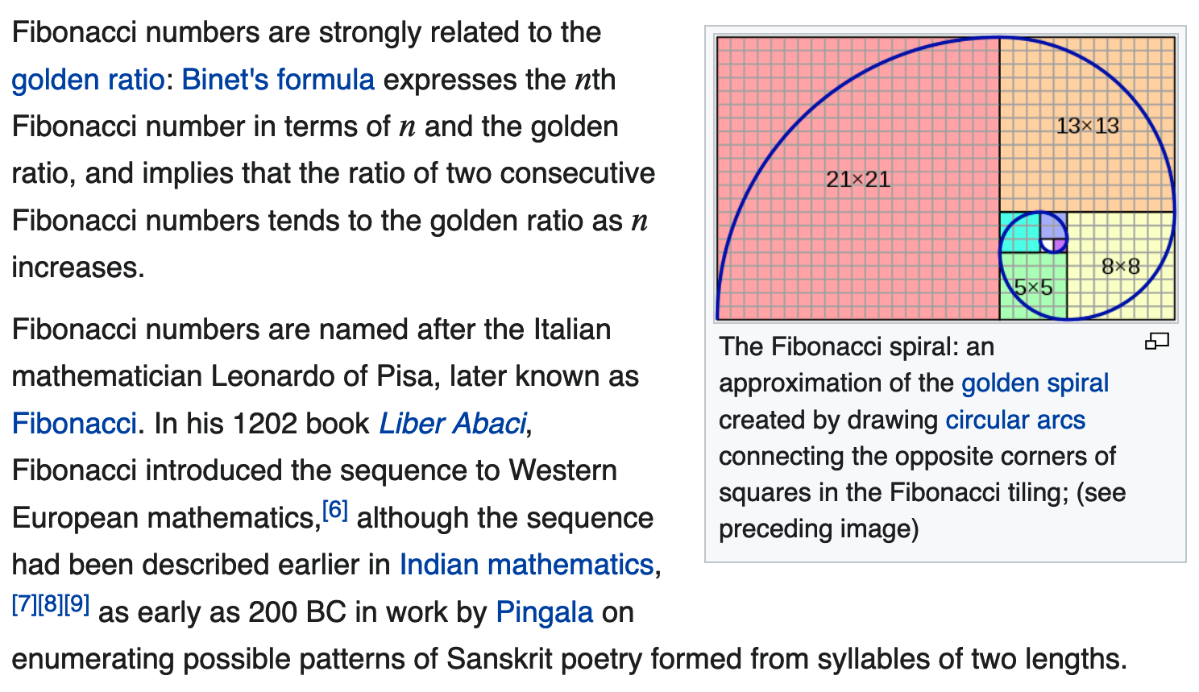
Fibonacci and the Golden (Logarithmic) Spiral

Slide 40
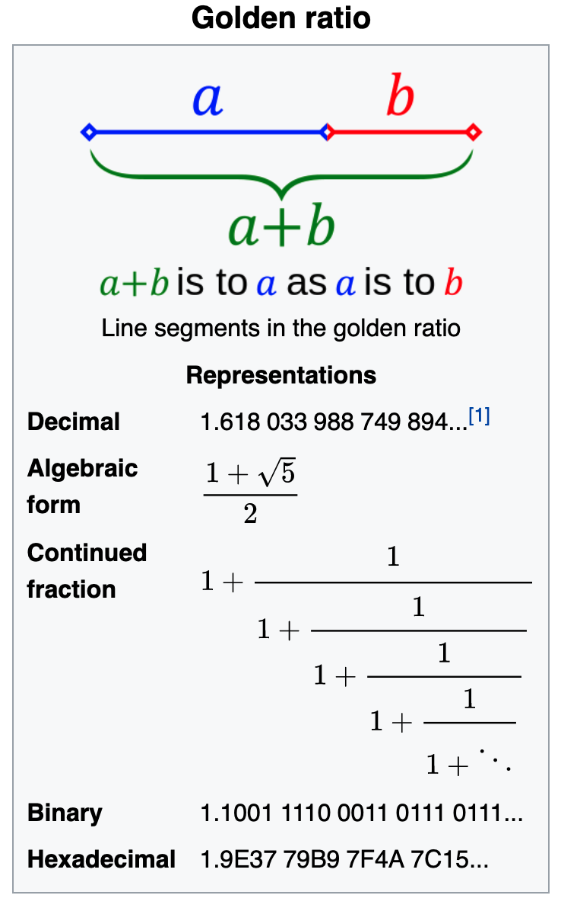
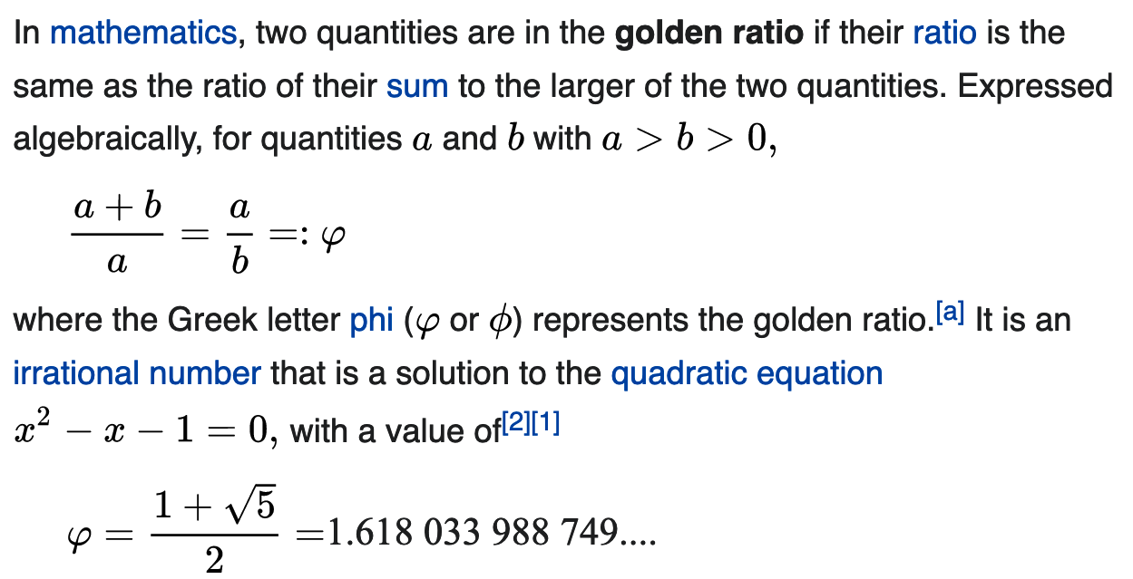
Golden Ratio https://en.wikipedia.org/wiki/Golden_ratio

Slide 41
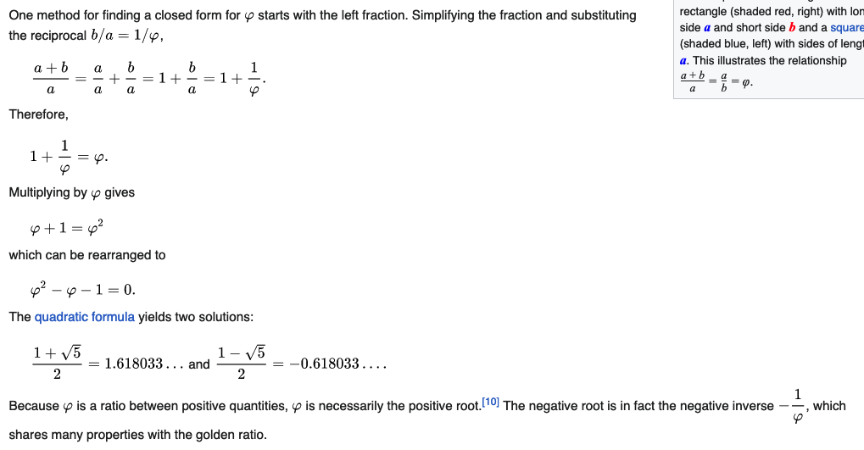
Golden Ratio – Computing its Value https://en.wikipedia.org/wiki/Golden_ratio

Slide 42
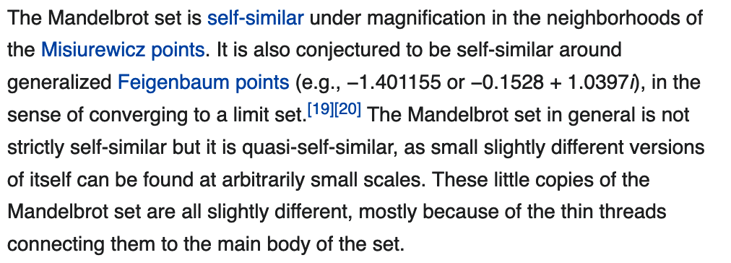
Self-Similarity

Slide 43
Image Gallery of M-set
The Mandelbrot set shows more intricate detail the closer one looks or magnifies the image, usually called "zooming in".
The foregoing example of an image sequence zooming to a selected c value gives an impression of the infinite richness of different geometrical structures and explains some of their typical rules.
The magnification of the last image relative to the first one is about 1010 to 1.
Relating to an ordinary monitor, it represents a section of a Mandelbrot set with a diameter of 4 million kilometers.
Its border would show an astronomical number of different fractal structures.

Slide 44
Images

Slide 45
Images

Slide 46
Images
Ended 1/25/2022

Slide 47
Julia – Fatou Sets
Julia sets are associated with the Mandelbrot set
In the context of complex dynamics, a topic of mathematics, the Julia set and the Fatou set are two complementary sets (Julia "laces" and Fatou "dusts") defined from a function.
Informally, the Fatou set of the function consists of values with the property that all nearby values behave similarly under repeated iteration of the function
The Julia set consists of values such that an arbitrarily small perturbation can cause drastic changes in the sequence of iterated function values.
Thus, the behavior of the function on the Fatou set is "regular", while on the Julia set its behavior is "chaotic".

Slide 48
Julia Sets
To find the Julia sets associated with the M-set, we fix the value of z in:
z_{n+1} = z_{n}² + c
and test values of c in that vicinity.
Some examples are shown in the following
Recall that with the M-set, we always set z₀ = 0 and test values of c

Slide 49
Filled Julia Sets

Slide 50
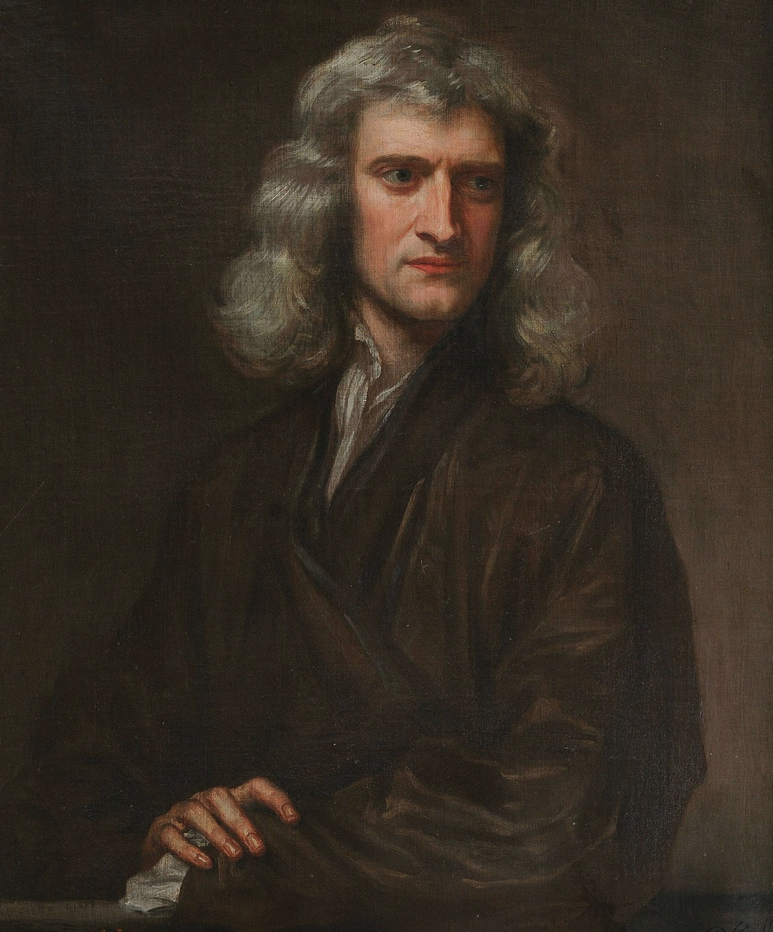
Fractal Basin Boundaries: Newton’s Method
The name "Newton's method" is derived from Isaac Newton's description of a special case of the method in De analysi per aequationes numero terminorum infinitas (written in 1669, published in 1711 by William Jones) and in De metodis fluxionum et serierum infinitarum (written in 1671, translated and published as Method of Fluxions in 1736 by John Colson).
However, his method differs substantially from the modern method
Newton applied the method only to polynomials, starting with an initial root estimate and extracting a sequence of error corrections.
He used each correction to rewrite the polynomial in terms of the remaining error, and then solved for a new correction by neglecting higher-degree terms.
He did not explicitly connect the method with derivatives or present a general formula.
Newton applied this method to both numerical and algebraic problems, producing Taylor series in the latter case.

Slide 51
Newton’s Method
Newton's method was first published in 1685 in A Treatise of Algebra both Historical and Practical by John Wallis.
In 1690, Joseph Raphson published a simplified description in Analysis Aequationum Universalis.
Raphson also applied the method only to polynomials, but he avoided Newton's tedious rewriting process by extracting each successive correction from the original polynomial.
This allowed him to derive a reusable iterative expression for each problem.
Finally, in 1740, Thomas Simpson described Newton's method as an iterative method for solving general nonlinear equations using calculus, essentially giving the description above.
In the same publication, Simpson also gives the generalization to systems of two equations and notes that Newton's method can be used for solving optimization problems by setting the gradient to zero.
Arthur Cayley in 1879 in The Newton–Fourier imaginary problem was the first to notice the difficulties in generalizing Newton's method to complex roots of polynomials with degree greater than 2 and complex initial values. This opened the way to the study of the theory of iterations of rational functions.

Slide 52
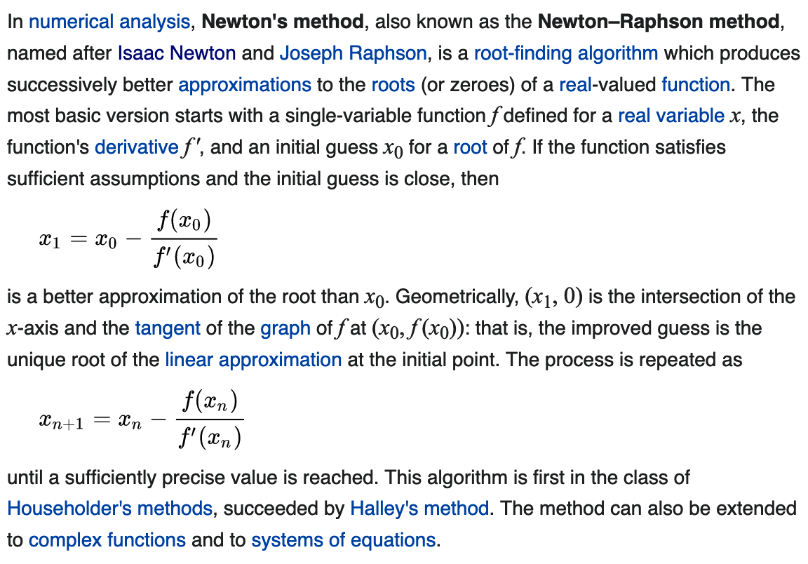
Newton’s Method: Real-Valued Functions
Starting Value
f(x)
Tangent Line
First Approximation to root
x
Root

Slide 53
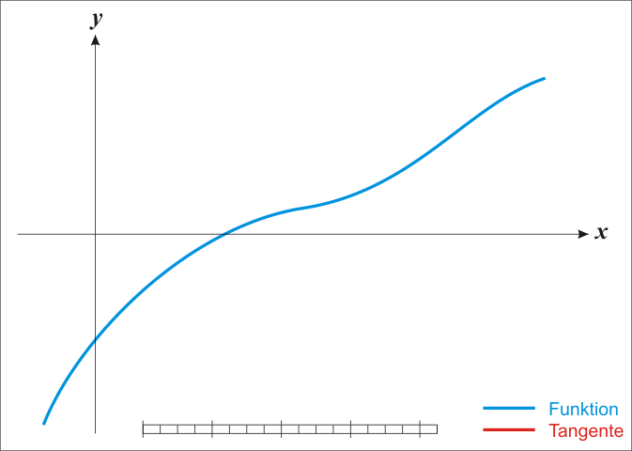
Origin of Newton’s Method

Slide 54
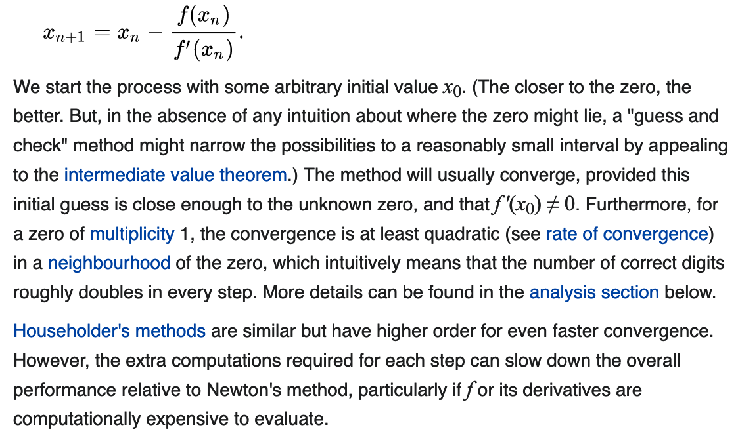
Origin of Newton’s Method

Slide 55
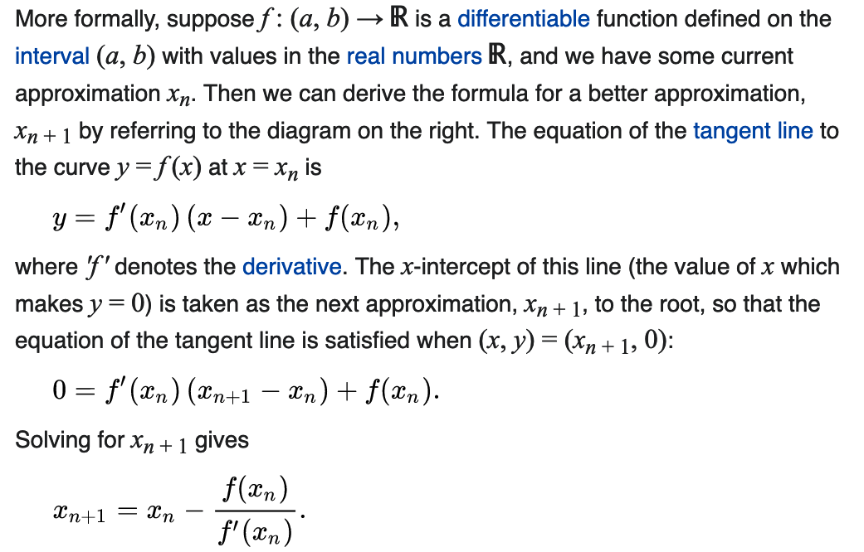
Origin of Newton’s Method

Slide 56
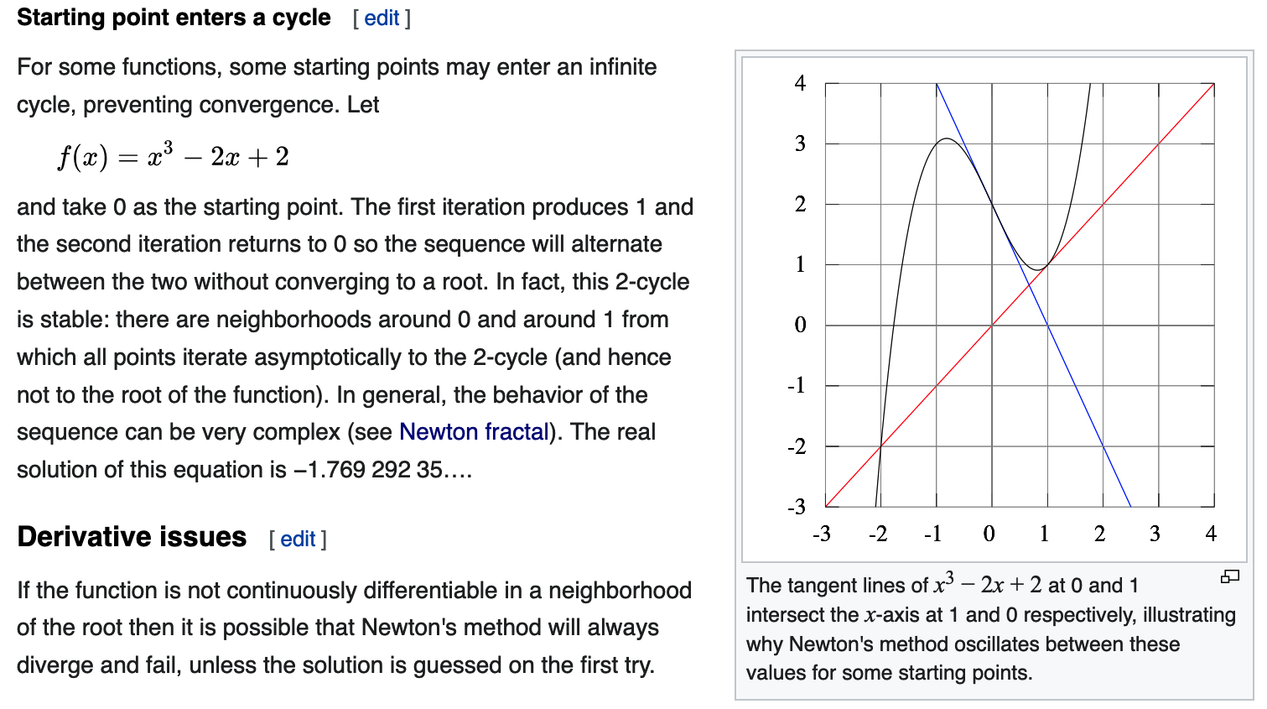
Some Difficuilties with Newton’s Method

Slide 57
“Non-Chaotic” Basins of Attraction
We will discuss this in more detail soon!

Slide 58
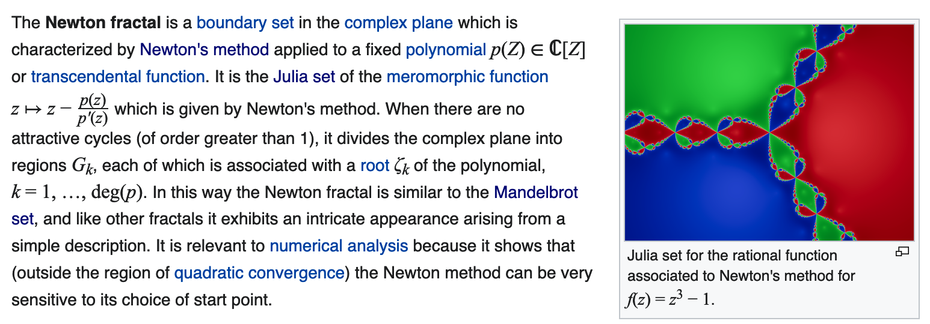
Newton’s Fractal for: f(z) = z³ - 1
What we expect
2i
$$−\frac{1}{2}+i\frac{\sqrt{3}}{2}$$
1
$$−\frac{1}{2}−i\frac{\sqrt{3}}{2}$$
-2i
-2
2
Note: The cube roots of 1 are given by: 1; $−\frac{1}{2}+i\frac{\sqrt{3}}{2}$; $−\frac{1}{2}−i\frac{\sqrt{3}}{2}$
Complex plane

Slide 59
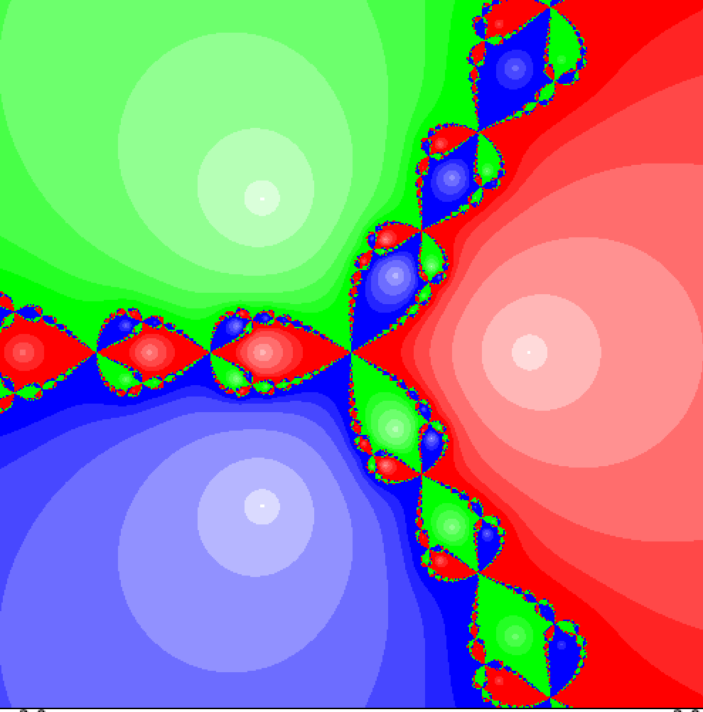
Newton’s Fractal for: f(z) = z³ - 1
$$z_{n+1}= \frac{2z_{n}^{3}−1}{3z_{n}^{2}}$$
What we find!
2i
$$−\frac{1}{2}+i\frac{\sqrt{3}}{2}$$
1
$$−\frac{1}{2}−i\frac{\sqrt{3}}{2}$$
-2i
-2
2
Note: The cube roots of 1 are given by: 1; $−\frac{1}{2}+i\frac{\sqrt{3}}{2}$; $−\frac{1}{2}−i\frac{\sqrt{3}}{2}$
Complex plane

Slide 60
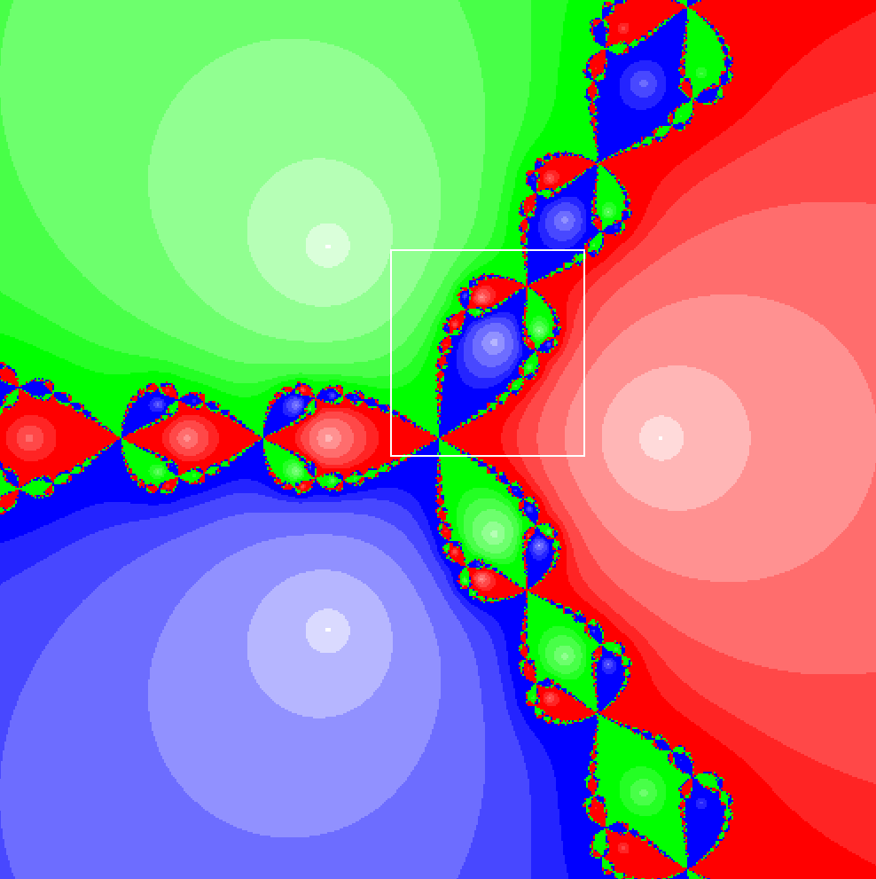
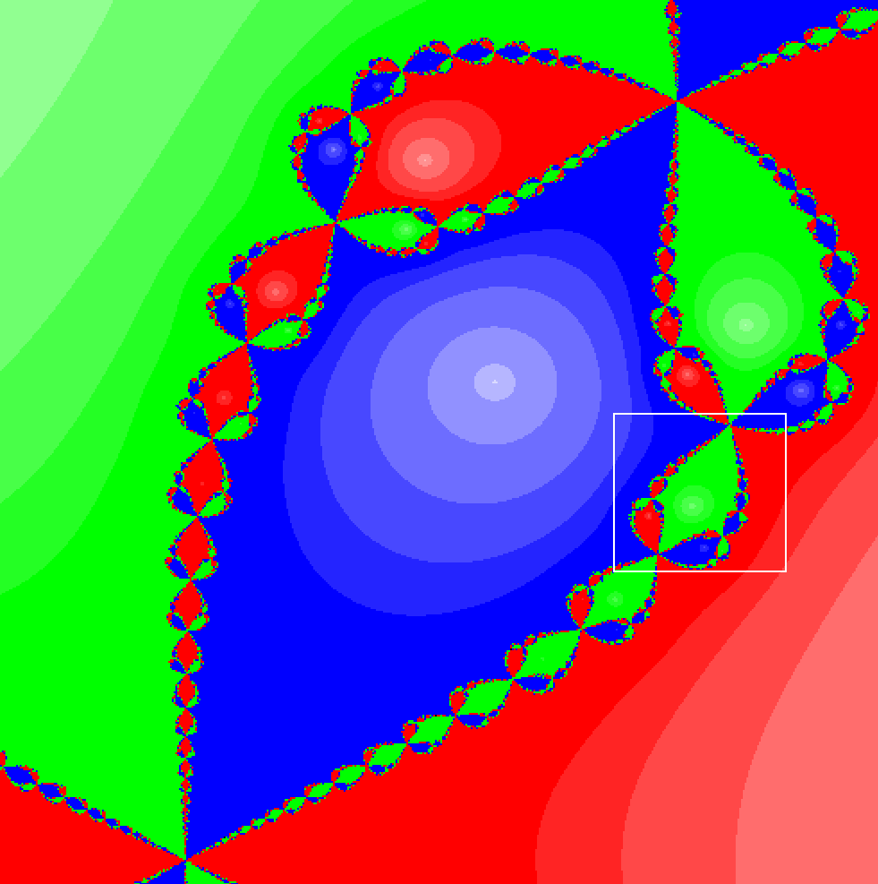
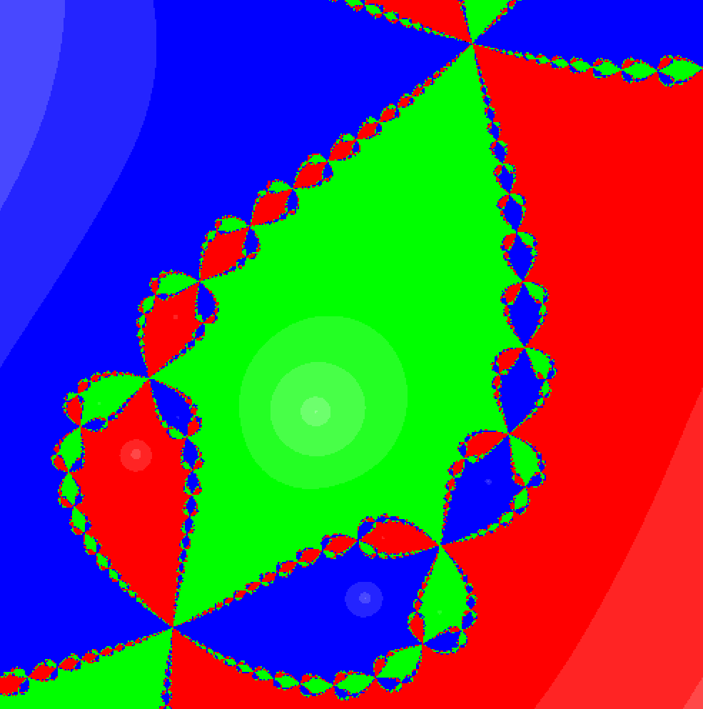
Series of Zooms Show Self-Similarity Basins of Attraction are not Simple!
It can be shown that the boundaries of the basins of attraction are in fact fractals!

