Slide 1
Complex Systems Physics-EPS 30
Lecture
Introduction to Dynamical Systems
https://en.wikipedia.org/wiki/Dynamical_system
https://en.wikipedia.org/wiki/Double_pendulum
https://en.wikipedia.org/wiki/Network_effect

Slide 2
Add slides on state space, phase space
https://en.wikipedia.org/wiki/Phase_space
https://en.wikipedia.org/wiki/State_space
https://en.wikipedia.org/wiki/State-space_representation
Density of states and probability:
https://en.wikipedia.org/wiki/Density_of_states

Slide 3
State Space or Phase Space https://en.wikipedia.org/wiki/State_space
A state space is the set of all possible configurations of a system.
It is a useful abstraction for reasoning about the behavior of a given system and is widely used in the fields of artificial intelligence and game theory.
For instance, the toy problem Vacuum World has a discrete finite state space in which there are a limited set of configurations that the vacuum and dirt can be in.
A "counter" system, where states are the natural numbers starting at 1 and are incremented over time has an infinite discrete state space.
The angular position of an undamped pendulum is a continuous (and therefore infinite) state space.

Slide 4
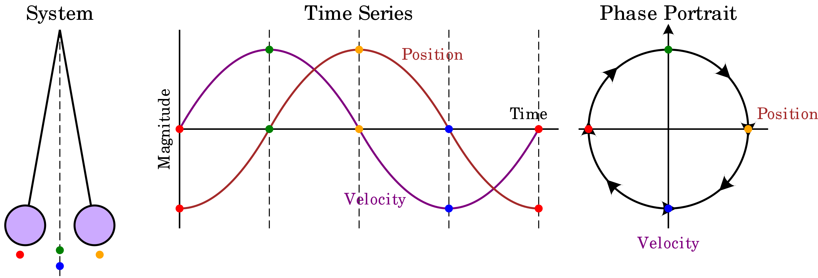
State Space or Phase Space
The motion of an ensemble of systems in this space can be studied by classical statistical mechanics.
The local density of points in such systems obeys Liouville's theorem*, and so can be taken as constant.
Within the context of a model system in classical mechanics, the phase space coordinates of the system at any given time are composed of all of the system's dynamical variables.
Because of this, it is possible to calculate the state of the system at any given time in the future or the past.
*The density of states in an ensemble of many identical states with different initial conditions is constant along every trajectory in phase space.

Slide 5
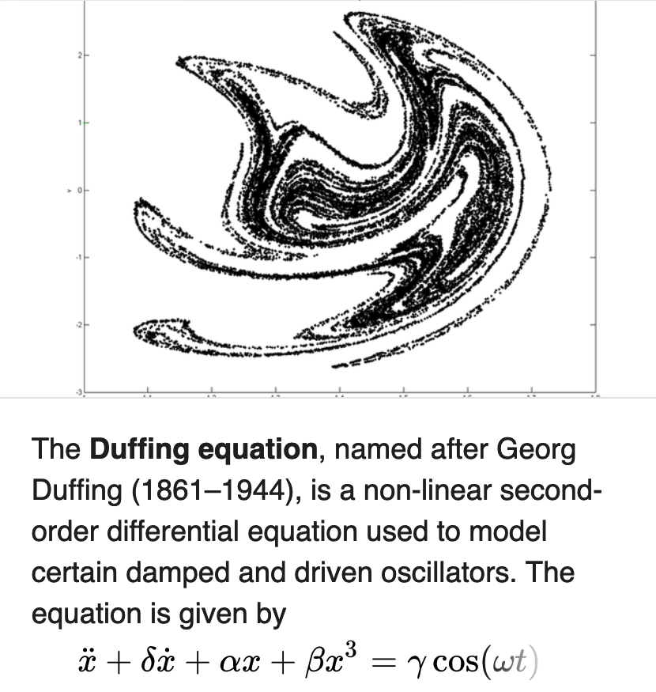
State Space or Phase Space https://en.wikipedia.org/wiki/Phase_space
In dynamical system theory, a phase space is a space in which all possible states of a system are represented, with each possible state corresponding to one unique point in the phase space.
For mechanical systems, the phase space usually consists of all possible values of position and momentum variables.
The concept of phase space was developed in the late 19th century by Ludwig Boltzmann, Henri Poincaré, and Josiah Willard Gibbs.
Velocity
Position
Phase Path of the Duffing Oscillator
Ended Here 2/2/2024

Slide 6
State Space or Phase Space
In a phase space, every degree of freedom or parameter of the system is represented as an axis of a multidimensional space;
a one-dimensional system is called a phase line, while a two-dimensional system is called a phase plane.
For every possible state of the system or allowed combination of values of the system's parameters, a point is included in the multidimensional space.
The system's evolving state over time traces a path (a phase space trajectory for the system) through the high-dimensional space.
The phase space trajectory represents the set of states compatible with starting from one particular initial condition.
Example of a “Landau double well” potential
Evolution of an “ensemble” (a group) of classical systems in phase space (top). The systems are a massive particle in a one-dimensional potential well (red curve, lower figure). The initially compact ensemble becomes swirled up over time.

Slide 7
State Space or Phase Space
As a whole, the phase diagram represents all that the system can be, and its shape can easily elucidate qualities of the system that might not be obvious otherwise.
A phase space may contain a great number of dimensions.
For instance, a gas containing many molecules may require a separate dimension for each particle's x, y and z positions and momenta (6 dimensions for an idealized monatomic gas)
For more complex molecular systems additional dimensions are required to describe vibrational modes of the molecular bonds, as well as spin around 3 axes.
Phase spaces are easier to use when analyzing the behavior of mechanical systems restricted to motion along axes of rotation or translation
Example: In robotics, analyzing the range of motion of a robotic arm or determining the optimal path to achieve a particular position/momentum result.
Phase space of a dynamic system with focal stability, showing one phase space trajectory

Slide 8
Low Dimensional Systems
For simple systems, there may be as few as one or two degrees of freedom.
One degree of freedom occurs when one has an autonomous ordinary differential equation in a single variable:
$\frac{dx}{dt}=f(x)$
The resulting one-dimensional system is called a phase line, and the qualitative behavior of the system is immediately visible from the phase line.
The simplest non-trivial examples are the exponential growth model/decay (one unstable/stable equilibrium) and the logistic growth model (two equilibria, one stable, one unstable).

Slide 9
Phase Portrait: Time Series Flow
Position
The phase space of a two-dimensional system is called a phase plane
This occurs in classical mechanics for a single particle moving in one dimension, and where the two variables are position and velocity.
In this case, a sketch of the phase portrait may give qualitative information about the dynamics of the system, such as the limit cycle of the Van der Pol oscillator shown in the diagram.
Here, the horizontal axis gives the position and vertical axis the velocity.
As the system evolves, its state follows one of the lines (trajectories) on the phase diagram.
Speed

Slide 10
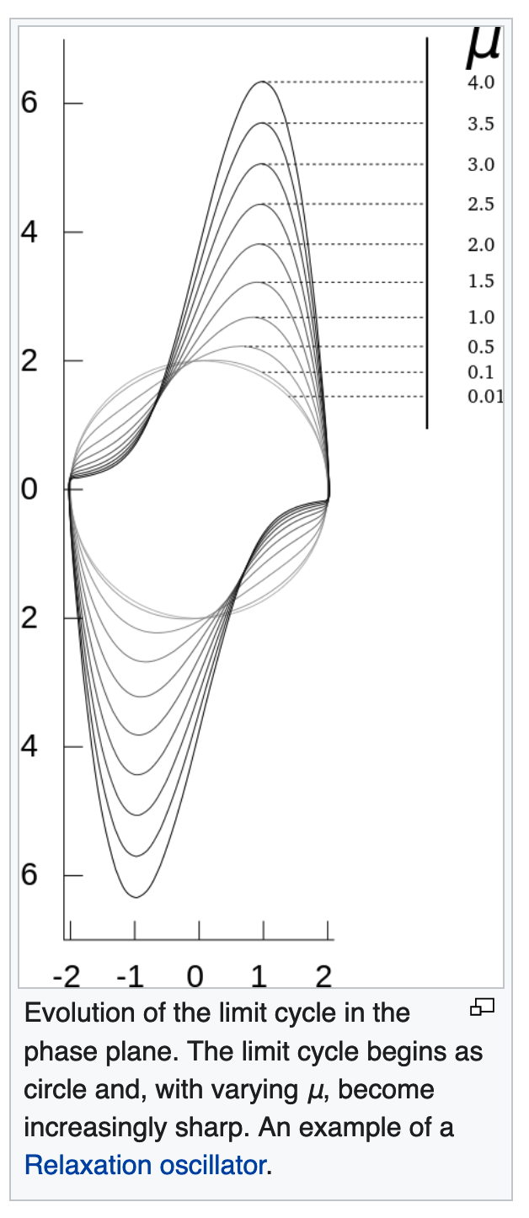
Van der Pol Oscillator
In dynamics, the Van der Pol oscillator is a non-conservative oscillator with non-linear damping. It evolves in time according to the second-order differential equation:
where x is the position coordinate, which is a function of the time t, and μ is a scalar parameter indicating the nonlinearity and the strength of the damping.
Balthasar Van der Pol found stable oscillations, which he subsequently called relaxation-oscillations and are now known as a type of limit cycle in electrical circuits employing vacuum tubes.
When these circuits were driven near the limit cycle, they become entrained, i.e., the driving signal pulls the current along with it.
Van der Pol and his colleague, van der Mark, reported in the September 1927 issue of Nature that at certain drive frequencies an irregular noise was heard, which was later found to be the result of deterministic chaos.

Slide 11
Density of States
The density of states is a concept useful in complex systems
Each possible configuration, or energy level of the system is assumed to be associated with a given set of microstates
The possible system microstates are assumed to have equal a priori probability for the given configuration or energy level
There is a preference for the system to occupy configurations that have the largest number of microstates, given the external conditions
Phase transitions occur when external conditions change, and a new configuration is represented by the largest number of microstates

Slide 12
Density of States: Example of Parallel Parking
Parallel parking is considered to be one of the most stressful and difficult skills for new drivers to learn
While parallel parking is a required part of most driving tests, several states in the US have dropped it as a requirement.
Parallel parking illustrates the density of states idea
There are relatively few states corresponding to the parked car configuration
There are many more states that allow escape from the parked configuration
Ended 1/27/2022

Slide 13
Dynamical Systems
In mathematics, a dynamical system is a system in which a function describes the time dependence of a point in a geometrical state space.
Examples include the mathematical models that describe the swinging of a clock pendulum, the flow of water in a pipe, and the number of fish each springtime in a lake.
At any given time, a dynamical system has a state given by a tuple of real numbers (a vector) that can be represented by a point in an appropriate state space.
The evolution rule of the dynamical system is a function that describes what future states follow from the current state.
Often the function is deterministic, that is, for a given time interval only one future state follows from the current state (Markov process)
However, some systems are stochastic (e.g., statistical in nature), in that random events also affect the evolution of the state variables.
Typically: $\frac{dx}{dt}=F\left(x\left(t\right)\right)$where x(t) is a state variable
and F is a function nonlinear in x(t) or as a map: $x_{n+1}=F(x_{n})$

Slide 14
Dynamical Systems
In physics, a dynamical system is described as a "particle or ensemble of particles whose state varies over time and thus obeys differential equations involving time derivatives (or difference equations)".
In order to make a prediction about the system's future behavior, an analytical solution of such equations or their integration over time through computer simulation is realized.
The study of dynamical systems is the focus of dynamical systems theory, which has applications to a wide variety of fields such as mathematics, physics, biology, chemistry, engineering, economics, history, and medicine.
Dynamical systems are a fundamental part of chaos theory, logistic map dynamics, bifurcation theory, the self-assembly and self-organization processes, and the edge of chaos concept.
Typically: $\frac{dx}{dt}=F\left(x\left(t\right)\right)$where x(t) is a state variable
and F is a function nonlinear in x(t) or as a map: $x_{n+1}=F(x_{n})$

Slide 15
History
Many people regard French mathematician Henri Poincaré as the founder of dynamical systems.
Poincaré published two now classical monographs, "New Methods of Celestial Mechanics" (1892–1899) and "Lectures on Celestial Mechanics" (1905–1910).
In them, he successfully applied the results of their research to the problem of the motion of three bodies and studied in detail the behavior of solutions (frequency, stability, asymptotic, and so on).
These papers included the Poincaré recurrence theorem, which states that certain systems will, after a sufficiently long but finite time, return to a state very close to the initial state.
Aleksandr Lyapunov developed many important approximation methods.
His methods, which he developed in 1899, make it possible to define the stability of sets of ordinary differential equations.
He created the modern theory of the stability of a dynamical system.

Slide 16
History
In 1913, George David Birkhoff proved Poincaré's "Last Geometric Theorem", a special case of the three-body problem, a result that made him world-famous.
In 1927, he published his Dynamical Systems.
Birkhoff's most durable result has been his 1931 discovery of what is now called the ergodic theorem.
Combining insights from physics on the ergodic hypothesis with measure theory, this theorem solved, at least in principle, a fundamental problem of statistical mechanics.
The ergodic theorem has also had repercussions for dynamics.
Stephen Smale made significant advances as well.
His first contribution was the Smale horseshoe map that jumpstarted significant research in dynamical systems.

Slide 17
Nonlinear Systems
Simple nonlinear dynamical systems and even piecewise linear systems can exhibit a completely unpredictable behavior, which might seem to be random, despite the fact that they are fundamentally deterministic. (Lorenz equations)
This seemingly unpredictable behavior has been called chaos.
This branch of mathematics deals with the long-term qualitative behavior of dynamical systems.
Here, the focus is not on finding precise solutions to the equations defining the dynamical system (which is often hopeless), but rather to answer questions like:
"Will the system settle down to a steady state in the long term, and if so, what are the possible attractors?" or
"Does the long-term behavior of the system depend on its initial condition?"

Slide 18
Topics and Applications

Slide 19
Overview of Dynamical Systems
The concept of a dynamical system has its origins in Newtonian mechanics.
There, as in other natural sciences and engineering disciplines, the evolution rule of dynamical systems is an implicit relation that gives the state of the system for only a short time into the future.
The relation is either a differential equation, or discrete difference equation.
To determine the state for all future times requires iterating the relation many times—each advancing time a small step.
The iteration procedure is referred to as solving the system or integrating the system.
If the system can be solved, given an initial point it is possible to determine all its future positions, a collection of points known as a trajectory or orbit.
Typically: $\frac{dx}{dt}=F\left(x\left(t\right)\right)$where x(t) is a state variable
and F is a function nonlinear in x(t) or as a map: $x_{n+1}=F(x_{n})$

Slide 20
Computing Orbits
Before the advent of computers, finding an orbit required sophisticated mathematical techniques and could be accomplished only for a small class of dynamical systems.
Numerical methods implemented on computers have simplified the task of determining the orbits of a dynamical system.
For simple dynamical systems, knowing the trajectory is often sufficient, but most dynamical systems are too complicated to be understood in terms of individual trajectories.

Slide 21
Problems with Determining Orbits
The systems studied may only be known approximately—the parameters of the system may not be known precisely or terms may be missing from the equations.
The approximations used bring into question the validity or relevance of numerical solutions.
To address these questions several notions of stability have been introduced in the study of dynamical systems, such as Lyapunov stability or structural stability.
The stability of the dynamical system implies that there is a class of models or initial conditions for which the trajectories would be equivalent.
i.e., is it possible to model a real system with a dynamical model? Can you find parameters that adequately fit the model data to the real data?
The operation for comparing orbits to establish their equivalence changes with the different notions of stability.

Slide 22
Problems with Determining Orbits
The type of trajectory may be more important than one particular trajectory.
Some trajectories may be periodic, whereas others may wander through many different states of the system.
Applications often require enumerating these classes or maintaining the system within one class.
Classifying all possible trajectories has led to the qualitative study of dynamical systems, that is, properties that do not change under coordinate changes.
Linear dynamical systems and systems that have two numbers (position and momentum) describing a state are examples of dynamical systems where the possible classes of orbits are understood.

Slide 23
Problems with Determining Orbits
The behavior of trajectories as a function of a control parameter may be what is needed for an application.
As the control parameter is varied, the dynamical systems may have bifurcation points where the qualitative behavior of the dynamical system changes.
For example, it may go from having only periodic motions to apparently erratic behavior, as if random.
In these cases, it may be necessary to compute averages using one very long trajectory or many different trajectories.
The averages are well defined for ergodic systems, where time averages are assumed to be equal to group, or “ensemble” averages.
Understanding the probabilistic aspects of dynamical systems has helped establish the foundations of statistical mechanics and of chaos, such as transition to turbulence of a fluid.

Slide 24
To Start: Simple Harmonic (Periodic) Motion https://en.wikipedia.org/wiki/Simple_harmonic_motion
In mechanics and physics, simple harmonic motion (sometimes abbreviated SHM) is a special type of periodic motion
The restoring force on the moving object is directly proportional to the magnitude of the object's displacement and acts towards the object's equilibrium position.
It results in an oscillation which, if uninhibited by friction or any other dissipation of energy, continues indefinitely.
Simple harmonic motion can serve as a mathematical model for a variety of motions but is typified by the oscillation of a mass on a spring when it is subject to the linear elastic restoring force given by Hooke's law.
The motion is sinusoidal in time and demonstrates a single resonant frequency.
x
$$\frac{d^{2}x}{dt^{2}}+\frac{k}{m}x=g$$
(Phase space = State space)

Slide 25
Simple Harmonic (Periodic) Motion https://en.wikipedia.org/wiki/Pendulum
Other phenomena can be modeled by simple harmonic motion, including the motion of a simple pendulum
For it to be an accurate model, the net force on the object at the end of the pendulum must be proportional to the displacement (and even so, it is only a good approximation when the angle of the swing is small; see small-angle approximation).
Simple harmonic motion can also be used to model molecular vibration as well.
Simple harmonic motion provides a basis for the characterization of more complicated periodic motion through the techniques of Fourier analysis.
From the first scientific investigations of the pendulum around 1602 by Galileo Galilei, the regular motion of pendulums was used for timekeeping, and was the world's most accurate timekeeping technology until the 1930s.

Slide 26
Chaotic Double Pendulum
In physics and mathematics, in the area of dynamical systems, a double pendulum is a pendulum with another pendulum attached to its end
It is a simple physical system that exhibits rich dynamic behavior with a strong sensitivity to initial conditions.
The motion of a double pendulum is governed by a set of coupled ordinary differential equations and is chaotic.
A double pendulum consists of two pendulums attached end to end.

Slide 27
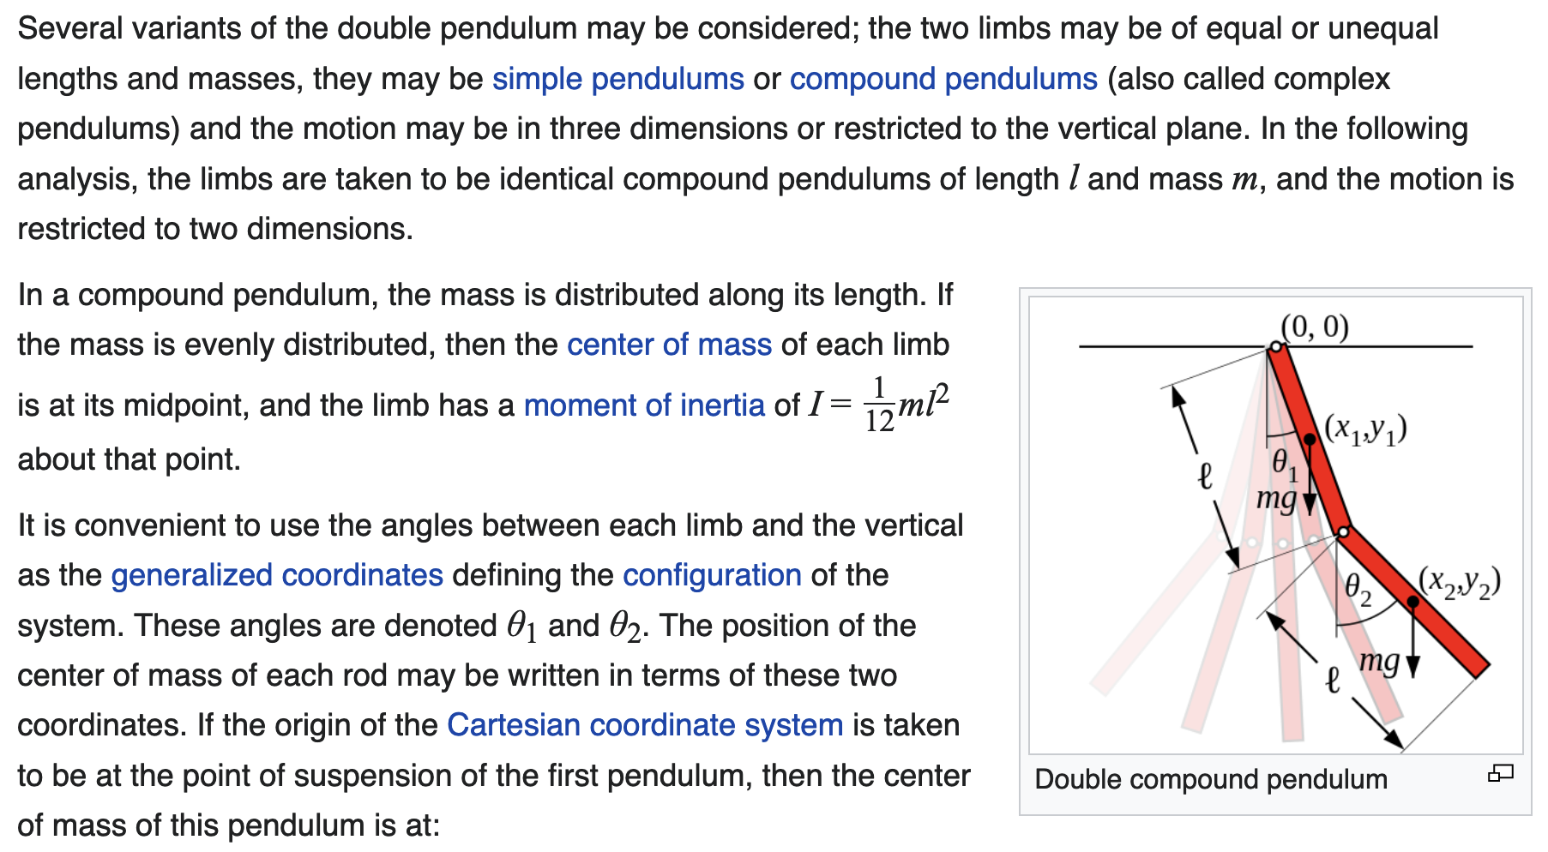
Formulation of Equations of Motion
“Hamiltonian mechanics” is used to write the equations of motion

Slide 28
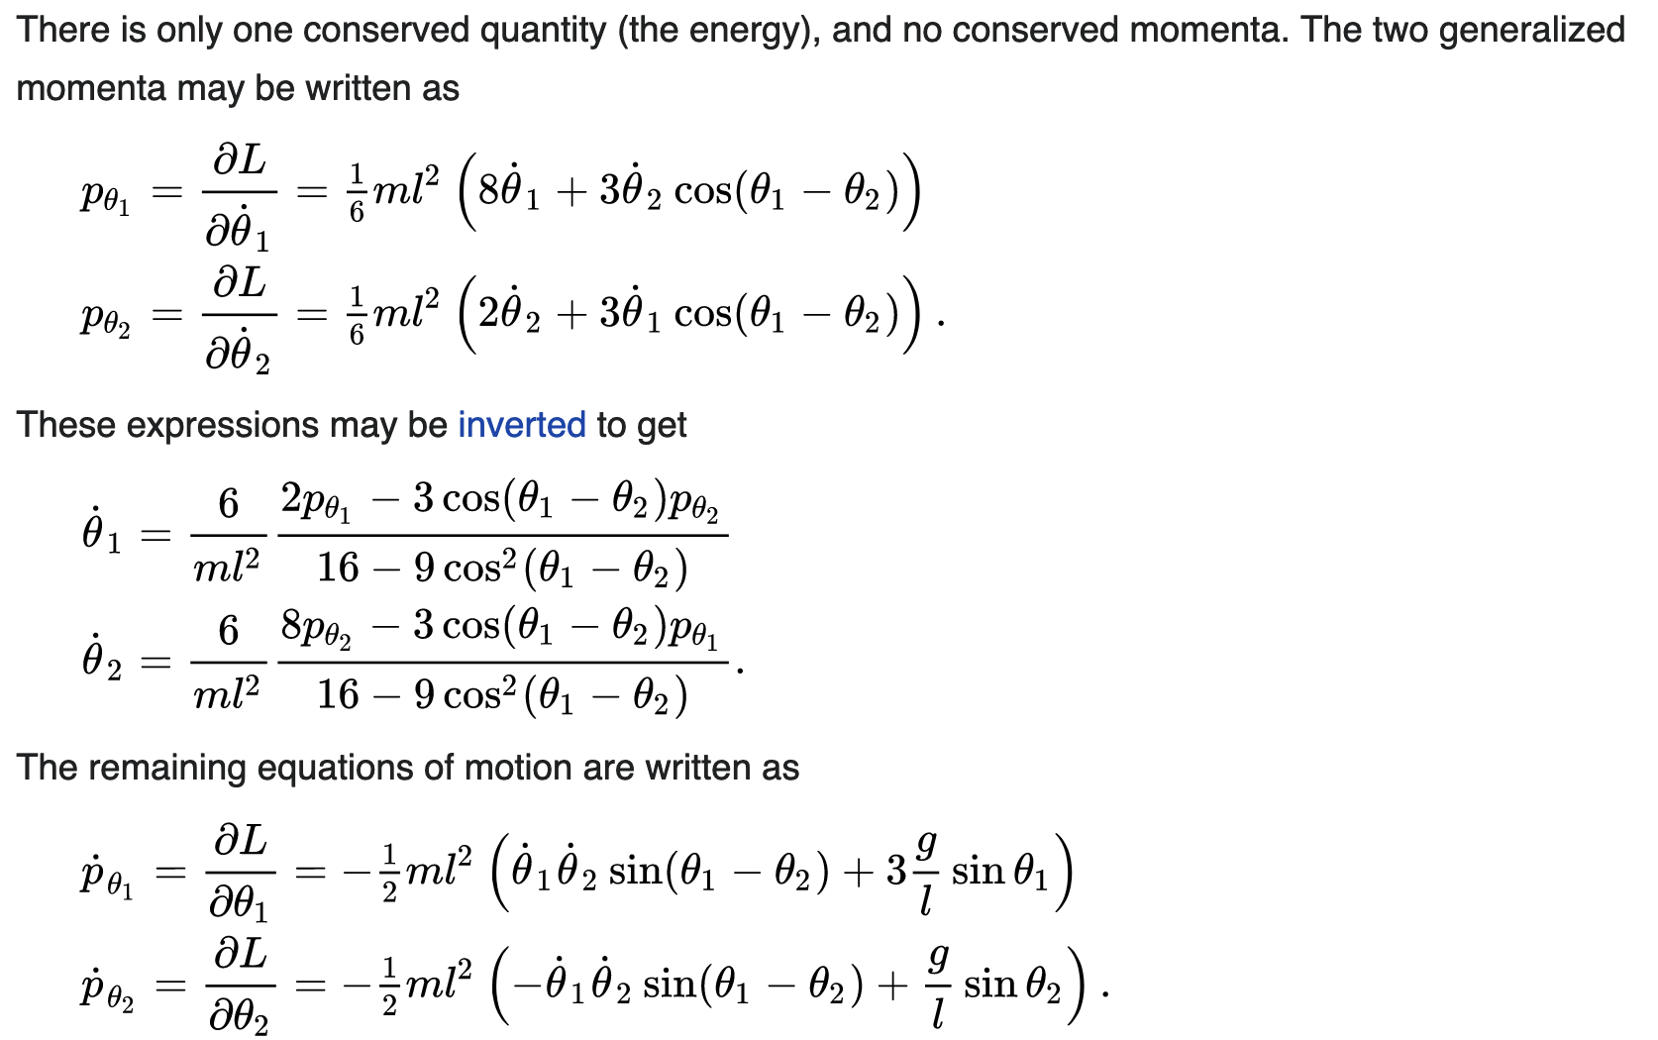
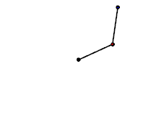
Equations of Motion (Complicated!)
From Numerical Integration
Trajectories

Slide 29
Other Results
Long exposure of double pendulum
Tracked with LED
Three double pendula with nearly the same initial conditions, illustrating sensitive dependence

Slide 30
Feedback
Feedback occurs when outputs of a system are routed back as inputs as part of a chain of cause-and-effect that forms a circuit or loop.
The system can then be said to feed back into itself. The notion of cause-and-effect has to be handled carefully when applied to feedback systems:
Simple causal reasoning about a feedback system is difficult because the first system influences the second and second system influences the first, leading to a circular argument.
This makes reasoning based upon cause and effect tricky, and it is necessary to analyze the system as a whole.
— Karl Johan Åström and Richard M.Murray, Feedback Systems: An Introduction for Scientists and Engineers
A feedback loop where all outputs of a process A or P are available as causal inputs to that process.

Slide 31
Recall: Acoustic Feedback https://www.perfectcircuit.com/articles/feedback
Acoustic feedback is essentially an oscillator that produces vibrations as it circulates through the microphone, speaker, and amplifier configuration.
The resonance eventually congeals around a specific (emergent) frequency, causing the rest of the loop to vibrate at the same frequency.
For this reason, feedback loops are sometimes referred to as electromechanical oscillators.

Slide 32
Recall: Video Feedback
Video feedback is the process of pointing a camera at the screen displaying the camera's output.
This creates a feedback loop of images infinitely repeating onto and over themselves creating interesting patterns.
An initial curious result has become a studied phenomena that relates to other sciences such as cellular automata, reaction diffusion and non-linear dynamics.
All you need is a camera and a monitor or TV capable of displaying the camera's output.
Any camera and monitor/TV combination will usually work. Different quality cameras and screens will all lead to unique results.

Slide 33
Definitions
The terms "positive" and "negative" were first applied to feedback prior to WWII.
The idea of positive feedback was already current in the 1920s with the introduction of the regenerative circuit.
Friis and Jensen (1924) described regeneration in a set of electronic amplifiers as a case where the "feed-back" action is positive in contrast to negative feed-back action, which they mention only in passing.
Harold Stephen Black's classic 1934 paper first details the use of negative feedback in electronic amplifiers.
According to Black, positive feed-back increases the gain of the amplifier, negative feed-back reduces it.

Slide 34
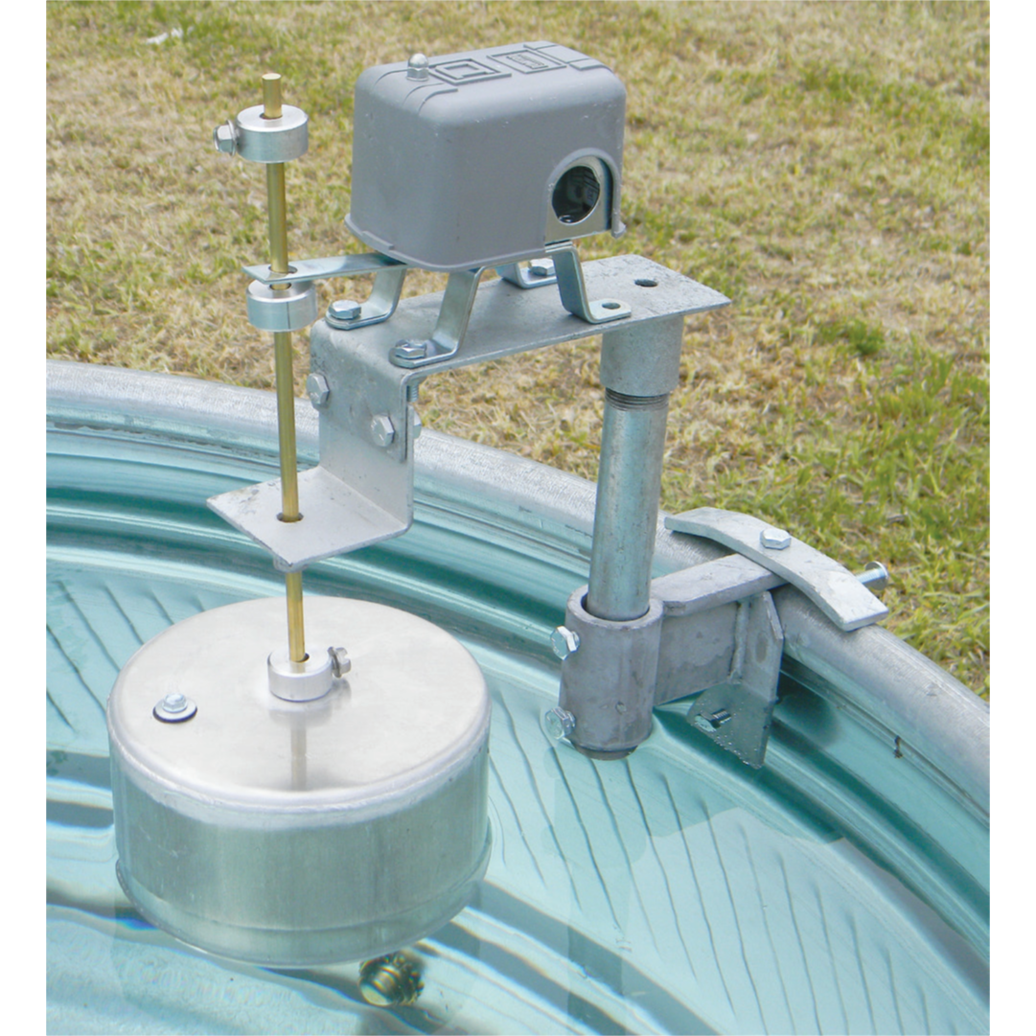
Feedback: History
Self-regulating mechanisms have existed since antiquity, and the idea of feedback had started to enter economic theory in Britain by the 18th century, but it was not at that time recognized as a universal abstraction and so did not have a name.
The first ever known artificial feedback device was a float valve, for maintaining water at a constant level, invented in 270 BC in Alexandria, Egypt.
This device illustrated the principle of feedback: a low water level opens the valve, the rising water then provides feedback into the system, closing the valve when the required level is reached.
This then reoccurs in a circular fashion as the water level fluctuates.

Slide 35
Feedback: History
Centrifugal governors were used to regulate the distance and pressure between millstones in windmills since the 17th century.
In 1788, James Watt designed his first centrifugal governor following a suggestion from his business partner Matthew Boulton, for use in the steam engines of their production.
Early steam engines employed a purely reciprocating motion and were used for pumping water – an application that could tolerate variations in the working speed, but the use of steam engines for other applications called for more precise control of the speed.
In 1868, James Clerk Maxwell wrote a famous paper, "On governors", that is widely considered a classic in feedback control theory.
The verb phrase to feed back, in the sense of returning to an earlier position in a mechanical process, was in use in the US by the 1860s, and in 1909, Nobel laureate Karl Ferdinand Braun used the term "feed-back" as a noun to refer to (undesired) coupling between components of an electronic circuit.

Slide 36
Positive and Negative Feedback
Positive feedback: If the signal feedback from output is in phase with the input signal, the feedback is called positive feedback. (self-exciting or de-stabilizing)
Negative feedback: If the signal feedback is of opposite polarity or out of phase by 180° with respect to input signal, the feedback is called negative feedback. (self-inhibiting or stabilizing)
Maintaining a desired system performance despite disturbance using negative feedback to reduce system error (negative feedback)
Classic example of negative feedback: A house thermostat for heating and cooling

Slide 37
Alternatively: Positive and Negative Feedback
Positive feedback: If the signal feedback from output is in phase with the input signal, the feedback is called positive feedback. (self-exciting or de-stabilizing)
Negative feedback: If the signal feedback is of opposite polarity or out of phase by 180° with respect to input signal, the feedback is called negative feedback. (self-inhibiting or stabilizing)

Slide 38
Applications: Dynamical Systems
By using feedback properties, the behavior of a system can be altered to meet the needs of an application; systems can be made stable, responsive or held constant.
Physicists have shown that adaptation to the Edge of Chaos occurs in almost all systems with feedback.
The edge of chaos is a transition space between order and disorder that is hypothesized to exist within a wide variety of systems.
This transition zone is a region of bounded instability that engenders a constant dynamic interplay between order and disorder.

Slide 39
Digression: Edge of Chaos (to be discussed in more detail later)
The phrase edge of chaos was coined in the late 1980s by chaos theory physicist Norman Packard.
In the next decade, Packard and mathematician Doyne Farmer co-authored many papers on understanding how self-organization and order emerges at the edge of chaos.
One of the original catalysts that led to the idea of the edge of chaos were the experiments with cellular automata done by computer scientist Christopher Langton where a transition phenomenon was discovered.
The phrase refers to an area in the range of a variable, λ (lambda), which was varied while examining the behavior of a cellular automaton (CA, to be discussed later)
As λ varied, the behavior of the CA went through a phase transition (change of macroscopic state) of behaviors.
Langton found a small range of CAs can be capable of universal computation (see Turing).
At around the same time physicist James P. Crutchfield (UC Davis) and others used the phrase onset of chaos to describe more or less the same concept.

Slide 40
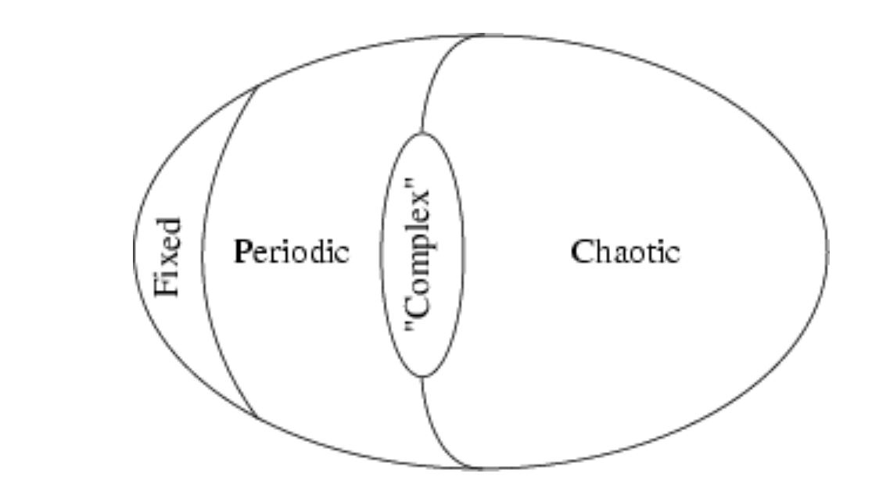
Phase Transitions in Complex Systems https://theory.org/complexity/cdpt/html/node5.html
III
II
I
IV
(To be Discussed Later)

Slide 41
Digression: Edge of Chaos
In the sciences in general, the phrase Edge of Chaos has come to refer to a metaphor that some physical, biological, economic and social systems operate in a region between order and either complete randomness or chaos, where the complexity is maximal.
The generality and significance of the idea, however, has since been called into question by Melanie Mitchell and others.
The phrase has also been borrowed by the business community and is sometimes used inappropriately and in contexts that are far from the original scope of the meaning of the term.
Stuart Kauffman has studied mathematical models (“NK Model”) of evolving systems in which the rate of evolution is maximized near the edge of chaos.

Slide 42
Adaptation by Feedback to the Edge of Chaos
Adaptation plays a vital role for all living organisms and systems.
All of them are constantly changing their inner properties to better fit in the current environment.
The most important instruments for the adaptation are the self-adjusting parameters inherent for many natural systems.
The prominent feature of systems with self-adjusting parameters is an ability to avoid chaos (uncontrolled evolution).
The name for this phenomenon is "Adaptation to the edge of chaos".
Adaptation to the edge of chaos refers to the idea that many complex adaptive systems (CAS) seem to intuitively evolve toward a regime near the boundary between chaos and order.
Physics has shown that edge of chaos is the optimal settings for control of a system.
It is also an optional setting that can influence the ability of a physical system to perform primitive functions for computation.

Slide 43
Adaptation in Complex Adaptive Systems (CAS)
In CAS, coevolution generally occurs near the edge of chaos, and a balance should be maintained between flexibility and stability to avoid structural failure.
As a response to coping with turbulent environments;
CAS can bring out flexibility, creativity, agility, and innovation near the edge of chaos
Provided the network structures have sufficient decentralized, non-hierarchical network architectures.
Because of the importance of adaptation in many natural systems, adaptation to the edge of the chaos takes a prominent position in many scientific researches.
Physicists demonstrated that adaptation to a state at the boundary of chaos and order occurs in population of cellular automata rules which optimize the performance of a genetic algorithm (to be discussed later)
Another example of this phenomenon is the self-organized criticality (SOC) in avalanche and earthquake models (to be discussed)
Self-adjusting logistic map dynamics exhibit adaptation to the edge of chaos.

Slide 44
Example of Negative Feedback
As an example of negative feedback, the diagram might represent a cruise control system in a car, for example, that matches a target speed such as the speed limit.
The controlled system is the car; its input includes the combined torque from the engine and from the changing slope of the road (the disturbance).
The car's speed (status) is measured by a speedometer.
The error signal is the departure of the speed as measured by the speedometer from the target speed (set point).
This measured error is interpreted by the controller to adjust the accelerator, commanding the fuel flow to the engine (the effector).
The resulting change in engine torque, the feedback, combines with the torque exerted by the changing road grade to reduce the error in speed, minimizing the road disturbance.
A feedback loop for a negative feedback system
(dampens fluctuations)

Slide 45
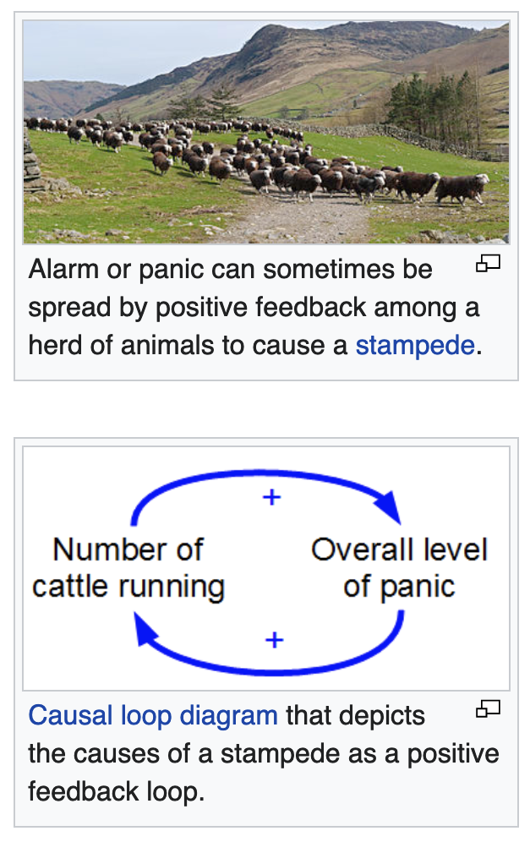
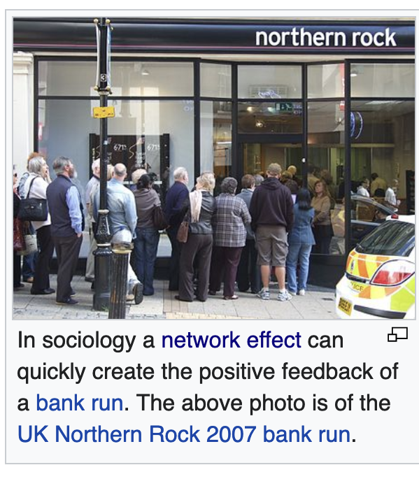
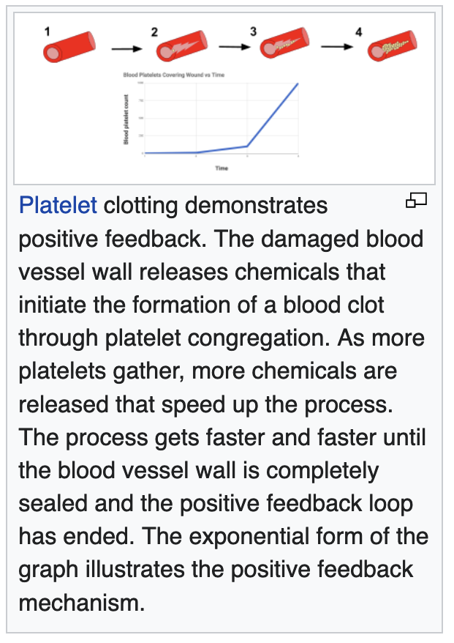
Examples of Positive Feedback: https://en.wikipedia.org/wiki/Positive_feedback

Slide 46
Examples of Feedback: Biology
In biological systems such as organisms, ecosystems, or the biosphere, most parameters must stay under control within a narrow range around a certain optimal level under certain environmental conditions.
The deviation of the optimal value of the controlled parameter can result from the changes in internal and external environments.
A change of some of the environmental conditions may also require change of that range to change for the system to function.
The value of the parameter to maintain is recorded by a reception system and conveyed to a regulation module via an information channel, an example of this is insulin oscillations.
Biological systems contain many types of regulatory circuits, both positive and negative.
As in other contexts, positive and negative do not imply that the feedback causes good or bad effects.
A negative feedback loop is one that tends to slow down a process, whereas the positive feedback loop tends to accelerate it.

Slide 47
Examples of Positive Feedback: Immune System (COVID)
A cytokine storm, or hypercytokinemia is a potentially fatal immune reaction consisting of a positive feedback loop between cytokines and immune cells, with highly elevated levels of various cytokines.
Explanation (complex!):
In normal immune function, positive feedback loops can be utilized to enhance the action of B lymphocytes.
When a B cell binds its antibodies to an antigen and becomes activated, it begins releasing antibodies and secreting a complement protein called C3.
Both C3 and a B cell's antibodies can bind to a pathogen, and when a B cell has its antibodies bind to a pathogen with C3, it speeds up that B cell's secretion of more antibodies and more C3, thus creating a positive feedback loop.

Slide 48
Global Warming
Climate "forcings" may push a climate system in the direction of warming or cooling
Increased atmospheric concentrations of greenhouse gases cause warming at the surface.
Forcings are external to the climate system and feedbacks are internal processes of the system.
Some feedback mechanisms act in relative isolation to the rest of the climate system while others are tightly coupled.
Forcings, feedbacks and the dynamics of the climate system determine how much and how fast the climate changes.
The main positive feedback in global warming is the tendency of warming to increase the amount of water vapor in the atmosphere, which in turn leads to further warming.
The main negative feedback comes from the Stefan–Boltzmann law, the amount of heat radiated from the Earth into space is proportional to the fourth power of the temperature of Earth's surface and atmosphere.

Slide 49
Examples of Feedback: Climate Science
The climate system is characterized by strong positive and negative feedback loops between processes that affect the state of the atmosphere, ocean, and land.
A simple example is the ice–albedo positive feedback loop whereby melting snow exposes more dark ground (of lower albedo, i.e., reflectivity), which in turn absorbs heat and causes more snow to melt.
Ice–albedo feedback is a positive feedback climate process where a change in the area of ice caps, glaciers, and sea ice alters the albedo (reflectivity) and surface temperature of a planet:
Ice is very reflective, therefore some of the solar energy is reflected back to space.
At higher latitudes, warmer temperatures melt the ice sheets.
However, if warm temperatures decrease the ice cover and the area is replaced by water or land, the albedo decreases.
This increases the amount of solar energy absorbed, leading to more warming.
In the geologically recent past, the ice–albedo positive feedback has played a major role in the advances and retreats of the Pleistocene (~2.6 Ma to ~10 ka ago) ice sheets.

Slide 50
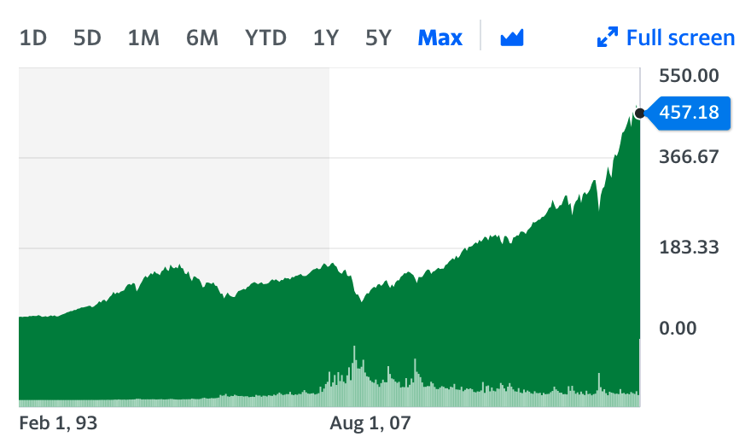
Examples of Feedback: Markets (Also called “Investor Herding” or Fear Of Missing Out or “FOMO”)
SPY ETF
The stock market is an example of a system prone to oscillatory "hunting", governed by positive and negative feedback resulting from cognitive and emotional factors among market participants.
For example:
When stocks are rising (a bull market), the belief that further rises are probable gives investors an incentive to buy (positive feedback—reinforcing the rise, see also stock market bubble and momentum investing); “FOMO”
but the increased price of the shares, and the knowledge that there must be a peak after which the market falls, ends up deterring buyers (negative feedback—stabilizing the rise).
Once the market begins to fall regularly (a bear market), some investors may expect further losing days and refrain from buying (positive feedback—reinforcing the fall), “FUD”
But others may buy because stocks become more and more of a bargain (negative feedback—stabilizing the fall, see also contrarian investing).
George Soros used the word reflexivity, to describe feedback in the financial markets and developed an investment theory based on this principle.
We will talk about markets later

Slide 51
Brian Arthur (Santa Fe Institute) https://en.wikipedia.org/wiki/W._Brian_Arthur
W. Brian Arthur was born in 1945 in Belfast, Northern Ireland.
Arthur received his PhD in Operations Research (1973) and an M. A. in Economics (1973) from the University of California, Berkeley.
At age 37, Dr. Arthur was the youngest endowed chair holder at Stanford University.
Arthur is the former Morrison Professor of Economics and Population Studies; Professor of Human Biology, Stanford University, 1983–1996. He is the co-founder of the Morrison Institute for Population and Resource Studies at Stanford.
Arthur is noted for his seminal works "studying the impacts of positive feedback or increasing returns in economies, and how these increasing returns magnify small, random occurrences in the market place."

Slide 52
The Network Effect (Also known as “Increasing Returns”)
In economics, a network effect (also called network externality or demand-side economies of scale) is the phenomenon by which the value or utility a user derives from a good or service depends on the number of users of compatible products.
Network effects are typically positive, resulting in a given user deriving more value from a product as other users join the same network.
The adoption of a product by an additional user can be broken into two effects:
An increase in the value to all other users ( "total effect")
The enhancement of other non-users' motivation for using the product ("marginal effect").
While the idea was originally formulated for businesses, it has general validity.

Slide 53
Network Effect
Network effects can be direct or indirect.
Direct network effects arise when a given user's utility increases with the number of other users of the same product or technology, meaning that adoption of a product by different users is complementary.
This effect is separate from effects related to price, such as a benefit to existing users resulting from price decreases as more users join.
Direct network effects can be seen with social networking services, including Twitter, Facebook, Airbnb, Uber, and LinkedIn
Telecommunications devices like the telephone, and instant messaging services such as MSN, AIM or QQ.
Indirect (or cross-group) network effects arise when there are "at least two different customer groups that are interdependent, and the utility of at least one group grows as the other group(s) grow".
For example, hardware may become more valuable to consumers with the growth of compatible software.

Slide 54
Network Effect
Network effects are commonly mistaken for economies of scale, which describe decreasing average production costs in relation to the total volume of units produced.
Economies of scale are a common phenomenon in traditional industries such as manufacturing, whereas network effects are most prevalent in new economy industries, particularly information and communication technologies.
Network effects are the demand side counterpart of economies of scale, as they function by increasing a customer's willingness to pay rather than decreasing the supplier's average cost.
Upon reaching critical mass, a bandwagon effect can result.
As the network continues to become more valuable with each new adopter, more people are incentivised to adopt, resulting in a positive feedback loop. (Bitcoin adoption wave is an example)
Multiple equilibria and market tipping are two key potential outcomes in markets that exhibit network effects.
Consumer expectations are key in determining which outcomes will result.

Slide 55
Network Effect (Market Tipping Point)
Network effects give rise to the potential outcome of market tipping, defined as "the tendency of one system to pull away from its rivals in popularity once it has gained an initial edge".
Tipping results in a market in which only one good or service dominates and competition is stifled.
This is because network effects tend to incentivise users to coordinate their adoption of a single product.
Therefore, tipping can result in a natural form of market concentration in markets that display network effects.
However, the presence of network effects does not necessarily imply that a market will tip; the following additional conditions must be met:
The utility derived by users from network effects must exceed the utility they derive from differentiation
Users must have high costs of multihoming (i.e. adopting more than one competing networks)
Users must have high switching costs

Slide 56
Network Effect
Network effects were a central theme in the arguments of Theodore Vail, the first post-patent president of Bell Telephone, in gaining a monopoly on US telephone services.
In 1908, when he presented the concept in Bell's annual report, there were over 4,000 local and regional telephone exchanges, most of which were eventually merged into the Bell System.
Network effects were popularized by Robert Metcalfe, stated as Metcalfe's law.
Metcalfe was one of the co-inventors of Ethernet and a co-founder of the company 3Com.
In selling the product, Metcalfe argued that customers needed Ethernet cards to grow above a certain critical mass if they were to reap the benefits of their network.
According to Metcalfe, the rationale behind the sale of networking cards was that the cost of the network was directly proportional to the number of cards installed, but the value of the network was proportional to the square of the number of users.
This was expressed algebraically as having a cost of N, and a value of N².
While the actual numbers behind this proposition were never firm, the concept allowed customers to share access to expensive resources like disk drives and printers, send e-mail, and eventually access the Internet.

Slide 57
Critical Mass
In the early phases of a network technology, incentives to adopt the new technology are low.
After a certain number of people have adopted the technology, network effects become significant enough that adoption becomes a dominant strategy.
This point is called critical mass: at the critical mass point, the value obtained from the good or service is greater than or equal to the price paid for the good or service.
When a product reaches critical mass, network effects will drive subsequent growth until a stable balance is reached.
Therefore, a key business concern must then be how to attract users prior to reaching critical mass.
Critical quality is closely related to consumer expectations, which will be affected by price and quality of products or services, the company's reputation and the growth path of the network.
Thus, one way is to rely on extrinsic motivation, such as a payment, a fee waiver, or a request for friends to sign up.
A more natural strategy is to build a system that has enough value without network effects, at least to early adopters. Then, as the number of users increases, the system becomes even more valuable and is able to attract a wider user base.

Slide 58
Critical Mass
Beyond critical mass, the increasing number of subscribers generally cannot continue indefinitely.
After a certain point, most networks become either congested or saturated, stopping future uptake.
Congestion occurs due to overuse.
The applicable analogy is that of a telephone network.
While the number of users is below the congestion point, each additional user adds additional value to every other customer.
However, at some point, the addition of an extra user exceeds the capacity of the existing system.
After this point, each additional user decreases the value obtained by every other user.
In practical terms, each additional user increases the total system load, leading to busy signals, the inability to get a dial tone, and poor customer support.
This also true for bandwidth limitations of internet networks

Slide 59
Negative Network Externalities
Negative network externalities, in the mathematical sense, are those that have a negative effect compared to normal (positive) network effects.
Just as positive network externalities (network effects) cause positive feedback and exponential growth, negative network externalities create negative feedback and exponential decay.
In nature, negative network externalities are the forces that pull towards equilibrium, are responsible for stability, and represent physical limitations keeping systems bounded.
Besides, negative network externalities has four characteristics, which are namely, more login retries, longer query times, longer download times and more download attempts.
Therefore, congestion occurs when the efficiency of a network decreases as more people use it, and this reduces the value to people already using it.
Traffic congestion that overloads the freeway and network congestion on connections with limited bandwidth both display negative network externalities.

Slide 60
Network Effect: The Telephone
Network effects are the incremental benefit gained by each user for each new user that joins a network.
An example of a direct network effect is the telephone.
Originally when only a small number of people owned a telephone the value it provided was minimal.
Not only did other people need to own a telephone for it to be useful, but it also had to be connected to the network through the users home.
As technology advanced it became more affordable for people to own a telephone.
This created more value and utility due to the increase in users.
Eventually increased usage through exponential growth led to the telephone is used by almost every household adding more value to the network for all users.
Without the network effect and technological advances the telephone would have no where near the amount of value or utility as it does today.

Slide 61
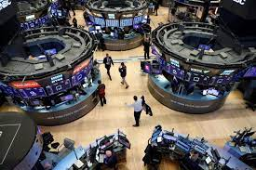
Network Effect: Stock Exchanges
Stock exchanges and derivatives exchanges feature a network effect.
Market liquidity is a major determinant of transaction cost in the sale or purchase of a security, as a bid–ask spread exists between the price at which a purchase can be made versus the price at which the sale of the same security can be made.
In an exchange, as the number of sellers and buyers with symmetric information increases, liquidity increases, and transaction costs decrease
This then attracts a larger number of buyers and sellers to the exchange.
The network advantage of financial exchanges is apparent in the difficulty that startup exchanges have in dislodging a dominant exchange.
For example, the Chicago Board of Trade has retained overwhelming dominance of trading in US Treasury bond futures despite the startup of Eurex US trading of identical futures contracts.
Similarly, the Chicago Mercantile Exchange has maintained dominance in trading of Eurobond interest rate futures despite a challenge from Euronext.Liffe.

Slide 62
Network Effect: Cryptocurrencies
Cryptocurrencies such as Bitcoin, also feature network effects. Bitcoin's unique properties make it an attractive asset to users and investors.
The more users that join the network, the more valuable and secure it becomes.
This method creates incentive for users to join so that when the network and community grows, a network effect occurs, making it more likely that new people will also join.
Bitcoin provides its users with financial value through the network effect which may lead to more investors due to the appeal of financial gain.
This is an example of an indirect network effect as the value only increases due to the initial network being created.
Recent innovations continue to drive bitcoin, including the advent of the Lightning network, and the Taproot upgrade, both recent innovations

Slide 63
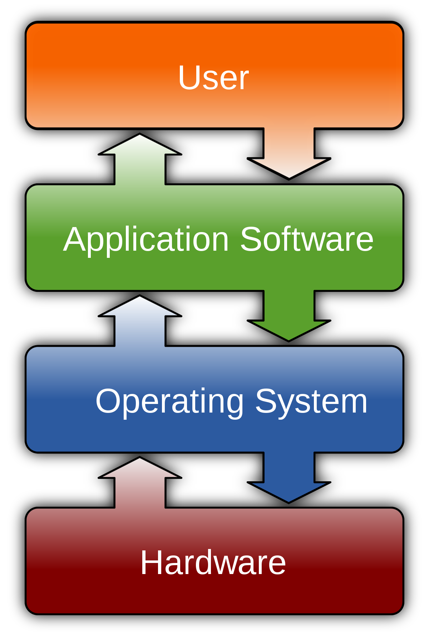
Network Effect: Software
Widely used computer software benefits from powerful network effects.
The software-purchase characteristic is that it is easily influenced by the opinions of others, so the customer base of the software is the key to realizing a positive network effect.
Although customers' motivation for choosing software is related to the product itself, media interaction and word-of-mouth recommendations from purchased customers can still increase the possibility of software being applied to other customers who have not purchased it, thereby resulting in network effects.
In 2007 Apple released the iPhone followed by the app store.
Most iPhone apps rely heavily on the existence of strong network effects.
This enables the software to grow in popularity very quickly and spread to a large userbase with very limited marketing needed.
The Freemium business model has evolved to take advantage of these network effects by releasing a free version that will not limit the adoption or any users and then charge for premium features as the primary source of revenue.

Slide 64
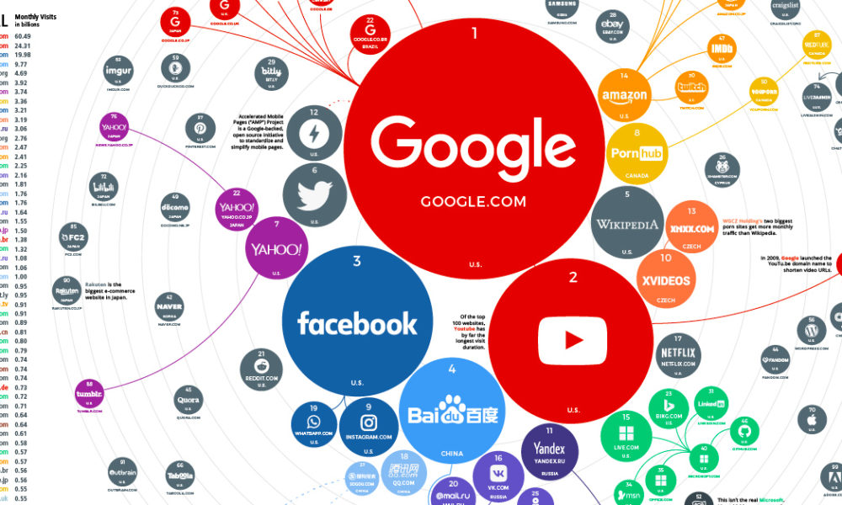
Network Effect: Web Sites
Many web sites benefit from a network effect.
One example is web marketplaces and exchanges.
For example, eBay would not be a particularly useful site if auctions were not competitive.
As the number of users grows on eBay, auctions grow more competitive, pushing up the prices of bids on items.
This makes it more worthwhile to sell on eBay and brings more sellers onto eBay, which, in turn, drives prices down again due to increased supply.
Increased supply brings even more buyers to eBay.
Essentially, as the number of users of eBay grows, prices fall and supply increases, and more and more people find the site to be useful.

Slide 65
Network Effect: Web Sites
Network effects were used as justification in business models by some of the dot-com companies in the late 1990s.
These firms operated under the belief that when a new market comes into being which contains strong network effects, firms should care more about growing their market share than about becoming profitable.
The justification was that market share would determine which firm could set technical and marketing standards and giving these companies a first-mover advantage.
Social networking websites are good examples.
The more people register onto a social networking website, the more useful the website is to its registrants.
Google uses the network effect in its advertising business with its Google AdSense service.
AdSense places ads on many small sites, such as blogs, using Google technology to determine which ads are relevant to which blogs.
Thus, the service appears to aim to serve as an exchange (or ad network) for matching many advertisers with many small sites.
In general, the more blogs AdSense can reach, the more advertisers it will attract, making it the most attractive option for more blogs.

Slide 66
Network Effect: Web Sites
By contrast, the value of a news site is primarily proportional to the quality of the articles, not to the number of other people using the site.
Similarly, the first generation of search engines experienced little network effect, as the value of the site was based on the value of the search results.
This allowed Google to win users away from Yahoo! without much trouble, once users believed that Google's search results were superior.
Some commentators mistook the value of the Yahoo! brand (which does increase as more people know of it) for a network effect protecting its advertising business.

Slide 67
Network Effects: Credit Cards
For credit cards that are now widely used, large-scale applications on the market are closely related to network effects.
Credit card, as one of the currency payment methods in the current economy, which was originated in 1949.
Early research on the circulation of credit cards at the retail level found that credit card interest rates were not affected by macroeconomic interest rates and remained almost unchanged.
Later, credit cards gradually entered the network level due to changes in policy priorities and became a popular trend in payment in the 1980s.
Different levels of credit cards separate benefit from two types of network effects.
The application of credit cards related to external network effects, which is because when this has become a payment method, and more people use credit cards.
As each additional person uses the same credit card, the value for the rest of the people who use the credit card will increase.

Slide 68
Network Effects: Credit Cards
The credit card system at the network level could be seen as a two-sided market.
On the one hand, the number of cardholders attracts merchants to use credit cards as a payment method.
On the other hand, an increasing number of merchants can also attract more new cardholders.
In other words, the use of credit cards has increased significantly among merchants which leads to increased value.
This can conversely increase the cardholder's credit card value and the number of users.
Moreover, credit card services also display a network effect between merchant discounts and credit accessibility.

Slide 69
Network Effects: Credit Cards
When credit accessibility increases where greater sales can be obtained, merchants are willing to be charged more discounts by credit card issuers.
Visa has become a leader in the electronic payment industry through the network effect of credit cards as its competitive advantage.
Visa now processes bitcoin payments as well
From 2016, Visa's credit card market share has risen from a quarter to as much as half of the total market in four years, so Visa benefits from the network effect.
Every additional Visa cardholder is more attractive to merchants, and merchants can also attract more new cardholders through the brand.
In other words, the popularity and convenience of Visa in the electronic payment market, lead more people and merchants choose to use Visa, which greatly increases the value of Visa.
Note, by the way, that Visa and the other credit cards can process about 5000 transactions per second.
With the advent of the new Lightning network for bitcoin, instead of processing only about 7 transactions per second on the bitcoin base layer, now more than 25 million bitcoin transactions per second can be processed.

Slide 70
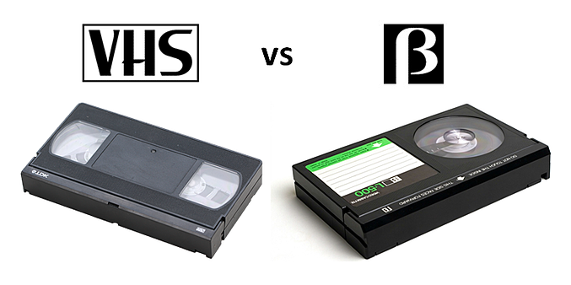
Network Effect: VHS - Betamax
The videotape format war was a period of competition or "format war" of incompatible models of consumer-level analog video videocassette and video cassette recorders (VCR) in the late 1970s and the 1980s
It mainly involved the Betamax and Video Home System (VHS) formats.
VHS ultimately emerged as the preeminent format, even though it was inferior technologically
While VHS machines' lower retail price was a major factor, the principal battleground proved to be recording time.
The original Sony Betamax video recorder for the NTSC television system could record for only 60 minutes, identical to the previous U-matic format, which had been sufficient for use in television studios.
JVC's VHS could manage 120 minutes, followed by RCA's entrance into the market with a 240-minute recorder using VHS.
These challenges sparked a mini-war to see who could achieve the longest recording time.

Slide 71
Network Effect: VHS - Betamax
Betamax is, in theory, a superior recording format over VHS due to resolution (250 lines vs. 240 lines), slightly superior sound, and a more stable image
Betamax recorders were also of higher-quality construction.
However, these differences were negligible to consumers, and thus did not justify either the extra cost of a Betamax VCR (which was often significantly more expensive than a VHS equivalent) or Betamax's shorter recording time.
Beta sales dwindled away, and VHS emerged as the winner of the domestic / home-market format war.
The video format war is now a highly scrutinized event in business and marketing history, leading to a plethora of market investigations into why Betamax failed.

Slide 72
Network Effect: Automobiles https://www.hemmings.com/stories/2020/12/18/did-an-outbreak-of-hoof-and-mouth-disease-lead-to-the-demise-of-stanley-and-steam-cars-in-general
If automotive history is human history over the last century and a half, then of course the pandemics that have shaped human progress over that time have also had some bearing on the course of automotive evolution.
Take, for instance, the deaths of John and Horace Dodge due -- directly or indirectly -- to the 1918 influenza epidemic:
Had those two not contracted that virus, the Dodge brand would likely be a far more dominating presence in the automotive landscape today.
Or take the hoof-and-mouth disease outbreak of 1914, which, as some histories argue, sidelined another pair of automotive pioneer brothers and hobbled steam car manufacturers in their attempt to stave off the growing threat from internal combustion cars.
Steam cars would fill their water tanks from public horse troughs, which were common at the time.
When the hoof and mouth outbreak occurred, these were removed, paving the way for gasoline-powered cars

Slide 73
Synchronization of Chaotic Systems
Synchronization of chaos is a phenomenon that may occur when two, or more, dissipative chaotic systems are coupled.
There are interactions and feedback.
Because of the exponential divergence of the nearby trajectories of chaotic systems, having two chaotic systems evolving in synchrony might appear surprising.
However, synchronization of coupled or driven chaotic oscillators is a phenomenon well established experimentally and reasonably well-understood theoretically.
Synchronization of chaos is a rich phenomenon and a multi-disciplinary subject with a broad range of applications.
Synchronization may present a variety of forms depending on the nature of the interacting systems and the type of coupling, and the proximity between the systems.
Example: Synchronization of Metronomes or Clocks

Slide 74
Examples https://physicsworld.com/a/the-secret-of-the-synchronized-pendulums/
Synchronization – two or more events happening at the same time – is one of the most common phenomena in nature.
Ballet dancers moving in harmony to the rhythm of music.
Violinists in an orchestra playing perfectly in unison.
A school of fish swimming gracefully together in the sea.
Extending from unconscious entities to human beings, it’s even an Olympic sport in the form of synchronized swimming or diving.
Synchronization is essential to life too.
Pacemaker cells, for example, have to fire electrical discharges synchronously to ensure our hearts beat properly.

Slide 75
Phase Synchronization
Phase synchronization occurs when the coupled chaotic oscillators keep their phase difference bounded while their amplitudes remain uncorrelated.
This phenomenon occurs even if the oscillators are not identical.
Observation of phase synchronization requires a previous definition of the phase of a chaotic oscillator.
In many practical cases, it is possible to find a plane in phase space in which the projection of the trajectories of the oscillator follows a rotation around a well-defined center.
If this is the case, the phase is defined by the angle, φ(t), described by the segment joining the center of rotation and the projection of the trajectory point onto the plane.
If φ₁(t) and φ₂(t) denote the phases of the two coupled oscillators, synchronization of the phase is given by the relation n φ₁(t) = m φ₂(t) with m and n integers.

Slide 76
Modern Great Earthquakes http://earthquake.usgs.gov/earthquakes/world/10_largest_world.php
Sorted by Magnitude

Slide 77
Great Earthquakes vs. Time Since 1900 http://www.groundtruthtrekking.org/Graphics/Largest-earthquakes.html

Slide 78
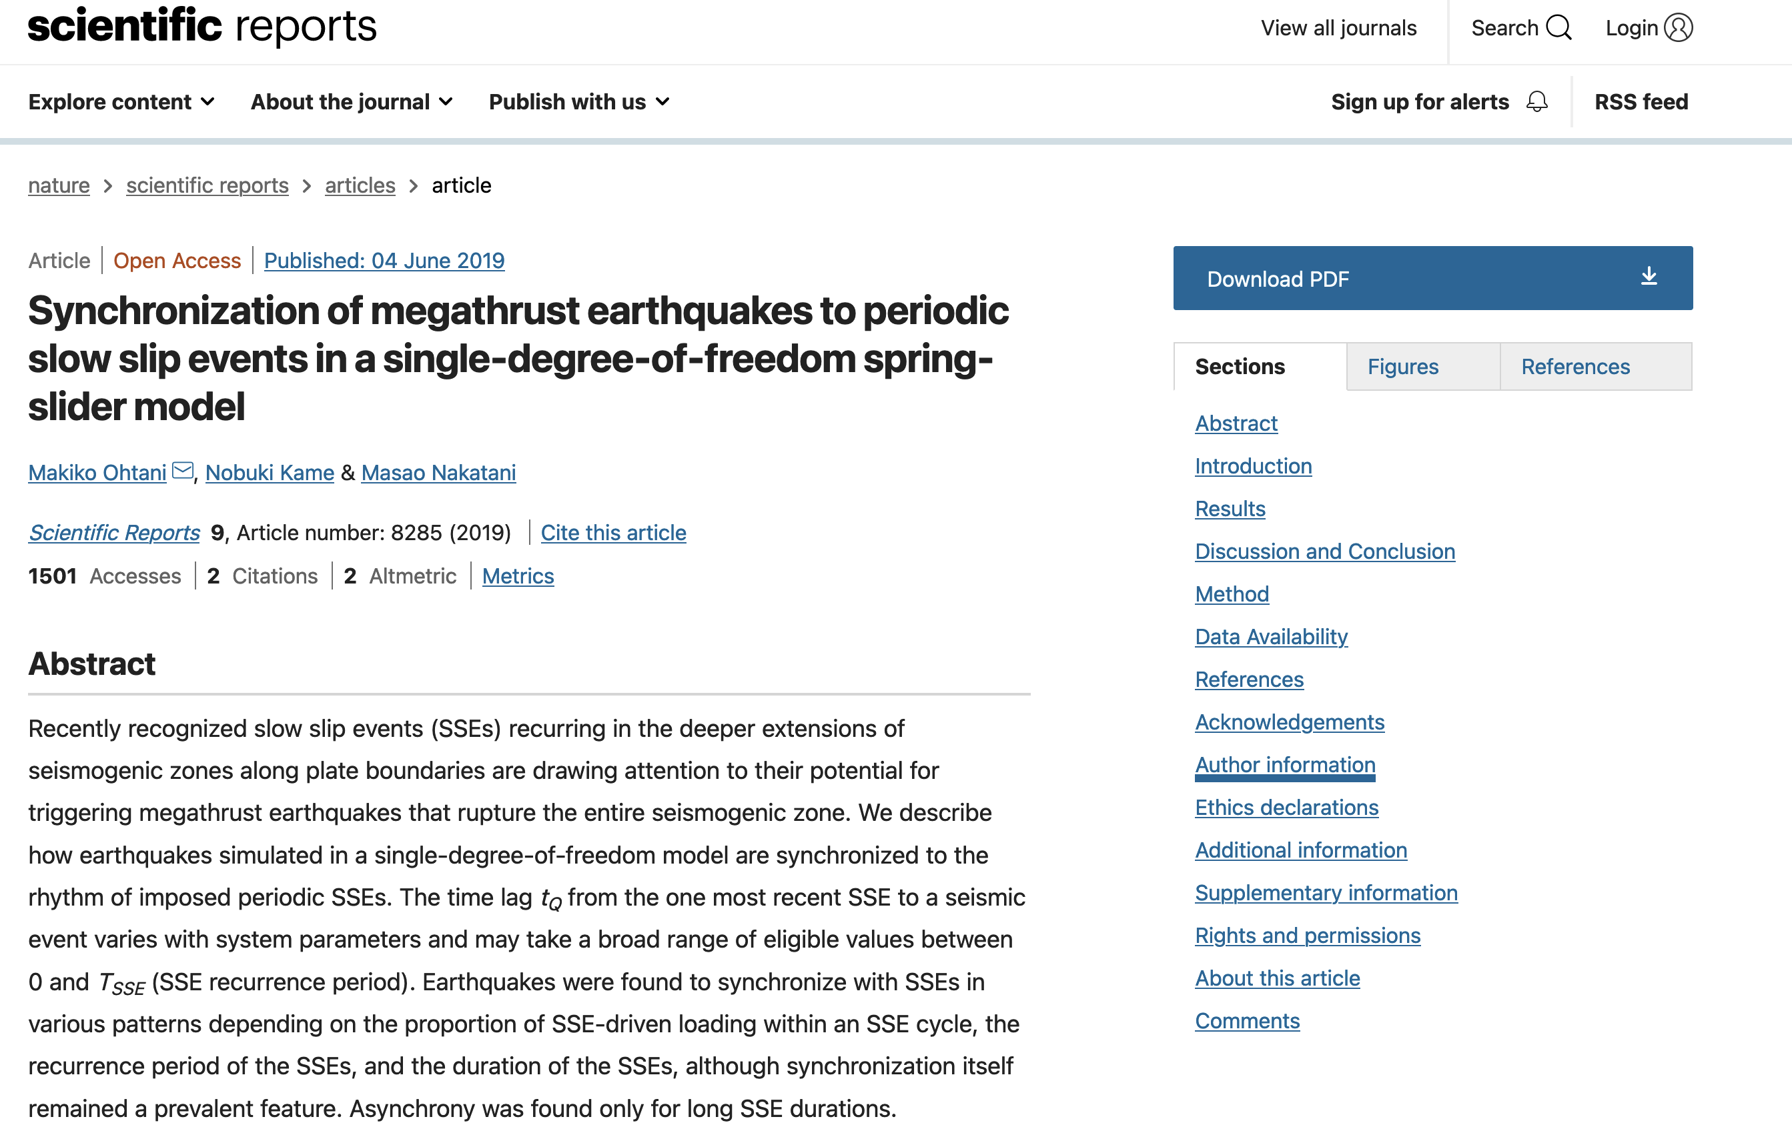
In earthquakes

Slide 79
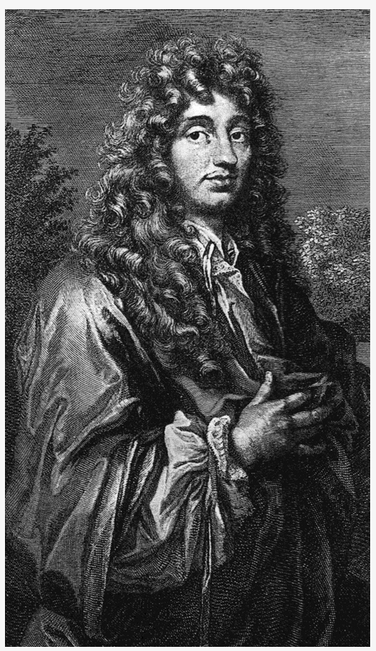
Discovery of Phase Synchronization https://www.aps.org/publications/apsnews/201706/history.cfm
Being bedridden is never much fun, but sometimes it can lead to scientific insight.
Such was the case with 17th century Dutch astronomer Christiaan Huygens.
He became the first to report the phenomenon of coupled oscillation in two pendulum clocks (which he invented) in his bedroom while recovering from an illness in 1665.
Huygens suggested that this effect was due to “imperceptible movements” in the wooden beams supporting the clocks.
In 2000, Georgia Tech physicists conducted experiments and found that Huygens’ intuition on this score was correct.
The culprit is indeed small vibrations: as the pendulums swing, the clocks exert tiny forces on the beam that connects them.

Slide 80
Example of Synchronized Pendulums
The fact that pairs of moving pendulums can become synchronized was first observed by the great Dutch scientist Christiaan Huygens back in the 17th century.
But as Jonatan Pena Ramirez and Henk Nijmeijer explain, synchronized pendulums still have today’s researchers scratching their heads

Slide 81
Example: Firefly Trees
Seeing a sparkling carpet of fireflies in your backyard can be a magical experience. But imagine seeing them all flashing at once—in a symphony of light.
Synchronous species of fireflies are very special, they exist only in a handful of places throughout the world.
Here are a few places where you can find them, if you know where to look:
Great Smokey Mountains Park
Southeast Asia Mangrove Forests
Cajon Bonito, Arizona
https://www.youtube.com/watch?v=EnwVVE-EGVw&t=30s

