Slide 1
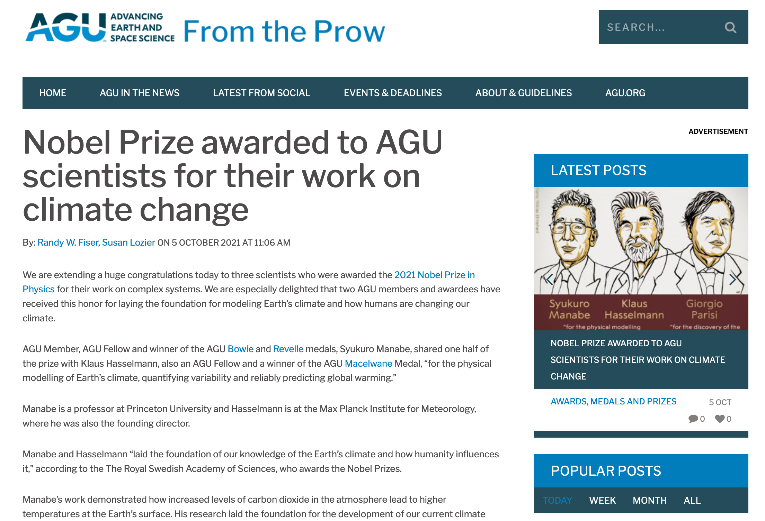
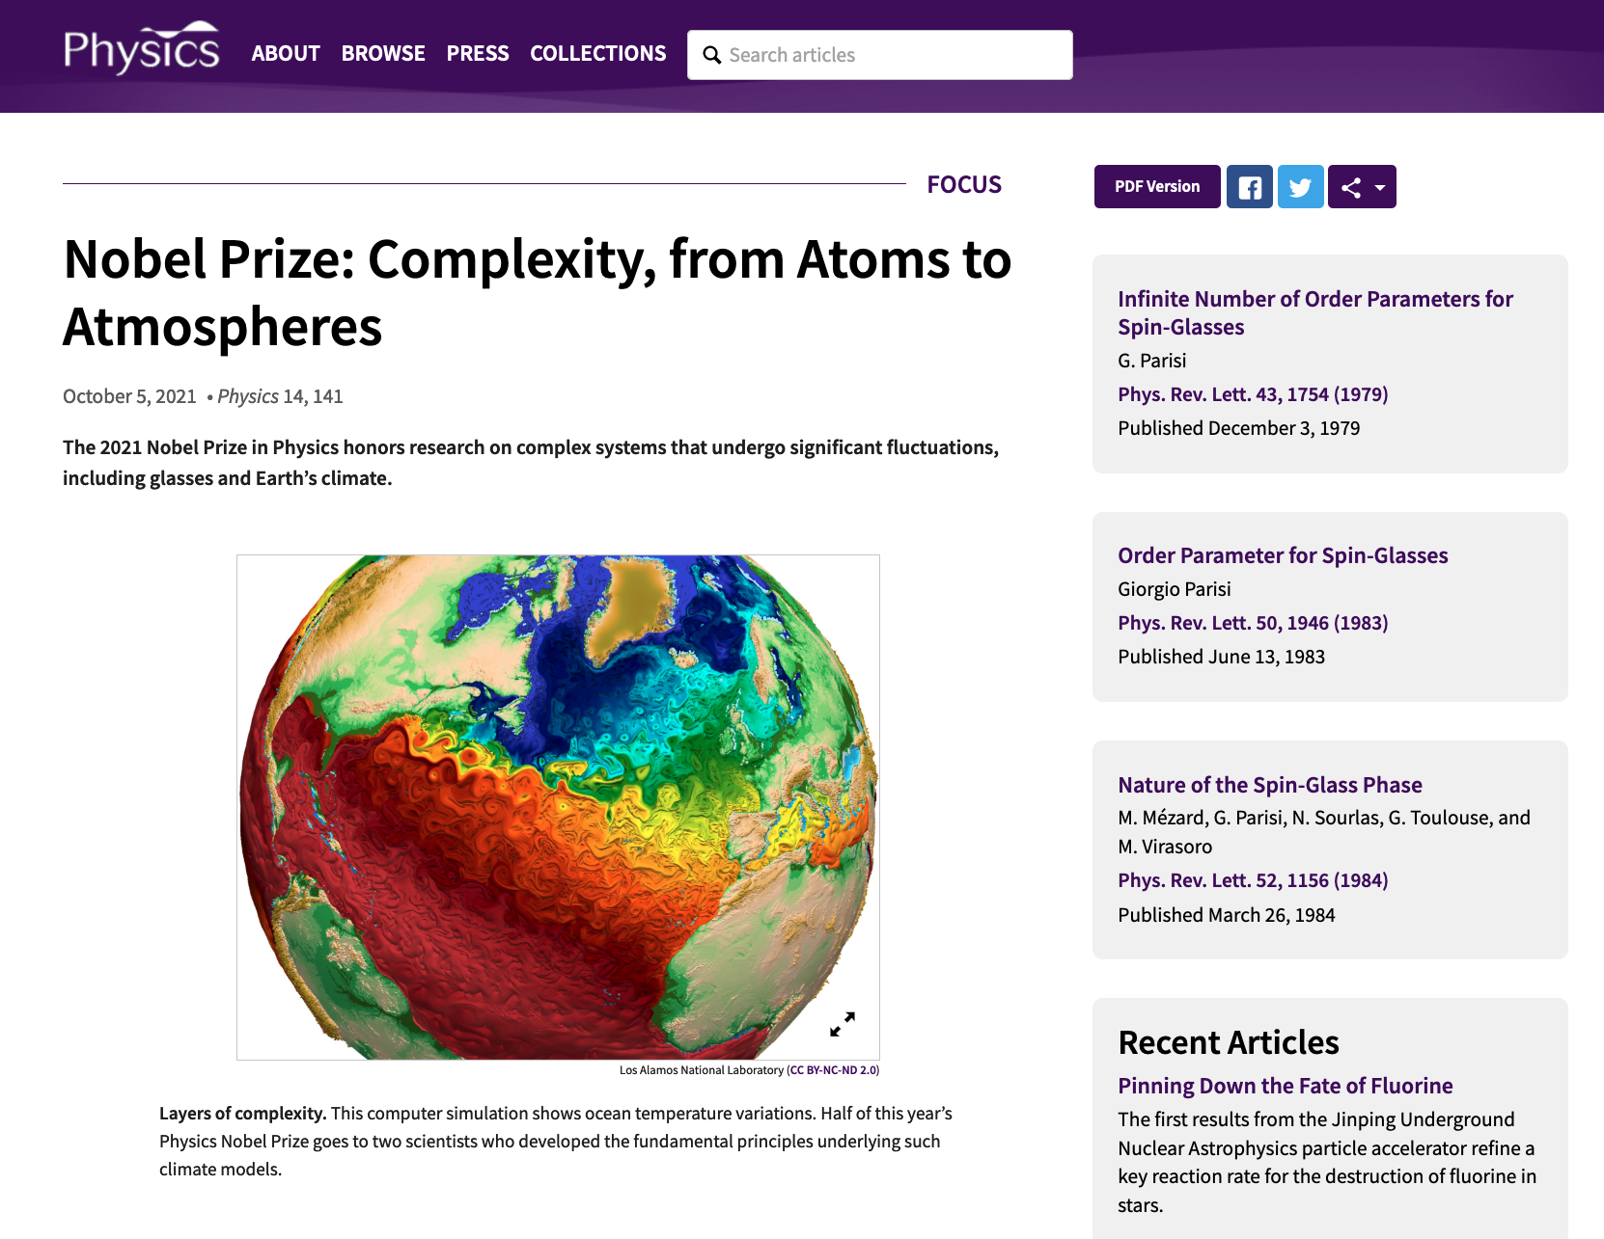
Example of Nature’s Dynamical Systems: Atmospheric Modes
Simulation: https://en.wikipedia.org/wiki/General_circulation_model

Slide 2
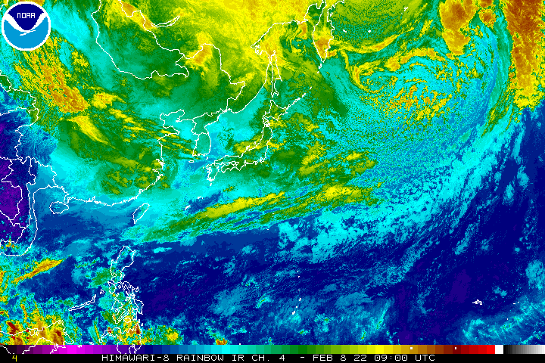
Animated GIF of Equatorial Pacific https://www.ssd.noaa.gov/jma/nwpac/rb-animated.gif Also: https://www.nhc.noaa.gov/satellite.php?text

Slide 3
Lorenz Equations: Simple Model of the Atmosphere https://en.wikipedia.org/wiki/Chaos_theory
Recall: In 1963, Edward Lorenz, with the help of Ellen Fetter, developed a simplified mathematical model for atmospheric convection, based on a mode expansion of fluid convection (Saltzman equations)
The model is a system of three ordinary differential equations now known as the Lorenz equations
Here x(t) is proportional to the convective velocity, y(t) is proportional to the horizontal temperature variation, and z(t) is proportional to the vertical temperature variation
$σ, ρ, β$are system parameters proportional to the Prandtl number, the Rayleigh number, and the thermal diffusivity

Slide 4
Atmospheric Circulation http://en.wikipedia.org/wiki/Atmospheric_circulation
Atmospheric circulation is the large-scale movement of air, and the means (together with the smaller ocean circulation) by which thermal energy is distributed on the surface of the Earth.
The large-scale structure of the atmospheric circulation varies from year to year, but the basic climate structure remains fairly constant.
As a rule, the "cells" of Earth's atmosphere shift polewards in warmer climates (e.g. interglacials compared to glacials), but remain largely constant even due to continental drift
They are, fundamentally, a property of the Earth's size, rotation rate, heating and atmospheric depth, all of which change little.

Slide 5
Hadley Cell http://en.wikipedia.org/wiki/Atmospheric_circulation
The Hadley cell is a closed circulation loop, which begins at the equator with warm, moist air lifted aloft in equatorial low-pressure areas (the Intertropical Convergence Zone, ITCZ) to the tropopause and carried poleward.
At about 30°N/S latitude, it descends in a high-pressure area.
Some of the descending air travels equatorially along the surface, closing the loop of the Hadley cell and creating the Trade Winds.
Though the Hadley cell is described as lying on the equator, it is more accurate to describe it as following the sun’s zenith point, or what is termed the "thermal equator," which undergoes a semiannual north-south migration.”

Slide 6
Polar Cell http://en.wikipedia.org/wiki/Atmospheric_circulation
Warm air rises at lower latitudes and moves pole-ward through the upper troposphere at both the north and south poles.
When the air reaches the polar areas, it has cooled considerably, and descends as a cold, dry high-pressure area, moving away from the pole along the surface but twisting westward as a result of the Coriolis effect to produce the Polar easterlies.
The outflow from the cell creates harmonic waves in the atmosphere known as Rossby waves.
These ultra-long waves play an important role in determining the path of the jet stream, which travels within the transitional zone between the tropopause and the Ferrel cell.
By acting as a heat sink, the Polar cell also balances the Hadley cell in the Earth’s energy equation.

Slide 7
Dynamical Modes and Patterns
The atmosphere can be considered to be a combination (superposition) of dynamical modes
These modes can be shown to arise from the equations of motion (Navier-Stokes equations)
The modes correspond to characteristic patterns or regularities
Examples of this type of “mode decomposition” for other systems include:
Harmonics for waves in music and mathematics
Principal Component Analysis which is used for fingerprint identification by the FBI and in biometric analysis of “Eigenfaces”
Basis vectors or Eigenvectors
For the atmosphere, these modes are defined by characteristic wind speeds, atmosphere and ocean temperatures, and other features
Both spatial and temporal patterns are seen in the mode decompositions
Often the equations of motion of the atmosphere can be written as an infinite series of equations, each of which describes the evolution of a particular mode

Slide 8
Atmospheric Modes http://en.wikipedia.org/wiki/Climatology
Atmospheric modes are examples of patterns or “coherent structures” in the climate system
These are modes that have certain recognizable characteristics
Knowledge of these modes is often used in weather forecasting
These modes include:
El Niño – Southern Oscillation (ENSO)
Madden-Julian Oscillation (MJO)
North Atlantic Oscillation (NAO)
Northern Annular Mode (NAM) which is also known as the Arctic oscillation (AO)
Northern Pacific (NP) Index
Pacific Decadal Oscillation (PDO)
Interdecadal Pacific Oscillation (IPO)

Slide 9
ENSO: El Nino-Southern Oscillation http://en.wikipedia.org/wiki/El_Nino
“El Niño (/ɛlˈniːnjoʊ/, /-ˈnɪn-/, Spanish pronunciation: [el ˈniɲo]) is a band of anomalously warm ocean water temperatures that periodically develops off the western coast of South America and can cause climatic changes across the Pacific Ocean.
There is a phase of 'El Niño–Southern Oscillation' (ENSO), which refers to variations in the temperature of the surface of the tropical eastern Pacific Ocean (El Niño and La Niña) and in air surface pressure in the tropical western Pacific.
The two variations are coupled: the warm oceanic phase, El Niño, accompanies high air surface pressure in the western Pacific, which forces the water eastward
The cold phase, La Niña, accompanies low air surface pressure in the western Pacific, which forces the water westward.
Mechanisms that cause the oscillation remain under study.
The extremes of this climate pattern's oscillations cause extreme weather (such as floods and droughts) in many regions of the world.
Developing countries dependent upon agriculture and fishing, particularly those bordering the Pacific Ocean, are the most affected.
El niño is Spanish for "the boy", and the capitalized term El Niño refers to the Christ child, Jesus, because periodic warming in the Pacific near South America is usually noticed around Christmas.”

Slide 10
Southern Oscillation http://en.wikipedia.org/wiki/El_Nino
“The Southern Oscillation is the atmospheric component of El Niño.
This component is an oscillation in surface air pressure between the tropical eastern and the western Pacific Ocean waters.
The strength of the Southern Oscillation is measured by the Southern Oscillation Index (SOI).
The SOI is computed from fluctuations in the surface air pressure difference between Tahiti and Darwin, Australia.
El Niño episodes are associated with negative values of the SOI, meaning there is below normal pressure over Tahiti and above normal pressure of Darwin, Australia – SOI is negative during an El Nino
Low atmospheric pressure tends to occur over warm water and high pressure occurs over cold water, in part because of deep convection over the warm water.
El Niño episodes are defined as sustained warming of the central and eastern tropical Pacific Ocean.
This results in a decrease in the strength of the Pacific trade winds, and a reduction in rainfall over eastern and northern Australia.”

Slide 11
Walker Circulation https://en.wikipedia.org/wiki/Walker_circulation

Slide 12
Normal Conditions http://en.wikipedia.org/wiki/El_Nino
“Normal Pacific pattern: Equatorial winds gather warm water pool toward the west. Cold water upwells along South American coast. (NOAA / PMEL / TAO)”

Slide 13
El Nino Conditions http://en.wikipedia.org/wiki/El_Nino
“El Niño conditions: Warm water pool approaches the South American coast. The absence of cold upwelling increases warming.”

Slide 14
La Nina Conditions http://en.wikipedia.org/wiki/El_Nino
“La Niña conditions: Warm water is farther west than usual.”

Slide 15
Onset of El Nino http://en.wikipedia.org/wiki/El_
“The first signs of an El Niño are:
Rise in surface pressure over the Indian Ocean, Indonesia, and Australia
Fall in air pressure over Tahiti and the rest of the central and eastern Pacific Ocean
Trade winds in the south Pacific weaken or head east
Warm air rises near Peru, causing rain in the northern Peruvian deserts
Then warm water spreads from the west Pacific and the Indian Ocean to the east Pacific.
The warm water takes the rain with it, causing extensive drought in the western Pacific and rainfall in the normally dry eastern Pacific (failure of the monsoon).
El Niño's warm rush of nutrient-poor water heated by its eastward passage in the Equatorial Current, replaces the cold, nutrient-rich surface water of the Humboldt Current.
When El Niño conditions last for many months, extensive ocean warming and the reduction in easterly trade winds limits upwelling of cold nutrient-rich deep water, and its economic impact to local fishing for an international market can be serious.”
Notes:
Start here 2017-11-17

Slide 16
To Repeat: Normal & El Nino Conditions http://spaceplace.nasa.gov/el-nino/en/

Slide 17
ENSO: El Nino and La Nina http://www.climate.gov

Slide 18
https://www.weather.gov/mhx/ensowhat
Typical late fall through early spring upper-level jet stream positions associated with moderate to strong La Niña (left) and El Niño (right) events. During La Niña, a variable Pacific jet stream in association with a polar jet stream shifted further south favors below normal precipitation across the southern US, with below normal temperatures across the northern US. During El Niño, a strong and amplified Pacific jet stream extending across the southern US in association with a polar jet stream shifted further north into Canada favors above normal precipitation across the southern US, and above normal temperatures over the northern US. Based on original graphics from NOAA’s Climate Prediction Center.

Slide 19
ENSO: Time Series http://www.webberweather.com/multivariate-enso-index.html
High pressure Tahiti, Low pressure Darwin = La Nina
ENSO cycles tend to last 2-7 years. ENSO events typically last 6-18 months.
Low pressure Tahiti, High pressure Darwin = El Nino
The Southern Oscillation Index (SOI) is a standardized index based on the observed sea level pressure differences between Tahiti and Darwin, Australia.
The SOI is one measure of the large-scale fluctuations in air pressure occurring between the western and eastern tropical Pacific (i.e., the state of the Southern Oscillation) during El Niño and La Niña episodes.
The negative phase of the SOI represents below-normal air pressure at Tahiti and above-normal air pressure at Darwin.
Prolonged periods of negative (positive) SOI values coincide with abnormally warm (cold) ocean waters across the eastern tropical Pacific typical of El Niño (La Niña) episodes.
SOI = Air pressure at Tahiti – Air pressure at Darwin, Australia

Slide 20
Current Conditions https://www.cpc.ncep.noaa.gov/products/precip/CWlink/MJO/enso.shtml
NWS Climate Prediction Center

Slide 21
Current Conditions https://www.cpc.ncep.noaa.gov/products/precip/CWlink/MJO/enso.shtml
NWS Climate Prediction Center

Slide 22
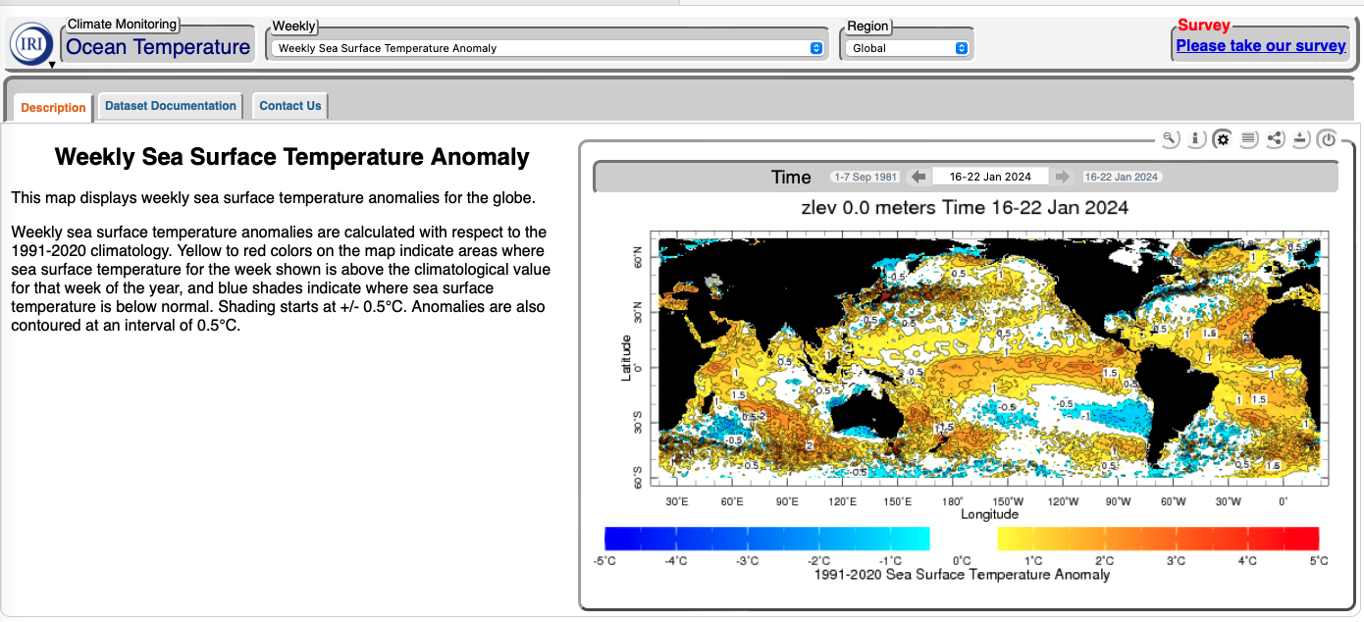
Weekly Sea Temperature Anomalies 7 February 2024
https://iridl.ldeo.columbia.edu/maproom/Global/Ocean_Temp/Weekly_Anomaly.html

Slide 23
Impacts https://www.washingtonpost.com/weather/2024/02/08/la-nina-watch-el-nino-demise

Slide 24
Madden-Julian Oscillation http://en.wikipedia.org/wiki/Madden-Julian_oscillation
“The Madden–Julian oscillation (MJO) is the largest element of the intraseasonal (30–90 days) variability in the tropical atmosphere.
It is a large-scale coupling between atmospheric circulation and tropical deep convection.
Rather than being a standing pattern (like ENSO) it is a traveling pattern, propagating eastwards at approximately 4 to 8 m/s (9 to 18 mph), through the atmosphere above the warm parts of the Indian and Pacific oceans.
This overall circulation pattern manifests itself in various ways, most clearly as anomalous rainfall.
This was discovered by Roland Madden and Paul Julian (again the comparison with ENSO is instructive, since their local effects on Peruvian fisheries were discovered long before the global structure of the pattern was recognized).”

Slide 25
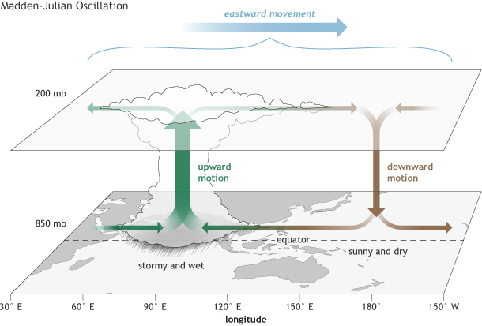
Madden-Julian Oscillation https://www.climate.gov/news-features/blogs/enso/what-mjo-and-why-do-we-care

Slide 26
Madden-Julian Oscillation https://www.climate.gov/news-features/blogs/enso/what-mjo-and-why-do-we-care

Slide 27
MJO Progression http://en.wikipedia.org/wiki/Madden-Julian_oscillation
“The MJO is characterized by an eastward progression of large regions of both enhanced and suppressed tropical rainfall, observed mainly over the Indian Ocean and Pacific Ocean.
The anomalous rainfall is usually first evident over the western Indian Ocean and remains evident as it propagates over the very warm ocean waters of the western and central tropical Pacific.
The wet phase of enhanced convection and precipitation is followed by a dry phase where thunderstorm activity is suppressed.
Each cycle lasts approximately 30–90 days.
Because of this pattern, The MJO is also known as the 30-90-day oscillation, 30-90-day wave, or intra-seasonal oscillation”
Date Line
A Hovmöller diagram of the 5-day running mean of outgoing longwave radiation showing the MJO. Time increases from top to bottom in the figure, so contours that are oriented from upper-left to lower-right represent movement from west to east.

Slide 28
MJO Influence http://en.wikipedia.org/wiki/Madden-Julian_oscillation
“There is evidence that the MJO modulates activity particularly for the strongest storms by providing a large-scale environment that is favorable (or unfavorable) for development
As the MJO progresses east, the favored region for tropical cyclone activity shifts eastward from the western Pacific to the eastern Pacific and finally to the Atlantic basin.
There is an inverse relationship between tropical cyclone activity in the western north Pacific basin and the north Atlantic basin, however.
When one basin is active, the other is normally quiet, and vice versa.
The main reason for this appears to be the phase of the MJO, which is normally in opposite modes between the two basins at any given time.
Sea surface temperatures (SST) must be sufficiently warm and vertical wind shear must be sufficiently weak for tropical disturbances to form and persist.
The MJO is monitored routinely by both the USA National Hurricane Center and the USA Climate Prediction Center during the Atlantic hurricane (tropical cyclone) season to aid in anticipating periods of relative activity or inactivity.”

Slide 29
Links of MJO to ENSO http://en.wikipedia.org/wiki/Madden-Julian_oscillation
“There is strong year-to-year (interannual) variability in MJO activity, with long periods of strong activity followed by periods in which the oscillation is weak or absent.
This interannual variability of the MJO is partly linked to the El Niño-Southern Oscillation (ENSO) cycle.
In the Pacific, strong MJO activity is often observed 6 – 12 months prior to the onset of an El Niño episode but is virtually absent during the maxima of some El Niño episodes, while MJO activity is typically greater during a La Niña episode.
Strong events in the Madden–Julian oscillation over a series of months in the western Pacific can speed the development of an El Niño or La Niña but usually do not in themselves lead to the onset of a warm or cold ENSO event.
Changes in the structure of the MJO with the seasonal cycle and ENSO might facilitate more substantial impacts of the MJO on ENSO.
For example, the surface westerly winds associated with active MJO convection are stronger during advancement toward El Niño and the surface easterly winds associated with the suppressed convective phase are stronger during advancement toward La Nina.”

Slide 30
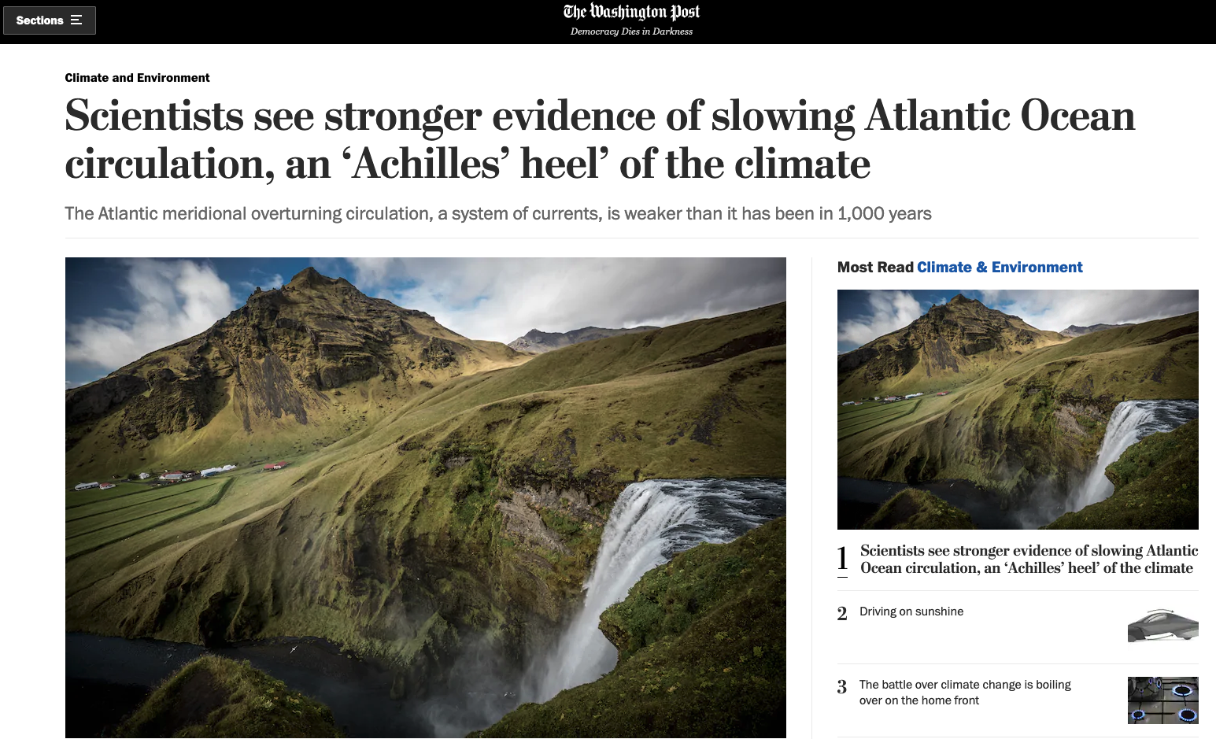
Washington Post 2/25/2021
https://www.washingtonpost.com/climate-environment/2021/02/25/atlantic-ocean-currents-weakening-amoc-gulf-stream/
Start Here 2/26/2021

Slide 31
Example: Atlantic Meridional Overturning Circulation (AMOC) https://www.livescience.com/gulf-stream-close-to-collapse
One of the most crucial ocean current systems for regulating the Northern Hemisphere's climate could be on the verge of total collapse due to climate change, a new study has revealed.
The Atlantic Meridional Overturning Circulation (AMOC), which includes the Gulf Stream and is responsible for moderating large parts of the world's climate, has undergone "an almost complete loss of stability over the last century", according to a new analysis.
The currents work like a conveyor belt to transport warm, salty water northward from the tropics and cold water back south along the seafloor.
This giant conveyor belt had already been shown to be at its weakest in more than a thousand years, but now it could be veering toward a total breakdown.
End 3/1/2022

Slide 32
Example: Atlantic Meridional Overturning Circulation (AMOC) https://en.wikipedia.org/wiki/Shutdown_of_thermohaline_circulation#/media/File:Thermohaline_Circulation_2.png

Slide 33
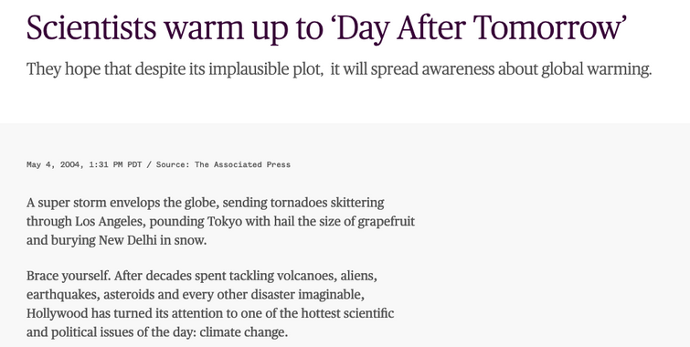

Slide 34
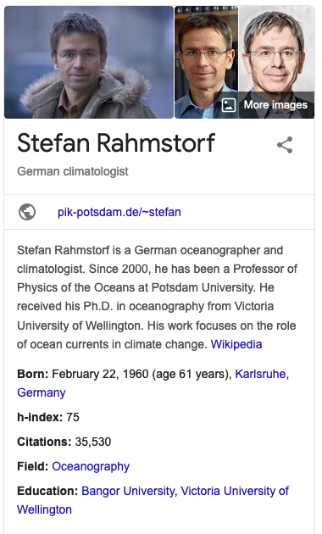
Ended Here 2/7/2024

Slide 35
Example: Atlantic Meridian Overturning Circulation (AMOC) https://esd.copernicus.org/articles/12/601/2021/

Slide 36
Phase Transitions (Tipping Points) in Ocean Circulations http://oceantippingpoints.org/our-work/glossary

Slide 37
Hysteresis Landau-Ginzburg-Wilson Potential
Stable
Metastable
Potential Energy:
U[φ] = ε φ² + α φ⁴ - h φ
Balance of Forces:
(Euler-Lagrange Equation)
dU[φ]/d φ = 0 = 2ε φ + 4α φ³ - h
or
2ε φ + 4α φ³ = h
Dashed Line:
Unstable Branch

Slide 38
Hysteresis in Nonlinear Systems Nomenclature for Phase Transitions
System gradually follows the blue-red path in response to the external forcing.
System becomes metastable along red dashed lines
At Tipping Points (spinodals), sudden large transitions to a new state will occur indicated by the green dashed arrows
System is unstable along the green dotted line
This is a first order phase transition
Response Variable
Or
System State
(“Order Parameter”)
Metastable State
Tipping Point
External Forcing
Also called a bifurcation transition

Slide 39
Possible Scenario for a Global Climate Tipping Point
Tipping points are first-order phase transitions, also called nucleation transitions
Nucleation occurs suddenly, not gradually when a critical value of a forcing parameter is reached
Dashed Line:
Unstable Branch
Main point: Nucleation transitions are sudden
Main point: Nucleation transitions happen gradually, then suddenly

Slide 40
Example: Atlantic Meridian Overturning Circulation (AMOC) https://esd.copernicus.org/articles/12/601/2021/

Slide 41
Example: Atlantic Meridian Overturning Circulation (AMOC) https://www.pnas.org/content/118/9/e2017989118
Simulations from General Circulation Models

Slide 42
Hysteresis in Nonlinear Systems Nomenclature for Phase Transitions
System gradually follows the blue-red path in response to the external forcing.
System becomes metastable along red dashed lines
At Tipping Points (spinodals), sudden large transitions to a new state will occur indicated by the green dashed arrows
System is unstable along the green dotted line
This is a first order phase transition
Response Variable
Or
System State
(“Order Parameter”)
Metastable State
Tipping Point
External Forcing
Also called a bifurcation transition

Slide 43
Phase Transition Model for Global Warming

Slide 44
https://www.washingtonpost.com/climate-environment/2024/02/08/1-5-celsius-global-warming-record/

