Slide 1
Lecture 20
Hedging and Black-Scholes Equation
John Rundle Econophysics PHYS 250

Slide 2
Delta Hedge https://en.wikipedia.org/wiki/Delta_neutral
In finance, delta neutral describes a portfolio of related financial securities, in which the portfolio value remains unchanged when small changes occur in the value of the underlying security.
Such a portfolio typically contains options and their corresponding underlying securities such that positive and negative delta components offset, resulting in the portfolio's value being relatively insensitive to changes in the value of the underlying security.
A related term, delta hedging is the process of setting or keeping the delta of a portfolio as close to zero as possible.
In practice, maintaining a zero delta is very complex because there are risks associated with re-hedging on large movements in the underlying stock's price, and research indicates portfolios tend to have lower cash flows if re-hedged too frequently.

Slide 3
Delta Hedge https://en.wikipedia.org/wiki/Delta_neutral
Note: “Value” = “Cost”

Slide 4
Delta Hedge https://en.wikipedia.org/wiki/Delta_neutral
Delta measures the sensitivity of the value of an option to changes in the price of the underlying stock assuming all other variables remain unchanged.
Mathematically, delta (Δ) is represented as partial derivative Δ = ∂V/∂S of the option's fair value V with respect to the price S of the underlying security.
Δ is a function of S, and also a function of strike price and time to expiry.
Therefore, if a position is correctly delta neutral (or, instantaneously delta-hedged ) its instantaneous change in value, for an infinitesimal change in the value of the underlying security, will be zero
A portfolio that is delta neutral is effectively hedged, so that its overall value will not change for small changes in the price of its underlying security.

Slide 5
Delta Hedge https://en.wikipedia.org/wiki/Delta_neutral
Delta hedging- i.e. establishing the required hedge - may be accomplished by buying or selling an amount of the underlying security that corresponds to the delta of the portfolio.
By adjusting the amount bought or sold on new positions, the portfolio delta can be made to sum to zero, and the portfolio is then delta neutral. (“Rational pricing delta hedging”).
Options market makers, or others, may form a delta neutral portfolio using related options instead of the underlying security.
The portfolio's delta (assuming the same underlier) is then the sum of all the individual options' deltas.
This method can also be used when the underlier is difficult to trade, for instance when an underlying stock is hard to borrow and therefore cannot be sold short.

Slide 6
Delta Hedge https://en.wikipedia.org/wiki/Delta_neutral
The existence of a delta neutral portfolio was shown as part of the original proof of the Black–Scholes model, the first comprehensive model to produce correct prices for some classes of options.
From the Taylor expansion of the value of an option, we get the change in the value of an option, C(S) , for a change in the value of the underlying security (“underlier”) (ϵ):
C ( S + ϵ ) = C (S) + ϵ C ′(S) + 1/2 ϵ² C″(S) + . .
where C′(S) = Δ (“delta”) and C″(S) = Γ (gamma).
See Greeks (finance) for a detailed discussion of all the derivatives and their names .
For any small change in the stock (“underlier”), we can ignore the second-order term and use the quantity Δ to determine how much of the underlier to buy or sell to create a hedged portfolio.
In practice, maintaining a delta neutral portfolio requires continuous recalculation of the position’s “Greeks” and rebalancing of the underlier's position.
Typically, this rebalancing is performed daily or weekly.

Slide 7
Delta Hedge: Motivation Mantegna and Stanley (2007)
A company in the United States must pay 10,000 euro to European firms in 180 days.
The company can write a forward contract at the present exchange rate for the above sum or can buy a call option for a given strike price at 180 days' maturity.
This eliminates the risk associated with fluctuations in the USD/euro exchange rate, but has a cost - either exposure to losses in a forward contract, or simply the direct cost in an option contract

Slide 8
Delta Hedge: Derivation Mantegna and Stanley (2007)
To examine more closely the procedure of hedging, we consider a simplified version of our problem, namely a binomial model of stock prices (Cox et al., J. Fin. Econ, 7, 229-263 (1979).
The stock price S at each time step t may assume only two values .
Suppose a hedger at each time step holds a number Δ_{h} of shares for each option sold on the same stock.
In order to minimize the risk, the hedger needs to determine the value of Δ_{h} that makes the portfolio riskless.
In this example, the investor sells call options on a stock and use the revenue to buy shares on that same stock at t=0
This leads to a “revenue neutral” portfolio
Question. What is the appropriate price to sell the options so as to make the portfolio riskless under small changes in stock price S
“u” = stock price up
“d” = stock price down
(Revenue neutral)
Schematic illustration of the binomial model. Here S denotes the stock share price, where C denotes the cost of an option issued on the underlying stock. For a given time horizon t=t₁, the prices S_{u} , S_{d} denote the possible stock price values, while C_{u} and C_{d} and denote the possible values of options.

Slide 9
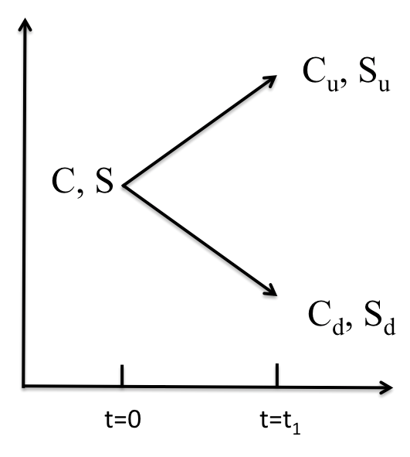
Delta Hedge: Derivation Mantegna and Stanley (2007)
The value* φ of the portfolio is:
φ = S Δ_{h} – C
where S is the spot stock price, Δ_{h} is the number of shares bought by the investor at time t, and C is the value of the option sold at time t.
A riskless investment requires that φ_{u} = φ_{d} , where φ_{u} is the portfolio value if the stock goes up, while φ_{d} is the portfolio value if the stock goes down.
Thus: S_{u} Δ_{h} – C_{u} = S_{d} Δ_{h} – C_{d} , or
In the limit when t becomes infintesimal, the number of shares needed to make the porfolio riskless is thus given by:
*Note: The stock owned is an asset (+). The call option sold is a liability (-)

Slide 10
Derivation of Black-Scholes: Itô's Lemma https://en.wikipedia.org/wiki/It%C3%B4's_lemma
In mathematics, Itô's lemma is an identity used in the Itô calculus to find the differential of a time-dependent function of a stochastic process.
It serves as the stochastic calculus counterpart of the chain rule.
It can be heuristically derived by forming the Taylor series expansion of the function up to its second derivatives and retaining terms up to first order in the time increment and second order in the Wiener process increment.
The lemma is widely employed in mathematical finance, and its best known application is in the derivation of the Black–Scholes equation for option values.

Slide 11
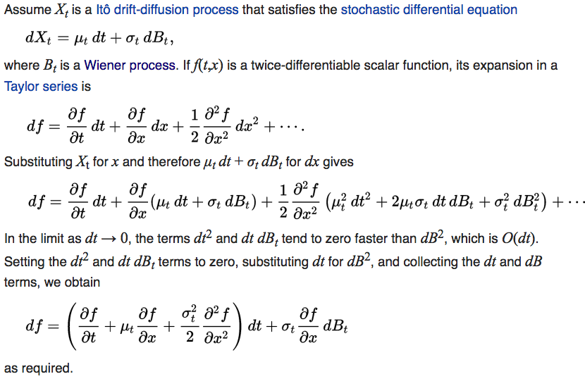
Itô's Lemma https://en.wikipedia.org/wiki/It%C3%B4's_lemma
For a random walk,
f will turn out to be the value or cost of the option

Slide 12
Black-Scholes Model https://en.wikipedia.org/wiki/Black-Scholes_model
What is the Black-Scholes Model?
The Black–Scholes equation is a linear partial differential equation, that describes the price of the option over time:
The key financial insight behind the equation is that one can perfectly hedge the option by buying and selling the underlying asset in just the right way and consequently "eliminate risk".
This hedge, in turn, implies that there is only one right price for the option, as returned by the Black–Scholes formula (see the next section).
Note: This implicitly assumes that only small changes in stock price occur!!
Note: r is a risk-free rate of return, V is the value (cost) of the option, S is the spot stock price, $σ$ is volatility

Slide 13
Black-Scholes Model: Assumptions https://en.wikipedia.org/wiki/Black-Scholes_model
The Black–Scholes model assumes that the market consists of at least one risky asset, usually called the stock, and one riskless asset, usually called the money market, cash, or bond.
Assumptions on the assets:
(Riskless rate) The rate of return on the riskless asset is constant and thus called the risk-free interest rate.
(Random walk) The instantaneous log return of stock price is an infinitesimal random walk with drift, a geometric Brownian motion, and we will assume its drift and volatility are constant (see next slide)
The stock does not pay a dividend.

Slide 14
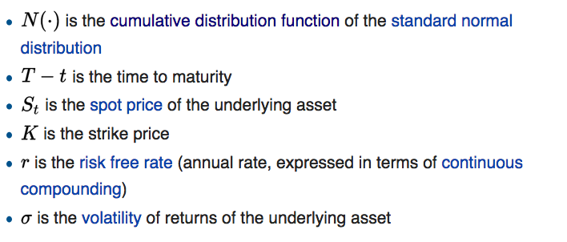
Definitions https://en.wikipedia.org/wiki/Black-Scholes_mode

Slide 15
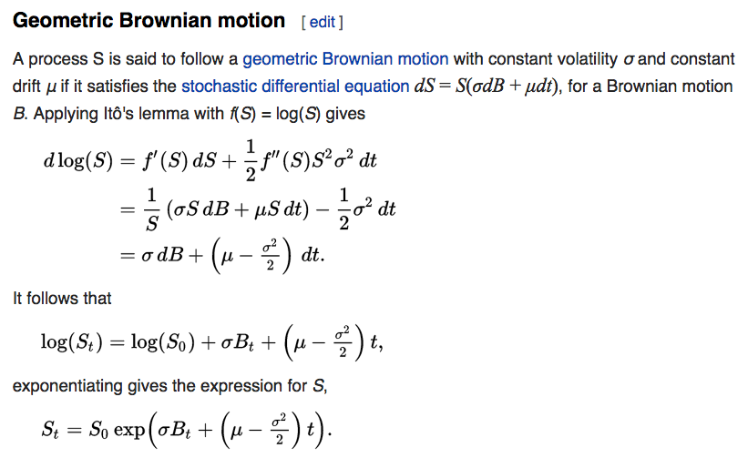
Aside: Geometric Brownian Motion https://en.wikipedia.org/wiki/It%C3%B4's_lemma
Note: f is an implicit function of t only. So partial derivative of f with respect to t is zero in Itô's lemma..

Slide 16
Black-Scholes Model: Assumptions https://en.wikipedia.org/wiki/Black-Scholes_model
Assumptions on the markets:
There is no arbitrage opportunity (i.e., there is no way to make a riskless profit).
It is possible to borrow and lend any amount, even fractional, of cash at the riskless rate.
It is possible to buy and sell any amount, even fractional, of the stock (this includes short selling).
The above transactions do not incur any fees or costs (i.e., frictionless market).

Slide 17
Black-Scholes Model https://en.wikipedia.org/wiki/Black-Scholes_model
With these assumptions, suppose there is a derivative security also trading in this market.
We specify that this security will have a certain payoff at a specified date in the future, depending on the value(s) taken by the stock up to that date.
For the special case of a European call or put option, Black and Scholes showed that "it is possible to create a hedged position, consisting of a long position in the stock and a short position in the option, whose value will not depend on the price of the stock”.
Their dynamic hedging strategy led to a partial differential equation which governed the price of the option.
Its solution is given by the Black–Scholes formula.

Slide 18
Black-Scholes Equation: Derivation https://en.wikipedia.org/wiki/Black-Scholes_equation
The following derivation is given in Hull's Options, Futures, and Other Derivatives.
That, in turn, is based on the classic argument in the original Black–Scholes paper.
It is assumed that the value of the underlying stock follows a geometric Brownian motion:
where W is a stochastic variable (Brownian motion).
Note that W, and consequently its infinitesimal increment dW, represents the only source of uncertainty in the price history of the stock
(Note that dW = dB_{t} from before)

Slide 19
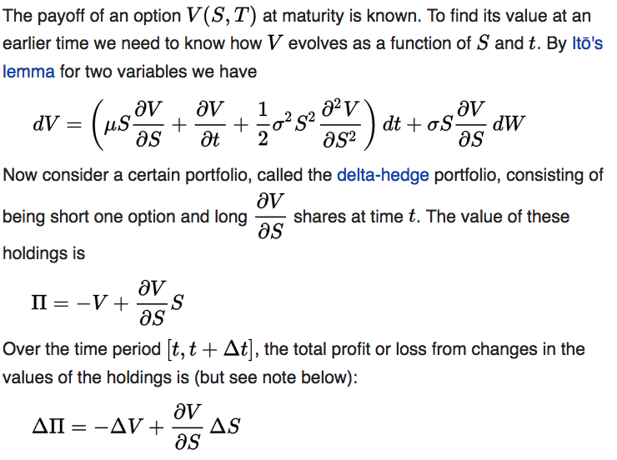
Black-Scholes Equation: Derivation https://en.wikipedia.org/wiki/Black-Scholes_equation
This is the delta hedge we discussed earlier

Slide 20
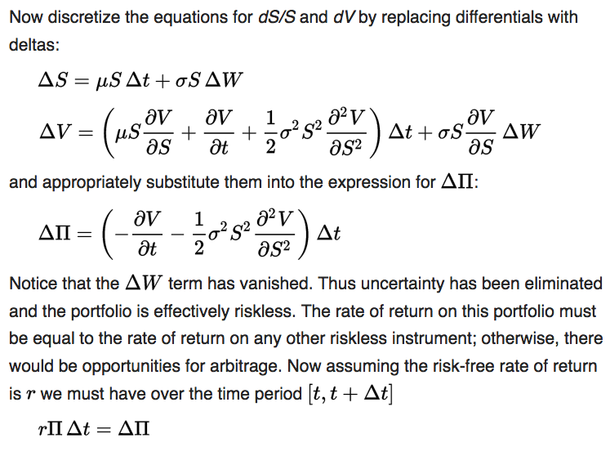
Black-Scholes Equation: Derivation https://en.wikipedia.org/wiki/Black-Scholes_equation
(Recall: )
We require that the return from the delta hedge over Δt equal the risk free rate of return to prevent arbitrage opportunities!

Slide 21
Black-Scholes Equation: Derivation https://en.wikipedia.org/wiki/Black-Scholes_equation
With the assumptions of the Black–Scholes model, this second order partial differential equation holds for any type of option as long as its price function V is twice differentiable with respect to S and once with respect to t .

Slide 22
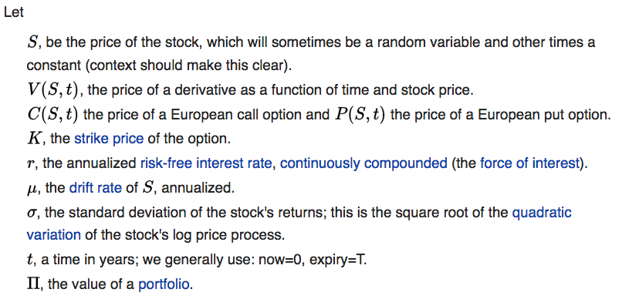
Black-Scholes Model https://en.wikipedia.org/wiki/Black-Scholes_model

Slide 23
Black-Scholes Model https://en.wikipedia.org/wiki/Black-Scholes_model

Slide 24
Black-Scholes: Call Option https://en.wikipedia.org/wiki/Black-Scholes_model
The Black–Scholes formula calculates the price of European put and call options.
This price is consistent with the Black–Scholes equation as above
This follows since the formula can be obtained by solving the equation for the corresponding terminal and boundary conditions.
The value of a call option for a non-dividend-paying underlying stock in terms of the Black–Scholes parameters is:

Slide 25
Black-Scholes: Put Option https://en.wikipedia.org/wiki/Black-Scholes_model
The Black–Scholes formula calculates the price of European put and call options.
This price is consistent with the Black–Scholes equation as above
This follows since the formula can be obtained by solving the equation for the corresponding terminal and boundary conditions.
The value of a put option for a non-dividend-paying underlying stock in terms of the Black–Scholes parameters is:

Slide 26
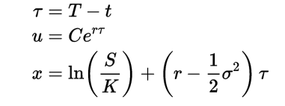
Equivalence to Diffusion https://en.wikipedia.org/wiki/Black-Scholes_equation
To solve the PDE we recognize that it is a Cauchy–Euler equation which can be transformed into a diffusion equation by introducing the change-of-variable transformation:
Then the Black-Scholes equation becomes a linear diffusion equation:

Slide 27
Options: Risks https://en.wikipedia.org/wiki/Black-Scholes_model
The assumptions of the Black–Scholes model are not all empirically valid.
Among the most significant limitations are:
The underestimation of extreme moves, yielding tail risk, which can be hedged with out-of-the-money options;
The assumption of instant, cost-less trading, yielding liquidity risk, which is difficult to hedge;
The assumption of a stationary process, yielding volatility risk, which can be hedged with volatility hedging;
The assumption of continuous time and continuous trading, yielding gap risk.

Slide 28
Options: Risks https://en.wikipedia.org/wiki/Black-Scholes_model
Results using the Black–Scholes model differ from real world prices because of simplifying assumptions of the model.
One significant limitation is that in reality security prices do not follow a strict stationary log-normal process, nor is the risk-free interest actually known (and is not constant over time).
The variance has been observed to be non-constant leading to models such as GARCH to model volatility changes.
Pricing discrepancies between empirical and the Black–Scholes model have long been observed in options that are far out-of-the-money, corresponding to extreme price changes
Such events would be very rare if returns were lognormally distributed, but are observed much more often in practice.
GARCH = Generalized Autoregressive Conditional Heteroskedasticity

Slide 29
Options: Risks https://en.wikipedia.org/wiki/Black-Scholes_model
Nevertheless, Black–Scholes pricing is widely used in practice, because it is:
Easy to calculate
A useful approximation, particularly when analyzing the direction in which prices move when crossing critical points
A robust basis for more refined models
Invertible, as the model's original output, price, can be used as an input and one of the other variables solved for: the implied volatility calculated in this way is often used to quote option prices and is used as the basis for the VIX

Slide 30
Volatility Smile https://en.wikipedia.org/wiki/Volatility_smile http://www.investopedia.com/terms/v/volatilitysmile.asp
Volatility smiles are implied volatility patterns that arise in pricing financial options.
In particular for a given expiration, options whose strike price differs substantially from the underlying asset's price command higher prices (and thus implied volatilities) than what is suggested by standard option pricing models.
These options are said to be either deep in-the-money or out-of-the-money.

Slide 31
Volatility Smile https://en.wikipedia.org/wiki/Volatility_smile
Equity options traded in American markets did not show a volatility smile before the Crash of 1987 but began showing one afterwards.
It is believed that investor reassessments of the probabilities of fat-tail have led to higher prices for out-the-money options.
This anomaly implies deficiencies in the standard Black-Scholes option pricing model which assumes constant volatility and log-normal distributions of underlying asset returns.
Empirical asset returns distributions, however, tend to exhibit fat-tails (kurtosis) and skew.
Modelling the volatility smile is an active area of research in quantitative finance, and better pricing models such as the stochastic volatility model partially address this issue.

Slide 32
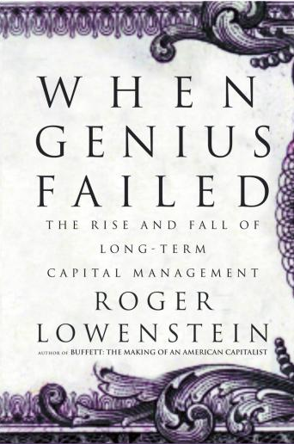
Long Term Capital Management
A Cautionary Tale

Slide 33
Market Volatility, 1962-2008 http://economistsview.typepad.com/economistsview/2007/02/shocks_to_uncer.html

Slide 34
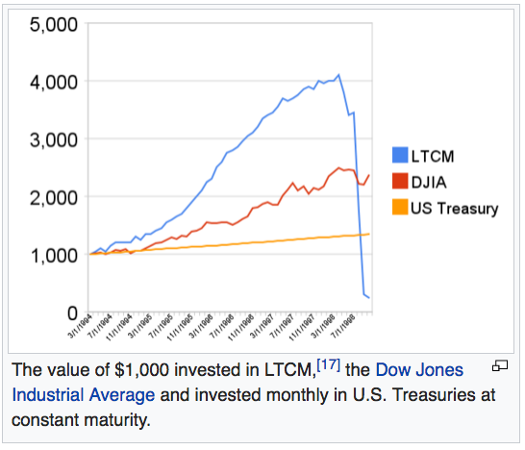
Long Term Capital Management https://en.wikipedia.org/wiki/Long-Term_Capital_Management

Slide 35
Long Term Capital Management https://en.wikipedia.org/wiki/Long-Term_Capital_Management
Long-Term Capital Management L.P. (LTCM) was a hedge fund management firm based in Greenwich, Connecticut that used absolute-return trading strategies combined with high financial leverage.
The firm's master hedge fund, Long-Term Capital Portfolio L.P., collapsed in the late 1990s, leading to an agreement on September 23, 1998 among 16 financial institutions
These included Bankers Trust, Barclays, Bear Stearns, Chase Manhattan Bank, Credit Agricole, Credit Suisse First Boston, Deutsche Bank, Goldman Sachs, JP Morgan, Lehman Brothers, Merrill Lynch, Morgan Stanley, Paribas, Salomon Smith Barney, Societe Generale, and UBS — for a $3.6 billion recapitalization (bailout) under the supervision of the Federal Reserve.

Slide 36
Long Term Capital Management https://en.wikipedia.org/wiki/Long-Term_Capital_Management
LTCM was founded in 1994 by John W. Meriwether, the former vice-chairman and head of bond trading at Salomon Brothers.
Members of LTCM's board of directors included Myron S. Scholes and Robert C. Merton, who shared the 1997 Nobel Memorial Prize in Economic Sciences for A new method to determine the value of derivatives”.
Initially successful with annualized return of over 21% (after fees) in its first year, 43% in the second year and 41% in the third year, in 1998 it lost $4.6 billion in less than four months following the 1997 Asian financial crisis and 1998 Russian financial crisis requiring financial intervention by the Federal Reserve, with the fund liquidating and dissolving in early 2000.

Slide 37
Long Term Capital Management https://en.wikipedia.org/wiki/Long-Term_Capital_Management
The core investment strategy of the company was then known as involving convergence trading
Using quantitative models to exploit deviations from fair value in the relationships between liquid securities across nations and asset classes.
In fixed income the company was involved in US Treasuries, Japanese Government Bonds, UK Gilts, Italian BTPs, and Latin American debt, although their activities were not confined to these markets or to government bonds.

Slide 38
Long Term Capital Management https://en.wikipedia.org/wiki/Long-Term_Capital_Management
The magnitude of discrepancies in valuations in this kind of trade is small (for the benchmark Treasury convergence trade, typically a few basis points)
So in order to earn significant returns for investors, LTCM used leverage to create a portfolio that was a significant multiple (varying over time depending on their portfolio composition) of investors' equity in the fund.
It was also necessary to access the financing market in order to borrow the securities that they had sold short.
In order to maintain their portfolio, LTCM was therefore dependent on the willingness of its counterparties in the government bond (repurchase, or repo) market to continue to finance their portfolio

Slide 39
Long Term Capital Management https://en.wikipedia.org/wiki/Long-Term_Capital_Management
If the company was unable to extend its financing agreements, then it would be forced to sell the securities it owned and to buy back the securities it was short at market prices, regardless of whether these were favorable from a valuation perspective.
At the beginning of 1998, the firm had equity of $4.72 billion and had borrowed over $124.5 billion with assets of around $129 billion, for a debt-to-equity ratio of over 25 to 1.
It had off-balance sheet derivative positions with a notional value of approximately $1.25 trillion, most of which were in interest rate derivatives such as interest rate swaps.
The fund also invested in other derivatives such as equity options.

Slide 40
Long Term Capital Management https://en.wikipedia.org/wiki/Long-Term_Capital_Management
Although periods of distress have often created tremendous opportunities for relative value strategies, this did not prove to be the case on this occasion
The seeds of LTCM's demise were sown before the Russian default of 17 August 1998.
LTCM had returned $2.7 bn to investors in Q4 of 1997, although it had also raised a total in capital of $1.066bn from UBS and $133m from CSFB.
Since position sizes had not been reduced, the net effect was to raise the leverage of the fund.

Slide 41
Long Term Capital Management https://en.wikipedia.org/wiki/Long-Term_Capital_Management
Although 1997 had been a very profitable year for LTCM (27%), the lingering effects of the 1997 Asian crisis continued to shape developments in asset markets into 1998.
Although this crisis had originated in Asia, its effects were not confined to that region.
The rise in risk aversion had raised concerns amongst investors regarding all markets heavily dependent on international capital flows, and this shaped asset pricing in markets outside Asia too.

Slide 42
Long Term Capital Management https://en.wikipedia.org/wiki/Long-Term_Capital_Management
Long-Term Capital Management did business with nearly everyone important on Wall Street.
Much of LTCM's capital was composed of funds from the same financial professionals with whom it traded.
As LTCM teetered, Wall Street feared that Long-Term's failure could cause a chain reaction in numerous markets, causing catastrophic losses throughout the financial system.
After LTCM failed to raise more money on its own, it became clear it was running out of options.
On September 23, 1998, Goldman Sachs, AIG, and Berkshire Hathaway offered then to buy out the fund's partners for $250 million, to inject $3.75 billion and to operate LTCM within Goldman's own trading division.
The offer was stunningly low to LTCM's partners because at the start of the year their firm had been worth $4.7 billion.
Warren Buffett gave Meriwether less than one hour to accept the deal; the time lapsed before a deal could be worked out.

Slide 43
Long Term Capital Management https://en.wikipedia.org/wiki/Long-Term_Capital_Management
Seeing no options left, the Federal Reserve Bank of New York organized a bailout of $3.625 billion by the major creditors to avoid a wider collapse in the financial markets.
The principal negotiator for LTCM was general counsel James G. Rickards.
The contributions from the various institutions were as follows
$300 million: Bankers Trust, Barclays, Chase, Credit Suisse First Boston, Deutsche Bank, Goldman Sachs, Merrill Lynch, J.P.Morgan, Morgan Stanley, Salomon Smith Barney, UBS
$125 million: Société Générale
$100 million: Paribas, Credit Agricole
Bear Stearns and Lehman Brothers declined to participate.
Later, in the crisis of 2007-2009, when Bear Stearns and Lehman Brothers went bankrupt, there was little interest on the Street in helping them stay afloat

Slide 44
Long Term Capital Management https://en.wikipedia.org/wiki/Long-Term_Capital_Management
In return, the participating banks got a 90% share in the fund and a promise that a supervisory board would be established.
LTCM's partners received a 10% stake, still worth about $400 million, but this money was completely consumed by their debts.
The partners once had $1.9 billion of their own money invested in LTCM, all of which was wiped out.
The fear was that there would be a chain reaction as the company liquidated its securities to cover its debt, leading to a drop in prices, which would force other companies to liquidate their own debt creating a vicious cycle.

Slide 45
Long Term Capital Management https://en.wikipedia.org/wiki/Long-Term_Capital_Management
The total losses were found to be $4.6 billion. The losses in the major investment categories were (ordered by magnitude):
$1.6 bn in swaps
$1.3 bn in equity volatility
$430 mn in Russia and other emerging markets
$371 mn in directional trades in developed countries
$286 mn in Dual-listed company pairs (such as VW, Shell)
$215 mn in yield curve arbitrage
$203 mn in S&P 500 stocks
$100 mn in junk bond arbitrage
no substantial losses in merger arbitrage

Slide 46
Long Term Capital Management: Aftermath https://en.wikipedia.org/wiki/Long-Term_Capital_Management
After the bailout, Long-Term Capital Management continued operations.
In the year following the bailout, it earned 10%.
By early 2000, the fund had been liquidated, and the consortium of banks that financed the bailout had been paid back
But the collapse was devastating for many involved.
The theories of Merton and Scholes took a public beating.
In its annual reports, Merrill Lynch observed that mathematical risk models "may provide a greater sense of security than warranted; therefore, reliance on these models should be limited.”

Slide 47
Long Term Capital Management: Aftermath https://en.wikipedia.org/wiki/Long-Term_Capital_Management
After helping unwind LTCM, Meriwether launched JWM Partners.
Haghani, Hilibrand, Leahy, and Rosenfeld signed up as principals of the new firm.
By December 1999, they had raised $250 million for a fund that would continue many of LTCM's strategies—this time, using less leverage.
With the credit crisis of 2008, JWM Partners LLC was hit with a 44% loss from September 2007 to February 2009 in its Relative Value Opportunity II fund.
As such, JWM Hedge Fund was shut down in July 2009.
In 1998, the chairman of Union Bank of Switzerland resigned as a result of a $780 million loss incurred from the short put option on LTCM, which had become very significantly in the money due to its collapse.

